Slide 1

Spam detection in Crowd Sourcing
Department of Computer Science
Rollwala Computer Centre
Presented By :
Shivangi Chotaliya (06)
Rathod Ajinkya (30)
Under the Guidance of :
Dr. Hardik Joshi

Slide 2
Abstract
We are working on tweets that has been done by users who travel in trains and have tweeted about the complaint of Indian Railways.
Determine whether the tweet is grievance or non-grievance with the help of cohen’s kappa score pinpoint precision.
Our job is to identify whether they were relevant or not.
For evaluation, data has been retrieved from @RailMinIndia which is an official Account of Railway Government of India.

Slide 3
Abstract
The complaint tweet identification problem is modelled with the help of taggers who can give reviews.
A confusion matrix is created based on tagger reviews. Cohen's Kappa is apply to the matrix and acquire the correct accuracy and evaluate if the tweet is grievance or non-grievance.
The implementation of the methodology will be done using Django framework which is based Python programming language.

Slide 4

Cohen’s kappa
Railway
Grievance
Non-grievance
Tweet
Tagger
Confusion matrix
Railway
Complaint
Tweets

Slide 5


Slide 6
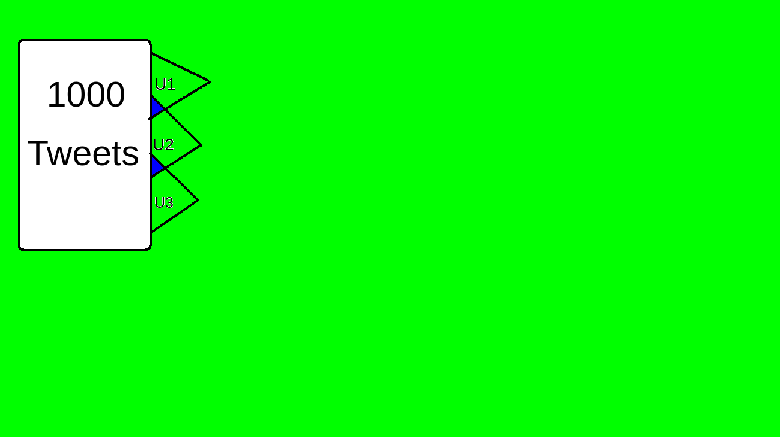

Slide 7


Slide 8
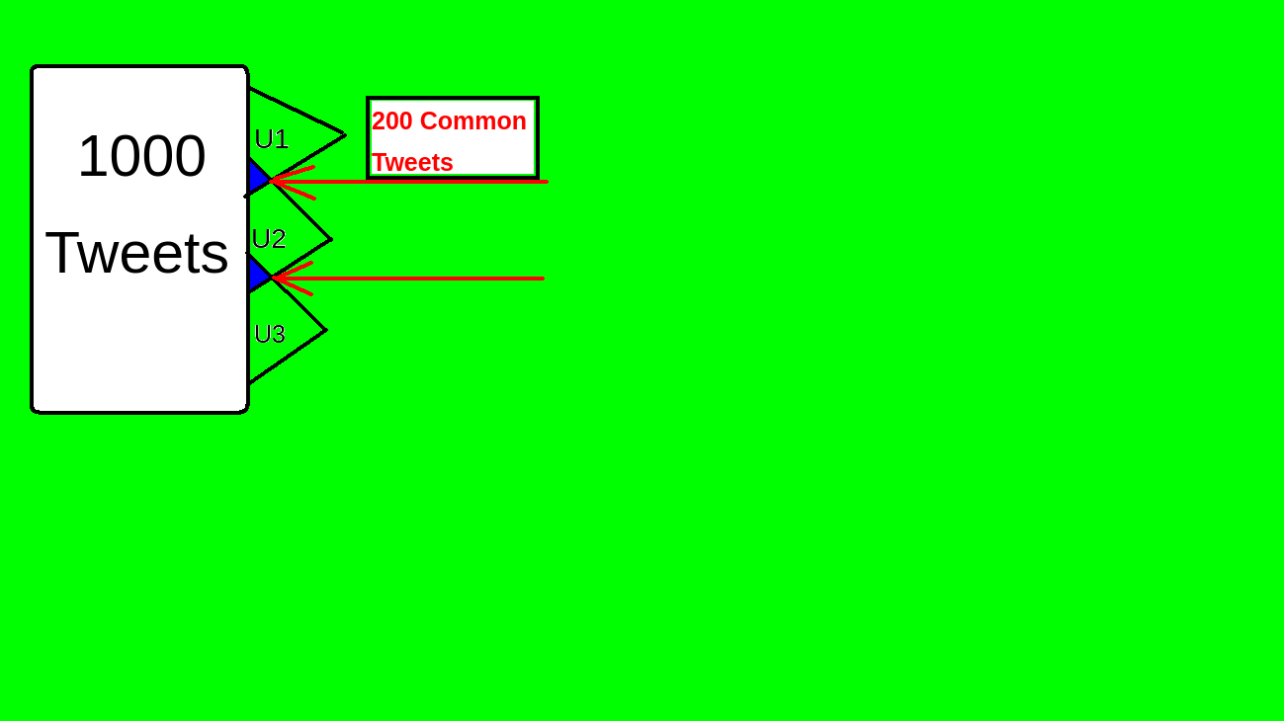

Slide 9
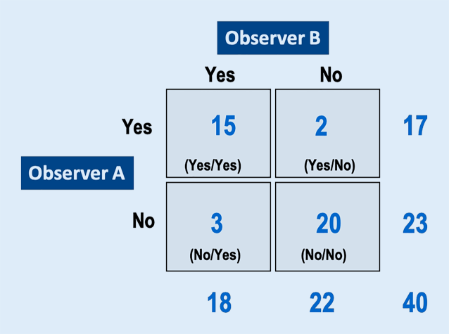

Slide 10
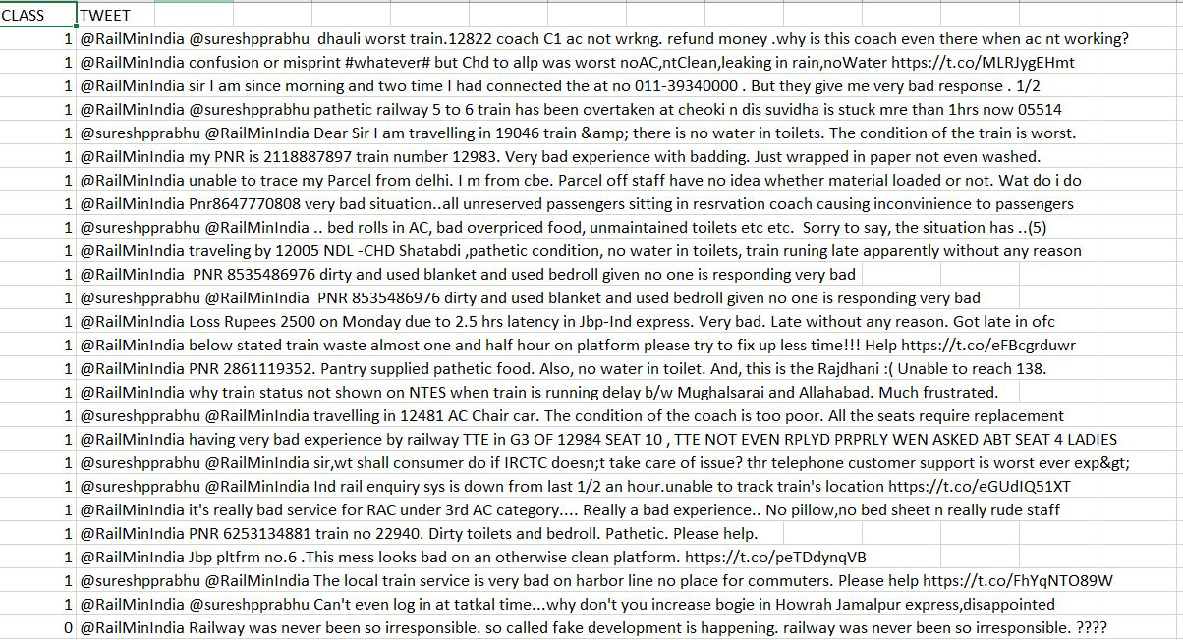
5.3 Dataset Used (CSV file)

Slide 11
Research Problem

Slide 12
Spam Detection
Twitter spam has long been a critical but difficult problem to be addressed
Hear we are collecting all the tweets and identifying the spam with the help of confusion matrix and cohen’s kappa

Slide 13

Crowdsourcing Tweets
Crowdsourcing is a technique for getting help, ideas or information from large groups of people on social networks.
Twitter is a convenient social
medium for asking a question
and getting an instant answer
from the people who see the tweet.
We use crowdsourcing for finding
grievance or non-grievance tweets
for Railway.

Slide 14
Cohen's kappa
Cohen's kappa coefficient (κ) is a statistic that is used to measure inter-rater reliability (and also intra-rater reliability) for qualitative (categorical) items.
It is generally thought to be a more robust measure than simple percent agreement calculation, as κ takes into account the possibility of the agreement occurring by chance.

Slide 15
Inter-rater agreement Kappas
In statistics, inter-rater reliability, inter-rater agreement, or concordance is the degree of agreement among raters. It gives a score of how much homogeneity, or consensus, there is in the ratings given by judges.

Slide 16
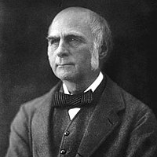
History
The first mention of a kappa-like statistic
is attributed to Galton (1892) and
Smeeton (1985).
The seminal paper introducing kappa
as a new technique was published by Jacob Cohen
in the journal Educational and Psychological Measurement in 1960.

Slide 17
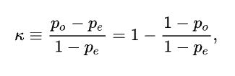
Definition
Cohen's kappa measures the agreement between two raters who each classify N items into C mutually exclusive categories.
po is the relative observed agreement(Actual) among raters.
Pe is a chance agreement(Expected) among raters.
If the raters are in raters are in complete agreement then k=1.
If there is no agreement among the raters then k=0.
It is possible for the statistic to be negative,which implies that there is no effective agreement between the two raters or the agreement is worse than random.

Slide 18
Steps(Example)
Collecting all the tweets from Railway official Accounts
  Ex. we collect 9 Tweets.
  @RailMinIndia PNR 8535486976 dirty and used blanket and used bedroll given no one is responding very bad
  @sureshpprabhu @RailMinIndia Dear Sir I am travelling in 19046 train &amp; there is no water in toilets. The condition of the train is worst.

Slide 19

Cohen’s kappa (calculation with example)
There's two parts to this:
  Calculate observed agreement (Actual)
  Calculate agreement by chance(Expected)

Slide 20
Let’s say we’re dealing with “yes” and “no” answers and 2 raters. Here are the ratings:
Tagger1 = ['yes', 'no', 'yes', 'yes', 'yes', 'yes', 'no', 'yes', 'yes']
Tagger2 = ['yes', 'no', 'no', 'yes', 'yes', 'yes', 'yes', 'yes', 'yes']
Turning these ratings into a confusion matrix:
 | Tagger 2 Yes | Tagger 2 No
Tagger 1 Yes | 6 | 1
Tagger2 No | 1 | 1

Slide 21
Observed agreement = (6 + 1) / 10 = 0.7
Chance agreement = probability of randomly saying yes (P_yes) + probability of randomly saying no (P_no)
P_yes = (6 + 1) / 10 * (6 + 1) / 10 = 0.49
P_no = (1 + 1) / 10 * (1 + 1) / 10 = 0.04
Chance agreement = 0.49 + 0.04 = 0.53
Since the observed agreement is larger than chance agreement we’ll get a positive Kappa.
  Kappa = 1 - (1 - 0.7) / (1 - 0.53) = 0.36
Or just using sklearn's implementation
  from sklearn.metrics import cohen_kappa_score
  cohen_kappa_score(Tagger1, Tagger2)
  which returns 0.35714.

Slide 22
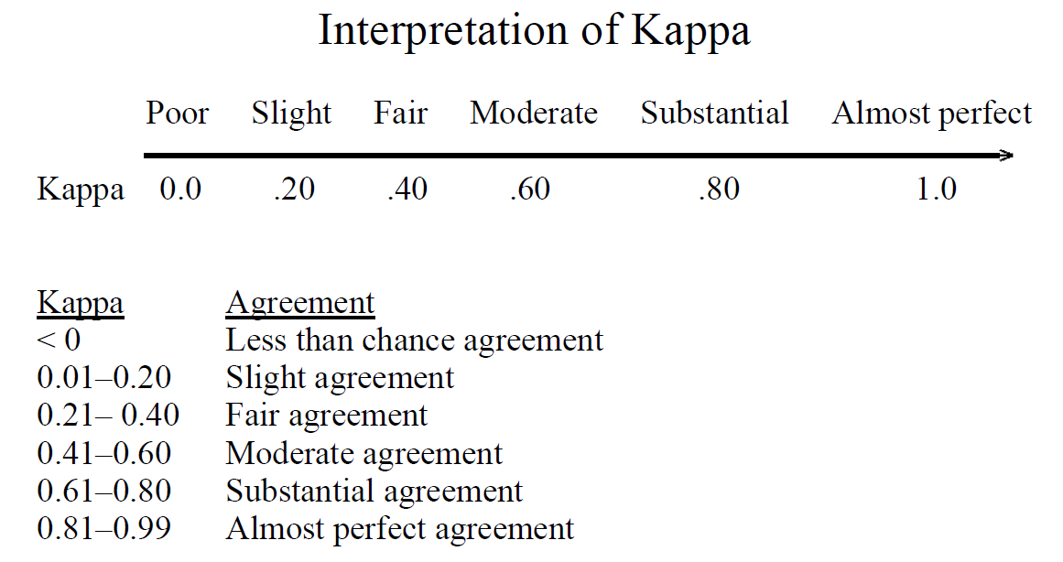
Interpretation of kappa

Slide 23
Special cases
Less than chance agreement
  Tagger1 = ['no', 'no', 'no', 'no', 'no', 'yes', 'no', 'no', 'no', 'no']
  Tagger2 = ['yes', 'no', 'no', 'yes', 'yes', 'no', 'yes', 'yes', 'yes', 'yes']
  cohen_kappa_score(rater1, rater2)
  -0.2121
If all the ratings are the same and opposite
  This case reliably produces a kappa of 0
  Tagger1 = ['yes'] * 10
  Tagger2 = ['no'] * 10
  cohen_kappa_score(rater1, rater2)
  0.0

Slide 24
Random ratings
For random ratings Kappa follows a normal distribution with a mean of about zero.
As the number of ratings increases there’s less variability in the value of Kappa in the distribution.

Slide 25
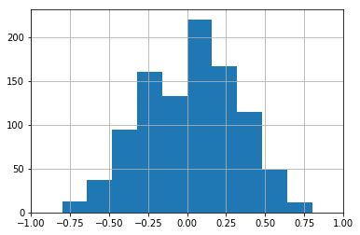
10 random ratings for each rater (random sample of 1,000 inter-rater Kappa calculations)

Slide 26
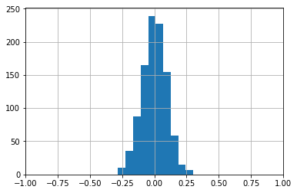
100 random ratings for each rater (random sample of 1,000 inter-rater Kappa calculations)

Slide 27
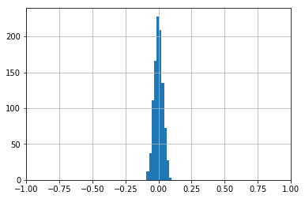
1000 random ratings for each rater (random sample of 1,000 inter-rater Kappa calculations)

Slide 28
Limitations of Cohen’s Kappa
Cohen's Kappa only applied to 2 raters rating the exact same items.
κ = 0 when the observed allocation is apparently random
Kappa is an index that considers observed agreement with respect to a baseline agreement.
Kappa's baseline agreement is the agreement that would be expected due to random allocation.

Slide 29
Literature Survey – Research Papers

Slide 30
Paper -1
Title : A Simplified Cohen’s Kappa for Use in Binary Classification Data Annotation Tasks
Authors : Juan Wang, Yongyi Yang, Bin Xia
Published In: IEEE Access
Year of Publication: 2019

Slide 31
Introduction
Binary Classification
  Binary classification refers to those classification tasks that have two class labels.
  Examples : Email spam detection (spam or not).
  Typically, binary classification tasks involve one class that is the normal state and another class that is the abnormal state.

Slide 32
Introduction
Binary Classification
  For example “not spam” is the normal state and “spam” is the abnormal state. Another example is “cancer not detected” is the normal state of a task that involves a medical test and “cancer detected” is the abnormal state.
  The class for the normal state is assigned the class label 0 and the class with the abnormal state is assigned the class label 1.

Slide 33
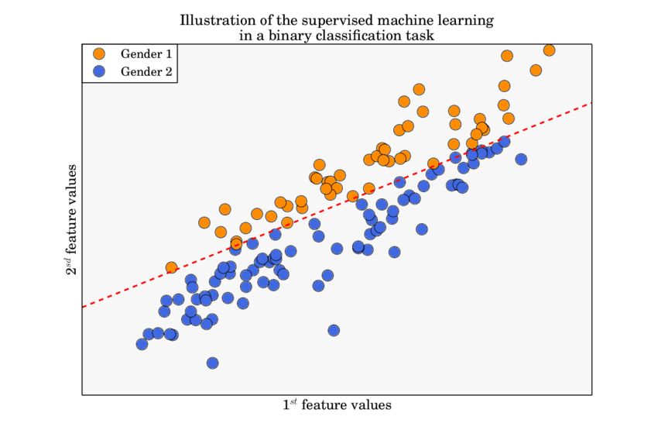

Slide 34
Paper-I Data Annotation
Data Annotation :-
  Data annotation is simply the process of labeling information so that machines can use it.
  It is especially useful for supervised machine learning (ML), where the system relies on labeled datasets to process, understand, and learn from input patterns to arrive at desired outputs.
It has been demonstrated that the quality of the data labels can have a number of effects on the resulting classifier, ranging from the classification performance, the complexity of the classifier model, to the number of required training samples

Slide 35
Paper-I Cohen’s kappa
Cohen's kappa coefficient (κ) is a statistic that is used to measure inter-rater reliability for qualitative (categorical) items.
In binary classification tasks, Cohen’s kappa is often used as a quality measure for data
annotations, which is inconsistent with its original purpose as an inter-annotator consistency / inter-rater reliability (two or more people agree on the same point) measure.
Therefore, it is important to assess(judge or form the opinion about something) the quality of annotations prior to their use in supervised learning
One such metric is Cohen’s kappa coefficient which has been accepted as the de facto standard for measurement of inter-annotator agreement
Mathematically, Cohen’s kappa is defined as:
where pA is the observed(actual) relative agreement between two annotators, and pE is the hypothetical (expected) probability

Slide 36

Cohen’s kappa is also cited for its problems associated with bias and prevalence in the interpretation of kappa Values.
The bias problem is caused by the difference in the distribution of annotation categories of the two annotators.
The prevalence problem arises when the underlying distribution of class categories is skewed.
Based on the 2×2 confusion matrix, Feuerman and Miller obtained the following relationship:
for Se not equal Sp, where Se is sensitivity, Sp is specificity, α is the proportion of examples in the positive class, and β = 1 − α
The analytic relationship between kappa and commonly used classification metrics (e.g., sensitivity and specificity) is non-linear, and thus is difficult to be applied for interpretation of the classification performance of the annotations

Slide 37
Paper-I Final conclusion
In the previous study, based on an annotation generation model, we derived a linear relationship.
κ = Se + Sp − 1 derivation to the more general case of biased annotations.
We derive a simplified, linear relationship of kappa, sensitivity and specificity by employing the 1st-order Taylor approximation. This relationship is further simplified by relating to Youden’s J statistic, a metric used for classification performance.
We provide an analysis on the linear coefficients in the simplified relationship and the approximation error, and conduct a linear regression analysis to assess the relationship by using a synthetic dataset where the ground truth is known
The results demonstrate the effectiveness of the developed relationship when no severe bias and prevalence issues exist.
In addition, the relationship between kappa and Youden’s J is also validated on a real-life dataset collected from a diabetic retinopathy (DR) screening study.
The discrepancy between kappa and Youden’s J is demonstrated to be an effective measure for annotator assessment when no ground truth is available.
Ground truth is a term used in various fields to refer to information that is known to be real or true, provided by direct observation and measurement as opposed to information provided by inference.

Slide 38
Paper-I Methods
Annotation Generation Model
Cohen’s Kappa coefficient
Sensitivity and Specificity
Kappa Approximation

Slide 39
Annotation Generation Model
Let LXi be the annotation of an instance provided by the ith annotator (i ∈ {1, 2}) and c ∈ {0, 1} be the category of the labels, in which c = 1 denotes positive class and c = 0 is negative class. The annotation process above suggests an annotation generation model with latent variable l for the easy and hard types, i.e., l = E (easy) and l = H (hard).
(Hint : Xi is annotator , c=1 denotes positive class , c=2 denotes negative class, E= easy , H=hard
latent variable – a variable that cannot be observed because it is hidden and no measurement error associated with it. )
It is described by conditions as follows:
P(X1 = c|l = E) = P(X2 = c|l = E) (2)
P(X1 = X2|l = E) = 1 (3)
P(X1, X2|l = H) = P(X1|l = H)P(X2|l = H) (4)
Equations (2) and (3) represents that the two annotators perfectly agree on the easy instances. Equation (4) denotes that the two annotators independently provide labels for the hard Instances.
The annotation generation model yields κ = 1 for easy instances and κ = 0 for hard instances [26]. When the population consists of both easy and hard instances, 0 < κ < 1. These results together indicate that 0 ≤ κ ≤ 1 when the annotation generation model is considered

Slide 40

B)Cohen’s Kappa coefficient
To investigate the relationship between kappa and classification metrics, one annotator has to be ground-truth annotator.
Cohen’s kappa can be expressed as:

Slide 41
C)Sensitivity and Specificity
Se + Sp = 1 + e
This relationship indicates that the summation of sensitivity and specificity is determined by the proportion of easy instances in the dataset.
Youden’s J statistic is a performance summary for binary classification task. It is defined as J , Se+Sp−1. Equation suggests the following relationship between eand Youden’s J:
  J = e
It indicates that Youden’s J measures the proportion of the easy instances.

Slide 42
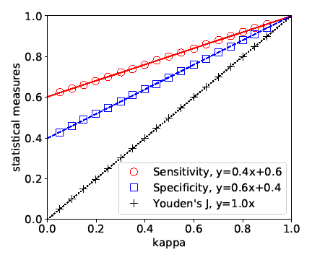

Slide 43
D)Kappa Approximation
KAPPA APPROXIMATION WITH RESPECT TO E,For e > 0, equation
KAPPA APPROXIMATION WITH RESPECT TO H .To eliminate the issue of potential great error when e is large
RELATIONSHIP OF KAPPA, SENSITIVITY AND SPECIFICITY

Slide 44
5.Proposed Approach

Slide 45

5.1 Programming Language
Python
  Python is a programming language that lets you work more quickly and integrate your systems more effectively.
Advantages/Benefits of Python
  Open Source and Community Development
  Presence of Third Party Modules
  Learning Ease and Support Available
  Productivity and Speed
  User-friendly Data Structures

Slide 46
Applications for Python
  Web and Internet Development:
  Scientific and Numeric
  Python's standard library supports many Internet protocols
  Education
  Desktop GUIs
  Software Development
  Business Applications

Slide 47

5.2 API used
5.2.1 Pandas
5.2.2 metrics
5.2.3 pylab
5.2.4 seaborn
5.2.5 matplotlib
5.2.6 pycm

Slide 48

5.2.1 Pandas
Pandas is a software
library written
for the Python programming
language for data
manipulation and analysis.

Slide 49
Features of Panda
A fast and efficient DataFrame object for data manipulation with integrated indexing
Time series-functionality: date range generation and frequency conversion, moving window statistics, date shifting and lagging. Even create domainspecific time offsets and join time series without losing data
Tools for reading and writing data between in-memory data structures and different formats CSV and text files, Microsoft Excel, SQL databases, and the fast HDF5 format
Intelligent data alignment and integrated handling of missing data: gain automatic label-based alignment in computations and easily manipulate messy data into an orderly form
Flexible reshaping and pivoting of data sets
Highly optimized for performance, with critical code paths written in Cython or C
Intelligent label-based slicing, fancy indexing, and subsetting of large data sets

Slide 50
5.2.3 Pylab
Pylab is a module that provides a Matlab like namespace by importing functions from the modules Numpy and Matplotlib. Numpy provides efficient numerical vector calculations based on underlying Fortran and C binary libraries. Matplotlib contains functions to create visualizations of data.

Slide 51
5.2.4 seaborn
Seaborn is a data visualization library built on top of matplotlib and closely integrated with pandas data structures in Python. Visualization is the central part of Seaborn which helps in exploration and understanding of data.

Slide 52
5.2.5 matplotlib
Matplotlib is an amazing visualization library in Python for 2D plots of arrays.
Matplotlib is a multi-platform data visualization library built on NumPy arrays and designed to work with the broader SciPy stack. It was introduced by John Hunter in the year 2002

Slide 53
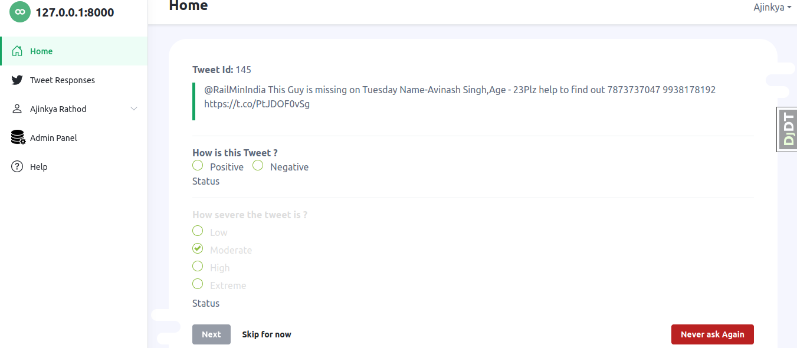

Slide 54
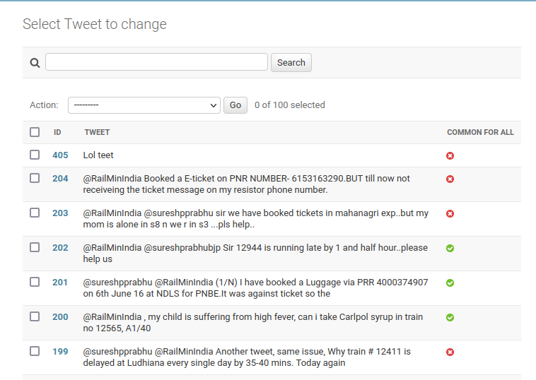

Slide 55
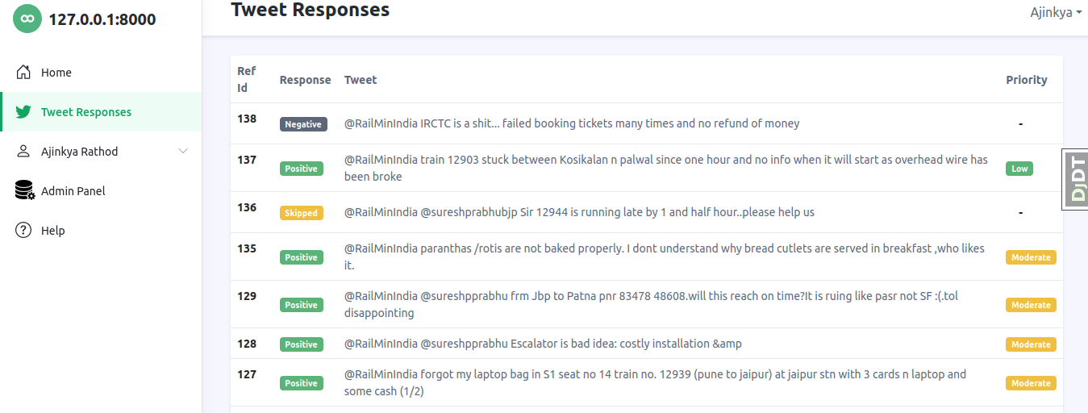

Slide 56
References
https://towardsdatascience.com/inter-rater-agreement-kappas-69cd8b91ff75
https://www.wikiwand.com/en/Cohen%27s_kappa#/History
https://machinelearningmastery.com/types-of-classification-in-machine-learning/
https://www.sciencedirect.com/science/article/pii/S016740481730250X
https://smallbusiness.chron.com/crowdsource-twitter-34435.html
https://github.com/amirziai/learning/blob/master/statistics/Inter-rater%20agreement%20kappas.ipynb

Slide 57
Future Work
Multi-tagger
Machine Learning Based
Remove the Limitations of Kappa
Multi-class classification
  (Gwet's AC1, Scott's Pi, Bennett's S)

Slide 58
Thank You
Any Questions ?

Slide 59
Special Thanks to
Dr. Hiren Joshi

