Slide 2
Operator | Description
+ | Addition
- | Subtraction
* | Multiplication
** | Exponentiation (ES2016)
/ | Division
% | Modulus (Remainder)
++ | Increment
-- | Decrement

Slide 3
JavaScript Data Types
JavaScript variables can hold many data types: numbers, strings, objects and more:
var length = 16; // Number var lastName = "Johnson"; // String var x = {firstName:"John", lastName:"Doe"}; // Object
var x = 16 + "Volvo"; An:16Volvo
var x = 16 + 4 + "Volvo"; ans:20Volvo

Slide 4
Function :
When JavaScript reaches a return statement, the function will stop executing.
If the function was invoked from a statement, JavaScript will "return" to execute the code after the invoking statement.
Functions often compute a return value. The return value is "returned" back to the "caller":
!DOCTYPE html>
<html>
<body>
<h2>JavaScript Functions</h2>
<p>This example calls a function which performs a calculation and returns the result:</p>
<p id="demo"></p>
<script>
var x = myFunction(4, 3);
document.getElementById("demo").innerHTML = x;
function myFunction(a, b) {
return a * b;
}
</script>
</body>
</html>

Slide 5
function
<!DOCTYPE html>
<html>
<body>
<h2>JavaScript Functions</h2>
<p>This example calls a function to convert from Fahrenheit to Celsius:</p>
<p id="demo"></p>
<script>
function toCelsius(f) {
return (5/9) * (f-32);
}
document.getElementById("demo").innerHTML = toCelsius(77);
</script>
</body>
</html>

Slide 6
JS event
OPTION: 1
<html>
<body>
<button onclick="document.getElementById('demo').innerHTML=Date()">The time is?</button>
<p id="demo"></p>
</body>
</html>
OPTION: 2
<html>
<body>
<button onclick="this.innerHTML=Date()">The time is?</button>
</body>
</html>

Slide 7
Common HTML Events
Here is a list of some common HTML events:
Event | Description
onchange | An HTML element has been changed
onclick | The user clicks an HTML element
onmouseover | The user moves the mouse over an HTML element
onmouseout | The user moves the mouse away from an HTML element
onkeydown | The user pushes a keyboard key
onload | The browser has finished loading the page

Slide 8
JS Array
<!DOCTYPE html>
<html>
<body>
<h2>JavaScript Arrays</h2>
<p id="demo"></p>
<script>
var cars = ["Saab", "Volvo", "BMW"];
document.getElementById("demo").innerHTML = cars;
</script>
</body>
</html>
JS Array using New keyword
var cars = new Array("Saab", "Volvo", "BMW");

Slide 9
JS Array : accessing element
document.getElementById("demo").innerHTML = cars[0];
JS Array : accessing last element
<!DOCTYPE html>
<html>
<body>
<h2>JavaScript Arrays</h2>
<p>JavaScript array elements are accesses using numeric indexes (starting from 0).</p>
<p id="demo"></p>
<script>
var fruits = ["Banana", "Orange", "Apple", "Mango"];
var last = fruits[fruits.length-1];
document.getElementById("demo").innerHTML = last;
</script>
</body>
</html>

Slide 10
JS Array : looping through array
<!DOCTYPE html>
<html>
<body>
<h2>JavaScript Arrays</h2>
<p>The best way to loop through an array is using a standard for loop:</p>
<p id="demo"></p>
<script>
var fruits, text, fLen, i;
fruits = ["Banana", "Orange", "Apple", "Mango"];
fLen = fruits.length;
text = "<ul>";
for (i = 0; i < fLen; i++) {
text += "<li>" + fruits[i] + "</li>";
}
text += "</ul>";
document.getElementById("demo").innerHTML = text;
</script>
</body>
</html>

Slide 11
JS if else
<!DOCTYPE html>
<html>
<body>
<p>Click the button to get a time-based greeting:</p>
<button onclick="myFunction()">Try it</button>
<p id="demo"></p>
<script>
function myFunction() {
var greeting;
var time = new Date().getHours();
if (time < 10) {
greeting = "Good morning";
} else if (time < 20) {
greeting = "Good day";
} else {
greeting = "Good evening";
}
document.getElementById("demo").innerHTML = greeting;
}
</script>
</body>
</html>

Slide 12
JS switch
<!DOCTYPE html>
<html>
<body>
<p id="demo"></p>
<script>
var day;
switch (new Date().getDay()) {
case 0:
day = "Sunday";
break;
case 1:
day = "Monday";
break;
case 2:
day = "Tuesday";
break;
case 3:
day = "Wednesday";
break;
case 4:
day = "Thursday";
break;
case 5:
day = "Friday";
break;
case 6:
day = "Saturday";
}
document.getElementById("demo").innerHTML = "Today is " + day;
</script>
</body>
</html>

Slide 13
JS while
<!DOCTYPE html>
<html>
<body>
<p id="demo"></p>
<script>
var cars = ["BMW", "Volvo", "Saab", "Ford"];
var i = 0;
var text = "";
while (cars[i]) {
text += cars[i] + "<br>";
i++;
}
document.getElementById("demo").innerHTML = text;
</script>
</body>
</html>

Slide 17
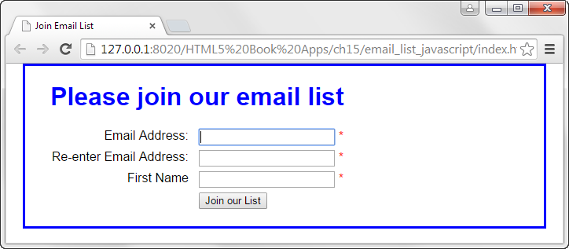

Slide 20
