Slide 1

CS197c: Programming in C++
Lecture 1
Marc Cartright
http://ciir.cs.umass.edu/~irmarc/cs197C/index.html

Slide 2
Administration : course details
Number of credits : 1 (no audit allowed)
Graded class (you must choose Pass/Fail)
Class time : Wednesdays 3:35 – 5:00 pm
Course webpage
  http://ciir.cs.umass.edu/~irmarc/cs197c/index.html
Office hours
  Thursdays, 10am-12pm
  If you cannot make that time, email me to work something out.

Slide 3
Administration : prerequisites
Should have prior programming experience
  C or JAVA or Python
Will need to have basic knowledge of UNIX/Linux OS
  Must be able to work on edlab machines

Slide 4
Administration : reading material
References:
  Lots online
  Lecture notes
  Examples
Recommended books:
  C++ for Java programmers, Mark Weiss
  Practical C++, Robert W. McGregor
  C++ Primer, Stanley B. Lippman

Slide 5
Administration : grading
6 Short Quizzes
  Assigned after lecture, due that Friday
  Total of 15% of final grade.
4 Programming Assignments
  2 weeks for each assignment = NO EXCUSES
  Each is 20% of final grade
5% for participation/effort
Talking is ok, but you must program alone
No late days

Slide 6
Syllabus
Lecture 1 : C/C++ basics, tools, Makefiles, C data types, ADTs
Lecture 2 : C libraries
Lecture 3 : Classes in C++, C++ I/O
Lecture 4 : Memory & Pointers
Lecture 5 : More Pointers
Lecture 6 : Templates and the STL
Lecture 7 : Reflection, Exceptions, C++11
Lecture 8 : Adv. Topics: Boost and OpenGL

Slide 7
Syllabus: Programming
Lecture 1 : C/C++ basics, tools, Makefiles, C data types, ADTs
Lecture 2 : C libraries
Lecture 3 : Classes in C++, C++ I/O
Lecture 4 : Memory & Pointers
Lecture 5 : More Pointers
Lecture 6 : Templates and the STL
Lecture 7 : Reflection, Exceptions, C++11
Lecture 8 : Adv. Topics: Boost and OpenGL

Slide 8
Syllabus: Quizzes
Lecture 1 : C/C++ basics, tools, Makefiles, C data types, ADTs
Lecture 2 : C libraries
Lecture 3 : Classes in C++, C++ I/O
Lecture 4 : Memory & Pointers
Lecture 5 : More Pointers
Lecture 6 : Templates and the STL
Lecture 7 : Reflection, Exceptions, C++11
Lecture 8 : Adv. Topics: Boost and OpenGL

Slide 9
Administration : Assignments
P1
  Purpose: establish workflow, practice with only C
  Series of small programming tasks
  Lots of reading/writing using functions
  Learn about the C Library

Slide 10
Administration : Assignments
P2
  Purpose: Dealing with Classes and Pointers
  Implement a doubly-linked list w/ pointers
  Above and Beyond: add iterator, reverse_iterator

Slide 11
Administration : Assignments
P3
  Purpose: Getting used to templates
  Extending the Linked List as a templated class
  Using the STL

Slide 12
Administration : Assignments
P4
  Purpose: Putting together templates, classes, and pointers
  Implement some of a Red-Black Tree
  Above and Beyond: Do a B-Tree

Slide 13
Administration : Policies
I will provide: Makefiles, Header files, Test Cases
You provide: Code that compiles on an EDLAB machine using the makefile and header file
If it does not compile, it will not be graded.
  no exceptions
  whining and/or excuses are examples of what will drop your participation grade
If it is late, it will not be graded.

Slide 14
Administration : Policies
Cheating/Plagiarism is not tolerated
  Offending assignment will be given 0
  Participation component of class dropped to 0 instantly
  Incident will be escalated to university officials for disciplinary action
  Guide on academic honesty:
  http://www.umass.edu/dean_students/codeofconduct/acadhonesty/

Slide 15

What is C++ ?
Originally (C with classes)
Designed to handle larger code bases
Characteristics
  Low-level (memory management exposed)
  Has object support (classes etc.)
  Strongly typed (types unambiguous)
  C++ is very big
C++ is in there...
C
Java

Slide 16
C++ and C
C: the canonical systems language
  Developed in 1972
C is C++’s daddy
  Developed in 1979, by Bjarne Stroustrup
  (Almost) all valid C code is valid C++
  C++ designed as a superset of C
  “C makes it easy to shoot yourself in the foot; C++ makes it harder, but when you do it blows your whole leg off”

Slide 17
C++ and Java
C++ is Java’s crazy uncle
Some similarities
  Java based on some C++ syntax
  Many object-oriented features shared
Some differences
  C++ has no runtime checks
  C++ does not have a virtual machine
Will feel like we’re going backwards, because we are

Slide 18
How is C++ going to help you ?
Will help you write operating systems
  Earn a good grade in 230 (or equivalent)
Gives better appreciation of Java
Helps you write various applications:
  Games like World of Warcraft
  Firefox
  MATLAB, and more...
Helps you get a job
  e.g. most Microsoft software is written in C++

Slide 19
Before C++ : Tools
Compiling tools: make and g++
Text editors : vim or emacs or anything you like
Debugger : gdb
Basic Unix:
cd, ls, rm, less, cp, mv, ssh, scp, man

Slide 20
Tools : make and g++
Make : used to build executables from source code
  Handles compiling and linking
  Similar to ant for Java
g++ : the gnu C++ compiler
  Large number of options (-g , -o, -c, -E, -v)
  Outputs an executable for that operating system

Slide 21
Tools : text editors
Good text editors can make life easier
  Syntax highlighting
  Parenthesis matching
Recommended editors
  emacs (my preference)
  vim
On your own
  Visual Studio, NetBeans, Eclipse...

Slide 22
Tools : gdb debugger
The gnu debugger
  Examine live programs
    Watch variables and memory
    Start and stop control flow
    Set break points

Slide 23
Tools : Unix commands
cd : change directory
ls : see directory contents
rm : delete a file
less : read a text file
cp : copy a file
mv : rename or move a file
ssh : secure shell login
scp : secure remote copy
man : read about a command

Slide 24
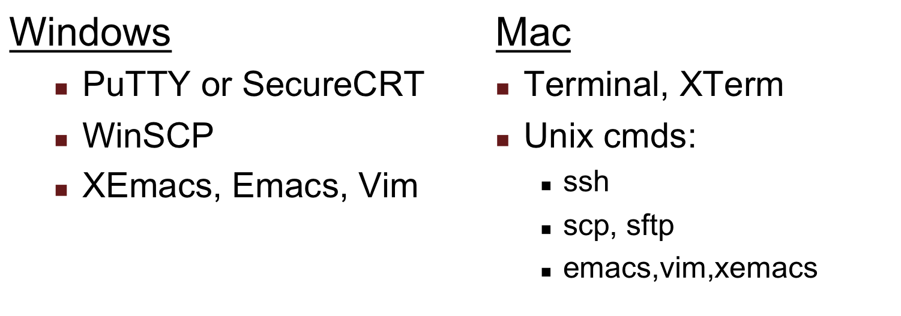
Windows and Mac Tools
I will not help you install or setup anything for class.

Slide 25
To See More...
Examples on class website (see first slide)
  use of various concepts
  quick tutorial on Unix commands
  use of some tools

Slide 26
Compilation Models
Source code → machine executable code
C++
Java
source code
compile
time
source code
Preprocessor
Compiler
Compiler
Java bytecode
assembly code
run
time
Virtual Machine
Assembler
object code
executable code
libraries
Linker
executable code
partially taken from http://www.cs.cf.ac.uk/Dave/C/node3.html

Slide 27
Preprocessor Directives (some...)
#include
  drags in header files
#define, #undef
  C-style macros
  constants
  predecessor to inlining
#ifdef
#ifndef
#else
#endif
Preprocessor version of if/else

Slide 28
C++ Compilation Model: Linking
“Linking” puts together separate object files to make final output (done by link editor)
  program
  another object file
2 types of linking: static and dynamic

Slide 29
Static Linking
All included libraries are copied into the object file:
object code
vector
vector
source
iostream
source
iostream
Linker
map
string
map
string

Slide 30
Dynamic Linking
Object file contains pointers to libraries, resolves at runtime:
iostream
vector
iostream
vector
source
Linker
object code
map
source
string
map
string

Slide 31
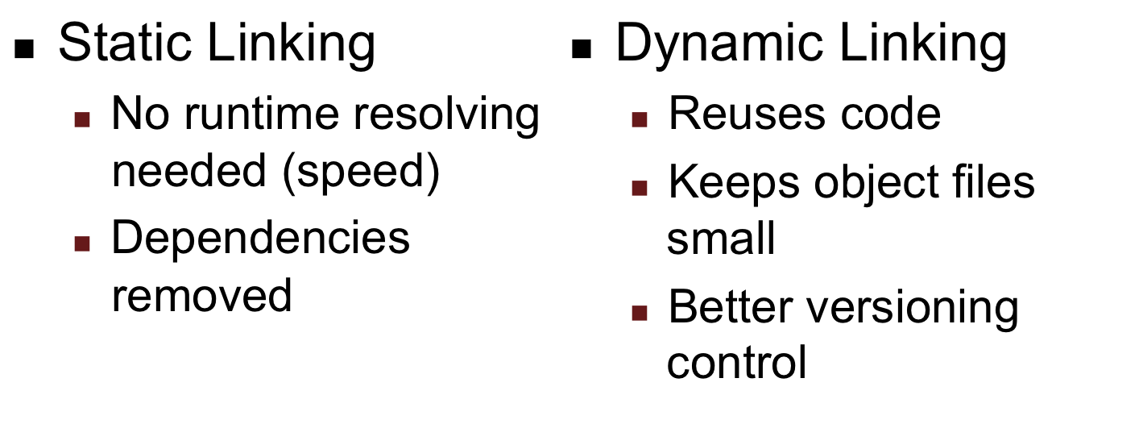
Linking Comparison

Slide 32
Makefiles
CC=g++
all: main
main: main.cpp Parser.o
${CC} –I. –L. –o parser main.cpp Parser.o
clean:
rm –f parser *.o *~

Slide 33
Makefiles
CC=g++
all: main
main: main.cpp Parser.o
${CC} –I. –L. –o parser main.cpp Parser.o
clean:
rm –f parser *.o *~

Slide 34
Makefiles: Setting variables
CC=g++
Allows a variable, but just does string replacement:
<variable>=<value>
When using the variable:
${<variable>}, e.g. ${CC}

Slide 35
Makefiles
CC=g++
all: main
main: main.cpp Parser.o
${CC} –I. –L. –o parser main.cpp Parser.o
clean:
rm –f parser *.o *~

Slide 36
Makefiles: Setting targets
all: main
Targets are used to manage build configurations:
<target>: <dependencies>
<command(s)>
Dependencies can be other targets, source files, object files...
Need only dependencies or commands

Slide 37
Makefiles
CC=g++
all: main
main: main.cpp Parser.o
${CC} –I. –L. –o parser main.cpp Parser.o
clean:
rm –f parser *.o *~

Slide 38
Makefiles
CC=g++
all: main
main: main.cpp Parser.o
${CC} –I. –L. –o parser main.cpp Parser.o
clean:
rm –f parser *.o *~

Slide 39
Makefiles: Example Target
target
dependencies
main: main.cpp Parser.o
${CC} –I. –L. –o parser main.cpp Parser.o
command
To run this target: make main

Slide 40
Makefiles: Example Target
target
source file
object file
main: main.cpp Parser.o
${CC} –I. –L. –o parser main.cpp Parser.o
remember this is
actually “g++”
input files
output file name

Slide 41
Makefiles: Example Target
main: main.cpp Parser.o
${CC} –I. –L. –o parser main.cpp Parser.o
what about these?
-I<path> adds a path for the compiler to search for header files
-L<path> adds a path for the linker to search for object files and libraries

Slide 42
Makefiles
That was one example
Makefiles are a dark art
The first 10% will get you 80% of the way
The rest is usually more than you need, but makes you an expert

Slide 43
Basics : primitive data types
char (represents byte)
int
long
float
double
bool (masks of 0 and 1)
C-string
C++ string

Slide 44
Basics : arrays
Contiguous block of memory of n cells
Each cell is the size of the provided type:
  char[40] = 40 * 1 byte per char = 40
  double[23] = 23 * 8 bytes per double = 184
Arrays also double as pointers (later)
Also can allocate arrays dynamically (later)

Slide 45
Basics: strings
In C, strings are arrays of characters:
char * str = “can has cheezburger”;
str =
In C++, you have the string class:
c a n h a s c h e e z b u r g e r \0
str[2] = ‘n’;
termination char
#include <string>
string str1 = “koala”;
string str2;
str2 = str1;
str2 += “ in a tree”;
if (str2 == str1) ...
if (str1 > str2) ...

Slide 46
Basics: strings
C-strings and C++ strings are functionally equivalent
C++ string provides better encapsulation
  char str[5] = “abcd”; char c = str[22];
  is syntactically ok, semantically bad, but it will run (until there’s a crash)
  string will automatically resize
  and more (adv. I/O will show this)

Slide 47
Basics : control flow
if(variable == A)
do something
switch(variable)
{
case A:
do something;
break;
default :
}
if(condition) {
do something;
} else {
do something else;
}
if-else clause

Slide 48
Basics : iteration
for(int i=0; i<10; i++)
{
do something;
}
while(condition)
{
do something;
}
loop for 10 times
loop while condition holds

Slide 49
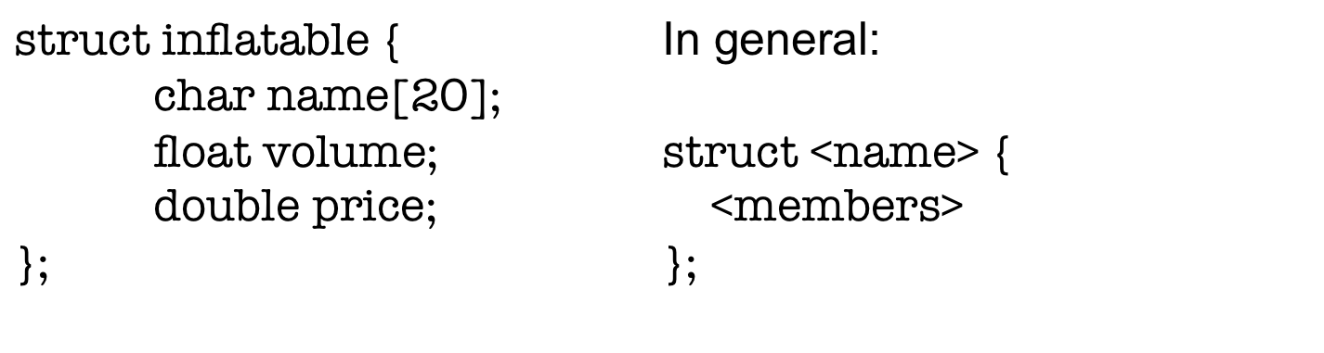
struct
Composite object
Only stores internal data, no methods
Predecessor to classes (can be extended)
Later:
inflatable balloon;
inflatable tire;

Slide 50
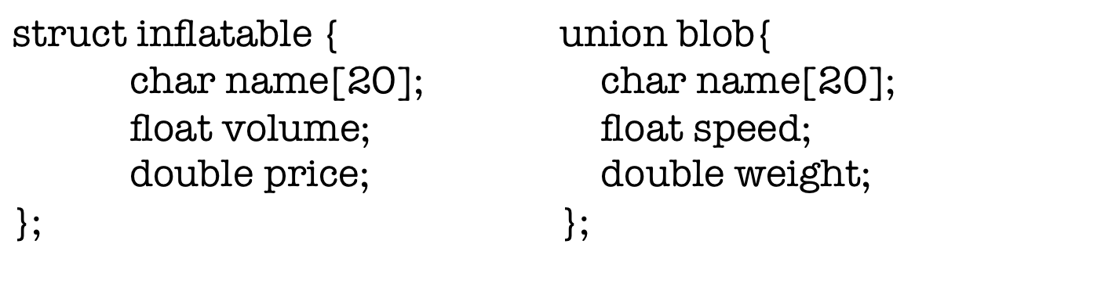
union
Fixed-width, multi-role object
Only stores enough for biggest type
inflatable uses (20 + 4 + 8 =) 32 bytes.
blob uses 20 bytes.

Slide 51
union
union blob{
char name[20];
float speed;
double weight;
};
blob.weight
blob.speed
blob.name

Slide 52
enum
Allows for restricted values for a variable.
Example:
  enum spectrum { red, orange, yellow, ... };
  spectrum signal = yellow;
In reality
  compiler assigns numbers to each member
  they only act as masks
  can assign yourself:
  enum spectrum { red=1, orange=7, ... };

Slide 53
typedef
Aliases existing types
General form:
  typedef <original type> <alias name>
Example
  Nodes in a red-black tree are ‘red’ or ‘black’
  typedef enum { ‘RED’, ‘BLACK’ } Color;
    original type: enum {‘RED’, ‘BLACK’}
    alias: Color
  Later:
  Color c = RED;

Slide 54
Aliased new types
typedef struct AbstractDataType {
struct AbstractDataType *parent;
void *data;
std::string description;
} ADT;

Slide 55
Aliased new types
typedef struct AbstractDataType {
struct AbstractDataType *parent;
void *data;
std::string description;
} ADT;
typedef <type> <name>;

Slide 56
Aliased new types
typedef struct AbstractDataType {
struct AbstractDataType *parent;
void *data;
std::string description;
} ADT;
typedef <type> <name>;

Slide 57
Aliased new types
Pointers are also fair game:
typedef struct AbstractDataType {
struct AbstractDataType *parent;
void *data;
std::string description;
} *ADT;
typedef <type> <name>;
In use: ADT ptr = new ADT();

Slide 58
Next lecture
Part 1 of the C++ Standard Library:
The C Library

