Slide 1


CS197c: Programming in C++
Lecture 2
Marc Cartright
http://ciir.cs.umass.edu/~irmarc/cs197c/index.html

Slide 2
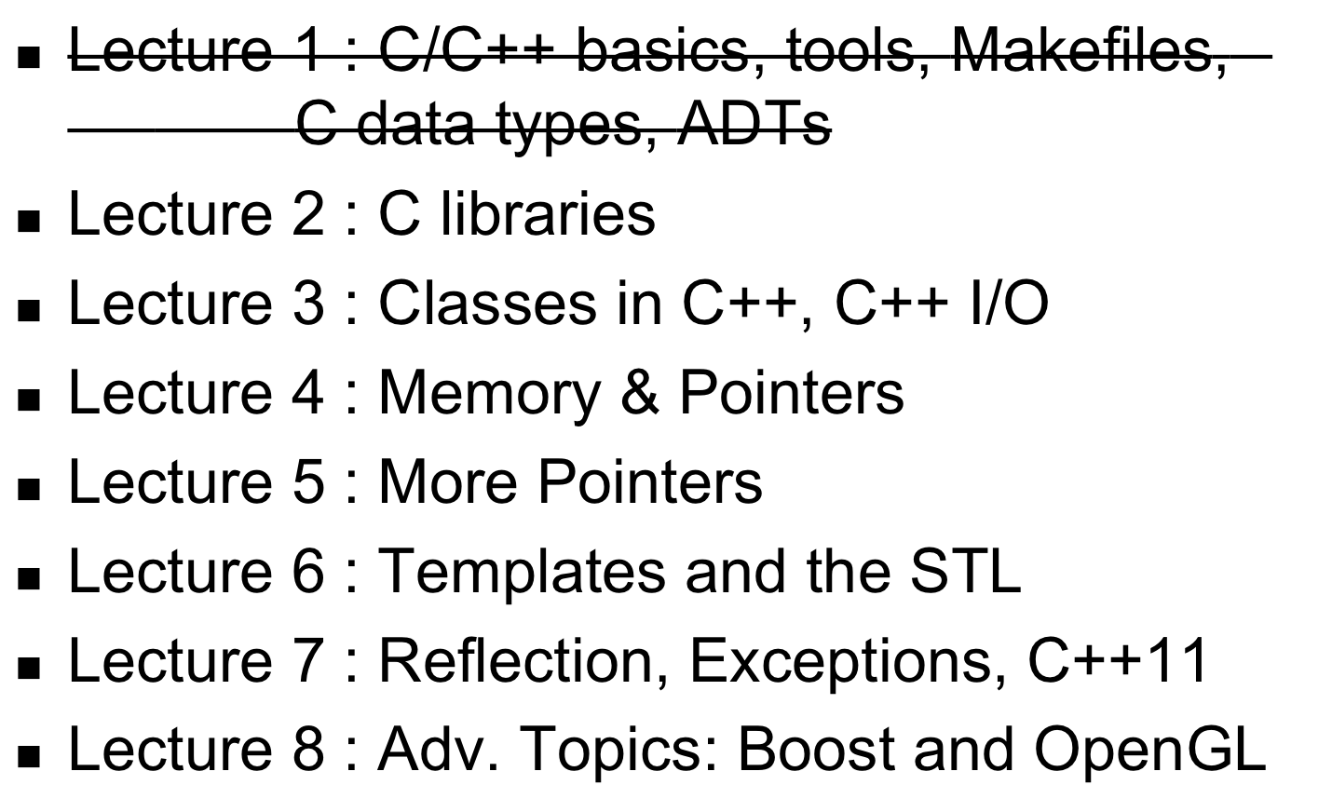
Syllabus

Slide 3
Today
C Libraries

Slide 4
Recap: Compilation Models
Source code → machine executable code
C++
Java
source code
compile
time
source code
Preprocessor
Compiler
Compiler
Java bytecode
assembly code
run
time
Virtual Machine
Assembler
object code
executable code
libraries
Linker
executable code
partially taken from http://www.cs.cf.ac.uk/Dave/C/node3.html

Slide 5
Recap: Compilation Models
Source code → machine executable code
C++
Java
source code
compile
time
source code
Preprocessor
Compiler
Compiler
Java bytecode
assembly code
run
time
Virtual Machine
Assembler
object code
executable code
libraries
Linker
executable code
partially taken from http://www.cs.cf.ac.uk/Dave/C/node3.html

Slide 6
C++ Compilation Model: Linking
“Linking” puts together separate object files to make final output (done by link editor)
  program
  another object file
2 types of linking: static and dynamic

Slide 7
Static Linking
All included libraries are copied into the object file:
object code
cstdlib
cstdlib
source
cstdio
source
cstdio
Linker
cmath
cstring
cmath
cstring

Slide 8
Dynamic Linking
Object file contains pointers to libraries, resolves at runtime:
cstdio
cstdlib
cstdio
cstdlib
source
Linker
object code
cmath
source
cstring
cmath
cstring

Slide 9
Today’s Goals:
Understand
  how to access libraries
  use of headers to expose interfaces
  what’s available in the C library

Slide 10
Finally, some code
Hello world !!
#include <cstdio>
int main(int argc, char * argv[]) {
printf(“Hello world!\n”);
return 0;
}

Slide 11
Finally, some code
Hello world !!
#include <cstdio>
int main(int argc, char * argv[]) {
printf(“Hello world!\n”);
return 0;
}
Preprocessor includes header file

Slide 12
Components of C/C++ software
Header files (.h in C, optional ext in C++)
  Global declaration, class declarations
  Included in other files
  Preprocessor literally replaces #include with file contents
  Should be guarded against multiple or recursive inclusions
Implementation files (.c / .cc or .cpp)
  All implementation of code elements

Slide 13
Header files and source files
header file
function and class implementations
(.c/.cc/.cpp files)
client code

Slide 14
Header files
Sample header:
#ifndef MYHEADER
#define MYHEADER
float cosine(float x);
<function declarations>
<class declarations>
#endif
Protects against multiple inclusion

Slide 15
Finally, some code
Hello world !!
#include <cstdio>
int main(int argc, char * argv[]) {
printf(“Hello world!\n”);
return 0;
}
Main function for C/C++

Slide 16
Main
void main()
int main()
int main(int argc, char * argv[])
Serves as entry point to program
1st variant takes no arguments, returns no status
2nd variant takes no args but returns status
3rd accepts args and returns status
  Most widely used, no harm in doing it

Slide 17
Finally, some code
Hello world !!
#include <cstdio>
int main(int argc, char * argv[]) {
printf(“Hello world!\n”);
return 0;
}
Arguments from cmd line

Slide 18
Command-Line Arguments
Similar to Java, but not quite
  1st argument is program call
  Arguments come as C-strings
>> ./myprogram input1.txt 5 “holy cow!”
int main(int argc, char *argv[]) {
...
}
argv[0] = “./myprogram”
argv[1] = “input1.txt”
argv[2] = “5”
argv[3] = “holy cow!”
argc = 4

Slide 19
Finally, some code
Hello world !!
#include <cstdio>
int main(int argc, char * argv[]) {
printf(“Hello world!\n”);
return 0;
}
prints to stdout

Slide 20
I/O in C
C is function-based
  printf(<format string>, <args>+);
  scanf(<format string>, <receivers>+);
Specify what the output should look like, then arguments are swapped in
  printf(“I’m only going to count to %d.\n”, 3);
  printf(“My name is %s.\n”, “HAL”);
newline

Slide 21
Finally, some code
Hello world !!
#include <cstdio>
int main(int argc, char * argv[]) {
printf(“Hello world!\n”);
return 0;
}
returns status value – simple way to communicate with calling process

Slide 22
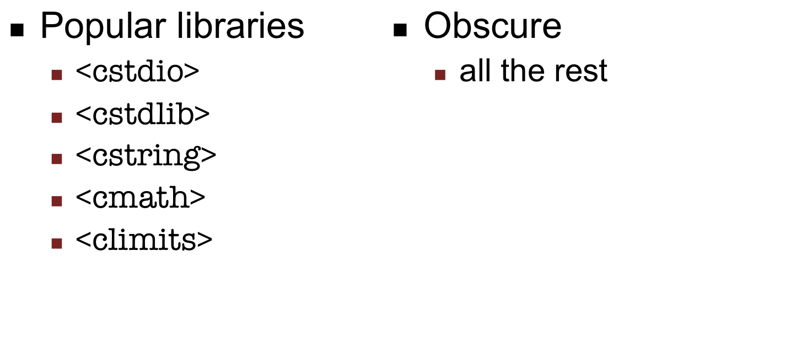
The C library
Reference: http://en.wikipedia.org/wiki/C_standard_library

Slide 23
<cstdio>
Contains functions for input and output
  printf/scanf probably most commonly used
  fprintf is the file-based variant
  sprintf prints TO a string (like a StringBuilder)
When playing with files:
  fopen/fclose
  fflush, fseek ftell, feof, and so on

Slide 24
<cstdlib>
Collection of utility functions and constants
  defines the NULL value
C-string ←→ numeric conversions
  atoi, atol, strtol, atof, strtod
Random numbers
  rand, srand
C-Memory handling (skipping)
Process control
  exit, abort, getenv, system

Slide 25
<cstring>
Collection of string manipulation functions
Popular functions
  strlen : determine the length of a C string
  strcmp : lexicographically compare two C strings

Slide 26
<cmath>
Collection of mathematical functions and constants
  Constants: M_E, M_PI, M_SQRT2
  Functions: cos, sin, log10, pow(x,y), etc.

Slide 27
<climits>
Collection of limiting constants for the data types
  LONG_MIN, LONG,MAX, INT_MIN, INT_MAX
Necessary because different systems implement data types differently
  LONG_MAX on 32-bit compiler: 2³¹
  LONG_MAX on 64-bit compiler: 2⁶³

Slide 28
Other libraries
Provide other utility functions, worth at least reading over
Wikipedia a good reference
Every computer has the C libraries somewhere on it

Slide 29
Walkthrough
C Library example

Slide 30
Next lecture
Into C++: Classes

