Slide 1


CS197c: Programming in C++
Lecture 3
Marc Cartright
http://ciir.cs.umass.edu/~irmarc/cs197c/index.html

Slide 2
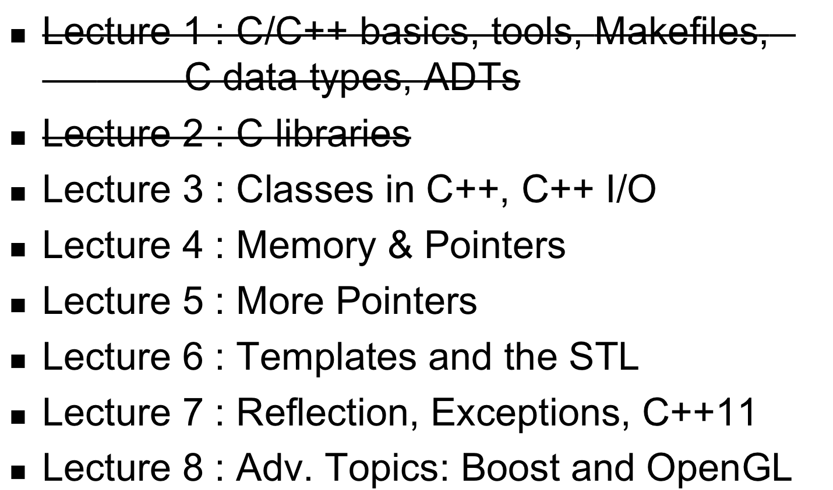
Syllabus

Slide 3
C++ Classes
Conceptually similar to Java classes
Mostly syntax differences:
class Foo {
// member declarations here
};
// method definitions out here

Slide 4
C++ Headers and Classes
Usually only function declarations, type defs
Foo.h:
class Foo {
private:
int id;
string name;
public:
Foo(string n); //constructor
~Foo(); //destructor
string getName() { return name; } //inlined!
};

Slide 5
C++ Headers and Classes
Source contains function/method definitions:
Foo.cpp:
#include “Foo.h”
Foo::Foo(string n) { name = n; }
Foo::~Foo() {}
string Foo::getName() { return name; } // or define it here

Slide 6
Inheritance
Sharing an interface among a group of related classes
One class is the base class
Remaining classes are derived classes (or subclasses) of the base class and inherit the base class’s interface

Slide 7
Differences from Java
C++ allows multiple inheritance
  In reality: Hideous idea. Not needed
  Java goes too far the other way
  Newer languages use mixins
No interfaces explicitly
  Pure virtual (abstract) classes take this role

Slide 8
Syntax for inheritance
To derive a class from another class
  class derivedclass : access baseClassname{…}
  Example :
    Class Rectangle : public GraphicalObject { … }

Slide 9
Access issues in inheritance
When base class is inherited public
  class Rectangle : public Graph {..}
  public in base class => public in derived class
  protected in base class => protected in derived class
When base class inherited as protected
  Class circle : protected Oval { …}
  Public in base class => protected in derived
  Protected in base class => protected in derived
When base class inherited as private
  Class square : private Rectangle { … }
  Public in base class => private in derived class
  Protected in base class => private in derived class

Slide 10
Overriding/dominated inherited members
If Y is a subclass of X, then Y object inherits all the protected and public member data
You might want to define a local version of an inherited member
class X { class Y : public X {
public : public :
void f() { cout<<“exec”;} void f() {cout<<“no”;}
}; };

Slide 11
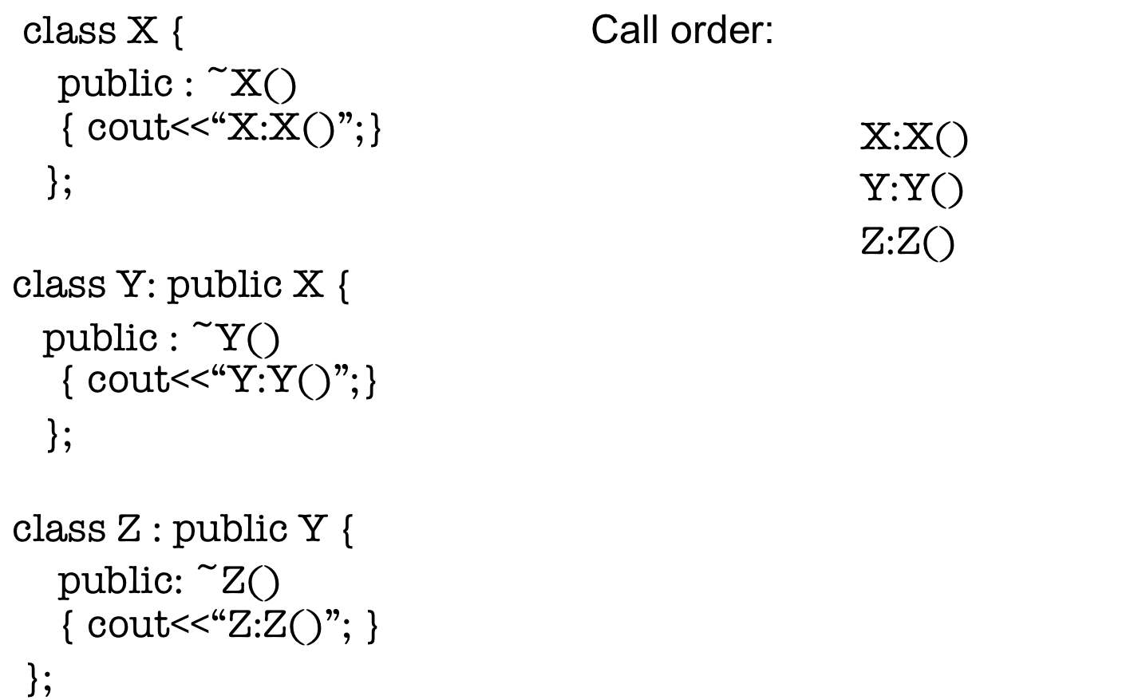
Parent Constructors

Slide 12
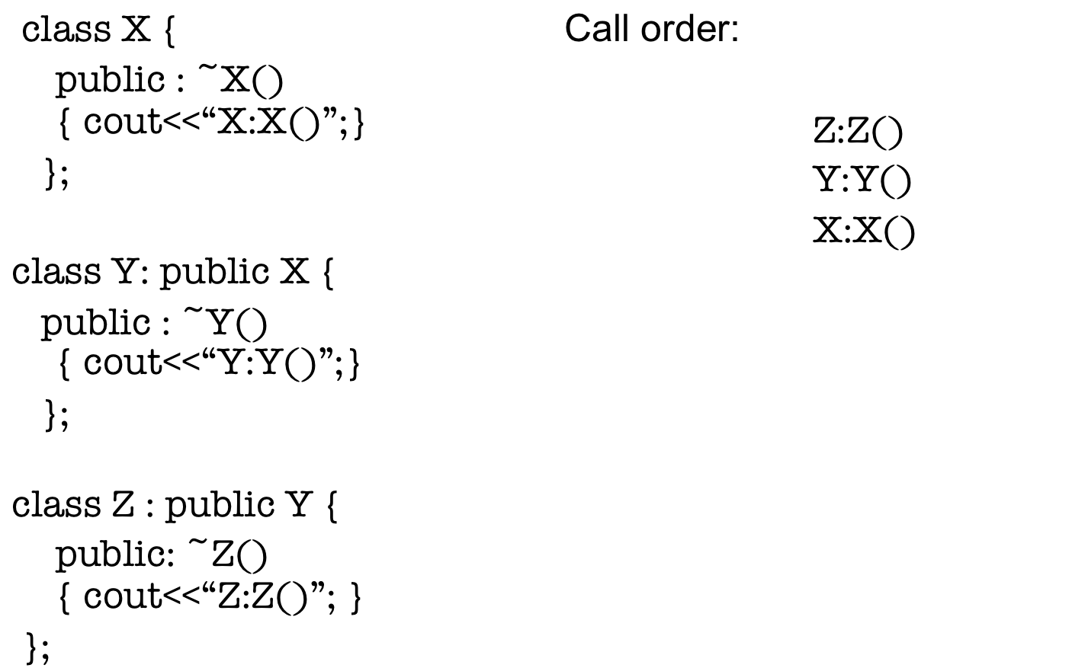
Parent Destructors

Slide 13
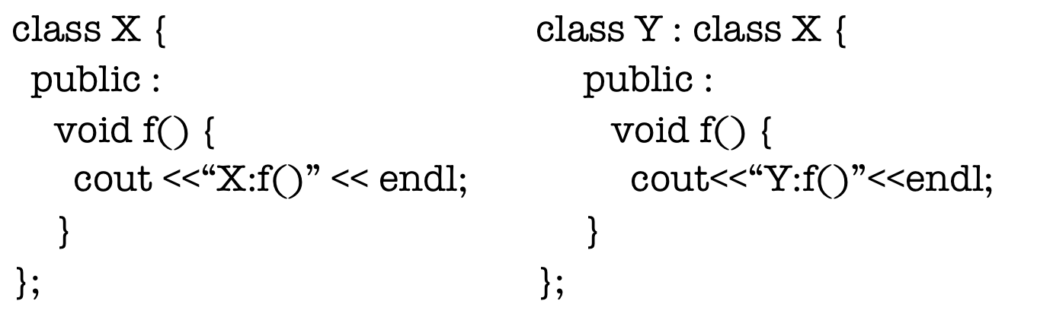
Virtual methods
main () {
X x;
Y y;
X *p = &x;
p -> f(); p = &y; p->f();
}

Slide 14
How do you only declare a method?
class X {
public : virtual void f() { cout <<“X:f()”;}
};
what is the output now?
The methods signature in the derived class must exactly match the method’s signature in the base class
You can never alter the return type of a virtual method

Slide 15
Pure Virtual Classes
Predecessor to abstract classes in Java
Cannot be instantiated
Definition is incomplete
class X {
public :
virtual void f() = 0;
};
(see examples virtual1.cpp and virtual2.cpp)

Slide 16
Inner Classes
Example: iterator
class X {
public: // ← what if private?
class iterator {
// definition in here
};
};

Slide 17
Overloading Operators : Basics
What : redefine operators on a per-class basis
Why : C++ likes to make objects look like primitives
Which operators? Almost all of them:
  Relational (==, != , < , > )
  Arithmetic/Bitwise/Logical (+, -, /,*,--, ++, ||, &&, |, &)
  Assignment ( =, += , -=)
  Unary (+, -)
  I/O (<<, >>)
  Access ((),[], ->, ->*, , (the comma) )
  Memory (new , delete, new[], delete[])

Slide 18
Overloading operators: Basics
Off limits:
  sizeof
  membership (., .*)
  ::
  ?:
  typeid, const_cast, dynamic_cast, static_cast (reflection)

Slide 19
Overloading example
Person p1, p2;
cout<<p1;
What is really going on here?

Slide 20
Overloading example
Person p1, p2;
cout<<p1;
What is really going on here?
  cout<<p1 → operator<<(cout,p1)

Slide 21
More about overloading
Operator has different definitions depending on which object it is operating on
Operators should take care to release memory if they are replacing one piece of dynamic memory with another

Slide 22
Overloaded operator syntax
T& operator=(const T&);
Return type is reference to an object of the same class T
Thus function must return the object that is being assigned
How do you implement this?

Slide 23
Example of overloaded arithmetic operator
Conventional way of doing it
  Ratio product (Ratio x, Ratio y)
  {
  Ratio z(x.num*y.num, x.den*y.den);
  return z;
  }
  call : Z = product(x,y);
Operator overloading
  Ratio operator*(Ratio x, Ratio y)
  {
  Ratio z(x.num*y.num, x.den*y.den);
  return z;
  }
  call : Z = x * y;

Slide 24
Non-member function
Previous example :
  product is a non member function (vs member)
Product requires access to private members. Make use of friend modifier
class Ratio
{
friend Ratio operator* (const Ratio &, const Ratio &);
}

Slide 25
Member vs. Non-member
Member
  Ratio &operator*(Ratio &other) ...
  Modifies object in place
Non-Member
  Ratio operator*(Ratio x, Ratio y)...
  Takes 2 arguments and returns some Ratio

Slide 26
Post and Pre increment
(Post increment)++
  Ratio Ratio::operator++(int)
  How would you implement it?
++ (Pre increment)
  Ratio Ratio::operator++()
  How is it different from post increment?
  Dummy argument (int)

Slide 27
Subscript operator []
How would you implement in the Ratio class
Say for a ratio 22/7 1st index is the numerator and 2nd index is the denominator
  e.g. r[0] = 22, r[1] = 7
How might you implement this?
LET’S TAKE A LOOK
(blobs.cpp)

Slide 28
Namespaces: Back to C++ code
Hello world !!
#include <iostream>
using namespace std;
int main(int argc, char * argv[]) {
cout<<“Hello world !”<< endl;
return 0;
}
Specifies use of a given namespace

Slide 29
Namespaces
Similar to Java’s package scheme
Used to avoid name collisions
namespace cs197c {
Person teacher;
Person[] students;
...
}
cs197c::teacher = new Person();
using cs197c;
teacher = new Person();
w/o using
with using

Slide 30
I/O of C++
std::cin is standard input
std::cout is standard output
std::cerr is standard error
#include <iostream>
using namespace std;
cout << “Beam me up, Scotty.\t” << 5 << 3.425654 << endl;
contains declarations
puts in scope
produces newline
calls can be chained, different operands

Slide 31
I/O in C++
Standard input (cin)
int value, input;
  cin >> value >> input;
Standard output (cout)
cout << “Hello world!” << endl;
Standard error (cerr)
  Same behavior as cout, but separate stream

Slide 32
I/O in C++
Available stream implementations:
  <iostream>: cout, cin, cerr
  <fstream> is the equivalent, but for files
  <stringstream> transfers stream functionality to a string.
Let’s get into some detail...

Slide 33
Setting flags on a stream
Flags affect the behavior of streams
  Example: cout.setf(ios_base::showpos);
  will show plus signs in front of positive numbers
Types of flags
  numerical formatting
  filling spaces
  etc…

Slide 34
Manipulators
Instead of using setf() all day long...
Convenience functions for the streams
  endl
  flush
  hex, dec, oct
  fixed, scientific...many more
Example (printing in hexadecimal):
int i = 45;
cout << hex << i << flush;

Slide 35
Raw Output
Say you just want to put 8 bytes on the stream...
write method to the rescue!
ostream &write( const char *s, streamsize n);
streamsize is really an integer
Paraphrase: “write n bytes starting at s”

Slide 36
Raw Output (cont’d)
Example:
double d = 2.718281828;
cout.write((const char *) &d, sizeof(double));
Also:
char c = ‘A’;
cout.put( c );

Slide 37
Reading input
Simple line-at-a-time interface: getline
  fstream iofile("input.txt",ios::in);
  if(!iofile.fail()) {
  while(!iofile.eof()) {
  char data[MAX];
  iofile.getline(data,MAX);
  // Manipulate ‘data’ variable here
  }
  }
  iofile.close();
cin is the preferred method of input processing in C++

Slide 38
Reading input (cont’d)
Use cin:
  for (cin >> num; cin.good(); cin >> num) {
  sum += num;
  }
  // cin failed to read since the loop ended.
  // Need to clear the stream to read more...
  cin.clear();
  cin >> num;

Slide 39
Raw Input
Similar to cout’s raw methods:
  get
Single-byte input
  char c;
  cin.get( c );
Multibyte input
  long l;
  cin.get((char *) &l, sizeof(long));

Slide 40
Programming Assignment 2
Implement a Linked List of integers
Provided
  Makefile (won’t compile yet)
  Header file (LinkedList.h)
  PDF of assignment
You provide
  LinkedList.cpp

Slide 41
Programming Assignment 2
Will exercise knowledge of defining classes
Also needs pointers (next week)
Examples are available
Each individual method is not complicated

Slide 42
Next class
Memory Management
&
Pointers

