Slide 1


CS197c: Programming in C++
Lecture 4
Marc Cartright
http://ciir.cs.umass.edu/~irmarc/cs197c/index.html

Slide 2
Programming assignment Recap
PA2 due 9am next morning after class
  Please try to attend
  Ask questions earlier
  Easier than PA1 (I think...)
Things to not do:
  Leave part of an assignment blank
  Ignore the scaffolding given for the assignment
  Not look at lecture notes or examples

Slide 3
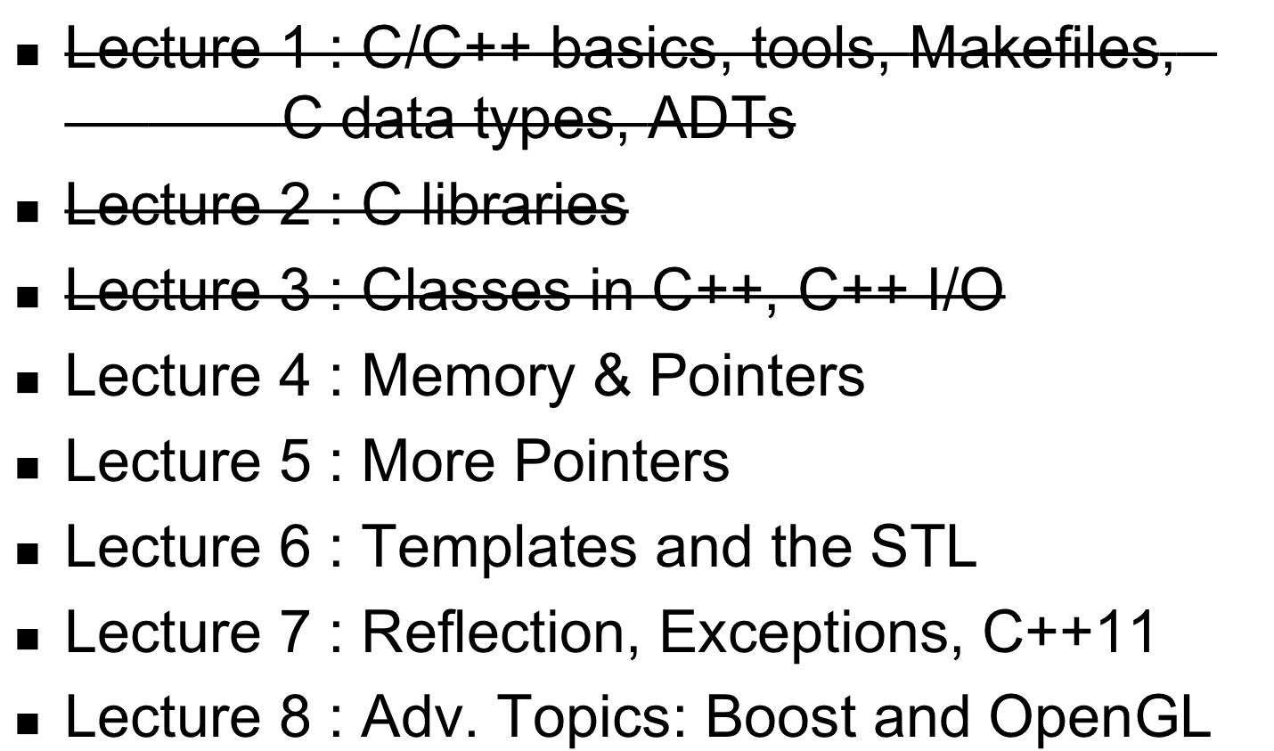
Syllabus

Slide 4
The modern memory model
the stack
Contents
local primitives
return addresses
function params
Growth : Ordered from function calls
Direction : high to low
Control : automatic
OS
Stack
Heap
Application
Reserved

Slide 5
The modern memory model
the heap
Contents
allocated objects
growth : chaotic, from new
direction : low to high
control : manual
OS
Stack
Heap
Application
Reserved

Slide 6
The modern memory model
other stuff
the operating system
the application code
etc.
OS
Stack
Heap
Application
Reserved

Slide 7
How Java looks at things ?
Primitives
  allocated on the runtime stack
Objects
  allocated on the heap
  accessed using references
  created using new()
  destroyed using garbage collection

Slide 8
How does C++ look at things ?
Primitives
  allocated on the runtime stack
Objects
  can be allocated on the stack or heap
  accessed using pointers
  created using new()
  destroyed using delete()

Slide 9
What are pointers anyway ?
variables which store locations of other vars
  locations = addresses
pointers usually point to things of only one kind
since pointers hold locations, they hold machine words (they are ints)
C/C++ has pointers
Java has pointers (sort of)
  Luckily it spares you from this

Slide 10
Common operators
* operator
  declaration: int *p; int *q;
  dereference: int a = (*p) + (*q);
& operator
  address of: int a = 12; int *p = &a;
-> operator
  class/structure reference:
  vector<int> *v = new vector<int>();
  int len = v->length();

Slide 11
Pointer Sample code
int main()
{
int x = 3;
int *y;
y = &x;
x = 4;
*y = 5;
}
Stack
x
3
1000

Slide 12
Pointer Sample code
int main()
{
int x = 3;
int *y;
y = &x;
x = 4;
*y = 5;
}
Stack
x
3
1000
y
??
1004

Slide 13
Pointer Sample code
int main()
{
int x = 3;
int *y;
y = &x;
x = 4;
*y = 5;
}
Stack
x
3
1000
y
1000
1004

Slide 14
Pointer Sample code
int main()
{
int x = 3;
int *y;
y = &x;
x = 4;
*y = 5;
}
Stack
x
4
1000
y
1000
1004

Slide 15
Pointer Sample code
int main()
{
int x = 3;
int *y;
y = &x;
x = 4;
*y = 5;
}
Stack
x
5
1000
y
1000
1004

Slide 16
Other Pointers about pointers
NULL
  Shorthand for 0 pointer – any type
  Points to nowhere
pointer declaration
  int *ptr1, ptr; // error
  int *ptr1, *ptr; // correct
be careful about precedence
  *ptr += 1;
  *ptr++;

Slide 17
Pointers vs. arrays
Functionally equivalent, syntactically different
int *nums is the same as int nums[]
*(nums + 24) is also the same as nums[24]
How does the pointer know how far to skip if you say nums[24] (or nums + 24)?

Slide 18
Pointers vs. arrays
Functionally equivalent, syntactically different
int *nums is the same as int nums[]
*(nums + 24) is also the same as nums[24]
How does the pointer know how far to skip if you say nums[24] (or nums + 24)?
A single array increment moves sizeof(type) bytes over in the array.

Slide 19
new()
new() is similar to Java
  allocates objects from the heap
  Calls constructor functions
But not totally
  You just cannot forget about the object
    You have to garbage collect on your own
  Arrays
    We can dynamically allocate primitive arrays
    int *array = new int[10];

Slide 20
delete()
C++ has no garbage collection
  you must delete() everything you new()
  otherwise : memory leak
  activates destructor
delete() has no Java counterpart
  Finalize does not count
you can delete arrays too
  delete[] () operator

Slide 21
Example of delete() and new()
Obj o1;
Obj *op1 = &o1;
o1.foo();
op1 -> foo();
(*op1).foo();
Obj *op2 = new Obj();
op1 = op2;
delete op2;
op1->foo();
delete op1;

Slide 22
Example of delete() and new()
Obj o1;
Obj *op1 = &o1;
o1.foo();
op1 -> foo();
(*op1).foo();
Obj *op2 = new Obj();
op1 = op2;
delete op2;
op1->foo();
delete op1;

Slide 23
Example of delete() and new()
Obj o1;
Obj *op1 = &o1;
o1.foo();
op1 -> foo();
(*op1).foo();
Obj *op2 = new Obj();
op1 = op2;
delete op2;
op1->foo();
delete op1;

Slide 24
Example of delete() and new()
Obj o1;
Obj *op1 = &o1;
o1.foo();
op1 -> foo();
(*op1).foo();
Obj *op2 = new Obj();
op1 = op2;
delete op2;
op1->foo(); // can’t do this; why?
delete op1; // can’t do this either

Slide 25
Memory headaches
stale pointers
multiple deletes
deleting something not newed
dereferencing null pointers
out-of-bound pointers
and so, so much more...

Slide 26
Function pointers
function name is actually a const pointer
  address of the code that implements it
Pointer to a function is a pointer whose address is the address of the function name
Example
int f(int);
  int (*pf) (int);
        pf = &f;

Slide 27
References : a remedy
Essentially an alias
  int &i = k;
Usable for primitives and objects
Can never be repointed
Can never be null
No explicit dereferencing required
  C++ does it for you
All objects in Java do this under the hood

Slide 28
Other remedies
Use C++ types where ever possible
  strings Vs C-strings
Use references where ever possible
Use a debugger to detect memory errors
  gdb
  The ever-useful “printline debugging”
  Or you can pray

Slide 29
Next Lecture
More Pointer Practice

