Slide 1


CS197c: Programming in C++
Lecture 5
Marc Cartright
http://ciir.cs.umass.edu/~irmarc/cs197c/index.html

Slide 2
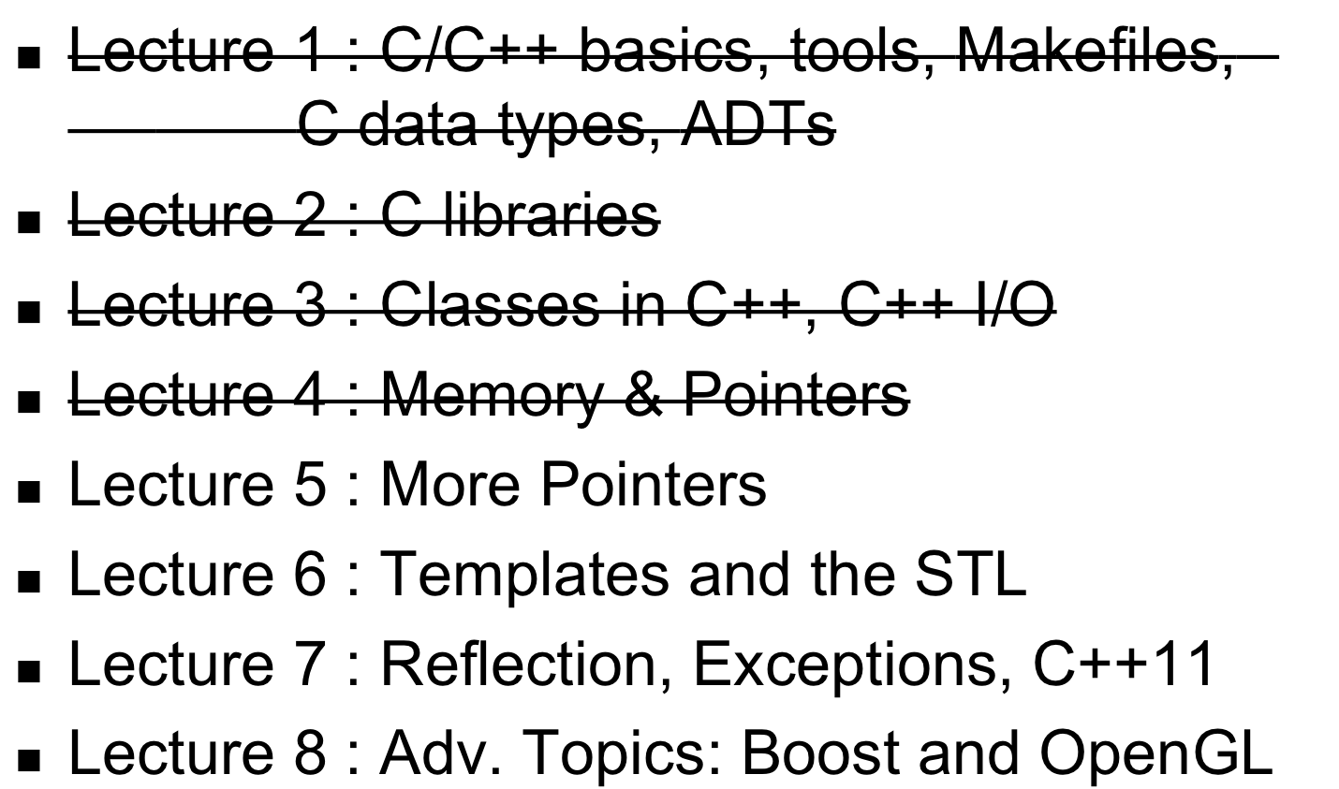
Syllabus

Slide 3
Schedule for Today
Form groups of 2-3
~20 minutes working on the problems
Review Problems
Quick lecture on Pointers & Classes
Q &A

Slide 4
QUIZ TIME!!!

Slide 5
# 1
int **p = &&n;

Slide 6
# 1
int **p = &(&n);
This makes no sense – how can you take the address
of just an address?

Slide 7
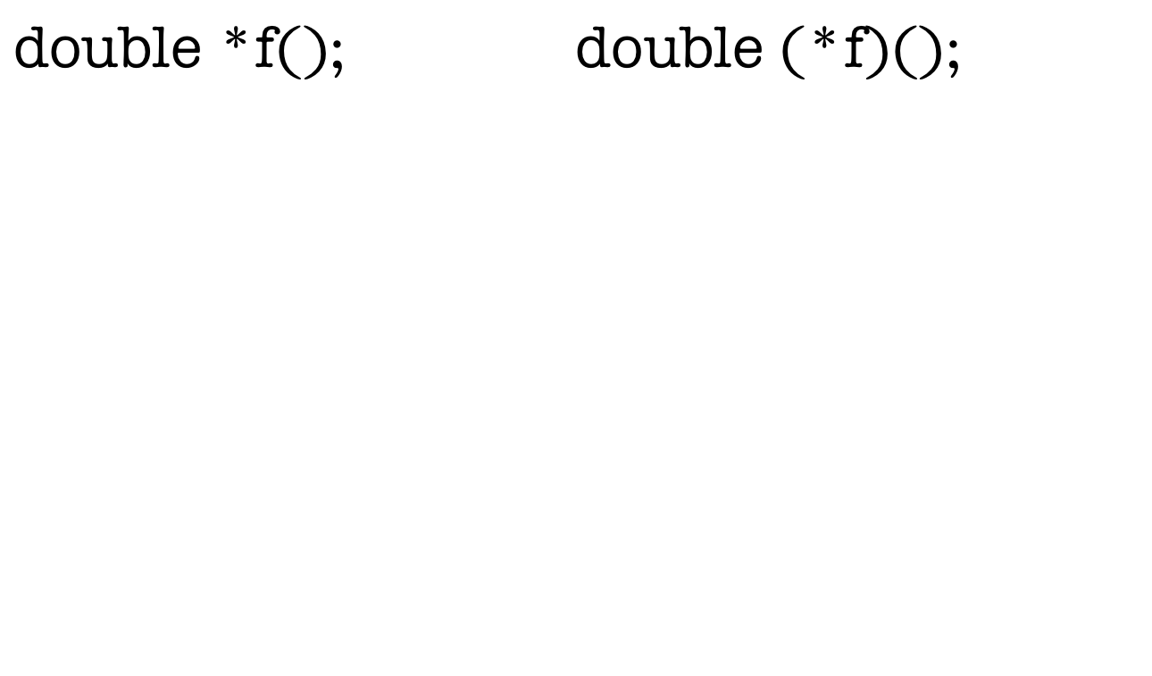
# 2

Slide 8
# 2
This function is called ‘f’, takes no arguments, and returns a pointer to a double.
Example:
#include <cmath>
double *dblptr;
dblptr = f();
double cosine = cos((*dblptr));

Slide 9
# 2
This is a pointer to a function (the pointer name is ‘f’), and it returns a double.
Example:
#include <cstdlib>
f = &drand48(); // our function pointer now looks at
// drand48 – PRNG for doubles.
double result = f();

Slide 10
# 3
float x = 3.14159;
float *p = &x;
short d = 44;
short *q = &d;
p = q;

Slide 11
# 3
float x = 3.14159;
float *p = &x;
short d = 44;
short *q = &d;
p = q;
Can’t assign a pointer of one type to another unless
you’re casting up in the class hierarchy.

Slide 12
# 4
What is the code you would use to allocate a 2-D primitive array of ints of size m by n?
Hint: You will need to use double pointers -- pointers that point to pointers.

Slide 13
# 4
What is the code you would use to allocate a 2-D primitive array of ints of size m by n?
Hint: You will need to use double pointers -- pointers that point to pointers.
int **arr = new int*[m];
for (int i = 0; i < m; i++) {
arr[i] = new int[n];
}

Slide 14
# 5
Delete the 2-D array.
int **arr = new int*[m];
for (int i = 0; i < m; i++) {
arr[i] = new int[n];
}

Slide 15
# 5
Delete the 2-D array.
int **arr = new int*[m];
for (int i = 0; i < m; i++) {
arr[i] = new int[n];
}
for (int i = 0; i < m; i++) {
delete [] arr[i];
}
delete [] arr;

Slide 16
# 6
Random selection of student answers!

Slide 17
# 7
int m = 44;
int *p = &m;
int &r = m;
int n = (*p)++;
int *q = p - 1;
r = *(--p) + 1;
++*q;
(i) m (ii) n (iii) &m (iv) *p (v) r (vi) *q

Slide 18
# 7
int m = 44;
int *p = &m;
int &r = m;
int n = (*p)++;
int *q = p - 1;
r = *(--p) + 1;
++*q;
(i) m (ii) n (iii) &m (iv) *p (v) r (vi) *q
Ok, there’s a lot going on here...
Let’s go line by line!

Slide 19
# 7
int m = 44;
int *p = &m;
int &r = m;
int n = (*p)++;
int *q = p - 1;
r = *(--p) + 1;
++*q;
Var | Value
m | ?
n | ?
&m | ?
*p | ?
r | ?
*q | ?

Slide 20
# 7
int m = 44;
int *p = &m;
int &r = m;
int n = (*p)++;
int *q = p - 1;
r = *(--p) + 1;
++*q;
m is allocated at address 0x3fffd00, and assigned value 44.
Var | Value
m | 44
n | ?
&m | 0x3fffd00
*p | ?
r | ?
*q | ?

Slide 21
# 7
int m = 44;
int *p = &m;
int &r = m;
int n = (*p)++;
int *q = p - 1;
r = *(--p) + 1;
++*q;
p is allocated at address 0x3fffd04, and assigned pointer value 0x3fffd00 (addr. of m).
Var | Value
m | 44
n | ?
&m | 0x3fffd00
*p | 44
r | ?
*q | ?

Slide 22
# 7
int m = 44;
int *p = &m;
int &r = m;
int n = (*p)++;
int *q = p - 1;
r = *(--p) + 1;
++*q;
r is allocated at address 0x3fffd08, and also assigned reference value 0x3fffd00.
Var | Value
m | 44
n | ?
&m | 0x3fffd00
*p | 44
r | 44
*q | ?

Slide 23
# 7
int m = 44;
int *p = &m;
int &r = m;
int n = (*p)++;
int *q = p - 1;
r = *(--p) + 1;
++*q;
n is allocated at address 0x3fffd0c. We first dereference p, retrieving value 44. Since we're using the postfix increment, the value returned is the value before incrementing, therefore n is assigned 44, and then m is incremented to 45.
Var | Value
m | 45
n | 44
&m | 0x3fffd00
*p | 45
r | 45
*q | ?

Slide 24
# 7
int m = 44;
int *p = &m;
int &r = m;
int n = (*p)++;
int *q = p - 1;
r = *(--p) + 1;
++*q;
q is allocated at address 0x3fffd10. We use pointer math here, and take the address stored at p and decrement it by one according to the base type, which is int. Therefore, we subtract 4 from the address stored at p, and q is assigned 0x3fffd00 - 4 = 0x3fffcfc.
Var | Value
m | 45
n | 44
&m | 0x3fffd00
*p | 45
r | 45
*q | *(0x3fffcfc)

Slide 25
# 7
int m = 44;
int *p = &m;
int &r = m;
int n = (*p)++;
int *q = p - 1;
r = *(--p) + 1;
++*q;
We first decrement p (prefix decrement), then take the value at the address, which is (&m - 4), and add one to it. If x is the value at address 0x3fffcfc, then r, and therefore m, are assigned the value x+1.
Var | Value
m | 45
n | 44
&m | 0x3fffd00
*p | 45
r | 45
*q | *(0x3fffcfc)

Slide 26
# 7
int m = 44;
int *p = &m;
int &r = m;
int n = (*p)++;
int *q = p - 1;
r = *(--p) + 1;
++*q;
We first decrement p (prefix decrement), then take the value at address (&m - 4), and add one to it. r, and therefore m, are now set to that value.
Var | Value
m | (*q)+1
n | 44
&m | 0x3fffd00
*p | (*q)+1
r | (*q)+1
*q | *(0x3fffcfc)

Slide 27
# 7
int m = 44;
int *p = &m;
int &r = m;
int n = (*p)++;
int *q = p - 1;
r = *(--p) + 1;
++*q;
(variable substitution to decouple)
Var | Value
m | x+1
n | 44
&m | 0x3fffd00
*p | x+1
r | x+1
*q | *(0x3fffcfc)

Slide 28
# 7
int m = 44;
int *p = &m;
int &r = m;
int n = (*p)++;
int *q = p - 1;
r = *(--p) + 1;
++*q;
Dereference q and increment the value.
Var | Value
m | x+1
n | 44
&m | 0x3fffd00
*p | x+1
r | x+1
*q | x+1

Slide 29
We’ve seen
Pointers
int n = 32;
int *p = &n;
Classes
class Student {
public:
int numClasses;
...

Slide 30
So let’s put them together
Pointers and classes are extremely useful together:
class Student {
public:
Student();
~Student();
private:
vector<Course *> courses; // vector of courses
};

Slide 31
Why bother?
Better control
More efficient (memory)
More efficient (speed)

Slide 32
Passing Pointers
A function can return the address of an object that was created on the heap. In this example, the function's return type is pointer to Student.
Student *makeUpNewStudent() {
Student *s = new Student();
s->firstName = “Pablo”; return s;
}

Slide 33
Passing Pointers (cont’d)
(continued)... The caller of the function can receive the address and store it in a pointer variable. As long as the pointer remains active, the Student object is accessible.
Student *makeUpNewStudent() {
Student *s = new Student();
s->firstName = “Pablo”; return s;
}
Student *sPtr = makeupNewStudent();

Slide 34
Semantics with Pointers
A const-qualified pointer guarantees that the program has read-only access to the data referenced by the pointer:
const int * ptr;
Declaring a constant pointer guarantees only that the pointer itself cannot be modified: int * const ptr;

Slide 35
Pointers and Classes
Pointers are effective when encapsulated in classes, because you can control the pointers' lifetimes.
The constructor creates the array, and the destructor deletes it. Very little can go wrong,...

Slide 36
Pointers and Classes (cont’d)
...except when making a copy of a Student object. The default copy constructor used by C++ leads to problems. In the example, a course assigned to student X ends up in the list of courses for student Y. (demo)

Slide 37
Copying with classes
Hmm...that didn’t go according to plan
How can we fix it?

Slide 38
Copying with classes
Solution:
  Explicitly defining the copy constructor!
  Student::Student(Student s) {
  //deep copy course items here
  }

Slide 39
Next Lecture
Templates
&
The Standard Template Library (STL)
Now: Q&A on PA2

