Slide 1


CS197c: Programming in C++
Lecture 6
Marc Cartright
http://ciir.cs.umass.edu/~irmarc/cs197c/index.html

Slide 2
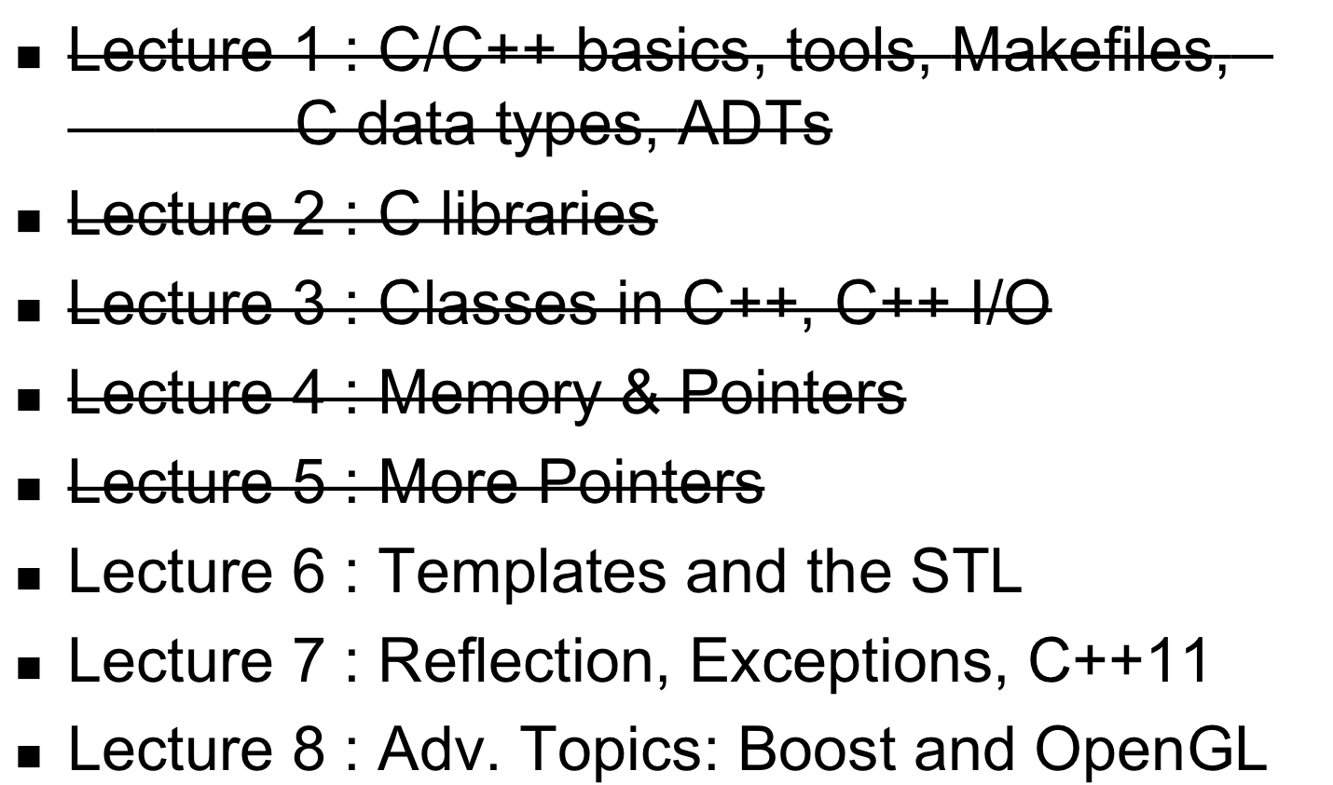
Syllabus

Slide 3
Today’s lecture
Templates
&
The Standard Template Library (STL)

Slide 4
Template Types
Function Templates
  General Templates
  Overloading
  Explicit Specializations
Class Templates
  General
  Explicit

Slide 5
So what do templates look like?
There are function templates:
template <class T>
void quickPrint(T t) { cout << t << endl; }
quickPrint<float>(4.5);
quickPrint<string>(“fourteen”);

Slide 6
So what do templates look like?
…and class templates
template <class T>
class Foo {
// declarations
bool contains(T &item);
};
template <class T>
bool Foo<T>::contains(T &item)
{ //definition using T }

Slide 7
General Idea Behind the Magic...
quickPrint<float>(4.5); compiles to
void quickPrint(float t) { cout << t << endl; }
and
quickPrint<string>(“fourteen”); compiles to
void quickPrint(string t) { cout << t << endl; }

Slide 8
Function Templates
Generic programming for functions:
template <class T> // ← newer: <typename T>
void reverse(T arr[], int c) {
T tmp;
for (int i = 0; i < (c/2); i++){
tmp = arr[i];
arr[i] = arr[c-i-1];
arr[c-i-1] = tmp;
}
}

Slide 9
Specializing the Template:
Given:
template <class T> void reverse(T arr[], int c)
In action:
int nums[10];
for (int i = 0; i < 10; i++) nums[i] = i;
reverse(nums, 10); // ← note the specialization is implicit

Slide 10
Function Templates (cont’d)
We can overload as well…
template <class T> void reverse(T arr[], int c) {…}
template <class T> void reverse(T *arr, int c) {
T tmp;
for (int i = 0; i < (c/2); i++){
tmp = arr[i];
arr[i] = arr[c-i-1];
arr[c-i-1] = tmp;
}
}

Slide 11
Function Templates (cont’d)
Explicit Specialization: special cases
Given: template <class T> void reverse(T arr[], int c)
template <> void reverse<int>(int arr[], int c) {
// do cool stuff specific to ints
}

Slide 12
Function Templates (cont’d)
General Templates are familiar
  Built for any appropriate type
Explicit Specializations: specific behavior for one type
Selection preferences:
1) non-template | void reverse(int arr[], int c);
2) exp. specialization | template <> void reverse<int>(int arr[], int c);
3) template | template <class T> void reverse(T arr[], int c);

Slide 13
Class Templates
Generic programming for whole classes:
template <class T>
class Trie
{
// declarations, members, etc.
void add(T &item);
};
template <class T> void Trie<T>::add(T &item) {
// def
}

Slide 14
Class Templates (cont’d)
To use our class template:
#include “Trie.hpp”
Trie<int> myTrie;
// cool stuff here
Note: specialization is explicit

Slide 15
Class Templates (cont’d)
Further reading (if you’re interested...):
  Recursive templating
  expression arguments
  explicit specializations (similar to function templates)
  partial specializations
  templates as members
  templates as parameters
  and more...

Slide 16
Some Template Gotchas
Templates are not defined functions and classes; they are meta-defintions
  Don’t compile as usual
  Separate copy for each specialization
  Also means you may need to put the function “definitions” in the header file
    cf export
Can lead to code bloat

Slide 17
What is the STL?
A library of template based reusable components
  Implements common data structures and algorithms
Uses generic programming based on templates
  Similar to generics in Java

Slide 18
Why use STL at all ?
Code has been tested for decades
  Solid, efficient code base
Provides interfaces which are easy to use
Do not have to mess with internal mechanism of how the data structures are implemented

Slide 19
So what is the STL made up of ?
Containers
  Data structures that store objects of any type
Iterators
  tool used to traverse elements in containers
Algorithms
  common algorithms like searching and sorting

Slide 20
Containers
Sequence containers
  Linear data structures
  E.g. lists, vectors, deque
Associative containers
  Non-linear containers
  E.g. maps, multimaps, sets, multisets
Container adapters
  Constrained sequence containers
  E.g., stacks and queues

Slide 21
Sequence containers
Commonalities
  assume an ordering of elements
  allows sorting
Examples:
  vector (based on array)
  queue (based on...queue)
  deque (double-ended queue)
  list (based on linked lists)

Slide 22
Some methods for sequences
size()
capacity()
insert(iterator, const T & x)
erase(iterator)
pop_back()
reserve()
clear()

Slide 23
Vectors
based on arrays
Allow direct access to its elements using an overloaded ‘[]’ operator
Insertion at the end is efficient
  Use the push_back method
Insertion and deletion in the middle is expensive
  An entire portion of the vector needs to be moved

Slide 24
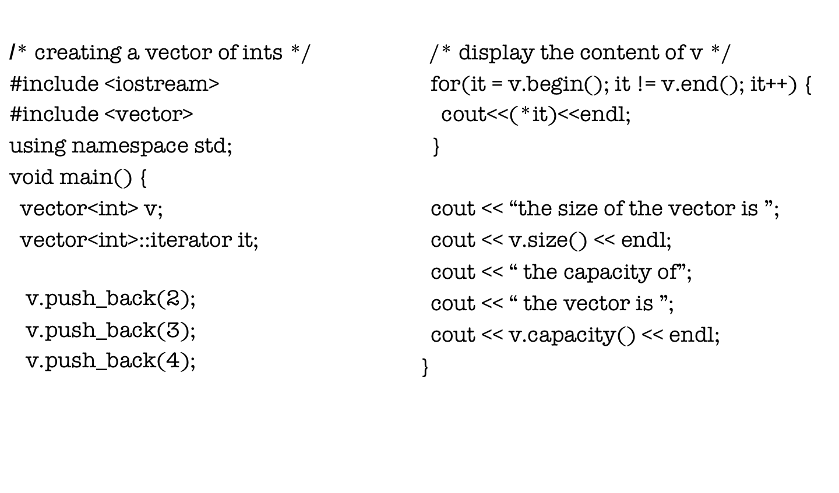
Example of using a vector

Slide 25
Lists
Implemented using doubly linked list
Insertion and deletion are efficient at any point of the list
Bidirectional iterators are used to traverse the list in both directions

Slide 26
Deque (“deck”)
Stands for double-ended queue
Combines the benefits of list and vector
Provides indexed access using indexes (not possible in lists)
Provides efficient insertion and deletion (not efficient in vectors)

Slide 27
Associative containers
Associative containers use keys to store and retrieve elements
There are four types of associative containers
  Set , multiset, map, multimap
  All associative containers maintain keys in sorted order
  All associative containers support bidirectional iterators

Slide 28
Mulitsets
Multisets are implemented using red-black trees
Multiset allows duplicate keys
The ordering is determined by the STL comparator function object less<T>
Keys sorted by less<T> must support the comparison operator

Slide 29
Sets
Exactly like multisets
But does not allow duplicate keys

Slide 30
Example of (multi)set
#include <iostream>
#include <set>
void main() {
multiset<int, less<int> > ms;
ms.insert(10);
ms.insert(10);
cout<<ms.count(10);
multiset<int, less<int> >::iterator it = ms.find(10);
if(it != ms.end()) cout<<“10 was found”<<endl;
}

Slide 31
Multimaps
associate keys to values
implemented using red-black trees
insertion is done using objects of the class pair
the ordering is determined by the STL comparator function object less<T>

Slide 32
Multimaps example
#include <iostream>
#include <map>
int main()
{
multimap<int, double> mp;
mp.insert(pair<int,double>(10,14.5));
multimap<int, double>::iterator it;
for(it=mp.begin(); it != mp.end();it++)
cout<<it->first<<“ “<<it->second;
}

Slide 33
Container Adapters (Stacks)
LIFO data structure
They are implemented with vector, list, and deque(by default)
Header file <stack>
Examples
  stack using vector : stack<int, vector<int>> s1
  stack using list : stack<int, list<int>> s2
  Stack using deque : stack<int> s3

Slide 34
Iterators
Iterators are pointers to elements of sequence and associative containers
  Type const_iterator defines iterator to a container element that cannot be modified
  Type iterator defines iterator to a container element that can be modified
All sequence and associative containers provide the begin() and end() methods
  Returns iterators pointing to the first and one after the last element in the container

Slide 35
Iterators (cont..)
If it points to a element in the container
  it++ (++it) points to the next element in the container
  (*it) is the actual element in the container
The iterator resulting from end() can only be used to detect whether the iterator has reached the end of the container.

Slide 36
STL Algorithms
Some popular ones:
  sort
  binary_search
  min/max
  set_union / set_intersection
  and more…

Slide 37
STL Algorithms (cont’d)
sort example:
bool mycomp(int i, int j) { return (i<j);}
int nums[] = { 19, 2, 45, 6 };
vector<int> myvec(nums, nums+4);
sort(myvec.begin(), myvec.end(), mycomp);

Slide 38
STL Algorithms (cont’d)
copy example:
vector<int> myvec();
myvec.push_back(7);
myvec.push_back(11);
vector<int> newvec(myvec.size());
copy(myvec.begin(), myvec.end(), newvec.begin());
/* newvec better have enough room! */

Slide 39
Next class
Reflection,
C++ Exception,
and C++11

