Slide 1


CS197c: Programming in C++
Lecture 7
Marc Cartright
http://ciir.cs.umass.edu/~irmarc/cs197c/index.html

Slide 2
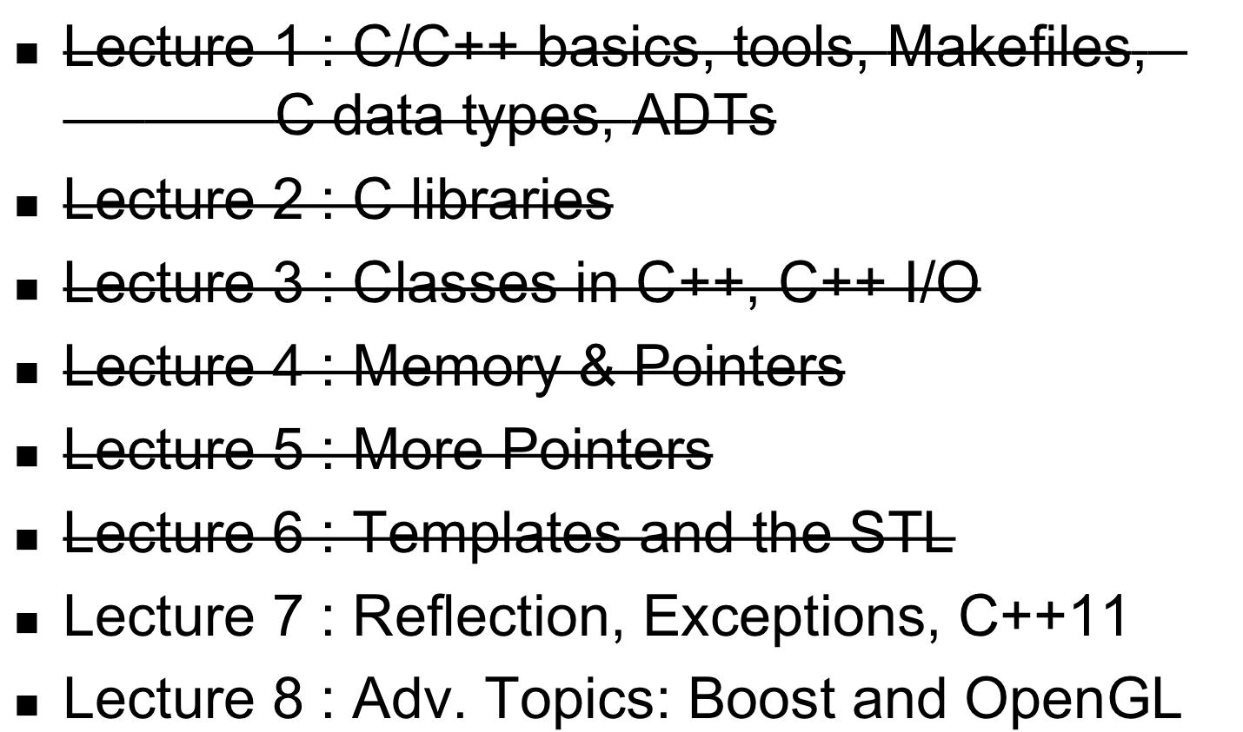
Syllabus

Slide 3
Today’s lecture
Reflection,
C++ Exceptions,
and C++11

Slide 4
Reflection in C++: RTTI
RTTI: Run-Time Type Information
  rudimentary reflection utilities
Why RTTI? Sometimes you need to know exactly what you’re looking at
3 components supported in the language (recently):
  dynamic_cast operator
  typeid operator
  type_info data type

Slide 5
RTTI: dynamic_cast
Attempts a safe typecast
Say we have:
class Vehicle {}
class Car : public Vehicle {}
class Coupe : public Car {}
and later...
Vehicle *v; // ← assume this was given a value earlier
Coupe *c = dynamic_cast<Coupe *>(v);
// at this point c is either a valid pointer or null

Slide 6
RTTI: typeid and type_info
Used for type equivalence
typeid returns a std::type_info object
Similar to instanceof in Java:
if (typeid(Coupe) == typeid(*v)) ...

Slide 7
C++ Exceptions
Syntactically similar to Java:
float div(int a, int b) {
if (b == 0) throw “Cannot divide by zero”;
return ((float) a / (float) b);
}
try {
float c = div(7, 0);
} catch (const char * s) {
cerr << s;
}

Slide 8
C++ Exceptions using objects
Libraries for handling exceptions:
  <exception> : interface to exceptions
  <stdexcept> : some standard exception types
First define the “error object”:
class bad_div {
public:
int v1;
int v2;
bad_div(int a = 0, int b = 0) : v1(a), v2(b){}
};

Slide 9
C++ Exceptions using objects
Default behavior:
try {
float c = div(7, 0);
} catch (exception &e) {
cerr << “Uh-oh:” << e.what() << endl;
}
Better than nothing
Not overly informative

Slide 10
C++ Exceptions using objects
Modify our try/catch block:
float div(int a, int b) throw(bad_div) {
if (b == 0) throw bad_div(a,b);
return ((float) a / (float) b);
}
try {
float c = div(7, 0);
} catch (bad_div & bd) {
cerr << “Bad arguments to div: “ << bd.v1 << “, “ << bd.v2 << endl;
}

Slide 11
C++ Exceptions
Multiple catches allowed:
try {
// suspicious code
} catch (thrown obj 1) {
} catch (thrown obj 2) {
} catch(…) {
// Catch whatever wasn’t handled above
}

Slide 12
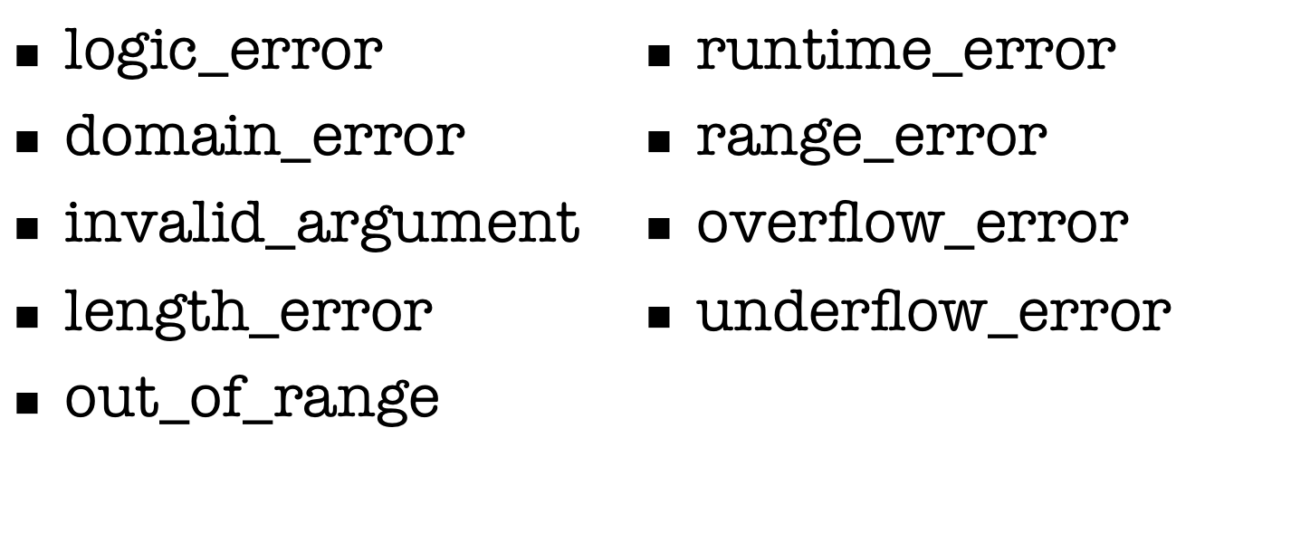
<stdexcept>
Saves us some work, but not as rich as Java...

Slide 13
Uncaught Exceptions
try {
float c = div(7, 0);
} catch (bad_div & bd) {
// catching code
}
If some other exception type is thrown, we’re in trouble unless we handle it:
void uncaughtHandler() { cout << “I’m dead…\n”; exit(5);}
set_terminate(uncaughtHandler);

Slide 14
Problems w/ set_terminate
Last-ditch
  last thing to happen
Ends sloppily
  terminate by default calls abort

Slide 15
Unexpected Exceptions
float div(int a, int b) throw(bad_div) {
if (b == 0) throw bad_div(a,b);
if (a == b) throw dumb_div(a,b);
return ((float) a / (float) b);
}
This is an unexpected exception, and also causes an abort of the program unless we set a handler:
void handleUnexpected() {
throw std::bad_exception(); // ← replace it with a // generic exception
}
set_unexpected(handleUnexpected);
Not specified to be thrown!

Slide 16
C++ Exception problems
Behavior is harder to predict with dynamic allocation and templates
  Not like Java
Default behavior is to drop everything on the floor
  Java stops mid-sentence and shows you what happened
No stack tracing built-in

Slide 17
C++11
Update to the definition of the C++ language
  Current working draft is 1334 pages!
  New standard is probably better than Java
Lots of new features
  Way too many to actually cover (40 sections)
  Many compiler installations not compliant
We’ll introduce some of them today
Most, if not all examples, lifted from Wikipedia (highly suggested resource):
http://en.wikipedia.org/wiki/C++11

Slide 18
C++11 Algorithms
#include <algorithm>
//are all of the elements positive?
all_of(first, first+n, ispositive()); //false
//is there at least one positive element?
any_of(first, first+n, ispositive()); //true
// are none of the elements positive?
none_of(first, first+n, ispositive()); //false
Taken from:
http://www.softwarequalityconnection.com/2011/06/the-biggest-changes-in-c11-and-why-you-should-care/

Slide 19
C++11 Initializer Lists
struct Object {
float first;
int second;
};
Object scalar = {0.43f, 10}; //One Object, with
//first=0.43f and second=10
Object anArray[] = {{13.4f, 3},
{43.28f, 29},
{5.934f, 17}}; //An array of three
//Objects

Slide 20
C++11 Ranged for loops
Old and busted:
int len = 5;
int my_array[len] = {1,2,3,4,5};
for (int i = 0; i < len; i++) { cout << my_array[i] << endl; }
New hotness
int my_array[5] = {1, 2, 3, 4, 5};
for (int &x : my_array) {cout << x << endl; }

Slide 21
C++11 String Literals
Make it easier to simply write literal stings
UTF-8, -16, and -32 character literals:
  u8"This is a Unicode Character: \u2018.”
  u"This is a bigger Unicode Char: \u2018."
  U"This is a Unicode Character: \u2018.”
Raw Strings:
  R"(The String Data \ Stuff " )"
  R"delimiter(The String Data \ Stuff " )delimiter"

Slide 22
C++11 Smart Pointers
Goal: OMG Garbage Collection thank you!
Not written into the language
  Added as available library
Options:
  auto_ptr (deprecated)
  unique_ptr
  shared_ptr
  weak_ptr

Slide 23
C++11 Smart Pointers - 1
std::unique_ptr<int> p1 = new int(5);
std::unique_ptr<int> p2 = p1; //Compile error.
std::unique_ptr<int> p3 = std::move(p1);
//Transfers ownership. p3 now owns the memory and
//p1 is rendered invalid.
p3.reset(); //Deletes the memory.
p1.reset(); //Does nothing.

Slide 24
C++11 Smart Pointers - 2
std::shared_ptr<int> p1 = new int(5);
std::shared_ptr<int> p2 = p1; //Both now own the memory.
p1.reset(); //Memory still exists, due to p2.
p2.reset(); //Deletes the memory, since no one else owns
//the memory.

Slide 25
C++11 Smart Pointers - 3
std::shared_ptr<int> p1 = new int(5);
std::weak_ptr<int> wp1 = p1; //p1 owns the memory.
{ std::shared_ptr<int> p2 = wp1.lock(); //Now p1 and p2 own the
//memory.
if(p2) //Always check to see if the memory still exists
{
//Do something with p2
}
} //p2 is destroyed. Memory is owned by p1.
p1.reset(); //Memory is deleted.
std::shared_ptr<int> p3 = wp1.lock(); //Memory is gone, so we get an
//empty shared_ptr.
if(p3) { //Will not execute this. }

Slide 26
C++11 unions
//for placement new
#include <new>
struct Point {
Point() {}
Point(int x, int y): x_(x), y_(y) {}
int x_, y_;
};
union U { int z; double w;
Point p; // Illegal in C++; point has a non-trivial
//constructor. However, this is legal in C++11. U() { new( &p ) Point(); } // Can work, but only if
// manually defined
};

Slide 27
C++11 Type Inference
Instead of you digging around and guessing variable types, let the compiler and runtime do it for you
This can be REALLY helpful when you’re not familiar with a new library, or you just wanna save space

Slide 28
C++11 Type Inference - 2
Explicit initializers can be inferred:
auto some_strange_callable_type = boost::bind(&some_function, _2, _1, some_object);
auto other_variable = 5;
Can determine other variable types:
int some_int;
decltype(some_int) other_integer_variable = 5;

Slide 29
C++11 Type Inference - 3
Which means, for loops, instead of :
vector<int> v = {1,2,3,4,5,6,7};
for (std::vector<int>::const_iterator it = v.begin(); it != v.end(); ++it)
we can do:
vector<int> v = {1,2,3,4,5,6,7};
for (auto itr = v.cbegin(); it != v.cend(); ++it) //cbegin returns a
//const_iterator

Slide 30
C++11 Regular Expressions
Regular Expressions can make life much easier when parsing
Usually hard to use if the language doesn’t have built-in support
C++11 does though!

Slide 31
C++11 Regular Expressions - 2
const char *reg_esp = R"([ ,.\t\n;:])”; // List of separator characters.
std::regex rgx(reg_esp); // 'regex' is an instance of the template class
// 'basic_regex' with argument of type 'char'.
std::cmatch match; // 'cmatch' is an instance of the template class
// 'match_results' with argument of type 'const char *'.
const char *target = "Unseen University - Ankh-Morpork";
// Identifies all words of 'target' separated by characters of 'reg_esp’.
if( std::regex_search( target, match, rgx ) ) {
// If words separated by specified characters are present.
const size_t n = match.size();
for( size_t a = 0; a < n; a++ ) {
std::string str( match[a].first, match[a].second );
std::cout << str << "\n";
}
}

Slide 32
C++11 – Wrap Up (for now)
I can go on and on and ON
And for some of it, I can’t even explain yet
Minor change of plan: Lecture 8 will include more components of C++11, +Boost, +OpenGL (a little)

Slide 33
P4 Introduction
Red-Black Tree
  balanced binary search tree
Insert and Delete are complex
  Usually: 1 lecture each
  Implemented for you
Low-level helpers need finishing
  rotate methods
  min, max
  successor, predecessor

Slide 34
Next Lecture
More C+11,
Boost, OpenGL

