Slide 1


CS197c: Programming in C++
Lecture 8
Marc Cartright
http://ciir.cs.umass.edu/~irmarc/cs197c/index.html

Slide 2
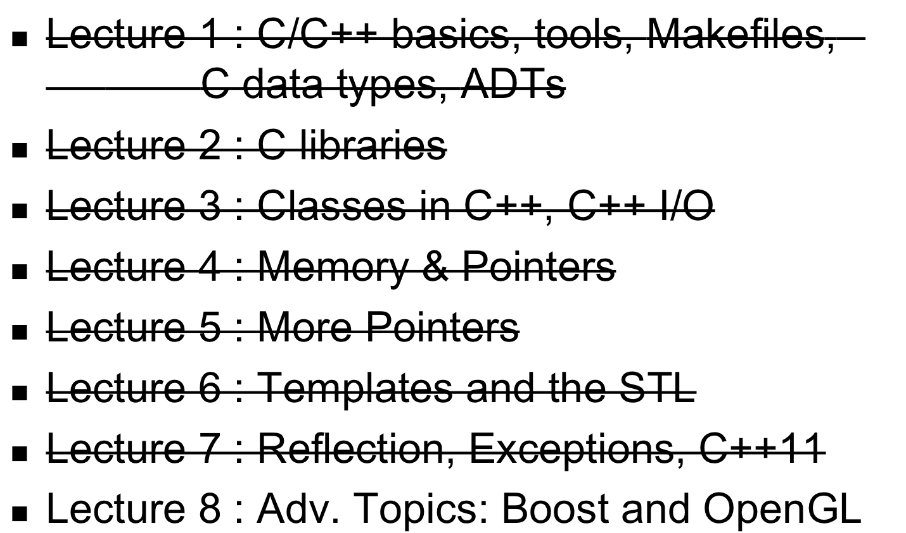
Syllabus

Slide 3
Today’s lecture
Evaluations,
Boost,
OpenGL,
and Conclusion

Slide 4
Evaluations
Class Name: CS 197c (F11)
Class Number: 10830
Instructor: Marc Cartright

Slide 5
Boost
http://www.boost.org
A free library set of C++ functions/classes
Open source
  heavily reviewed/debugged
  ported to many places
  like STL on steroids
Big and complex

Slide 6
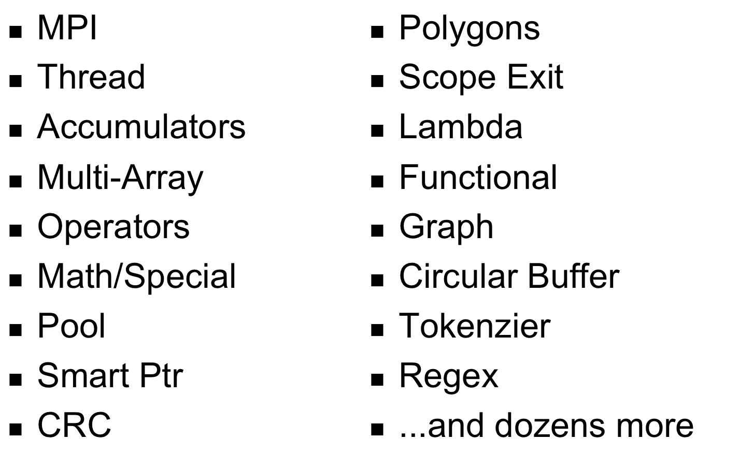
Boost Libraries

Slide 7
Boost
Was going to cover Smart_Ptr library...
BUT, found something way more interesting... uBLAS and CRTP!
uBLAS = Boost’s version of linear algebra
admits stuff like C = u(A - B);
where A,B,C are vectors and u is a scalar
uBLAS is one of the fastest LA libraries on the planet...how?

Slide 8
CRTP
“Curiously Recurring Template Pattern”
// The Curiously Recurring Template Pattern (CRTP)
template <typename T> struct base
{ // ... };
struct derived : base<derived>
{ // ... };

Slide 9
CRTP
“Curiously Recurring Template Pattern”
// The Curiously Recurring Template Pattern (CRTP)
template <typename T> struct base
{ // ... };
struct derived : base<derived>
{ // ... };
What is this is I don’t even...?

Slide 10
CRTP (all following examples taken from Wikipedia)
“Curiously Recurring Template Pattern”
// The Curiously Recurring Template Pattern (CRTP)
template <typename T> struct base
{ // ... };
struct derived : base<derived>
{ // ... };
The derived class is the template for
the base class, meaning it provides
the context in which the base class
operates

Slide 11
CRTP Example: Static Polymorphism
template <class Derived>
struct Base {
void interface() {
// ... static_cast<Derived*>(this)->implementation(); // ...
}
static void static_func() {
// ... Derived::static_sub_func(); // ...
}
};
struct Derived : Base<Derived> {
void implementation();
static void static_sub_func();
};
Notes:
Used to:
select subclass methods at compile time (avoids needing to set all inherited methods to virtual)
avoids problem of an inherited method not being able to call an overridden method (otherwise need virtual)

Slide 12
CRTP Example: Polymorphic Copy Construction
// Base class has a pure virtual function for cloning
class Shape {
public: virtual ~Shape() {}
virtual Shape *clone() const = 0;
};
// This CRTP class implements clone() for Derived
template <typename Derived>
class Shape_CRTP: public Shape {
public: Shape *clone() const {
return new Derived(static_cast<Derived const&>(*this));
}
};
// Every derived class inherits from Shape_CRTP instead of Shape
class Square: public Shape_CRTP<Square> {};
class Circle: public Shape_CRTP<Circle> {};
Notes:
Used to:
- provide a default clone method via construction

Slide 13
CRTP in Boost: Expression Templates
Expression Template:
  templates act as part of an expression
  Each template is an operation
Why use them?
  Consider C = u(A - B); again
    need temporary value to evaluate A-B (say T)
    need another temp to evaluate u * T
  Expression templates provide a way to create a single constructor accepting all three variables for the single return value (C)

Slide 14
CRTP in Boost: Expression Templates
// A CRTP base class for Vecs with a size and indexing:
template <typename E>
class VecExpression {
public: template <class T>
typename T::size_type size() const {
return static_cast<E const&>(*this).size();
}
template <class T>
typename T::value_type operator[](size_type i) const {
return static_cast<E const&>(*this)[i];
}
operator E&() { return static_cast<E&>(*this); }
operator E const&() const { return static_cast<const E&>(*this); }
};
Notes:
General class – EVERYTHING is an expression

Slide 15
CRTP in Boost: Expression Templates
// The actual Vec class:
class Vec : public VecExpression<Vec> {
std::vector<double> _data;
public:
typedef std::vector<double>::size_type size_type;
typedef std::vector<double>::value_type value_type;
typedef std::vector<double>::reference reference;
reference operator[](size_type i) { return _data[i]; }
value_type operator[](size_type i) const { return _data[i]; }
size_type size() const { return _data.size(); }
// Construct a given size:
Vec(size_type n) : _data(n) {}
// Construct from any VecExpression:
template <typename E> Vec(VecExpression<E> const& vec) {
E const& v = vec;
_data.resize(v.size());
for (size_type i = 0; i != v.size(); ++i) { _data[i] = v[i]; }
} };
Notes:
Data-holding class

Slide 16
CRTP in Boost: Expression Templates
template <typename E1, typename E2>
class VecDifference : public VecExpression<VecDifference<E1, E2> > {
E1 const& _u;
E2 const& _v;
public:
typedef Vec::size_type size_type;
typedef Vec::value_type value_type;
VecDifference(VecExpression<E1> const& u, VecExpression<E2> const& v) : _u(u), _v(v) {
assert(u.template size<E1>() == v.template size<E2>());
}
size_type size() const { return _v.size(); }
value_type operator[](Vec::size_type i) const { return _u[i] - _v[i]; }
};
Notes:
VecExpression specialization to hold a difference

Slide 17
CRTP in Boost: Expression Templates
template <typename E>
class VecScaled : public VecExpression<VecScaled<E> > {
double _alpha;
E const& _v;
public:
VecScaled(double alpha,
VecExpression<E> const& v) : _alpha(alpha), _v(v) {}
Vec::size_type size() const { return _v.size(); }
Vec::value_type operator[](Vec::size_type i) const {
return _alpha * _v[i];
}
};
Notes:
VecExpression specialization to hold scaling of a vector

Slide 18
CRTP in Boost: Expression Templates
// Now we can overload operators:
template <typename E1, typename E2>
VecDifference<E1,E2> const
operator-(VecExpression<E1> const& u,
VecExpression<E2> const& v) {
return VecDifference<E1,E2>(u,v);
}
template <typename E> VecScaled<E> const
operator*(double alpha, VecExpression<E> const& v) {
return VecScaled<E>(alpha,v);
}
Notes:
operators

Slide 19
CRTP in Boost: Expression Templates
Whew! We have all that now. So going back to C = u(A - B); ... what really happens?
  Note that C = u(A - B); is really C = u * (A - B);

Slide 20
CRTP in Boost: Expression Templates
C = u * (A - B);
We just overloaded this...
  constructs a VecDifference
C = u * (VecDifference(A,B));

Slide 21
CRTP in Boost: Expression Templates
C = u * (VecDifference(A,B));
This is overloaded as well!
  constructs VecScaled
C = VecScaled(u, (VecDifference(A,B)));
C is of type
  VecScaled<VecDifference<Vec,Vec> >
Constructor contains direct assignment to C

Slide 22
CRTP in Boost: Expression Templates
Boost is fast, because is it FAT
  Lots of code bloat, but very little wasted temporary space
  Operator overloading provides nice syntax while implementing this recursive construction
Good example of hacking C++ into being very efficient.

Slide 23
Boost: Exception
Eases creation/maintenance of exception hierarchies
  Provides base universal exception object
Boilerplate code for exception objects
Allows efficient wrapping as exceptions bubble
(DEMO & WALKTHROUGH)

Slide 24
OpenGL
“OpenGL (Open Graphics Library) is a standard specification defining a cross-language, cross-platform API for writing applications that produce 2D and 3D computer graphics. The interface consists of over 250 different function calls which can be used to draw complex three-dimensional scenes from simple primitives.”
- Wikipedia entry on “OpenGL”
→ OpenGL is a standard, implementation is completely platform-specific

Slide 25
OpenGL
Written in C (function calls only)
Commands communicate directly with graphics card
“Required” reading:
OpenGL Programming Guide, 7th ed
(Red Book)

Slide 26
OpenGL
Demo / Taste of OpenGL

Slide 27
Recapitulation: C++
Great improvement over C
  C has no: objects, namespaces, exceptions...
Not as advanced as Java
  No built-in GC
  Multiple inheritance, operator overloading not always helpful
  Not cross-platform

Slide 28
Recapitulation: C++
Lots of systems/libraries in C/C++
  Any OS kernel, drivers
  Boost
  OpenGL
  Lots of Google
  MySQL
  Firefox
  and tons more

Slide 29
Recapitulation: C++
Tools
  g++, make, gdb
Pointers and Memory Management
  don’t forget references!
Templates
operator overloading
  I/O (streams)
C++ syntax (inheritance, definitions)
C structures
  structs, unions, enums, typedefs

Slide 30
FIN
Thanks for
  listening
  coming to class
  doing homework
  and quizzes!
Open for more questions
  Email

