Slide 1
css

Slide 2
css
CSS is used to control the style of a web document in a simple and easy way.
CSS is the acronym for "Cascading Style Sheet".

Slide 3
Why to Learn CSS?
Cascading Style Sheets, fondly referred to as CSS, is a simple design language intended to simplify the process of making web pages presentable.
Create Stunning Web site
Become a web designer
Control web
Learn other languages

Slide 4
Hello World using CSS.
<head>
<title>The style Attribute</title>
<style>
h1{
color:aliceblue
}
h2{
color:coral
}
</style>
</head>

Slide 5
Applications of CSS
CSS saves time
Pages load faster
Easy maintenance
Superior styles to HTML
Multiple Device Compatibility
Global web standards

Slide 6
CSS - Syntax
A CSS comprises of style rules that are interpreted by the browser and then applied to the corresponding elements in your document. A style rule is made of three parts −
Selector − A selector is an HTML tag at which a style will be applied. This could be any tag like <h1> or <table> etc.
Property − A property is a type of attribute of HTML tag. Put simply, all the HTML attributes are converted into CSS properties. They could be color, border etc.
Value − Values are assigned to properties. For example, color property can have value either red or #F1F1F1 etc.

Slide 7
You can put CSS Style Rule Syntax as follows −
selector { property: value }
Example − You can define a table border as follows −
table{ border :1px solid #C00; }

Slide 8
The Type Selectors
This is the same selector we have seen above. Again, one more example to give a color to all level 1 headings −
h1 { color: #36CFFF; }

Slide 9
The Universal Selectors
Rather than selecting elements of a specific type, the universal selector quite simply matches the name of any element type −
* { color: #000000; }

Slide 10
The Descendant Selectors
Suppose you want to apply a style rule to a particular element only when it lies inside a particular element. As given in the following example, style rule will apply to <em> element only when it lies inside <ul> tag.

Slide 11
p i
{
color:chocolate
}

Slide 12
The Class Selectors
You can define style rules based on the class attribute of the elements. All the elements having that class will be formatted according to the defined rule.

Slide 13
.black
{
color:brown
}
===================
<div id="content" align="right" class="black">
<h5>Content Articles</h5>
<p>Actual content goes here.....</p>
<h1>Content Articles</h1>
<h5>Content Articles</h5>
</div>

Slide 14
This rule renders the content in black for every element with class attribute set to black in our document. You can make it a bit more particular. For example −

Slide 15
<style>
h5.black
{
color:darkorange
}
</style>
=============
<h5 class="black">Content Articles</h5>

Slide 16
The ID Selectors
You can define style rules based on the id attribute of the elements. All the elements having that id will be formatted according to the defined rule.
<style>
h1#p1{
color:crimson
}
</style>

Slide 17
<p id="p1">my<h1 id="p1"> data</h1></p>

Slide 18
The Child Selectors
You have seen the descendant selectors. There is one more type of selector, which is very similar to descendants but have different functionality. Consider the following example −
body > p {
color: red
}

Slide 19
The Attribute Selectors
You can also apply styles to HTML elements with particular attributes. The style rule below will match all the input elements having a type attribute with a value of text −

Slide 20
p[align=right] {
color: red
}

Slide 21
Multiple Style Rules
You may need to define multiple style rules for a single element. You can define these rules to combine multiple properties and corresponding values into a single block as defined in the following example −

Slide 22
p{
color:crimson;
font-family :'Gill Sans', 'Gill Sans MT', Calibri, 'Trebuchet MS', sans-serif;
margin:5px;
letter-spacing:.4px;
text-transform:uppercase;
}

Slide 23
Grouping Selectors
You can apply a style to many selectors if you like. Just separate the selectors with a comma, as given in the following example −

Slide 24
h1,h5{
color:crimson;
font-family :'Gill Sans', 'Gill Sans MT', Calibri, 'Trebuchet MS', sans-serif;
margin:5px;
letter-spacing:.4px;
text-transform:uppercase;
}

Slide 25
CSS - Inclusion
There are four ways to associate styles with your HTML document. Most commonly used methods are inline CSS and External CSS.

Slide 26
Embedded CSS - The <style> Element
You can put your CSS rules into an HTML document using the <style> element. This tag is placed inside the <head>...</head> tags. Rules defined using this syntax will be applied to all the elements available in the document. Here is the generic syntax −

Slide 27
<!DOCTYPE html>
<html>
<head>
<style type="text/css" media="all">
body {
background-color: linen;
}
h1 {
color: maroon;
margin-left: 40px;
}
</style>
</head>
<body>
<h1>This is a heading</h1>
<p>This is a paragraph.</p>
</body>
</html>

Slide 28
Inline CSS - The style Attribute
You can use style attribute of any HTML element to define style rules. These rules will be applied to that element only. Here is the generic syntax −
<element style = "...style rules....">

Slide 29
<html>
<head>
</head>
<body>
<h1 style="color:#36C;">
This is inline CSS
</h1>
</body>
</html>

Slide 30
External CSS - The <link> Element
The <link> element can be used to include an external stylesheet file in your HTML document.
An external style sheet is a separate text file with .css extension. You define all the Style rules within this text file and then you can include this file in any HTML document using <link> element.
Here is the generic syntax of including external CSS file

Slide 31
<link rel="stylesheet" href="f1.css" media=" all" />

Slide 32
F1.css
h1, h2, h3 {
color:brown;
font-weight: normal;
letter-spacing: .4em;
margin-bottom: 1em;
text-transform: lowercase;
}

Slide 33
<head>
<link rel="stylesheet" href="f1.css" media=" all" />
</head>
<body>
<h1>
This is inline CSS
</h1>
<h2>
This is inline CSS
</h2>
<h3>
This is inline CSS
</h3>
<h4>
This is inline CSS
</h4>
<h5>
This is inline CSS
</h5>
</body>
</html>

Slide 34
CSS Rules Overriding
Any inline style sheet takes highest priority. So, it will override any rule defined in <style>...</style> tags or rules defined in any external style sheet file.
Any rule defined in <style>...</style> tags will override rules defined in any external style sheet file.
Any rule defined in external style sheet file takes lowest priority, and rules defined in this file will be applied only when above two rules are not applicable.

Slide 35
CSS Comments
Many times, you may need to put additional comments in your style sheet blocks. So, it is very easy to comment any part in style sheet. You can simple put your comments inside /*.....this is a comment in style sheet.....*/.

Slide 36
<!DOCTYPE html>
<html>
<head>
<style>
p {
color: red;
/* This is a single-line comment */
text-align: center;
}
/* This is a multi-line comment */
</style>
</head>
<body>
<p>Hello World!</p>
</body>
</html>

Slide 37
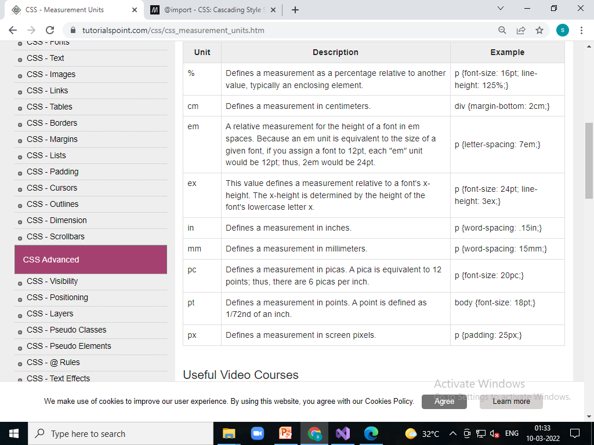
CSS - Measurement Units

Slide 38
CSS - Colors

Slide 39
CSS - Backgrounds
This chapter teaches you how to set backgrounds of various HTML elements. You can set the following background properties of an element −
The background-color property is used to set the background color of an element.
The background-image property is used to set the background image of an element.
The background-repeat property is used to control the repetition of an image in the background.
The background-position property is used to control the position of an image in the background.
The background-attachment property is used to control the scrolling of an image in the background.
The background property is used as a shorthand to specify a number of other background properties.

Slide 40
Set the Background Color
<html>
<head>
</head>
<body>
<p style="background-color:yellow;">
This text has a yellow background color.
</p>
</body>
</html>

Slide 41
Set the Background Image
<head>
<style>
body {
background-image: url("/images/bulp.jpg");
background-color: #cccccc;
}
</style>
</head>
<body>
<h1>Hello World!</h1>
</body>
<html>

Slide 42
Repeat the Background Image
<html>
<head>
<style>
body {
background-image: url("/images/bulp.jpg");
background-repeat:no-repeat;
}
</style>
</head>
<body>
<p>Tutorials point</p>
</body>
</html>

Slide 43
repeat the background image vertically.
<html>
<head>
<style>
body {
background-image: url("/images/bulp.jpg");
background-repeat: repeat-x;
}
</style>
</head>
<body>
<p>Tutorials point</p>
</body>
</html>

Slide 44
Set the Background Image Position
<html>
<head>
<style>
body {
background-image: url("images/bulp.jpg");
background-position: 10px 10px;
background-repeat: no-repeat;
}
</style>
</head>
<body>
<p>Tutorials point</p>
</body>
</html>

Slide 45
Set background image fix
<!DOCTYPE html>
<html>
<head>
<style>
body {
background-image: url('/images/bulp.jpg');
background-repeat: no-repeat;
background-attachment: fixed;
}
</style>
</head>
<body>
<p>The background-image is fixed. Try to scroll down the page.</p>
<p>The background-image is fixed. Try to scroll down the page.</p>
<p>The background-image is fixed. Try to scroll down the page.</p>
<p>The background-image is fixed. Try to scroll down the page.</p>
<p>The background-image is fixed. Try to scroll down the page.</p>
<p>The background-image is fixed. Try to scroll down the page.</p>
<p>The background-image is fixed. Try to scroll down the page.</p>
<p>The background-image is fixed. Try to scroll down the page.</p>
<p>The background-image is fixed. Try to scroll down the page.</p>
</body>
</html>
<!-- background-image: url("images/bulp.jpg");-->

Slide 46
CSS - Fonts
You can set following font properties of an element −
The font-family property is used to change the face of a font.
The font-style property is used to make a font italic or oblique.
The font-variant property is used to create a small-caps effect.
The font-weight property is used to increase or decrease how bold or light a font appears.
The font-size property is used to increase or decrease the size of a font.
The font property is used as shorthand to specify a number of other font properties.

Slide 47
Set the Font Family
Following is the example, which demonstrates how to set the font family of an element. Possible value could be any font family name.

Slide 48
<head>
</head>
<body>
<p style="font-family:georgia,garamond,serif;">
This text is rendered in either georgia, garamond, or the
default serif font depending on which font you have at your system.
</p>
</body>
</html>

Slide 49
Set the Font Style
Following is the example, which demonstrates how to set the font style of an element. Possible values are normal, italic and oblique.

Slide 50
<html>
<head>
</head>
<body>
<p style="font-style:italic;">
This text will be rendered in italic style
</p>
</body>
</html>

Slide 51
Set the Font Variant
<html>
<head>
</head>
<body>
<p style="font-variant:small-caps;">
This text will be rendered as small caps
</p>
</body>
</html>

Slide 52
Set the Font Weight
The following example demonstrates how to set the font weight of an element. The font-weight property provides the functionality to specify how bold a font is. Possible values could be normal, bold, bolder, lighter, 100, 200, 300, 400, 500, 600, 700, 800, 900.

Slide 53
<html>
<head>
</head>
<body>
<p style="font-weight:bold;">
This font is bold.
</p>
<p style="font-weight:bolder;">
This font is bolder.
</p>
<p style="font-weight:500;">
This font is 500 weight.
</p>
</body>
</html>

Slide 54
Set the Font Size
The following example demonstrates how to set the font size of an element. The font-size property is used to control the size of fonts. Possible values could be xx-small, x-small, small, medium, large, x-large, xx-large, smaller, larger, size in pixels or in %.

Slide 55
<html>
<head>
</head>
<body>
<p style="font-size:20px;">
This font size is 20 pixels
</p>
<p style="font-size:small;">
This font size is small
</p>
<p style="font-size:large;">
This font size is large
</p>
</body>
</html>

Slide 56
Shorthand Property
<html>
<head>
</head>
<body>
<p style="font:italic small-caps bold 15px georgia;">
Applying all the properties on the text at once.
</p>
</body>
</html>

Slide 57
CSS - Text
You can set following text properties of an element −
The color property is used to set the color of a text.
The direction property is used to set the text direction.
The letter-spacing property is used to add or subtract space between the letters that make up a word.
The word-spacing property is used to add or subtract space between the words of a sentence.
The text-indent property is used to indent the text of a paragraph.
The text-align property is used to align the text of a document.
The text-decoration property is used to underline, overline, and linethrough text.
The text-transform property is used to capitalize text or convert text to uppercase or lowercase letters.
The white-space property is used to control the flow and formatting of text.
The text-shadow property is used to set the text shadow around a text.

Slide 58
Set the Text Color
<html>
<head>
</head>
<body>
<p style="color:red;">
This text will be written in red.
</p>
</body>
</html>

Slide 59
Set the Text Direction
<html>
<head>
</head>
<body>
<p style="direction:rtl;">
This text will be rendered from right to left
</p>
</body>
</html>

Slide 60
<html>
<head>
<style>
p {
direction:ltr
}
</style>
</head>
<body>
<p >
This text will be rendered from right to left
</p>
</body>
</html>

Slide 61
Set the Space between Characters
<html>
<head>
</head>
<body>
<p style="letter-spacing:5px;">
This text is having space between letters.
</p>
</body>
</html>

Slide 62
Set the Space between Words
<html>
<head>
</head>
<body>
<p style="word-spacing:5px;">
This text is having space between words.
</p>
</body>
</html>

Slide 63
Set the Text Indent
<html>
<head>
</head>
<body>
<p style="text-indent:2cm;">
This text will have first line indented by 1cm and this line will remain at
its actual position this is done by CSS text-indent property.
</p>
</body>
</html>

Slide 64
Set the Text Alignment
<html>
<head>
</head>
<body>
<p style="text-align:right;">
This will be right aligned.
</p>
<p style="text-align:center;">
This will be center aligned.
</p>
<p style="text-align:left;">
This will be left aligned.
</p>
</body>
</html>

Slide 65
Decorating the Text
<html>
<head>
</head>
<body>
<p style="text-decoration:underline;">
This will be underlined
</p>
<p style="text-decoration:line-through;">
This will be striked through.
</p>
<p style="text-decoration:overline;">
This will have a over line.
</p>
</body>
</html>
This will produ

Slide 66
Set the Text Cases
<html>
<head>
</head>
<body>
<p style="text-transform:capitalize;">
This will be capitalized
</p>
<p style="text-transform:uppercase;">
This will be in uppercase
</p>
<p style="text-transform:lowercase;">
This will be in lowercase
</p>
</body>
</html>

Slide 67
Set the White Space between Text
<html>
<head>
</head>
<body>
<p style="white-space:pre;">
This text has a line break and the white-space pre setting
tells the browser to honor it just like the HTML pre tag.
</p>
</body>
</html>

Slide 68
Set the Text Shadow
<html>
<head>
</head>
<body>
<p style="text-shadow:4px 4px 8px blue;">
If your browser supports the CSS text-shadow property,
this text will have a blue shadow.
</p>
</body>
</html>

Slide 69
CSS - Using Images
Images play an important role in any webpage. Though it is not recommended to include a lot of images, but it is still important to use good images wherever required.

Slide 70
CSS plays a good role to control image display. You can set the following image properties using CSS.
The border property is used to set the width of an image border.
The height property is used to set the height of an image.
The width property is used to set the width of an image.
The -moz-opacity property is used to set the opacity of an image.

Slide 71
The Image Border Property
The border property of an image is used to set the width of an image border. This property can have a value in length or in %.
A width of zero pixels means no border.

Slide 72
<html>
<head>
</head>
<body>
<img style="border:0px;" src="/images/fish.png" />
<br />
<img style="border:3px dashed red; " src="/images/OIP.jpg" />
<img style="border:5px solid blue; "src="/images/OIP.jpg" />
</body>
</html>

Slide 73
The Image Height Property
The height property of an image is used to set the height of an image. This property can have a value in length or in %. While giving value in %, it applies it in respect of the box in which an image is available.

Slide 74
<html>
<head>
</head>
<body>
<img style="border:0px;" src="/images/fish.png" />
<br />
<img style="border:3px dashed red; height:100px " src="/images/OIP.jpg" />
<img style="border:5px solid blue; height:50%; "src="/images/OIP.jpg" />
</body>
</html>

Slide 75
The Image Width Property
<html>
<head>
</head>
<body>
<img style="border:0px;" src="/images/fish.png" />
<br />
<img style="border:3px dashed red; height:100px; width:500px" src="/images/OIP.jpg" />
<img style="border:5px solid blue; height:50%;width:25% "src="/images/OIP.jpg" />
</body>
</html>

Slide 76
The opacity Property
<html>
<head>
</head>
<body>
<img style="border:0px;" src="/images/fish.png" />
<br />
<img style="border:3px dashed red; opacity:0.4; height :100px; width:500px" src="/images/OIP.jpg" />
<img style="border:5px solid blue; opacity:0.3;height:50%;width:25% "src="/images/OIP.jpg" />
</body>
</html>

Slide 77
CSS - Links
This chapter teaches you how to set different properties of a hyper link using CSS. You can set following properties of a hyper link −
We will revisit the same properties when we will discuss Pseudo-Classes of CSS.
The :link signifies unvisited hyperlinks.
The :visited signifies visited hyperlinks.
The :hover signifies an element that currently has the user's mouse pointer hovering over it.
The :active signifies an element on which the user is currently clicking.

Slide 78
<html>
<head>
<style type="text/css">
a:link {
color: #000000
}
a:visited {
color: #006600
}
a:hover {
color: #FFCC00
}
a:active {
color: #FF00CC
}
</style>
</head>
<body>
<a href="http://www.google.com">click here for data</a>
<img style="border:0px;" src="/images/fish.png" />
<br />
<img style="border:3px dashed red; opacity:0.4; height :100px; width:500px" src="/images/OIP.jpg" />
<img style="border:5px solid blue; opacity:0.3;height:50%;width:25% "src="/images/OIP.jpg" />
</body>
</html>

Slide 79
CSS - Tables
This tutorial will teach you how to set different properties of an HTML table using CSS. You can set following properties of a table −
The border-collapse specifies whether the browser should control the appearance of the adjacent borders that touch each other or whether each cell should maintain its style.
The border-spacing specifies the width that should appear between table cells.
The caption-side captions are presented in the <caption> element. By default, these are rendered above the table in the document. You use the caption-side property to control the placement of the table caption.
The empty-cells specifies whether the border should be shown if a cell is empty.
The table-layout allows browsers to speed up layout of a table by using the first width properties it comes across for the rest of a column rather than having to load the whole table before rendering it.

Slide 80
The border-collapse Property
<html>
<head>
<style type="text/css">
table.one {
border-collapse: collapse;
}
table.two {
border-collapse: separate;
}
td.a {
border-style: dotted;
border-width: 3px;
border-color: #000000;
padding: 10px;
}
td.b {
border-style: solid;
border-width: 3px;
border-color: #333333;
padding: 10px;
}
</style>
</head>
<body>
<table class="one">
<caption>Collapse Border Example</caption>
<tr><td class="a"> Cell A Collapse Example</td><td class="b">naext data</td></tr>
<tr><td class="b"> Cell B Collapse Example</td><td class="a">this data</td></tr>
</table>
<br />
<table class="two">
<caption>Separate Border Example</caption>
<tr><td class="a"> Cell A Separate Example</td></tr>
<tr><td class="b"> Cell B Separate Example</td></tr>
</table>
</body>
</html>

Slide 81
The border-spacing Property
The border-spacing property specifies the distance that separates adjacent cells'. borders. It can take either one or two values; these should be units of length.
If you provide one value, it will applies to both vertical and horizontal borders. Or you can specify two values, in which case, the first refers to the horizontal spacing and the second to the vertical spacin

Slide 82
<html>
<head>
<style type="text/css">
table.one {
border-collapse: separate;
width: 400px;
border-spacing: 10px;
}
table.two {
border-collapse: separate;
width: 400px;
border-spacing: 10px 40px;
}
</style>
</head>
<body>
<table class="one" border="1">
<caption>Separate Border Example with border-spacing</caption>
<tr><td> Cell A Collapse Example</td></tr>
<tr><td> Cell B Collapse Example</td></tr>
</table>
<br />
<table class="two" border="1">
<caption>Separate Border Example with border-spacing</caption>
<tr><td> Cell A Separate Example</td></tr>
<tr><td> Cell B Separate Example</td></tr>
</table>
</body>
</html>

Slide 83
The empty-cells Property
The empty-cells property indicates whether a cell without any content should have a border displayed.
This property can have one of the three values - show, hide or inherit.
Here is the empty-cells property used to hide borders of empty cells in the <table> element.

Slide 84
<html>
<head>
<style type="text/css">
table.empty {
width: 350px;
border-collapse: separate;
empty-cells: hide;
}
td.empty {
padding: 5px;
border-style: solid;
border-width: 1px;
border-color: #999999;
}
</style>
</head>
<body>
<table class="empty">
<tr>
<th></th>
<th>Title one</th>
<th>Title two</th>
</tr>
<tr>
<th>Row Title</th>
<td class="empty">value</td>
<td class="empty">value</td>
</tr>
<tr>
<th>Row Title</th>
<td class="empty">value</td>
<td class="empty">value</td>
</tr>
</table>
</body>
</html>

Slide 85
CSS - Borders
The border properties allow you to specify how the border of the box representing an element should look. There are three properties of a border you can change −

Slide 86
The border-color specifies the color of a border.
The border-style specifies whether a border should be solid, dashed line, double line, or one of the other possible values.
The border-width specifies the width of a border.

Slide 87
The border-color Property
The border-color property allows you to change the color of the border surrounding an element. You can individually change the color of the bottom, left, top and right sides of an element's border using the properties −
border-bottom-color changes the color of bottom border.
border-top-color changes the color of top border.
border-left-color changes the color of left border.
border-right-color changes the color of right border.

Slide 88
<html>
<head>
<style type="text/css">
p.example1 {
border: 1px solid;
border-bottom-color: #009900; /* Green */
border-top-color: #FF0000; /* Red */
border-left-color: #330000; /* Black */
border-right-color: #0000CC; /* Blue */
}
p.example2 {
border: 1px solid;
border-color: #009900; /* Green */
}
</style>
</head>
<body>
<p class="example1">
This example is showing all borders in different colors.
</p>
<p class="example2">
This example is showing all borders in green color only.
</p>
</body>
</html>
<html>
<head>
<style type="text/css">
p.example1 {
border: 1px solid;
border-bottom-color: #009900; /* Green */
border-top-color: #FF0000; /* Red */
border-left-color: #330000; /* Black */
border-right-color: #0000CC; /* Blue */
}
p.example2 {
border: 1px solid;
border-color: #009900; /* Green */
}
</style>
</head>
<body>
<p class="example1">
This example is showing all borders in different colors.
</p>
<p class="example2">
This example is showing all borders in green color only.
</p>
</body>
</html>

Slide 89
The border-style Property
The border-style property allows you to select one of the following styles of border −
none − No border. (Equivalent of border-width:0;)
solid − Border is a single solid line.
dotted − Border is a series of dots.
dashed − Border is a series of short lines.
double − Border is two solid lines.
groove − Border looks as though it is carved into the page.
ridge − Border looks the opposite of groove.
inset − Border makes the box look like it is embedded in the page.
outset − Border makes the box look like it is coming out of the canvas.
hidden − Same as none, except in terms of border-conflict resolution for table elements.

Slide 90
You can individually change the style of the bottom, left, top, and right borders of an element using the following properties −
border-bottom-style changes the style of bottom border.
border-top-style changes the style of top border.
border-left-style changes the style of left border.
border-right-style changes the style of right border

Slide 91
<html>
<head>
</head>
<body>
<p style="border-width:4px; border-style:none;">
This is a border with none width.
</p>
<p style="border-width:4px; border-style:solid;">
This is a solid border.
</p>
<p style="border-width:4px; border-style:dashed;">
This is a dashed border.
</p>
<p style="border-width:4px; border-style:double;">
This is a double border.
</p>
<p style="border-width:4px; border-style:groove;">
This is a groove border.
</p>
<p style="border-width:4px; border-style:ridge">
This is a ridge border.
</p>
<p style="border-width:4px; border-style:inset;">
This is a inset border.
</p>
<p style="border-width:4px; border-style:outset;">
This is a outset border.
</p>
<p style="border-width:4px; border-style:hidden;">
This is a hidden border.
</p>
<p style="border-width:4px;
border-top-style:solid;
border-bottom-style:dashed;
border-left-style:groove;
border-right-style:double;">
This is a a border with four different styles.
</p>
</body>
</html>

Slide 92
The border-width Property
The border-width property allows you to set the width of an element borders. The value of this property could be either a length in px, pt or cm or it should be set to thin, medium or thick.
You can individually change the width of the bottom, top, left, and right borders of an element using the following properties −
border-bottom-width changes the width of bottom border.
border-top-width changes the width of top border.
border-left-width changes the width of left border.
border-right-width changes the width of right border.

Slide 93
<html>
<head>
</head>
<body>
<p style="border-width:4px; border-style:solid;">
This is a solid border whose width is 4px.
</p>
<p style="border-width:4pt; border-style:solid;">
This is a solid border whose width is 4pt.
</p>
<p style="border-width:thin; border-style:solid;">
This is a solid border whose width is thin.
</p>
<p style="border-width:medium; border-style:solid;">
This is a solid border whose width is medium;
</p>
<p style="border-width:thick; border-style:solid;">
This is a solid border whose width is thick.
</p>
<p style="border-bottom-width:4px;border-top-width:10px;
border-left-width: 2px;border-right-width:15px;border-style:solid;">
This is a a border with four different width.
</p>
</body>
</html>

Slide 94
Border Properties Using Shorthand
The border property allows you to specify color, style, and width of lines in one property −
The following example shows how to use all the three properties into a single property. This is the most frequently used property to set border around any element.

Slide 95
<html>
<head>
</head>
<body>
<p style="border:4px solid red;">
This example is showing shorthand property for border.
</p>
</body>
</html>

Slide 96
CSS - Paddings
The padding-bottom specifies the bottom padding of an element.
The padding-top specifies the top padding of an element.
The padding-left specifies the left padding of an element.
The padding-right specifies the right padding of an element.
The padding serves as shorthand for the preceding properties.

Slide 97
The padding-bottom Property
The padding-bottom property sets the bottom padding (space) of an element. This can take a value in terms of length of %.

Slide 98
<html>
<head>
</head>
<body>
<p style="padding-bottom: 15px; border:1px solid black;">
This is a paragraph with a specified bottom padding
</p>
<p style="padding-bottom: 5%; border:1px solid black;">
This is another paragraph with a specified bottom padding in percent
</p>
</body>
</html>

Slide 99
The padding-top Property
<html>
<head>
</head>
<body>
<p style="padding-top: 15px; border:1px solid black;">
This is a paragraph with a specified top padding
</p>
<p style="padding-top: 5%; border:1px solid black;">
This is another paragraph with a specified top padding in percent
</p>
</body>
</html>

Slide 100
The padding-left Property
<html>
<head>
</head>
<body>
<p style="padding-left: 15px; border:1px solid black;">
This is a paragraph with a specified left padding
</p>
<p style="padding-left: 15%; border:1px solid black;">
This is another paragraph with a specified left padding in percent
</p>
</body>
</html>

Slide 101
The padding-right Property
<html>
<head>
</head>
<body>
<p style="padding-right: 15px; border:1px solid black;">
This is a paragraph with a specified right padding
</p>
<p style="padding-right: 5%; border:1px solid black;">
This is another paragraph with a specified right padding in percent
</p>
</body>
</html>

Slide 102
The Padding Property
<html>
<head>
</head>
<body>
<p style="padding: 15px; border:1px solid black;">
all four padding will be 15px
</p>
<p style="padding:10px 2%; border:1px solid black;">
top and bottom padding will be 10px, left and right
padding will be 2% of the total width of the document.
</p>
<p style="padding: 10px 2% 10px; border:1px solid black;">
top padding will be 10px, left and right padding will
be 2% of the total width of the document, bottom padding will be 10px
</p>
<p style="padding: 10px 2% 10px 10px; border:1px solid black;">
top padding will be 10px, right padding will be 2% of
the total width of the document, bottom padding and top padding will be 10px
</p>
</body>
</html>

Slide 103
CSS - Cursors
<html>
<head>
</head>
<body>
<p>Move the mouse over the words to see the cursor change:</p>
<div style="cursor:auto">Auto</div>
<div style="cursor:crosshair">Crosshair</div>
<div style="cursor:default">Default</div>
<div style="cursor:pointer">Pointer</div>
<div style="cursor:move">Move</div>
<div style="cursor:e-resize">e-resize</div>
<div style="cursor:ne-resize">ne-resize</div>
<div style="cursor:nw-resize">nw-resize</div>
<div style="cursor:n-resize">n-resize</div>
<div style="cursor:se-resize">se-resize</div>
<div style="cursor:sw-resize">sw-resize</div>
<div style="cursor:s-resize">s-resize</div>
<div style="cursor:w-resize">w-resize</div>
<div style="cursor:text">text</div>
<div style="cursor:wait">wait</div>
<div style="cursor:help">help</div>
</body>
</html>

Slide 104
CSS - Outlines
The outline-width property is used to set the width of the outline.
The outline-style property is used to set the line style for the outline.
The outline-color property is used to set the color of the outline.
The outline property is used to set all the above three properties in a single statement.

Slide 105
The outline-width Property
<html>
<head>
</head>
<body>
<p style="outline-width:thin; outline-style:solid;">
This text is having thin outline.
</p>
<br />
<p style="outline-width:thick; outline-style:solid;">
This text is having thick outline.
</p>
<br />
<p style="outline-width:5px; outline-style:solid;">
This text is having 5x outline.
</p>
</body>
</html>

Slide 106
The outline-style Property
none − No border. (Equivalent of outline-width:0;)
solid − Outline is a single solid line.
dotted − Outline is a series of dots.
dashed − Outline is a series of short lines.
double − Outline is two solid lines.
groove − Outline looks as though it is carved into the page.
ridge − Outline looks the opposite of groove.
inset − Outline makes the box look like it is embedded in the page.
outset − Outline makes the box look like it is coming out of the canvas.
hidden − Same as none

Slide 107
<html>
<head>
</head>
<body>
<p style="outline-width:thin; outline-style:solid;">
This text is having thin solid outline.
</p>
<br />
<p style="outline-width:thick; outline-style:dashed;">
This text is having thick dashed outline.
</p>
<br />
<p style="outline-width:5px;outline-style:dotted;">
This text is having 5x dotted outline.
</p>
</body>
</html>

Slide 108
The outline-color Property
<html>
<head>
</head>
<body>
<p style="outline-width:thin; outline-style:solid;outline-color:red">
This text is having thin solid red outline.
</p>
<br />
<p style="outline-width:thick; outline-style:dashed;outline-color:#009900">
This text is having thick dashed green outline.
</p>
<br />
<p style="outline-width:5px;outline-style:dotted;outline-color:rgb(13,33,232)">
This text is having 5x dotted blue outline.
</p>
</body>
</html>

Slide 109
CSS - Dimension
We have the following properties that allow you to control the dimensions of a box.
The height property is used to set the height of a box.
The width property is used to set the width of a box.
The line-height property is used to set the height of a line of text.
The max-height property is used to set a maximum height that a box can be.
The min-height property is used to set the minimum height that a box can be.
The max-width property is used to set the maximum width that a box can be.
The min-width property is used to set the minimum width that a box can be.

Slide 110
The Height and Width Properties
<html>
<head>
</head>
<body>
<p style="width:400px; height:100px; border:1px solid red; padding:5px; margin:10px;">
This paragraph is 400pixels wide and 100 pixels high
</p>
</body>
</html>

Slide 111
The line-height Property
The line-height property allows you to increase the space between lines of text. The value of the line-height property can be a number, a length, or a percentage.

Slide 112
<html>
<head>
</head>
<body>
<p style="width:400px; height:100px; border:1px solid red; padding:5px; margin:10px; line-height:30px;">
This paragraph is 400pixels wide and 100 pixels high and here line height is 30pixels.
This paragraph is 400 pixels wide and 100 pixels high and here line height is 30pixels.
</p>
</body>
</html>

Slide 113
The max-height Property
The max-height property allows you to specify maximum height of a box. The value of the max-height property can be a number, a length, or a percentage.

Slide 114
<html>
<head>
</head>
<body>
<p style="width:400px; max-height:20px; border:1px solid red; padding:5px; margin:10px;">
This paragraph is 400px wide and max height is 10px
This paragraph is 400px wide and max height is 10px
This paragraph is 400px wide and max height is 10px
This paragraph is 400px wide and max height is 10px
</p>
<br>
<br>
<br>
<img alt="logo" src="/css/images/logo.png" width="195" height="84" />
</body>
</html>

Slide 115
The min-height Property
he min-height property allows you to specify minimum height of a box. The value of the min-height property can be a number, a length, or a percentage.

Slide 116
<html>
<head>
</head>
<body>
<p style="width:400px; min-height:200px; border:1px solid red; padding:5px; margin:10px;">
This paragraph is 400px wide and min height is 200px
This paragraph is 400px wide and min height is 200px
This paragraph is 400px wide and min height is 200px
This paragraph is 400px wide and min height is 200px
</p>
<img alt="logo" src="/css/images/logo.png" width="95" height="84" />
</body>
</html>

Slide 117
The max-width Property
The max-width property allows you to specify maximum width of a box. The value of the max-width property can be a number, a length, or a percentage.

Slide 118
<html>
<head>
</head>
<body>
<p style="max-width:100px; height:200px; border:1px solid red; padding:5px; margin:10px;">
This paragraph is 200px high and max width is 100px
This paragraph is 200px high and max width is 100px
This paragraph is 200px high and max width is 100px
This paragraph is 200px high and max width is 100px
This paragraph is 200px high and max width is 100px
</p>
<img alt="logo" src="/images/css.gif" width="95" height="84" />
</body>
</html>

Slide 119
The min-width Property
The min-width property allows you to specify minimum width of a box. The value of the min-width property can be a number, a length, or a percentage.

Slide 120
<html>
<head>
</head>
<body>
<p style="min-width:400px; height:100px; border:1px solid red; padding:5px; margin:10px;">
This paragraph is 100px high and min width is 400px
This paragraph is 100px high and min width is 400px
</p>
<img alt="logo" src="/css/images/css.gif" width="95" height="84" />
</body>
</html>

Slide 121
CSS - Scrollbars
There may be a case when an element's content might be larger than the amount of space allocated to it. For example, given width and height properties do not allow enough room to accommodate the content of the element.
CSS provides a property called overflow which tells the browser what to do if the box's contents is larger than the box itself. This property can take one of the following values −

Slide 122
<html>
<head>
<style type="text/css">
.scroll {
display: block;
border: 1px solid red;
padding: 5px;
margin-top: 5px;
width: 300px;
height: 50px;
overflow: scroll;
}
.auto {
display: block;
border: 1px solid red;
padding: 5px;
margin-top: 5px;
width: 300px;
height: 50px;
overflow: auto;
}
</style>
</head>
<body>
<p>Example of scroll value:</p>
<div class="scroll">
I am going to keep lot of content here just to show you how
scrollbars works if there is an overflow in an element box.
This provides your horizontal as well as vertical scrollbars.
</div>
<br />
<p>Example of auto value:</p>
<div class="auto">
I am going to keep lot of content here just to show you how
scrollbars works if there is an overflow in an element box.
This provides your horizontal as well as vertical scrollbars.
</div>
</body>
</html>

Slide 123
CSS - Visibility
A property called visibility allows you to hide an element from view. You can use this property along with JavaScript to create very complex menu and very complex webpage layouts.

Slide 124
<html>
<head>
</head>
<body>
<p>
This paragraph should be visible in normal way.
</p>
<p style=";">
This paragraph shovisibility:hiddenuld not be visible.
</p>
</body>
</html>

Slide 125
CSS - Positioning
CSS helps you to position your HTML element. You can put any HTML element at whatever location you like. You can specify whether you want the element positioned relative to its natural position in the page or absolute based on its parent element.

Slide 126
CSS - Layers
CSS gives you opportunity to create layers of various divisions. The CSS layers refer to applying the z-index property to elements that overlap with each other.
The z-index property is used along with the position property to create an effect of layers. You can specify which element should come on top and which element should come at bottom.
A z-index property can help you to create more complex webpage layouts. Following is the example which shows how to create layers in CSS.

Slide 127
<html>
<head>
</head>
<body>
<div style="background-color:red;
width:300px;
height:100px;
position:relative;
top:10px;
left:80px;
z-index:2">
</div>
<div style="background-color:yellow;
width:300px;
height:100px;
position:relative;
top:-60px;
left:35px;
z-index:1;">
</div>
<div style="background-color:green;
width:300px;
height:100px;
position:relative;
top:-220px;
left:120px;
z-index:3;">
</div>
</body>
</html>

Slide 128
CSS - Pseudo Classes
CSS pseudo-classes are used to add special effects to some selectors. You do not need to use JavaScript or any other script to use those effects. A simple syntax of pseudo-classes is as follows −

Slide 129
The most commonly used pseudo-classes are as follows −

Slide 130
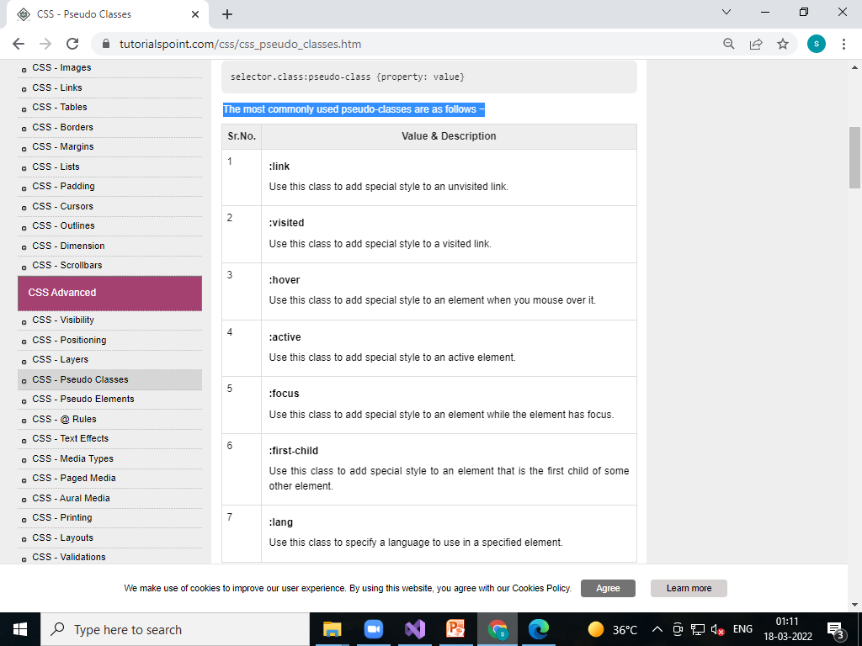

Slide 131
The :link,visited,hover,active,focus pseudo-class
<html>
<head>
<style type="text/css">
a:link {
color: #000000
}
a:visited {
color: #006600
}
a:hover {
color: #FFCC00
}
a:active {
color: #FF00CC
}
a:focus {
color: #0000FF
}
</style>
</head>
<body>
<a href="">Black Link</a>
</body>
</html>

Slide 132
The :first-child pseudo-class
The :first-child pseudo-class matches a specified element that is the first child of another element and adds special style to that element that is the first child of some other element.

Slide 133
<html>
<head>
<style type="text/css">
div > p:first-child {
text-indent: 25px;
}
</style>
</head>
<body>
<div>
<p>First paragraph in div. This paragraph will be indented</p>
<p>Second paragraph in div. This paragraph will not be indented</p>
</div>
<p>But it will not match the paragraph in this HTML:</p>
<div>
<h3>Heading</h3>
<p>The first paragraph inside the div. This paragraph will not be effected.</p>
</div>
</body>
</html>

Slide 134
CSS - Pseudo Elements
CSS pseudo-elements are used to add special effects to some selectors. You do not need to use JavaScript or any other script to use those effects. A simple syntax of pseudo-element is as follows −

Slide 135
The most commonly used pseudo-elements are as follows −

Slide 136
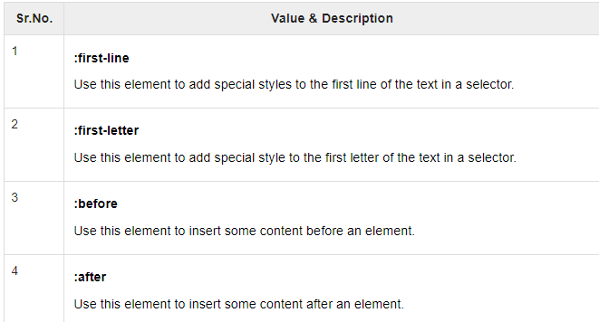

Slide 137
<html>
<head>
<style type="text/css">
p:first-line {
text-decoration: underline;
}
p.noline:first-line {
text-decoration: none;
}
</style>
</head>
<body>
<p class="noline">
This line would not have any underline because this belongs to nline class.
</p>
<p>
The first line of this paragraph will be underlined as defined in the
CSS rule above. Rest of the lines in this paragraph will remain normal.
This example shows how to use :first-line pseduo element to give effect
to the first line of any HTML element.
</p>
</body>
</html>

Slide 138
The :first-letter pseudo-element
<html>
<head>
<style type="text/css">
p:first-letter {
font-size: 5em;
}
p.normal:first-letter {
font-size: 10px;
}
</style>
</head>
<body>
<p class="normal">
First character of this paragraph will be normal and will have font size 10 px;
</p>
<p>
The first character of this paragraph will be 5em big as defined in the
CSS rule above. Rest of the characters in this paragraph will remain
normal. This example shows how to use :first-letter pseduo element
to give effect to the first characters of any HTML element.
</p>
</body>
</html>

Slide 139
The :before pseudo-element
<html>
<head>
<style type = "text/css">
p:before {
content: url(/images/OIP.jpg)
}
</style>
</head>
<body>
<p> This line will be preceded by a bullet.</p>
<p> This line will be preceded by a bullet.</p>
<p> This line will be preceded by a bullet.</p>
</body>
</html>

Slide 140
The :after pseudo-element
<html>
<head>
<style type="text/css">
p:after {
content: url(/images/fish.png)
}
</style>
</head>
<body>
<p> This line will be succeeded by a bullet.</p>
<p> This line will be succeeded by a bullet.</p>
<p> This line will be succeeded by a bullet.</p>
</body>
</html>

Slide 141
CSS Filters - Text and Image Effects
You can use CSS filters to add special effects to text, images and other aspects of a webpage without using images or other graphics. Filters only work on Internet Explorer 4.0. If you are developing your site for multiple browsers, then it may not be a good idea to use CSS filters because there is a possibility that it would not give any advantage.

Slide 142
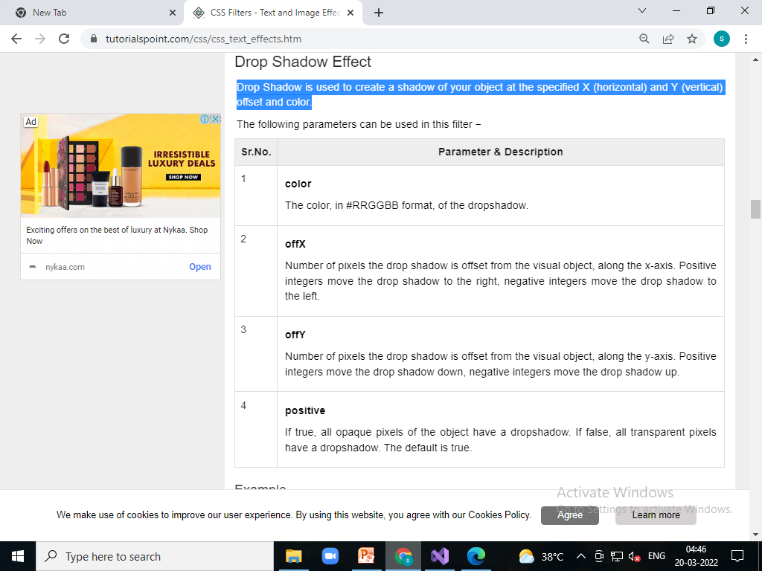
Drop Shadow Effect

Slide 143
<html>
<head>
</head>
<body>
<p>Image Example:</p>
<img src="/css/images/logo.png"
alt="CSS Logo"
style="filter:drop-shadow(2px 2px 1px #FF0000);">
<p>Text Example:</p>
<div style="width: 357;
height: 50;
font-size: 30pt;
font-family: Arial Black;
color: red;
filter:drop-shadow(3px 3px 2px #000000);">CSS Tutorials</div>
</body>
</html>

Slide 144
Grayscale Effect
<html>
<head>
</head>
<body>
<p>Image Example:</p>
<img src="/images/bulp.jpg"
alt="CSS Logo"
style="filter: grayscale(50%)">
<p>Text Example:</p>
<div style="width: 357;
height: 50;
font-size: 30pt;
font-family: Arial Black;
color: red;
filter: grayscale(50%)">CSS Tutorials</div>
</body>
</html>

Slide 145
Invert Effect
<html>
<head>
</head>
<body>
<p>Image Example:</p>
<img src="/images/fish.png"
alt="CSS Logo"
style="filter: invert(100%)">
<p>Text Example:</p>
<div style="width: 357;
height: 50;
font-size: 30pt;
font-family: Arial Black;
color: red;
filter: invert(100%)">CSS Tutorials</div>
</body>
</html>

Slide 146
CSS3 - Rounded Corners
CSS3 Rounded corners are used to add special colored corner to body or text by using the border-radius property.A simple syntax of rounded corners is as follows −

Slide 147
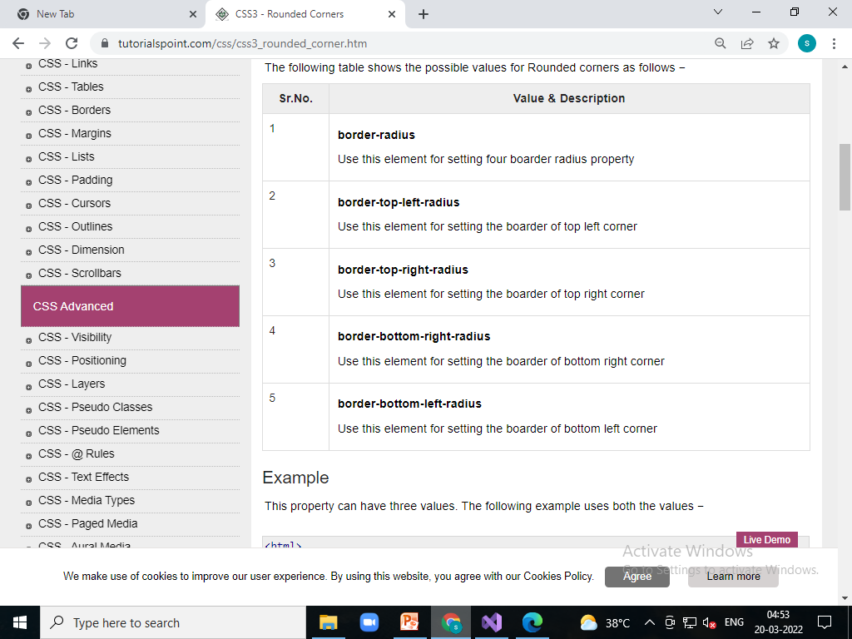

Slide 148
<html>
<head>
<style>
#rcorners1 {
border-radius: 25px;
background: #8AC007;
padding: 20px;
width: 200px;
height: 150px;
}
#rcorners2 {
border-radius: 25px;
border: 2px solid #8AC007;
padding: 20px;
width: 200px;
height: 150px;
}
#rcorners3 {
border-radius: 25px;
background: url(/images/bulp.jpg);
background-position: left top;
background-repeat: repeat;
padding: 20px;
width: 200px;
height: 150px;
}
</style>
</head>
<body>
<p id="rcorners1">Rounded corners!</p>
<p id="rcorners2">Rounded corners!</p>
<p id="rcorners3">Rounded corners!</p>
</body>
</html>

Slide 149
Each Corner property
<html>
<head>
<style>
#rcorners1 {
border-radius: 15px 100px 90px 50px;
background: #a44170;
padding: 20px;
width: 100px;
height: 100px;
}
#rcorners2 {
border-radius: 15px 50px 30px;
background: #a44170;
padding: 20px;
width: 100px;
height: 100px;
}
#rcorners3 {
border-radius: 15px 50px;
background: #a44170;
padding: 20px;
width: 100px;
height: 100px;
}
</style>
</head>
<body>
<p id="rcorners1"></p>
<p id="rcorners2"></p>
<p id="rcorners3"></p>
</body>
<body>

Slide 150
CSS3 - Border Image
<html>
<head>
<style>
#borderimg1 {
border: 10px solid transparent;
padding: 15px;
border-image-source: url(/images/bulp.jpg);
border-image-repeat: round;
border-image-slice: 30;
border-image-width: 10px;
}
#borderimg2 {
border: 10px solid transparent;
padding: 15px;
border-image-source: url(/images/bulp.jpg);
border-image-repeat: round;
border-image-slice: 30;
border-image-width: 20px;
}
#borderimg3 {
border: 10px solid transparent;
padding: 15px;
border-image-source: url(/images/bulp.jpg);
border-image-repeat: round;
border-image-slice: 30;
border-image-width: 30px;
}
</style>
</head>
<body>
<p id="borderimg1">This is image boarder example.</p>
<p id="borderimg2">This is image boarder example.</p>
<p id="borderimg3">This is image boarder example.</p>
</body>
</html>

Slide 151
CSS3 - Multi Background
<html>
<head>
<style>
#multibackground {
background-image: url(/images/fish.jpg) , url(/images/fish.png);
background-position: left top, left top;
background-repeat: no-repeat, repeat;
padding: 75px;
}
</style>
</head>
<body>
<div id="multibackground">
<h1>www.tutorialspoint.com</h1>
<p>
Tutorials Point originated from the idea that there exists a class of
readers who respond better to online content and prefer to learn new
skills at their own pace from the comforts of their drawing rooms.
The journey commenced with a single tutorial on HTML in 2006 and elated
by the response it generated, we worked our way to adding fresh tutorials
to our repository which now proudly flaunts a wealth of tutorials and
allied articles on topics ranging from programming languages to web designing
to academics and much more..
</p>
</div>
</body>
</html>

Slide 152
CSS3 - Gradients
What is Gradients?
Gradients displays the combination of two or more colors as shown below −
Types of gradients
Linear Gradients(down/up/left/right/diagonally)
Radial Gradients

Slide 153
Linear gradients
Linear gradients are used to arrange two or more colors in linear formats like top to bottom.

Slide 154
Top to bottom
<html>
<head>
<style>
#grad1 {
height: 100px;
background: -webkit-linear-gradient(pink,green);
}
</style>
</head>
<body>
<div id="grad1"></div>
</body>
</html>

Slide 155
Left to right
<html>
<head>
<style>
#grad1 {
height: 100px;
background: -webkit-linear-gradient(left, red, blue);
}
</style>
</head>
<body>
<div id="grad1"></div>
</body>
</html>

Slide 156
Diagonal
<html>
<head>
<style>
#grad1 {
height: 100px;
background: -webkit-linear-gradient(left top, red, blue);
}
</style>
</head>
<body>
<div id="grad1"></div>
</body>
</html>

Slide 157
Multi color
<html>
<head>
<style>
#grad2 {
height: 100px;
background: -webkit-linear-gradient(red, orange, pink, red, gray, green,pink);
}
</style>
</head>
<body>
<div id="grad2"></div>
</body>
</html>

Slide 158
CSS3 Radial Gradients
<html>
<head>
<style>
#grad1 {
height: 100px;
width: 550px;
background: -webkit-radial-gradient(red 5%, green 15%, pink 60%);
}
</style>
</head>
<body>
<div id="grad1"></div>
</body>
</html>

Slide 159
CSS3 Repeat Radial Gradients
<html>
<head>
<style>
#grad1 {
height: 100px;
width: 550px;
background: -webkit-repeating-radial-gradient(blue, yellow 10%, green 15%);
}
</style>
</head>
<body>
<div id="grad1"></div>
</body>
</html>

Slide 160
CSS3 - Shadow
CSS3 supported to add shadow to text or elements.Shadow property has divided as follows −
Text shadow
Box Shadow

Slide 161
Text shadow
<html>
<head>
<style>
h1 {
text-shadow: 2px 2px;
}
h2 {
text-shadow: 2px 2px red;
}
h3 {
text-shadow: 2px 2px 5px red;
}
h4 {
color: white;
text-shadow: 2px 2px 4px #000000;
}
h5 {
text-shadow: 0 0 3px #FF0000;
}
h6 {
text-shadow: 0 0 3px #FF0000, 0 0 5px #0000FF;
}
p {
color: white;
text-shadow: 1px 1px 2px black, 0 0 25px blue, 0 0 5px darkblue;
}
</style>
</head>
<body>
<h1>TCIL IT</h1>
<h2>TCIL IT.com</h2>
<h3>TCIL IT.com</h3>
<h4>TCIL IT.com</h4>
<h5>TCIL IT.com</h5>
<h6>TCIL IT.com</h6>
<p>TCIL IT.com</p>
</body>
</html>
</html>

Slide 162
Box shadow(same as Text shadow)
<html>
<head>
<style>
#rcorners1
{
box-shadow: 5px 5px 6px 2px blue, 10px 10px 6px 2px red, 15px 15px 6px 2px green;
background:url("css/images/3.jpg");
background-repeat: no-repeat;
background-size:cover;
border-radius: 100px 50px;
height: 400px;
width:300px;
}
</style>
</head>
<body>
<p id="rcorners1"></p>
<p id="rcorners2"></p>
<p id="rcorners3"></p>
</body>
<body>

Slide 163
CSS3 - Text
CSS3 contained several extra features, which is added later on.
text-overflow
word-wrap
word-break

Slide 164
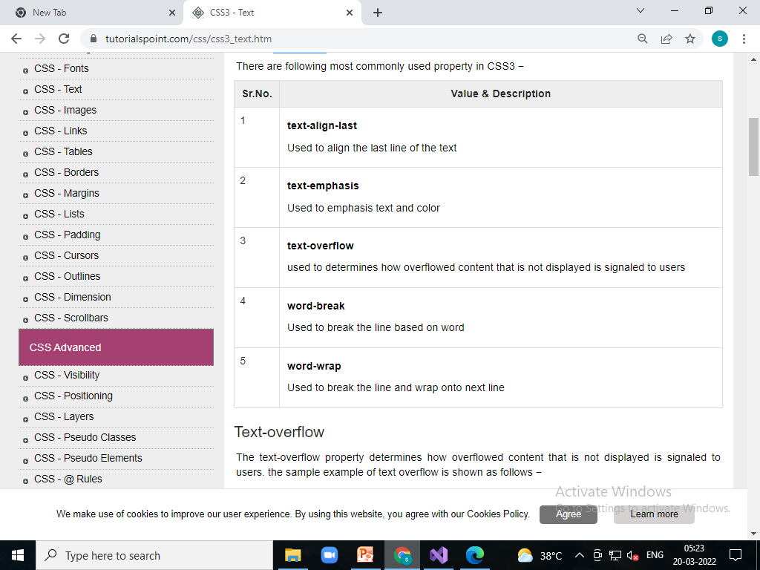

Slide 165
Text-Align
<html>
<head>
<style>
#rcorners1
{
text-align-last: right;
border:2px solid red;
height: 100px;
width:400px;
}
</style>
</head>
<body>
<p id="rcorners1">hhello
hellohellohellohellohellohellohellohellohellohellohellohello
hellohellohellohello
helloellohello</p>
</body>
<body>

Slide 166
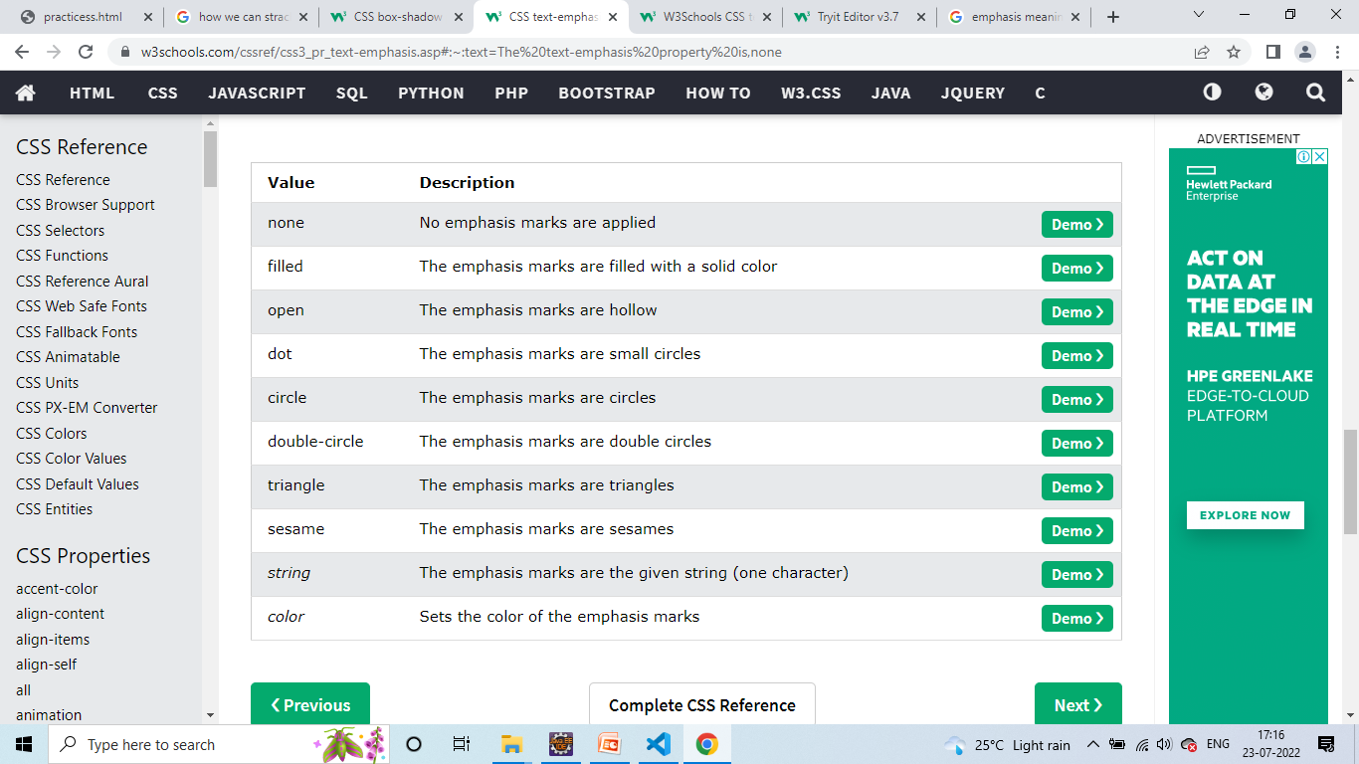
Text-empasize

Slide 167
Text-empasize
<html>
<head>
<style>
#p1
{
text-align-last: right;
text-emphasis:none;
border:2px solid red;
height: 100px;
width:400px;
}
#p2
{
text-align-last: right;
text-emphasis:filled;
border:2px solid red;
height: 100px;
width:400px;
}
</style>
</head>
<body>
<p id="p1"> Text Emphasis</p>
<p id="p2"> Text Emphasis</p>
</body>
<body>

Slide 168
Text-overflow
The text-overflow property determines how overflowed content that is not displayed is signaled to users. the sample example of text overflow is shown as follows −

Slide 169
<html>
<head>
<style>
p.text1 {
white-space: nowrap;
width: 500px;
border: 1px solid #000000;
overflow: hidden;
text-overflow: clip;
}
p.text2 {
white-space: nowrap;
width: 500px;
border: 1px solid #000000;
overflow: hidden;
text-overflow: ellipsis;
}
</style>
</head>
<body>
<b>Original Text:</b>
<p>
Tutorials Point originated from the idea that there exists a class of
readers who respond better to online content and prefer to learn new
skills at their own pace from the comforts of their drawing rooms.
</p>
<b>Text overflow:clip:</b>
<p class="text1">
Tutorials Point originated from the idea that there exists
a class of readers who respond better to online content and prefer
to learn new skills at their own pace from the comforts of their
drawing rooms.
</p>
<b>Text overflow:ellipsis</b>
<p class="text2">
Tutorials Point originated from the idea that there exists
a class of readers who respond better to online content and
prefer to learn new skills at their own pace from the comforts
of their drawing rooms.
</p>
</body>
</html>

Slide 170
CSS3 Word Breaking
Used to break the line, following code shows the sample code of word breaking.

Slide 171
<html>
<head>
<style>
p.text1 {
width: 140px;
border: 1px solid #000000;
word-break: keep-all;
}
p.text2 {
width: 140px;
border: 1px solid #000000;
word-break: break-all;
}
</style>
</head>
<body>
<b>line break at hyphens:</b>
<p class="text1">
Tutorials Point originated from the idea that there exists a
class of readers who respond better to online content and prefer
to learn new skills at their own pace from the comforts of
their drawing rooms.
</p>
<b>line break at any character</b>
<p class="text2">
Tutorials Point originated from the idea that there exists a
class of readers who respond better to online content and
prefer to learn new skills at their own pace from the comforts
of their drawing rooms.
</p>
</body>
</html>
</html>

Slide 172
CSS word wrapping
Word wrapping is used to break the line and wrap onto next line.the following code will have sample syntax −

Slide 173
<html>
<head>
<style>
p.text1 {
width: 140px;
border: 1px solid #000000;
word-wrap: break-word;
}
</style>
</head>
<body>
<b>line break at hyphens:</b>
<p class="text1">
Tutorials Point originated from the idea that there exists a
class of readers who respond better to online content and prefer
to learn new skills at their own pace from the comforts of
their drawing rooms.
</p>
<b>line break at any character</b>
<p class="text2">
Tutorials Point originated from the idea that there exists a
class of readers who respond better to online content and
prefer to learn new skills at their own pace from the comforts
of their drawing rooms.
</p>
</body>
</html>
</html>

Slide 174
Rotate 20 degrees
<html>
<head>
<style>
div {
width: 300px;
height: 100px;
background-color: pink;
border: 1px solid black;
}
div#myDiv {
-webkit-transform: rotate(20deg);
}
</style>
</head>
<body>
<div>
Tutorials point.com.
</div>
<div id="myDiv">
Graphix Technology Pune
</div>
</body>
</html>

Slide 175
Rotate -20 degrees
Box rotation with -20 degrees angle as shown below −

Slide 176
<html>
<head>
<style>
div {
width: 300px;
height: 100px;
background-color: pink;
border: 1px solid black;
}
div#myDiv {
-webkit-transform: rotate(-20deg);
}
</style>
</head>
<body>
<div>
Tutorials point.com.
</div>
<div id="myDiv">
Tutorials point.com
</div>
</body>
</html>

Slide 177
Skew X axis
Box rotation with skew x-axis as shown below −

Slide 178
<html>
<head>
<style>
div {
width: 300px;
height: 100px;
background-color: pink;
border: 1px solid black;
}
div#skewDiv {
-webkit-transform: skewX(20deg);
}
</style>
</head>
<body>
<div>
Tutorials point.com.
</div>
<div id="skewDiv">
Tutorials point.com
</div>
</body>
</html>

Slide 179
Skew Y axis
Box rotation with skew y-axis as shown below −

Slide 180
<html>
<head>
<style>
div {
width: 300px;
height: 100px;
background-color: pink;
border: 1px solid black;
}
div {
-webkit-transform: skewY(20deg);
}
</style>
</head>
<body>
<div>
Tutorials point.com.
</div>
<div id="skewDiv">
Tutorials point.com
</div>
</body>
</html>

Slide 181
CSS3 – Animation(Moving left animation)
<html>
<head>
<style>
h1{
-webkit-animation-duration: 3s;
-webkit-animation-name: slidein;
color:blue;
-webkit-animation-delay: 1s;
-webkit-animation-direction: reverse;
-webkit-animation-iteration-count:infinite;
}
@-webkit-keyframes slidein
{
from
{
margin-left: 100%;
}
to
{
margin-left: 0%;
}
}
</style>
</head>
<body>
<h1>
Graphix technologyS
</h1>
</body>
<body>

Slide 182
End

