Slide 1
HTML

Slide 2
HTML stands for Hyper Text Markup Language, which is the most widely used language on Web to develop web pages.
HTML was created by Berners-Lee in late 1991 but "HTML 2.0" was the first standard HTML specification which was published in 1995. HTML 4.01 was a major version of HTML and it was published in late 1999.
Though HTML 4.01 version is widely used but currently we are having HTML-5 version which is an extension to HTML 4.01, and this version was published in 2012.

Slide 3
Why to Learn HTML?
Create Web site -
Become a web designer -
Understand web -
Learn other languages -

Slide 4
HTML Document Structure
<html>
<head>
Document header related tags
</head>
<body>
Document body related tags
</body>
</html>

Slide 5
HTML - Basic Tags

Slide 6
Heading Tag
<!DOCTYPE html>
<html>
<head>
<title>Heading Example</title>
</head>
<body>
<h1>This is heading 1</h1>
<h2>This is heading 2</h2>
<h3>This is heading 3</h3>
<h4>This is heading 4</h4>
<h5>This is heading 5</h5>
<h6>This is heading 6</h6>
</body>
</html>

Slide 7
Paragraph Tag
The <p> tag offers a way to structure your text into different paragraphs. Each paragraph of text should go in between an opening <p> and a closing </p> tag as shown below in the example −

Slide 8
<!DOCTYPE html>
<html>
<head>
<title>Paragraph Example</title>
</head>
<body>
<p>Here is a first paragraph of text.</p>
<p>Here is a second paragraph of text.</p>
<p>Here is a third paragraph of text.</p>
</body>
</html>

Slide 9
Line Break Tag
Whenever you use the <br /> element, anything following it starts from the next line. This tag is an example of an empty element, where you do not need opening and closing tags, as there is nothing to go in between them.
The <br /> tag has a space between the characters br and the forward slash. If you omit this space, older browsers will have trouble rendering the line break, while if you miss the forward slash character and just use <br> it is not valid in XHTML.

Slide 10
<!DOCTYPE html>
<html>
<head>
<title>Line Break Example</title>
</head>
<body>
<p>
Hello<br/>
You delivered your assignment ontime.<br/>
Thanks<br/>
Mahnaz
</p>
</body>
</html>

Slide 11
Centering Content
<!DOCTYPE html>
<html>
<head>
<title>Centring Content Example</title>
</head>
<body>
<p>This text is not in the center.</p>
<center>
<p>This text is in the center.</p>
</center>
</body>
</html>

Slide 12
Horizontal Lines
Horizontal lines are used to visually break-up sections of a document. The <hr> tag creates a line from the current position in the document to the right margin and breaks the line accordingly.

Slide 13
<!DOCTYPE html>
<html>
<head>
<title>Horizontal Line Example</title>
</head>
<body>
<p>This is paragraph one and should be on top</p>
<hr />
<p>This is paragraph two and should be at bottom</p>
</body>
</html>

Slide 14
Preserve Formatting
Sometimes, you want your text to follow the exact format of how it is written in the HTML document. In these cases, you can use the preformatted tag <pre>.

Slide 15
<!DOCTYPE html>
<html>
<head>
<title>Preserve Formatting Example</title>
</head>
<body>
<pre>
function testFunction( strText ){
alert (strText)
}
</pre>
</body>
</html>

Slide 16
Nonbreaking Spaces
<!DOCTYPE html>
<html>
<head>
<title>Nonbreaking Spaces Example</title>
</head>
<body>
<p>hello we are &nbsp; &nbsp;&nbsp;&nbsp;&nbsp;&nbsp;&nbsp; here. hello</p>
</body>
</html>

Slide 17
HTML - Elements
An HTML element is defined by a starting tag. If the element contains other content, it ends with a closing tag.
So here <p>....</p> is an HTML element, <h1>...</h1> is another HTML element. There are some HTML elements which don't need to be closed, such as <img.../>, <hr /> and <br /> elements. These are known as void elements.

Slide 18
HTML Tag vs. Element
An HTML element is defined by a starting tag. If the element contains other content, it ends with a closing tag.
For example, <p> is starting tag of a paragraph and </p> is closing tag of the same paragraph but <p>This is paragraph</p> is a paragraph element.

Slide 19
Nested HTML Elements
<!DOCTYPE html>
<html>
<head>
<title>Nested Elements Example</title>
</head>
<body>
<h1>This is <i>italic</i> heading</h1>
<p>This is <u>underlined</u> paragraph</p>
</body>
</html>

Slide 20
HTML - Attributes
An attribute is used to define the characteristics of an HTML element and is placed inside the element's opening tag. All attributes are made up of two parts − a name and a value

Slide 21
The name is the property you want to set. For example, the paragraph <p> element in the example carries an attribute whose name is align, which you can use to indicate the alignment of paragraph on the page.
The value is what you want the value of the property to be set and always put within quotations. The below example shows three possible values of align attribute: left, center and right.

Slide 22
<!DOCTYPE html>
<html>
<head>
<title>Align Attribute Example</title>
</head>
<body>
<p align="left">This is left aligned</p>
<p align="center">This is center aligned</p>
<p align="right">This is right aligned</p>
</body>
</html>

Slide 23
Core Attributes
The four core attributes that can be used on the majority of HTML elements (although not all) are −
Id
Title
Class
Style

Slide 24
The Id Attribute
The id attribute of an HTML tag can be used to uniquely identify any element within an HTML page. There are two primary reasons that you might want to use an id attribute on an element −
If an element carries an id attribute as a unique identifier, it is possible to identify just that element and its content.
If you have two elements of the same name within a Web page (or style sheet), you can use the id attribute to distinguish between elements that have the same name.

Slide 25
<!DOCTYPE html>
<html>
<head>
<title>Align Attribute Example</title>
</head>
<body>
<p id="html">This para explains what is HTML</p>
<p id="css">This para explains what is Cascading Style Sheet</p>
</body>
</html>

Slide 26
The title Attribute
The title attribute gives a suggested title for the element. They syntax for the title attribute is similar as explained for id attribute −
The behavior of this attribute will depend upon the element that carries it, although it is often displayed as a tooltip when cursor comes over the element or while the element is loading.

Slide 27
<!DOCTYPE html>
<html>
<head>
<title>The title Attribute Example</title>
</head>
<body>
<h3 title="Hello HTML!">Titled Heading Tag Example</h3>
</body>
</html>

Slide 28
The class Attribute
The class attribute is used to associate an element with a style sheet, and specifies the class of element. You will learn more about the use of the class attribute when you will learn Cascading Style Sheet (CSS). So for now you can avoid it.

Slide 29
class = "className1 className2 className3"

Slide 30
The style Attribute
The style attribute allows you to specify Cascading Style Sheet (CSS) rules within the element.

Slide 31
<!DOCTYPE html>
<html>
<head>
<title>The style Attribute</title>
</head>
<body>
<p style="font-family:arial; color:#FF0000;">Some text...</p>
</body>
</html>

Slide 32
Internationalization Attributes
There are three internationalization attributes, which are available for most (although not all) XHTML elements.
dir
lang
xml:lang

Slide 33
The dir Attribute
The dir attribute allows you to indicate to the browser about the direction in which the text should flow. The dir attribute can take one of two values, as you can see in the table that follows −

Slide 34
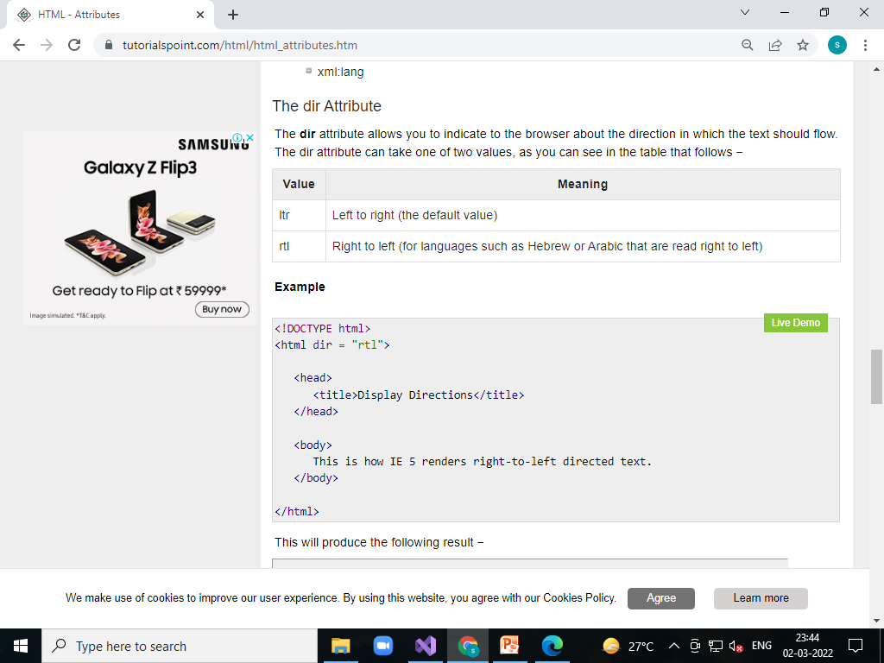

Slide 35
<!DOCTYPE html>
<html dir="rtl">
<head>
<title>Display Directions</title>
</head>
<body>
This is how IE 5 renders right-to-left directed text.
</body>
</html>

Slide 36
The lang Attribute
he lang attribute allows you to indicate the main language used in a document, but this attribute was kept in HTML only for backwards compatibility with earlier versions of HTML. This attribute has been replaced by

Slide 37
<!DOCTYPE html>
<html lang="en">
<head>
<title>English Language Page</title>
</head>
<body>
This page is using English Language
</body>
</html>

Slide 38
HTML - Formatting

Slide 39
Bold Text
Anything that appears within <b>...</b> element, is displayed in bold as shown below −

Slide 40
<!DOCTYPE html>
<html>
<head>
<title>Bold Text Example</title>
</head>
<body>
<p>The following word uses a <b>bold</b> typeface.</p>
</body>
</html>

Slide 41
Italic Text
Anything that appears within <i>...</i> element is displayed in italicized as shown below −

Slide 42
<!DOCTYPE html>
<html>
<head>
<title>Italic Text Example</title>
</head>
<body>
<p>The following word uses an <i>italicized</i> typeface.</p>
</body>
</html>

Slide 43
Underlined Text
Anything that appears within <u>...</u> element, is displayed with underline as shown below −

Slide 44
<!DOCTYPE html>
<html>
<head>
<title>Underlined Text Example</title>
</head>
<body>
<p>The following word uses an <u>underlined</u> typeface.</p>
</body>
</html>

Slide 45
Strike Text
Anything that appears within <strike>...</strike> element is displayed with strikethrough, which is a thin line through the text as shown below −

Slide 46
<!DOCTYPE html>
<html>
<head>
<title>Strike Text Example</title>
</head>
<body>
<p>The following word uses a <strike>strikethrough</strike> typeface.</p>
</body>
</html>

Slide 47
Monospaced Font
The content of a <tt>...</tt> element is written in monospaced font. Most of the fonts are known as variable-width fonts because different letters are of different widths (for example, the letter 'm' is wider than the letter 'i'). In a monospaced font, however, each letter has the same width.

Slide 48
<!DOCTYPE html>
<html>
<head>
<title>Monospaced Font Example</title>
</head>
<body>
<p>The following word uses a <tt>monospaced</tt> typeface.</p>
</body>
</html>

Slide 49
Superscript Text
The content of a <sup>...</sup> element is written in superscript; the font size used is the same size as the characters surrounding it but is displayed half a character's height above the other characters.

Slide 50
<!DOCTYPE html>
<html>
<head>
<title>Superscript Text Example</title>
</head>
<body>
<p>The following word uses a <sup>superscript</sup> typeface.</p>
</body>
</html>

Slide 51
Subscript Text
The content of a <sub>...</sub> element is written in subscript; the font size used is the same as the characters surrounding it, but is displayed half a character's height beneath the other characters.

Slide 52
<!DOCTYPE html>
<html>
<head>
<title>Subscript Text Example</title>
</head>
<body>
<p>The following word uses a <sub>subscript</sub> typeface.</p>
</body>
</html>

Slide 53
Inserted Text
Anything that appears within <ins>...</ins> element is displayed as inserted text.

Slide 54
<!DOCTYPE html>
<html>
<head>
<title>Inserted Text Example</title>
</head>
<body>
<p>I want to drink <del>cola</del> <ins>wine</ins></p>
</body>
</html>

Slide 55
Deleted Text
<!DOCTYPE html>
<html>
<head>
<title>Inserted Text Example</title>
</head>
<body>
<p>I want to drink <del>cola</del> <ins>wine</ins></p>
</body>
</html>

Slide 56
Larger Text
The content of the <big>...</big> element is displayed one font size larger than the rest of the text surrounding it as shown below −

Slide 57
<!DOCTYPE html>
<html>
<head>
<title>Larger Text Example</title>
</head>
<body>
<p>The following word uses a <big>big</big> typeface.</p>
</body>
</html>

Slide 58
Smaller Text
The content of the <small>...</small> element is displayed one font size smaller than the rest of the text surrounding it as shown below −

Slide 59
<!DOCTYPE html>
<html>
<head>
<title>Smaller Text Example</title>
</head>
<body>
<p>The following word uses a <small>small</small> typeface.</p>
</body>
</html>

Slide 60
Grouping Content
The <div> and <span> elements allow you to group together several elements to create sections or subsections of a page.
For example, you might want to put all of the footnotes on a page within a <div> element to indicate that all of the elements within that <div> element relate to the footnotes. You might then attach a style to this <div> element so that they appear using a special set of style rules.

Slide 61
<!DOCTYPE html>
<html>
<head>
<title>Div Tag Example</title>
</head>
<body>
<div id="content" align="left">
<h5>Content Articles</h5>
<p>Actual content goes here.....</p>
</div>
<div id="menu" align="middle">
<a href="/index.htm">HOME</a> |
<a href="/about/contact_us.htm">CONTACT</a> |
<a href="/about/index.htm">ABOUT</a>
</div>
</body>
</html>

Slide 62
The <span>
The <span> element, on the other hand, can be used to group inline elements only. So, if you have a part of a sentence or paragraph which you want to group together, you could use the <span> element as follows.

Slide 63
<!DOCTYPE html>
<html>
<head>
<title>Span Tag Example</title>
</head>
<body>
<p>
This is the example of <span style="color:green">span tag</span>
and the <span style="color:red">div tag</span> alongwith CSS
</p>
</body>
</html>

Slide 64
HTML - Phrase Tags

Slide 65
Emphasized Text
Anything that appears within <em>...</em> element is displayed as emphasized text.

Slide 66
<!DOCTYPE html>
<html>
<head>
<title>Emphasized Text Example</title>
</head>
<body>
<p>The following word uses an <em>emphasized</em> typeface.</p>
</body>
</html>

Slide 67
Marked Text
Anything that appears with-in <mark>...</mark> element, is displayed as marked with yellow ink.

Slide 68
<!DOCTYPE html>
<html>
<head>
<title>Marked Text Example</title>
</head>
<body>
<p>The following word has been <mark>marked</mark> with yellow</p>
</body>
</html>

Slide 69
Strong Text
Anything that appears within <strong>...</strong> element is displayed as important text.

Slide 70
<!DOCTYPE html>
<html>
<head>
<title>Strong Text Example</title>
</head>
<body>
<p>The following word uses a <strong>strong</strong> typeface.</p>
</body>
</html>

Slide 71
Text Abbreviation
You can abbreviate a text by putting it inside opening <abbr> and closing </abbr> tags. If present, the title attribute must contain this full description and nothing else.

Slide 72
<!DOCTYPE html>
<html>
<head>
<title>Text Abbreviation</title>
</head>
<body>
<p>My best friend's name is <abbr title="Abhishek">Abhy</abbr>.</p>
</body>
</html>

Slide 73
Acronym Element
The <acronym> element allows you to indicate that the text between <acronym> and </acronym> tags is an acronym.
At present, the major browsers do not change the appearance of the content of the <acronym> element.

Slide 74
<!DOCTYPE html>
<html>
<head>
<title>Acronym Example</title>
</head>
<body>
<p>This chapter covers marking up text in <acronym>XHTML</acronym>.</p>
</body>
</html>

Slide 75
Text Direction
The <bdo>...</bdo> element stands for Bi-Directional Override and it is used to override the current text direction.

Slide 76
<!DOCTYPE html>
<html>
<head>
<title>Text Direction Example</title>
</head>
<body>
<p>This text will go left to right.</p>
<p><bdo dir="rtl">This text will go right to left.</bdo></p>
</body>
</html>

Slide 77
Special Terms
The <dfn>...</dfn> element (or HTML Definition Element) allows you to specify that you are introducing a special term. It's usage is similar to italic words in the midst of a paragraph.
Typically, you would use the <dfn> element the first time you introduce a key term. Most recent browsers render the content of a <dfn> element in an italic font.

Slide 78
<!DOCTYPE html>
<html>
<head>
<title>Special Terms Example</title>
</head>
<body>
<p>The following word is a <dfn>special</dfn> term.</p>
</body>
</html>

Slide 79
Quoting Text
When you want to quote a passage from another source, you should put it in between <blockquote>...</blockquote> tags.
Text inside a <blockquote> element is usually indented from the left and right edges of the surrounding text, and sometimes uses an italicized font.

Slide 80
<!DOCTYPE html>
<html>
<head>
<title>Blockquote Example</title>
</head>
<body>
<p>The following description of XHTML is taken from the W3C Web site:</p>
<blockquote>
XHTML 1.0 is the W3C's first Recommendation for XHTML,following on
from earlier work on HTML 4.01, HTML 4.0, HTML 3.2 and HTML 2.0.
</blockquote>
</body>
</html>

Slide 81
Short Quotations
The <q>...</q> element is used when you want to add a double quote within a sentence.

Slide 82
<!DOCTYPE html>
<html>
<head>
<title>Double Quote Example</title>
</head>
<body>
<p>Amit is in Spain, <q>I think I am wrong</q>.</p>
</body>
</html>

Slide 83
Text Citations
If you are quoting a text, you can indicate the source placing it between an opening <cite> tag and closing </cite> tag
As you would expect in a print publication, the content of the <cite> element is rendered in italicized text by default.

Slide 84
<!DOCTYPE html>
<html>
<head>
<title>Citations Example</title>
</head>
<body>
<p>This HTML tutorial is derived from <cite>W3 Standard for HTML</cite>.</p>
</body>
</html>

Slide 85
Computer Code
Any programming code to appear on a Web page should be placed inside <code>...</code> tags. Usually the content of the <code> element is presented in a monospaced font, just like the code in most programming books.

Slide 86
<!DOCTYPE html>
<html>
<head>
<title>Computer Code Example</title>
</head>
<body>
<p>Regular text. <code>This is code.</code> Regular text.</p>
</body>
</html>

Slide 87
Keyboard Text
When you are talking about computers, if you want to tell a reader to enter some text, you can use the <kbd>...</kbd> element to indicate what should be typed in, as in this example.

Slide 88
<!DOCTYPE html>
<html>
<head>
<title>Keyboard Text Example</title>
</head>
<body>
<p>Regular text. <kbd>This is inside kbd element</kbd> Regular text.</p>
</body>
</html>

Slide 89
Programming Variables
This element is usually used in conjunction with the <pre> and <code> elements to indicate that the content of that element is a variable.

Slide 90
<!DOCTYPE html>
<html>
<head>
<title>Variable Text Example</title>
</head>
<body>
<p><code>document.write("<var>user-name</var>")</code></p>
</body>
</html>

Slide 91
Program Output
The <samp>...</samp> element indicates sample output from a program, and script etc. Again, it is mainly used when documenting programming or coding concepts.

Slide 92
<!DOCTYPE html>
<html>
<head>
<title>Program Output Example</title>
</head>
<body>
<p>Result produced by the program is <samp>Hello World!</samp></p>
</body>
</html>

Slide 93
Address Text
The <address>...</address> element is used to contain any address.

Slide 94
<!DOCTYPE html>
<html>
<head>
<title>Address Example</title>
</head>
<body>
<address>388A, Road No 22, Jubilee Hills - Hyderabad</address>
</body>
</html>

Slide 95
HTML - Meta Tags
HTML lets you specify metadata - additional important information about a document in a variety of ways. The META elements can be used to include name/value pairs describing properties of the HTML document, such as author, expiry date, a list of keywords, document author etc.
The <meta> tag is used to provide such additional information. This tag is an empty element and so does not have a closing tag but it carries information within its attributes.
You can include one or more meta tags in your document based on what information you want to keep in your document but in general, meta tags do not impact physical appearance of the document so from appearance point of view, it does not matter if you include them or not.

Slide 96
Adding Meta Tags to Your Documents
You can add metadata to your web pages by placing <meta> tags inside the header of the document which is represented by <head> and </head> tags. A meta tag can have following attributes in addition to core attributes −

Slide 97
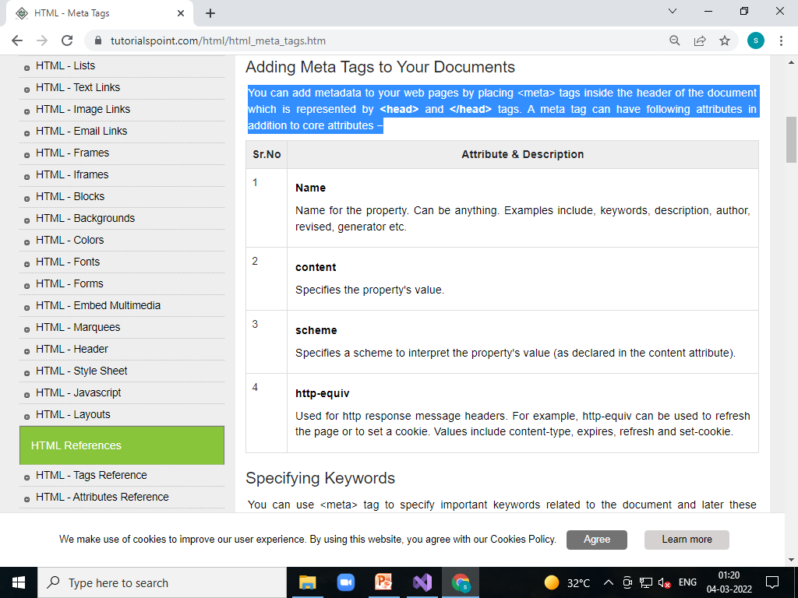

Slide 98
Specifying Keywords
You can use <meta> tag to specify important keywords related to the document and later these keywords are used by the search engines while indexing your webpage for searching purpose.

Slide 99
<!DOCTYPE html>
<html>
<head>
<title>Meta Tags Example</title>
<meta name="keywords" content="HTML, Meta Tags, Metadata" />
</head>
<body>
<p>Hello HTML5!</p>
</body>
</html>

Slide 100
Document Description
You can use <meta> tag to give a short description about the document. This again can be used by various search engines while indexing your webpage for searching purpose.

Slide 101
<!DOCTYPE html>
<html>
<head>
<title>Meta Tags Example</title>
<meta name="keywords" content="HTML, Meta Tags, Metadata" />
<meta name="description" content="Learning about Meta Tags." />
</head>
<body>
<p>Hello HTML5!</p>
</body>
</html>

Slide 102
Document Revision Date
You can use <meta> tag to give information about when last time the document was updated. This information can be used by various web browsers while refreshing your webpage.

Slide 103
<!DOCTYPE html>
<html>
<head>
<title>Meta Tags Example</title>
<meta name="keywords" content="HTML, Meta Tags, Metadata" />
<meta name="description" content="Learning about Meta Tags." />
<meta name="revised" content="Tutorialspoint, 3/7/2014" />
</head>
<body>
<p>Hello HTML5!</p>
</body>
</html>

Slide 104
Document Refreshing
A <meta> tag can be used to specify a duration after which your web page will keep refreshing automatically.

Slide 105
<!DOCTYPE html>
<html>
<head>
<title>Meta Tags Example</title>
<meta name="keywords" content="HTML, Meta Tags, Metadata" />
<meta name="description" content="Learning about Meta Tags." />
<meta name="revised" content="Tutorialspoint, 3/7/2014" />
<meta http-equiv="refresh" content="5" />
</head>
<body>
<p>Hello HTML5!</p>
</body>
</html>
Page Redirection

Slide 106
Page Redirection
You can use <meta> tag to redirect your page to any other webpage. You can also specify a duration if you want to redirect the page after a certain number of seconds.

Slide 107
<!DOCTYPE html>
<html>
<head>
<title>Meta Tags Example</title>
<meta name="keywords" content="HTML, Meta Tags, Metadata" />
<meta name="description" content="Learning about Meta Tags." />
<meta name="revised" content="Tutorialspoint, 3/7/2014" />
<meta http-equiv="refresh" content="5; url = http://www.tutorialspoint.com" />
</head>
<body>
<p>Hello HTML5!</p>
</body>
</html>

Slide 108
Setting Cookies
Cookies are data, stored in small text files on your computer and it is exchanged between web browser and web server to keep track of various information based on your web application need.
You can use <meta> tag to store cookies on client side and later this information can be used by the Web Server to track a site visitor.

Slide 109
<!DOCTYPE html>
<html>
<head>
<title>Meta Tags Example</title>
<meta http-equiv="cookie" content="userid = xyz; expires = Wednesday, 08-Aug-15 23:59:59 GMT;" />
</head>
<body>
<p>Hello HTML5!</p>
</body>
</html>

Slide 110
Setting Author Name
You can set an author name in a web page using meta tag. See an example below −

Slide 111
<!DOCTYPE html>
<html>
<head>
<title>Meta Tags Example</title>
<meta name="keywords" content="HTML, Meta Tags, Metadata" />
<meta name="description" content="Learning about Meta Tags." />
<meta name="author" content="Mahnaz Mohtashim" />
</head>
<body>
<p>Hello HTML5!</p>
</body>
</html>

Slide 112
Specify Character Set
You can use <meta> tag to specify character set used within the webpage.

Slide 113
<!DOCTYPE html>
<html>
<head>
<title>Meta Tags Example</title>
<meta name="keywords" content="HTML, Meta Tags, Metadata" />
<meta name="description" content="Learning about Meta Tags." />
<meta name="author" content="Mahnaz Mohtashim" />
<meta http-equiv="Content-Type" content="text/html; charset = UTF-8" />
</head>
<body>
<p>Hello HTML5!</p>
</body>
</html>

Slide 114
HTML - Comments
Comment is a piece of code which is ignored by any web browser. It is a good practice to add comments into your HTML code, especially in complex documents, to indicate sections of a document, and any other notes to anyone looking at the code. Comments help you and others understand your code and increases code readability.
HTML comments are placed in between <!-- ... --> tags. So, any content placed with-in <!-- ... --> tags will be treated as comment and will be completely ignored by the browser.

Slide 115
<!DOCTYPE html>
<html>
<head>
<!-- Document Header Starts -->
<title>This is document title</title>
</head> <!-- Document Header Ends -->
<body>
<p>Document content goes here.....</p>
</body>
</html>

Slide 116
Valid vs Invalid Comments
Comments do not nest which means a comment cannot be put inside another comment. Second the double-dash sequence "--" may not appear inside a comment except as part of the closing --> tag. You must also make sure that there are no spaces in the start-of comment string.

Slide 117
<!DOCTYPE html>
<html>
<head>
<title>Valid Comment Example</title>
</head>
<body>
<!-- This is valid comment -->
<p>Document content goes here.....</p>
</body>
</html>

Slide 118
Invalid comment
<!DOCTYPE html>
<html>
<head>
<title>Invalid Comment Example</title>
</head>
<body>
< !-- This is not a valid comment -->
<p>Document content goes here.....</p>
</body>
</html>

Slide 119
Multiline Comments
So far we have seen single line comments, but HTML supports multi-line comments as well.
You can comment multiple lines by the special beginning tag <!-- and ending tag --> placed before the first line and end of the last line as shown in the given example below.

Slide 120
<!DOCTYPE html>
<html>
<head>
<title>Multiline Comments</title>
</head>
<body>
<!--
This is a multiline comment and it can
span through as many as lines you like.
-->
<p>Document content goes here.....</p>
</body>
</html>

Slide 121
HTML - Images
Images are very important to beautify as well as to depict many complex concepts in simple way on your web page. This tutorial will take you through simple steps to use images in your web pages.

Slide 122
Insert Image
You can insert any image in your web page by using <img> tag. Following is the simple syntax to use this tag.
<img src = "Image URL" ... attributes-list/>

Slide 123
<!DOCTYPE html>
<html>
<head>
<title>Using Image in Webpage</title>
</head>
<body>
<p>Simple Image Insert</p>
<img src="/images/ulp.jpg" alt="Test Image" />
</body>
</html>

Slide 124
Set Image Width/Height
You can set image width and height based on your requirement using width and height attributes. You can specify width and height of the image in terms of either pixels or percentage of its actual size.

Slide 125
<!DOCTYPE html>
<html>
<head>
<title>Using Image in Webpage</title>
</head>
<body>
<p>Simple Image Insert</p>
<img src="/images/fish.jpg" alt="Test Image" width="150" height="100">
</body>
</html>

Slide 126
Set Image Border
<!DOCTYPE html>
<html>
<head>
<title>Using Image in Webpage</title>
</head>
<body>
<p>Simple Image Insert</p>
<img src="/images/fish.png" alt="Test Image" width="150" height="100" border = "3" />
</body>
</html>

Slide 127
Set Image Alignment
By default, image will align at the left side of the page, but you can use align attribute to set it in the center or right.

Slide 128
<!DOCTYPE html>
<html>
<head>
<title>Using Image in Webpage</title>
</head>
<body>
<p>Simple Image Insert</p>
<img src=“css/images/fish.png" alt="Test Image" width="150" height="100" border = "3" align="right"/>
</body>
</html>

Slide 129
HTML - Tables
The HTML tables allow web authors to arrange data like text, images, links, other tables, etc. into rows and columns of cells.
The HTML tables are created using the <table> tag in which the <tr> tag is used to create table rows and <td> tag is used to create data cells. The elements under <td> are regular and left aligned by default

Slide 130
<!DOCTYPE html>
<html>
<head>
<title>HTML Tables</title>
</head>
<body>
<table border="1">
<tr>
<td>Row 1, Column 1</td>
<td>Row 1, Column 2</td>
</tr>
<tr>
<td>Row 2, Column 1</td>
<td>Row 2, Column 2</td>
</tr>
</table>
</body>
</html>

Slide 131
Table Heading
Table heading can be defined using <th> tag. This tag will be put to replace <td> tag, which is used to represent actual data cell. Normally you will put your top row as table heading as shown below, otherwise you can use <th> element in any row. Headings, which are defined in <th> tag are centered and bold by default.

Slide 132
<!DOCTYPE html>
<html>
<head>
<title>HTML Table Header</title>
</head>
<body>
<table border="1">
<tr>
<th>Name</th>
<th>Salary</th>
</tr>
<tr>
<td>Ramesh Raman</td>
<td>5000</td>
</tr>
<tr>
<td>Shabbir Hussein</td>
<td>7000</td>
</tr>
</table>
</body>
</html>

Slide 133
Cellpadding and Cellspacing Attributes
There are two attributes called cellpadding and cellspacing which you will use to adjust the white space in your table cells. The cellspacing attribute defines space between table cells, while cellpadding represents the distance between cell borders and the content within a cell.

Slide 134
<!DOCTYPE html>
<html>
<head>
<title>HTML Table Cellpadding</title>
</head>
<body>
<table border="1" cellpadding="5" cellspacing="5">
<tr>
<th>Name</th>
<th>Salary</th>
</tr>
<tr>
<td>Ramesh Raman</td>
<td>5000</td>
</tr>
<tr>
<td>Shabbir Hussein</td>
<td>7000</td>
</tr>
</table>
</body>
</html>

Slide 135
Colspan and Rowspan Attributes
You will use colspan attribute if you want to merge two or more columns into a single column. Similar way you will use rowspan if you want to merge two or more rows.

Slide 136
<!DOCTYPE html>
<html>
<head>
<title>HTML Table Colspan/Rowspan</title>
</head>
<body>
<table border="1">
<tr>
<th>Column 1</th>
<th>Column 2</th>
<th>Column 3</th>
</tr>
<tr>
<td rowspan="3">Row 1 Cell 1</td>
<td>Row 1 Cell 2</td>
<td>Row 1 Cell 3</td>
</tr>
<tr>
<td>Row 2 Cell 2</td>
<td>Row 2 Cell 3</td>
</tr>
<tr>
<td colspan="2">Row 3 Cell 1</td>
</tr>
</table>
</body>
</html>

Slide 137
Tables Backgrounds
You can set table background using one of the following two ways −
bgcolor attribute − You can set background color for whole table or just for one cell.
background attribute − You can set background image for whole table or just for one cell.
You can also set border color also using bordercolor attribute.
Note − The bgcolor, background, and bordercolor attributes deprecated in HTML5. Do not use these attributes.

Slide 138
<!DOCTYPE html>
<html>
<head>
<title>HTML Table Background</title>
</head>
<body>
<table border="1" bordercolor="gray" bgcolor="red">
<tr>
<th>Column 1</th>
<th>Column 2</th>
<th>Column 3</th>
</tr>
<tr>
<td rowspan="2">Row 1 Cell 1</td>
<td>Row 1 Cell 2</td>
<td>Row 1 Cell 3</td>
</tr>
<tr>
<td>Row 2 Cell 2</td>
<td>Row 2 Cell 3</td>
</tr>
<tr>
<td colspan="3">Row 3 Cell 1</td>
</tr>
</table>
</body>
</html>

Slide 139
Table Height and Width
You can set a table width and height using width and height attributes. You can specify table width or height in terms of pixels or in terms of percentage of available screen area.

Slide 140
<!DOCTYPE html>
<html>
<head>
<title>HTML Table Width/Height</title>
</head>
<body>
<table border="1" width="400" height="150">
<tr>
<td>Row 1, Column 1</td>
<td>Row 1, Column 2</td>
</tr>
<tr>
<td>Row 2, Column 1</td>
<td>Row 2, Column 2</td>
</tr>
</table>
</body>
</html>

Slide 141
Table Caption
The caption tag will serve as a title or explanation for the table and it shows up at the top of the table. This tag is deprecated in newer version of HTML/XHTML.

Slide 142
<!DOCTYPE html>
<html>
<head>
<title>HTML Table Caption</title>
</head>
<body>
<table border="1" width="100%">
<caption>This is the caption</caption>
<tr>
<td>row 1, column 1</td>
<td>row 1, columnn 2</td>
</tr>
<tr>
<td>row 2, column 1</td>
<td>row 2, columnn 2</td>
</tr>
</table>
</body>
</html>

Slide 143
Table Header, Body, and Footer
Tables can be divided into three portions − a header, a body, and a foot. The head and foot are rather similar to headers and footers in a word-processed document that remain the same for every page, while the body is the main content holder of the table.
The three elements for separating the head, body, and foot of a table are −
<thead> − to create a separate table header.
<tbody> − to indicate the main body of the table.
<tfoot> − to create a separate table footer.
A table may contain several <tbody> elements to indicate different pages or groups of data. But it is notable that <thead> and <tfoot> tags should appear before <tbody>

Slide 144
<!DOCTYPE html>
<html>
<head>
<title>HTML Table</title>
</head>
<body>
<table border="1" width="100%">
<thead>
<tr>
<td colspan="4">This is the head of the table</td>
</tr>
</thead>
<tfoot>
<tr>
<td colspan="4">This is the foot of the table</td>
</tr>
</tfoot>
<tbody>
<tr>
<td>Cell 1</td>
<td>Cell 2</td>
<td>Cell 3</td>
<td>Cell 4</td>
</tr>
</tbody>
</table>
</body>
</html>

Slide 145
Nested Tables
You can use one table inside another table. Not only tables you can use almost all the tags inside table data tag <td>.

Slide 146
<!DOCTYPE html>
<html>
<head>
<title>HTML Table</title>
</head>
<body>
<table border="1" width="100%">
<tr>
<td>
<table border="1" width="100%">
<tr>
<th>Name</th>
<th>Salary</th>
</tr>
<tr>
<td>Ramesh Raman</td>
<td>5000</td>
</tr>
<tr>
<td>Shabbir Hussein</td>
<td>7000</td>
</tr>
</table>
</td>
</tr>
</table>
</body>
</html>

Slide 147
HTML - Lists
HTML offers web authors three ways for specifying lists of information. All lists must contain one or more list elements. Lists may contain −
<ul> − An unordered list. This will list items using plain bullets.
<ol> − An ordered list. This will use different schemes of numbers to list your items.
<dl> − A definition list. This arranges your items in the same way as they are arranged in a dictionary.

Slide 148
HTML Unordered Lists
An unordered list is a collection of related items that have no special order or sequence. This list is created by using HTML <ul> tag. Each item in the list is marked with a bullet.

Slide 149
<!DOCTYPE html>
<html>
<head>
<title>HTML Unordered List</title>
</head>
<body>
<ul>
<li>Beetroot</li>
<li>Ginger</li>
<li>Potato</li>
<li>Radish</li>
</ul>
</body>
</html>

Slide 150
The type Attribute
You can use type attribute for <ul> tag to specify the type of bullet you like. By default, it is a disc. Following are the possible options −
<ul type = "square">
<ul type = "disc">
<ul type = "circle">

Slide 151
<!DOCTYPE html>
<html>
<head>
<title>HTML Unordered List</title>
</head>
<body>
<ul type="circle">
<li>Beetroot</li>
<li>Ginger</li>
<li>Potato</li>
<li>Radish</li>
</ul>
</body>
</html>

Slide 152
HTML Ordered Lists
If you are required to put your items in a numbered list instead of bulleted, then HTML ordered list will be used. This list is created by using <ol> tag. The numbering starts at one and is incremented by one for each successive ordered list element tagged with <li>.

Slide 153
<!DOCTYPE html>
<html>
<head>
<title>HTML Ordered List</title>
</head>
<body>
<ol>
<li>Beetroot</li>
<li>Ginger</li>
<li>Potato</li>
<li>Radish</li>
</ol>
</body>
</html>

Slide 154
The type Attribute
You can use type attribute for <ol> tag to specify the type of numbering you like. By default, it is a number. Following are the possible options −

Slide 155
<ol type="1">
- Default-Case Numerals.
<ol type="I">
- Upper-Case Numerals.
<ol type="i">
- Lower-Case Numerals.
<ol type="A">
Upper-Case Letters.
<ol type="a"> - Lower-Case Letters.

Slide 156
<!DOCTYPE html>
<html>
<head>
<title>HTML Ordered List</title>
</head>
<body>
<ol type="i">
<li>Beetroot</li>
<li>Ginger</li>
<li>Potato</li>
<li>Radish</li>
</ol>
</body>
</html>

Slide 157
The start Attribute
You can use start attribute for <ol> tag to specify the starting point of numbering you need. Following are the possible options −

Slide 158
<ol type="1" start="4">
- Numerals starts with 4.
<ol type="I" start="4">
- Numerals starts with IV.
<ol type="i" start="4">
- Numerals starts with iv.
<ol type="a" start="4">
- Letters starts with d.
<ol type="A" start="4"> - Letters starts with D.

Slide 159
<!DOCTYPE html>
<html>
<head>
<title>HTML Ordered List</title>
</head>
<body>
<ol type="i" start="3">
<li>Beetroot</li>
<li>Ginger</li>
<li>Potato</li>
<li>Radish</li>
</ol>
</body>
</html>

Slide 160
HTML Definition Lists
HTML and XHTML supports a list style which is called definition lists where entries are listed like in a dictionary or encyclopedia. The definition list is the ideal way to present a glossary, list of terms, or other name/value list.
Definition List makes use of following three tags.
<dl> − Defines the start of the list
<dt> − A term
<dd> − Term definition
</dl> − Defines the end of the list

Slide 161
<!DOCTYPE html>
<html>
<head>
<title>HTML Definition List</title>
</head>
<body>
<dl>
<dt><b>HTML</b></dt>
<dd>This stands for Hyper Text Markup Language</dd>
<dt><b>HTTP</b></dt>
<dd>This stands for Hyper Text Transfer Protocol</dd>
</dl>
</body>
</html>

Slide 162
HTML - Text Links
A webpage can contain various links that take you directly to other pages and even specific parts of a given page. These links are known as hyperlinks.
Hyperlinks allow visitors to navigate between Web sites by clicking on words, phrases, and images. Thus you can create hyperlinks using text or images available on a webpage.
Note − I recommend you to go through a short tutorial on Understanding URL

Slide 163
Linking Documents
A link is specified using HTML tag <a>. This tag is called anchor tag and anything between the opening <a> tag and the closing </a> tag becomes part of the link and a user can click that part to reach to the linked document. Following is the simple syntax to use <a> tag.

Slide 164
<!DOCTYPE html>
<html>
<head>
<title>Hyperlink Example</title>
</head>
<body>
<p>Click following link</p>
<a href="https://www.tutorialspoint.com" target="_self">Tutorials Point</a>
</body>
</html>

Slide 165
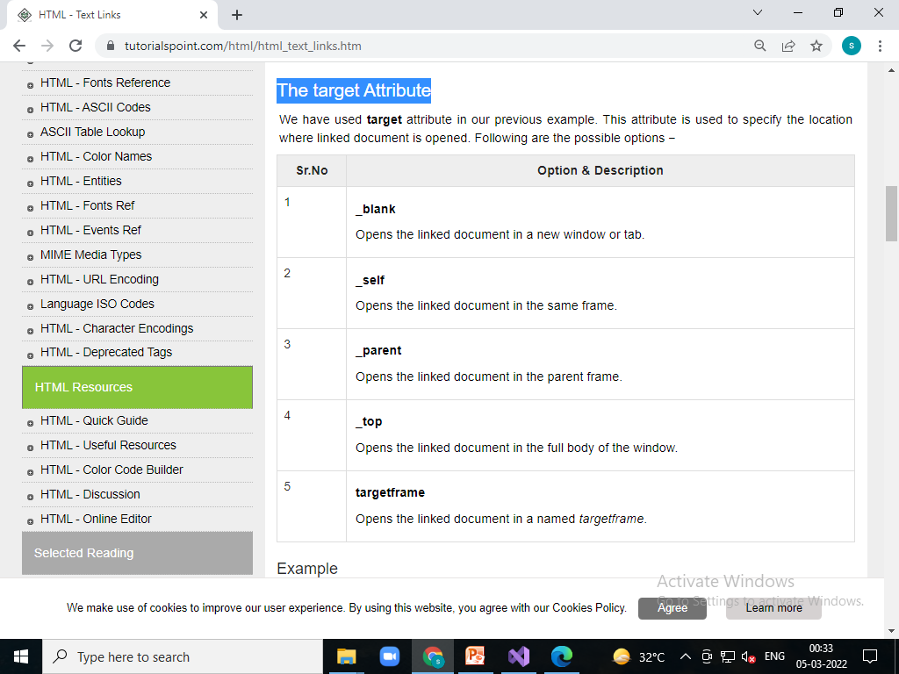
The target Attribute

Slide 166
<!DOCTYPE html>
<html>
<head>
<title>Hyperlink Example</title>
<base href="https://www.tutorialspoint.com/">
</head>
<body>
<p>Click any of the following links</p>
<a href="/html/index.htm" target="_blank">Opens in New</a> |
<a href="/html/index.htm" target="_self">Opens in Self</a> |
<a href="/html/index.htm" target="_parent">Opens in Parent</a> |
<a href="/html/index.htm" target="_top">Opens in Body</a>
</body>
</html>

Slide 167
Linking to a Page Section
You can create a link to a particular section of a given webpage by using name attribute. This is a two-step process.
Create link refernce- <a name="bottom">here we are bottom</a>
Create link to jump-
<a href="#bottom">goto top</a>

Slide 168
HTML - Image Links
We have seen how to create hypertext link using text and we also learnt how to use images in our webpages. Now, we will learn how to use images to create hyperlinks.

Slide 169
<!DOCTYPE html>
<html>
<head>
<title>Image Hyperlink Example</title>
</head>
<body>
<p>Click following link</p>
<a href="https://www.tutorialspoint.com" target="_self">
<img src="/images/fish.png" alt="Tutorials Point" border="0" />
</a>
</body>
</html>

Slide 170
HTML - Frames
HTML frames are used to divide your browser window into multiple sections where each section can load a separate HTML document. A collection of frames in the browser window is known as a frameset. The window is divided into frames in a similar way the tables are organized: into rows and columns.

Slide 171
Creating Frames
To use frames on a page we use <frameset> tag instead of <body> tag. The <frameset> tag defines, how to divide the window into frames. The rows attribute of <frameset> tag defines horizontal frames and cols attribute defines vertical frames. Each frame is indicated by <frame> tag and it defines which HTML document shall open into the frame.

Slide 172
<!DOCTYPE html>
<html>
<head>
<title>HTML Frames</title>
</head>
<frameset rows="10%,70%,20%">
<frame name="top" src="\seond.html" />
<frame name="main" src="\seond.html" />
<frame name="bottom" src=""/>
<noframes>
<body>
Your browser does not support frames.
</body>
</noframes>
</frameset>
</html>

Slide 173
HTML - Blocks
All the HTML elements can be categorized into two categories (a) Block Level Elements (b)Inline Elements.

Slide 174
Block Elements
Block elements appear on the screen as if they have a line break before and after them. For example, the <p>, <h1>, <h2>, <h3>, <h4>, <h5>, <h6>, <ul>, <ol>, <dl>, <pre>, <hr />, <blockquote>, and <address> elements are all block level elements. They all start on their own new line, and anything that follows them appears on its own new line.

Slide 175
Inline Elements
Inline elements, on the other hand, can appear within sentences and do not have to appear on a new line of their own. The <b>, <i>, <u>, <em>, <strong>, <sup>, <sub>, <big>, <small>, <li>, <ins>, <del>, <code>, <cite>, <dfn>, <kbd>, and <var> elements are all inline elements.

Slide 176
Grouping HTML Elements
There are two important tags which we use very frequently to group various other HTML tags
(i) <div> tag and
(ii) <span> tag

Slide 177
The <div> tag
This is the very important block level tag which plays a big role in grouping various other HTML tags and applying CSS on group of elements. Even now <div> tag can be used to create webpage layout where we define different parts (Left, Right, Top etc.) of the page using <div> tag. This tag does not provide any visual change on the block but this has more meaning when it is used with CSS.

Slide 178
<!DOCTYPE html>
<html>
<head>
<title>HTML div Tag</title>
</head>
<body>
<!-- First group of tags -->
<div style="color:red">
<h4>This is first group</h4>
<p>Following is a list of vegetables</p>
<ul>
<li>Beetroot</li>
<li>Ginger</li>
<li>Potato</li>
<li>Radish</li>
</ul>
</div>
<!-- Second group of tags -->
<div style="color:green">
<h4>This is second group</h4>
<p>Following is a list of fruits</p>
<ul>
<li>Apple</li>
<li>Banana</li>
<li>Mango</li>
<li>Strawberry</li>
</ul>
</div>
</body>
</html>

Slide 179
The <span> tag
The HTML <span> is an inline element and it can be used to group inline-elements in an HTML document. This tag also does not provide any visual change on the block but has more meaning when it is used with CSS.
The difference between the <span> tag and the <div> tag is that the <span> tag is used with inline elements whereas the <div> tag is used with block-level elements.

Slide 180
<!DOCTYPE html>
<html>
<head>
<title>HTML span Tag</title>
</head>
<body>
<p>
This is <span style="color:red">red</span> and this is
<span style="color:green">green</span>
</p>
</body>
</html>

Slide 181
HTML - Backgrounds
By default, your webpage background is white in color. You may not like it, but no worries. HTML provides you following two good ways to decorate your webpage background.
HTML Background with Colors
HTML Background with Images
Now let's see both the approaches one by one using appropriate examples.

Slide 182
Html Background with Colors
The bgcolor attribute is used to control the background of an HTML element, specifically page body and table backgrounds.

Slide 183
<!DOCTYPE html>
<html>
<head>
<title>HTML Background Colors</title>
</head>
<body>
<!-- Format 1 - Use color name -->
<table bgcolor="yellow" width="100%">
<tr>
<td>
This background is yellow
</td>
</tr>
</table>
<!-- Format 2 - Use hex value -->
<table bgcolor="#6666FF" width="100%">
<tr>
<td>
This background is sky blue
</td>
</tr>
</table>
<!-- Format 3 - Use color value in RGB terms -->
<table bgcolor="rgb(255,0,255)" width="100%">
<tr>
<td>
This background is green
</td>
</tr>
</table>
</body>
</html>

Slide 184
Html Background with Images
<!DOCTYPE html>
<html>
<head>
<title>HTML Background Images</title>
</head>
<body>
<!-- Set table background -->
<table background="/images/bulp.jpg" width="100%" height="100">
<tr>
<td>
This background is filled up with HTML image.
</td>
</tr>
</table>
</body>
</html>

Slide 185
HTML - Colors
Colors are very important to give a good look and feel to your website. You can specify colors on page level using <body> tag or you can set colors for individual tags using bgcolor attribute.
The <body> tag has following attributes which can be used to set different colors −
bgcolor − sets a color for the background of the page.
text − sets a color for the body text.
alink − sets a color for active links or selected links.
link − sets a color for linked text.
vlink − sets a color for visited links − that is, for linked text that you have already clicked on.

Slide 186
HTML Color Coding Methods
There are following three different methods to set colors in your web page −
Color names − You can specify color names directly like green, blue or red.
Hex codes − A six-digit code representing the amount of red, green, and blue that makes up the color.
Color decimal or percentage values − This value is specified using the rgb( ) property.

Slide 187
HTML Colors - Color Names
You can specify direct a color name to set text or background color. W3C has listed 16 basic color names that will validate with an HTML validator but there are over 200 different color names supported by major browsers.

Slide 188
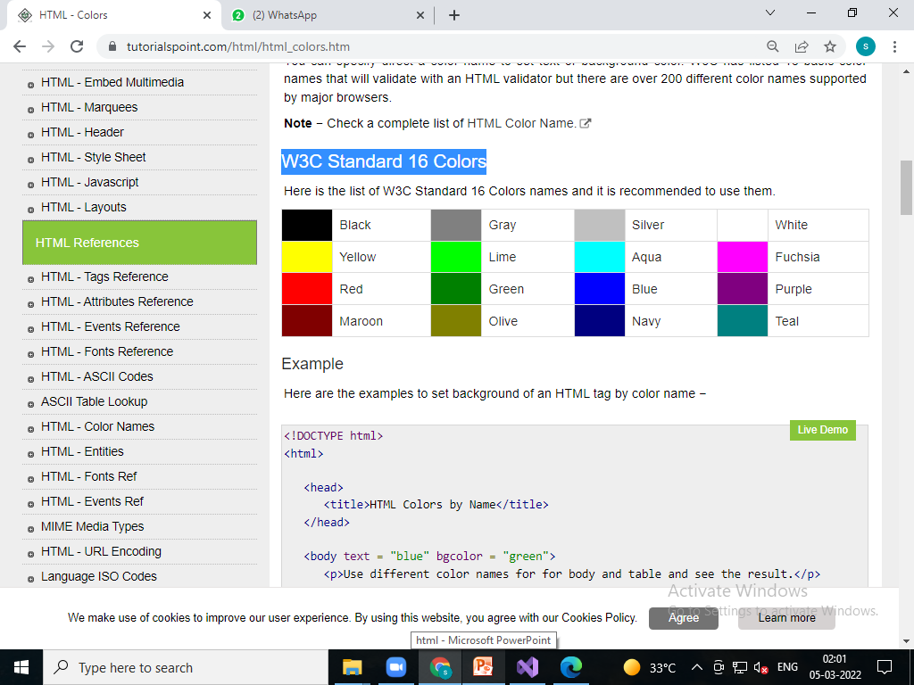
W3C Standard 16 Colors

Slide 189
<!DOCTYPE html>
<html>
<head>
<title>HTML Colors by Name</title>
</head>
<body text="blue" bgcolor="green">
<p>Use different color names for for body and table and see the result.</p>
<table bgcolor="black">
<tr>
<td>
<font color="white">This text will appear white on black background.</font>
</td>
</tr>
</table>
</body>
</html>

Slide 190
HTML Colors - Hex Codes
A hexadecimal is a 6 digit representation of a color. The first two digits(RR) represent a red value, the next two are a green value(GG), and the last are the blue value(BB).
A hexadecimal value can be taken from any graphics software like Adobe Photoshop, Paintshop Pro or MS Paint.
Each hexadecimal code will be preceded by a pound or hash sign #. Following is a list of few colors using hexadecimal notation.

Slide 191
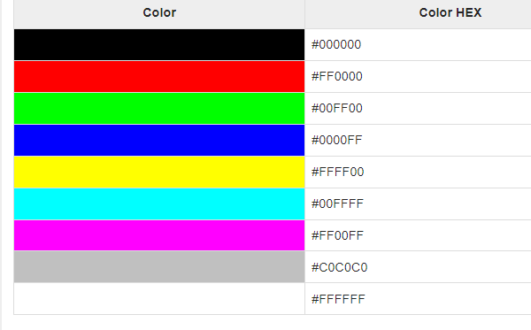

Slide 192
<!DOCTYPE html>
<html>
<head>
<title>HTML Colors by Hex</title>
</head>
<body text="#0000FF" bgcolor="#c0c0c0">
<p>Use different color hexa for for body and table and see the result.</p>
<table bgcolor="#000000">
<tr>
<td>
<font color="#FFFFFF">This text will appear white on black background.</font>
</td>
</tr>
</table>
</body>
</html>

Slide 193
HTML Colors - RGB Values
This color value is specified using the rgb( ) property. This property takes three values, one each for red, green, and blue. The value can be an integer between 0 and 255 or a percentage.
Note − All the browsers does not support rgb() property of color so it is recommended not to use it.

Slide 194
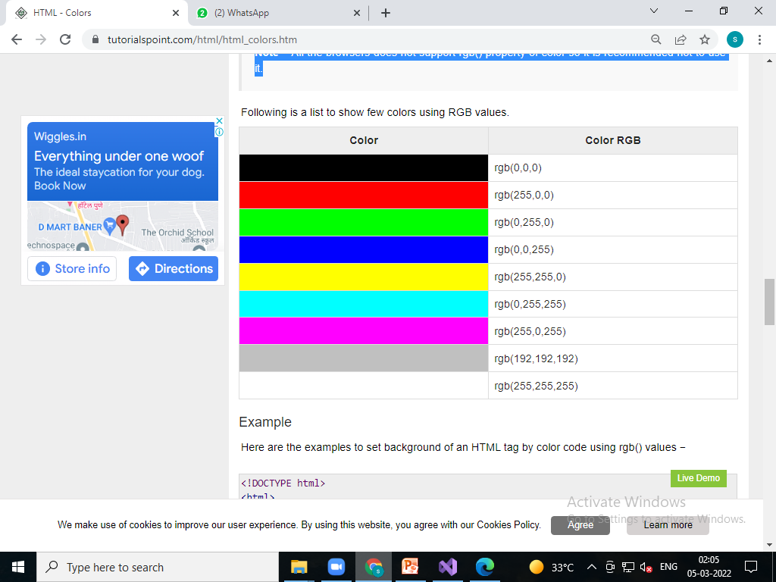

Slide 195
<!DOCTYPE html>
<html>
<head>
<title>HTML Colors by RGB code</title>
</head>
<body text="rgb(0,0,255)" bgcolor="rgb(0,144,0)">
<p>Use different color code for for body and table and see the result.</p>
<table bgcolor="rgb(0,0,0)">
<tr>
<td>
<font color="rgb(255,255,255)">This text will appear white on black background.</font>
</td>
</tr>
</table>
</body>
</html>

Slide 196
Browser Safe Colors
Here is the list of 216 colors which are supposed to be safest and computer independent colors. These colors very from hexa code 000000 to FFFFFF and they will be supported by all the computers having 256 color palette.

Slide 197
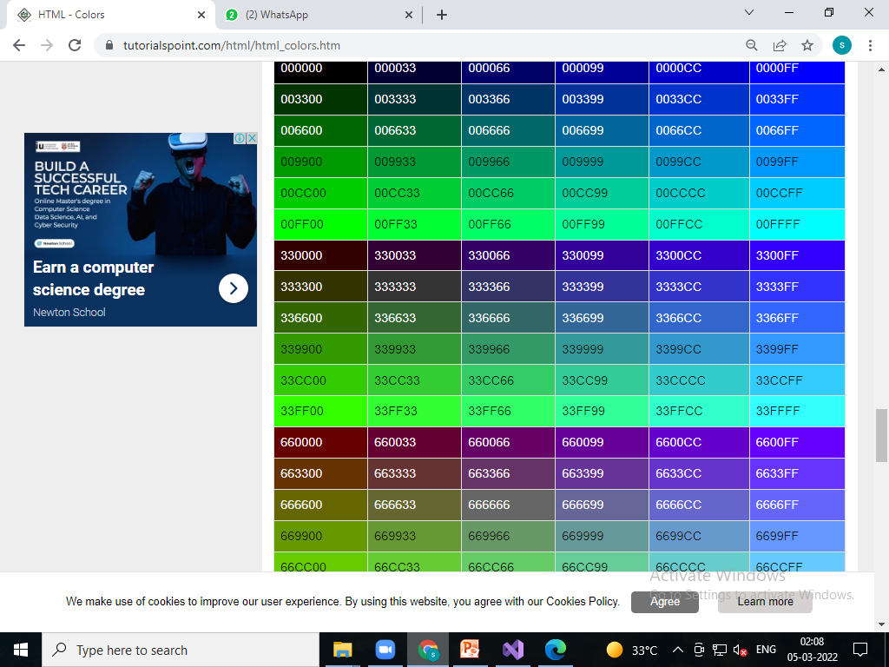

Slide 198
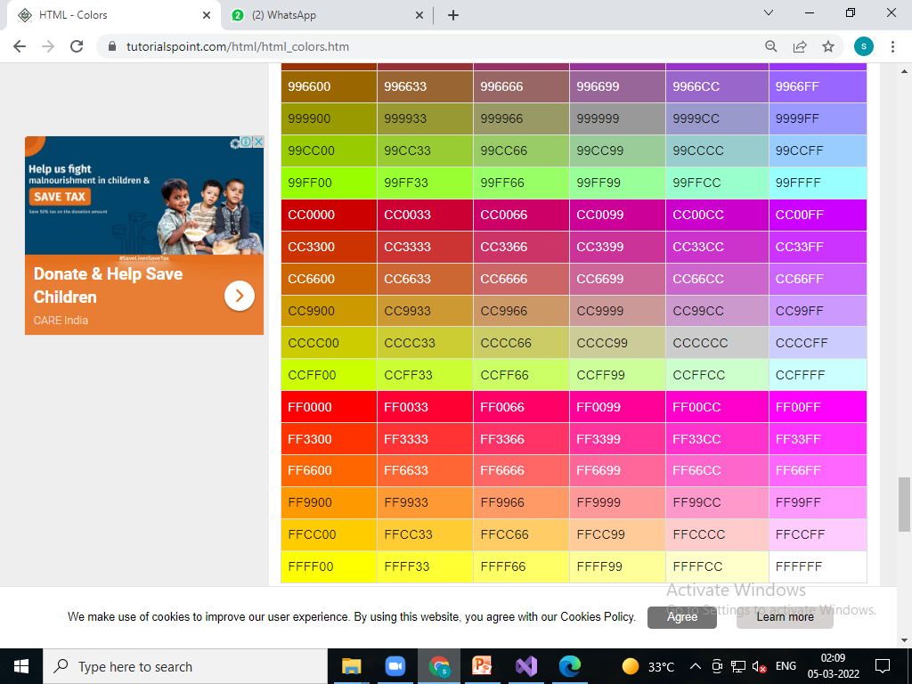

Slide 199
HTML - Fonts
Fonts play a very important role in making a website more user friendly and increasing content readability. Font face and color depends entirely on the computer and browser that is being used to view your page but you can use HTML <font> tag to add style, size, and color to the text on your website. You can use a <basefont> tag to set all of your text to the same size, face, and color.

Slide 200
Set Font Size
You can set content font size using size attribute. The range of accepted values is from 1(smallest) to 7(largest). The default size of a font is 3.

Slide 201
<!DOCTYPE html>
<html>
<head>
<title>Setting Font Size</title>
</head>
<body>
<font size="1">Font size = "1"</font><br />
<font size="2">Font size = "2"</font><br />
<font size="3">Font size = "3"</font><br />
<font size="4">Font size = "4"</font><br />
<font size="5">Font size = "5"</font><br />
<font size="6">Font size = "6"</font><br />
<font size="7">Font size = "7"</font>
</body>
</html>

Slide 202
Relative Font Size
<!DOCTYPE html>
<html>
<head>
<title>Relative Font Size</title>
</head>
<body>
<font size="-1">Font size = "-1"</font><br />
<font size="+6">Font size = "+1"</font><br />
<font size="+2">Font size = "+2"</font><br />
<font size="+3">Font size = "+3"</font><br />
<font size="+4">Font size = "+4"</font>
</body>
</html>

Slide 203
Setting Font Face
You can set font face using face attribute but be aware that if the user viewing the page doesn't have the font installed, they will not be able to see it. Instead user will see the default font face applicable to the user's computer.

Slide 204
<!DOCTYPE html>
<html>
<head>
<title>Font Face</title>
</head>
<body>
<font face="Times New Roman" size="5">Times New Roman</font><br />
<font face="Verdana" size="5">Verdana</font><br />
<font face="Comic sans MS" size=" 5">Comic Sans MS</font><br />
<font face="WildWest" size="5">WildWest</font><br />
<font face="BAlgerianedrock" size="5">Bedrock</font><br />
</body>
</html>

Slide 205
A visitor will only be able to see your font if they have that font installed on their computer. So, it is possible to specify two or more font face alternatives by listing the font face names, separated by a comma.

Slide 206
<font face = "arial,helvetica"> <font face = "Lucida Calligraphy,Comic Sans MS,Lucida Console">

Slide 207
Setting Font Color
You can set any font color you like using color attribute. You can specify the color that you want by either the color name or hexadecimal code for that color.

Slide 208
<!DOCTYPE html>
<html>
<head>
<title>Setting Font Color</title>
</head>
<body>
<font color="#FF00FF">This text is in pink</font><br />
<font color="red">This text is red</font>
</body>
</html>

Slide 209
The <basefont> Element
The <basefont> element is supposed to set a default font size, color, and typeface for any parts of the document that are not otherwise contained within a <font> tag. You can use the <font> elements to override the <basefont> settings.
The <basefont> tag also takes color, size and face attributes and it will support relative font setting by giving size a value of +1 for a size larger or −2 for two sizes smaller.

Slide 210
<!DOCTYPE html>
<html>
<head>
<title>Setting Font Color</title>
</head>
<body>
<font color="#FF00FF">This text is in pink</font><br />
<font color="red">This text is red</font>
</body>
</html>
<!DOCTYPE html>
<html>
<head>
<title>Setting Basefont Color</title>
</head>
<body>
<basefont face="arial, verdana, sans-serif" size="2" color="#ff0000">
<p>This is the page's default font.</p>
<h2>Example of the &lt;basefont&gt; Element</h2>
<p>
<font size="+2" color="darkgray">
This is darkgray text with two sizes larger
</font>
</p>
<p>
<font face="courier" size="-1" color="#000000">
It is a courier font, a size smaller and black in color.
</font>
</p>
</body>
</html>

Slide 211
HTML - Forms
HTML Forms are required, when you want to collect some data from the site visitor. For example, during user registration you would like to collect information such as name, email address, credit card, etc.
A form will take input from the site visitor and then will post it to a back-end application such as CGI, ASP Script or PHP script etc. The back-end application will perform required processing on the passed data based on defined business logic inside the application.
There are various form elements available like text fields, textarea fields, drop-down menus, radio buttons, checkboxes, etc.
The HTML <form> tag is used to create an HTML form and it has following syntax −

Slide 212
<form action = "Script URL" method = "GET|POST">
form elements like input, textarea etc.
</form>

Slide 213
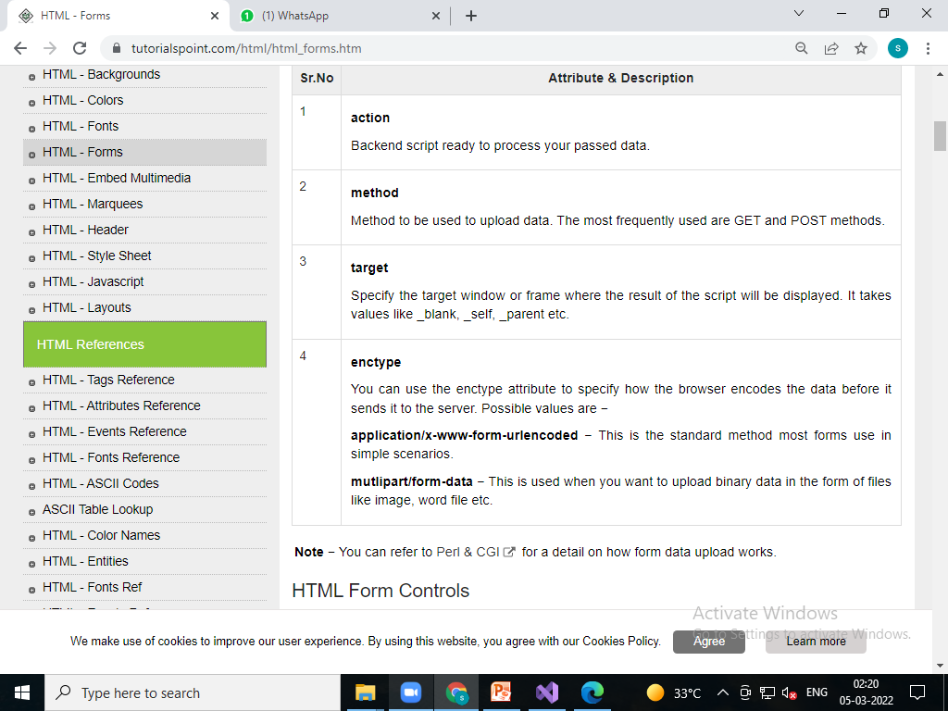
Form Attributes

Slide 214
HTML Form Controls
There are different types of form controls that you can use to collect data using HTML form −
Text Input Controls
Checkboxes Controls
Radio Box Controls
Select Box Controls
File Select boxes
Hidden Controls
Clickable Buttons
Submit and Reset Button

Slide 215
Text Input Controls
There are three types of text input used on forms −
Single-line text input controls − This control is used for items that require only one line of user input, such as search boxes or names. They are created using HTML <input> tag.
Password input controls − This is also a single-line text input but it masks the character as soon as a user enters it. They are also created using HTMl <input> tag.
Multi-line text input controls − This is used when the user is required to give details that may be longer than a single sentence. Multi-line input controls are created using HTML <textarea> tag.

Slide 216
Single-line text input controls
<!DOCTYPE html>
<html>
<head>
<title>Text Input Control</title>
</head>
<body>
<form>
First name: <input type="text" name="first_name" />
<br>
Last name: <input type="text" name="last_name" />
</form>
</body>
</html>

Slide 217
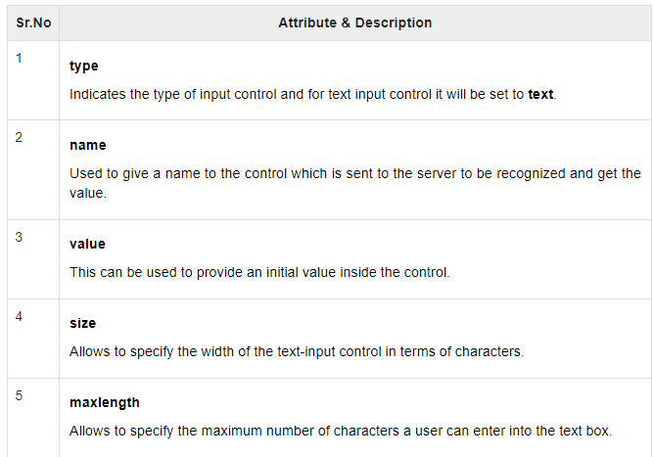

Slide 218
Password input controls
This is also a single-line text input but it masks the character as soon as a user enters it. They are also created using HTML <input>tag but type attribute is set to password.

Slide 219
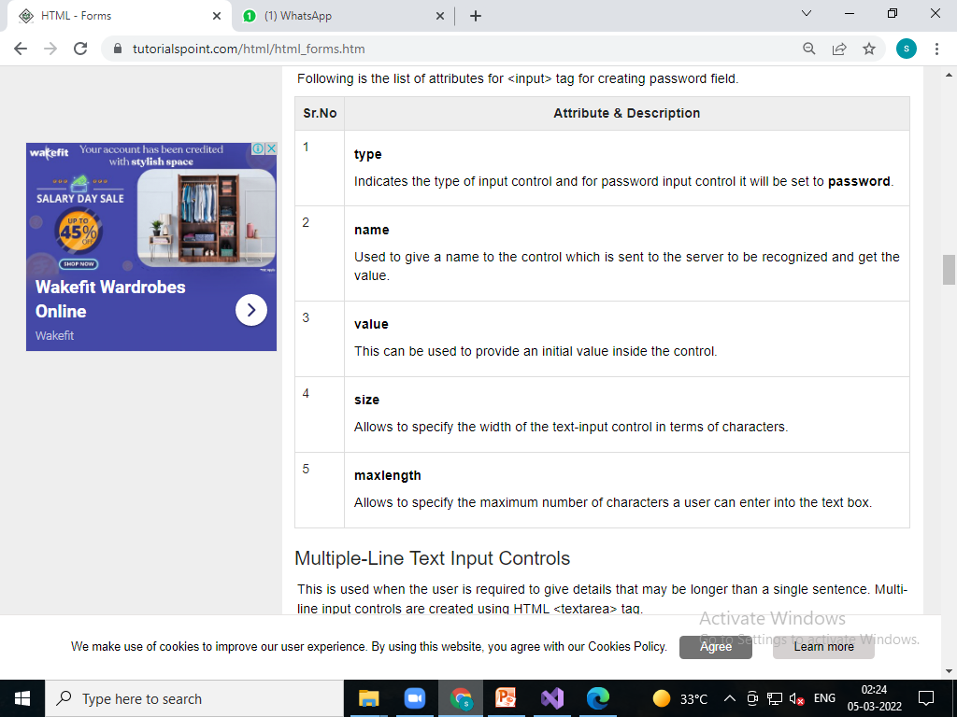

Slide 220
Multiple-Line Text Input Controls
This is used when the user is required to give details that may be longer than a single sentence. Multi-line input controls are created using HTML <textarea> tag.

Slide 221
<!DOCTYPE html>
<html>
<head>
<title>Multiple-Line Input Control</title>
</head>
<body>
<form>
Description : <br />
<textarea rows="5" cols="50" name="description">
Enter description here...
</textarea>
</form>
</body>
</html>

Slide 222
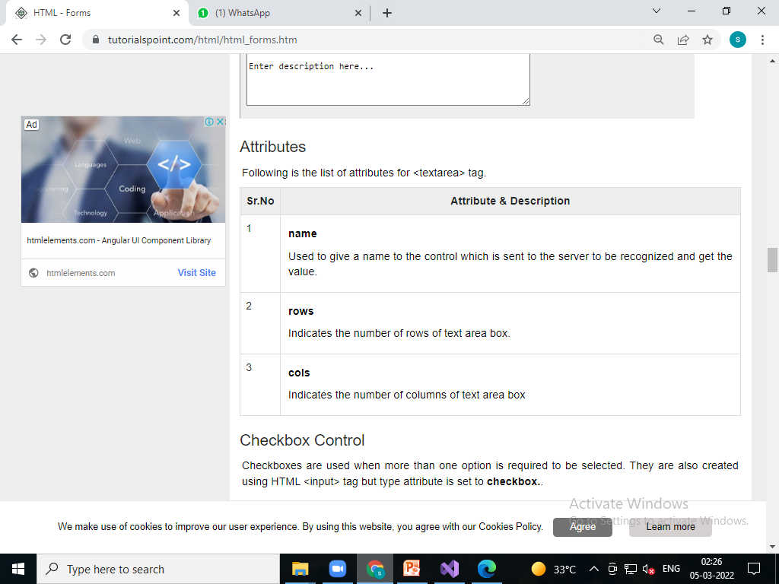

Slide 223
Checkbox Control
Checkboxes are used when more than one option is required to be selected. They are also created using HTML <input> tag but type attribute is set to checkbox..

Slide 224
<!DOCTYPE html>
<html>
<head>
<title>Checkbox Control</title>
</head>
<body>
<form>
<input type="checkbox" name="maths" value="on"> Maths
<input type="checkbox" name="physics" value="on"> Physics
</form>
</body>
</html>

Slide 225
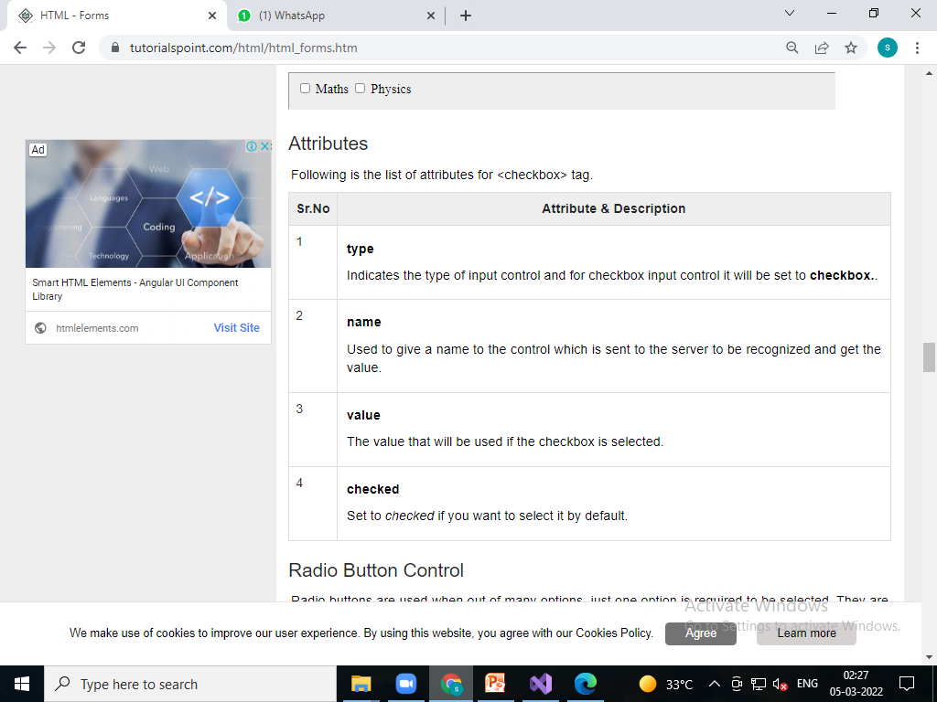

Slide 226
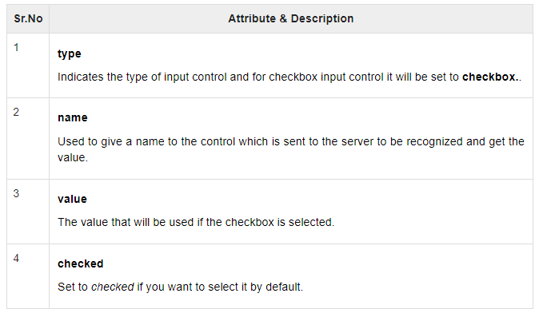
Attributes

Slide 227
Radio Button Control
Radio buttons are used when out of many options, just one option is required to be selected. They are also created using HTML <input> tag but type attribute is set to radio.

Slide 228
<!DOCTYPE html>
<html>
<head>
<title>Radio Box Control</title>
</head>
<body>
<form>
<input type="radio" name="subject" value="maths"> Maths
<input type="radio" name="subject" value="physics"> Physics
</form>
</body>
</html>

Slide 229
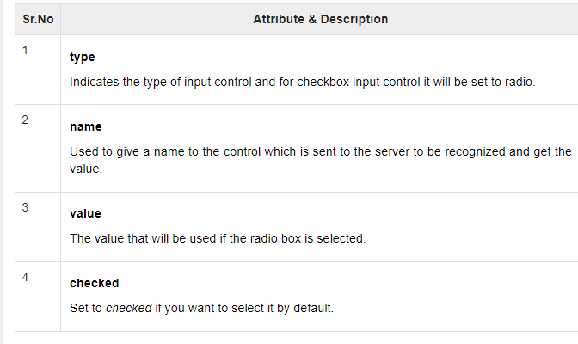
Attributes

Slide 230
Select Box Control
A select box, also called drop down box which provides option to list down various options in the form of drop down list, from where a user can select one or more options.

Slide 231
<!DOCTYPE html>
<html>
<head>
<title>Select Box Control</title>
</head>
<body>
<form>
<select name="dropdown">
<option value="Maths" selected>Maths</option>
<option value="Physics">Physics</option>
</select>
</form>
</body>
</html>

Slide 232
Attributes
Following is the list of important attributes of <select> tag −

Slide 233
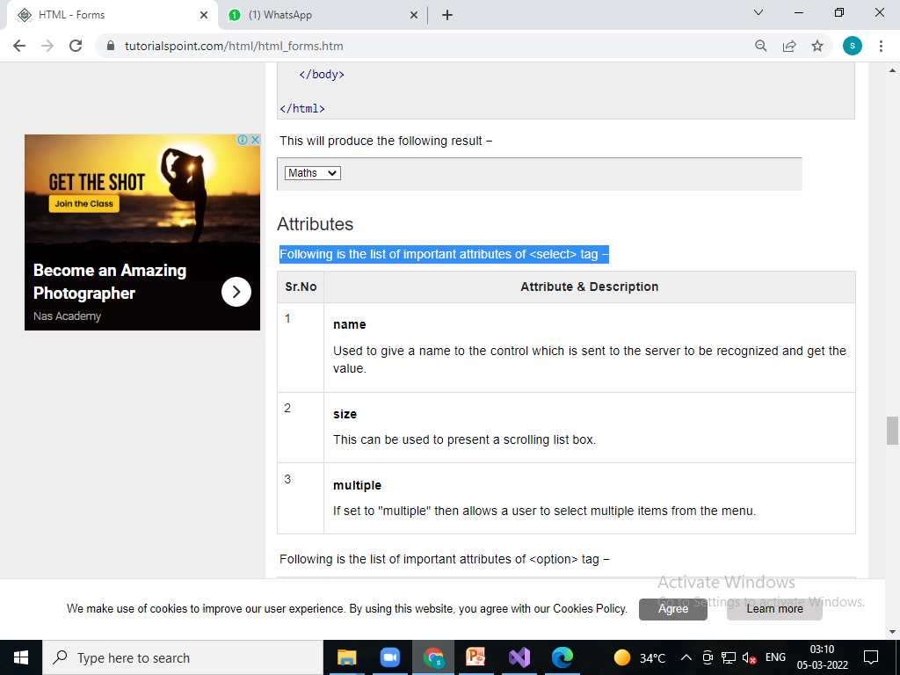

Slide 234
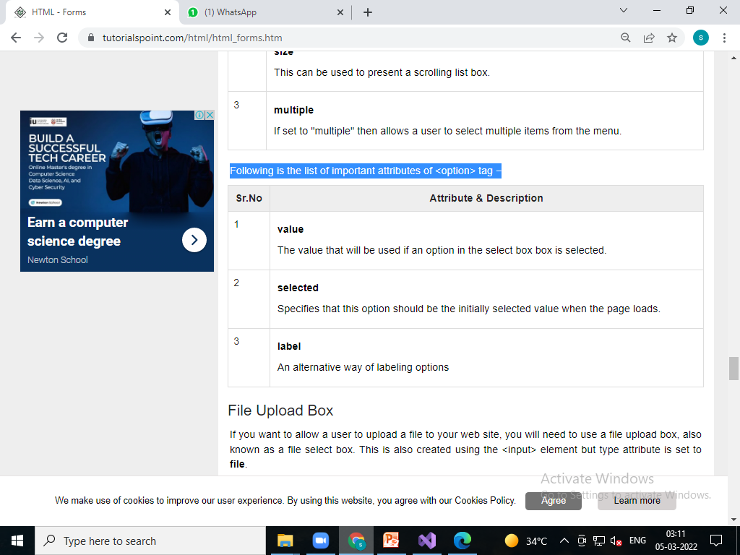
Following is the list of important attributes of <option> tag −

Slide 235
File Upload Box
If you want to allow a user to upload a file to your web site, you will need to use a file upload box, also known as a file select box. This is also created using the <input> element but type attribute is set to file.

Slide 236
<!DOCTYPE html>
<html>
<head>
<title>File Upload Box</title>
</head>
<body>
<form>
<input type="file" name="fileupload" accept="image/*" />
</form>
</body>
</html>

Slide 237
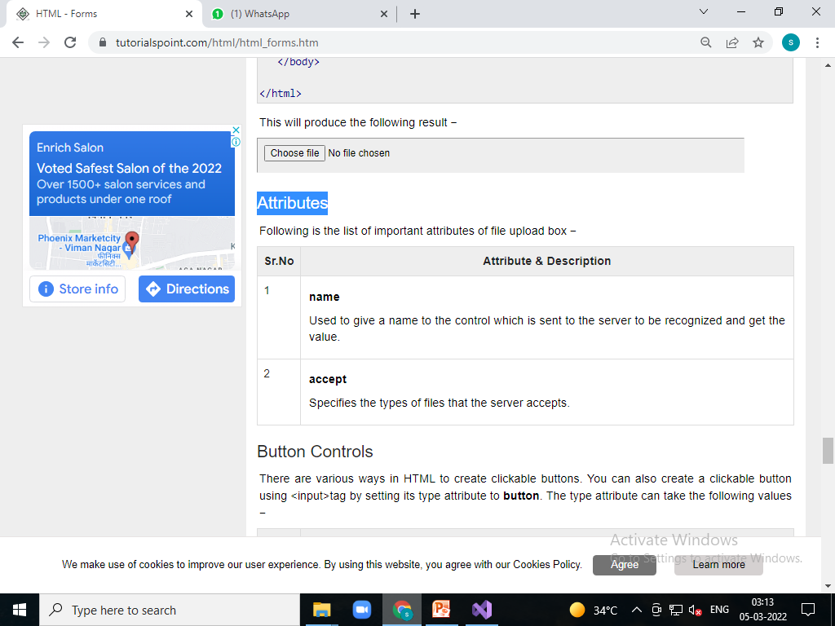
Attributes

Slide 238
Button Controls
There are various ways in HTML to create clickable buttons. You can also create a clickable button using <input>tag by setting its type attribute to button. The type attribute can take the following values −

Slide 239
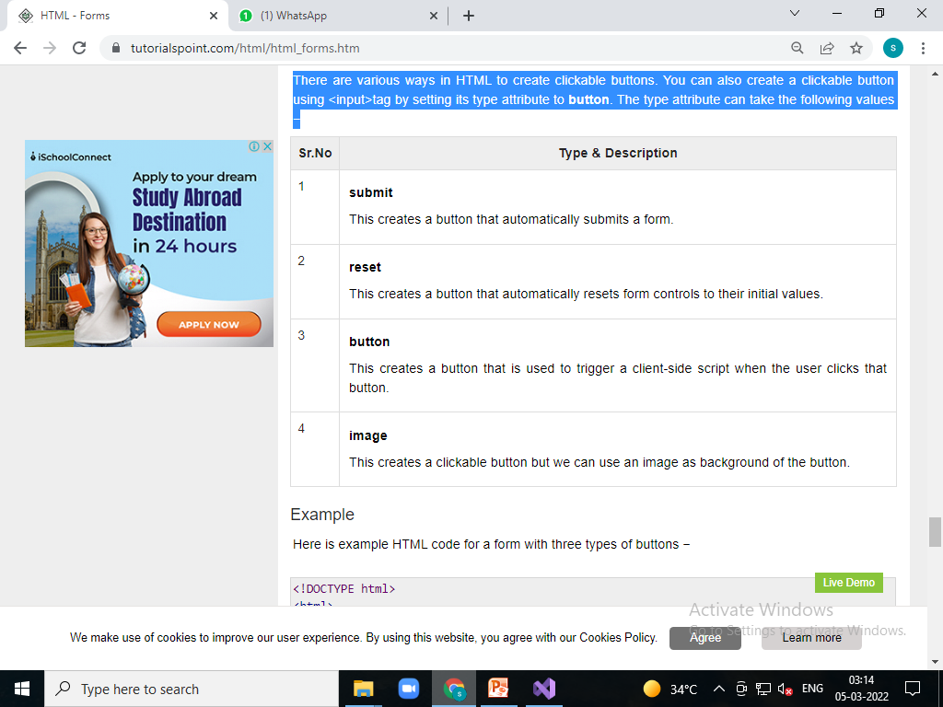

Slide 240
<!DOCTYPE html>
<html>
<head>
<title>File Upload Box</title>
</head>
<body>
<form>
<input type="submit" name="submit" value="Submit" />
<input type="reset" name="reset" value="Reset" />
<input type="button" name="ok" value="OK" />
<input type="image" name="imagebutton" src="/images/bulp.jpg" height="50" width="20"/>
</form>
</body>
</html>

Slide 241
Hidden Form Controls
Hidden form controls are used to hide data inside the page which later on can be pushed to the server. This control hides inside the code and does not appear on the actual page. For example, following hidden form is being used to keep current page number. When a user will click next page then the value of hidden control will be sent to the web server and there it will decide which page will be displayed next based on the passed current page.

Slide 242
<!DOCTYPE html>
<html>
<head>
<title>File Upload Box</title>
</head>
<body>
<form>
<p>This is page 10</p>
<input type="hidden" name="pagename" value="10" />
<input type="submit" name="submit" value="Submit" />
<input type="reset" name="reset" value="Reset" />
</form>
</body>
</html>

Slide 243
HTML - Embed Multimedia
Sometimes you need to add music or video into your web page. The easiest way to add video or sound to your web site is to include the special HTML tag called <embed>. This tag causes the browser itself to include controls for the multimedia automatically provided browser supports <embed> tag and given media type.
You can also include a <noembed> tag for the browsers which don't recognize the <embed> tag. You could, for example, use <embed> to display a movie of your choice, and <noembed> to display a single JPG image if browser does not support <embed> tag.

Slide 244
Supported Video Types
You can use various media types like Flash movies (.swf), AVI's (.avi), and MOV's (.mov) file types inside embed tag.
.swf files − are the file types created by Macromedia's Flash program.
.wmv files − are Microsoft's Window's Media Video file types.
.mov files − are Apple's Quick Time Movie format.
.mpeg files − are movie files created by the Moving Pictures Expert Group.

Slide 245
<!DOCTYPE html>
<html>
<head>
<title>HTML embed Tag</title>
</head>
<body>
<embed src="file:///F:/11%20to%2012%20full%20stack/music/zoom/video1215467711.mp4" width="200" height="200">
<noembed><img src="yourimage.gif" alt="Alternative Media"></noembed>
</embed>
</body>
</html>

Slide 246
HTML - Marquees
An HTML marquee is a scrolling piece of text displayed either horizontally across or vertically down your webpage depending on the settings. This is created by using HTML <marquees> tag.

Slide 247
<!DOCTYPE html>
<html>
<head>
<title>HTML marquee Tag</title>
</head>
<body>
<marquee>This is basic example of marquee</marquee>
</body>
</html>

Slide 248
<!DOCTYPE html>
<html>
<head>
<title>HTML marquee Tag</title>
</head>
<body>
<marquee width="50%">This example will take only 50% width</marquee>
</body>
</html>

Slide 249
<!DOCTYPE html>
<html>
<head>
<title>HTML marquee Tag</title>
</head>
<body>
<marquee direction="right">This text will scroll from left to right</marquee>
</body>
</html>

Slide 250
<!DOCTYPE html>
<html>
<head>
<title>HTML marquee Tag</title>
</head>
<body>
<marquee direction="up">This text will scroll from bottom to up</marquee>
</body>
</html>

Slide 251
HTML - Header
We have learnt that a typical HTML document will have following structure −

Slide 252
Document declaration tag
<html>
<head>
Document header related tags
</head>
<body>
Document body related tags
</body>
</html>

Slide 253
The HTML <title> Tag
<!DOCTYPE html>
<html>
<head>
<title>HTML Title Tag Example</title>
</head>
<body>
<p>Hello, World!</p>
</body>
</html>

Slide 254
The HTML <meta> Tag
<!DOCTYPE html>
<html>
<head>
<title>HTML Meta Tag Example</title>
<!-- Provide list of keywords -->
<meta name="keywords" content="C, C++, Java, PHP, Perl, Python">
<!-- Provide description of the page -->
<meta name="description" content="Simply Easy Learning by Tutorials Point">
<!-- Author information -->
<meta name="author" content="Tutorials Point">
<!-- Page content type -->
<meta http-equiv="content-type" content="text/html; charset = UTF-8">
<!-- Page refreshing delay -->
<meta http-equiv="refresh" content="30">
<!-- Page expiry -->
<meta http-equiv="expires" content="Wed, 21 June 2006 14:25:27 GMT">
<!-- Tag to tell robots not to index the content of a page -->
<meta name="robots" content="noindex, nofollow">
</head>
<body>
<p>Hello, World!</p>
</body>
</html>

Slide 255
The HTML <base> Tag
<!DOCTYPE html>
<html>
<head>
<title>HTML Base Tag Example</title>
<base href="https://www.tutorialspoint.com/" />
</head>
<body>
<img src="/images/logo.png" alt="Logo Image" />
<a href="/html/index.htm" title="HTML Tutorial" />HTML Tutorial</a>
</body>
</html>

Slide 256
The HTML <link> Tag
<!DOCTYPE html>
<html>
<head>
<title>HTML link Tag Example</title>
<base href="https://www.tutorialspoint.com/" />
<link rel="stylesheet" type="text/css" href="/css/style.css">
</head>
<body>
<p>Hello, World!</p>
</body>
</html>

Slide 257
The HTML <style> Tag
The HTML <style> tag is used to specify style sheet for the current HTML document. Following is an example to define few style sheet rules inside <style> tag −

Slide 258
<!DOCTYPE html>
<html>
<head>
<title>HTML style Tag Example</title>
<base href="https://www.tutorialspoint.com/" />
<style type="text/css">
.myclass {
background-color: #aaa;
padding: 10px;
}
</style>
</head>
<body>
<p class="myclass">Hello, World!</p>
</body>
</html>

Slide 259
The HTML <style> Tag
The HTML <style> tag is used to specify style sheet for the current HTML document. Following is an example to define few style sheet rules inside <style> tag −

Slide 260
<!DOCTYPE html>
<html>
<head>
<title>HTML style Tag Example</title>
<base href="https://www.tutorialspoint.com/" />
<style type="text/css">
.myclass {
background-color: #aaa;
padding: 10px;
}
</style>
</head>
<body>
<p class="myclass">Hello, World!</p>
</body>
</html>

Slide 261
The HTML <script> Tag
The HTML <script> tag is used to include either external script file or to define internal script for the HTML document. Following is an example where we are using JavaScript to define a simple JavaScript function −

Slide 262
<!DOCTYPE html>
<html>
<head>
<title>HTML script Tag Example</title>
<base href="http://www.tutorialspoint.com/" />
<script type="text/JavaScript">
function Hello() {
alert("Hello, World");
}
</script>
</head>
<body>
<input type="button" onclick="Hello();" name="ok" value="OK" />
</body>
</html>

Slide 263
Vedio tag
<!DOCTYPE HTML>
<html>
<body>
<video autoplay controls>
<source src="file:///F:/11%20to%2012%20full%20stack/music/zoom/video1215467711.mp4" type="video/mp4">
</video>
</body>
</html>

Slide 264
Audio tag
<!DOCTYPE HTML>
<html>
<body>
<audio autoplay controls>
<source src="file:///F:/11%20to%2012%20full%20stack/music/CenterOfTheUniverse.mp3" type="audio/mp3">
</audio>
</body>
</html>

Slide 265
End

