Slide 1




PIMA Diabetes Data Analysis
By Ajit Saunshikar
Mentored By Manoj Kumar

Slide 2


Diabetes Data Analysis
Pima Indians Diabetes Database is from Kaggle. This dataset is originally from the National Institute of Diabetes and Digestive and Kidney Diseases. The objective of the dataset is to diagnostically predict whether or not a patient has diabetes, based on certain diagnostic measurements.
Source:https://www.kaggle.com/datasets/uciml/pima-indians-diabetes-database/data
The dataset consists of 768 records with 9 Columns
We will do a EDA on this data set.
www.sivaacademy.net

Slide 3
Features Details
S.No. | Attribute-Name | Description | Feature Type
1 | Pregnancies | The number of times the patient has been pregnant. | Numerical
2 | Glucose | Plasma glucose concentration after a 2-hour oral glucose tolerance test. | Numerical
3 | BloodPressure | Diastolic blood pressure | Numerical
4 | SkinThickness | Triceps skinfold thickness | Numerical
5 | Insulin | 2-hour serum insulin | Numerical
6 | BMI | Body Mass Index | Numerical
7 | DiabetesPedigreeFunction | A function that scores the likelihood of diabetes based on family history. | Numerical
8 | Age | Patient's Age | Numerical
9 | Outcome | Indicating whether Diabetic or not 0 or 1 | Numerical
www.sivaacademy.net

Slide 4
Non-Visual Statistical Analysis
 | Count | min | max | mean | median
Pregrency | 768 | 0 | 17 | 3.845052 | 3
Glucose | 768 | 0 | 199 | 120.8945 | 117
BloodPresure | 768 | 0 | 122 | 69.10547 | 72
SkinThickness | 768 | 0 | 99 | 20.53646 | 23
Insulin | 768 | 0 | 846 | 79.79948 | 30.5
BMI | 768 | 0 | 67.1 | 31.99258 | 32
DiabetesPedigreeFunction | 768 | 0 | 2.42 | 0.471876 | 0.3725
Age | 768 | 21 | 81 | 33.24089 | 29
www.sivaacademy.net

Slide 5
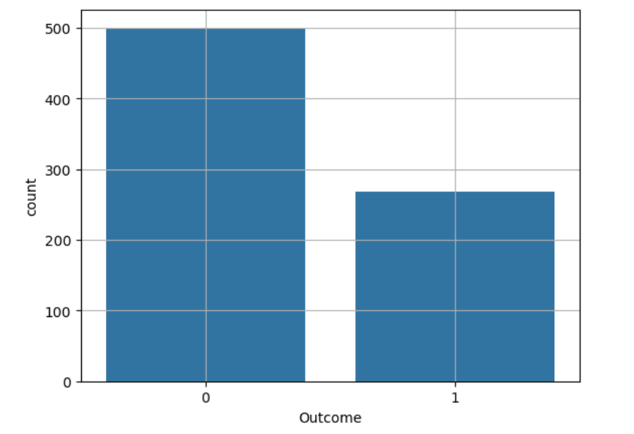
Univariant Bar Plot Of “Outcome”
The plot shows that of the 768 data,500 are non-diabetic and 268 are diabetic
www.sivaacademy.net

Slide 6
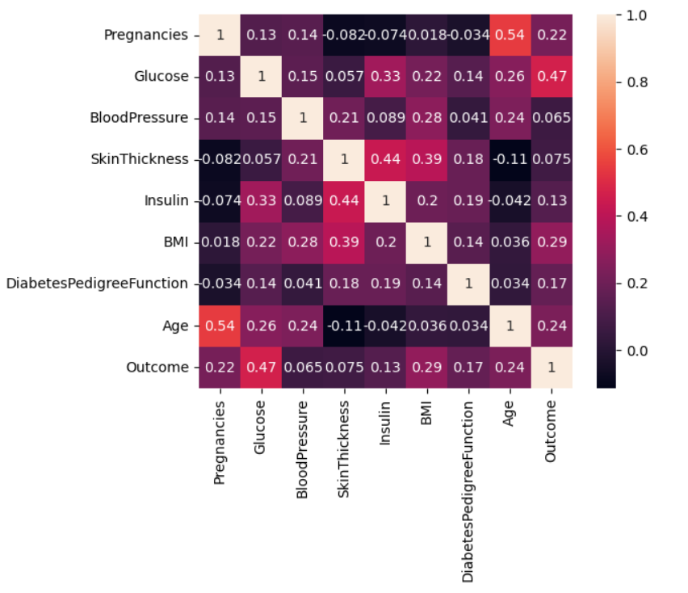
Co-Relationship between features
There is strong correlation between following
Glucose and Diabetes
Skin Thickness & Insulin
www.sivaacademy.net

Slide 7
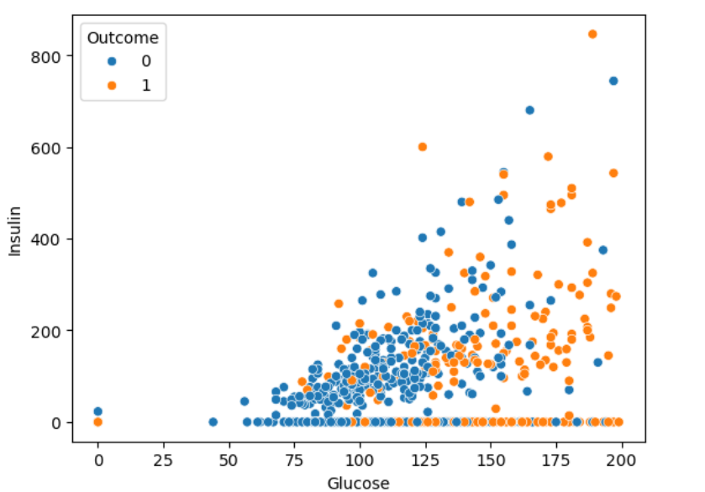
Bivariate Analysis in Diabetic Patient
Correlation between the Glucose and Insulin. In case of Higer glucose, the insulin level is slightly elevated
www.sivaacademy.net

Slide 8
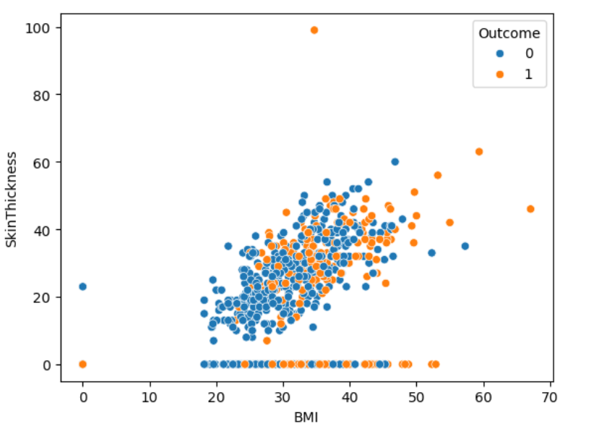
Bivariate Analysis in Diabetic Patient
Correlation between the BMI and SkinThickness. In case of diabetic patient, the skin thickness tend to be higher compared to non-diabetic
www.sivaacademy.net

Slide 9
INSIGHT
Of the many features Glucose parameter tend to have strong indication for Diabetes
There is slight corelation between Glucose and Insulin
Skin thickness has direct association with overweight, which in turn tend to have impact on diabetes.
www.sivaacademy.net

Slide 10

Thank You

