Slide 1
Scala School
Parser Combinators
16.02.2016 Matthew Lloyd

Slide 2

What's a Parser?
Takes in a String and a Grammar and Transforms
the string to something else
We are used to just seeing XML or JSON parsers
Scala gives us generic parsers
Think of them like super powerful Regular Expressions
Seite <number>
Parser Combinators

Slide 3
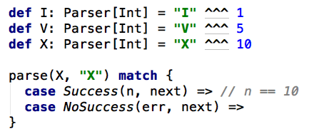
What do Parsers look like in Scala?
In their most basic form you can match a string,
and transform in to a value
Seite <number>
Parser Combinators

Slide 4
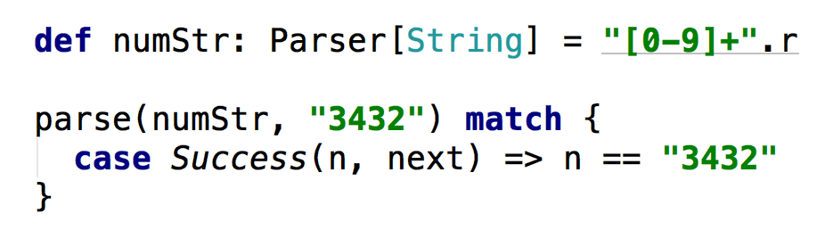
But I'm used to regular expressions, this seems like more work...
Well Regular Expressions can be treated as parsers in Scala!
Seite <number>
Parser Combinators

Slide 5
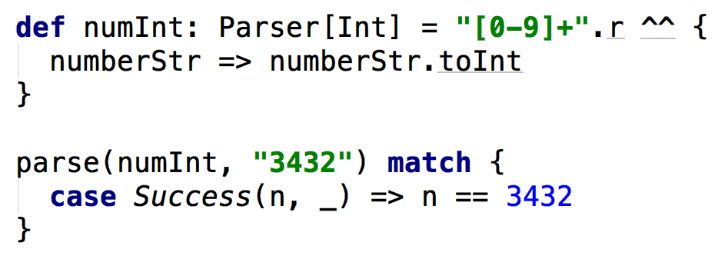
But that's still a string? How do I make it a number?
You can use the ^^ operator to transform it!
Seite <number>
Parser Combinators

Slide 6
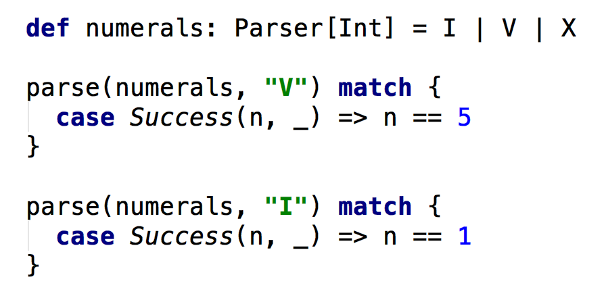
So how would I say "Some thing" OR "Other thing" ?
Simple! Just use the | operator!
Seite <number>
Parser Combinators
Notes:
Ordering is important here.
If I fails it will try V then X.

Slide 7

Okay cool but that seems pretty limited?
Wait! You can join (compose) parsers together with ~
Seite <number>
Parser Combinators
Notes:
A ~ B simply means, match A then match B.
There's 2 things going on here.
The ~ parser combinator and the ~ type.
This is confusing.
~ Type should be a tuple, if I were to create this library I'd use tuples instead of ~

Slide 8

Okay cool but that seems pretty limited?
Wait! You can join (compose) parsers together with ~
Composed parsers results are joined together with the ~ type
Think of ~ as a tuple
Maybe this syntax makes it more understandable:
Seite <number>
Parser Combinators
Notes:
A ~ B simply means, match A then match B.
There's 2 things going on here.
The ~ parser combinator and the ~ type.
This is confusing.
~ Type should be a tuple, if I were to create this library I'd use tuples instead of ~

Slide 9
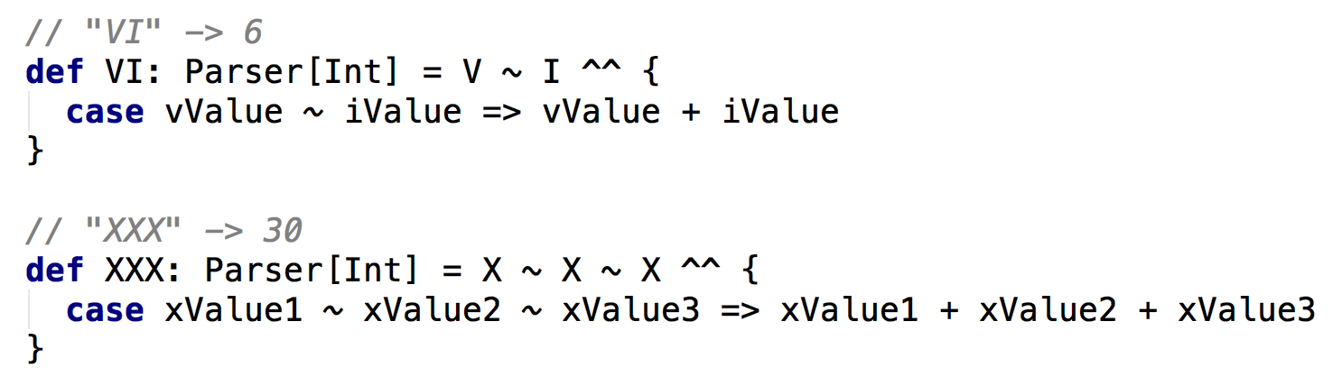
What? No! That's not what I want! This is confusing!
The reality is we never use the ~ type
It's always transformed into other things using ^^
Seite <number>
Parser Combinators

Slide 10
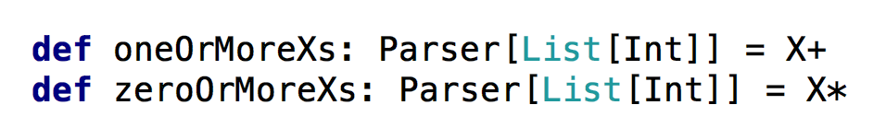
But wait that seems silly? Can't I make it repeat?
Sure! By adding + or * on to the end of your parser
+ means 1 or more
* means 0 or more
Seite <number>
Parser Combinators
Notes:
You will need to enable post fix operators by importing scala.language.postfixOps to stop IntelliJ giving you a warning.

Slide 11
But I want a number not a list of numbers!
Well use ^^ to map the result!
Be aware that sometimes you will need to place parentheses around parsers for it to make sense
Seite <number>
Parser Combinators
Notes:
You will need to enable post fix operators by importing scala.language.postfixOps to stop IntelliJ giving you a warning.

Slide 12
But I only need 3 Xs, It should fail if there's more. Can I do that?
Yes! You can use the repN parser!
It will match exactly 3 repetitions of the parser
Seite <number>
Parser Combinators
Notes:
You will need to enable post fix operators by importing scala.language.postfixOps to stop IntelliJ giving you a warning.

Slide 13
But there's a bunch of junk I don't care about in the string.
How do I ignore it?
So lets take the example of a JSON array,
where we don't care about the square brackets:
You use the squiggly arrow operators ~> and <~ !
Seite <number>
Parser Combinators
Notes:
Squiggly arrows are basically saying “Ignore this and look at that”
~> Ignore the left look at right
<~ Ignore right look at left

Slide 14
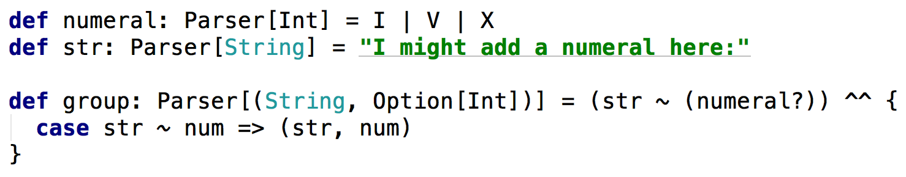
But what if I have optional parts?
You can use the postfix ? operator!
Adding ? after the parser means it is optional
The parser will not fail if it is not there
However it means the type is now Option[T]
Seite <number>
Parser Combinators
Notes:
Squiggly arrows are basically saying “Ignore this and look at that”
~> Ignore the left look at right
<~ Ignore right look at left

Slide 15
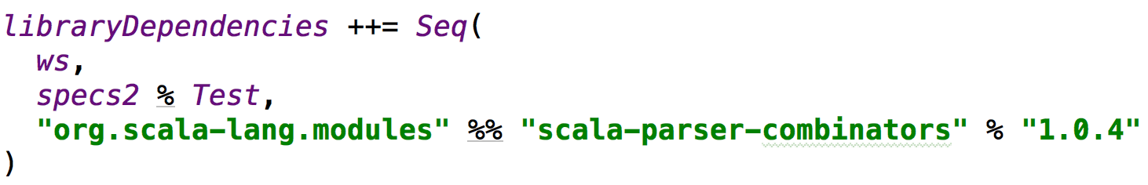
How do I use them?
You'll need to add the Parser Combinator library to your build.sbt
It used to be part of the core language until it wasn't.
Seite <number>
Parser Combinators
Notes:
Squiggly arrows are basically saying “Ignore this and look at that”
~> Ignore the left look at right
<~ Ignore right look at left

Slide 16
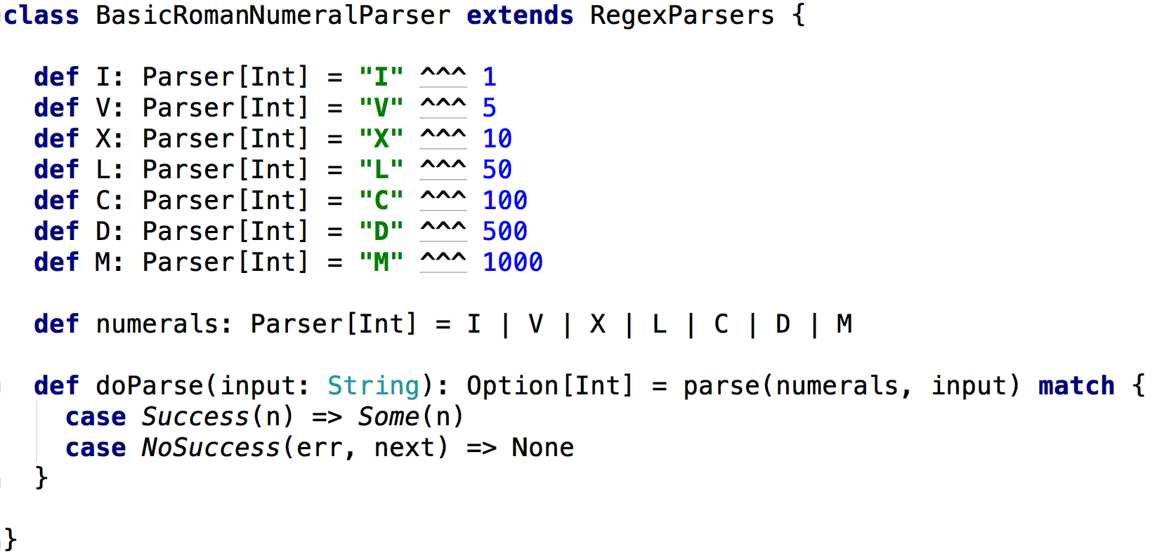
How do I use them?
Create a class and have it extend RegexParsers
Inside of that class you now have access to all of the parser methods
Seite <number>
Parser Combinators
Notes:
Squiggly arrows are basically saying “Ignore this and look at that”
~> Ignore the left look at right
<~ Ignore right look at left

Slide 17
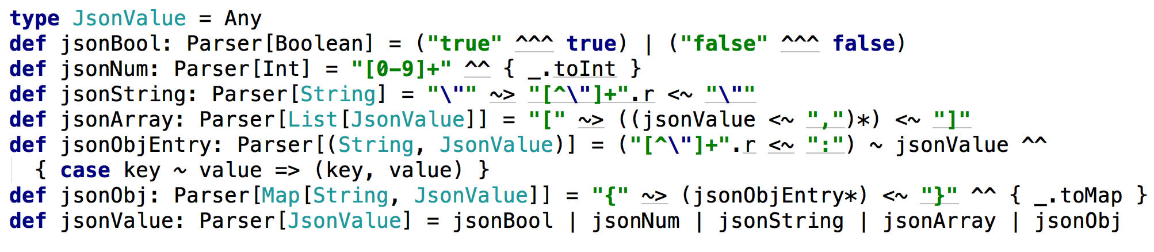
This is all very well and good, but what about real examples?
Okay then! Here's a (bad) JSON parser in 8 lines:
Seite <number>
Parser Combinators
Notes:
Squiggly arrows are basically saying “Ignore this and look at that”
~> Ignore the left look at right
<~ Ignore right look at left

