Slide 1
Show && Tell
Type Classes
16.02.2016 Matthew Lloyd

Slide 2
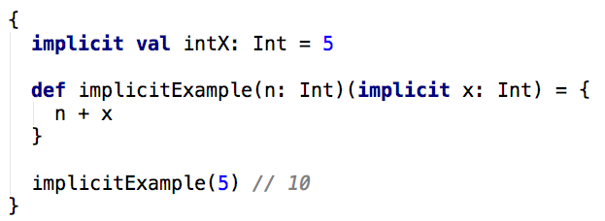
A Quick Reminder - Implicits
Implicit Parameters – We can provide parameters to
a method by specifying the parameters to be implicitly
provided:
The intX is provided to the method automatically as it is available
within scope.
Seite <number>
Typeclasses

Slide 3
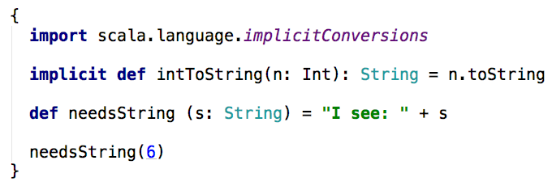
A Quick Reminder – Implicits
Implicit Conversion – We can provide methods to implicitly
convert between types:
By bringing in the intToString method to scope,
we can call needsString with an int.
Seite <number>
Typeclasses

Slide 4
What are Typeclasses?
A Type Class is an 'interface' that defines behaviour.
Allows us to define new behaviour for any type.
Not to be confused with traditional 'classes'.
Typeclass doesn't belong to the traditional hierarchy of types.
Instead of extending you create 'instances' for types.
Seite <number>
Typeclasses

Slide 5
What can I use them for?
Cross cutting concerns that are not type specific for example:
Serializing types to be transferred (e.g. Json / XML)
Equality of types
Converting to and from String
Seite <number>
Typeclasses

Slide 6

Where do we start?
Let's take Equality as an example. We might want to compare
Different types to see if they are equal. E.g:
However Int doesn't have any way of comparing between Ints and Roman Numerals...
Seite <number>
Typeclasses

Slide 7

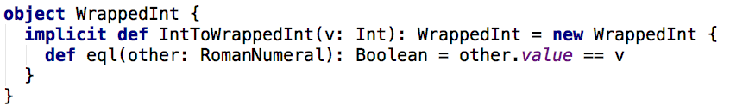
So how do we add functionality?
Well first we need to 'enhance' our integers.
So we need to create a 'wrapper' for Ints:
So we have a WrappedInt that defines the operation, now lets define an implicit conversion for Ints:
Seite <number>
Typeclasses

Slide 8

So how do we add functionality?
This now means now through
implicit conversion we can do the following:
Which is the same as:
Seite <number>
Typeclasses

Slide 9

How do we make it more generic?
So lets take a step back and think about a
more generic Equals trait:
Simple enough we take 2 things and return a boolean if they are the same.
Seite <number>
Typeclasses

Slide 10
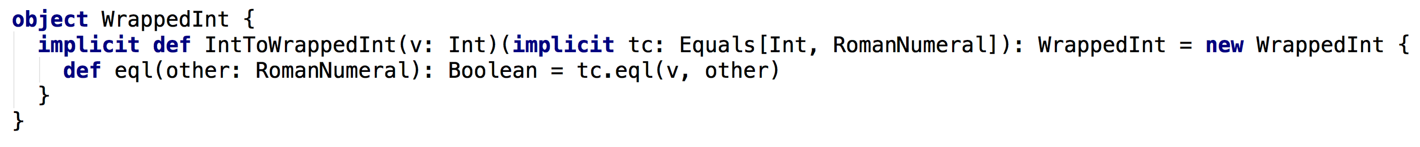
How do we make it more generic?
Let's make our WrappedInt use the Equals trait instead:
We pull in an implementation of Equals as an implicit parameter.
We can then use this to implement our eql method.
The key part here is the implementation of equality is external.
Seite <number>
Typeclasses

Slide 11
So what did we just do?
We have created a new trait to abstract out the idea of equality between any two items. Equals is our Type Class.
A representation of equality that can work for any type.
Our WrappedInt class gives us a way to promote standard integers
into the Type Class.
This is done via implicit conversions and implicit parameters.
implicit conversion adds the new operations.
implicit parameters bring the typeclass instance in to scope.
Seite <number>
Typeclasses

Slide 12
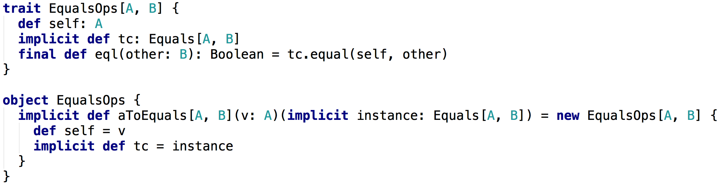
But WrappedInt is silly, can't that be generic too?
Yes it can, but we need to think of it slightly differently.
Instead of it 'wrapping an Int'
It should be 'adding operations to a value'
Seite <number>
Typeclasses

Slide 13
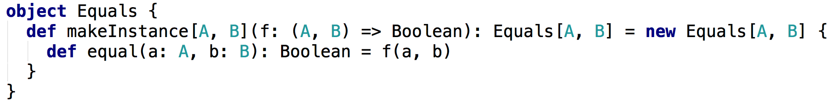
Okay, so I can add methods to any other type...
But where does the Equals implementation come from?
To make things easier, we can define a helper method:
Seite <number>
Typeclasses

Slide 14
Okay, so I can add methods to any other type...
But where does the Equals implementation come from?
This enables us to easily create a new Equals implementation like so:
These implementations of Equals are known as Type Class Instances
Seite <number>
Typeclasses

Slide 15
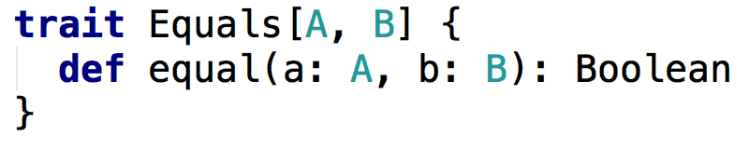
A Quick Recap
Equals is our Type Class.
It allows us to define operations that we can add to other types.
Type Classes exist outside the existing Type Hierarchy.
Seite <number>
Typeclasses

Slide 16
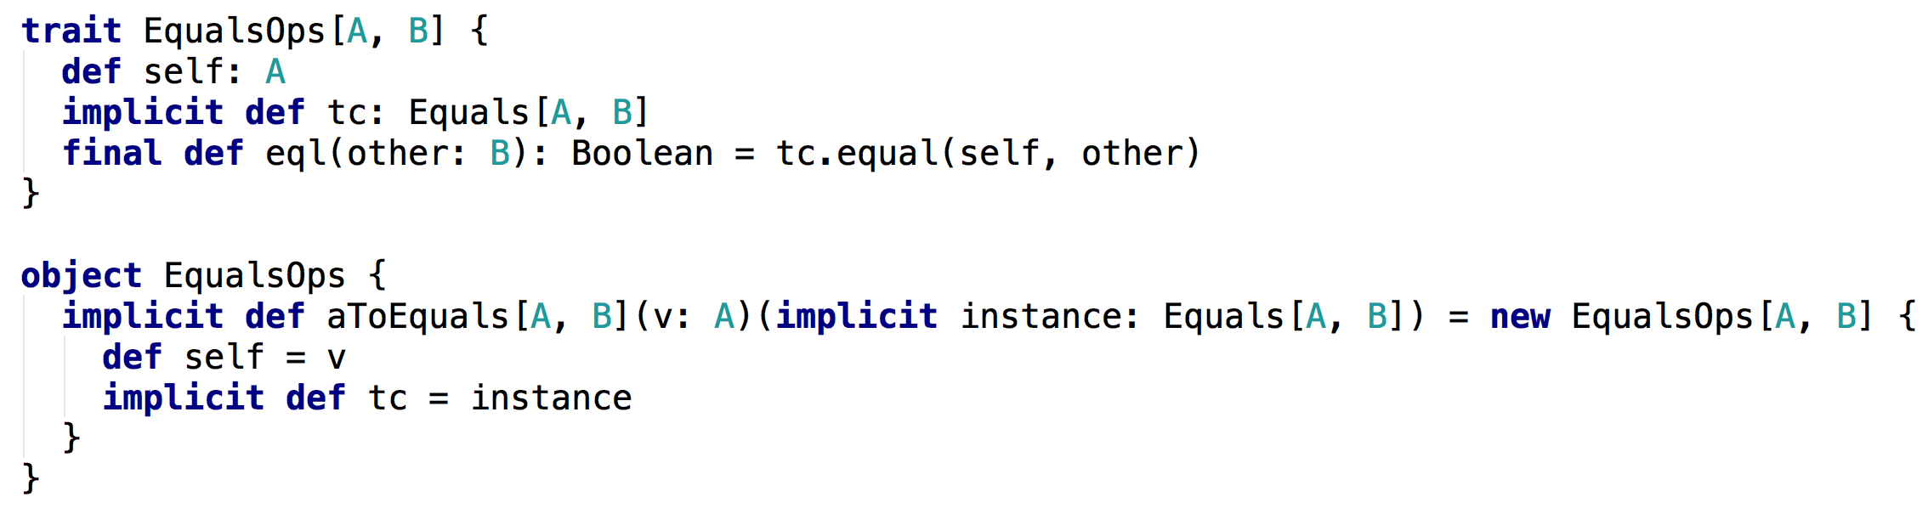
A Quick Recap
Operations Objects elevate values into our Type Class.
This is the glue that joins the values with our type specific implementations.
Seite <number>
Typeclasses

Slide 17
A Quick Recap
Operations Objects elevate values into our Type Class.
This is the glue that joins the values with our type specific implementations.
Seite <number>
Note: The final keyword is important!
Typeclasses

Slide 18
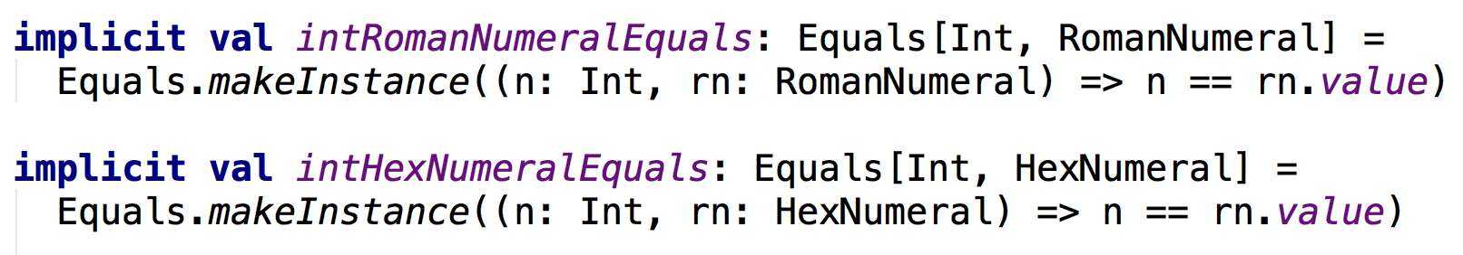
A Quick Recap
Type Class Instances are the implementations for types.
You can have multiple instances per Typeclass
Seite <number>
Typeclasses

Slide 19
Single vs Multi parameter Type classes
Single Parameter Type Classes are said to define a Set of Types.
E.g. toString, toJson, fromJson, Integral, Fractional, Float etc...
Multi Parameter Type Classes are said to define a Relationship between Types.
E.g. Equality, Ordering, Addition, Concatenation etc...
Seite <number>
Typeclasses

Slide 20
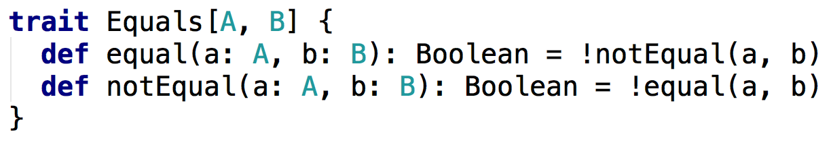
Taking it further...
You can define Type Classes to have self-referential implementations.
When you define your Type Class instance, you only need to override equal, and you get notEqual for free!
Seite <number>
Typeclasses

Slide 21
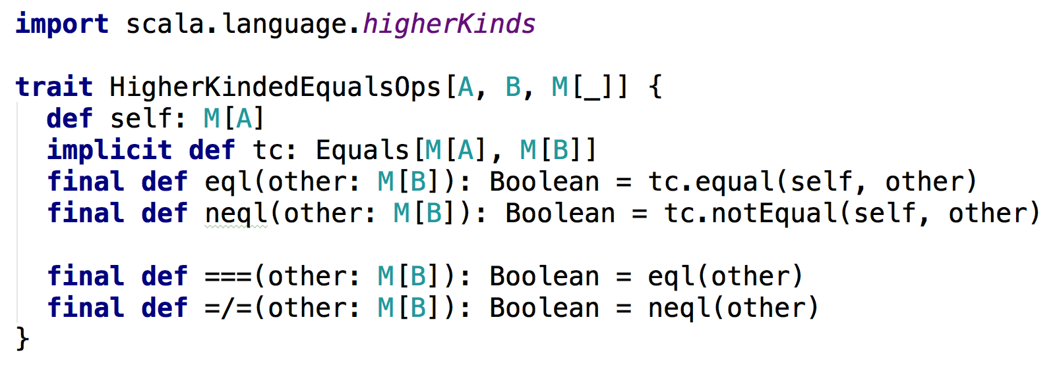
Taking it further...
By defining Higher Kinded Operations Objects you can compare container types.
Seite <number>
Typeclasses

Slide 22
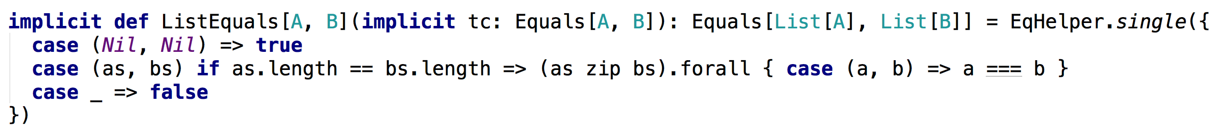
Taking it further...
Which means you can implement generic comparisons between Lists or Options.
Seite <number>
Typeclasses

Slide 23
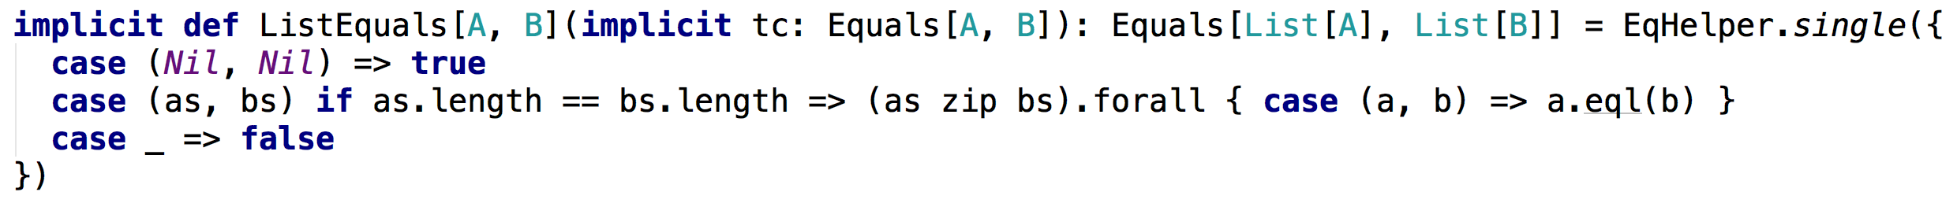
Taking it further...
Which means you can implement generic comparisons between Lists or Options.
Note how this accepts the implementation for Equals[A, B]
Seite <number>
Typeclasses

