Slide 1
Capstone project : Mentor discussion-2
Project : Bias Evaluation in ML models Domain : Healthcare Course Name : QM640 – Capstone project Student Name : Ajit Ashok Shenvi Mentor Name: Rishabh Pandey
Date : 19-Apr-2026

Slide 2
Executive Summary: Project
Background and Context
AI-driven predictive models are increasingly used in healthcare to improve outcomes, reduce costs, and support decision-making.
Despite their benefits, predictive models may exhibit bias across demographic groups such as gender, age, and race.
Such bias can lead to unequal identification of high-risk patients, resulting in inequitable care and operational inefficiencies.
Readmissions among diabetic patients remain a critical concern due to their impact on healthcare costs and quality metrics.
This study
Evaluates demographic disparities in model performance, with a focus on false negative rates in readmission prediction.
Assesses whether bias mitigation techniques can reduce disparities without compromising overall model performance.
Evaluating Bias in Readmission Prediction Models:
Demographic Disparities in Diabetic Patient Outcomes

Slide 3
Target Audience
No | Target Users | Motivation
1 | Hospital Administrators / Healthcare Executives - Responsible for readmission rates, cost control, compliance (CMS penalties). | They care as AI models influence patient prioritization and resource allocation
2 | Clinical Operations Managers - Manage: discharge planning, care coordination. | They care if model is biased as some patients may not receive follow-up care
3 | Healthcare Data & Analytics Teams - Build and deploy predictive models. | They care as they need to ensure models are fair and reliable
4 | Policy Makers / Regulators (Secondary) - Example: CMS (US healthcare system) | The are concerned with fairness, equity

Slide 4
Research Questions
The overall objective of this study is to evaluate whether predictive models for hospital readmission among diabetic patients exhibit bias across demographic groups and to assess the implications of such bias on healthcare decision-making and operational outcomes
Research Question 1 (RQ1): Performance Equity Across Demographic Groups
Does the predictive model demonstrate consistent classification performance across demographic groups such as gender, age, and race?
Research Question 2 (RQ2): Critical Error Disparities
Are certain demographic groups more likely to be misclassified as low risk despite being high-risk patients?
Research Question 3 (RQ3): Impact of Dataset Imbalance
Is model bias across demographic groups influenced by imbalance in the underlying dataset?
Research Question 4 (RQ4): Effectiveness of Bias Mitigation
Can bias in predictive outcomes be reduced through mitigation techniques without significantly degrading overall predictive performance?

Slide 5
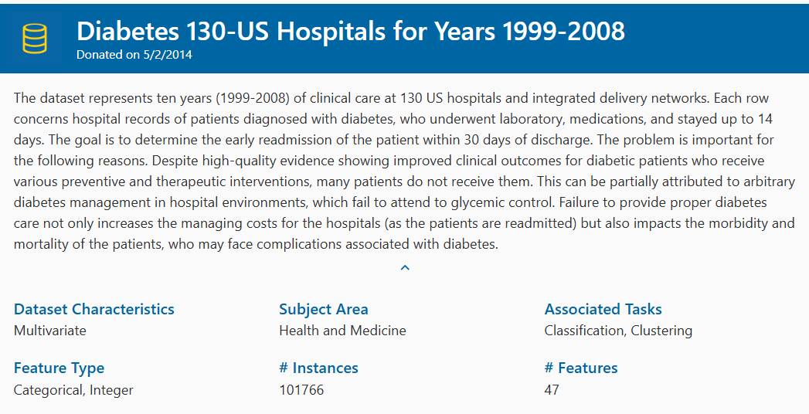
Data
Source : UCI Machine Learning Repository.
Diabetes 130-US Hospitals for Years 1999-2008 - UCI Machine Learning Repository

Slide 6
Data dictionary
Demographic Information | Encounter Information | Clinical and Utilization Features | Prior Healthcare Utilization | Treatment Information | Target Variable
Gender (Male, Female) Age (grouped into intervals such as 50-60, 60-70, etc.) Race (e.g., Caucasian, African American, others) | Admission type Discharge disposition Admission source Length of hospital stay | Number of lab procedures Number of medications Number of procedures Number of diagnoses | Number of outpatient visits Number of emergency visits Number of inpatient visits | Insulin usage Medication changes | NO → Not readmitted > 30 → Readmitted after 30 days < 30 → Readmitted within 30 days

Slide 7
Approach
Data Preprocessing : Missing value Handling, Encoding categorical variables, Feature selection, Target transformation
Modelling : Binary classification (Logistic regression), prediction, additional model – Random Forest, Gradient Boost
Bias analysis : RQ1 (Group wise performance selection), RQ2 (Disparity analysis), RQ3 (Dataset balancing), RQ4 (Bias mitigation)
RQ | Goal | Core Question | Focus Area | Data Used | Key Metric | Statistical Test | Why It Matters
RQ1 | Detect general bias | Does model performance differ across groups? | Overall correctness | All test data | Accuracy (correct vs incorrect) | Chi-square / Two-proportion test | Identifies whether the model is equally reliable across demographic groups
RQ2 | Detect harmful bias | Are high-risk patients missed more in certain groups? | Critical errors | Only actual readmitted patients | False Negative Rate (FNR) | Chi-square / Two-proportion test | Highlights inequity in identifying high-risk patients (most important clinically)
RQ3 | Explain bias | Is bias caused by dataset imbalance? | Source of disparity | Repeated model runs (original vs rebalanced data) | FNR Gap (difference across groups) | Paired t-test / Wilcoxon | Determines whether bias arises from data distribution issues
RQ4 | Solve bias | Can bias be reduced without hurting performance? | Bias mitigation | Repeated model runs (baseline vs mitigated model) | FNR Gap + F1/AUC | Paired t-test / Wilcoxon | Evaluates whether fairness can be improved without compromising model effectiveness

Slide 8
Approach…. contd
Hypothesis formulation and Statistical testing
RQ | Primary Metric | Statistic | Null Hypothesis | Alternative Hypothesis
RQ1 | Accuracy / Correctness | Chi-square test of independence | No difference in classification correctness across groups | Significant difference exists
RQ2 | False Negative Rate | Chi-square test or two-proportion z-test | No difference in false negative rates across groups | Significant difference exists
RQ3 | Disparity measures (FNR gap) | Paired t-test or Wilcoxon signed-rank test | Rebalancing does not change disparity | Rebalancing changes disparity
RQ4 | Disparity measures (FNR gap) Overall model performance (AUC, F1-score) | Paired t-test or Wilcoxon test | Mitigation does not reduce disparity without performance loss | Mitigation reduces disparity without performance loss

Slide 9
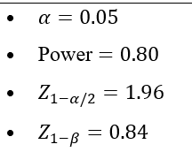
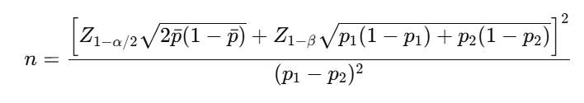
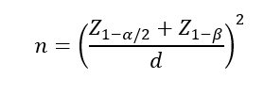
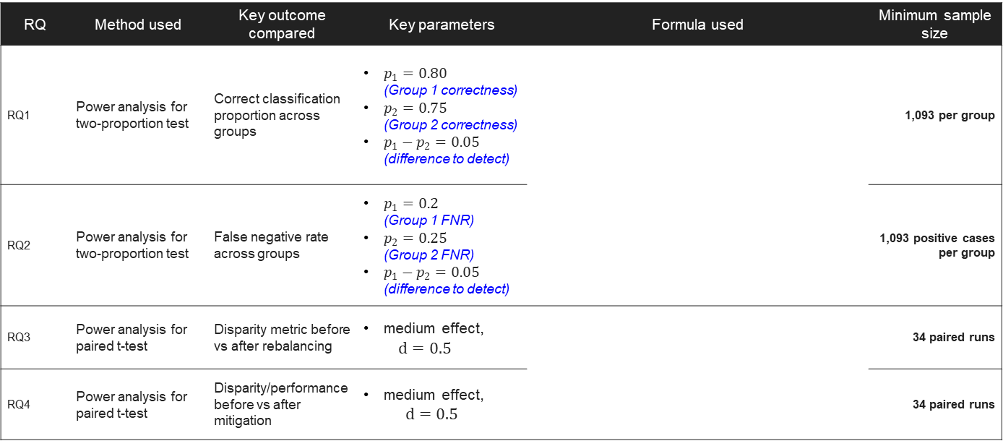
Sample size calculations
RQ | Method used | Key outcome compared | Key parameters | Formula used | Minimum sample size
RQ1 | Power analysis for two-proportion test | Correct classification proportion across groups | $p_{1}=0.80$ (Group 1 correctness) $p_{2}=0.75$ (Group 2 correctness) $p_{1}−p_{2}=0.05$ (difference to detect) |  | 1,093 per group
RQ2 | Power analysis for two-proportion test | False negative rate across groups | $p_{1}=0.2$ (Group 1 FNR) $p_{2}=0.25$ (Group 2 FNR) $p_{1}−p_{2}=0.05$ (difference to detect) |  | 1,093 positive cases per group
RQ3 | Power analysis for paired t-test | Disparity metric before vs after rebalancing | medium effect, $d=0.5$ |  | 34 paired runs
RQ4 | Power analysis for paired t-test | Disparity/performance before vs after mitigation | medium effect, $d=0.5$ |  | 34 paired runs

Slide 10
Applications
Readmission Risk Prediction Systems : Hospitals use models to identify high-risk patients and allocate follow-up care. This study helps ensure: these systems are fair across groups
Fairness Audits of AI Systems : Hospitals can audit models before deployment and detect bias This framework becomes: a bias evaluation template
Resource Allocation Decisions : Care managers decide: who gets intervention and who gets follow-up. Bias could lead to: unequal allocation. This study helps: make allocation equitable
Regulatory & Compliance Readiness : Healthcare increasingly requires: explainability and fairness. This study supports: compliance with ethical AI guidelines

Slide 11
Recommendations
No | Result | Recommendation
1 | If Bias is detected | Recommendation 1: Implement bias monitoring Healthcare organizations should routinely evaluate predictive models for disparities across demographic groups before and after deployment. Recommendation 2: Use fairness-aware modelling Apply: class balancing and reweighting Recommendation 3: Include fairness metrics in evaluation Model evaluation should extend beyond accuracy to include fairness metrics such as false negative rate across demographic groups. Recommendation 4: Human-in-the-loop decision making AI predictions should be supplemented with clinical judgment, particularly for high-risk decisions.
2 | If Bias is not detected | This is still valuable. Organizations should continue monitoring fairness to ensure sustained equitable performance over time
3 | If Mitigation works | Bias mitigation techniques should be incorporated into model development pipelines to improve equity without compromising predictive performance.
4 | If Trade-off Exists (Fairness vs Performance) | Organizations should explicitly define acceptable trade-offs between fairness and predictive accuracy based on clinical priorities and ethical considerations.

