Slide 1
Capstone project : Mentor discussion-3
Project : Bias Evaluation in ML models Domain : Healthcare Course Name : QM640 – Capstone project Student Name : Ajit Ashok Shenvi Mentor Name: Rishabh Pandey
Date : 03-May-2026

Slide 2
Executive Summary: Project
Background and Context
AI-driven predictive models are increasingly used in healthcare to improve outcomes, reduce costs, and support decision-making.
Despite their benefits, predictive models may exhibit bias across demographic groups such as gender, age, and race.
Such bias can lead to unequal identification of high-risk patients, resulting in inequitable care and operational inefficiencies.
Readmissions among diabetic patients remain a critical concern due to their impact on healthcare costs and quality metrics.
This study
Evaluates demographic disparities in model performance, with a focus on false negative rates in readmission prediction.
Assesses whether bias mitigation techniques can reduce disparities without compromising overall model performance.
Evaluating Bias in Readmission Prediction Models:
Demographic Disparities in Diabetic Patient Outcomes

Slide 3
Target Audience
No | Target Users | Motivation
1 | Hospital Administrators / Healthcare Executives - Responsible for readmission rates, cost control, compliance (CMS penalties). | They care as AI models influence patient prioritization and resource allocation
2 | Clinical Operations Managers - Manage: discharge planning, care coordination. | They care if model is biased as some patients may not receive follow-up care
3 | Healthcare Data & Analytics Teams - Build and deploy predictive models. | They care as they need to ensure models are fair and reliable
4 | Policy Makers / Regulators (Secondary) - Example: CMS (US healthcare system) | The are concerned with fairness, equity

Slide 4
Research Questions
The overall objective of this study is to evaluate whether predictive models for hospital readmission among diabetic patients exhibit bias across demographic groups and to assess the implications of such bias on healthcare decision-making and operational outcomes
Research Question 1 (RQ1): Performance Equity Across Demographic Groups
Does the predictive model demonstrate consistent classification performance across demographic groups such as gender, age, and race?
Research Question 2 (RQ2): Critical Error Disparities
Are certain demographic groups more likely to be misclassified as low risk despite being high-risk patients?
Research Question 3 (RQ3): Impact of Dataset Imbalance
Is model bias across demographic groups influenced by imbalance in the underlying dataset?
Research Question 4 (RQ4): Effectiveness of Bias Mitigation
Can bias in predictive outcomes be reduced through mitigation techniques without significantly degrading overall predictive performance?

Slide 5
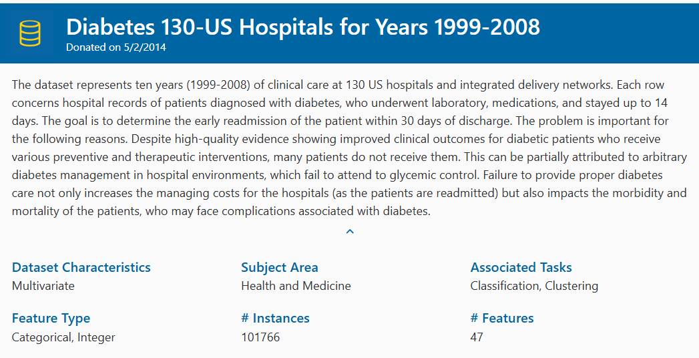
Data
Source : UCI Machine Learning Repository.
Diabetes 130-US Hospitals for Years 1999-2008 - UCI Machine Learning Repository

Slide 6
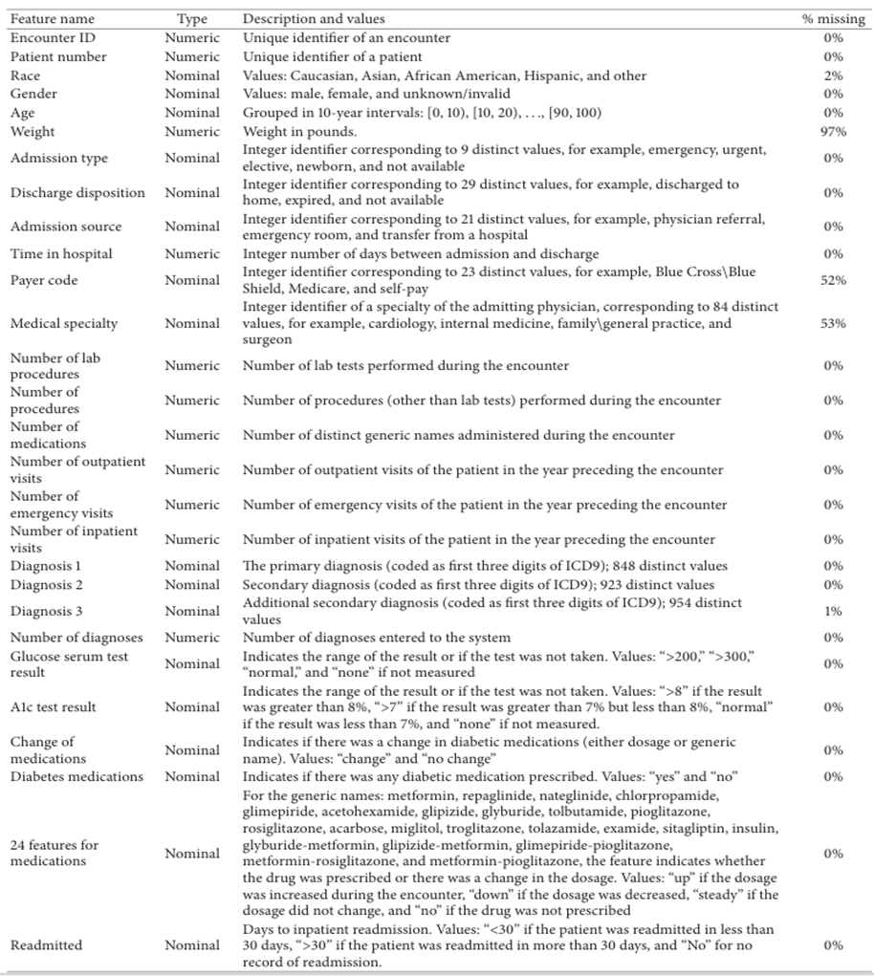
Data Dictionary

Slide 7
Approach
Data Preprocessing : Missing value Handling, Encoding categorical variables, Feature selection, Target transformation
Modelling : Binary classification (Logistic regression), prediction, additional model – Random Forest, Gradient Boost
Bias analysis : RQ1 (Group wise performance selection), RQ2 (Disparity analysis), RQ3 (Dataset balancing), RQ4 (Bias mitigation)
RQ | Goal | Core Question | Focus Area | Data Used | Key Metric | Statistical Test | Why It Matters
RQ1 | Detect general bias | Does model performance differ across groups? | Overall correctness | All test data | Accuracy (correct vs incorrect) | Chi-square | Identifies whether the model is equally reliable across demographic groups
RQ2 | Detect harmful bias | Are high-risk patients missed more in certain groups? | Critical errors | Only actual readmitted patients | False Negative Rate (FNR) | Chi-square | Highlights inequity in identifying high-risk patients (most important clinically)
RQ3 | Explain bias | Is bias caused by dataset imbalance? | Source of disparity | Repeated model runs (original vs rebalanced data) | FNR Gap (difference across groups) | Paired t-test | Determines whether bias arises from data distribution issues
RQ4 | Solve bias | Can bias be reduced without hurting performance? | Bias mitigation | Repeated model runs (baseline vs mitigated model) | FNR Gap + F1/AUC | Paired t-test | Evaluates whether fairness can be improved without compromising model effectiveness

Slide 8
Approach…. contd
Hypothesis formulation and Statistical testing
RQ | Primary Metric | Statistic | Null Hypothesis | Alternative Hypothesis
RQ1 | Accuracy / Correctness | Chi-square test of independence | No difference in classification correctness across groups | Significant difference exists
RQ2 | False Negative Rate | Chi-square test or two-proportion z-test | No difference in false negative rates across groups | Significant difference exists
RQ3 | Disparity measures (FNR gap) | Paired t-test or Wilcoxon signed-rank test | Rebalancing does not change disparity | Rebalancing changes disparity
RQ4 | Disparity measures (FNR gap) Overall model performance (AUC, F1-score) | Paired t-test or Wilcoxon test | Mitigation does not reduce disparity without performance loss | Mitigation reduces disparity without performance loss

Slide 9
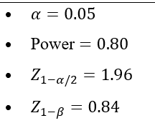
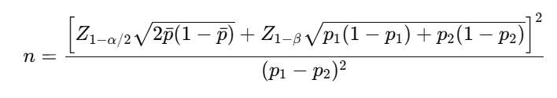
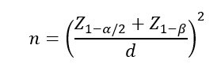
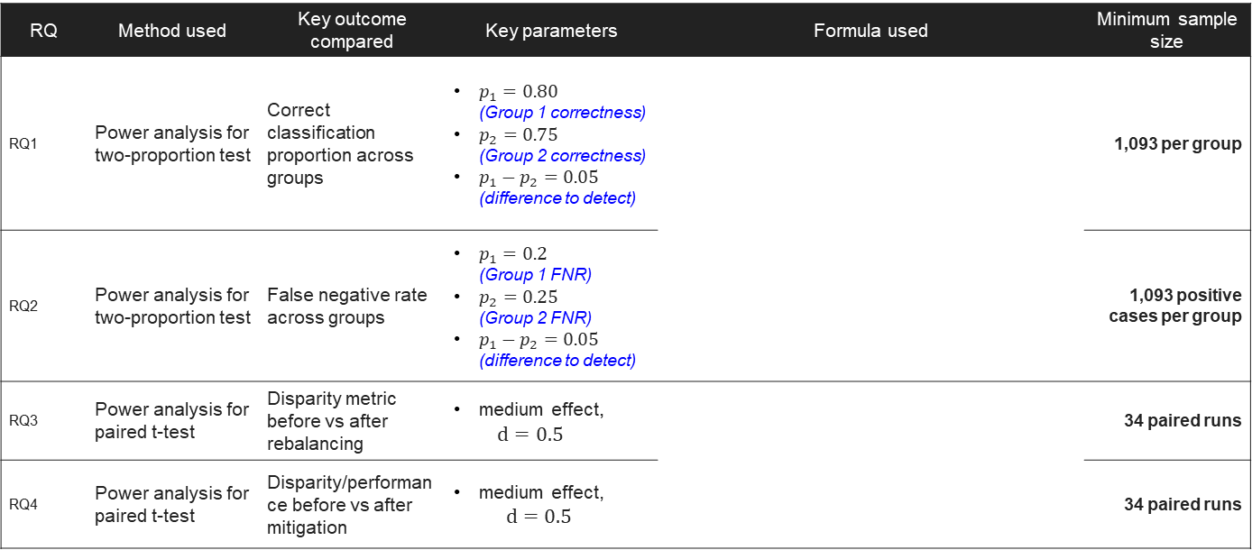
Sample size calculations
RQ | Method used | Key outcome compared | Key parameters | Formula used | Minimum sample size
RQ1 | Power analysis for two-proportion test | Correct classification proportion across groups | $p_{1}=0.80$ (Group 1 correctness) $p_{2}=0.75$ (Group 2 correctness) $p_{1}−p_{2}=0.05$ (difference to detect) |  | 1,093 per group
RQ2 | Power analysis for two-proportion test | False negative rate across groups | $p_{1}=0.2$ (Group 1 FNR) $p_{2}=0.25$ (Group 2 FNR) $p_{1}−p_{2}=0.05$ (difference to detect) |  | 1,093 positive cases per group
RQ3 | Power analysis for paired t-test | Disparity metric before vs after rebalancing | medium effect, $d=0.5$ |  | 34 paired runs
RQ4 | Power analysis for paired t-test | Disparity/performance before vs after mitigation | medium effect, $d=0.5$ |  | 34 paired runs

Slide 10
Applications
Readmission Risk Prediction Systems : Hospitals use models to identify high-risk patients and allocate follow-up care. This study helps ensure: these systems are fair across groups
Fairness Audits of AI Systems : Hospitals can audit models before deployment and detect bias This framework becomes: a bias evaluation template
Resource Allocation Decisions : Care managers decide: who gets intervention and who gets follow-up. Bias could lead to: unequal allocation. This study helps: make allocation equitable
Regulatory & Compliance Readiness : Healthcare increasingly requires: explainability and fairness. This study supports: compliance with ethical AI guidelines

Slide 11
Recommendations
No | Result | Recommendation
1 | If Bias is detected | Recommendation 1: Implement bias monitoring Healthcare organizations should routinely evaluate predictive models for disparities across demographic groups before and after deployment. Recommendation 2: Use fairness-aware modelling Apply: class balancing and reweighting Recommendation 3: Include fairness metrics in evaluation Model evaluation should extend beyond accuracy to include fairness metrics such as false negative rate across demographic groups. Recommendation 4: Human-in-the-loop decision making AI predictions should be supplemented with clinical judgment, particularly for high-risk decisions.
2 | If Bias is not detected | This is still valuable. Organizations should continue monitoring fairness to ensure sustained equitable performance over time
3 | If Mitigation works | Bias mitigation techniques should be incorporated into model development pipelines to improve equity without compromising predictive performance.
4 | If Trade-off Exists (Fairness vs Performance) | Organizations should explicitly define acceptable trade-offs between fairness and predictive accuracy based on clinical priorities and ethical considerations.

Slide 12
Literature study
Reference | Key Contribution | Relevance to Study | Linked Sections / RQs
Jiang et al. (2017) | Overview of AI applications in healthcare | Establishes role of AI and predictive analytics in healthcare decision-making | Introduction
Rajkomar et al. (2019) | Machine learning in clinical decision support | Justifies use of predictive models for patient risk and readmission prediction | Introduction, Background, RQ1
Kansagara et al. (2011) | Review of readmission prediction models and their limitations | Highlights limitations of existing models and need for deeper evaluation beyond accuracy | Problem Statement, RQ1
Strack et al. (2014) | Diabetes dataset and predictors of readmission | Provides the real-world dataset used in this study and supports empirical analysis | Data Description, All RQs
CMS (2020) | Hospital Readmissions Reduction Program (HRRP) | Establishes business and financial importance of readmission prediction | Background, Problem Statement
Obermeyer et al. (2019) | Evidence of racial bias in healthcare algorithms | Demonstrates real-world bias in predictive models, motivating fairness analysis | Problem Statement, RQ2
Chen et al. (2021) | AI and healthcare disparities | Highlights risks and need for equitable AI systems and mitigation strategies | Introduction, RQ2, RQ4
Mehrabi et al. (2021) | Survey of bias in machine learning | Provides framework for understanding sources of bias, including data imbalance | RQ3, RQ4
Cohen (1988) | Statistical power and effect size theory | Supports hypothesis testing design and interpretation of statistical significance | Methodology, Sample Size
Lwanga & Lemeshow (1991) | Sample size determination for health studies | Supports sample size calculations for proportion-based tests | RQ1, RQ2
Charan & Biswas (2013) | Practical sample size calculation methods | Reinforces applied statistical design and sample size justification | Methodology
Faul et al. (2007) | G*Power statistical analysis framework | Supports power analysis and robustness of statistical testing | Methodology

Slide 13
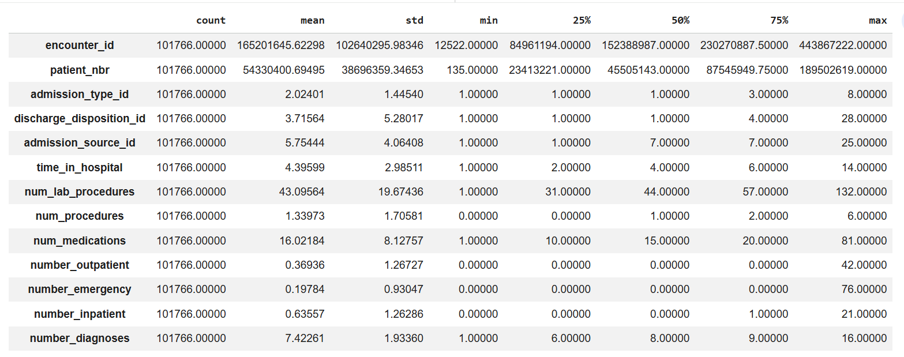
EDA – Basic Data Checks
There are 101766 records with 50 features
No duplicate records.
Number of values are missing – 97% data on weight feature, around 50% data on payer code and medical speciality feature
Statistical summary of numeric data

Slide 14
Data Dictionary

Slide 15
Preprocess data – Feature Exclusion
No predictive value; used only for identification
Significant missing values; unreliable for modelling
High cardinality; requires complex medical mapping
High dimensionality; low interpretability; introduces noise

Slide 16
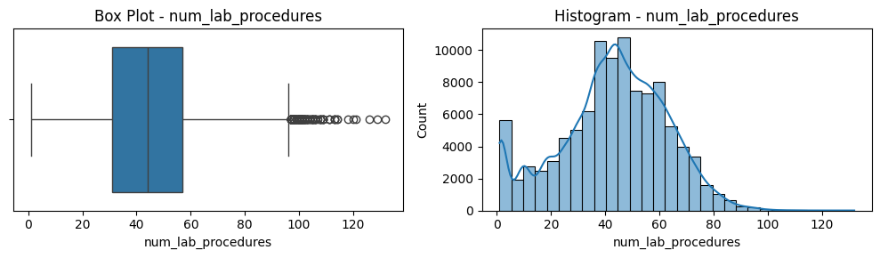
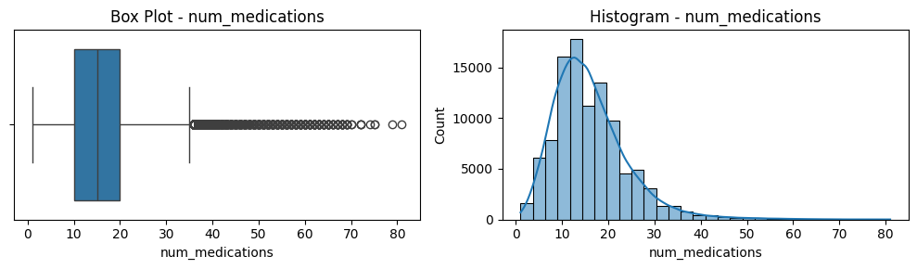
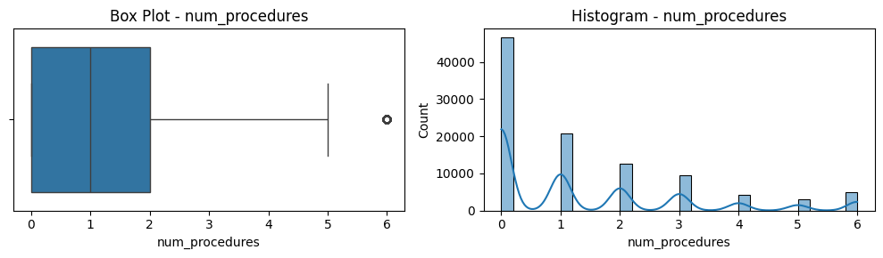
EDA
Clinical Activity and Treatment Intensity. These variables capture patient severity and treatment complexity and are important predictors of readmission.
The average number of lab procedures is approximately 43, with values ranging up to 132, indicating substantial variability in diagnostic intensity.
The number of medications ranges from 1 to 81 (mean ≈ 16), reflecting differences in treatment intensity across patients.
The number of procedures remains relatively low (mean ≈ 1.3), suggesting that most encounters involve limited procedural intervention.

Slide 17
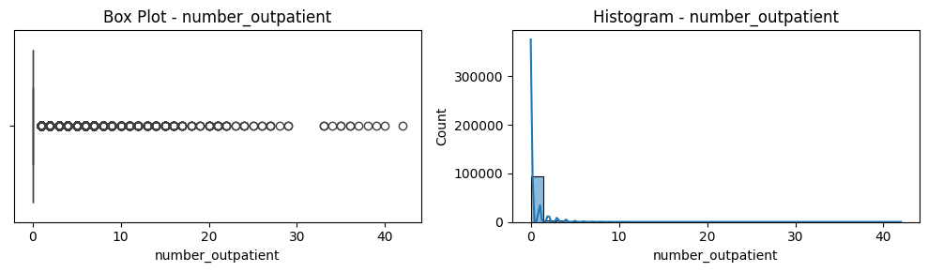
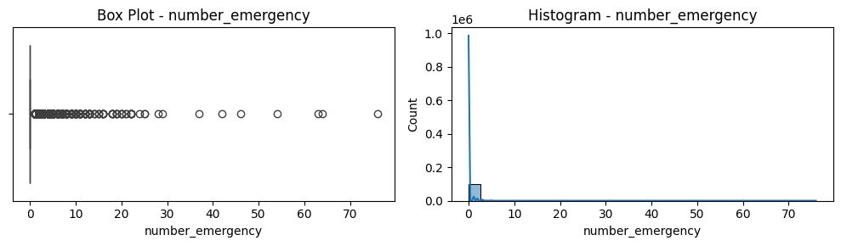
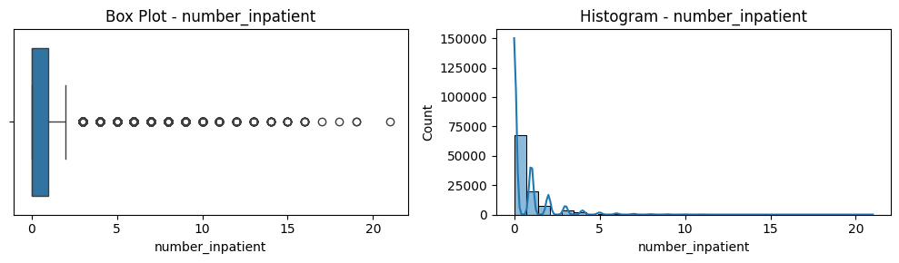
EDA
Healthcare Utilization Patterns. These variables indicate the pattern of hospital utilization
Variables such as number_outpatient, number_emergency, and number_inpatient exhibit highly skewed distributions, with median values of zero and maximum values as high as 42, 76, and 21 respectively.
Most patients have low prior utilization, while a small subset shows very high usage, representing high-risk patients.
These extreme values are clinically meaningful and are retained in the analysis.

Slide 18
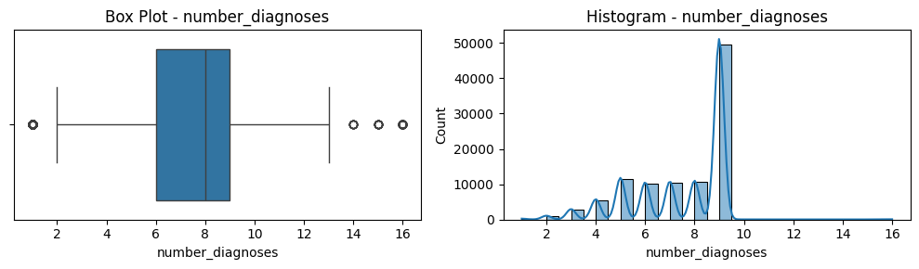
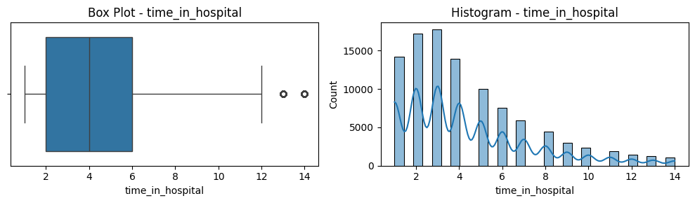
EDA
Comorbidity and Diagnosis Complexity. These variables serve as an important proxy for patient complexity
The number of diagnoses has a mean of 7.4 and ranges from 1 to 16, indicating that patients typically have multiple comorbid conditions. It is expected to influence readmission risk.
Time in hospital represents the length of stay for a patient during a hospital encounter, ranging from 1 to 14 days in this dataset. It serves as a proxy for illness severity and resource utilization, with longer stays typically indicating more complex or severe cases.

Slide 19
EDA – Clinical Utilization and Severity Indicators

Slide 20
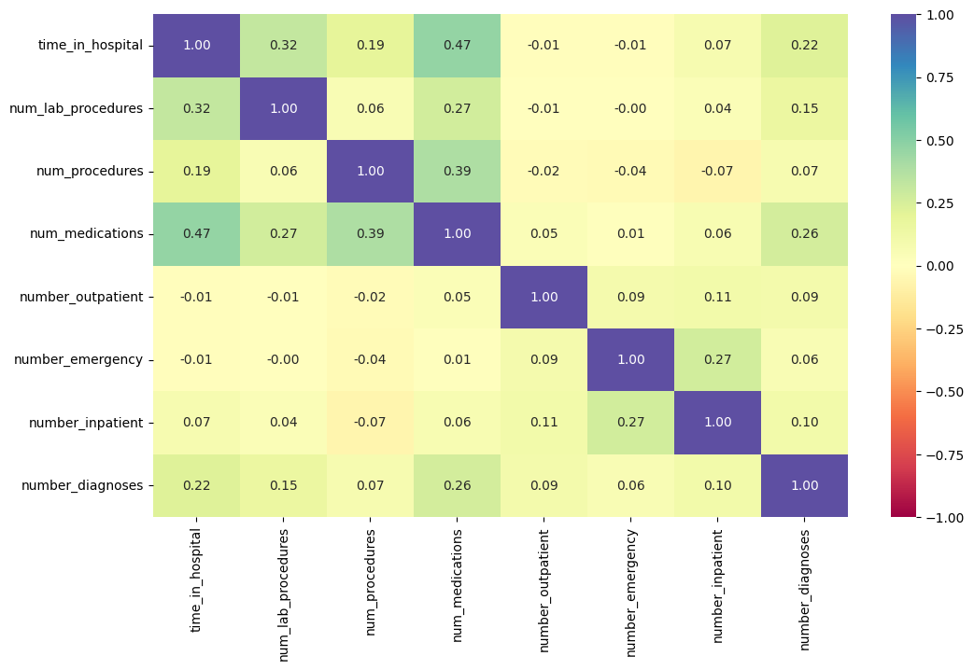
EDA

Slide 21
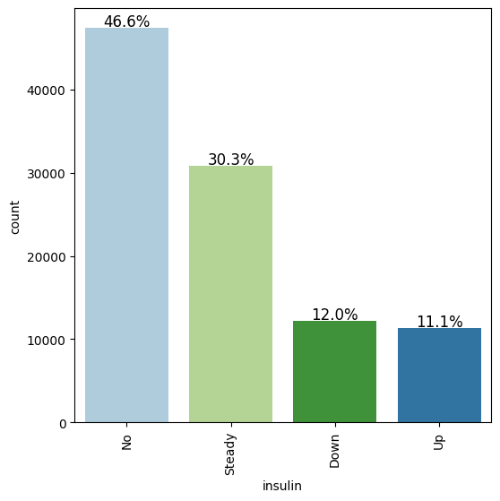
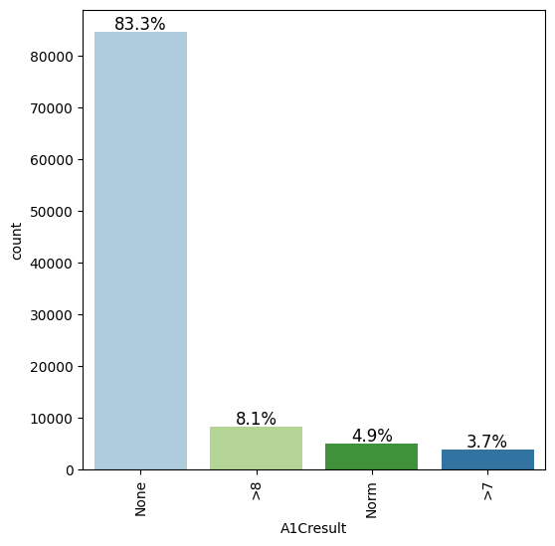
EDA
Diabetes Management Variables. These variables these variables relate to diabetes status, glucose control, and treatment
Insulin indicates whether insulin therapy was administered or adjusted during the hospital stay. It reflects treatment intensity and clinical response to the patient’s condition.
A1C result represents the patient’s average blood glucose level over the past 2–3 months, categorized into clinical ranges. It serves as an indicator of long-term diabetes control and overall disease management.

Slide 22
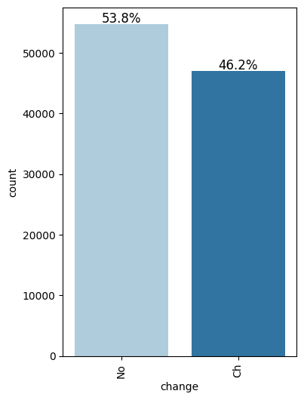
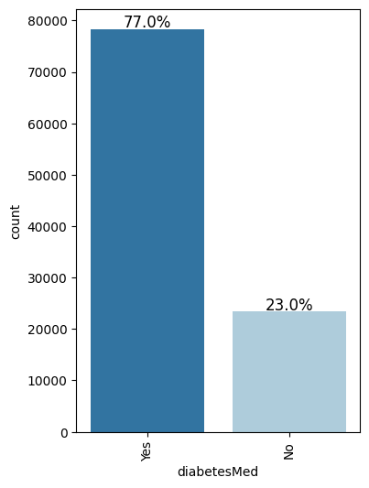
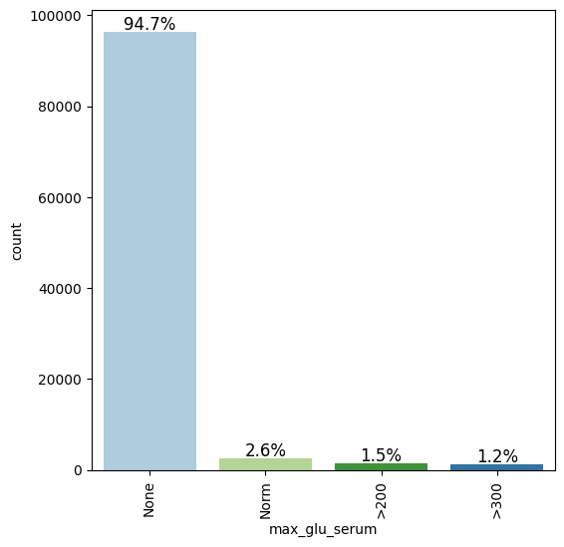
EDA
Diabetes Management Variables. These variables these variables relate to diabetes status, glucose control, and treatment
Change denotes whether there was any modification in the patient’s medication regimen during the encounter. It captures treatment adjustments that may influence patient outcomes and readmission risk.
Diabetes medication indicates whether the patient was prescribed any diabetes-related medication. It serves as a general indicator of ongoing disease management.
Max glucose serum indicates the highest recorded blood glucose level during the encounter, categorized into ranges or “None.” It reflects short-term glycemic control and can signal acute severity of the patient’s condition.

Slide 23
EDA – Diabetes Management Variables

Slide 24
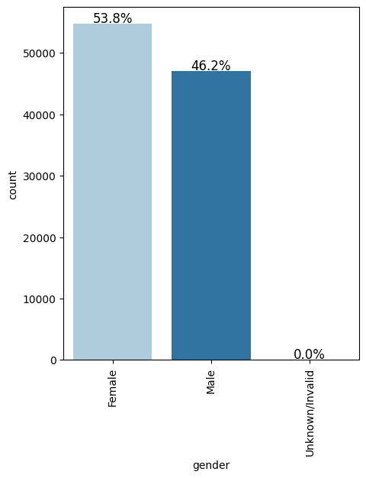
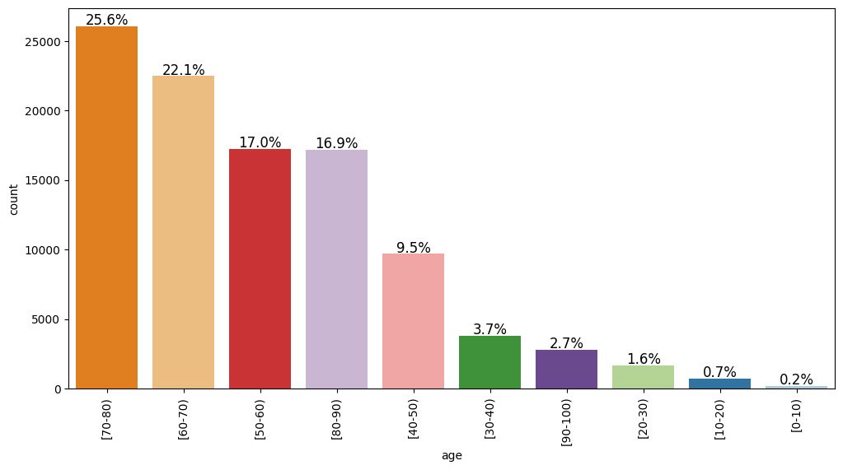
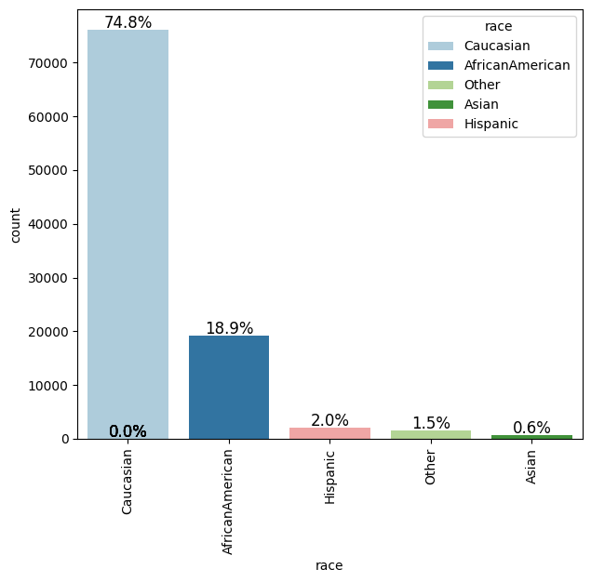
EDA
Gender. The gender variable consists of two categories - Male and Female. It is one of the key demographic attributes to assess whether the predictive models exhibit differences in performance across gender groups, particularly in identifying high-risk patients.
Age. The age variable is recorded in predefined categorical ranges (e.g., [0–10), [10–20), … [90–100)), rather than exact values. This representation reflects common healthcare data practices where patient age is grouped to preserve privacy
Race. The race variable includes multiple categories such as Caucasian (75%), African American (19%), Hispanic (2%), Asian (0.6%) and Other (1.5%) as shown in Figure 5. It captures patient ethnicity information relevant to analyze disparities in healthcare outcomes and model performance.

Slide 25
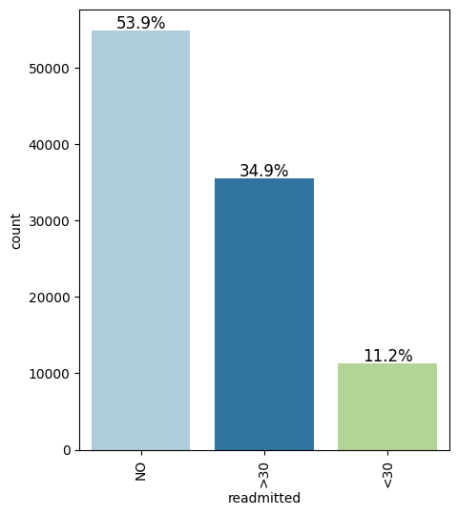
EDA – Target Variable
Readmitted is the target variables and it has 3 classes
Not re-admitted (54%),
readmitted after 30 days (35%)
readmitted within 30 days (11%)

Slide 26
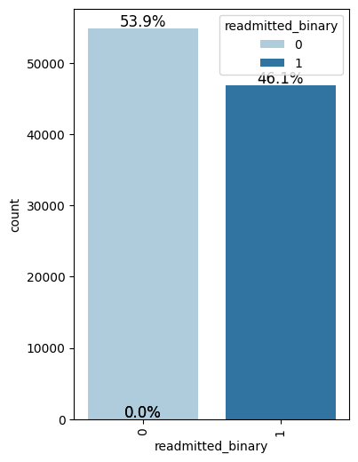
Feature Engineering
Target Encoding
Encode into binary values for classification
Not-readmitted -> 0
Readmitted after and within 30 days -> 1
New Variable – readmitted_binary

Slide 27
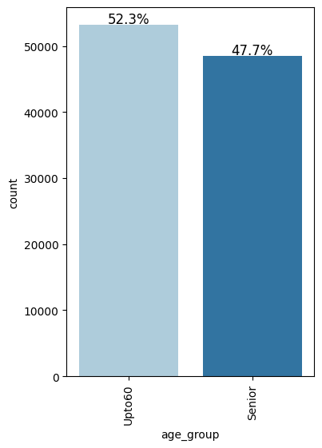
Feature Engineering
Age Grouping
Aggregate Age into 2 groups from multiple age brackets. This is to improve statistical power and simplify analysis
Age upto 60 years (<=60)
Senior – Age above 60 years (> 60)
New Variable – age_group

Slide 28
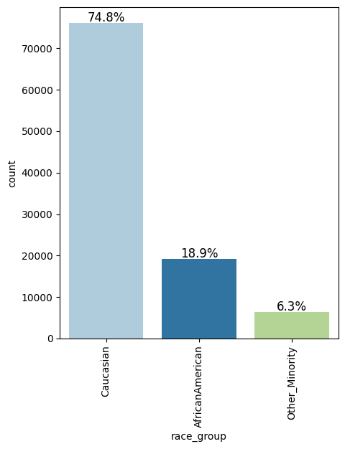
Feature Engineering
Race Consolidation
Consolidate Race from 5 categories to 3 categories to ensure sufficient sample size per group
Caucasian – same as original – 75%
AfricanAmerican – same as original – 19%
Combine Hispanic, Asian and Other into Other-minority – 6 %
New Variable – race_group

Slide 29
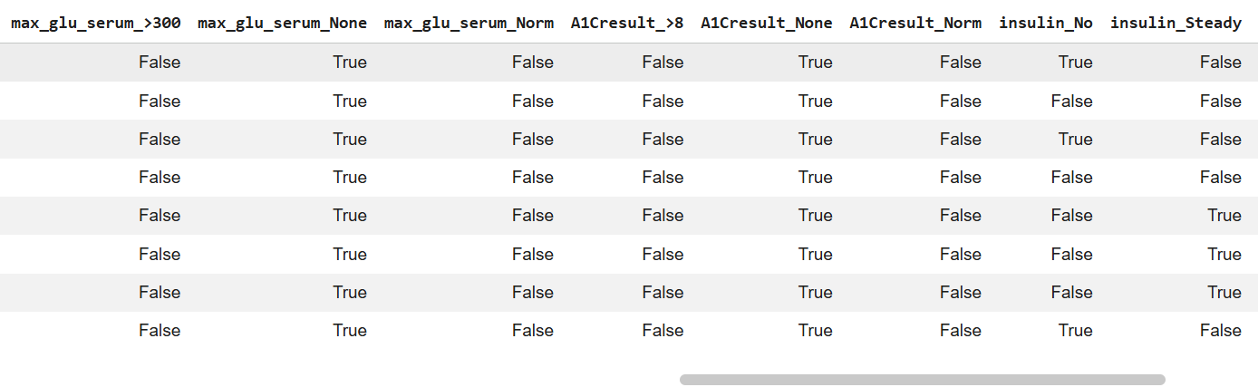
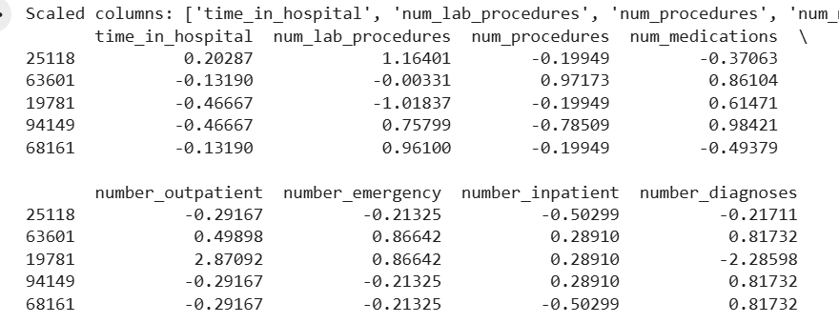
Feature Engineering
One hot encoding of categorical variables
Convert Categorical variables into one-hot encoded variables for model training
Scaling of continuous variables
Scale numeric variables (mean-centered and z-score) to Ensures stable model training and comparability

Slide 30
Modelling
Balance interpretability, robustness, and predictive capability while ensuring that bias analysis is not limited to a single modelling approach – 3 models used
Logistic regression. Primary baseline model due to its simplicity, interpretability, and widespread use in healthcare analytics.
Highly interpretable and widely accepted in healthcare
Serves as a standard baseline for comparison
Enables clear understanding of model behavior and bias
Random forest. Ensemble learning method that captures nonlinear relationships and feature interactions that may not be modeled by logistic regression.
Captures complex patterns in data
Provides robustness to noise and overfitting due to its bagging approach
Improved predictive performance with more flexible decision boundaries
Helps assess whether bias persists in nonlinear models
Gradient Boosting. More advanced ensemble technique that builds models sequentially to improve prediction accuracy
Has high predictive capability
Models complex relationships effectively
Serves as a benchmark for performance-oriented models

Slide 31
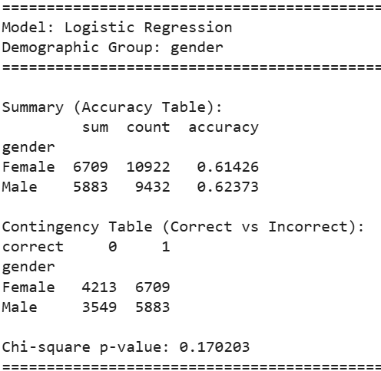
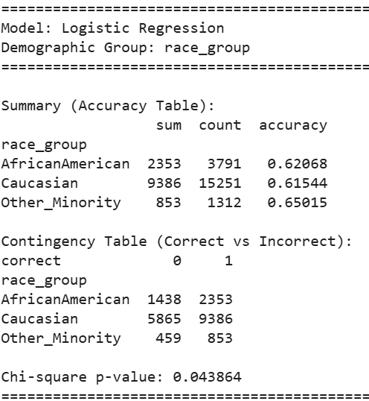
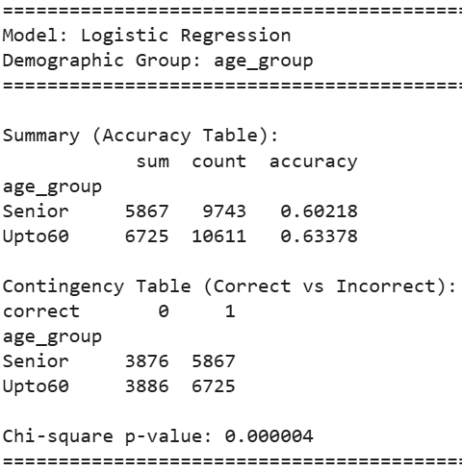
Results – RQ1
Performance Equity Across Demographic Groups.
model accuracy does not differ significantly across gender groups, suggesting consistent performance between male and female patients.
statistically significant differences were observed across race and age groups.
While the variation across race groups was modest, the model demonstrated lower accuracy for older patients compared to younger patients.
These findings suggest potential disparities in model performance, particularly with respect to age, and highlight the need for further analysis using error-specific metrics such as false negative rates.

Slide 32
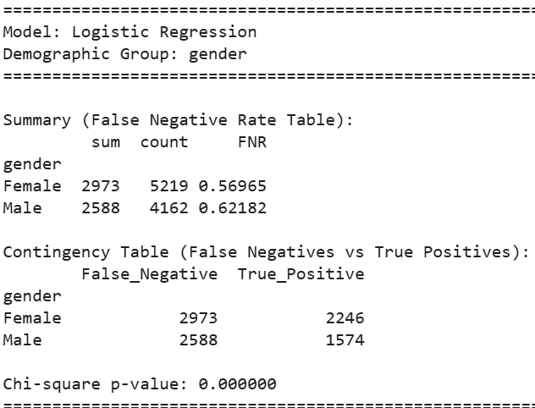
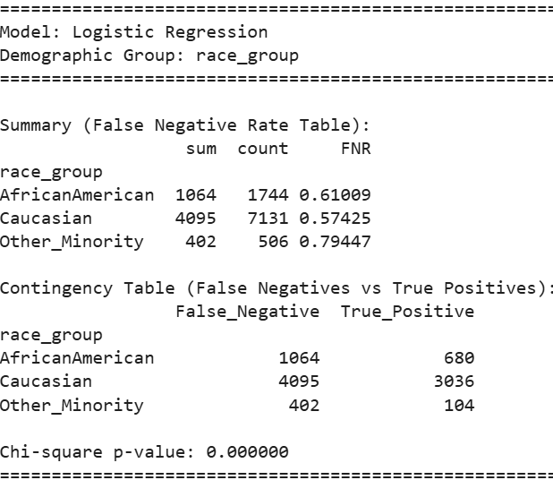
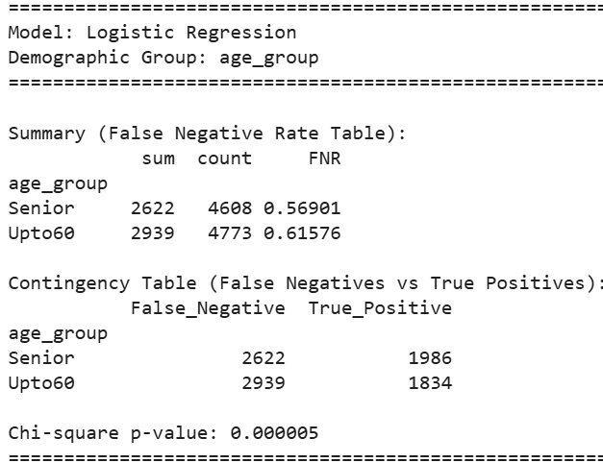
Results – RQ2
Critical Error Disparities
statistically significant differences in false negative rates across all demographic groups, revealing disparities in critical errors that are not apparent from overall accuracy measures alone.
The model exhibits higher false negative rates for male patients, younger patients, and particularly for minority race groups, with especially pronounced disparities observed in the “Other Minority” category.
This indicates that the model is more likely to misclassify high-risk patients as low risk in these populations, leading to potential missed interventions and adverse outcomes.
These findings highlight the limitations of relying solely on aggregate performance metrics and underscore the importance of fairness-aware evaluation in healthcare predictive models, particularly in identifying and addressing inequities in high-risk patient detection.

Slide 33
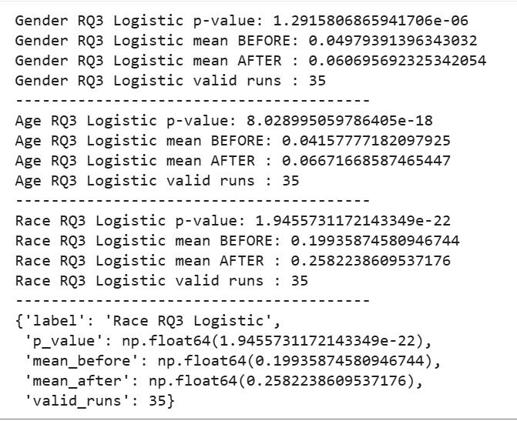
Results – RQ3
Impact of Dataset Imbalance
indicate statistically significant differences in false negative rate (FNR) gaps before and after dataset rebalancing across all demographic groups, with p-values well below 0.05 for gender, age, and race.
However, contrary to expectations, the mean FNR gap increased after rebalancing for all groups (gender: 0.0498 to 0.0607, age: 0.0416 to 0.0667, race: 0.1994 to 0.2582), indicating that rebalancing the dataset led to a worsening of disparity rather than a reduction.
This suggests that while dataset imbalance does influence model behavior, simple rebalancing alone does not necessarily improve fairness and may, in fact, exacerbate bias across demographic groups.
These findings highlight that bias in predictive models is not solely a function of data imbalance but may also be driven by underlying feature relationships and model dynamics, underscoring the need for more nuanced approaches to bias diagnosis and mitigation in healthcare predictive modeling.

Slide 34
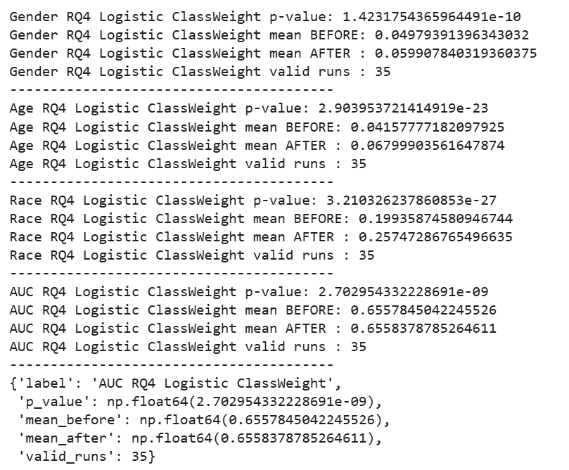
Results – RQ4
Effectiveness of Bias Mitigation
indicate statistically significant changes in false negative rate (FNR) gaps across all demographic groups following the application of class-weighted logistic regression, with p-values well below 0.05 for gender, age, and race.
However, the direction of change reveals that disparity increased rather than decreased, with mean FNR gaps rising for gender (0.0498 to 0.0599), age (0.0416 to 0.0680), and race (0.1994 to 0.2575).
This suggests that the class-weighting mitigation strategy, while intended to address imbalance, inadvertently exacerbates bias across demographic groups.
In contrast, overall model performance, as measured by AUC, remained effectively unchanged (0.6558 to 0.6558), indicating that the observed increase in bias is not associated with a meaningful degradation in predictive performance.
These findings demonstrate that commonly used mitigation techniques may not only fail to reduce bias but can also intensify disparities, highlighting the complexity of fairness in healthcare predictive models and the need for more targeted and context-aware mitigation approaches.

Slide 35
Results – Summary
Overall performance can be misleading (RQ1 vs RQ2).
The model appears reasonably consistent in accuracy (RQ1), suggesting it “works” at a high level.
However, it fails unevenly across groups when it matters most (RQ2), particularly in missing high-risk patients.
Insight: A model can look fair on average but still produce unequal and potentially harmful outcomes across populations.
1
Bias is concentrated in critical decisions, not general performance (RQ2)
Significant disparities exist in false negative rates, especially for minority groups and certain age segments.
These errors directly affect who gets intervention vs. who is overlooked.
Insight: The real risk is not overall error, but who is being missed -this is where bias has the greatest clinical and operational impact.
2
Data imbalance influences bias but not in a simple way (RQ3)
Changing the data distribution (rebalancing) significantly altered bias. However, bias increased rather than decreased.
Insight: Data imbalance matters but fixing it alone does not guarantee fairness. Bias is influenced by deeper relationships in the data and model behavior.
3
Common mitigation strategies may worsen fairness (RQ4)
Class weighting and rebalancing changed model behavior but increased disparity. Overall performance (AUC) remained the same.
Insight: Improving fairness is not automatic -standard techniques can shift errors across groups rather than reduce them.
4
Fairness and performance are not the same thing. The model’s predictive power stayed constant, but fairness worsened
Insight: A model can be accurate but unfair -performance metrics alone are insufficient for evaluating real-world impact.
5

