Slide 1
Applications in the Cloud

Slide 2
Agenda
App Engine
App Engine Standard Environment
App Engine Flexible Environment
Cloud Endpoints and Apigee Edge
Cloud Run
Quiz and Lab
Resources

Slide 3

App Engine is a PaaS for building scalable applications
App Engine makes deployment, maintenance, and scalability easy so you can focus on innovation.
Especially suited for building scalable web applications and mobile backends.
Notes:
App Engine is a platform for building scalable web applications and mobile backends. It allows you to concentrate on innovating your applications by managing the application infrastructure for you. For example, App Engine manages the hardware and networking infrastructure required to run your code.
App Engine provides you with built-in services and APIs such as NoSQL datastores, memcache, load balancing, health checks, application logging, and a user authentication API, common to most applications.
App Engine will scale your application automatically in response to the amount of traffic it receives so you only pay for the resources you use. Just upload your code and Google will manage your app's availability. There are no servers for you to provision or maintain.
Security Scanner automatically scans and detects common web application vulnerabilities. It enables early threat identification and delivers very low false-positive rates. You can easily set up, run, schedule, and manage security scans from the Cloud Console.
App Engine works with popular development tools such as Eclipse, IntelliJ, Maven, Git, Jenkins, and PyCharm. You can build your apps with the tools you love without changing your workflow.

Slide 4
Agenda
App Engine
App Engine Standard Environment
App Engine Flexible Environment
Cloud Endpoints and Apigee Edge
Cloud Run
Quiz and Lab
Resources

Slide 5
App Engine standard environment
Easily deploy your applications.
Autoscale workloads to meet demand.
Economical
Free daily quota
Usage based pricing
SDKs for development, testing and deployment.
Notes:
The App Engine standard environment is based on container instances running on Google's infrastructure. Containers are preconfigured with one of several available runtimes. Each runtime also includes libraries that support App Engine standard APIs. For many applications, the standard environment runtimes and libraries may be all you need.
The App Engine standard environment makes it easy to build and deploy an application that runs reliably even under heavy load and with large amounts of data. It includes the following features:
Persistent storage with queries, sorting, and transactions.
Automatic scaling and load balancing.
Asynchronous task queues for performing work outside the scope of a request.
Scheduled tasks for triggering events at specified times or regular intervals.
Integration with other Google Cloud services and APIs.

Slide 6
App Engine standard environment: Requirements
Specific versions of Java, Python, PHP, Go, Node.js, and Ruby (beta) are supported.
Your application must conform to certain sandbox constraints dependant on runtime.
Notes:
Software Development Kits (SDKs) for App Engine are available in all supported languages. Each SDK includes:
All of the APIs and libraries available to App Engine
A simulated, secure sandbox environment that emulates all of the App Engine services on your local computer
Deployment tools that allow you to upload your application to the cloud and manage different versions of your application
The SDK manages your application locally, and the Cloud Console manages your application in production. The Cloud Console uses a web-based interface to create new applications, configure domain names, change which version of your application is live, examine access and error logs, and much more.
Applications run in a secure, sandboxed environment, allowing the App Engine standard environment to distribute requests across multiple servers, and scaling servers to meet traffic demands. Your application runs within its own secure, reliable environment that is independent of the hardware, operating system, or physical location of the server.

Slide 7



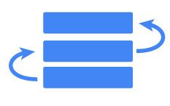
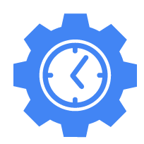


Example App Engine standard workflow: Web apps
App Engine can access a variety of services using dedicated APIs.
App Engine automatically scales & reliably serves your web application.
Develop & test the web application locally.
3
1
Project
Memcache
App Engine
App Servers
Task queues
2
Use the SDK to deploy to App Engine.
Application instances
Scheduled tasks
Application instances
Search
Application instances
Logs
Notes:
In this diagram we see App Engine standard environment in practice. You’ll develop your application and run a test version of it locally using the App Engine SDK. Then, when you’re ready, you’ll use the SDK to deploy it.
Each App Engine application runs in a Google Cloud project. App Engine automatically provisions server instances and scales and load-balances them. Meanwhile, your application can make calls to a variety of services using dedicated APIs. For example, a NoSQL datastore to make data persistent; caching of that data using memcache; searching; logging; user login; and the ability to launch actions not triggered by direct user requests, like task queues and a task scheduler.

Slide 8
Agenda
App Engine
App Engine Standard Environment
App Engine Flexible Environment
Cloud Endpoints and Apigee Edge
Cloud Run
Quiz and Lab
Resources

Slide 9
App Engine flexible environment
Build and deploy containerized apps with a click.
No sandbox constraints.
Can access App Engine resources.
Standard runtimes: Python, Java, Go, Node.js, PHP, .NET, and Ruby.
Custom runtime support: Any language that supports HTTP requests.
Package your runtime as a Dockerfile.
Notes:
If the restrictions of App Engine standard environment’s sandbox model don’t work for you, but you still want to take advantage of the benefits of App Engine (like automatic scaling up and down), consider App Engine flexible environment. Instead of the sandbox, App Engine flexible environment lets you specify the container your application runs in.
Your application runs inside Docker containers on Google Compute Engine virtual machines (VMs). App Engine manages these Compute Engine machines for you. They’re health-checked, healed as necessary, and you get to choose what geographical region they run in. And critical, backward-compatible updates to their operating systems are automatically applied. All this so that you can just focus on your code.
Microservices, authorization, SQL and noSQL databases, traffic splitting, logging, search, versioning, security scanning, memcache, and content delivery networks are all supported natively. In addition, the App Engine flexible environment allows you to customize your runtime and even the operating system of your virtual machine using Dockerfiles.
Runtimes: The flexible environment includes native support for Go, Java 8, PHP 5/7, Python 2.7/3.6, .NET, Node.js, and Ruby. Developers can customize these runtimes or provide their own runtime, such as Ruby or PHP, by supplying a custom Docker image or Dockerfile from the open source community.
Infrastructure customization: Because VM instances in the flexible environment are Compute Engine virtual machines, you can use SSH to connect to every single VM and Docker container for debugging purposes and further customization.
Performance: Take advantage of a wide array of CPU and memory configurations. You can specify how much CPU and memory each instance of your application needs, and the flexible environment will provision the necessary infrastructure for you.
App Engine manages your virtual machines, ensuring that:
Instances are health-checked, healed as necessary, and co-located with other module instances within the project.
Critical, backward-compatible updates are automatically applied to the underlying operating system.
VM instances are automatically located by geographical region according to the settings in your project. Google's management services ensure that all of a project's VM instances are co-located for optimal performance.
VM instances are restarted on a weekly basis. During restarts, Google's management services will apply any necessary operating system and security updates.
App Engine flexible environment apps that use standard runtimes can access App Engine services: Datastore, Memcache, task queues, logging, users, and so on.

Slide 10
Comparing the App Engine environments
 | Standard environment | Flexible environment
Instance startup | Seconds | Minutes
SSH access | No | Yes (although not by default)
Write to local disk | No (some runtimes have read and write access to the /tmp directory) | Yes, ephemeral (disk initialized on each VM startup)
Support for 3rd-party binaries | For certain languages | Yes
Network access | Via App Engine services | Yes
Pricing model | After free daily use, pay per instance class, with automatic shutdown | Pay for resource allocation per hour; no automatic shutdown
Notes:
Here’s a side-by-side comparison of the standard and flexible environments. Notice that the standard environment starts up instances of your application faster, but that you get less access to the infrastructure in which your application runs. For example, the flexible environment lets you ssh into the virtual machines on which your application runs; it lets you use local disk for scratch space; it lets you install third-party software; and it lets your application make calls to the network without going through App Engine. On the other hand, the standard environment’s billing can drop to zero for a completely idle application.

Slide 11
Deploying applications: GKE versus App Engine
 | Google Kubernetes Engine | App Engine flexible environment | App Engine standard environment
Language support | Any | Any | Specific versions of Python, Java, Node.js, Go, PHP, and Ruby (beta)
Service model | Hybrid | PaaS | PaaS
Primary use case | Container-based workloads | Web and mobile applications, container-based workloads | Web and mobile applications
Toward managed infrastructure
Toward dynamic infrastructure
Notes:
Because we mentioned App Engine’s use of Docker containers, you may be wondering how App Engine compares to Google Kubernetes Engine. Here’s a side-by-side comparison of App Engine with GKE. App Engine standard environment is for people who want the service to take maximum control of their application’s deployment and scaling. GKE gives the application owner the full flexibility of Kubernetes. App Engine flexible environment is in between.
Also, App Engine treats containers as a means to an end. But for GKE, containers are a fundamental organizing principle.

Slide 12
Agenda
App Engine
App Engine Standard Environment
App Engine Flexible Environment
Cloud Endpoints and Apigee Edge
Cloud Run
Quiz and Lab
Resources

Slide 13
APIs hide the details and enforce contracts
Complex, changeable implementation
API
Users
Simple, versioned interface
Notes:
Let’s be precise about what an Application Programme Interface, or API, is. A software service’s implementation can be complex and changeable. If other software services had to be explicitly coded all that detail in order to use that service, the result would be brittle and error-prone. So instead, application developers structure the software they write so that it presents a clean, well-defined interface that abstracts away needless detail, and then they document that interface. That’s an Application Programming Interface. The underlying implementation can change, as long as the interface doesn’t, and other pieces of software that use the API don’t have to know or care.
Sometimes you do have to change an API, such as to add or deprecate a feature. To make this kind of API change cleanly, developers version their APIs. Version 2 of an API might contain calls that version 1 does not; programs that consume the API can specify the API version they want to use in their calls.
Supporting an API is a very important task, and Google Cloud provides two API management tools. They approach related problems in a different way, and each has a particular forte.

Slide 14
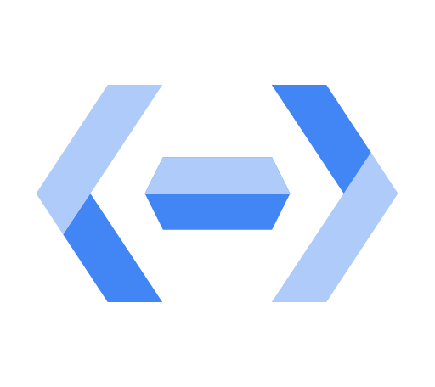
Cloud Endpoints helps you create and maintain APIs
Distributed API management through an API console.
Expose your API using a RESTful interface.
Control access and validate calls with JSON Web Tokens and Google API keys.
Identify web, mobile users with Auth0 and Firebase Authentication.
Generate client libraries.
Notes:
Cloud Endpoints is a distributed API management system. It provides an API console, hosting, logging, monitoring, and other features to help you create, share, maintain, and secure your APIs. You can use Cloud Endpoints with any APIs that support the OpenAPI Specification, formerly known as the Swagger spec.
Cloud Endpoints uses the distributed Extensible Service Proxy to provide low latency and high performance for serving even the most demanding APIs. Extensible Service Proxy is a service proxy based on NGINX. It runs in its own Docker container for better isolation and scalability. The proxy is containerized and distributed in the Container Registry and Docker registry, and can be used with App Engine, Google Kubernetes Engine, Compute Engine or Kubernetes.
Cloud Endpoints features
User authentication: JSON Web Token validation and a streamlined developer experience for Firebase Auth, Google Auth and Auth0.
Automated deployment: With App Engine, the proxy is deployed automatically with your application. On Google Kubernetes Engine or Compute Engine, use Google’s containerized ESP for simple deployment.
Logging and monitoring: Monitor traffic, error rates and latency, and review logs in Cloud Logging. Use Cloud Trace to dive into performance and BigQuery for analysis.
API keys: Generate API keys in the Cloud Console and validate on every API call. Share your API with other developers to allow them to generate their own keys.
Easy integration: Get started quickly by using one of Google’s Cloud Endpoints Frameworks or by simply adding an Open API specification to your deployment.

Slide 15
Cloud Endpoints: Supported platforms
Runtime environment
App Engine flexible environment
Google Kubernetes Engine
Compute Engine
Clients
Android
iOS
Javascript
Notes:
Cloud Endpoints supports applications running in Google Cloud’s compute platforms, in your choice of languages, and your choice of client technologies.

Slide 16
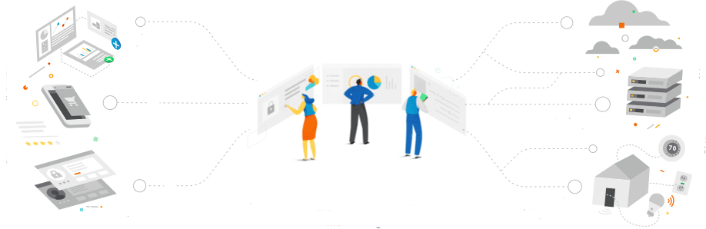
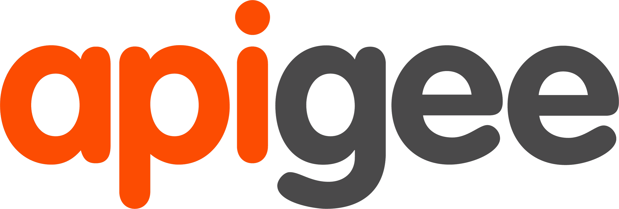
Apigee Edge helps you secure and monetize APIs
Partner apps
Cloud apps
Consumer apps
Systems of record
Employee apps
Internet of Things
Connected experiences
Design, Secure, Publish, Analyze, Monitor, and Monetize APIs
Manage microservices, Leverage developer portal
Backend systems
Notes:
Apigee Edge is also a platform for developing and managing API proxies. It has a different orientation, though: it has a focus on business problems like rate limiting, quotas, and analytics. Many users of Apigee Edge are providing a software service to other companies, and those features come in handy. Because the backend services for Apigee Edge need not be in Google Cloud, engineers also often use it when they are working to take a legacy application apart. Instead of replacing a monolithic application in one risky move, they can instead use Apigee Edge to peel off its services one by one, standing up microservices to implement each in turn, until the legacy application can finally be retired.

Slide 17
Agenda
App Engine
App Engine Standard Environment
App Engine Flexible Environment
Cloud Endpoints and Apigee Edge
Cloud Run
Quiz and Lab
Resources

Slide 18

Cloud Run
Enables stateless containers.
Abstracts away infrastructure management.
Automatically scales up and down.
Open API and runtime environment.
Notes:
Cloud Run is a managed compute platform that enables you to run stateless containers via web requests or Pub/Sub events. Cloud Run is serverless: it abstracts away all infrastructure management so you can focus on developing applications. It is built on Knative, an open-source, Kubernetes-based platform. It builds, deploys, and manages modern serverless workloads. Cloud Run gives you the choice of running your containers either fully-managed or in your own GKE cluster.
Cloud Run automatically scales up and down from zero depending on traffic almost instantaneously, so you never have to worry about scale configuration. Cloud Run also charges you only for the resources you use (calculated down to the nearest 100 milliseconds), so you will never have to pay for your over-provisioned resources.
With Cloud Run you can deploy your stateless containers with a consistent developer experience to a fully managed environment or to your own GKE cluster. This common experience is enabled by Knative, an open API and runtime environment built on Kubernetes that gives you freedom to move your workloads across different environments and platforms: fully managed on Google Cloud, on GKE, or anywhere Knative runs.

Slide 19
Agenda
App Engine
App Engine Standard Environment
App Engine Flexible Environment
Cloud Endpoints and Apigee Edge
Cloud Run
Quiz and Lab
Resources

Slide 20
Quiz 1
Name 3 advantages of using the App Engine flexible environment over App Engine standard environment.

Slide 21
Quiz 1
Name 3 advantages of using the App Engine flexible environment over App Engine standard environment.
The flexible environment allows SSH access, allows disk writes, and supports third-party binaries (also allows stack customization and background processes).

Slide 22
Quiz 2
What is the difference between Cloud Endpoints and Apigee Edge?

Slide 23
Quiz 2
What is the difference between Cloud Endpoints and Apigee Edge?
Cloud Endpoints helps you create and maintain APIs; Apigee Edge helps you secure and monetize APIs.

Slide 24
Lab Intro
Getting Started with App Engine
Duration: 20 minutes
Notes:
The objectives for this lab are for you to be able to:
Preview an App Engine application using Cloud Shell.
Launch an App Engine application.
Disable an App Engine application.

Slide 25
Agenda
App Engine
App Engine Standard Environment
App Engine Flexible Environment
Cloud Endpoints and Apigee Edge
Cloud Run
Quiz and Lab
Resources

Slide 26
Resources
App Engine https://cloud.google.com/appengine/docs/
App Engine flexible environment https://cloud.google.com/appengine/docs/flexible/
App Engine standard environment https://cloud.google.com/appengine/docs/standard/
Cloud Endpoints https://cloud.google.com/endpoints/docs/
Apigee Edge http://docs.apigee.com/api-services/content/what-apigee-edge
Cloud Run https://cloud.google.com/run/docs

