Slide 1
Getting Started with Google Cloud

Slide 2
Shared responsibilities model
Google is responsible for managing its infrastructure security.
You are responsible for securing your data.
Google helps you with best practices, templates, products, and solutions.
Responsibility
On-premises
Infrastructure as a Service
Platform as a Service
Managed
services
Content
Access policies
Usage
Deployment
Web application security
Identity
Operations
Access and authentication
Network security
OS, data, and content
Audit logging
Network
Storage and encryption
Hardware
Customer-managed
Google-managed
Notes:
When you build an application on your on-premises infrastructure, you’re responsible for the entire stack’s security: from the physical security of the hardware and the premises in which they are housed, through the encryption of the data on disk, the integrity of your network, and all the way up to securing the content stored in those applications. When you move an application to Google Cloud, Google handles many of the lower layers of security. Because of its scale, Google can deliver a higher level of security at these layers than most of its customers could afford to do on their own.
The upper layers of the security stack remain the customer’s responsibility. Google provides tools, such as Cloud Identity and Access Management, to help customers implement the policies they choose at these layers.

Slide 3
Agenda
Google Cloud Resource Hierarchy
Cloud Identity and Access Management (Cloud IAM)
Cloud Identity
Interacting with Google Cloud
Google Cloud Marketplace
Quiz and Lab
Resources

Slide 4





Resource hierarchy levels define trust boundaries
Group your resources according to your organization structure.
Org Node
Company
Dept X
Dept Y
Shared
Infra
Levels of the hierarchy provide trust boundaries and resource isolation.
Folders
Team A
Team B
Product 1
Product 2
Projects
Test GCP
Project
Prod GCP
Project
Resources
VMs
Storage
Notes:
You may find it easiest to understand the Google Cloud resource hierarchy from the bottom up. All the resources you use--whether they’re virtual machines, Cloud Storage buckets, tables in BigQuery, or anything else in Google Cloud--are organized into projects. Optionally, these projects may be organized into folders; folders can contain other folders. All the folders and projects used by your organization can be brought together under an organization node. Projects, folders, and organization nodes are all places where policies can be defined. Some Google Cloud resources let you put policies on individual resources too, like Cloud Storage buckets. (This course discusses Cloud Storage buckets later in the course.)
Policies are inherited downwards in the hierarchy.

Slide 5
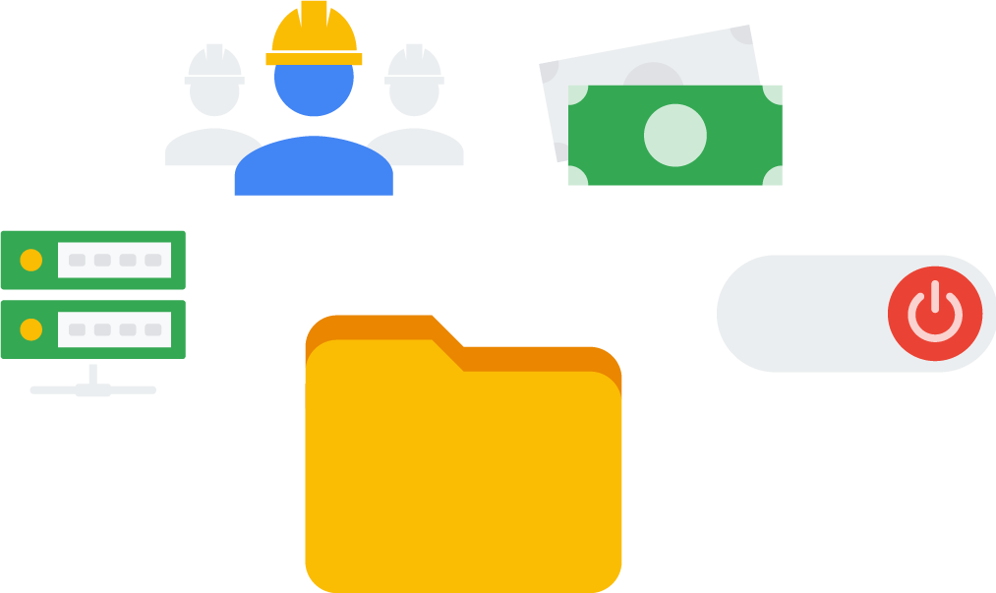
All Google Cloud services you use are associated with a project
Track resource and quota usage.
Enable billing.
Manage permissions and credentials.
Enable services and APIs.
Separate the administrative control plane.
Notes:
All Google Cloud resources belong to a Google Cloud project. Projects are the basis for enabling and using Google Cloud services, like managing APIs, enabling billing, adding and removing collaborators, and enabling other Google services. Each project is a separate compartment, and each resource belongs to exactly one. Projects can have different owners and users. They’re billed separately, and they’re managed separately.

Slide 6
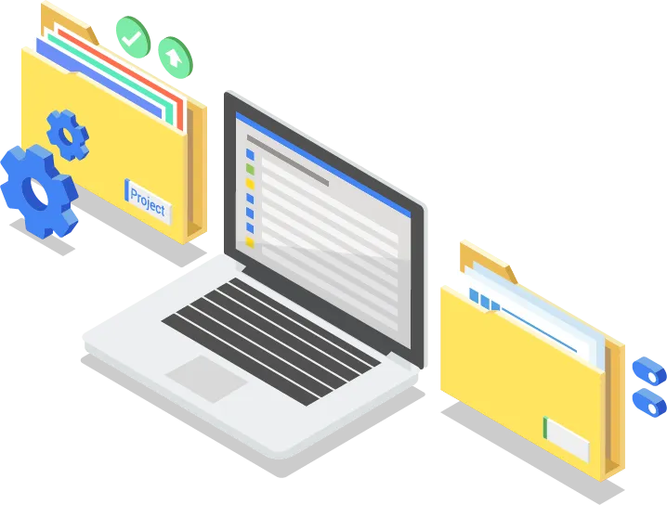
Use Resource Manager to programmatically manage your projects in Google Cloud
Get a list of all projects associated with an account.
Create new projects.
Update existing projects.
Delete projects.
Undelete, or recover, projects that you don't want to delete.
Notes:
Resource Manager provides methods that you can use to programmatically manage your projects in Google Cloud. With this API, you can do the following:
Get a list of all projects associated with an account.
Create new projects.
Update existing projects.
Delete projects.
Undelete, or recover, projects that you don't want to delete.
You can access Resource Manager in either of the following ways:
Through the RPC API
Through the REST API

Slide 7
Projects have three identifying attributes
Project ID
Project name
Project number
Globally unique
Need not be unique
Globally unique
Assigned by Google Cloud but mutable during creation
Chosen by you
Assigned by Google Cloud
Immutable after creation
Mutable
Immutable
Notes:
Each Google Cloud project has a name and project ID you assign. The project ID is a permanent, unchangeable identifier, and it has to be unique across Google Cloud. You’ll use project IDs in several contexts to tell Google Cloud which project you want to work with. On the other hand, project names are for your convenience, and you can change them. Google Cloud also assigns each of your projects a unique project number, and you’ll see it displayed to you in various contexts, but using it is mostly outside the scope of this course. In general, project IDs are made to be human-readable strings, and you’ll use them frequently to refer to projects.

Slide 8

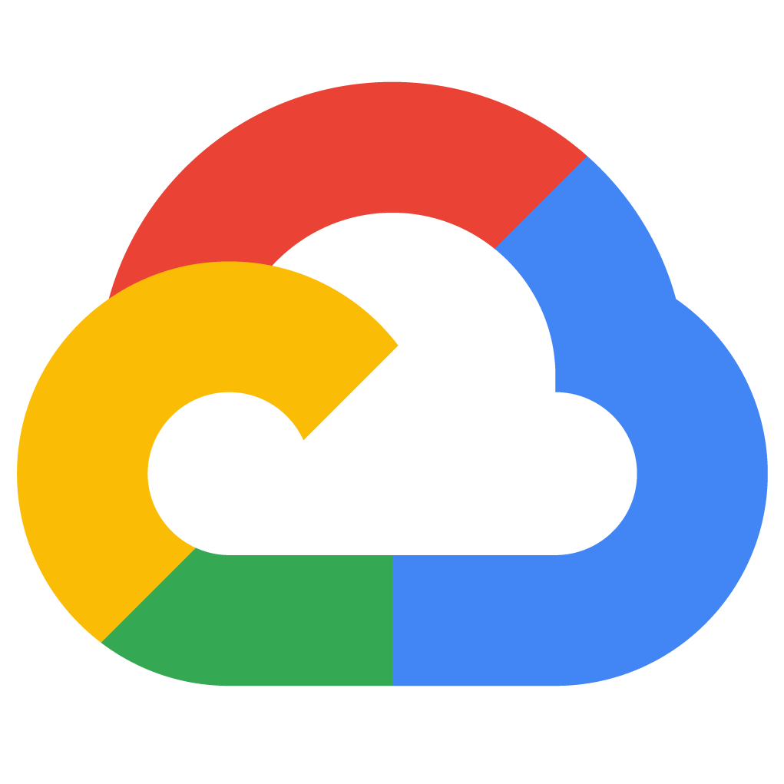
Folders offer flexible management
Folders group projects under an organization.
Folders can contain projects, other folders, or both.
Use folders to assign policies.
example.com
Folder A
Folder B
project_1
project_2
project_3
project_4
project_5
Notes:
The Cloud IAM Folders feature lets you assign policies to resources at a level of granularity you choose. The resources in a folder inherit IAM policies assigned to the folder.
A folder can contain projects, other folders, or a combination of both. You can use folders to group projects under an organization in a hierarchy. For example, your organization might contain multiple departments, each with its own set of Google Cloud resources. Folders allows you to group these resources on a per-department basis
Folders let teams have the ability to delegate administrative rights, so that they can work independently.

Slide 9
Folders offer flexible management
Folders group projects under an organization.
Folders can contain projects, other folders, or both.
Use folders to assign policies.
example.com
Folder A
Folder B
project_1
project_2
project_3
project_4
project_5
Notes:
The resources in a folder inherit IAM policies from the folder. So, if project 3 and project 4 are administered by the same team by design, you can put IAM policies onto Folder B instead. Doing it the other way-- putting duplicate copies of those policies on project 3 and project 4-- would be tedious and error-prone.
One word of caution: to use folders, you need an organization node at the top of the hierarchy.

Slide 10

The organization node organizes projects
The organization node is the root node for Google Cloud resources.
bob@example.com
Organization Admin
example.com
Create
project_1
project_2
alice@example.com
Project Creator
Notes:
You probably want to organize all the projects in your company into a single structure. Most companies want the ability to apply to have centralized visibility of how resources are being used, and also to apply policies centrally. That’s what the organization node is for. It’s the top of the hierarchy.

Slide 11
The organization node organizes projects
Notable organization roles:
Organization Policy Administrator: Broad control over all cloud resources
Project Creator: Fine-grained control of project creation
bob@example.com
Organization Admin
example.com
Create
project_1
project_2
alice@example.com
Project Creator
Notes:
There are some special roles associated with it. For example, you can designate an organization policy administrator, so that only people with privilege can change policies. You can also assign a project creator role, which is a great way to control who can spend money.
So how do you get an organization node? In part the answer depends on whether your company is also a Google Workspace customer. If you have a Workspace domain, Google Cloud projects will automatically belong to your organization node. Otherwise, you can use Google Cloud Identity to create one.
Here’s a tip: when you get a new organization node, it lets anyone in the domain create projects and billing accounts, just as they could before. That’s to avoid surprises and disruption. But it’d be a great first step with a new organization node to decide who on your team really should be able to do those things.
Once you have an organization node, you can create folders underneath it and put projects in.

Slide 12





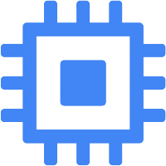
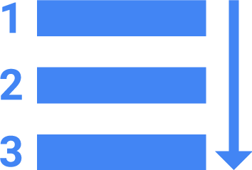



An example IAM resource hierarchy
A policy is set on a resource.
Each policy contains a set of roles and role members.
Resources inherit policies from parent.
Resource policies are a union of parent and resource.
A less restrictive parent policy overrides a more restrictive resource policy.
Organization
example.com
Project
bookshelf
static-assets
stream-ingest
Policy Inheritance
Compute
Engine
App
Engine
Cloud
Storage
Cloud
Storage
Pub/Sub
BigQuery
Resources
instance_a
queue_a
bucket_a
bucket_b
topic_a
dataset_a
Notes:
Here’s an example of how you might organize your resources. There are three projects, each of which uses resources from several Google Cloud services. In this example, we haven’t used any folders, although we always could move projects into folders if that became helpful.
Resources inherit the policies of their parent resource. For instance, if you set a policy at the organization level, it is automatically inherited by all its children projects. And this inheritance is transitive, which means that all the resources in those projects inherit the policy too.
There’s one important rule to keep in mind. The policies implemented at a higher level in this hierarchy can’t take away access that’s granted at lower level. For example, suppose that a policy applied on the “bookshelf” project gives user Pat the right to modify a Cloud Storage bucket. But a policy at the organization level says that Pat can only view Cloud Storage buckets, not change them. The more generous policy takes effect. Keep this in mind as you design your policies.

Slide 13
Agenda
Google Cloud Resource Hierarchy
Cloud Identity and Access Management (Cloud IAM)
Cloud Identity
Interacting with Google Cloud
Google Cloud Marketplace
Quiz and Lab
Resources

Slide 14





Cloud Identity and Access Management
Who
can do what
on which resource
Notes:
IAM lets administrators authorize who can take action on specific resources. An IAM policy has a “who” part, a “can do what” part, and an “on which resource” part.

Slide 15


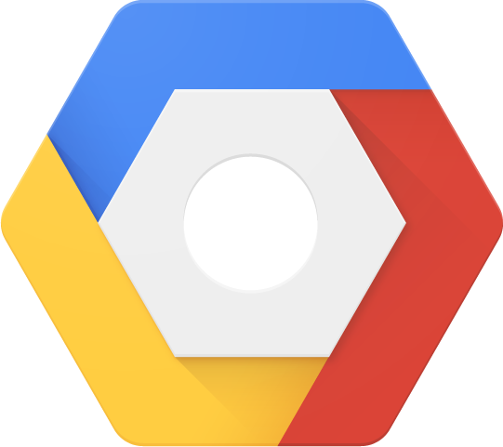

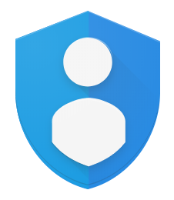
Who: IAM policies can apply to any of four types of principals
Google account test@gmail.com
Service account test@project_id.iam.gserviceaccount.com
Google group test@googlegroups.com
Who
Cloud Identity
example.com
Notes:
The “who” part of an IAM policy can be a Google account, a Google group, a service account, or an entire Workspace or Cloud Identity domain.

Slide 16
Can do what: IAM roles are collections of related permissions
Basic
Predefined
Custom
Notes:
The “can do what” part of an IAM policy is defined by a role. An IAM role is a collection of permissions, because, most of the time you need more than 1 permission to do meaningful work. For example, to manage virtual machine instances in a project, you have to be able to create, delete, start, stop and change virtual machines. So these permissions are grouped together into a role to make them easier to understand and easier to manage.
There are three kinds of roles in Cloud IAM. Let’s talk about each in turn.

Slide 17
IAM basic roles apply across all Google Cloud services in a project
can do what
on all resources
Notes:
Basic roles are broad. You apply them to a Google Cloud project, and they affect all resources in that project.

Slide 18




IAM basic roles offer fixed, coarse-grained levels of access
Owner
Invite members
Remove members
Delete projects
And...
Editor
Deploy applications
Modify code
Configure services
And...
Viewer
Read-only access
Billing Administrator
Manage billing
Add and remove administrators
A project can have multiple owners, editors, viewers, and billing administrators.
Notes:
These are the Owner, Editor, and Viewer roles. If you’re a viewer on a given resource, you can examine it but not change its state. If you’re an editor, you can do everything a viewer can do plus change its state. And if you’re an owner, you can do everything an editor can do plus manage roles and permissions on the resource. The owner role on a project lets you do one more thing too: you can set up billing. Often companies want someone to be able to control the billing for a project without the right to change the resources in the project, and that’s why you can grant someone the billing administrator role.
Be careful! If you have several people working together on a project that contains sensitive data, basic roles are probably too coarse a tool. Fortunately, Google Cloud IAM provides finer-grained types of roles.

Slide 19
IAM predefined roles apply to a particular Google Cloud service in a project
can do what
on Compute Engine resources in this project, or folder, or org
Notes:
Google Cloud services offers their own sets of predefined roles, and they define where those roles can be applied. For example, later in this course, we’ll talk more about Compute Engine, which offers virtual machines as a service. Compute Engine offers a set of predefined roles, and you can apply them to Compute Engine resources in a given project, a given folder, or an entire organization.
Another example: consider Cloud Bigtable, which is a managed database service. Cloud Bigtable offers roles that can apply across an entire organization, to a particular project, or even to individual Bigtable database instances.

Slide 20


IAM predefined roles offer more fine-grained permissions on particular services
Google Group
compute.instances.delete
compute.instances.get
compute.instances.list
compute.instances.setMachineType
compute.instances.start
compute.instances.stop
. . .
InstanceAdmin Role
project_a
Notes:
Compute Engine’s instanceAdmin role let's whoever has it perform a certain set of actions on virtual machines. What set of actions? Those listed here: listing them, reading and changing their configurations, and starting and stopping them. And which virtual machines? Well, that depends on where the role is applied.
In this example, all the users of a certain Google group have the role, and they have it on all the virtual machines in project A.

Slide 21
IAM custom roles let you define a precise set of permissions
Google Group
compute.instances.get
compute.instances.list
compute.instances.start
compute.instances.stop
. . .
InstanceOperator Role
project_a
Notes:
What if you need something even finer-grained? That’s what custom roles permit. A lot of companies use a “least-privilege” model, in which each person in your organization the minimal amount of privilege needed to do his or her job. So, for example, maybe I want to define an “instanceOperator” role, to allow some users to stop and start Compute Engine virtual machines but not reconfigure them. Custom roles allow me to do that.
A couple of cautions about custom roles. First, if you decide to use custom roles, you’ll need to manage the permissions that make them up. Some companies decide they’d rather stick with the predefined roles. Second, custom roles can only be used at the project or organization levels. They can’t be used at the folder level.

Slide 22


On which resource: Users get roles on specific items in the hierarchy
Organization
example.com
Project
bookshelf
static-assets
stream-ingest
Policy Inheritance
on which resource
Compute
Engine
App
Engine
Cloud
Storage
Cloud
Storage
Pub/Sub
BigQuery
Resources
instance_a
queue_a
bucket_a
bucket_b
topic_a
dataset_a
Notes:
When you give a user, group, or service account a role on a specific element of the resource hierarchy, the resulting policy applies to the element you chose, as well as to elements below it in the hierarchy.

Slide 23
Service accounts control server-to-server interactions
Provide an identity for carrying out server-to-server interactions in a project.
Used to authenticate from one service to another.
Used to control privileges used by resources so that applications can perform actions on behalf of authenticated end users.
Identified with an email address:
PROJECT_NUMBER-compute@developer.gserviceaccount.com
PROJECT_ID@appspot.gserviceaccount.com
Notes:
What if you want to give permissions to a Compute Engine virtual machine rather than to a person? That’s what service accounts are for. For instance, maybe you have an application running in a virtual machine that needs to store data in Google Cloud Storage. But you don’t want to let just anyone on the Internet have access to that data; only that virtual machine. So you’d create a service account to authenticate your VM to Cloud Storage. Service accounts are named with an email address, but instead of passwords they use cryptographic keys to access resources.

Slide 24
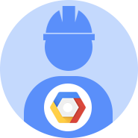


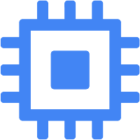
Service accounts and IAM
Service accounts authenticate using keys. Google manages keys for Compute Engine and App Engine. You can assign a predefined or custom IAM role to the service account.
Identity
IAM role
Resource
Service account
InstanceAdmin role
Compute instances
Notes:
In this simple example, a service account has been granted Compute Engine’s Instance Admin role. This would allow an application running in a VM with that service account to create, modify, and delete other VMs.
Incidentally, service accounts need to be managed too! For example, maybe Alice needs to manage what can act as a given service account, while Bob just needs to be able to view what can. Fortunately, in addition to being an identity, a service account is also a resource! So it can have IAM policies of its own attached to it. For instance, Alice can have the editor role on a service account and Bob can have the viewer role. This is just like granting roles for any other Google Cloud resource.

Slide 25
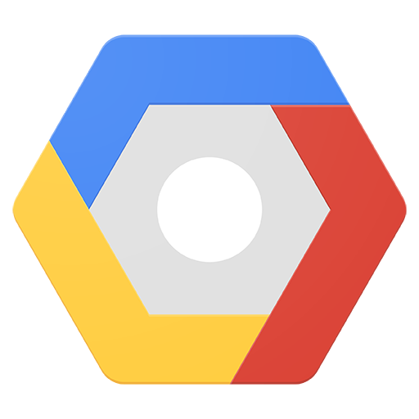
Example: Service accounts and IAM
VMs running component_1 are granted Editor access to project_b using Service Account 1.
VMs running component_2 are granted objectViewer access to bucket_1 using Service Account 2.
Service account permissions can be changed without recreating VMs.
project_a
project_b
component_1
Service Account 1 Editor
component_2
Service Account 2 Storage. objectViewer
bucket_1
Notes:
You can grant different groups of VMs in your project different identities. This makes it easier to manage different permissions for each group. You also can change the permissions of the service accounts without having to recreate the VMs.
Here’s a more complex example. Say you have an application that’s implemented across a group of Compute Engine virtual machines. One component of your application needs to have an editor role on another project, but another component doesn’t. So you would create two different service accounts, one for each subgroup of virtual machines. Only the first service account has privilege on the other project. That reduces the potential impact of a miscoded application or a compromised virtual machine.

Slide 26
Agenda
Google Cloud Resource Hierarchy
Cloud Identity and Access Management (Cloud IAM)
Cloud Identity
Interacting with Google Cloud
Google Cloud Marketplace
Quiz and Lab
Resources

Slide 27



What can you use to manage your Google Cloud administrative users?
User@gmail.com
Project A
Owner
Gmail account
Cloud Identity/Workspace
Service Account
User@yourcompany.com
Project B
Can be part
of a group
Instance Admin
Security@yourcompany.com
Note: You cannot use Cloud IAM to create or manage your users or groups.
Project B
Security Admin
Notes:
Many new Google Cloud customers get started by logging into the Cloud Console with a Gmail account. To collaborate with their teammates, they use Google Groups to gather together people who are in the same role. This approach is easy to get started with, but its disadvantage is that your team’s identities are not centrally managed. For example, if someone leaves your organization, there is no centralized way to remove their access to your cloud resources immediately.
Google Cloud customers who are also Workspace customers can define Google Cloud policies in terms of Workspace users and groups. This way, when someone leaves your organization, an administrator can immediately disable their account and remove them from groups using the Google Admin Console.
Google Cloud customers who are not Workspace customers can get these same capabilities through Cloud Identity. Cloud Identity lets you manage users and groups using the Google Admin Console, but you do not pay for or receive Workspace’s collaboration products such as Gmail, Docs, Drive, and Calendar. Cloud Identity is available in a free and a premium edition. The premium edition adds capabilities for mobile device management.

Slide 28
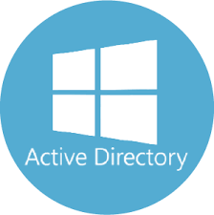
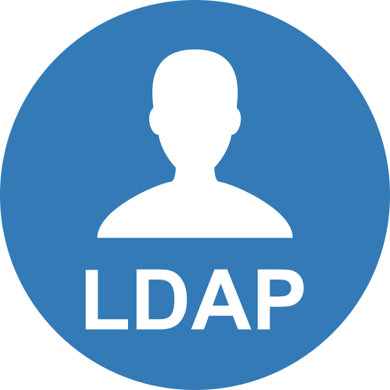
What if you already have a different corporate directory?
Google Cloud
Directory Sync
Scheduled sync
Users and groups in your existing directory service
Users and groups in your Cloud Identity domain
Notes:
Using Google Cloud Directory Sync, your administrators can log in and manage Google Cloud resources using the same usernames and passwords they already use. This tool synchronizes users and groups from your existing Active Directory or LDAP system with the users and groups in your Cloud Identity domain. The synchronization is one-way only; no information in your Active Directory or LDAP map is modified. Google Cloud Directory Sync is designed to run scheduled synchronizations without supervision, after its synchronization rules are set up.

Slide 29
Agenda
Google Cloud Resource Hierarchy
Cloud Identity and Access Management (Cloud IAM)
Cloud Identity
Interacting with Google Cloud
Google Cloud Marketplace
Quiz and Lab
Resources

Slide 30

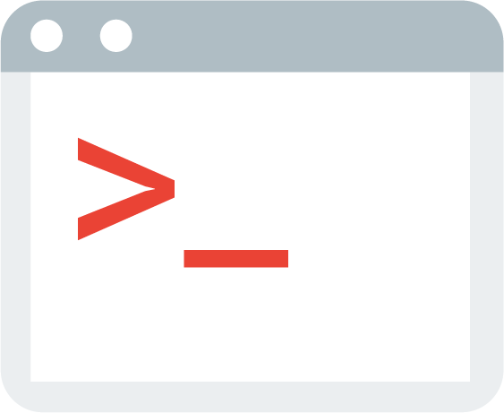

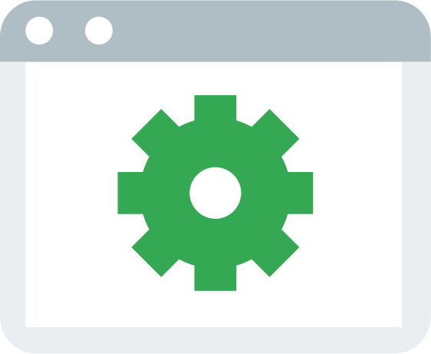
There are four ways to interact with Google Cloud
Google Cloud Console
Web user interface
Cloud SDK and Cloud Shell
Command-line interface
Cloud Console Mobile App
For iOS and Android
REST-based API
For custom applications
Notes:
There are four ways you can interact with Google Cloud, and we’ll talk about each in turn: the Cloud Console, the Cloud SDK and Cloud Shell, the mobile app, and the APIs.

Slide 31
Google Cloud Console
Centralized console for all project data.
Developer tools
Cloud Source Repositories
Cloud Shell
Test Lab (mobile app testing)
Access to product APIs.
Manage and create projects.
Notes:
The Cloud Console is Google Cloud’s Graphical User Interface (GUI) which helps you deploy, scale, and diagnose production issues in a simple web-based interface. With the Cloud Console, you can easily find your resources, check their health, have full management control over them, and set budgets to control how much you spend on them. Search to quickly find resources and connect to instances via SSH in the browser. Overcome the most complex tasks with Cloud Shell, your admin machine in the cloud, where you can use the built-in Cloud SDK.

Slide 32
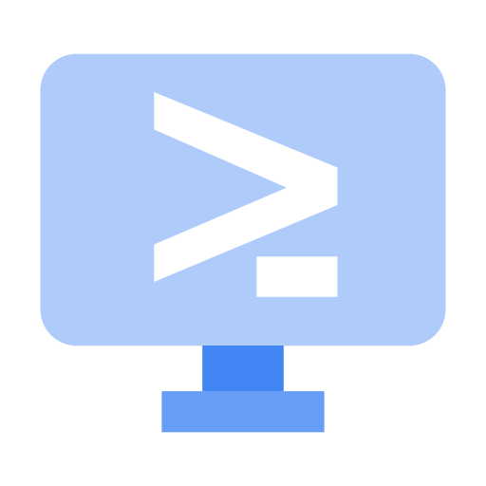
The Cloud SDK and Cloud Shell
The Cloud SDK includes CLI tools for Google Cloud products and services.
gcloud, gsutil (Cloud Storage), bq (BigQuery)
Available as a Docker image.
Available via Cloud Shell.
Containerized version of the Cloud SDK running on a Compute Engine instance.
Notes:
The Cloud SDK is a set of tools that you can use to manage resources and applications hosted on Google Cloud. These include the gcloud tool, which provides the main command-line interface for Google Cloud Platform products and services, as well as gsutil and bq. When installed, all of the tools within the Cloud SDK are located under the bin directory.
Cloud Shell provides you with command-line access to your cloud resources directly from your browser. Cloud Shell is a Debian-based virtual machine with a persistent 5-GB home directory, which makes it easy for you to manage your Google Cloud projects and resources. With Cloud Shell, the Cloud SDK gcloud command and other utilities you need are always installed, available, up to date, and fully authenticated when you need them.
For more information on the SDK command-line tools, see: https://cloud.google.com/sdk/cloudplatform
Note: Currently, the App Engine SDKs are separate downloads. For more information, see: https://cloud.google.com/appengine/downloads
Cloud Shell provides the following:
A temporary Compute Engine virtual machine instance running a Debian-based Linux operating system
Command-line access to the instance from a web browser using terminal windows in the Cloud Console
5 GB of persistent disk storage per user, mounted as your $HOME directory in Cloud Shell sessions across projects and instances
The Cloud SDK and other tools pre-installed on the Compute Engine instance
Language support, including SDKs, libraries, runtime environments and compilers for Java, Go, Python, Node.js, PHP and Ruby
Web preview functionality, which allows you to preview web applications running on the Cloud Shell instance through a secure proxy
Built-in authorization for access to projects and resources
You can use Cloud Shell to:
Create and manage Compute Engine instances.
Create and access Cloud SQL databases.
Manage Cloud Storage data.
Interact with hosted or remote Git repositories, including Cloud Source Repositories.
Build and deploy App Engine applications.
You can also use Cloud Shell to perform other management tasks related to your projects and resources, using either the gcloud command or other available tools.

Slide 33
RESTful APIs
Programmatic access to products and services
Typically use JSON as an interchange format
Use OAuth 2.0 for authentication and authorization
Enabled through the Cloud Console
To help you control spend, most include daily quotas and rates (limits)
Quotas and rates can be raised by request
Notes:
The services that make up Google Cloud offer Application Programming Interfaces, so that code you write can control them. These APIs are what’s called “RESTful”; in other words, they follow the “Representational state transfer” paradigm. In a broad sense, that means that your code can use Google services in much the same way that web browsers talk to web servers. The APIs name resources in Google Cloud with URLs. Your code can pass information to the APIs using JSON, which is a very popular way of passing textual information over the Web. And there’s an open system, OAuth2, for user login and access control.

Slide 34
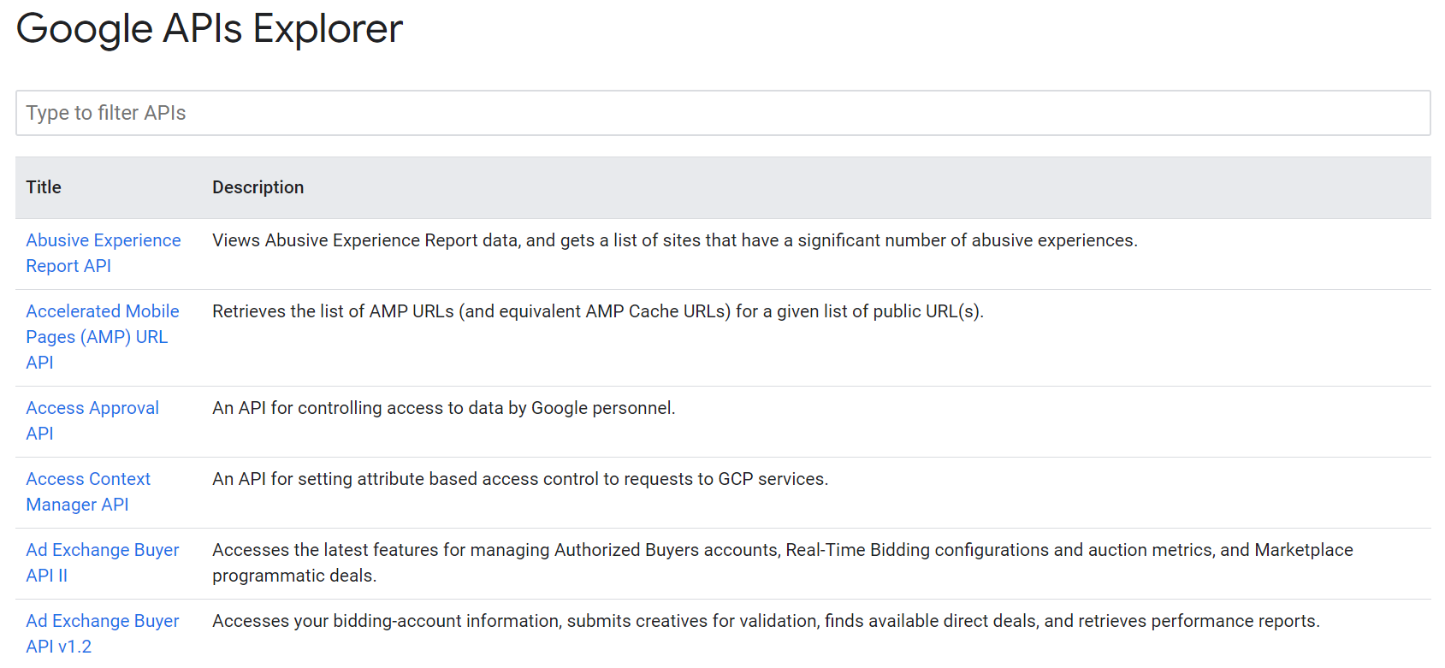
Use the Google APIs Explorer to help you write code
Notes:
The Cloud Console includes a tool called the Google APIs Explorer that helps you learn about the APIs interactively. It lets you see what APIs are available, and in what versions. These APIs expect parameters, and documentation on them is built-in. You can try the APIs interactively, even with user authentication.
Suppose you’ve explored an API, and you’re ready to build an application that uses it. Do you have to start coding from scratch? No. Google provides client libraries to take a lot of the drudgery out of the task of calling Google Cloud from your code.

Slide 35
Use client libraries to control Google Cloud resources from within your code
Cloud Client Libraries
Community-owned, hand-crafted client libraries
Google API Client Libraries
Open source, generated
Support various languages
Java, Python, JavaScript, PHP, .NET, Go, Node.js, Ruby, Objective-C, Dart
Notes:
There are two kinds of libraries. The Cloud Client libraries are Google Cloud’s latest and recommended libraries for its APIs. They adopt the native styles and idioms of each language. On the other hand, sometimes a Cloud Client library doesn’t support the newest services and features. In that case, you can use the Google API Client library for your desired languages. These libraries are designed for generality and completeness.

Slide 36



Cloud Console Mobile App
Manage virtual machines and database instances.
Manage apps in App Engine.
Manage your billing.
Visualize your projects with a customizable dashboard.
Notes:
The mobile app allows you to start, stop, and SSH into Compute Engine instances, and to see logs from each instance. You can stop and start Cloud SQL instances. You can also administer applications deployed on App Engine, by viewing errors, rolling back deployments, and changing traffic splitting.
You can also get up-to-date billing information for your projects and get billing alerts for projects that are going over budget.
You can set up customizable graphs showing key metrics such as CPU usage, network usage, requests per second, and server errors.
The mobile app also offers alerts and incident management.
Download the Cloud Console Mobile App from Google Play or from the iOS App Store.

Slide 37
Agenda
Google Cloud Resource Hierarchy
Cloud Identity and Access Management (Cloud IAM)
Cloud Identity
Interacting with Google Cloud
Google Cloud Marketplace
Quiz and Lab
Resources

Slide 38
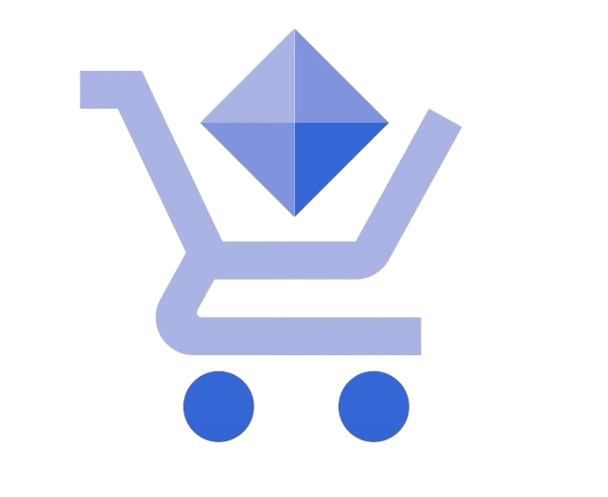
Cloud Marketplace gives quick access to solutions
A solution marketplace containing pre-packaged, ready-to-deploy solutions.
Some offered by Google
Others by third-party vendors
You pay for the underlying Google Cloud resource usage.
Some solutions also assess third-party license fees.
Notes:
If you want a quick way to get started with Google Cloud, with minimal effort this is what Cloud Marketplace provides. It’s a tool for quickly deploying functional software packages on Google Cloud. There’s no need to manually configure the software, virtual machine instances, storage, or network settings, although you can modify many of them before you launch if you like.
You will find solutions offered by Google in Cloud Marketplace as well as solutions offered by third-party vendors.
Most software packages in Cloud Marketplace are at no additional charge beyond the normal usage fees for Google Cloud resources. Some Cloud Marketplace images charge usage fees, particularly those published by third parties, with commercially licensed software. But they all show you estimates of their monthly charges before you launch them. Do be aware that these estimates are just that--estimates--and in particular they don’t attempt to estimate networking costs, since those will vary based on how you use the applications. A second note of caution: Google Cloud updates the base images for these software packages to fix critical issues and vulnerabilities, but it doesn’t update software after it’s been deployed. Fortunately, you’ll have access to the deployed systems so you can maintain them.
See the Cloud Marketplace documentation for details.

Slide 39
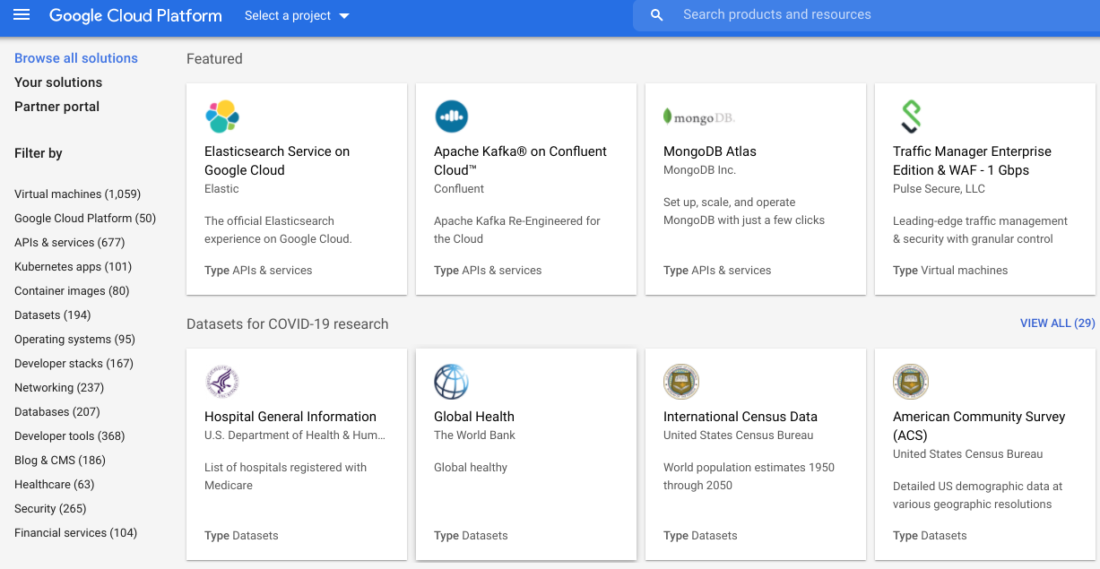
Cloud Marketplace catalog
Notes:
Cloud Marketplace offers ready-to-go development stacks, solutions, and services to accelerate development. So you spend less time installing and more time developing. Benefits include:
Deploying production-grade solutions in a few clicks,
Single billing for all your Google Cloud and third-party services,
Managing solutions using Deployment Manager,
Notifications when a security update is available, and
Direct access to partner support.

Slide 40
Agenda
Google Cloud Resource Hierarchy
Cloud Identity and Access Management (Cloud IAM)
Cloud Identity
Interacting with Google Cloud
Google Cloud Marketplace
Quiz and Lab
Resources

Slide 41
Quiz 1
True or False: If a Cloud IAM policy gives you Owner permissions at the project level, your access to a resource in the project may be restricted by a more restrictive policy on that resource.
True
False

Slide 42
Quiz 1
True or False: If a Cloud IAM policy gives you Owner permissions at the project level, your access to a resource in the project may be restricted by a more restrictive policy on that resource.
True
False

Slide 43
Quiz 2
True or False: All Google Cloud resources are associated with a project.
True
False

Slide 44
Quiz 2
True or False: All Google Cloud resources are associated with a project.
True
False

Slide 45
Quiz 3
Service accounts are used to provide which of the following?
Authentication between Google Cloud services.
Key generation and rotation when used with App Engine and Compute Engine.
A way to restrict the actions a resource (such as a VM) can perform.
A way to allow users to act with service account permissions.
All of the above.

Slide 46
Quiz 3
Service accounts are used to provide which of the following?
Authentication between Google Cloud services.
Key generation and rotation when used with App Engine and Compute Engine.
A way to restrict the actions a resource (such as a VM) can perform.
A way to allow users to act with service account permissions.
All of the above.

Slide 47
Lab Intro
Getting Started with Cloud Marketplace
Duration: 25 minutes

Slide 48
Agenda
Google Cloud Resource Hierarchy
Cloud Identity and Access Management (Cloud IAM)
Cloud Identity
Interacting with Google Cloud
Google Cloud Marketplace
Quiz and Lab
Resources

Slide 49
Resources
Google Cloud security https://cloud.google.com/security/
Configuring permissions https://cloud.google.com/docs/permissions-overview
Cloud Identity and Access Management (Cloud IAM) https://cloud.google.com/iam/
Cloud SDK installation and quick start https://cloud.google.com/sdk/#Quick_Start
gcloud tool guide https://cloud.google.com/sdk/gcloud/

