Slide 1
A ase study on cat’s activity prediction
PIP Case Study
By, Ajit Kr Mishra
Confidential
DD-MMM-YYYY
John Smith

Slide 2
Correctly classify the events as Elimination or Non-elimination and further classify the elimination events into Urination and Defecation
Sales department
global company in the Pet Care and pet food space
Client
Problem Statement

Slide 3
Topics:
01
｜
Data Preparation
02
｜
Exploratory Data Analysis at Initial Stage
03
｜
Exploratory Data Analysis at Final Stage
04
｜
Feature Engineering
05
｜
Model Performance Evaluation
06
｜
Residual Analysis
07
｜
Business Insights Discussion
08
｜
Conclusion

Slide 4
01
Data Preparation

Slide 5





Data Provided:
82 Folders
(Different device)
13,075 CSV files
13,075 JSON files
Cat’s Details
4 Load Sensor’s data at 0.025 second time interval
Activity
Name
Weight
Date

Slide 6
Data Preparation:
Data Preparation:
CSV Files:
LC0
Change in load_LC0
Absolute Change _LC0
Sum of all load sensors
change of load with time
X1
X2
X3
X2-X1
X3-X2
| X2-X1 |
| X3-X2 |
∑ | X2-X1 |
∑ | X3-X2 |
JSON Files:
Name: To analyze different cats separately
Weight: to create new features
Target Variable
Urination
Elimination
Activity:
Defecation
Non-elimination
At first labeled all the csv files with their activity (Defecation, Urination & Non-elimination)
Each csv files are converted to one row in the final datasheet for modelling.
Final data sheet has 13075 rows.

Slide 7
02
Exploratory Data Analysis at Initial Stage

Slide 8
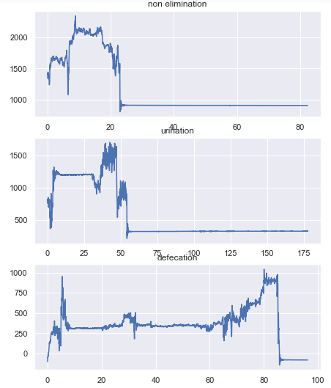
4 load sensors plot with time stamp:
This is the plot of load with time stamp of different activities
Here we can notice the duration of the activities
Variation in the line is representing cat is doing any activity

Slide 9
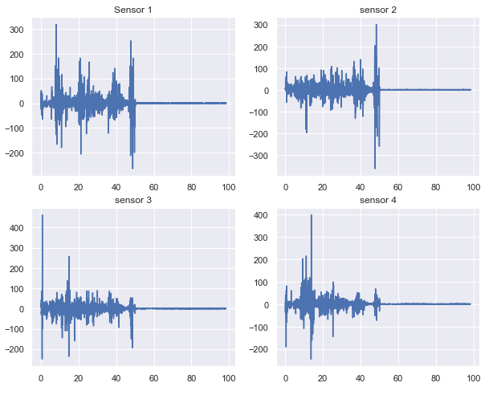
4 load sensors plot of change in load with time stamp :
This is the plot of all 4 load sensors value with differential sum of load with timestamp
Here we can see all the four load sensors are reacting at the same time.
Positive values are representing load is increasing with time and vice versa
If the differential loads are near about zero means cats are not moving and not doing any activities.

Slide 10
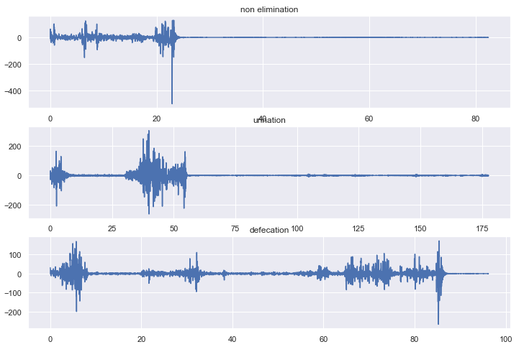
3 different activity with time stamp:
Urinating
Defecating
Filling or Digging
This plots are representing load differential load with timestamp of all 3 activity
Here we can notice the time difference between activities
Initial large values representing digging then loads near zero are representing they are doing that activity and after that the higher values are representing the cat is covering it.

Slide 11
03
Exploratory Data Analysis at Final Stage

Slide 12
Outlier Analysis:
Sum of all absolute differential loads:
Used flooring and caping technique.
I have taken Q3 as 0.98 after certain trial
Whisker width as 3.5
Other Outliers: (230 Rows)
Missing Value:
Name of the cat: There are 246 files where cat’s name is missing.

Slide 13
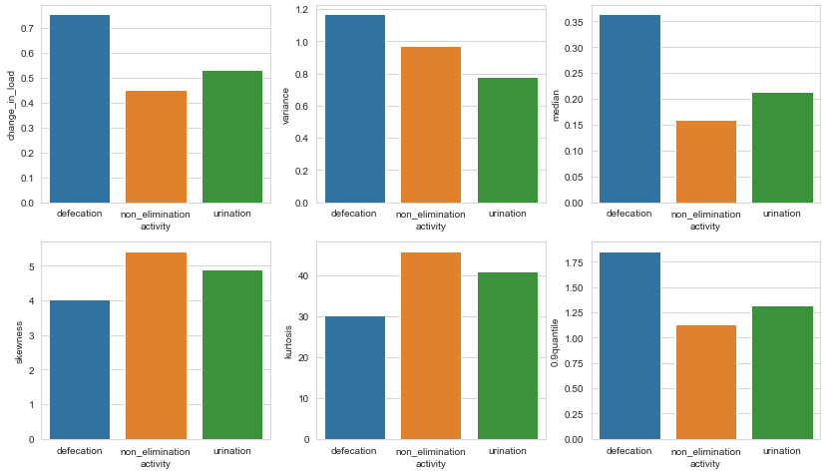
Statistical Measures of different activities:

Slide 14
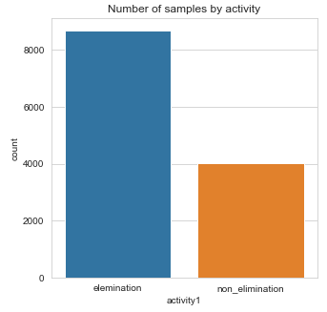
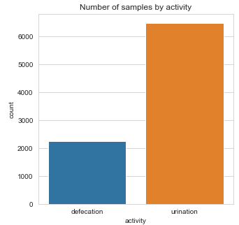
Comparison of number of rows with different activities:
Here we can notice that ‘Elimination’ data is more than ‘Non elimination’ data
In Elimination data the ‘Urination’ data is more than ‘Defecation’ data.

Slide 15
Does digging up and covering activity differ between urination and defecation? If so, how?
Performed t-test to answer this question.
we have 2 different activity (urination and defecation) using one independent variable (mean of sum of differential load)
Hypothesis:
Null Hypothesis (H0) : The average load sensor value is same.
Alternate Hypothesis (Ha) : The average load sensor value is different for urination and defecation
Hypothesis Result:
t-stat = -33.82
p-value = 1.29e-226 ~= 0
Reject Null Hypothesis
Select Alternate hypothesis
Conclusion:
digging up and covering activity is significantly different between urination and defecation

Slide 16
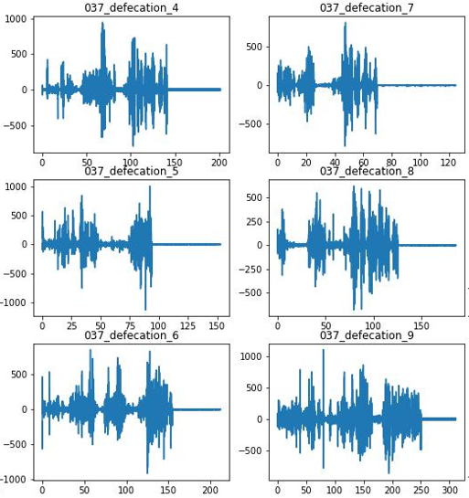
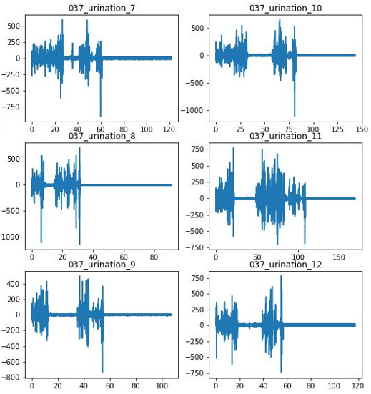
Defecation:
Urination:
From set of these two figures, we can clearly see the difference between digging and filling process of urination and defecation

Slide 17
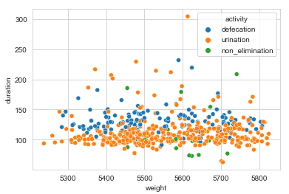
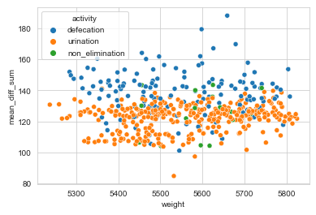
Relationship of weight with duration and Differential load of one cat:
There are not much change in duration of activity and differential load with change in weight

Slide 18
04
Feature Engineering

Slide 19
Created Features:
Change in Load:
Difference of load sensor’s value from its previous value provides the change in force per 0.025 sec. If it is +ve means it is increasing and if is -ve means it is decreasing.
Acceleration (a):
Force = Mass * Acceleration
Acceleration = Differential load / weight of the cat
Jerk :
Jerk is the rate of change of acceleration with time
Velocity (v):
acceleration = change in velocity with time
a2 = (v2-v1) / (t2-t1)
v2 = (0.025* a2) + v1 [As t2-t1 = 0.025 & initial v1=0]
Energy:
Here we have used Kinetic energy
E = 0.5 * m * v^2
Power:
Power = Force * Velocity
Momentum:
Momentum = Mass * Velocity

Slide 20
Relationship of features with target variables:
Here we can see the relationship of all the features with different activity.
activity | defecation | non_elimination | urination
Change in load (N/s) | 30.16 | 18.08 | 21.17
Variance | 1.167 | 0.97 | 0.78
Maximum | 14.13 | 10.86 | 11.46
Median | 0.36 | 0.16 | 0.21
Skewness | 4.03 | 5.42 | 4.89
Kurtosis | 30.25 | 45.90 | 40.87
0.9_quantile | 1.85 | 1.133 | 1.32
Acceleration (m/s^2) | 0.15 | 0.09 | 0.11
Jerk (m/s^3) | 2.68 | 1.70 | 1.82
Velocity (m/s) | 14.99 | 4.59 | 7.67
Energy (J) | 835.66 | 107.01 | 229.93
Power (watt) | 10.86 | 1.97 | 3.88
Momentum (N-S) | 72.32 | 21.62 | 37.06

Slide 21
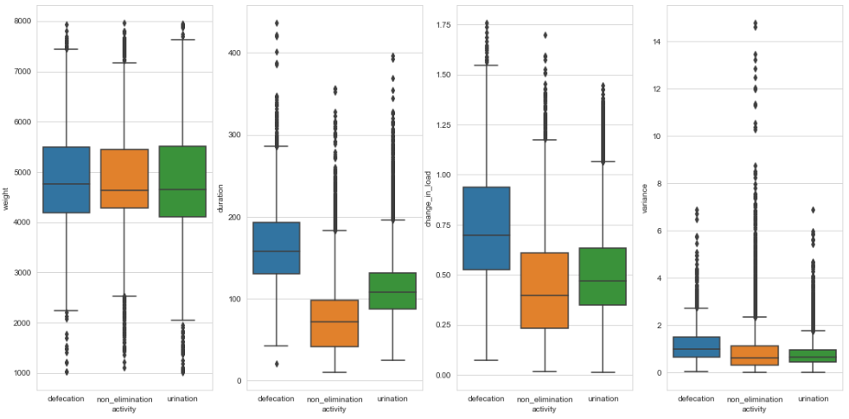
Relationship of features with target variables:
We can notice that weight is not changing much across activities. So, we will remove ‘weight’ column

Slide 22
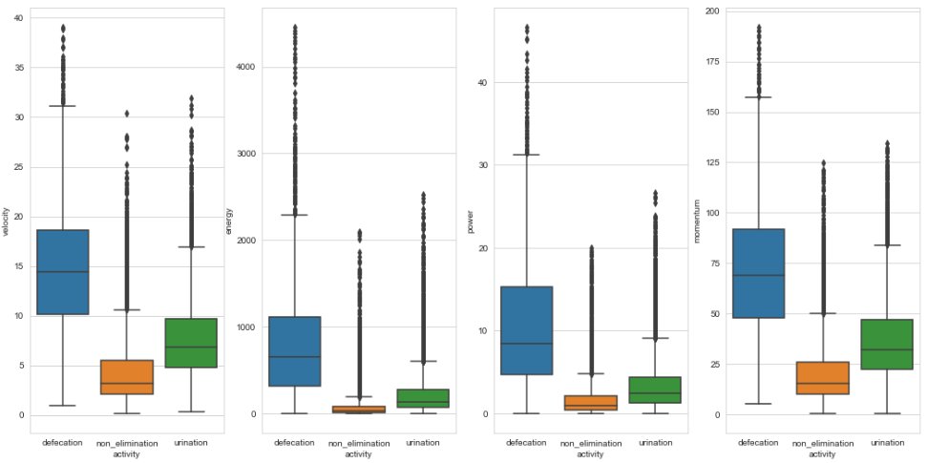
Relationship of features with target variables:

Slide 23
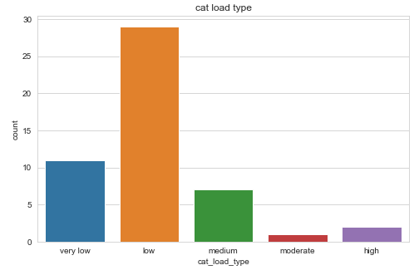
Comparison between different cat’s behavior:
Here we can see there are difference between applied load among cat morphology.
Category of the cats with load:
1. Very Low = 0.2 - 0.4
2. Low = 0.4 - 0.6
2. Medium = 0.6 – 0.8
3. Moderate = 0.8 – 1.0
4. High= 1.0 and above
Majority of the cat is applying differential load between 0.2-0.6 but there are some cat who are applying load more than 100 as well
From Hypothesis test:
P-value is 0 in One way ANOVA test is also representing there the cat’s behavior is different among different cat

Slide 24
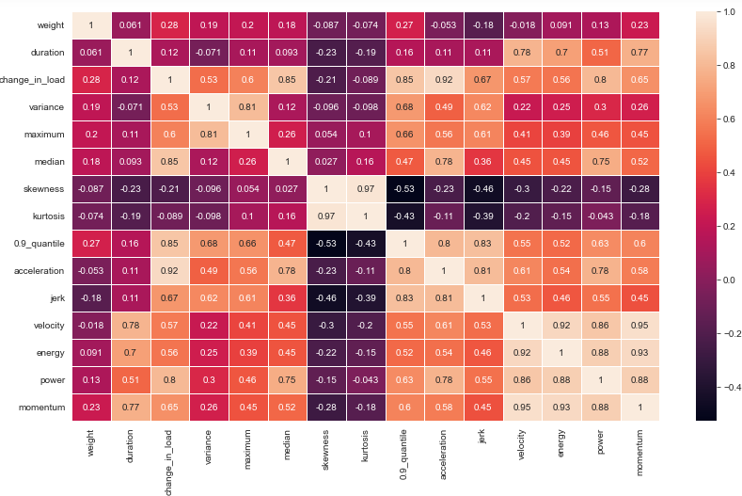
Correlation between Features:
Change in load ~ acceleration = 0.92
Change in load ~ 0.9_quantile = 0.85
Acceleration ~ differential load = 0.92
skewness ~ kurtosis = 0.97
velocity ~ energy = 0.89
velocity ~ power = 0.86
velocity ~ momentum = 0.95

Slide 25
05
Model Performance Evaluation

Slide 26
Feature Selection using Backward Elimination Method:
Calculation the P-value of all the features
Remove the feature with highest P-value
Continue this process till all features has p-value > 0.05
Final Features of Elimination and Non-elimination classification :
Dropped Features: ‘0.9 Quantile’ and ‘acceleration’
1. Duration
2. Change in load
3. Variance
4. Maximum
5. Median
6. Skewness
7. Kurtosis
8. Jerk
9. Velocity
10. Energy
11. Power
12. Momentum
Final Features of Urination and Defecation classification :
Dropped Features: ‘Kurtosis’ and ‘Variance’, ‘Maximum’, ‘Velocity’, ‘0.9 Quantile’
1. Duration
2. Change in load
3. Variance
4. Skewness
5. Acceleration
6. Jerk
7. Energy
8. Power
9. Momentum

Slide 27
Model Performance Comparison:
 | Train |  | Validation |  | Test
 | Accuracy % | ROC-AUC | Accuracy % | ROC-AUC | Accuracy % | ROC-AUC
Logistic Regression | 75.66 | 0.83 | 77.16 | 0.83 | 74.47 | 0.82
SVM | 75.79 | 0.83 | 76.55 | 0.84 | 73.93 | 0.82
KNN | 81.49 | 0.91 | 77.77 | 0.87 | 77.26 | 0.85
XG Boost | 86.61 | 0.94 | 83.1 | 0.91 | 81.64 | 0.89
Decision Tree | 86.41 | 0.94 | 80.76 | 0.87 | 73.62 | 0.86
Random Forest | 99.97 | 1 | 91.8 | 0.97 | 90.81 | 0.96
Best Result
 | Train |  | Validation |  | Test
 | Accuracy % | ROC-AUC | Accuracy % | ROC-AUC | Accuracy % | ROC-AUC
Logistic Regression | 80.54 | 0.88 | 79.82 | 0.88 | 80.55 | 0.88
SVM | 80.53 | 0.88 | 80.78 | 0.88 | 80.78 | 0.88
KNN | 83.07 | 0.92 | 79.25 | 0.87 | 79.52 | 0.88
XG Boost | 88.73 | 0.95 | 84.42 | 0.92 | 85.87 | 0.93
Decision Tree | 93.26 | 0.98 | 85.45 | 0.88 | 85.64 | 0.83
Random Forest | 99.99 | 1 | 91.16 | 0.97 | 91.16 | 0.97
Best Result

Slide 28
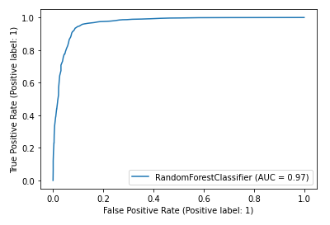
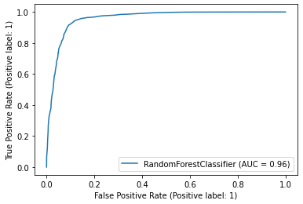
Random Forest Result for Elimination & Non-elimination:
Validation
Test
ROC-AUC
0.97
ROC-AUC
0.96
Accuracy : 91.8 %
Accuracy : 90.81 %
Predicted
Confusion Matrix:
Predicted
Confusion Matrix:
 | Non-elimination | Elimination
Non-elimination | 1604 | 141
Elimination | 147 | 1622
 | Non-elimination | Elimination
Non-elimination | 1618 | 155
Elimination | 168 | 1573
Actual
Actual
 | precision | recall | f1-score | support
Non-eli | 0.92 | 0.92 | 0.92 | 1745
Eliminate | 0.92 | 0.92 | 0.92 | 1763
 | precision | recall | f1-score | support
Non-eli | 0.91 | 0.91 | 0.91 | 1773
Eliminate | 0.91 | 0.9 | 0.91 | 1741

Slide 29
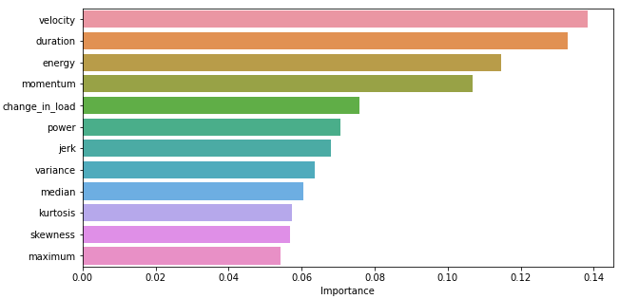
Importance of features using Random Forest for Elimination & Non-elimination

Slide 30
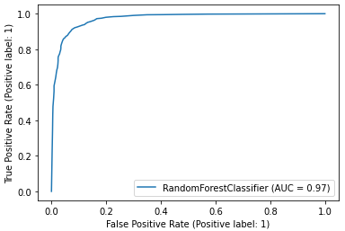
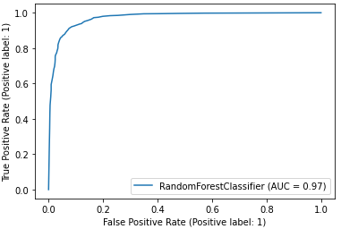
Random Forest Result for Urination & Defecation:
Validation
Test
ROC-AUC
0.97
ROC-AUC
0.97
Accuracy : 91.16 %
Accuracy : 91.16 %
Predicted
Confusion Matrix:
Predicted
Confusion Matrix:
 | Non-elimination | Elimination
Non-elimination | 1267 | 48
Elimination | 183 | 1114
 | Non-elimination | Elimination
Non-elimination | 1216 | 61
Elimination | 170 | 1165
Actual
Actual
 | precision | recall | f1-score | support
Non-eli | 0.87 | 0.96 | 0.92 | 1315
Eliminate | 0.96 | 0.86 | 0.91 | 1297
 | precision | recall | f1-score | support
Non-eli | 0.88 | 0.95 | 0.91 | 1277
Eliminate | 0.95 | 0.87 | 0.91 | 1335

Slide 31
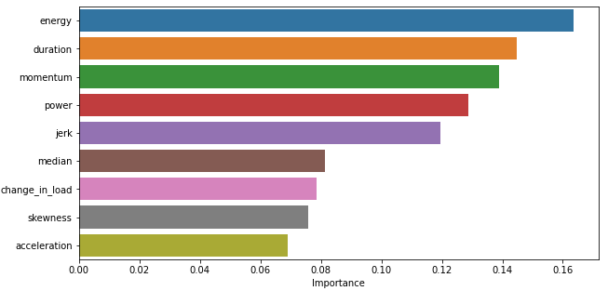
Importance of features using Random Forest for Urination and Defecation:

Slide 32
06
Residual Analysis

Slide 33
Case-1: Residual Analysis of Elimination & Non-elimination:
Predicted
 | Non-elimination | Elimination
Non-elimination | 1618 | 155
Elimination | 168 | 1573
Actual
8.74 % Non-elimination misidentified as Elimination
9.65 % Elimination misidentified as Non-elimination
Elimination Misidentified as Non-elimination:
Urination Rows : 94%, Defecation Rows : 6%

Slide 34
Pattern Analysis of Elimination, Misidentified as Non-elimination:
Those elimination has features value nearer to non-elimination values are misidentified as non-elimination

Slide 35
Pattern Analysis of Non-elimination, Misidentified as Elimination:
Those non-elimination has features value nearer to elimination values are misidentified as elimination

Slide 36
Case-2: Residual Analysis of Urination & Defecation:
4.78 % Defecation misidentified as Urination
12.73 % Urination misidentified as Defecation

Slide 37
Pattern Analysis of Urination Misidentified as Defecation:
Those Urination has features value nearer to Defecation values are misidentified as Defecation

Slide 38
Pattern Analysis of Defecation Misidentified as Urination:
Those Defecation has features value nearer to Urination values are misidentified as Urination

Slide 39
Model Performance Evaluation After adding a new feature “load/sec”:
Test accuracy improved. It was 91.16 % now it is 92.76 %
Misidentified as defecation was 170 now it has decreased to 103
Misidentified as urination was 61 now it has increased to 86
Previous Performance:
Current Performance:
Predicted
Predicted
 | Defecation | Urination
Defecation | 1216 | 61
Urination | 170 | 1165
 | Defecation | Urination
Defecation | 1191 | 86
Urination | 103 | 1232
Actual
Actual
ROC-AUC Score: 0.97
ROC-AUC Score: 0.98
4.78 % Defecation misidentified as Urination
12.73 % Urination misidentified as Defecation
6.73 % Defecation misidentified as Urination
7.71 % Urination misidentified as Defecation

Slide 40
07
Business Insights Discussion

Slide 41

Business Insights for Elimination or Non-elimination:
These are the weightage of features which impact predicting elimination or non-elimination:
Top 4 Features
Velocity (13.84%)
Duration (13.29%)
Energy (11.46%)
Momentum (10.68%)

Slide 42
Business Insights for Elimination or Non-elimination:
These values are indicating that cat will eliminate or not:
Practical Features:
Features | Non-elimination | Elimination
Duration | 75.90 Sec | 130.34 Sec
Change in load | 17.90 Newton/ sec | 24.54 Newton/ sec
Jerk (m/s³) | 1.69 m/s^3 | 2.08 m/s^3
Velocity (m/s) | 4.51 m/s | 10.12 m/s
Energy (Joule) | 90.67 Joule | 430.08 Joule
Power (Watt) | 1.80 Watt | 6.21 Watt
Momentum (Newton-Sec) | 20.06 Newton-sec | 49.29 Newton-sec
Statistical Features:
Features | Non-elimination | Elimination
Variance | 0.92 | 0.89
Maximum | 10.53 | 12.36
Median | 0.16 | 0.27
Skewness | 5.40 | 4.61
Kurtosis | 45.28 | 38.12

Slide 43
Business Insights for Elimination or Non-elimination:
Graph of 4 important features:

Slide 44

Business Insights for Urination & Defecation :
These are the weightage of features which impact predicting elimination or non-elimination:
Top 5 Features
Energy (16.36 %)
Duration (14.47 %)
Momentum (13.89 %)
Power (12.89 %)
Jerk (11.94 %)

Slide 45
Business Insights for Urination & Defecation :
These values are indicating that cat will eliminate or not:
Practical Features:
Features | Defecation | Urination
Duration | 169.86 sec | 103.53 sec
Change in load | 30.69 N/sec | 20.70 N/sec
Acceleration | 0.16 m/s^2 | 0.11 m/s^2
Jerk | 2.73 m/s^3 | 1.70 m/s^3
Energy | 882.58 Joule | 174.15 Joule
Power | 11.38 watt | 3.39 watt
Momentum | 74.36 N-sec | 33.043371 N-sec
Statistical Features:
Features | Defecation | Urination
Median | 0.38 | 0.21
Skewness | 4.06 | 5.12

Slide 46
Business Insights for Urination & Defecation :
Graph of 5 important features:

Slide 47
08
Conclusion

Slide 48
Conclusions:
Load sensors value, Weight of cat and Duration of the activity are the most important parameter to generate other features.
For Non-elimination initially there is some disturbance and then there is no disturbance in load sensor. Which indicates cat is not doing anything inside the liter after entering.
For Urination and defecation in load sensor’s values in between two disturbance there is not much change in values. It indicates cat is urinating or defecating at that time
For Defecation cat is digging and filling more number of time as compared to Urination
All the cats are not behaving similar.
Time taken for Non-elimination < Urination < Defecation
Most important features that helps in classification of activities are Energy, Duration, Momentum, Power, Jerk, Median, Change in load, Skewness etc
Load, Velocity, Energy, Power, Momentum for Non-elimination < Urination < Defecation
Skewness and Kurtosis for Non-elimination > Urination > Defecation
Those non-elimination misidentified as elimination has value nearer to non-elimination and vice versa.
Among Elimination misidentified as non-elimination, maximum are from urination
Model can predict the activity with about 91% accuracy

Slide 49
Thank You
Do you have any questions?
Ajit Kr Mishra
ajit.mishra@tigeranalytics.com
7003815677

