Slide 1

Yelp Food Recommendation System
BY: Muhammad Tayyab:1001256129
Shivam Bijoria:1001359394

Slide 2
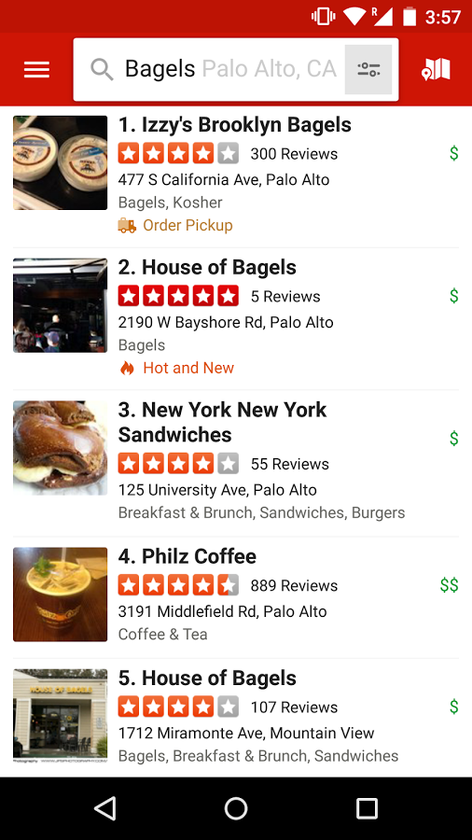
Project Description
Yelp provides vast database of reviews, ratings information about businesses
Develop a predictive model of customers’ restaurant ratings
Extract collaborative and content based features to identify customer and restaurant proﬁles.
Provide recommendations to users that best matches their profile.

Slide 3
Steps and Implementation
Data collection
Data processing
Implementation of baseline
Implementation of Cascaded KNN clustering
Implementation of weighted-bipartite graph projection, clustered weighted bipartite graph projection
Implementation of SVM classifiers on users
Results

Slide 4
Data
Can access data as part of yelp dataset challenge for educational purposes. Dataset is available at http://www.yelp.com/dataset challenge/.
2GB data comprising of 5 datasets.
Business, reviews, users, check-ins, tips
By using and combining various data ﬁelds, we identify both similar businesses and users to aggregate the likely sparse ratings per average user
There are problems with the Dataset.

Slide 5
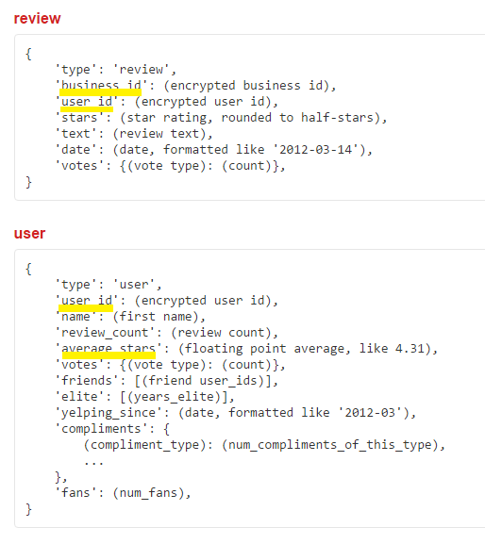
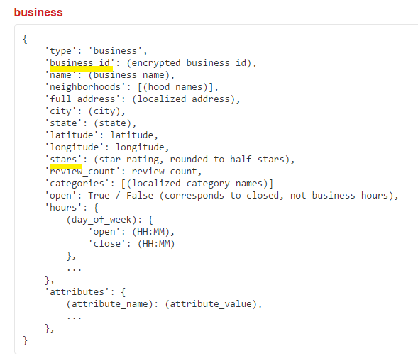
Data
1.6 million reviews
20K restaurants
.4 million users

Slide 6
Problems with Dataset
Dataset is too sparse. More than 90% of data is empty
There is a problem of cold start as there are large number of unknown users and businesses.
Cold start is a situation when a recommender system doesn’t have any historical information about user or item and is unable to make personalized recommendations.
Large number of ‘Grey Sheep’ unpredictable ratings.
When user C's profile in terms of the items is not similar to either of the users A and B.
Such a user in the recommender system for whom any useful recommendation cannot be made is termed as grey sheep

Slide 7
Data preprocessing
There is need of preprocessing because of the mentioned problems
Deal with missing values using imputation technique
We used only business, review and user datasets
Converted JSON to CSV format .
Python script to perform conversion
Feature Selection and combining important data attributes.

Slide 8
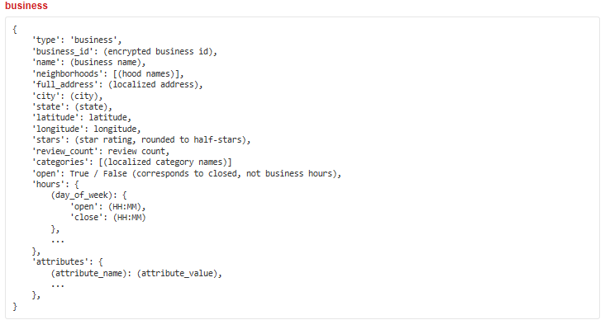
Data preprocessing

Slide 9
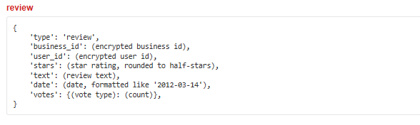
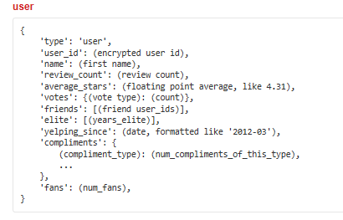
Data preprocessing

Slide 10
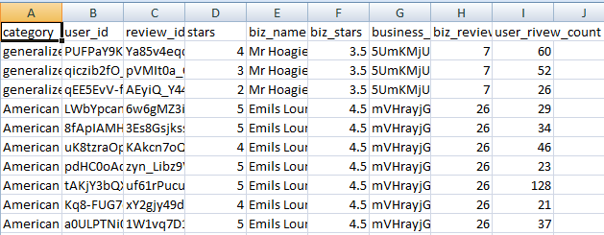
Data after processing
9 attributes and 26,140 instances

Slide 11
Naïve Baseline Formula
Complexity=20K X .35M X 1.5M
Tried with 1.5M,then .2M,then 10K,then 500.
Suggest to a particular user,those businesses whose recommended ratings comes out to be 5 stars.

Slide 12
Accuracy of recommendation:
Total examples | Correct prediction | Accuracy=correct pred./total ex.
281 | 121 | .4306
278 | 112 | .4028
139 | 70 | .5035
217 | 100 | .4608
98 | 45 | .50
200 | 80 | .4
304 | 130 | .4276
368 | 151 | .41032
1885 | 809 | .4292

Slide 13
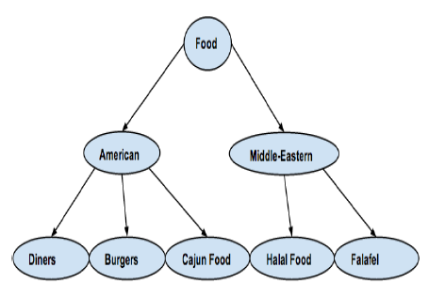

Hybrid Cascading KNN
Algorithm:
Cluster the restaurants based on most common category they share
Cluster the users based on restaurant category they reviewed most
Find the cluster to which user belongs
Find the most similar users within that category using KNN
Calculate predicted ratings of all the restaurants within that category by averaging ratings given by all the users in that cluster
Sort the predicted ratings in descending order.
Select k restaurants that have highest ratings and reviewed by the similar users but not by the users

Slide 14
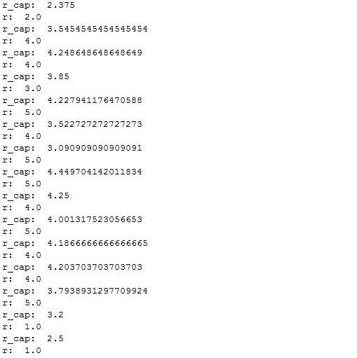

KNN output
Perform 10-fold cross validation
r_cap is the predicted rating of the restaurant
r is the actual rating of the restaurant
Evaluation metric used is RMSE( root mean square error)
Break the dataset into training and testing sets.
Calulating the RMSE value
RMSE = 1.45

Slide 15
SVM Classification
Constructed a separate dataset from yelp data for implementing this algorithm
Dataset built from business, reviews and users yelp data.
Contains 39 attributes and 97,555 instances
Dataset contains restaurant attributes, users who rated these restaurants and their ratings
Attributes include attire, accepts_creditcards,open Sunday, has parking, ambience, has wifi, has tv etc.

Slide 16
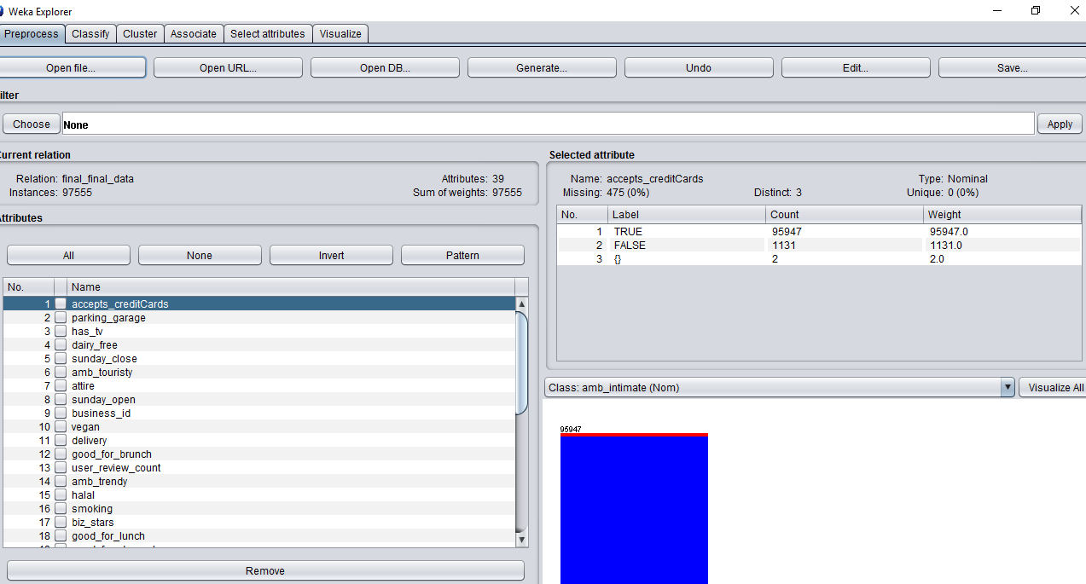
Dataset

Slide 17
Recommendation using SVM Classifier
We first reduced the dataset by only considering users who have reviewed more than 20 restaurants.
For every user ,we performed SVM with the label being the user’s rating of a restaurant on a scale of 1 to 5.
For each user, using features on the restaurants they reviewed, we learnt a hyperplane that reflects their preferences
Hence, how the user rates the restaurant corresponds to the distance of the restaurant to their hyperplane

Slide 18
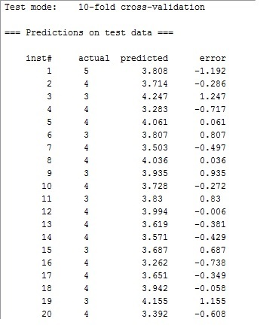
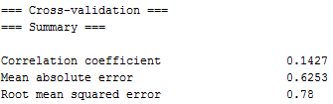
SVM output
Performed 10-fold cross validation got the following output

Slide 19
Results
RMSE

Slide 20
Results
If we compare the result, the SVM classifier gives the least root mean square error.
But in SVM We did not take into account the case where users reviewed the same restaurant multiple times.
In hybrid cascaded KNN clustering we are limited to predictions within the category where user has previously reviewed the most.

Slide 21
Future work and Recommendations
We can do content-based filtering for the recommendation but yelp has not given us data that describe restaurants
.We can implement divergent recommendation systems
For this goal, we can use machine learning methodologies and use various regression based models and collaborative filtering to predict ratings and user-restaurant similarity.
By combining these two predictions, we made "divergent recommendations" based on user and restaurant profiles.
So far we implemented methodologies that helped users find new restaurants for foods that users already enjoy. However, there are few options for users that want to try something unlike what they have tasted before.
we can build a recommendation system that can give restaurant suggestions that are highly different than the past places a user has tried.

Slide 22
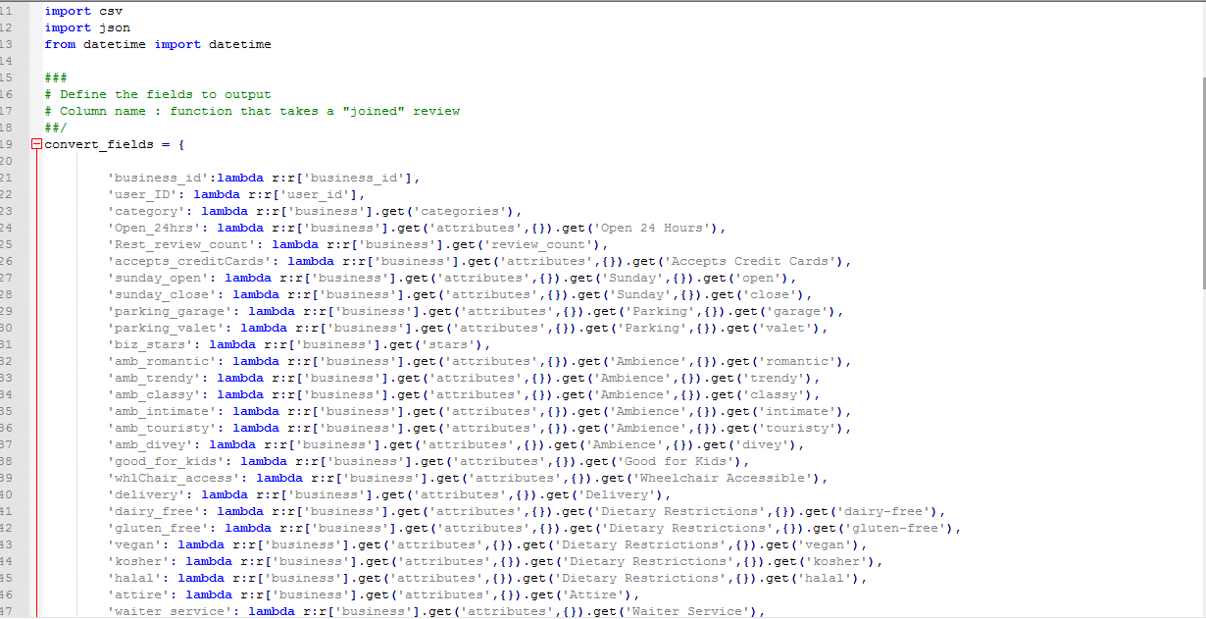
JSON to csv python script

Slide 23
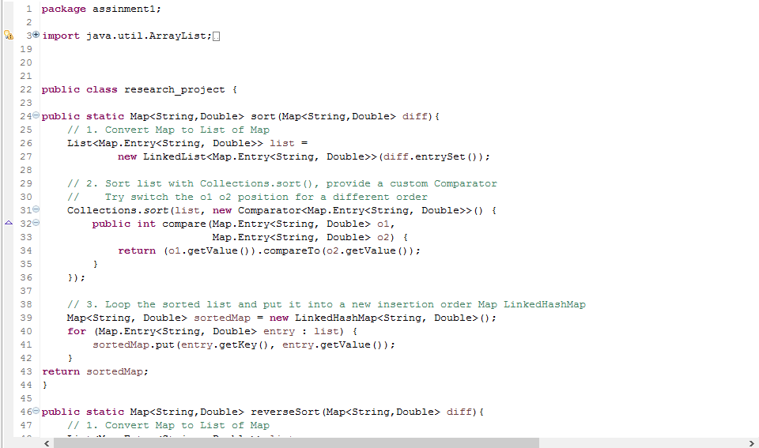
Hybrid Cascade KNN clustering code

Slide 24
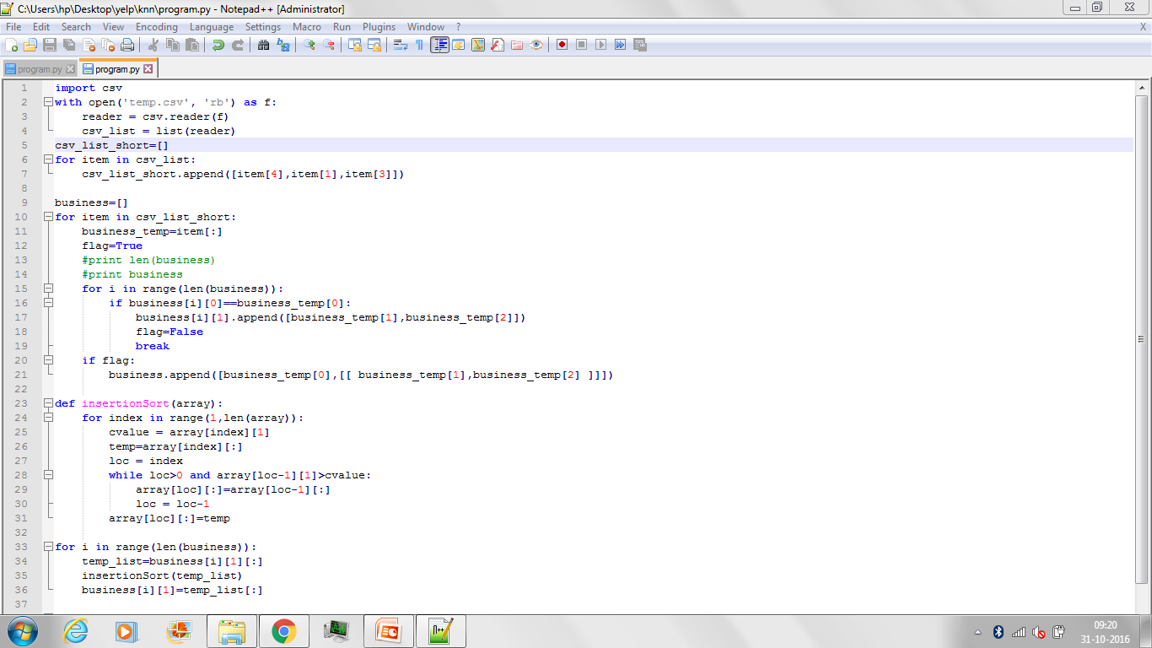

Slide 25
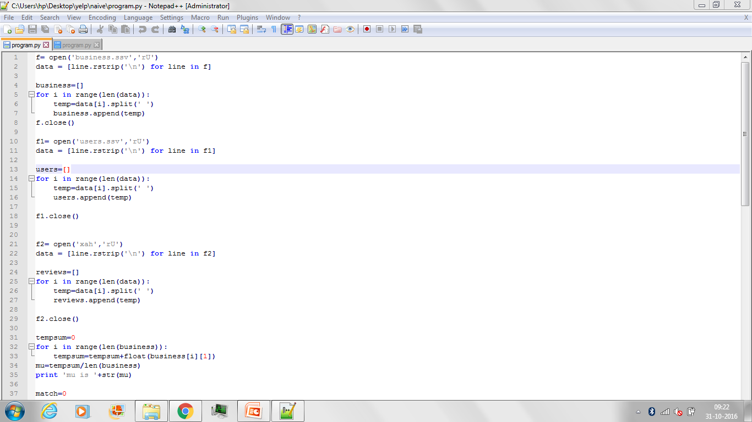

Slide 26
