Slide 1
Groupby
Comprehensive Pandas Tutorial

Slide 2
“groupby” follows a 3-step procedure:
STEP 1:
SPLIT

Slide 3
“groupby” follows a 3-step procedure:
STEP 2:
SPLIT
APPLY
AGGREGATE
FILTER
TRANSFORM

Slide 4
“groupby” follows a 3-step procedure:
STEP 3:
SPLIT
APPLY
COMBINE
AGGREGATE
FILTER
TRANSFORM

Slide 5
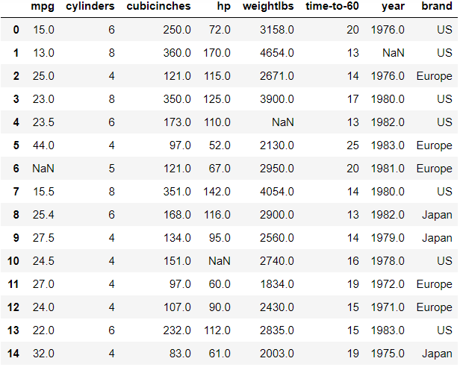
A dataset containing information about different cars

Slide 6
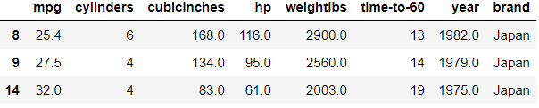
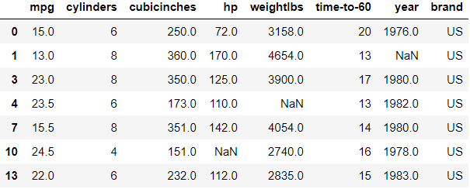
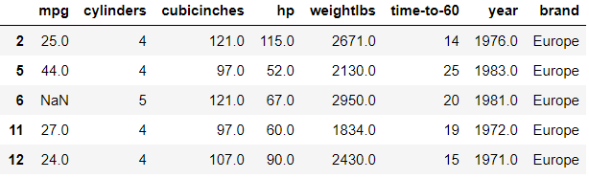
Step 1: SPLIT

Slide 7
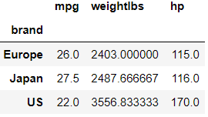
mean
max
median
2487.66
3556.83
2403.00
116
170
115
27.5
22.0
26.0
Step 2: APPLY (AGG)
Step 3: COMBINE

Slide 8
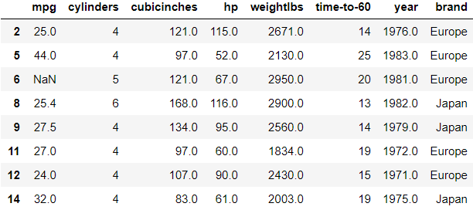
For eg. if mean mpg > 23
Step 2: FILTER
Step 3: COMBINE

Slide 9
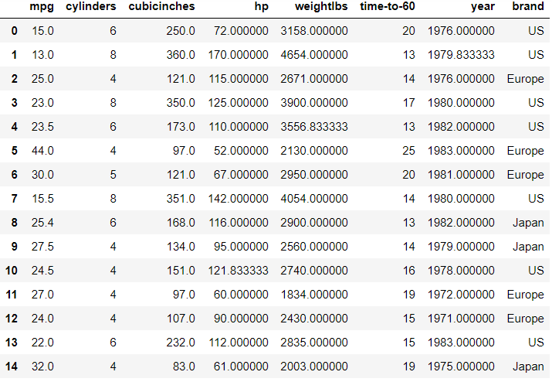
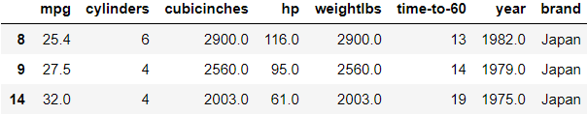
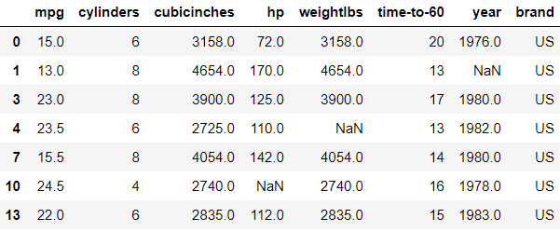
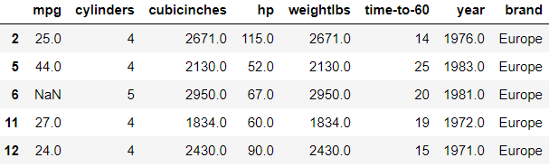
Step 2: TRANSFORM
Step 3: COMBINE
One of the use cases is to fill missing values according to values in each group

