Slide 1

Department of Computer Science and Business Systems
A Data-Driven Approach to Identifying and Preventing Burnout in High-Stress Environments Using ML
Mini Project-III
(UCBIL0571)
by
Under the Guidance of
Mrs. Pramila Gadyanavar
Asst. Professor
Roll no. | Name | PRN
A32 | Ajit Birajdar | 2324000805
A34 | Om Nalawade | 2324000862
A41 | Chinmai kulkarni | 2324001291
A43 | Anagha Shelake | 2324000941
Department of Computer Science and Business Systems
1

Slide 2
Problem Statement Title- A Data-Driven Approach to Identifying and Preventing Burnout in High-Stress Environments Using ML
Theme- Using machine learning to proactively detect and prevent stress-induced burnout.
Team ID-
Team Name- CalmPulse

Slide 3
A Data-Driven Approach to Identifying and Preventing Burnout in High-Stress Environments Using ML
Proposed Solution (Describe your Idea/Solution/Prototype)
Proposed Solution:- Develop an ML-based system that analyzes user data to predict burnout risk and offers personalized stress management tips and alerts.
Idea / Prototype:-
Collect data from self-reports (sleep, mood, stress, workload) & optional wearable/device inputs.
Extract features (sleep consistency, workload-break ratio, mood variability).
Predict burnout risk (Low / Medium / High) using ML models.
Provide personalized preventive suggestions & alerts via dashboard.
How It Addresses the Problem
Early detection of burnout patterns.
Personalized, context-aware recommendations.
Timely preventive actions to reduce impact.

Slide 4
Innovation and Uniqueness of solution:-
Smart Resource Library:- Curated tips, videos, and articles.
Calendar Sync:- Auto-track deadline stress.
Model Feedback Loop:- Users improve prediction accuracy.
Gamification:-Wellness scores, badges, and micro-challenges
4

Slide 5
TECHNICAL APPROACH
Technologies Used:-
Frontend:-
HTML, CSS, JavaScript:- For building a user-friendly interface.
Chart.js for visual representations.
Backend:-
Python :- To handle server-side logic and route requests
REST APIs:- To connect frontend with ML model and database.
Machine Learning:-
Scikit-learn / TensorFlow / :- building and training the stress detection model.
Pandas & NumPy:- For data preprocessing and manipulation.
Matplotlib / Seaborn:- For visualizing data trends and patterns.

Slide 6
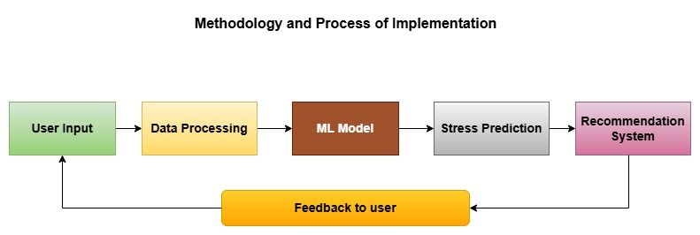
Database:-
MySQL / MongoDB:- For storing user profiles, responses, and stress
level predictions.
Flowchart:-
6
6

Slide 7
FEASIBILITY AND VIABILITY
Feasibility Analysis:-
Technically feasible with existing ML tools and web frameworks.
Increasing mental health awareness boosts user adoption.
Scalable for students and professionals alike.
Potential Challenges & Risks:-
Data privacy and user consent issues.
Low-quality or biased data affecting model accuracy.
User engagement may drop over time.
Over-reliance on predictions instead of professional help.
Strategies to Overcome:-
Ensure secure data handling.
Use validated questionnaires and diversify datasets
Add engaging UI/UX, reminders, and motivational features
Include disclaimers and links to professional resources

Slide 8
IMPACT AND BENEFITS
Potential Impact on Target Audience:-
Helps students and employees identify early signs of burnout.
Encourages self-awareness and mental well-being.
Promotes healthy work-life balance.
Benefits:-
Social:-
Promotes mental well-being
Reduces stigma
Enhances relationships
Economic:-
Cuts burnout-related costs
Increases productivity
Automates stress tracking
Environmental:-
Reduces paper use
Supports remote self-assessment

Slide 9
RESEARCH AND REFERENCES
[1] Stress, Burnout and Study-Related Behavior in University Students: A Cross- Sectional Cohort Analysis Before, During, and After the COVID-19 Pandemic, https://www.mdpi.com/3389024
[2] Student Burnout: A Review on Factors Contributing to Burnout Across Different Student Populations, https://www.mdpi.com/3167292
[3] Exploring the Influencing Factors of Learning Burnout: A Network Comparison in Online and Offline Environments, https://www.mdpi.com/3388302
[4] Burnout Risk Profiles in Psychology Students: An Exploratory Study with Machine Learning, https://www.mdpi.com/3262646

