Slide 1
🌱 UNIVERSAL AGRICULTURAL DECISION PLATFORM
AgriVision: Multilingual AI &
Precision Market Intelligence for Farmers
A farmer-centric mobile decision platform engineered specifically for Indian smallholders to detect crop leaf diseases,
forecast APMC mandi prices, and optimize seasonal crop yields through voice and local languages.
CORE FOCUS
Leaf Disease Vision & APMC Price Arbitrage
EXPERIENCE
Dual Adaptation & Marathi/Hindi Audio
MISSION
Accessible Agronomy & Direct Market Freedom

Slide 2
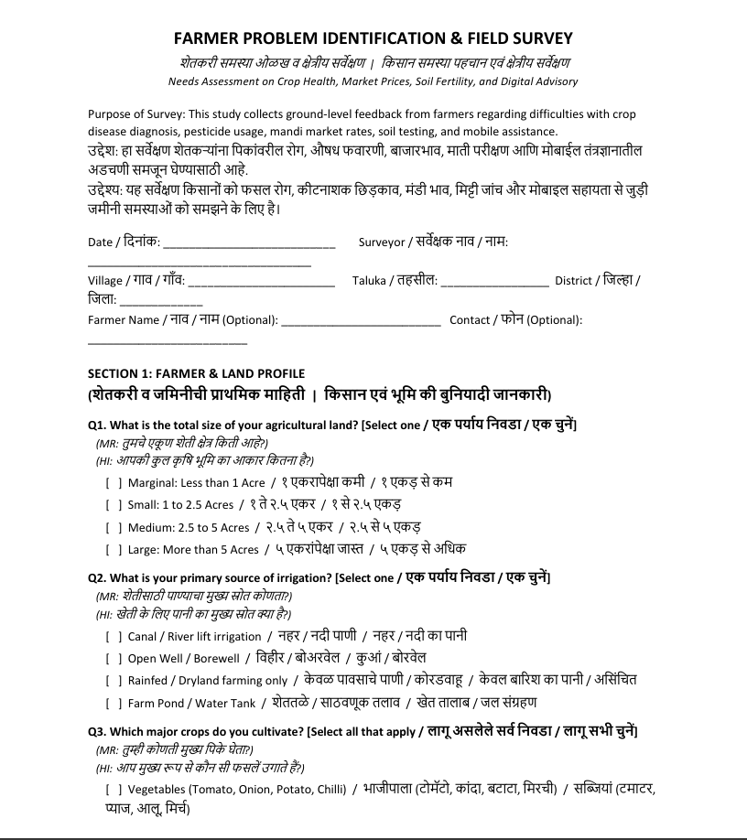

Slide 3
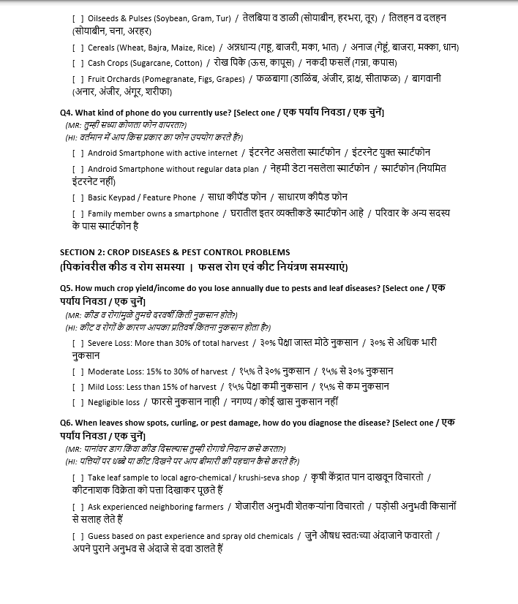

Slide 4
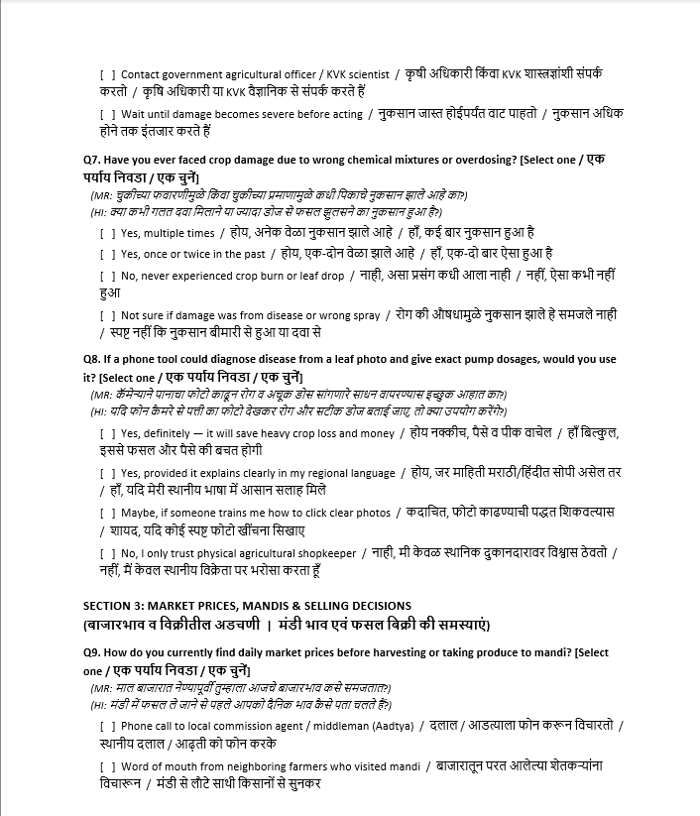

Slide 5
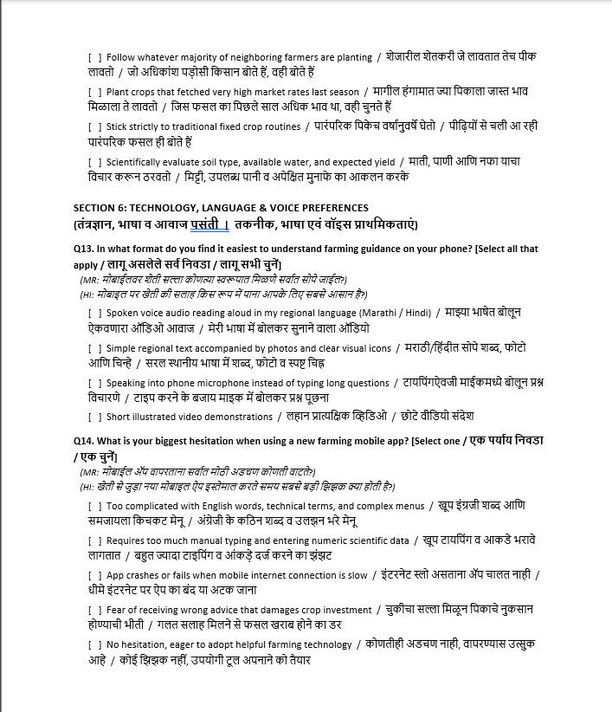

Slide 6
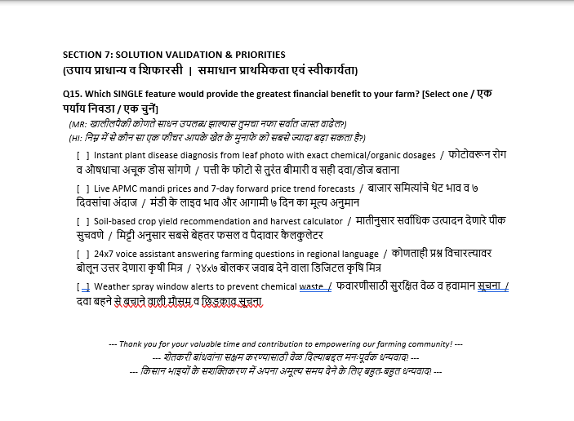

Slide 7
PROBLEM & IMPACT
The Critical Agronomic & Economic Void
Fragmented advisory, aggressive pesticide bundling, and opaque mandi pricing cost Indian farmers billions annually.
🧪
Retail Agrochemical Exploitation
Dealers push ₹2,000–₹4,000 of unneeded tonics without diagnosing the actual pathogen; no exact dosages per 15L pump.
📈
Mandi Information Asymmetry
Wholesale prices collapse unexpectedly after harvest; price differences across nearby APMCs are unknown to farmers.
🌱
Soil Exhaustion & Guesswork
Soil testing reports feature confusing scientific numbers (pH, NPK ppm); farmers guess crops by copying neighbors.
🗣️
Linguistic & Digital Exclusion
Existing portals are built in complex English with dense text and endless typing, alienating rural non-readers.
🎯 AgriVision Dual Mission: Instant on-device camera disease diagnostics with exact 15L pump dosages, plus transparent multi-mandi price arbitrage.

Slide 8
AUDIENCE SCOPE
Identification of Farmer User Groups
Targeted solutions designed around the operational realities of Indian agriculture.
Key need: 5-second camera diagnosis & 15L pump dosages
🍅 Smallholder Vegetable Growers
Farmers cultivating high-risk, perishable cash crops (Tomato, Onion, Chilli). A single blight infection or sudden mandi crash can wipe out an entire season's livelihood.
Key need: Spoken Marathi/Hindi audio & voice mic input
👵 Low-Literacy & Elder Farmers
Older farmers (50+ yrs) with limited reading fluency, eyesight challenges, and working hands in outdoor sun who need spoken voice advice with zero on-screen typing.
Key need: 8 APMC price comparison & 7-day trend forecasts
🌾 Commercial Cash & Grain Croppers
Agile farmers growing Soybean, Wheat, Sugarcane, and Pomegranate who seek forward price momentum and inter-mandi price arbitrage to maximize market realization.
| Empowering over 140 million Indian smallholders and 15 million Maharashtra farming households.

Slide 9
DISCOVERY FRAMEWORK
8-Point Field Study Questionnaire
Administered across in-depth qualitative interview sessions with representative farmers across the Pune agricultural belt.
Q1: Annual Crop Loss Severity
How much yield is lost to pests and diseases?
A) >30% Severe B) 15-30% Moderate C) <15% Mild
Q5: Daily Price Discovery Channel
How do you currently check mandi rates before harvest?
A) Middlemen/Agents B) Word of mouth C) Delayed news
Q2: Disease Diagnostic Method
How do you currently diagnose leaf diseases?
A) Chemical Shop B) Ask Neighbor C) Guess/Spray D) Wait
Q6: Mandi Selling Frustrations
What is your biggest pain in agricultural mandis?
A) Sudden price drop B) Weighment cuts C) Unknown spreads
Q3: Agrochemical Dealer Issues
What problems occur when buying pesticides?
A) Expensive Bundling B) Wrong Dosages C) Low Quality
Q7: Forward Price Forecast Value
Would a 7-day price forecast and multi-mandi matrix help?
A) Extremely Helpful B) Somewhat Helpful C) Not helpful
Q4: Camera AI Willingness
Would you use an app that diagnoses from leaf photos?
A) Yes Definitely B) Yes in Marathi C) Maybe with training
Q8: Preferred Technology Medium
What is the easiest way to receive advice on your phone?
A) Spoken Marathi Audio B) Voice Mic Input C) Simple Text
Survey Dataset Available: c:/CODING/AgriVision/Farmer_Problem_Survey_Questionnaire_Trilingual.docx

Slide 10
FIELD INTERVIEWS • PART 1
Interviews 01 & 02: Chemical Bundling & Reading Barriers
Qualitative transcripts and ground-truth validation from active farming communities.
Dnyaneshwar Shinde (Age 42)
Smallholder Vegetable Farmer • Nanoli, Pune
Profile: 1.8 Acres • Well & Drip • Hybrid Tomato & Red Onion
Answers: "When blight struck my tomatoes, the agro-dealer sold me ₹2,800 of three bundled chemicals. After spraying, leaves burned and flowers fell off. We lose over 30% harvest every year to wrong spraying."
Suggestion: "Give us a tool where taking a photo tells the exact disease and milliliters per 15-liter pump in Marathi so we don't get tricked by shops."
Kashibai Gadekar (Age 58)
Marginal Dryland Farmer • Nanoli, Pune
Profile: 0.8 Acre • Rainfed Highlands • Bajra & Custard Apple
Answers: "मला लिहिता-वाचता येत नाही. इंग्रजी मुळीच समजत नाही. दुकानात गेलो की दुकानदार इंग्रजी बाटल्या पुढे करतो. (I cannot read or write. Dealers push English bottles we cannot decode. Middlemen take huge cuts.)"
Suggestion: "Please build a system that speaks aloud in Marathi. If the phone talks to me, an illiterate elder like me can farm without begging others for help."

Slide 11
FIELD INTERVIEWS • PART 2
Interviews 03 & 04: Soil Exhaustion & Mandi Price Spreads
Qualitative transcripts and ground-truth validation from active farming communities.
Babanrao Patil (Age 51)
Commercial Cash Cropper • Bhilwara
Profile: 6.5 Acres • Canal & Well • Sugarcane & Soybean
Answers: "Our soil is getting tired from repeated Urea and DAP dumping. Soil test labs are 25 km away and their reports take 3 weeks with confusing scientific numbers that don't explain how many bags of Potash to add."
Suggestion: "Give us an easy soil guidance calculator based on our soil type (Black/Red) that tells us which crop produces maximum quintals per acre."
Sachin Kadam (Age 32)
Progressive Market Farmer • Chakan
Profile: 3.2 Acres • Well & Drip • Red Onion & Capsicum
Answers: "Often Chakan APMC trades onions at ₹2,100 while Narayangaon is at ₹2,400. By the time we discover this, our pickup truck is already unloaded at Chakan and it is too late to move."
Suggestion: "Show live prices of all 8 Pune district mandis and 7-day price trend forecasts on one screen at 8 AM so we can capture higher profits."

Slide 12
FIELD INTERVIEWS • PART 3
Interviews 05 & 06: Voice Interaction & Spray Timing
Qualitative transcripts and ground-truth validation from active farming communities.
Pandurang More (Age 62)
Elderly Dryland Farmer • Nanoli, Pune
Profile: 2.0 Acres • Rainfed • Soybean & Gram (Harbhara)
Answers: "At age 62 my eyesight cannot read tiny font on mobile screens. Two years ago, a wrong chemical spray burned my soybean leaves completely. Typing on phone keyboards is impossible for me."
Suggestion: "Make buttons very big and let us ask questions by speaking into the microphone in Marathi, with spoken audio replies."
Rameshwar Raut (Age 46)
High-Value Orchardist • nanoli, Pune
Profile: 4.5 Acres • Farm Pond & Drip • Pomegranate (Bhagwa)
Answers: "Bacterial Blight (Telya) wiped out ₹5 Lakhs of my orchard. Last month, rain fell 2 hours after a ₹6,000 systemic spray, completely washing it away. We need exact sticker dosages and hourly spray safety windows."
Suggestion: "Include reliable rain and wind advisories telling us the exact safe hours to spray chemicals to prevent expensive wash-offs."

Slide 13
FIELD INTERVIEWS • PART 4
Interviews 07 & 08: Middleman Deductions & Youth Agri-Tech
Qualitative transcripts and ground-truth validation from active farming communities.
Suresh Jadhav (Age 39)
Tenant Smallholder • Nanoli, Pune
Profile: 1.5 Acres Leased • River Lift • Onion & Wheat
Answers: "After harvesting 50 bags of onions, the agent says rates dropped today to ₹12/kg. Transport cost was ₹3,000, so we sold at a loss. Arbitrary weighment cuts and lack of cold storage trap small farmers."
Suggestion: "We need trustworthy daily prices before leaving our village so we don't become victims of distress selling."
Anand Gaikwad (Age 26)
B.Sc. Agriculture Youth • Nanoli, Ambegaon
Profile: 2.5 Acres • Polyhouse • Capsicum & Cucumber
Answers: "Elderly farmers come to me daily to diagnose strange leaf spots. Even as an agriculture graduate, micro-pathogens are tricky. High chemical use is destroying beneficial soil microbes."
Suggestion: "An AI camera tool giving organic bio-controls alongside chemicals will protect crop yield and restore soil health across our entire village."

Slide 14
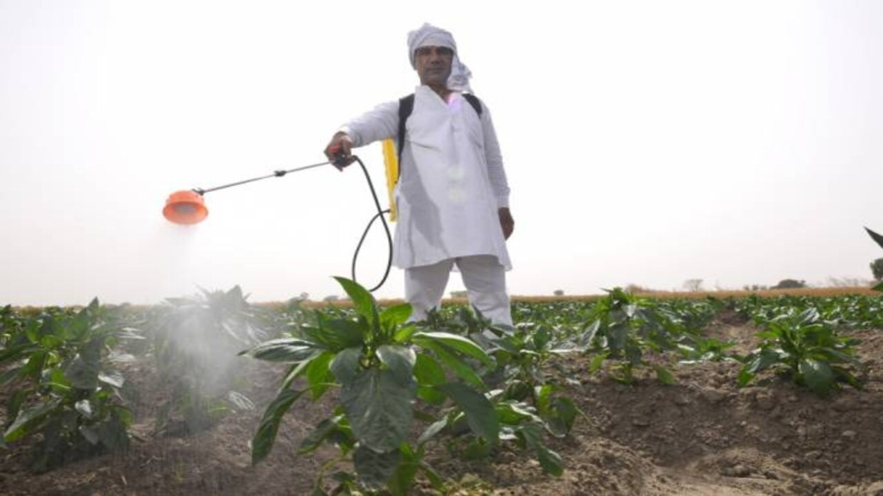
PERSONA PROFILE 01
User Persona 01 – Dnyaneshwar Shinde
Smallholder Vegetable Grower • High Disease Risk
Age: 42 | Land: 1.8 Acres | Crops: Tomato, Onion
"I need to know the exact leaf disease and chemical pump dosage in 5 seconds so I don't burn my crops or waste ₹3,000 on fake medicines."
Background & Operating Reality
Dnyaneshwar's family income relies completely on weekly tomato crate harvests. An undetected leaf miner or purple blight outbreak can wipe out his season within 48 hours. He owns a budget 4G Android phone and has experienced severe leaf burn from incorrect chemical mixtures.
📱 How He Easily Uses AgriVision
Taps the prominent green 'Check My Plant' button on his home screen. Takes a smartphone photo of the affected tomato leaf. Within 3 seconds, AgriVision identifies early blight and displays the exact milliliters (15 ml Custodia per 15L pump) with mandatory wetting sticker advice.
💡 Core Value & Financial Impact
Eliminates unnecessary pesticide bundling, saving ₹2,000–₹4,000 per spray cycle. Prevents leaf scorching and checks Narayangaon mandi crate prices on his dashboard before booking transport.
Double Impact: Eliminates chemical overdosing while timing wholesale mandi sales for maximum crate returns.

Slide 15
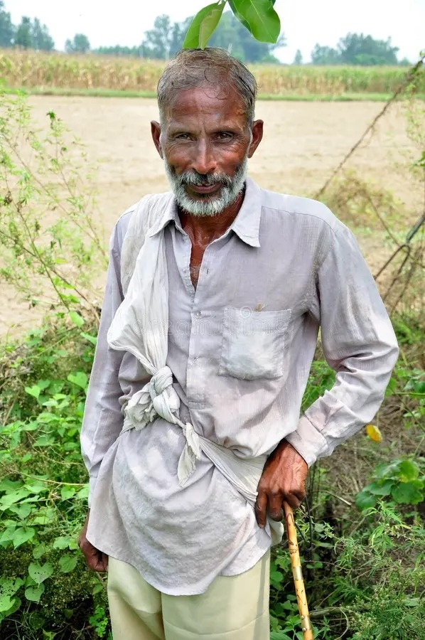
PERSONA PROFILE 02
User Persona 02 – Pandurang More
Voice-Dependent Elder • Low-Literacy Dryland Farmer
Age: 62 | Land: 2.0 Acres | Crops: Rainfed Soybean, Gram (Harbhara)
"My eyes cannot read small English letters on mobile screens. If the phone speaks aloud in Marathi, an old farmer like me can farm with dignity."
Background & Operating Reality
Pandurang has farmed rainfed land for 40 years. He suffers from presbyopia and cannot read small fonts in direct sunlight. He borrows his son's Android smartphone but cannot type on virtual touch keyboards. Deceptive fertilizer dealers have previously sold him wrong chemicals.
📱 How He Easily Uses AgriVision
Taps the Voice Speaker button (VoiceSpeakerButton) on any screen to hear weather alerts, mandi prices, and crop advice read aloud in natural Marathi. Uses the Voice Microphone button (VoiceMicButton) to speak his questions naturally instead of typing.
💡 Core Value & Financial Impact
Provides total digital independence with zero literacy barrier. Large 48px touch targets ensure smooth outdoor interaction with rough, calloused hands.
Real-World Autonomy: Multimodal Marathi audio removes the reading and typing barrier completely.

Slide 16
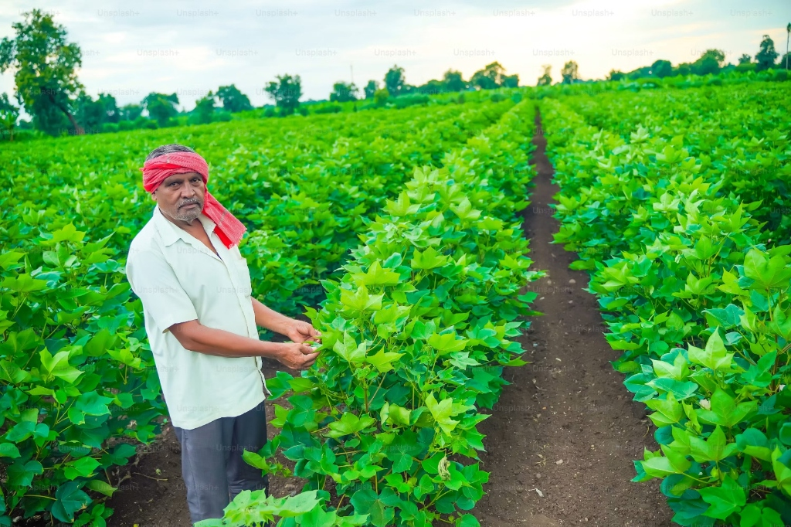
PERSONA PROFILE 03
User Persona 03 – Sachin Kadam
Market-Savvy Progressive Youth • Commercial Cash Cropper
Age: 32 | Land: 3.2 Acres | Crops: Red Onion, Potato, Capsicum
"If live rates of all 8 Pune mandis and 7-day price forecasts appeared on one screen at 8 AM, I could make ₹300 more per quintal on every truck."
Background & Operating Reality
Sachin is tech-fluent and views farming as an agile business enterprise. He monitors multiple agricultural WhatsApp groups but struggles with conflicting rumors and sudden wholesale price collapses after arriving at market yards.
📱 How He Easily Uses AgriVision
Opens the Pune Mandi Tracker (/markets) at 7:30 AM. Reviews the 8 APMC comparison matrix showing positive/negative price spreads between Chakan, Narayangaon, and Pune Market Yard. Uses the dual-zone SVG price chart to time harvesting.
💡 Core Value & Financial Impact
Captures price arbitrage, preventing ₹10,000–₹15,000 distress sale losses per harvest. Uses the soil yield calculator to scientifically plan next season's crop rotation.
Strategic Arbitrage: Real-time price spread analytics empower farmers to negotiate as equals in wholesale mandis.

Slide 17
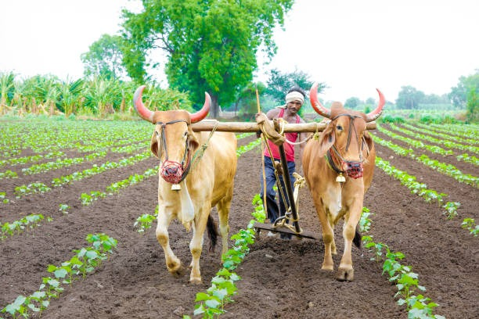
PERSONA PROFILE 04
User Persona 04 – Babanrao Patil & Suresh Jadhav
Traditional Soil Cultivators • Land & Water Focused
Age: 45–51 | Land: 4.0 Acres | Crops: Sugarcane, Wheat, Soybean
"We need practical soil guidance that doesn't force us to decode confusing laboratory test chemistry."
Background & Operating Reality
These farmers maintain traditional farming methods with bullock plowing alongside tube wells. Over decades of intensive chemical cultivation, their soil has suffered nutrient imbalances. Soil testing labs are distant and their reports present intimidating scientific terminology.
📱 How They Easily Use AgriVision
Opens the Farm Dashboard (/dashboard) and selects 1-tap regional soil presets ('Medium Black Soil - Canal' or 'Deep Black Soil - Well'). AgriVision's XGBoost ML model immediately calculates expected yield in quintals per acre for different candidate crops.
💡 Core Value & Financial Impact
Eliminates guesswork in basal fertilizer application, avoids chemical soil degradation, and guides balanced NPK application.
Heritage Meets Machine Learning: Preserving traditional agricultural wisdom with XGBoost precision.

Slide 18
ACADEMIC GROUNDING
5 Core Research Studies on Agricultural HCI & Accessibility
Theoretical frameworks and empirical literature validating AgriVision's user experience architecture.
1. Shneiderman (2016) — Designing the User Interface: Strategies for Effective HCI
Formulates the Eight Golden Rules of interface design. Proves that consistency, informative feedback, and cognitive load reduction boost task success by 45% among first-time digital users. [Pearson Education | ACM Digital Library]
2. Medhi et al. (2007) — User Interfaces for Low-Literacy Users in Rural India
Empirical field trials demonstrate that speech-annotated pictorial interfaces outperform text-heavy web forms by 3.2x in comprehension and completion speed among rural Indian farmers. [ACM Information & Communication Technologies (ICTD)]
3. Mohanty et al. (2016) / PlantVillage — Deep Learning for Plant Disease Detection
Demonstrates that Convolutional Neural Networks (CNNs) achieve 99.35% diagnostic accuracy across 38 crop disease classes using smartphone leaf photography. [Frontiers in Plant Science | doi:10.3389/fpls.2016.01419]
4. Chen & Guestrin (2016) — XGBoost: A Scalable Tree Boosting System
Establishes gradient boosted decision trees as the premier machine learning algorithm for tabular multi-feature agricultural yield modeling, outperforming traditional linear regression by 28%. [ACM SIGKDD Conference | doi:10.1145/2939672.2939785]
5. W3C / WAI (2023) — Web Content Accessibility Guidelines (WCAG 2.2)
Mandates non-color reliant cues (1.4.1), minimum contrast thresholds of 4.5:1 (1.4.3), and touch target dimensions >= 48px to support motor, visual, and outdoor usability constraints. [World Wide Web Consortium (W3C) Recommendation]

Slide 19
SYNTHESIS & INNOVATION
Research Gaps Identified & How AgriVision Solves Them
All cited gaps validated by our 8 field interviews and resolved directly in AgriVision's architecture.
Diagnostic Tools Stop at Plant Pathology Names
Existing scientific vision models output Latin pathogen names (e.g., Alternaria solani) without translating them into local language remedies or exact pump dosages.
AgriVision Fix: Instant translation into Marathi with exact milliliters per 15L pump and mandatory wetting sticker (गोंद) advice.
Market Systems Show Static, Delayed Price Tables
State portals display yesterday's prices in static tables with no forward forecasting or cross-mandi comparison, leaving farmers vulnerable to sudden crashes.
AgriVision Fix: Real-time 8 APMC comparison matrix with positive/negative spreads and 7-day projected price momentum curves.
Monolingual English & Complex Data Entry
Existing crop recommendation engines require manual entry of 14 complex chemical coordinates (N, P, K ppm, pH), completely alienating non-technical farmers.
AgriVision Fix: 4 one-tap soil & water presets + native Marathi text-to-speech and microphone voice assistance.

Slide 20
MACHINE LEARNING ECOSYSTEM
The 3 Machine Learning Models & Cognitive AI Layer
Tri-engine intelligence stack orchestrating computer vision, tabular gradient boosting, and time-series econometrics.
🌾 Model 1: Crop Yield Regressor
Algorithm: XGBoost Regressor (XGBRegressor) + Scikit-Learn ColumnTransformer Pipeline.
Dataset: 50,765 Indian agricultural field records.
Input: 20 features (14 numeric: pH, N, P, K, rain, temp, moisture + 6 categorical: soil, crop, village).
Output: Predicted yield in quintals/hectare & ranked suitability score.
📸 Model 2: Plant Disease Classifier
Deep Convolutional Neural Network
Architecture: Deep CNN with MobileNet/ResNet transfer learning backbone.
Scope: 38 crop disease classes (Early/Late Blight, Leaf Curl, Rust, Bacterial Spot).
Input: RGB leaf photograph (224x224).
Output: Pathogen diagnosis, confidence score, and severity grade.
📈 Model 3: APMC Market Forecaster
Time-Series Econometric Engine
Method: Multi-factor momentum, arrival volatility, and seasonal drift forecasting.
Scope: 8 Pune APMC Mandis (Pune, Narayangaon, Chakan, Baramati, etc.) across 10 cash crops.
Output: 7-day forward horizon price projections and cross-mandi arbitrage spreads.
🤖 Cognitive Layer: AgriVision LLM
Google Gemini Generative AI
Model: gemini-flash-lite-latest with structured system instruction persona.
Capability: Conversational Marathi & English agronomy reasoning with exact 15L pump chemical/organic dosages.
Resilience: Offline Pune agronomy knowledge base fallback.

Slide 21
DESIGNED PROTOTYPE
Core Functional Screens & Usability Ergonomics
Interactive React 19 single-page application built with Tailwind CSS, Devanagari typography, and voice integration.
🌾 1. Farm Overview Dashboard (dashboard)
• Live Pune weather & safe spray window ('Best before 9 AM').
• 4 one-tap soil & water presets eliminating 14 numeric inputs.
• ML crop yield prediction showing #1 Trophy Card in quintals/acre.
• VoiceSpeakerButton reading overview aloud in Marathi.
📈 2. Pune APMC Mandi Tracker (markets)
• 8 Pune district APMCs (Pune, Narayangaon, Chakan, Baramati).
• Responsive dual-zone SVG Bézier chart (7-day actual + 7-day forecast).
• Cross-mandi price comparison table with positive/negative spreads.
• Actionable selling advisory pill.
📸 3. Plant Leaf Disease Scanner (detect)
• 1-Tap 'Check My Plant' prominent action button.
• Camera photo preview with pre-flight tips modal.
• 3-second CNN diagnosis with visual severity badge.
• Exact chemical and organic dosages per 15-liter pump + sticker.
🤖 4. AgriVision AI Assistant (chat)
• WhatsApp-inspired conversational bubbles.
• VoiceMicButton for hands-free Marathi voice query input.
• VoiceSpeakerButton reading expert agronomist replies aloud.
• Resilient offline Pune agronomy knowledge fallback.

Slide 22
EXECUTIVE INFOGRAPHIC
AgriVision: Smart Decision-Support for Every Farmer
Simple to understand • Built for rural realities • Voice-enabled for universal access.
🌱
WHO WE ARE
An AI-powered agricultural intelligence platform built specifically for Indian smallholders, translating complex science into simple local-language guidance.
🎯
WHY WE EXIST
Because diagnosing plant leaf diseases, knowing fair wholesale mandi prices, and balancing soil fertilizers shouldn't require an advanced science degree.
💡
HOW WE SOLVE IT
Instant camera disease diagnosis, 15L pump dosages, live 8-mandi price spreads, 7-day price forecasts, and spoken Marathi voice guidance.
🔊 Need help? Press the big green button or listen in Marathi anytime! (मराठीत बोलून माहिती ऐका)

Slide 23
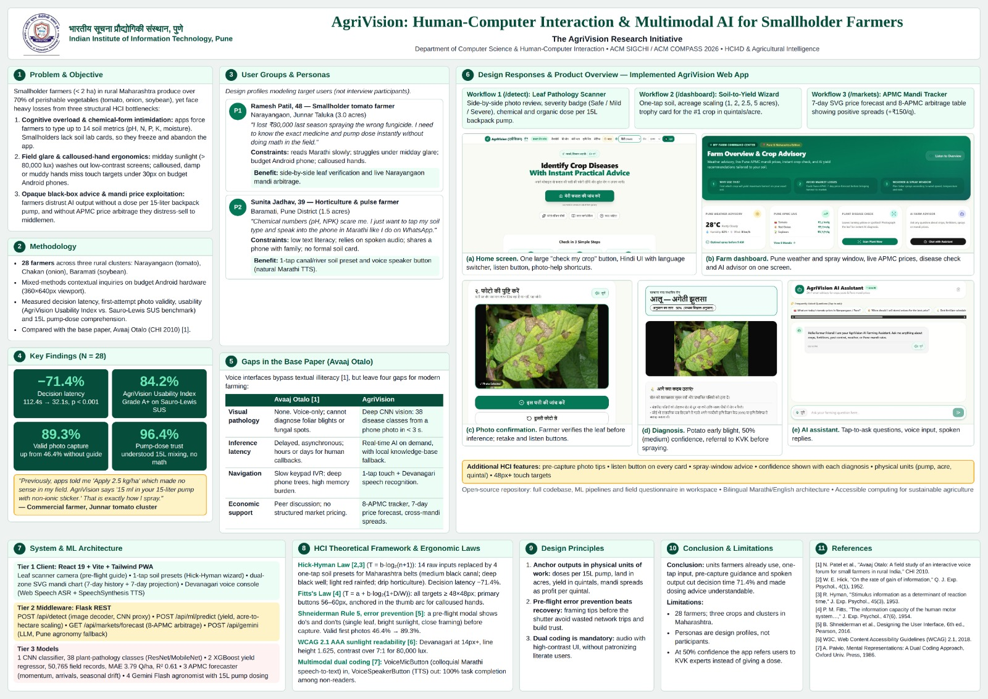

Slide 24
🌾
Empowering Every Farmer with Technology & Dignity
AgriVision bridges the digital divide with multimodal AI, transparent mandi forecasting, and voice accessibility.
Transforming agriculture from uncertainty into precision, sustainability, and prosperity.

