Slide 1
Develop a YouTube Clone Using The MERN Stack

Slide 2
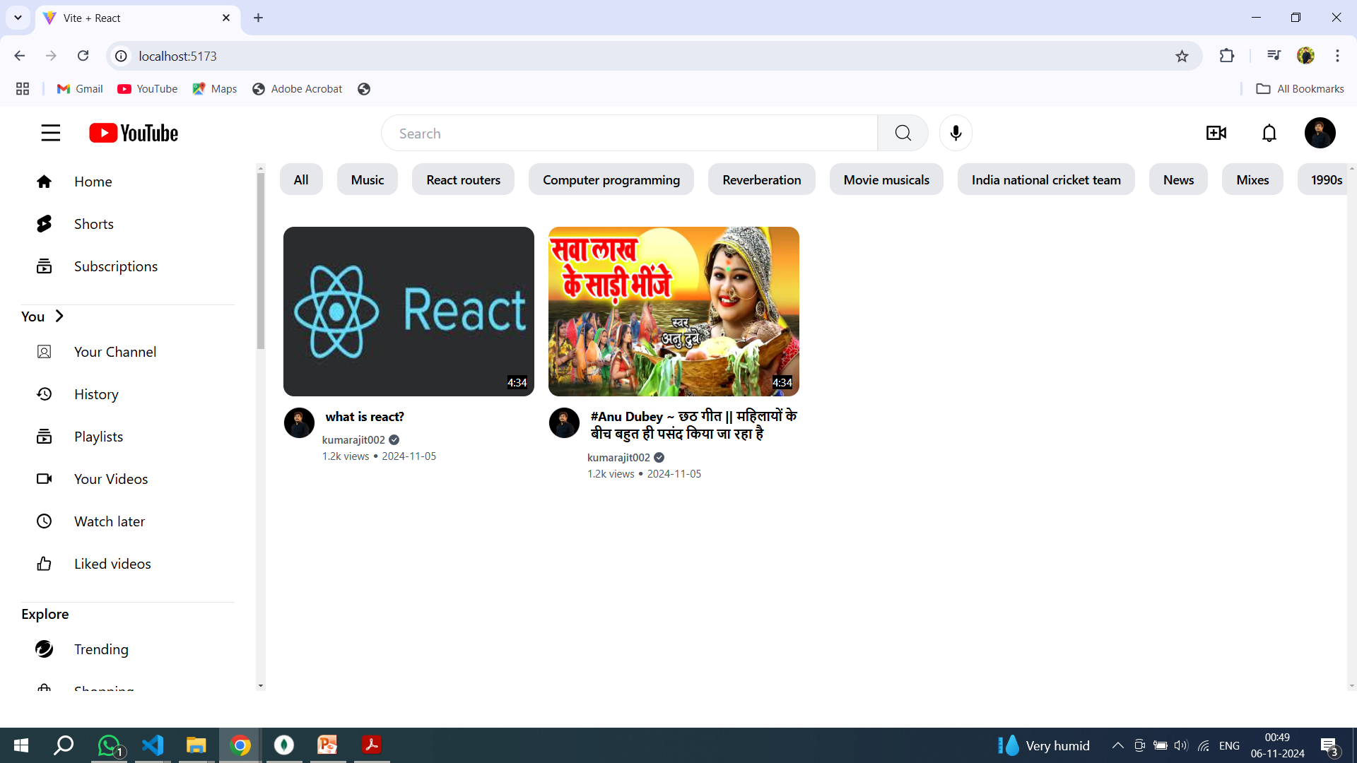
home page

Slide 3
features of Youtube
Menu option page
Home option page
Video upload option page
Login option page
Profile option page
Logout option
Comment option page
Channel create option page
Video playing option page

Slide 4
menu , navbar and Youtube icon
There is a menu side option on both left side and top side and that is a static option.
When you click on the menu a pop-up appears from it.
Navbar will be visible on all pages.
By clicking on the YouTube icon we come back to the home page.

Slide 5
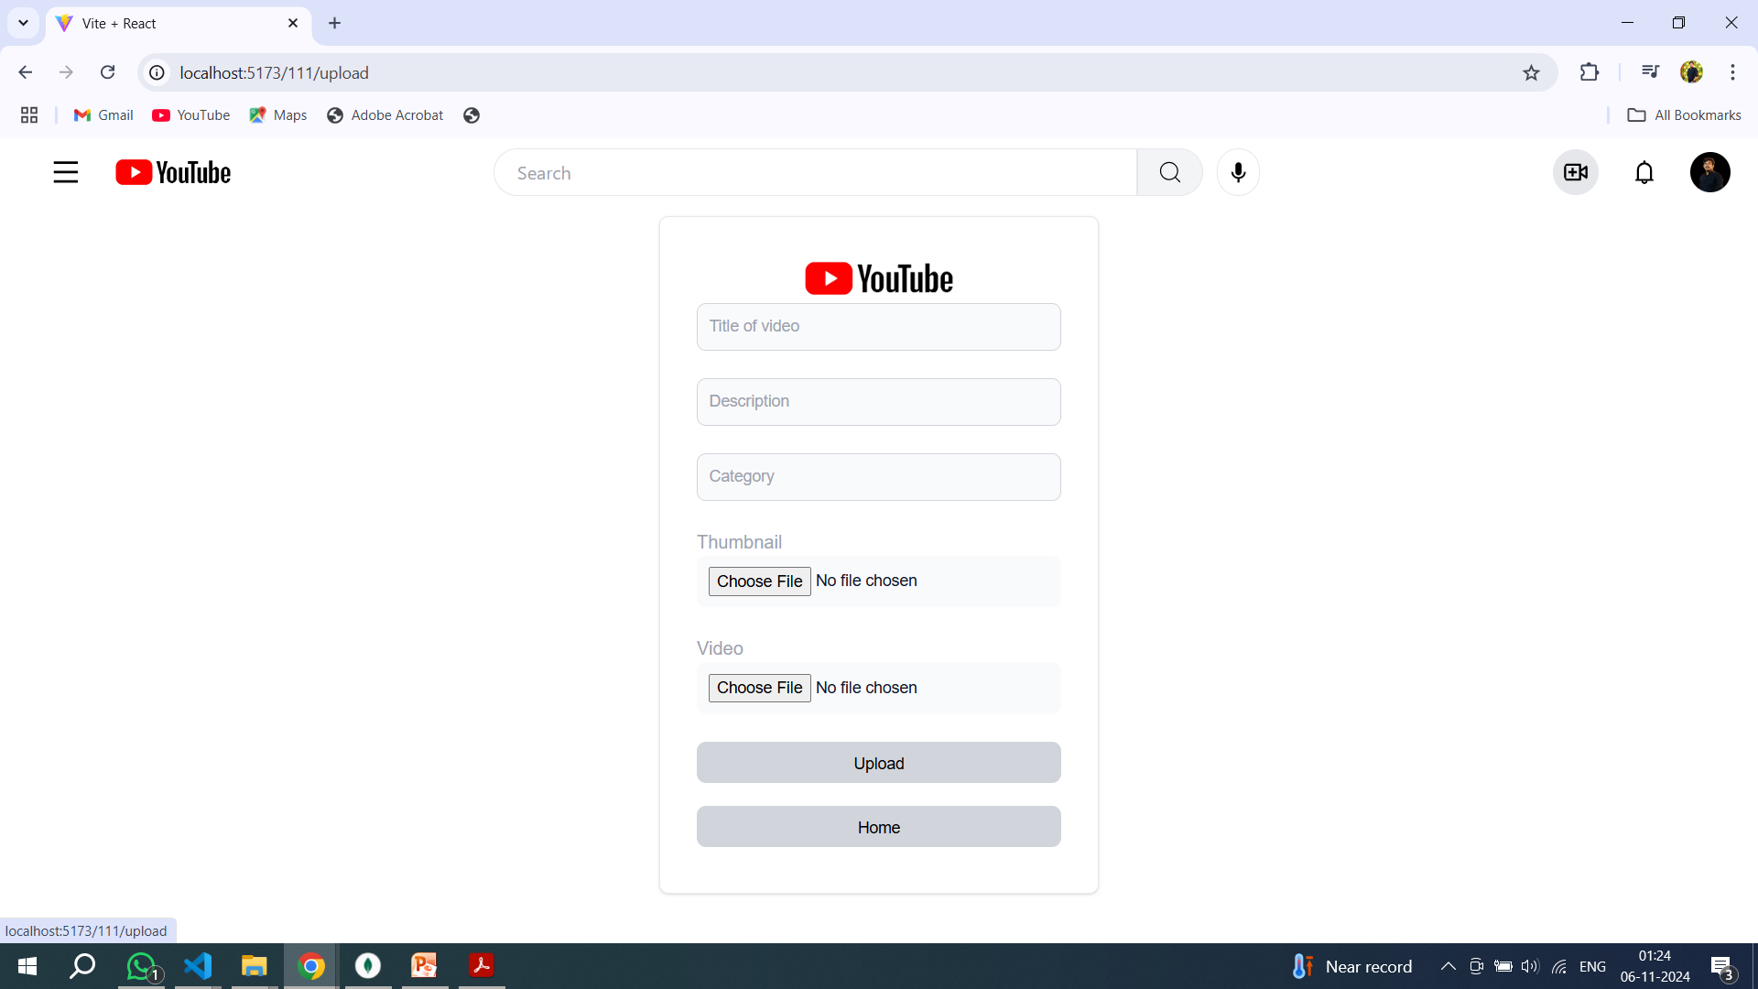
video add option.
After clicking on the video icon, the option to add a video option appears.

Slide 6
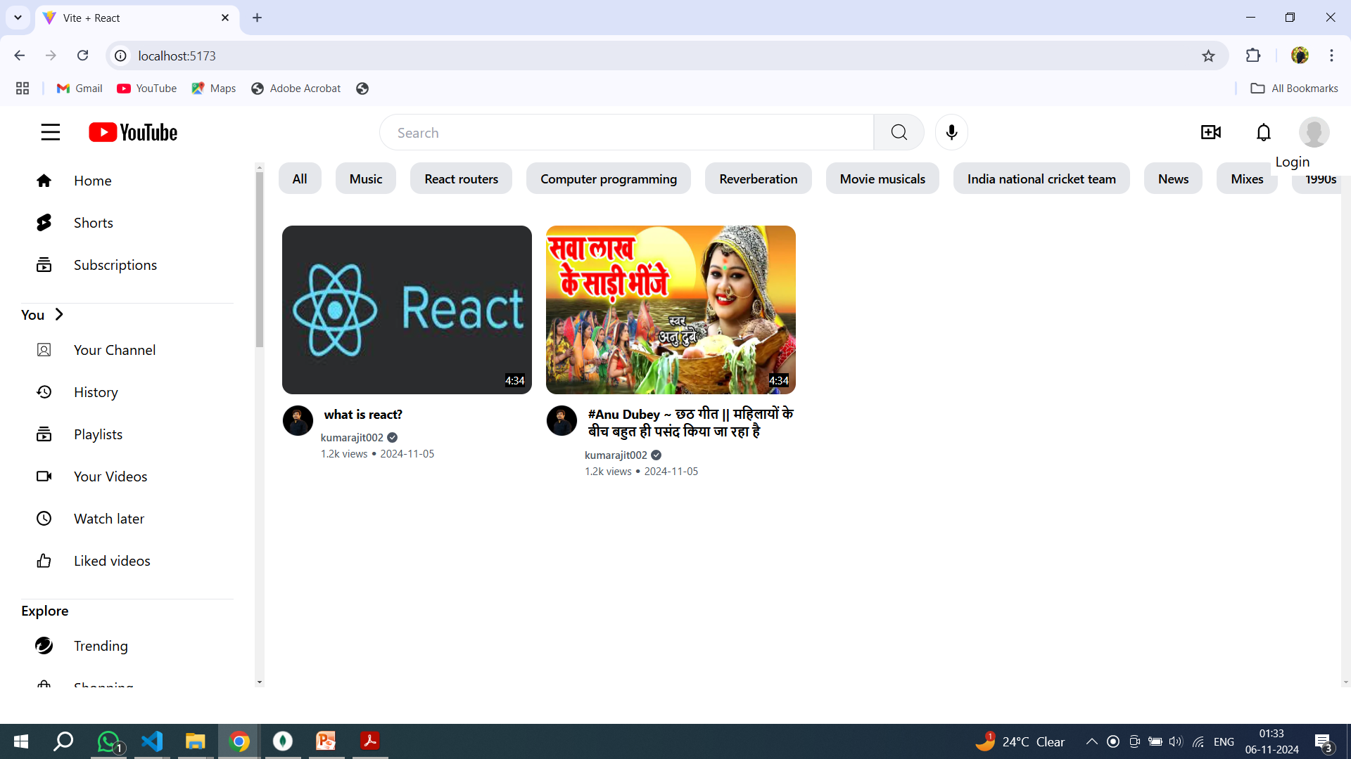
login , logout and profile
login

Slide 7
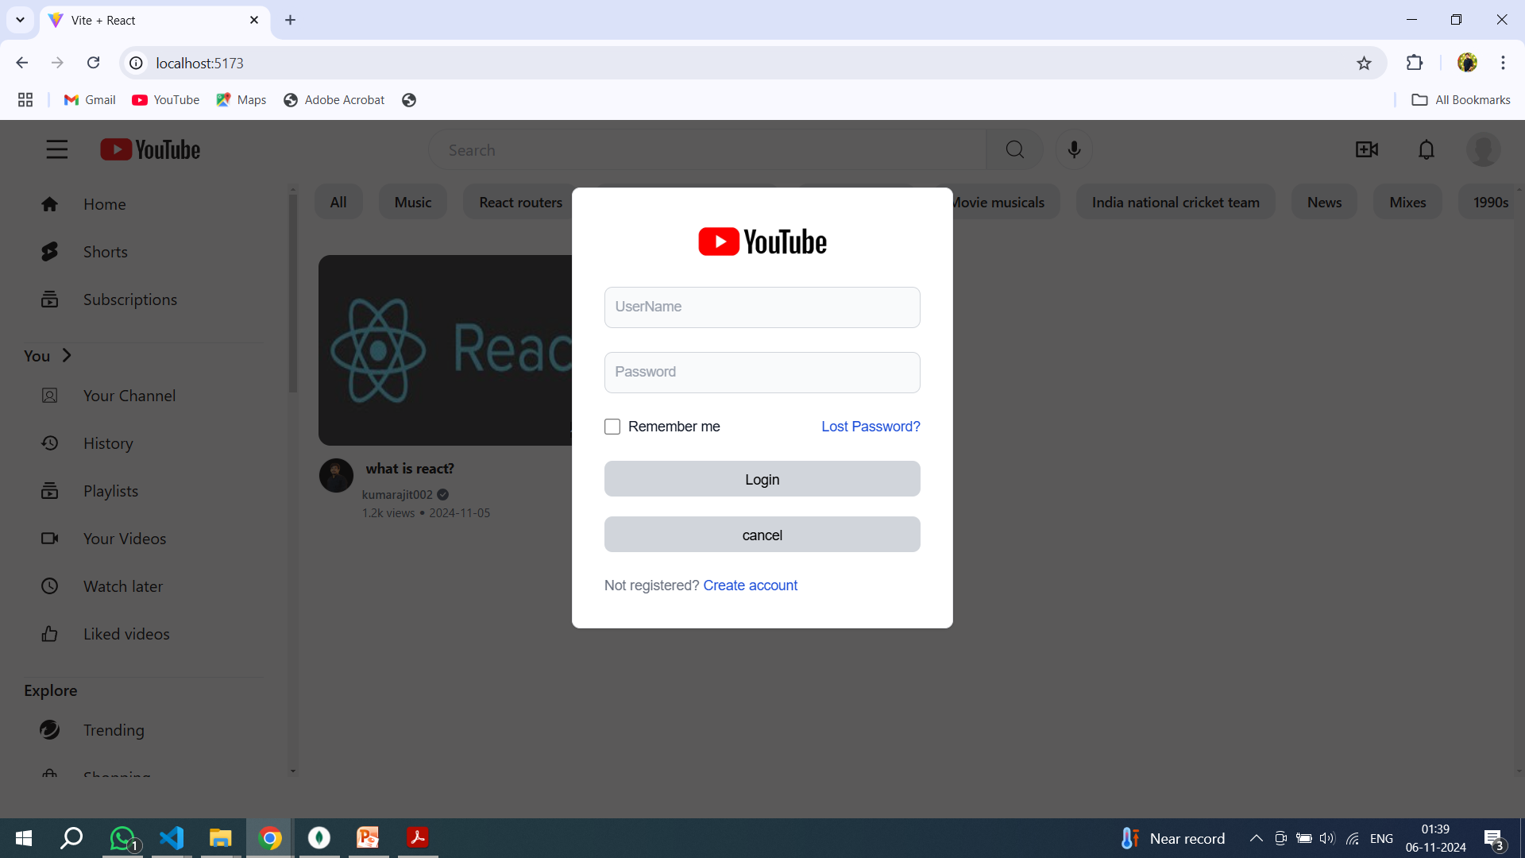
If a new user comes and tries to login, he will not be able to do so. First he will have to create a new
account. Then he can login.
click the create account

Slide 8
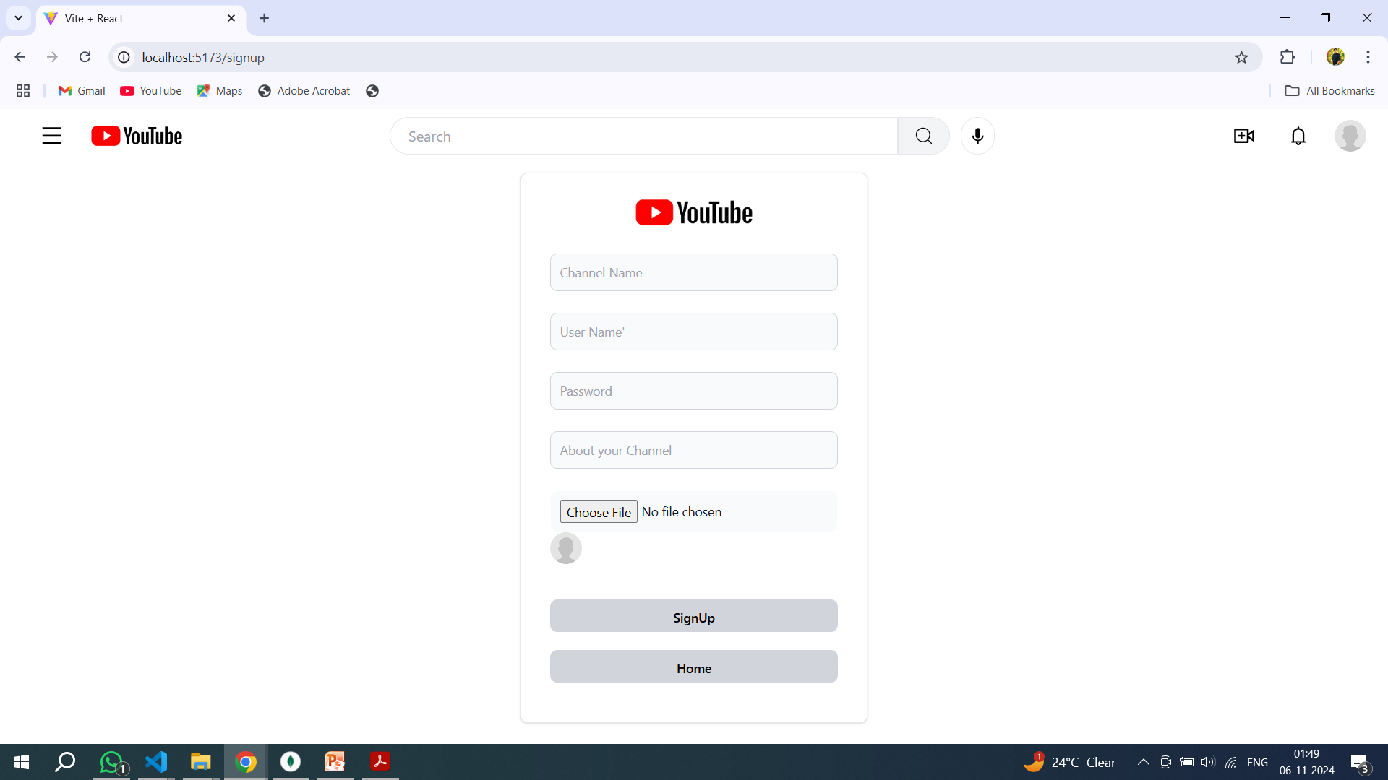
channel page
After clicking crate account open new window for create a account
After filling the details, click on sign up. After that the account will be created.
After the account is created, click on the home button and then go to Login. Then your account will be logged in.

Slide 9
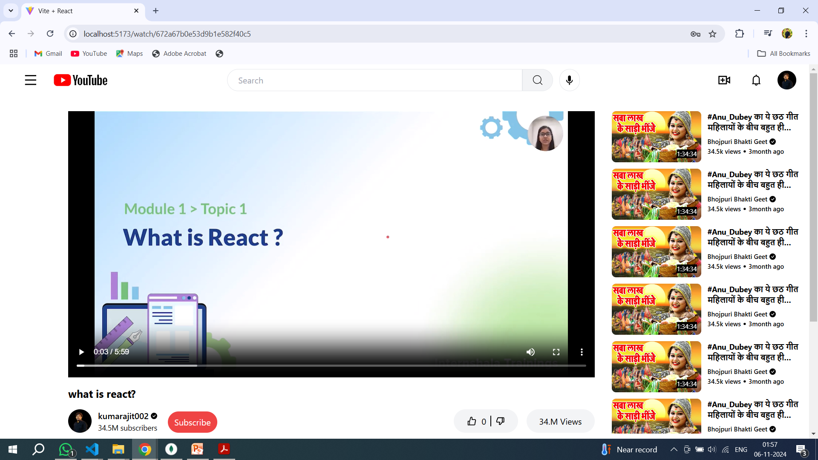
video player page
See the page ,

Slide 10
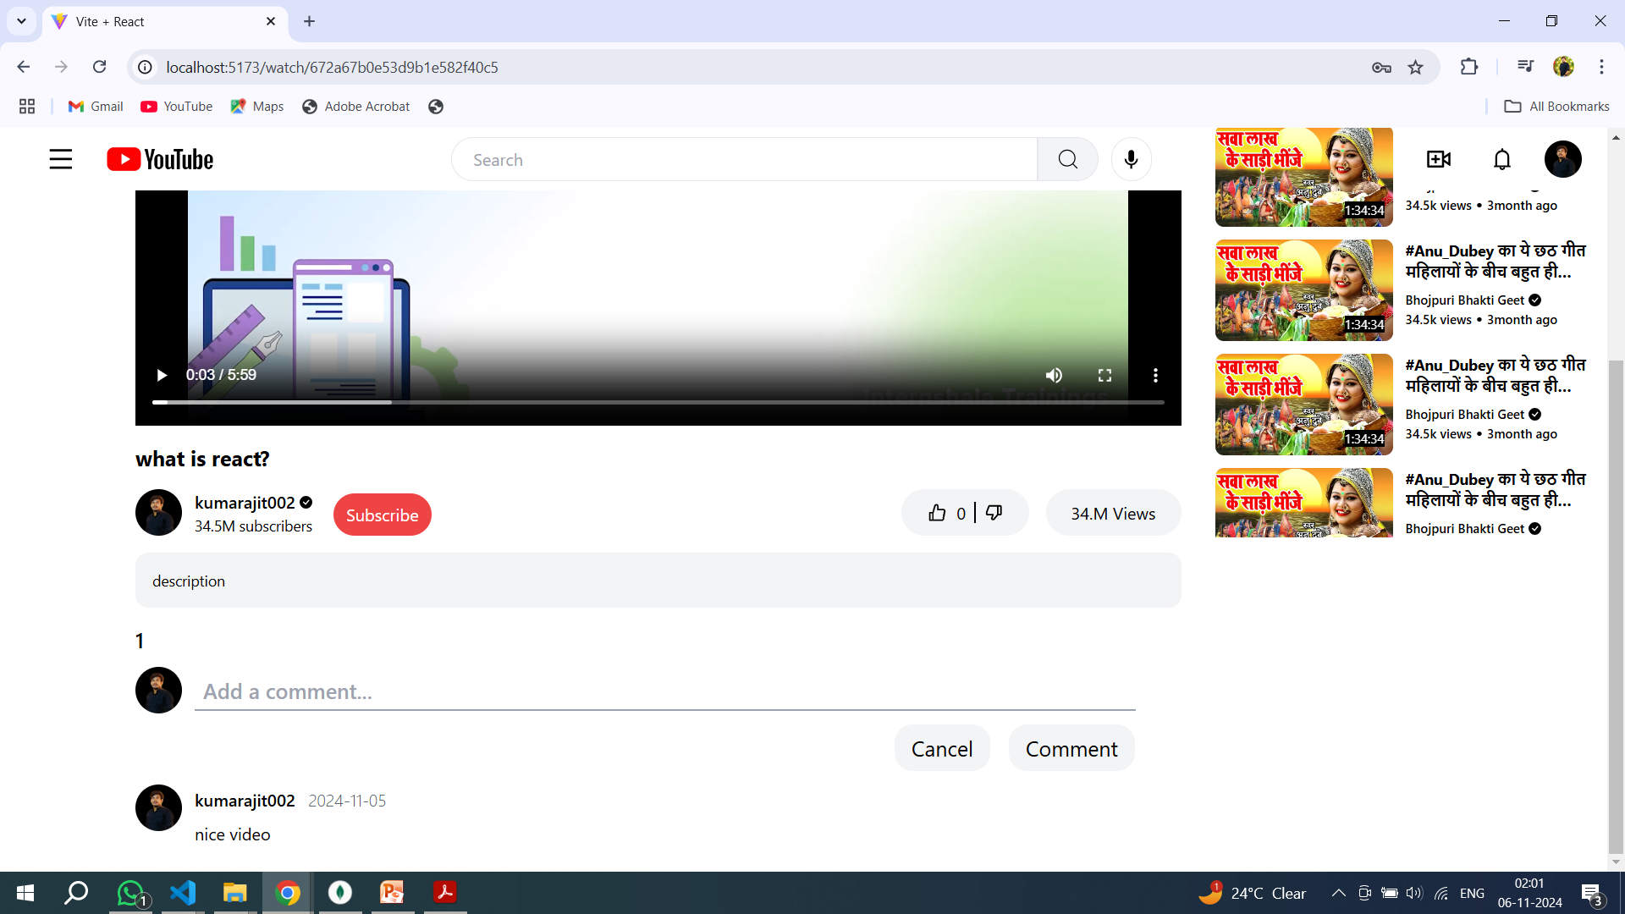
comment page

Slide 11
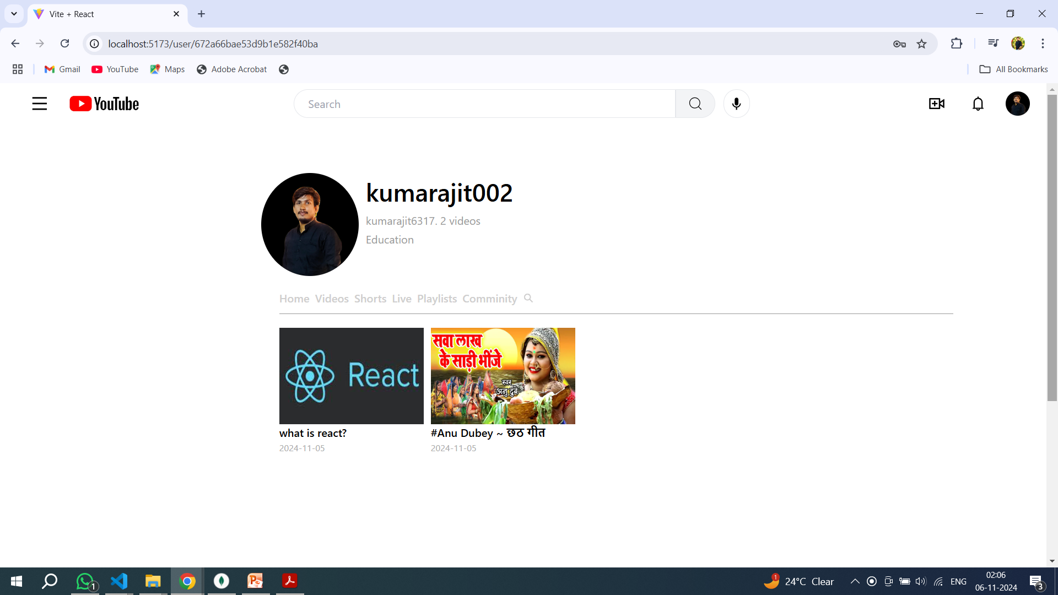
profile page

Slide 12
THANK YOU

