Slide 1
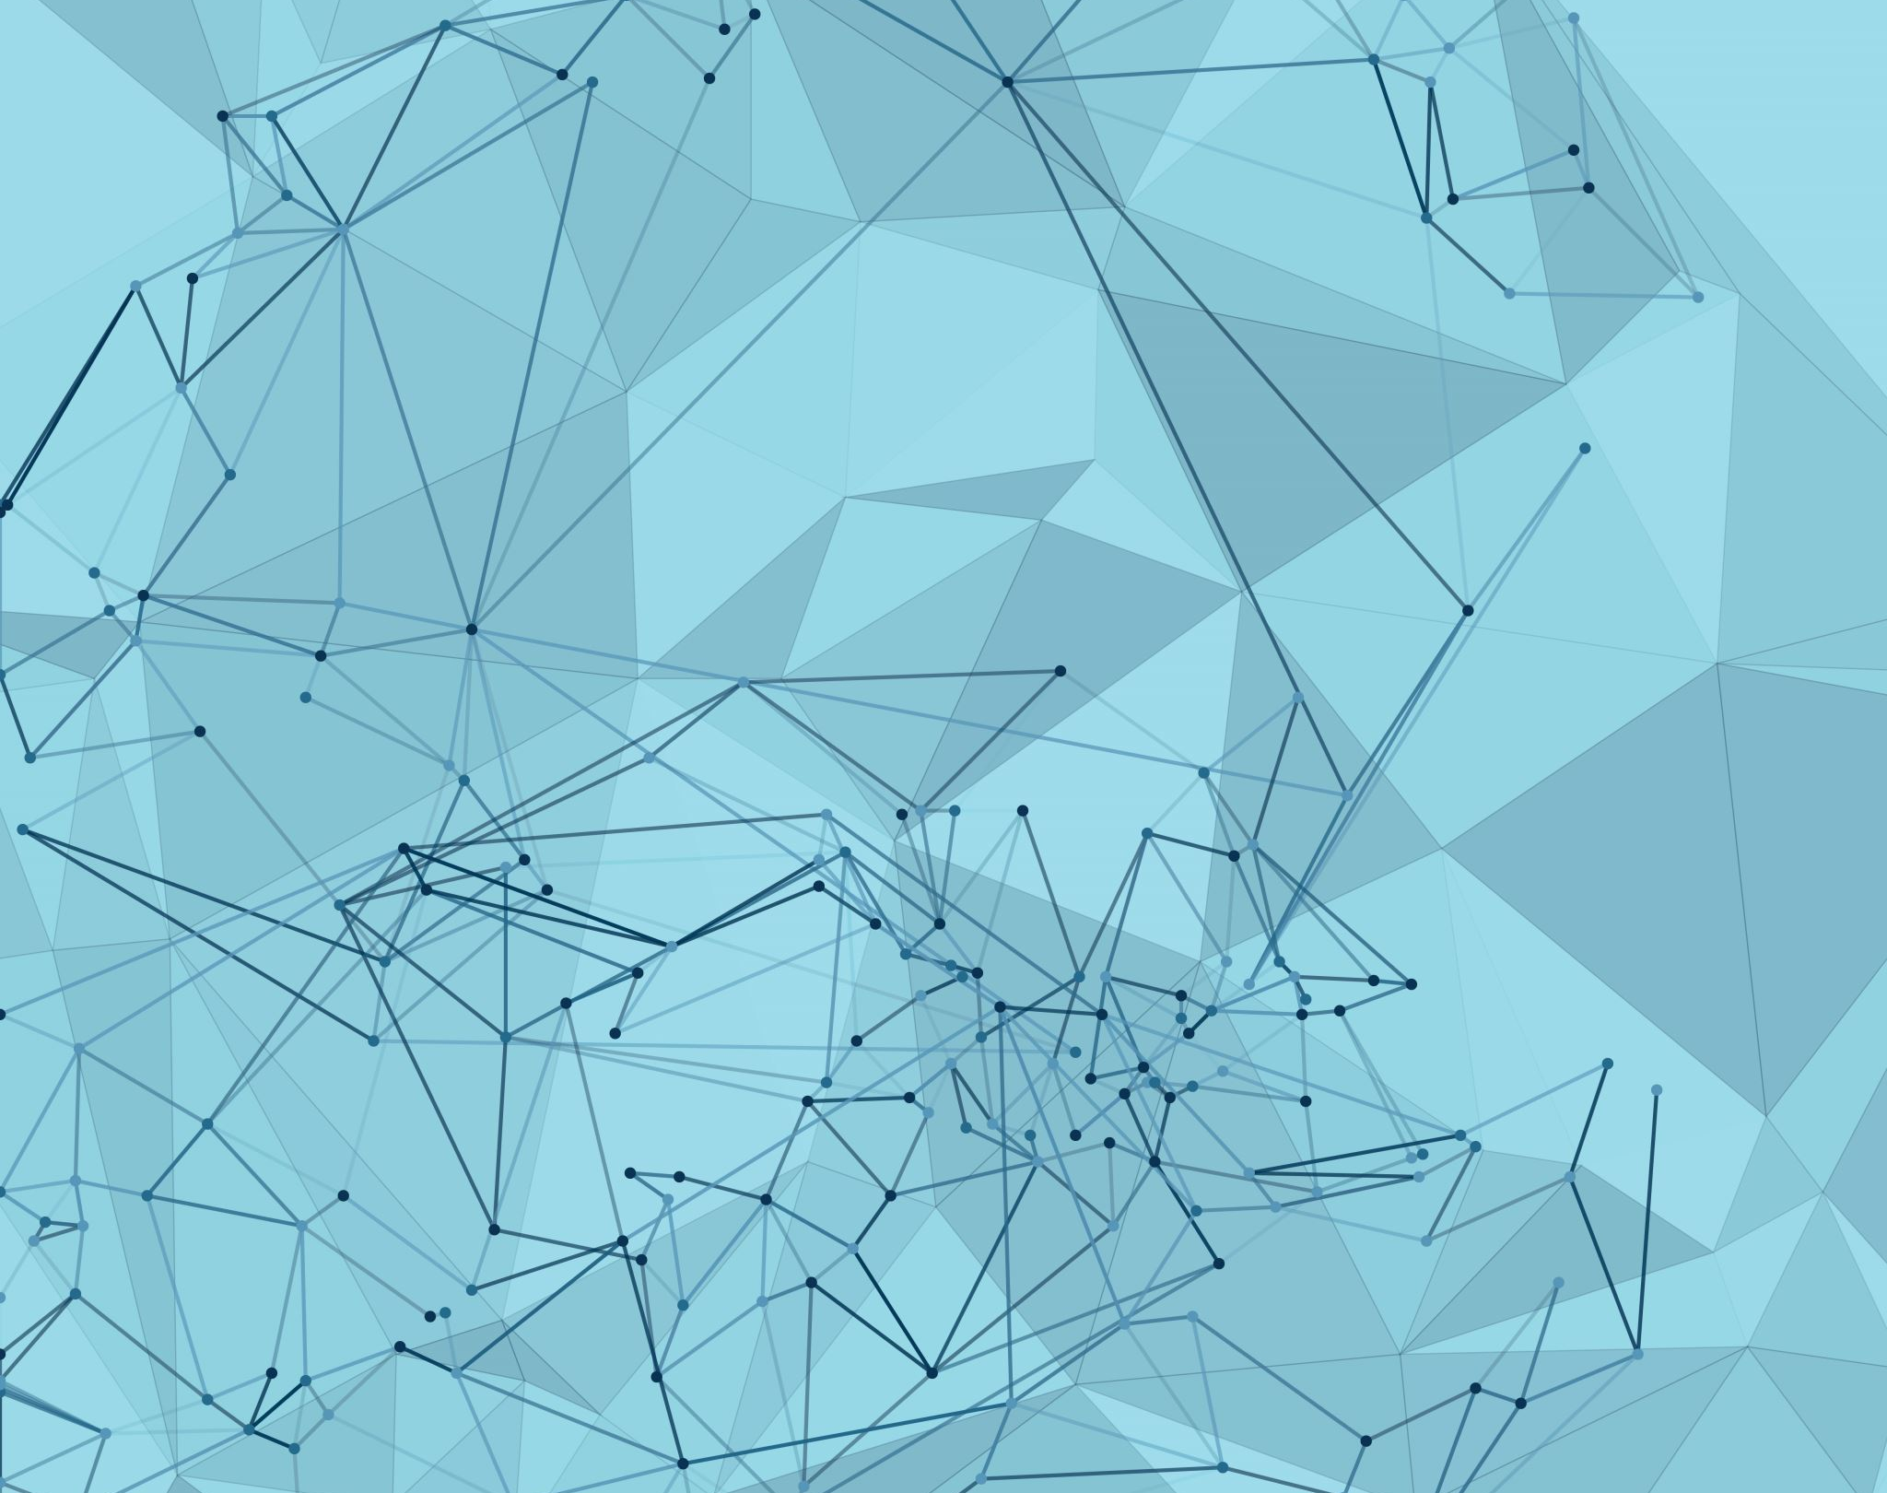
Blockchain based crowdfunding application
Submitted by :
ARYANSH CHAUDHARY

Slide 2
Problem statement
The problem with any crowdfunding application are the scams that take place , someone who donates money does not know whether the donated money will go for the desired cause or not .

Slide 3
History
A crowdfunding scam is an attempt to collect money for some cause. This scams are done on the people that think good for people and want to help people who are really in need , needless to say this is more often than not the case. Most people donate small amount but it sums up to be really big and scammers run away with it. Most of the fund raising platforms like Kickstarter , gofundme refund money but none have implemented the solution of web3 into the mix. Using web3. This can be reduced to minimum. Kickstarter is an online donation platform where people can donate money for a product that needs to be developed and after successful compilation of the product some items are given as a reward to the donors, but as you have already guessed this an idealcase scenario and mostly this is not the case, most of the managers take money from the donors and the product that was promise never see the light of day. Either the money taken go to the bank account or just there is a failure of a product. One such scam was in 2013 of montex watch project in this project there was $61,504 raised and no product was delivered. Another scam poses of 10 second automatic toothbrush in 2017 where around 3.9 million dollars were raised The Amabrush seemed super legit .

Slide 4
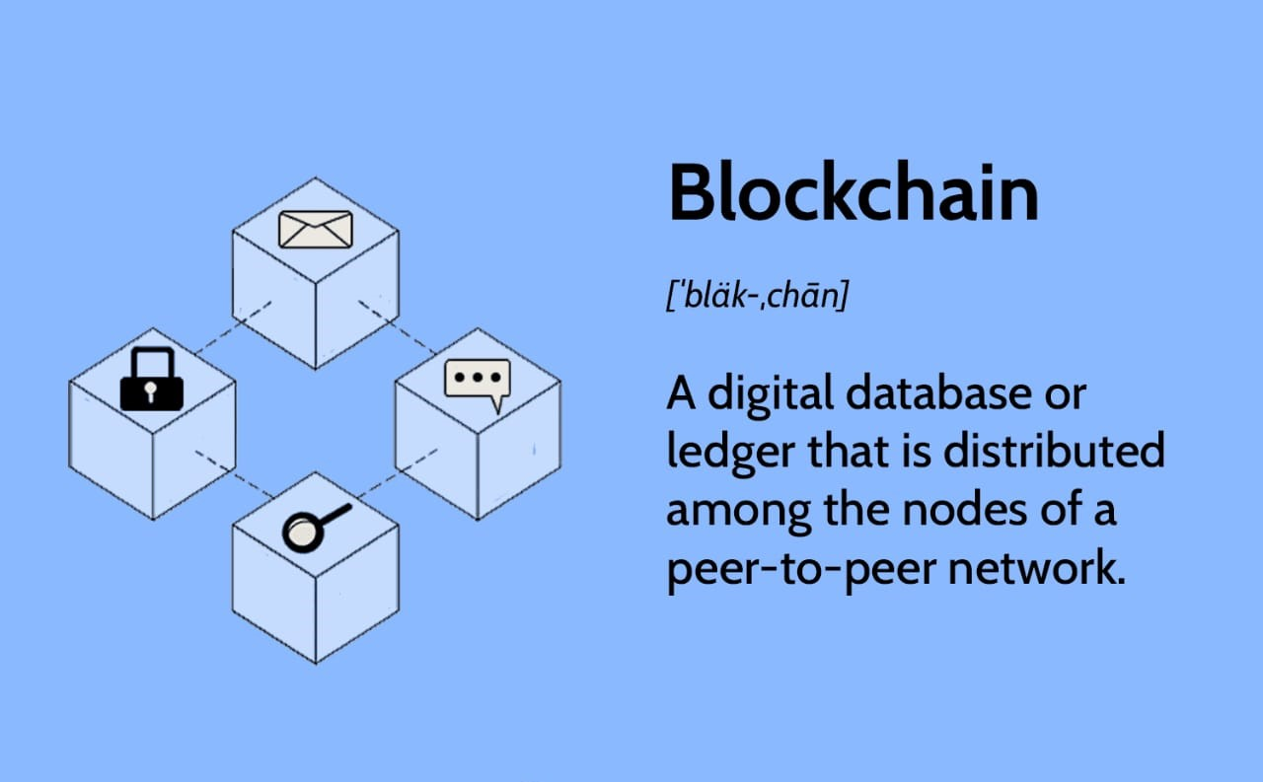

Slide 5
Motivation
Our major motivation to develop this application is to stop or minimize these kinds of scams that happen on these crowdfunding applications and to create an application that is secure taking the full advantage of blockchain technology. This application will be useful for the technical era, using web3 to develop applications to stop such scams, taking full advantage of the blockchain technology. In the upcoming future more and more applications will move on the web3, as we have already used to seen with NFTs, even video games are implementing these. So, finally its time to develop a crowdfunding application with a secure network where no one has the direct control over the money in the network and where the possibility of someone scamming you is slim.

Slide 6
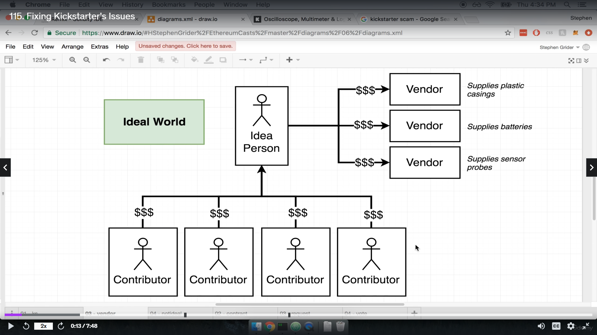
Ideal case

Slide 7
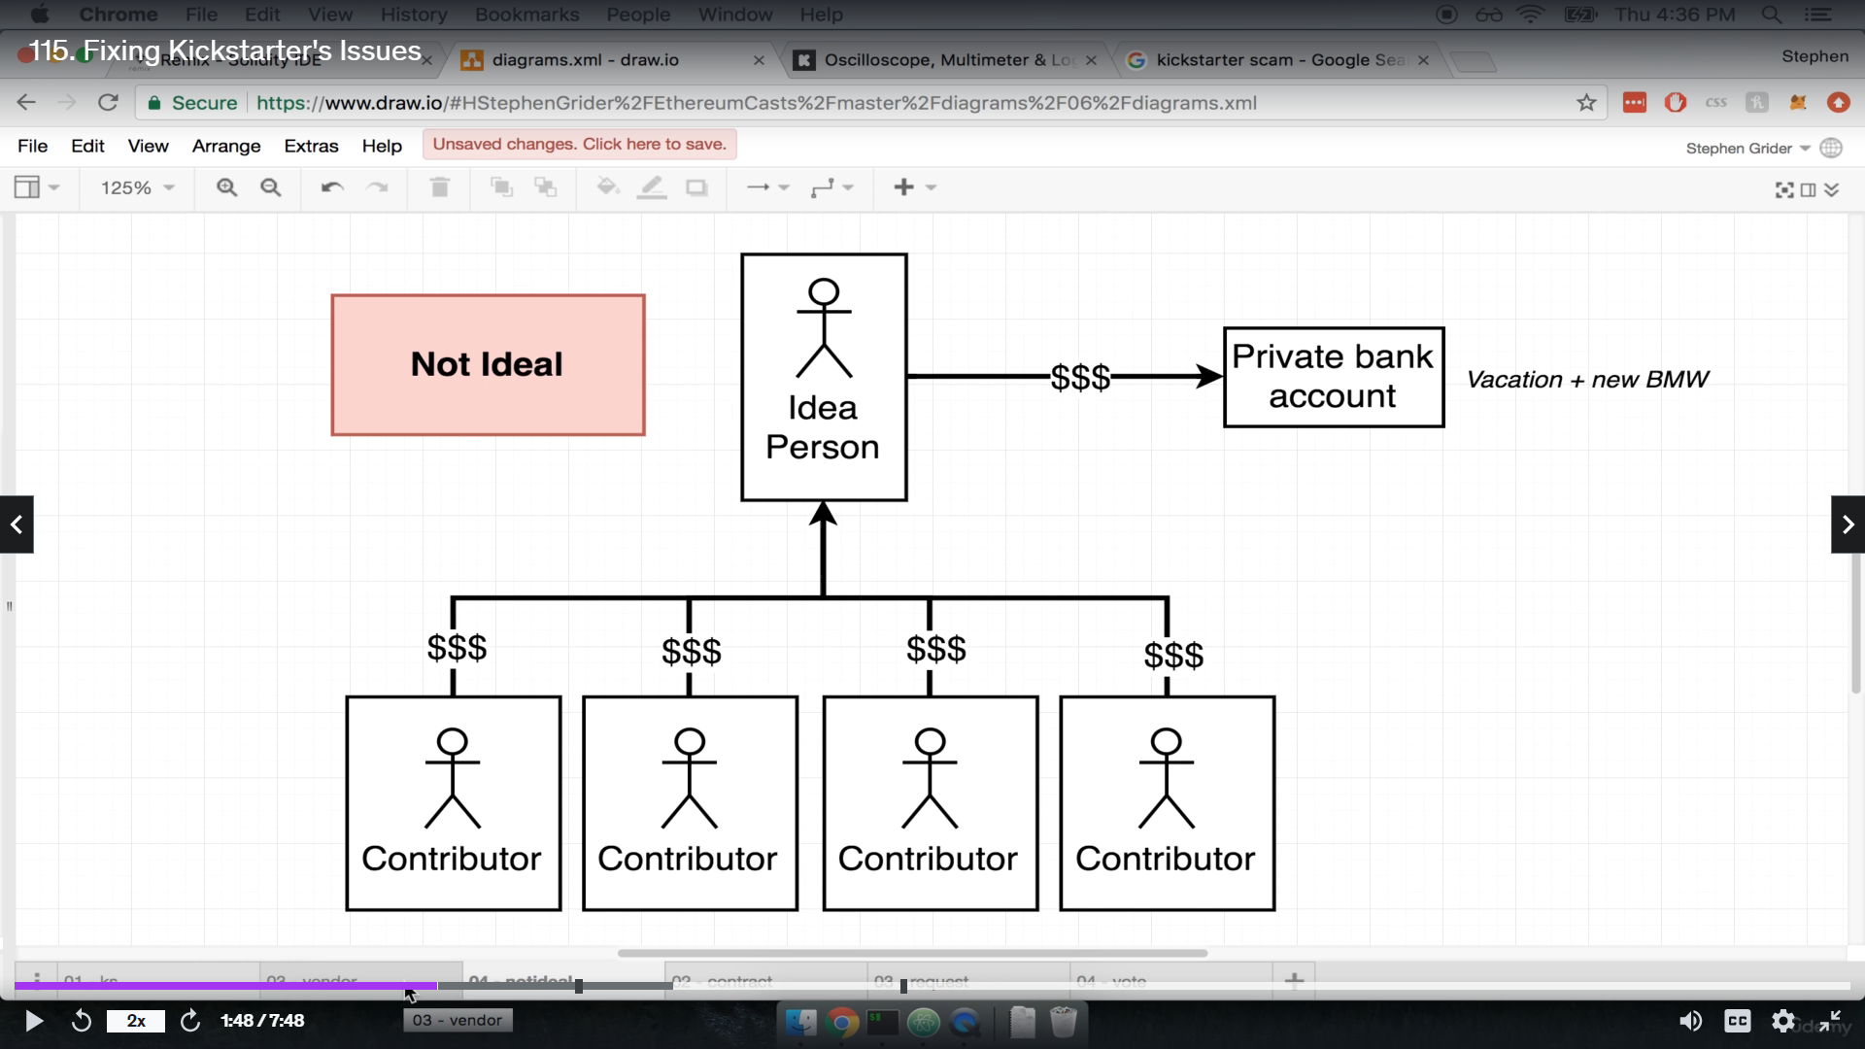
Real Case

Slide 8

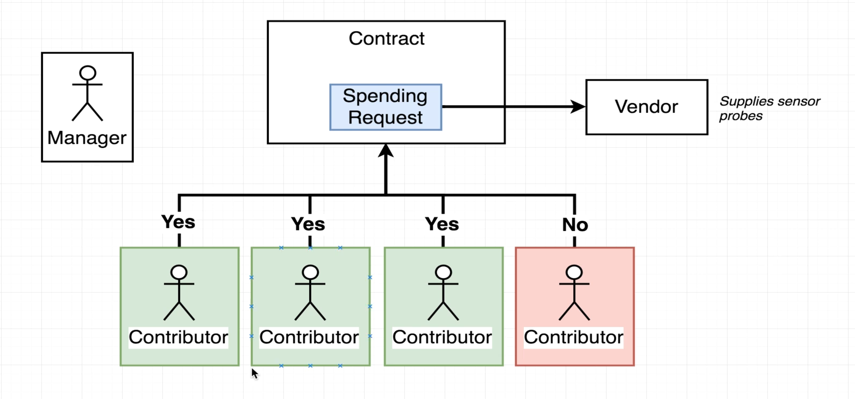
Contract design

Slide 9
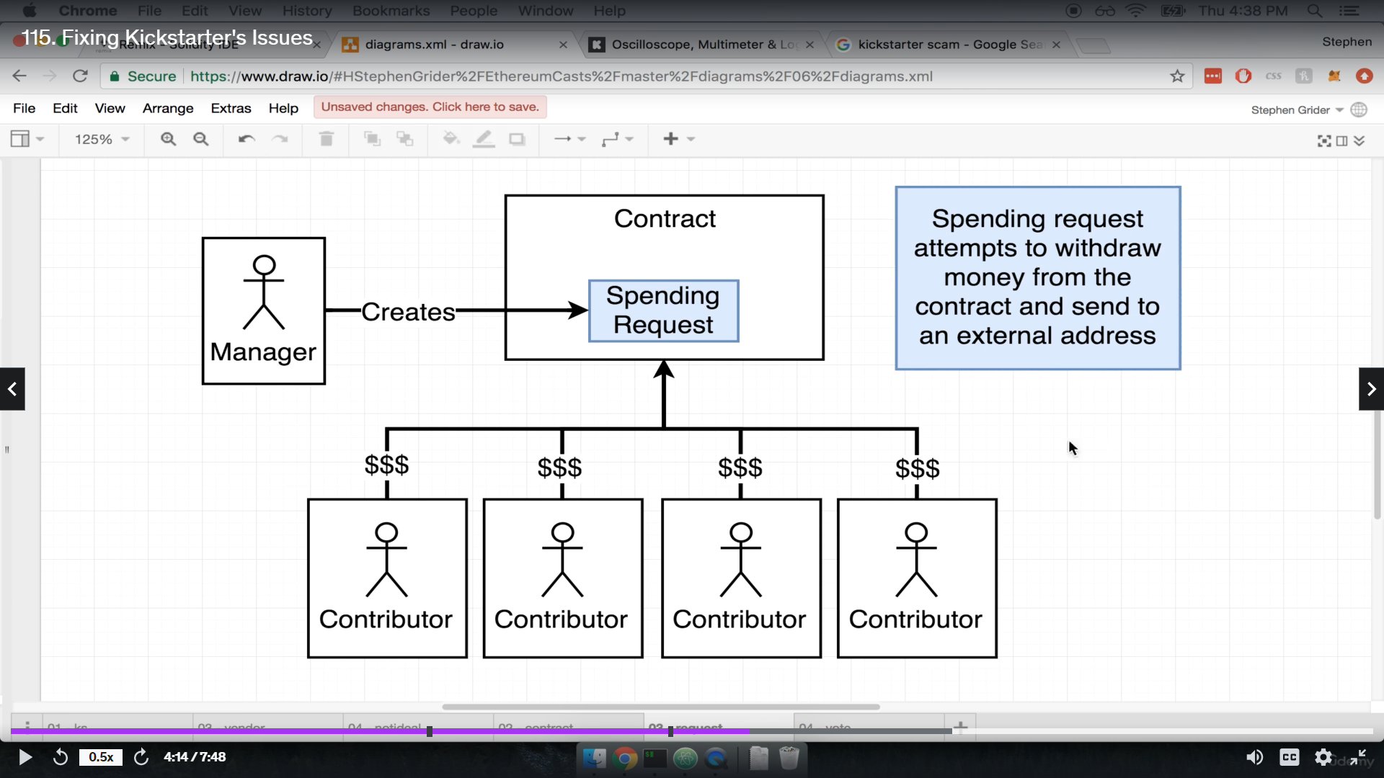
How do we solve this problem ?

Slide 10
Technology Involved
Blockchain
NextJs
Solidity
MetaMask

Slide 11
Variables in contract
Manager
Minimum contribution
Approvers
Requests

Slide 12
Functions in contract design
Campaign
Contribute
Create Request
Approve request
Finalize request

Slide 13
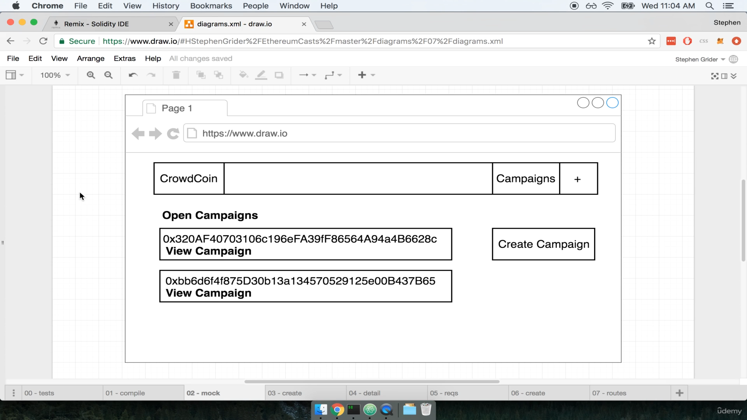
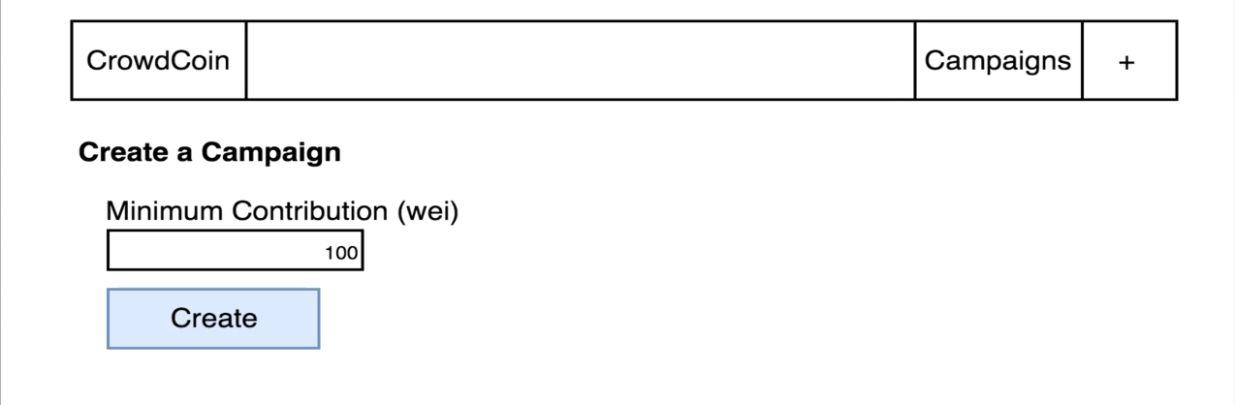
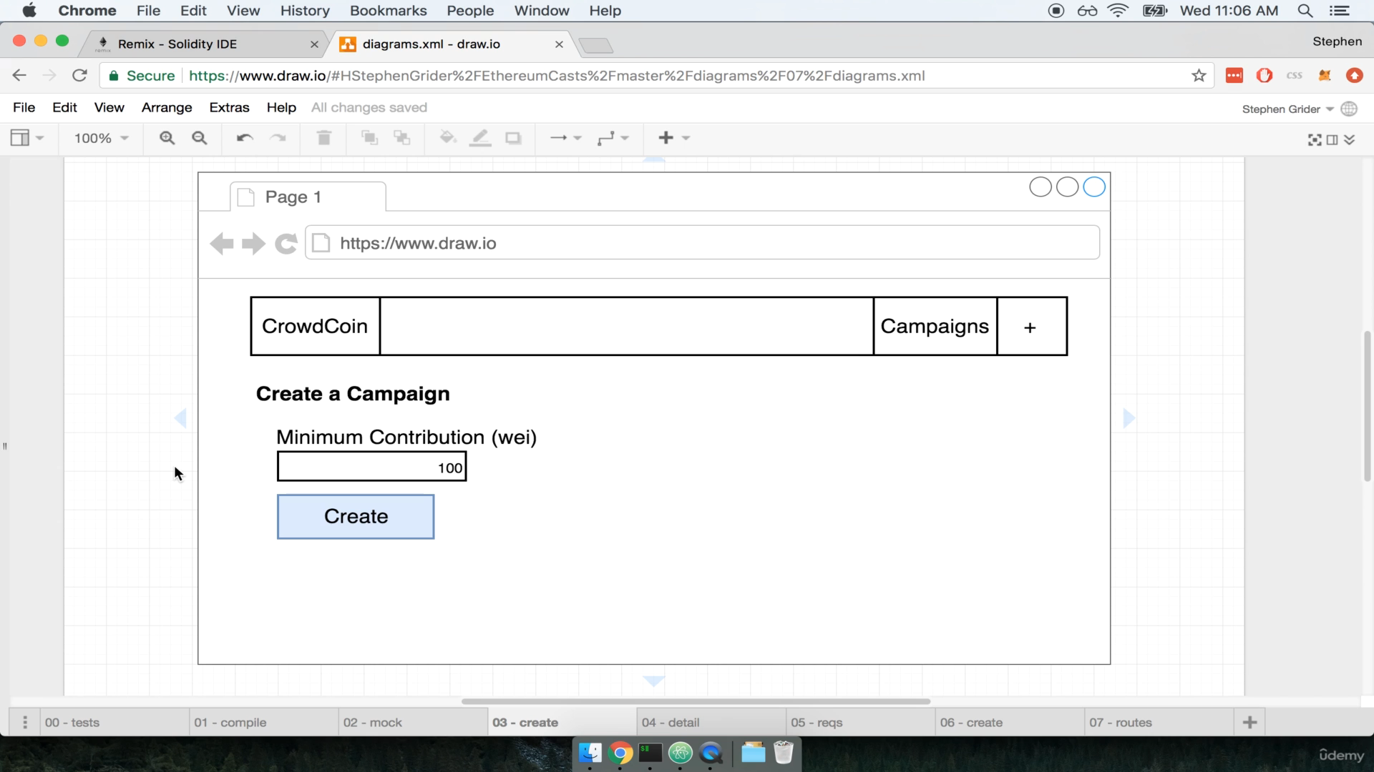
UI design

Slide 14
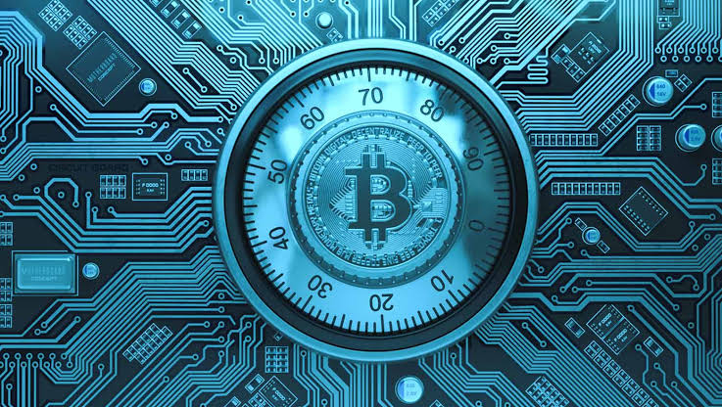
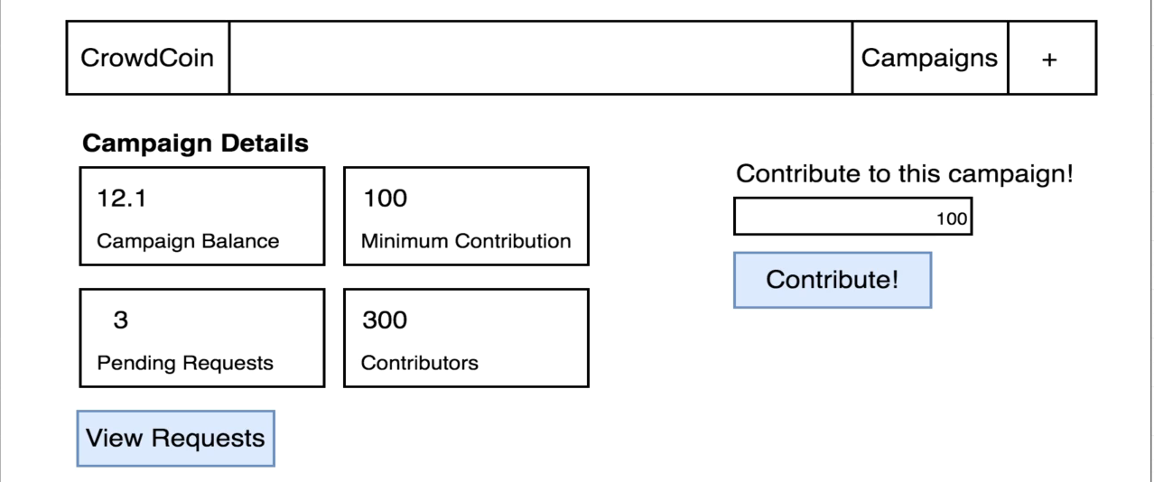
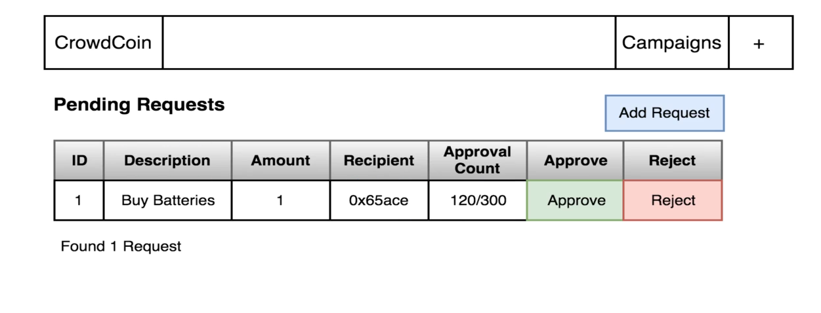

Slide 15
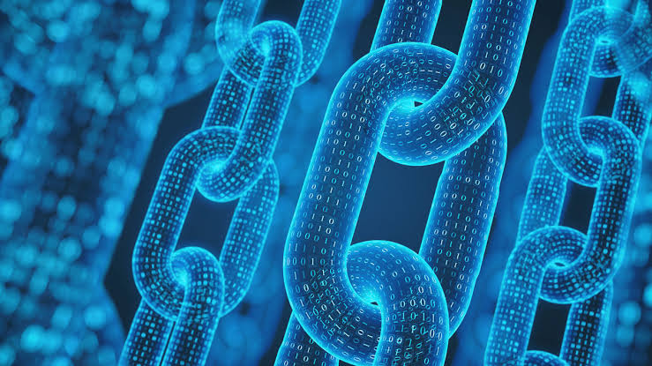
Future Scope
Integration of additional blockchain
Integeration of social features
Enchaned Governance Mechanisms

Slide 16
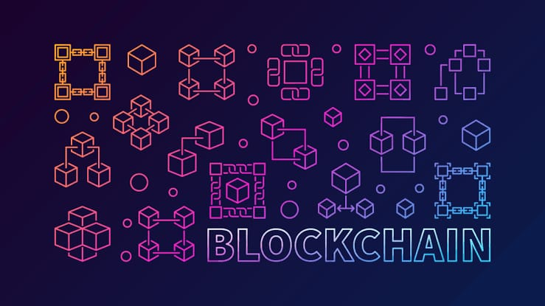
Thank you

