Slide 1


Data Collection and DBMS
SWATI SINGH
swatisingh@cdac.in

Slide 2
Session agenda
Database Schema Design
ER Diagram
Normal Forms
Stored Procedures

Slide 3
Database Schema
A database schema is a formal description of the structure or organization of a particular database. The term “database schema” is most commonly used in reference to relational databases, i.e. databases that organize information in tables and use the SQL query language.
What is Database Schema Design?
You can think of database schema design as a “blueprint” for how to store massive amounts of information in a database. By defining categories of data and relationships between those categories, database schema design makes data much easier to retrieve, consume, manipulate, and interpret.

Slide 4
Why is Database Schema Design Important ?
Relational database systems heavily depend on having a solid database schema in place. The goals of good database schema design include:
Reducing or eliminating data redundancy.
Preventing data inconsistencies and inaccuracies.
Ensuring the correctness and integrity of your data.
Facilitating rapid data lookup, retrieval, and analysis.
Keeping sensitive and confidential data secure, yet accessible to those who need it.

Slide 5
creating schema-
1) sqlplus / as sysdba;
2) create user username identified by password;
3)grant create session to username;
4)alter user username identified by password account unlock;
5)create schema authorization username; (in user)
6)grant connect, resource, dba to username;
7)create table tablename(column_name number, column_name varchar2(20));

Slide 6
STEPS IN DATABASE DESIGN –
Conceptual Design-
Requirement analysis like user needs, what must database do?
Logical Design-
It includes definition of entity relationships and normal forms.
Physical design-
Translates the ER Diagram into DBMS Tables.

Slide 7
Database Design Levels
Conceptual Design
Generic
Logical Design
Physical Design
Hardware
Specific

Slide 8
cardinality in a database -
Cardinality usually represents the relationship between the data in two different tables by highlighting how many times a specific entity occurs in comparison to another. For example, the database of an auto repair shop may show that a mechanic works with multiple customers every day.
Types of cardinality in databases:
One-to-one
One-to-many
Many-to-many

Slide 9
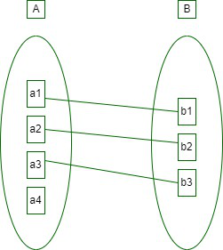
One-to-one : an entity in A is connected to at most one entity in B. Or we can say that a unit or item in B is connected to at most one unit or item in A.
Cardinality ratio = 1:1
Example: In a particular School, the School has one Principal of the School. They both serve one-to-one relationships.
school
1
Headed by
1
principal

Slide 10
One-to-many : In this type of cardinality mapping, an entity in X is associated with any number of entities in Y. Or we can say that one unit or item in Y can be connected to at most one unit or item in X.
Cardinality ratio = 1:N
Example: In a particular school, the school has multiple teacher. They serve one-to-many relationships.
x
y
a
1
b
2
c
3
school
1
Has
M
Teachers

Slide 11
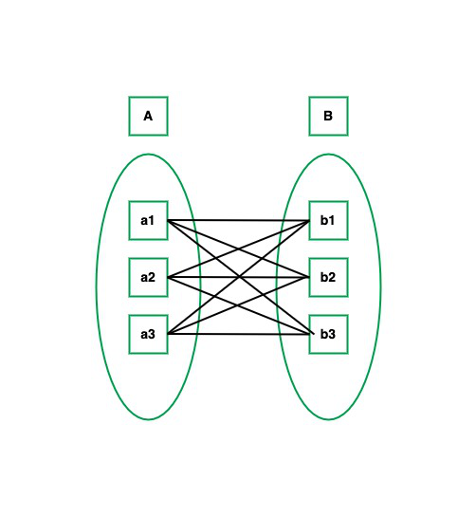
Many-to-many: In this type of cardinality mapping, an entity in A is associated with any number of entities in B, and an entity in B is associated with any number of entities in A.
Cardinality ratio = M:N
Example: In a particular school, multiple teacher teaches on multiple students. They serve many-to-many relationships.
Teacher
M
Has
M
Student

Slide 12
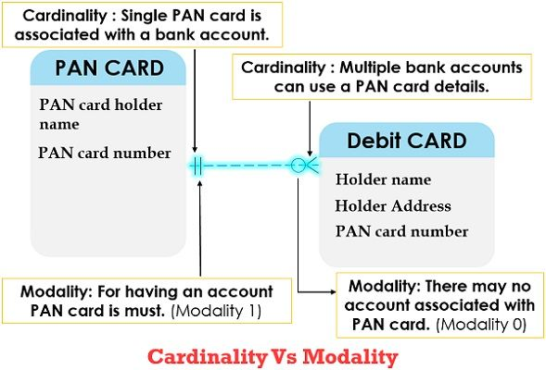
Modality -
It describes whether a relationship between two or more entities is even required or not. Or minimum number of row association.
the modality of the given relationship can be nullable or non-nullable.
Example-

Slide 13
Developing Entity Relationship Diagrams (ERDs)
WHY:
Entity Relationship Diagrams are a major data-modeling tool and will help organize the data in your project into entities and define the relationships between the entities. This process has proved to enable the analyst to produce a good database structure so that the data can be stored and retrieved in a most efficient manner.
INFORMATION:
Entity
A data entity is anything real or abstract about which we want to store. E.g. employee, payment, campus, book. Specific examples of an entity are called instances. E.g. the employee John Jones, Mary Smith's payment, etc.

Slide 14
Relationship
A data relationship is a natural association that exists between one or more entities. E.g. Employees process payments. Cardinality defines the number of occurrences of one entity for a single occurrence of the related entity. E.g. an employee may process many payments but might not process any payments depending on the nature of her job.
Attribute
A data attribute is a characteristic common to all or most instances of a particular entity. Synonyms include property, data element, field. E.g. Name, address, Employee Number, pay rate are all attributes of the entity employee. An attribute or combination of attributes that uniquely identifies one and only one instance of an entity is called a primary key or identifier. E.g. Employee Number is a primary key for Employee.

Slide 15
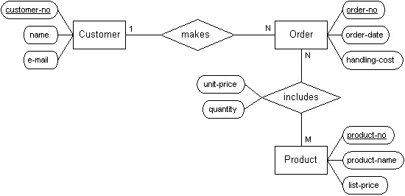
CONCEPTUAL DESIGNING ENTITY RELATIONSHIP DIAGRAM
ENTITIES
RELATIONSHIPS

Slide 16
Steps for ER
1.Identify Entities | Identify the roles, events, locations, tangible things or concepts about which the end-users want to store data.
2. Find Relationships | Find the natural associations between pairs of entities using a relationship matrix.
3. Draw Rough ERD | Put entities in rectangles and relationships on line segments connecting the entities.
4. Fill in Cardinality | Determine the number of occurrences of one entity for a single occurrence of the related entity.
5. Define Primary Keys | Identify the data attribute(s) that uniquely identify one and only one occurrence of each entity.
6. Draw Key-Based ERD | Eliminate Many-to-Many relationships and include primary and foreign keys in each entity.
7. Map Attributes | For each attribute, match it with exactly one entity that it describes.
8. Draw fully attributed ERD | Adjust the ERD from step 6 to account for entities or relationships discovered in step 8.
9. Check Results | Does the final Entity Relationship Diagram accurately depict the system data?

Slide 17
A SIMPLE EXAMPLE-
Problem statement for Company case study
A company has several departments. Each department has a supervisor and at least one employee. Employees must be assigned to at least one, but possibly more departments. At least one employee is assigned to a project, but an employee may be on vacation and not assigned to any projects. The important data fields are the names of the departments, projects, supervisors and employees, as well as the supervisor and employee number and a unique project number.

Slide 18
Identify Entities - The entities in this system are Department, Employee, Supervisor and Project. One is tempted to make Company an entity, but it is a false entity because it has only one instance in this problem. True entities must have more than one instance.
Find Relationships - We construct the following Entity Relationship Matrix:
 | Department | Employee | Supervisor | Project
Department |  | is assigned | run by
Employee | belongs to |  |  | works on
Supervisor | runs
Project |  | uses

Slide 19
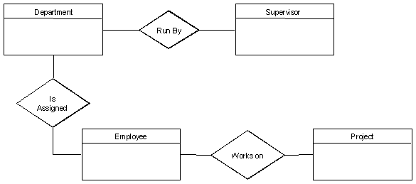
Draw Rough ERD- We connect the entities whenever a relationship is shown in the entity Relationship Matrix.

Slide 20
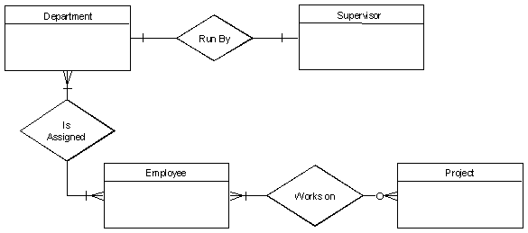
Fill in Cardinality - From the description of the problem we see that:
Each department has exactly one supervisor.
A supervisor is in charge of one and only one department.
Each department is assigned at least one employee.
Each employee works for at least one department.
Each project has at least one employee working on it.
An employee is assigned to 0 or more projects.

Slide 21
Define Primary Keys - The primary keys are Department Name, Supervisor Number, Employee Number, Project Number.
Draw Key-Based ERD - There are two many-to-many relationships in the rough ERD above, between Department and Employee and between Employee and Project. Thus we need the associative entities Department-Employee and Employee-Project. The primary key for Department-Employee is the concatenated key Department Name and Employee Number. The primary key for Employee-Project is the concatenated key Employee Number and Project Number.

Slide 22
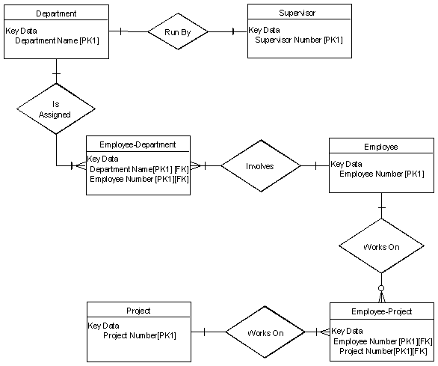

Slide 23

Identify Attributes- The only attributes indicated are the names of the departments, projects, supervisors and employees, as well as the supervisor and employee NUMBER and a unique project number.
Draw Fully Attributed ERD

Slide 24
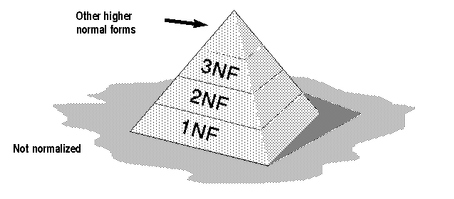
normalization

Slide 25
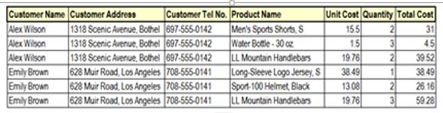
Database normalization is a database schema design technique, by which an existing schema is modified to minimize redundancy and dependency of data.
Normalization split a large table into smaller tables and define relationships between them to increases the clarity in organizing data.
FLAT TABLE

Slide 26
Normalization is needed to allow any relation in the database to be represented,
To allow a language like SQL to use powerful retrieval operations composed of atomic operations
To remove anomalies in insertion, deletion, and updating
To reduce the need for restructuring the database as new data types are added.
The Normalization process defines a set of hierarchical normal forms (NFs). Several normal forms have been proposed, including 1NF, 2NF, 3NF, BCNF (Boyce-Codd Normal Form).

Slide 27
The main goal of Database Normalization is to:
 Eliminate redundancy
 Organize data efficiently
 Reduce the potential for data anomalies.
DATA ANOMALY-
Data anomalies are inconsistencies in the data stored in a
database as a result of an operation such as update, insertion,
and/or deletion.

Slide 28
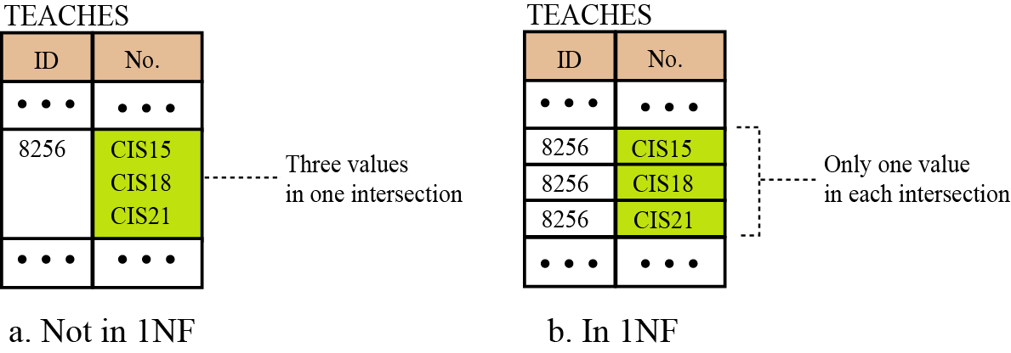
1ST NORMAL FORM:
Each table has a primary key: minimal set of attributes which can uniquely identify a record.
The values in each column of a table are atomic (No multi value attributes allowed).
There are no repeating groups: two columns do not store similar information in the same table.

Slide 29
Student_id | Student_name | Phone number
1 | akshay | 64981209,34976051
2 | anshul | 20981210,69976053
3 | nitesh | 56832095
Student_id | Student_name | Phone number
1 | akshay | 64981209
1 | akshay | 34976051
2 | anshul | 20981210
2 | anshul | 69976053
3 | nitesh | 56832095

Slide 30
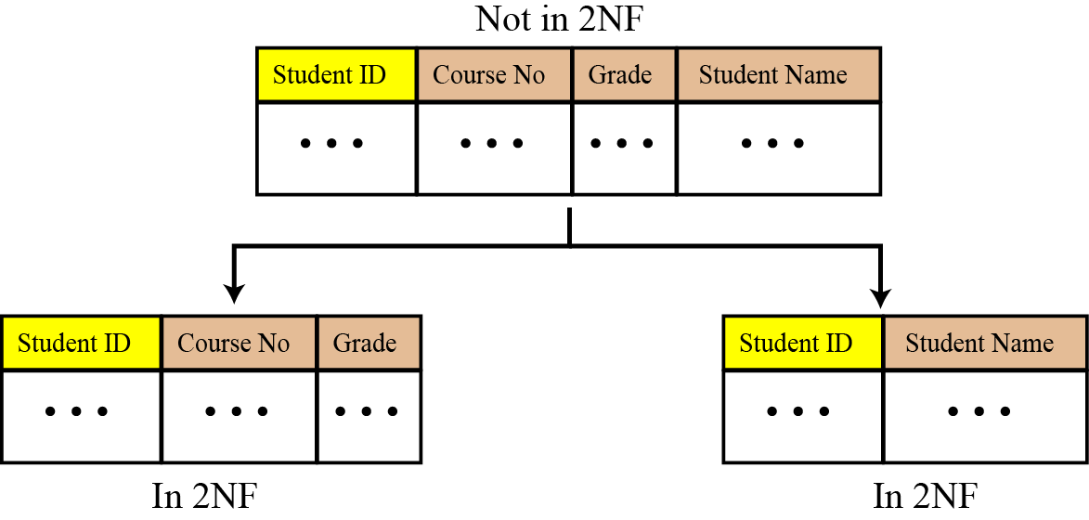
2ND NORMAL FORM :
All requirements for 1st NF must be met.
Redundant data across multiple rows of a table must be moved to a separate table.
The resulting tables must be related to each other by use of foreign key.

Slide 31
Student_id | Student_name | Phone number
1 | akshay | 64981209
1 | akshay | 34976051
2 | anshul | 20981210
2 | anshul | 69976053
3 | nitesh | 56832095
Student_id | Phone number
1 | 64981209
1 | 34976051
2 | 20981210
2 | 69976053
3 | 56832095
Student_id | Student_name
1 | akshay
2 | anshul
3 | nitesh

Slide 32
3RD NORMAL FORM :
All requirements for 2nd NF must be met.
Eliminate fields that do not depend on the primary key; 
That is, any field that is dependent not only on the primary key but also on another field must be moved to another table.

Slide 33
EMP_ID | EMP_NAME | EMP_ZIP | EMP_STATE | EMP_CITY
222 | Harry | 201010 | UP | Noida
333 | Stephan | 02228 | US | Boston
444 | Lan | 60007 | US | Chicago
555 | Katharine | 06389 | UK | Norwich
666 | John | 462007 | MP | Bhopal
EMP_ID | EMP_NAME | EMP_ZIP
222 | Harry | 201010
333 | Stephan | 02228
444 | Lan | 60007
555 | Katharine | 06389
666 | John | 462007
EMP_ZIP | EMP_STATE | EMP_CITY
201010 | UP | Noida
02228 | US | Boston
60007 | US | Chicago
06389 | UK | Norwich
462007 | MP | Bhopal

Slide 34
Stored procedure :
A stored procedure is a prepared SQL code that you can save, so the code can be reused over and over again.
You can also pass parameters to a stored procedure, so that the stored procedure can act based on the parameter value(s) that is passed and may or may not returns a value.
Syntax : Creating a Procedure
CREATE PROCEDURE procedure_name
AS
sql_statement
GO;
Syntax : Executing a Procedure
EXEC procedure_name;

Slide 35
The most important part is parameters. Parameters are used to pass values to the Procedure. There are 3 different types of parameters, they are as follows:
IN: This is the Default Parameter for the procedure. It always receives the values from calling program.
OUT: This parameter always sends the values to the calling program.
IN OUT: This parameter performs both the operations. It Receives value from as well as sends the values to the calling program.

Slide 36
Example -
CREATE PROCEDURE SelectAllEmployees
AS
SELECT * FROM Employees
GO;
Execute the stored procedure above -
EXEC SelectAllEmployees;

Slide 37
Stored Procedure With One Parameter
CREATE PROCEDURE SelectAllEmployees @Salary NUMBER
AS
SELECT * FROM Employees WHERE Salary = @Salary
GO;
----------------------------------------------------------------------------------------------
EXEC SelectAllEmployees @Salary = 17000;

Slide 38
Stored Procedure With Multiple Parameters
CREATE PROCEDURE SelectAllEmployees @Salary nvarchar(30), @JOB_ID nvarchar(10)
AS
SELECT * FROM Employees WHERE Salary = @Salary AND JOB_ID = @JOB_ID
GO;
------------------------------------------------------------------------------------------------------
EXEC SelectAllEmployees @Salary = 17000, @JOB_ID = 'IT_PROG';

Slide 39
CREATE OR REPLACE PROCEDURE PROCEDURE_NAME
IS
BEGIN
DBMS_OUTPUT.PUT_LINE('Hello World');
END;
/
Execute PROCEDURE_NAME;

Slide 40
CREATE OR REPLACE PROCEDURE PROCEDURE_NAME
(job_nm IN VARCHAR2, job_name OUT VARCHAR2)
IS
BEGIN
SELECT JOB_TITLE INTO job_name FROM JOBS where job_id=job_nm;
end;
/
----------------------------------------------------------------------------------------------------------------
declare
job_name varchar(30);
BEGIN
PROCEDURE_NAME('ST_MAN',job_name);
dbms_output.put_line(job_name);
end;
/

Slide 41
Advantages:
They result in performance improvement of the application. If a procedure is being called frequently in an application in a single connection, then the compiled version of the procedure is delivered.
They reduce the traffic between the database and the application, since the lengthy statements are already fed into the database and need not be sent again and again via the application.
They add to code reusability, similar to how functions and methods work in other languages such as C/C++ and Java.
Disadvantages:
Stored procedures can cause a lot of memory usage.

Slide 42
thank-you :)

