Slide 1

Basic Details of the Team and Problem Statement
Ministry/Organization Name/Student Innovation:
Ministry of Ayurveda, Yoga, Naturopathy, Unani, Siddha, Sowa-Rigpa and Homoeopathy (AYUSH).
PS Code: DK735
Problem Statement Title: App for Ayush Services Availability Team Name:
Team Leader Name: Ninad Sonawane
Institute Code (AISHE): C-1262
Institute Name: BMSCE
Theme Name: MedTech / BioTech / HealthTech

Slide 2
Idea/Approach Details
Add process flow chart or simulated image of prototype or any relevant image related to your idea
Describe your idea/Solution/Prototype here:
Describe your Technology stack here:
Next.js
Google Map API
Material UI library

Slide 3
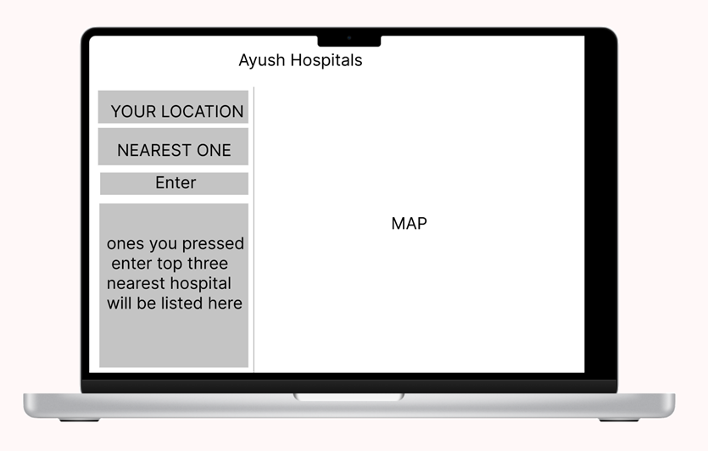
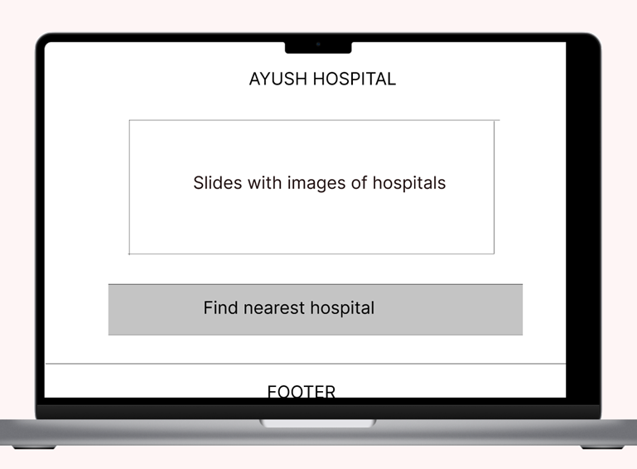
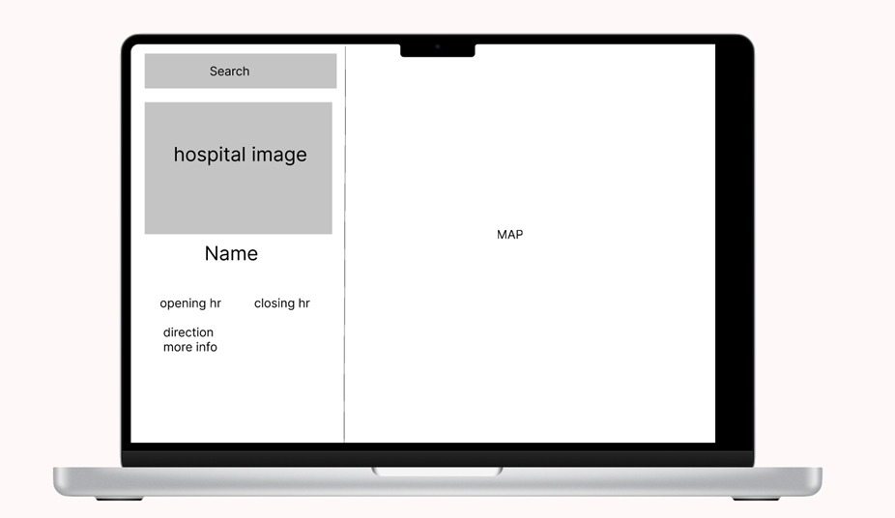
Approach/details

Slide 4
Idea/Approach Details
Describe your Use Cases here
Describe your Dependencies / Show stopper here
User will get its nearby Ayush Hospital detail.
All the details about the hospital will be provided.
We can extend the same idea for other unique public places or for other kind of people benefitting places.
Google maps API

Slide 5
Team Member Details
Team Leader Name: Ninad Sonawane
Branch (Btech/Mtech/PhD etc): Btech Stream (ECE, CSE etc): EEE Year (I,II,III,IV): II
Team Member 1 Name: Ajit J Gupta
Branch (Btech/Mtech/PhD etc): Btech Stream (ECE, CSE etc): EEE Year (I,II,III,IV): II
Team Member 2 Name: Ayush Sharma
Branch (Btech/Mtech/PhD etc): Btech Stream (ECE, CSE etc): AI/ML Year (I,II,III,IV): II
Team Member 3 Name: Pavan
Branch (Btech/Mtech/PhD etc): Btech Stream (ECE, CSE etc):AI/ML Year (I,II,III,IV): II
Team Member 4 Name: Keerthana
Branch (Btech/Mtech/PhD etc): Btech Stream (ECE, CSE etc) : ISE Year (I,II,III,IV): II
Team Member 5 Name: Advaith
Branch (Btech/Mtech/PhD etc): Btech Stream (ECE, CSE etc): AI/ML Year (I,II,III,IV): II
Team Mentor 1 Name: Type Your Name Here
Category (Academic/Industry): Expertise (AI/ML/Blockchain etc): Domain Experience (in years):
Team Mentor 2 Name: Type Your Name Here
Category (Academic/Industry): Expertise (AI/ML/Blockchain etc): Domain Experience (in years):

Slide 6
Important Pointers
Please ensure below pointers are met while

