Slide 1
LectureLens
Ajith Raj
2022MT13191
Software Systems
2023-24
Embedded Systems

Slide 2
LectureLens Overview
Project Title:
LectureLens
Brief Description:
LectureLens is openai based tool which is a lifeline for the constantly dangling working professional, managing the intricate balance between their career, personal and academic commitments.
This tool emerged from my personal challenges encountered throughout the WILP program.

Slide 3
LecTURE LENS ARCHITECTURE
Input (transcript.rtt)
Summarisation
Preprocessing
Student Prompt
Translation
Extract Text (Parsing)
OpenAI api call
Display Output
GPT-3.5 Turbo
Admin Prompt
Contextual data

Slide 4
Impact and Innovation
Massive help to all categories of students.
Category 1: Who attend all classes, this summarization would serve as a revision material.
Category 2: Who couldn’t attend a class due to professional or personal reasons, could see the insights from FAQ and make a decision on reviewing the course material.
Category 3: Who don’t attend any classes, for them this can be an extension of the lecture PPT to know exactly what the teacher taught instead of the PPT material. Lecture Lens helps in generating interest for this category of students to actually watch the recording and enhance their learnings.
BITS Admins will be able to review the course content video which can span upto 30 hours per course in just a matter of an hour to see if the topics being taught are inline with the curriculum requirements.

Slide 5
Conclusion
A learning aid like LectureLens has a massive usecase for WILP students who due to the professional and personal constraints are not able to dedicate enough time for their courses.
The data generated from the tools could serve as revision material, concept based searches, easy review for BITS administrators of class teaching standards

Slide 6
Future and Development
This Student information can be displayed in the Taxila when students tries to view the lecture recordings.
This information will help the students understand the lecture better by generating more interest in a specific lecture and help them learn better.
This information can be used by BITS Administrators to review a recordings of a course which can go upto 2*15 = 30 hours of recording. Even at 2x speed it will take 15 hours to review the cotent. With this kind of insight generation, it will take 30 minutes for an administrator to review the entire course content for a subject.

Slide 7
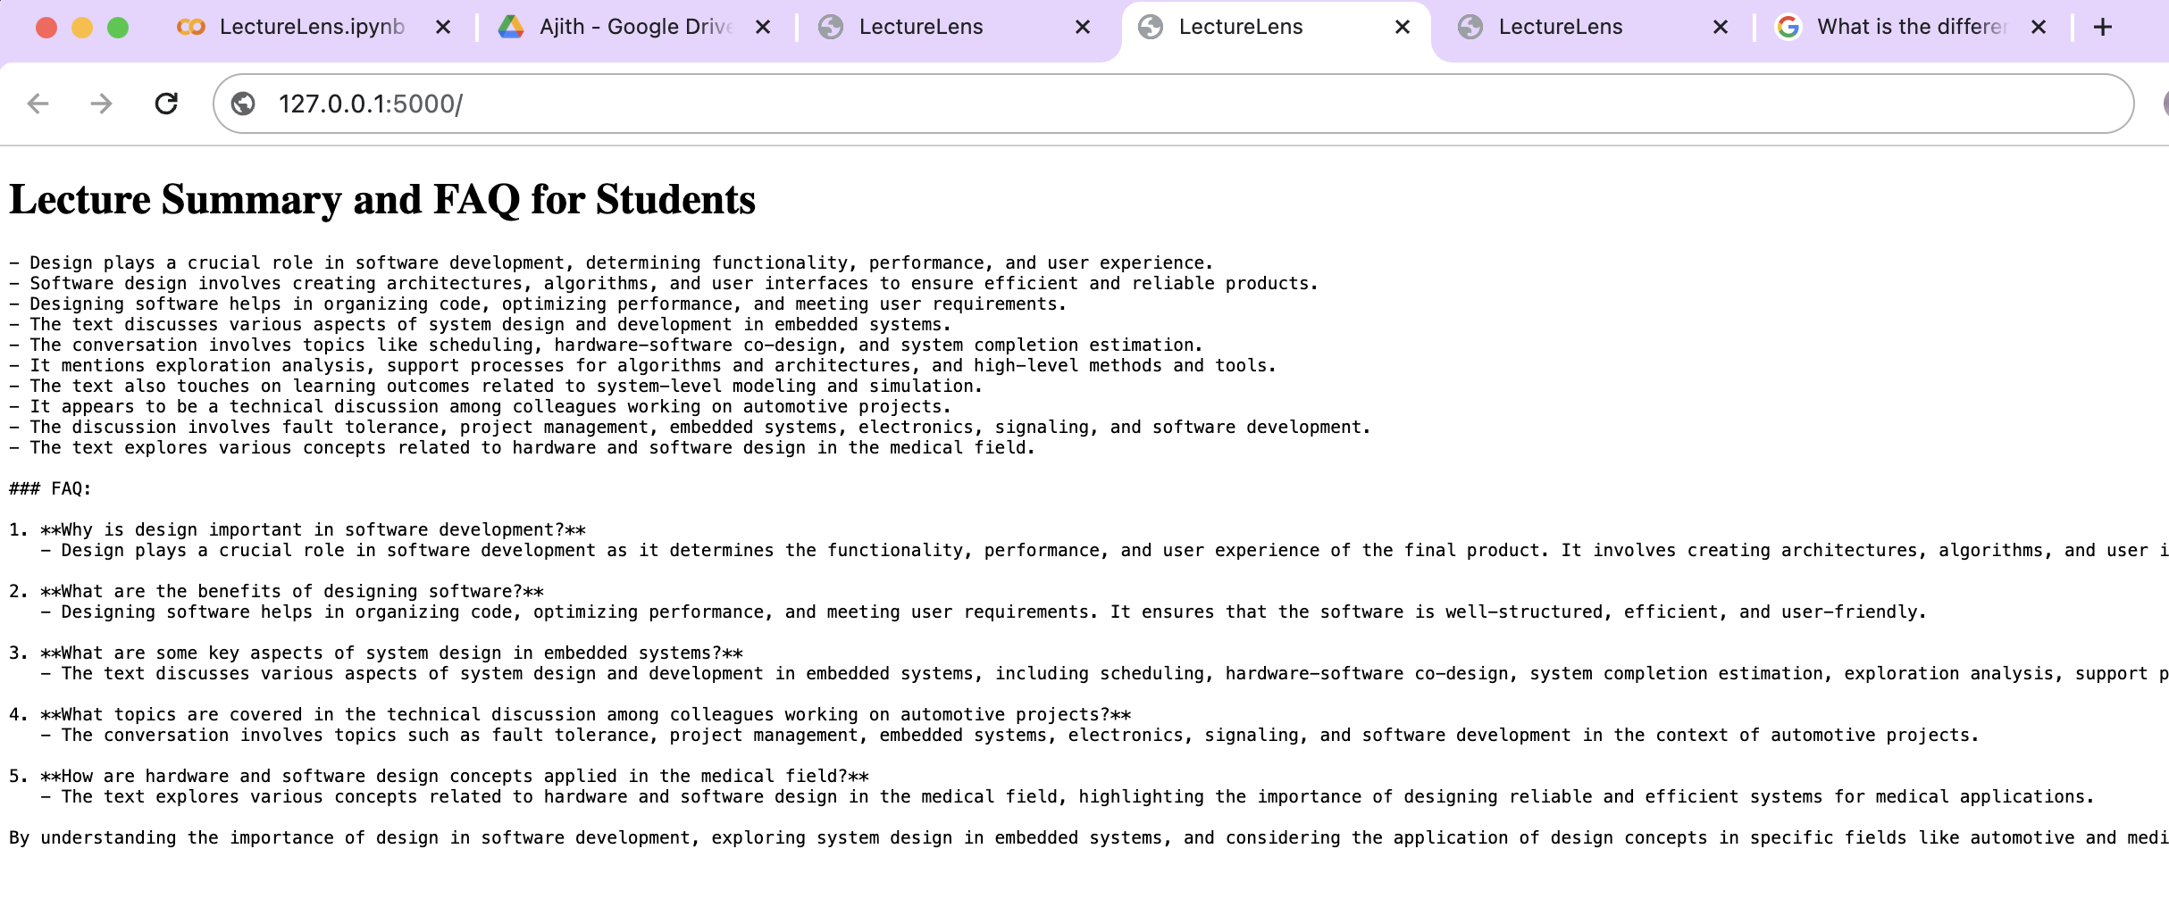
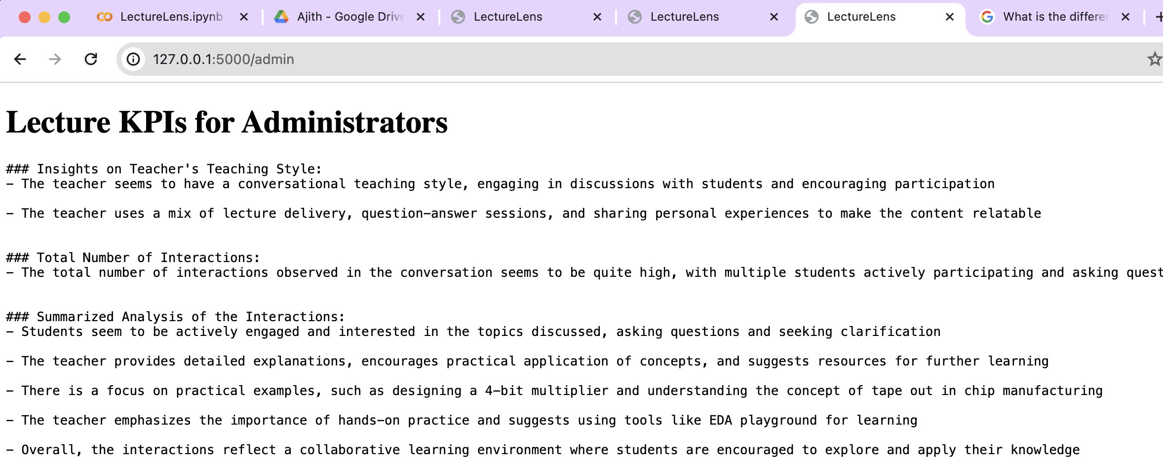
Demonstration – Sample Output

Slide 8
Prototype Details
Languages – Python, HTML
Modules – openai, Tokenizer, Flask, Regular Expressions, JSON

