Slide 1
Urban Waste Collection Optimization Using Path Finding Algorithms
19CSE314 – Software Engineering
Team Number: 09
Reg.No | Name of the Student
BL.EN.U4CSE22220 | D. Abhiram
BL.EN.U4CSE22231 | K. Dhanush Reddy
BL.EN.U4CSE22243 | P. Koushik Reddy

Slide 2
INTRODUCTION
INTRODUCTION
In rapidly urbanizing cities, effective waste collection has become a growing challenge due to increasing population density, traffic congestion, and fluctuating waste generation levels. Traditional waste management systems often follow rigid schedules and fixed routes, leading to inefficiencies in fuel usage, service time, and environmental impact.This project focuses on optimizing waste collection routes in Bengaluru using intelligent pathfinding algorithms such as Dijkstra’s, Bellman-Ford, Floyd-Warshall, Johnson’s, Nearest Neighbor, and Ant Colony Optimization (ACO).By integrating geospatial data, vehicle constraints, and route optimization techniques, the system aims to minimize travel time, reduce carbon emissions, and ensure timely collection from prioritized locations. The solution contributes towards building smarter, cleaner, and more sustainable urban environments.

Slide 3
LITERATURE SURVEY
S.No | Title of the Paper | Author | Inference | Research Gaps
1. | Optimization of Green Vehicle Paths Considering the Impact of Carbon Emissions | Li, Tingting et al. (2023) | Optimized MSW collection routes considering fuel usage and CO₂ emissions | Lack of real-time adaptation to traffic and waste volume fluctuations
2. | Waste Collection Optimisation: A Path to a Green and Sustainable City of Makkah | John Holman | A structured career guidance framework improves student employability and decision-making. | More studies are needed on how career guidance can be adapted to emerging digital careers.

Slide 4
LITERATURE SURVEY
S.No | Title of the Paper | Author | Inference | Research Gaps
3. | A Hybrid Firefly and Particle Swarm Optimization Algorithm for MSW Collection | Kaya, Serkan (2023) | Applied hybrid metaheuristics to minimize travel distance and improve operational efficiency | Does not integrate geospatial traffic or road condition data
4. | Optimizing Waste Collection Routes with QPSO-LR Algorithm and IoT Sensors | Velasquez et al. (2024) | Used sensor-driven data with adaptive algorithms for smart, real-time waste routing | Scalability challenges and limited cross-city benchmarking

Slide 5
PROBLEM STATEMENT
Urban waste collection in rapidly growing cities like Bengaluru is hindered by rigid routes, uneven waste distribution, and traffic congestion, leading to inefficiencies in time, fuel, and cost. Traditional systems lack adaptability and fail to optimize routes based on real-time conditions. This results in increased CO₂ emissions, unnecessary trips, and higher operational burden. There is a need for an intelligent routing solution that adapts to dynamic waste levels and urban traffic. Our project addresses this by implementing multiple pathfinding algorithms such as Dijkstra, Bellman-Ford, and Ant Colony Optimization. The system incorporates spatial data, vehicle constraints, and prioritization of high-waste zones. This aims to enhance collection efficiency and contribute to a greener, smarter city.

Slide 6
METHODOLOGY
The methodology for this project is designed to optimize waste collection routes by leveraging spatial data and graph-based algorithms. The process begins with the extraction of geographical coordinates for ten major waste collection points across Bengaluru using OpenStreetMap. A disposal point is also identified as the final destination for all routes. Using the Haversine formula, a distance matrix is constructed to calculate the pairwise distances between all points, considering Earth’s curvature.
Each waste collection point is assigned a simulated waste quantity and is classified into three categories: high (red), medium (orange), and low (green) based on threshold values. These priorities help in route ranking during optimization.

Slide 7
METHODOLOGY
Six routing algorithms are implemented:
Dijkstra’s Algorithm (greedy approach for shortest paths)
Bellman-Ford Algorithm (handles negative edge weights)
Johnson’s Algorithm (efficient for sparse graphs)
Floyd-Warshall Algorithm (all-pairs shortest path)
Nearest Neighbor (simple greedy heuristic)
Ant Colony Optimization (probabilistic, nature-inspired method)
Each algorithm is modified to respect vehicle capacity constraints. The outputs are evaluated based on execution time, total distance, fuel usage, CO₂ emission, and number of trips. These metrics are used to compare algorithms and determine the most efficient one for real-world application in smart city waste management.

Slide 8
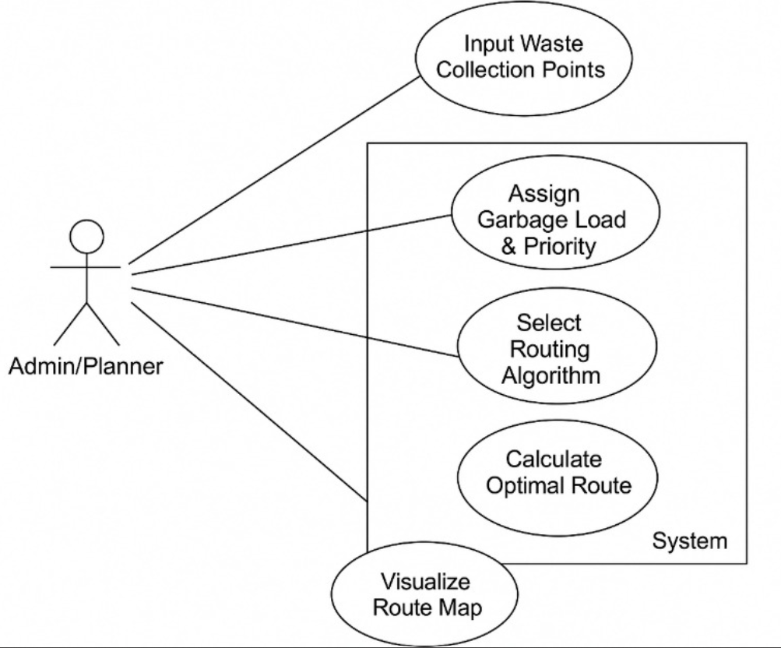
METHODOLOGY
Use Case Diagram:

Slide 9
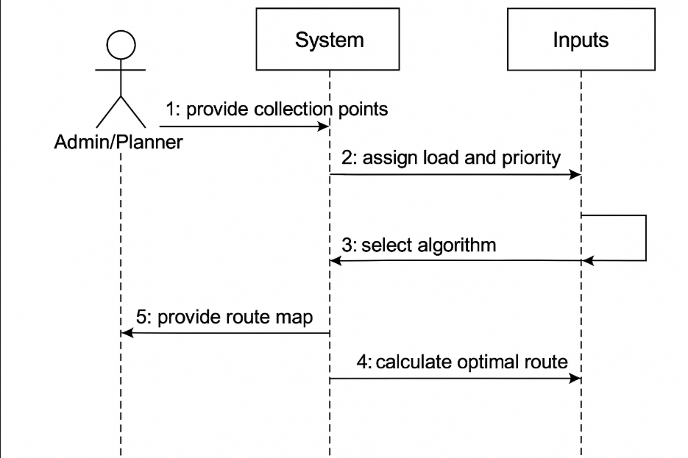
METHODOLOGY
Sequence Diagram:

Slide 10
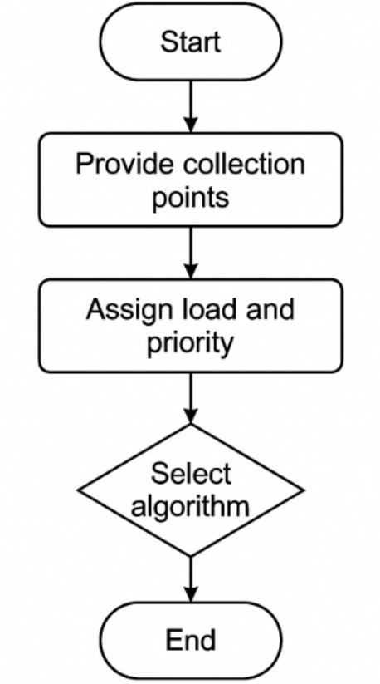
METHODOLOGY
Activity Diagram:

Slide 11
METHODOLOGY
Bug Report:
Bug ID | Description | Severity | Status | Fix Summary
BB-001 | Progress tracker not updating after marking resources | High | Fixed | Added backend route to update DB status
BB-002 | Learning resource links opening in same tab | Low | Fixed | Updated anchor tags with target="_blank"
BB-003 | Login error message not showing on invalid login | Medium | Fixed | Added conditional rendering in Flask template
BB-004 | Dashboard UI overlap on small screen devices | Medium | Fixed | Adjusted CSS media queries for mobile

Slide 12
METHODOLOGY
S. No | Module | Bug Description | Severity | Status | Fix Summary
1 | Distance Matrix Calculation | Incorrect distance values due to swapped lat-long input | High | Resolved | Implemented validation to check coordinate format
2 | Load Assignment | Load values not updating for all nodes | Medium | Resolved | Corrected loop indexing to assign values to all locations
3 | ACO Algorithm | Infinite loop due to improper termination condition | High | Resolved | Added iteration limit and pheromone decay condition
4 | Visualization | Route lines not showing for certain algorithms | Low | Resolved | Adjusted map rendering logic and ensured all routes are drawn
5 | Performance Metrics Calculation | Fuel consumption miscalculated due to wrong unit conversion | Medium | Resolved | Fixed the formula and added unit testing for verification

Slide 13
METHODOLOGY
Test Plan:
A comprehensive testing approach was followed to ensure the accuracy and efficiency of the urban waste collection optimization system. Unit tests were conducted to validate distance matrix generation using the Haversine formula and correct garbage load assignments across all collection points. Integration tests verified the successful execution of routing algorithms like Dijkstra, ensuring optimal routes were generated while respecting vehicle capacity limits. Functional testing confirmed that the system correctly handled garbage priority levels and vehicle constraints during route planning. UI testing validated that route visualizations were rendered accurately on the map, with proper color coding based on priority. Metrics such as total distance, fuel consumption, and CO₂ emissions were also cross-verified through test cases to ensure correctness. All test cases were successfully passed, confirming system reliability and performance under different scenarios.

Slide 14
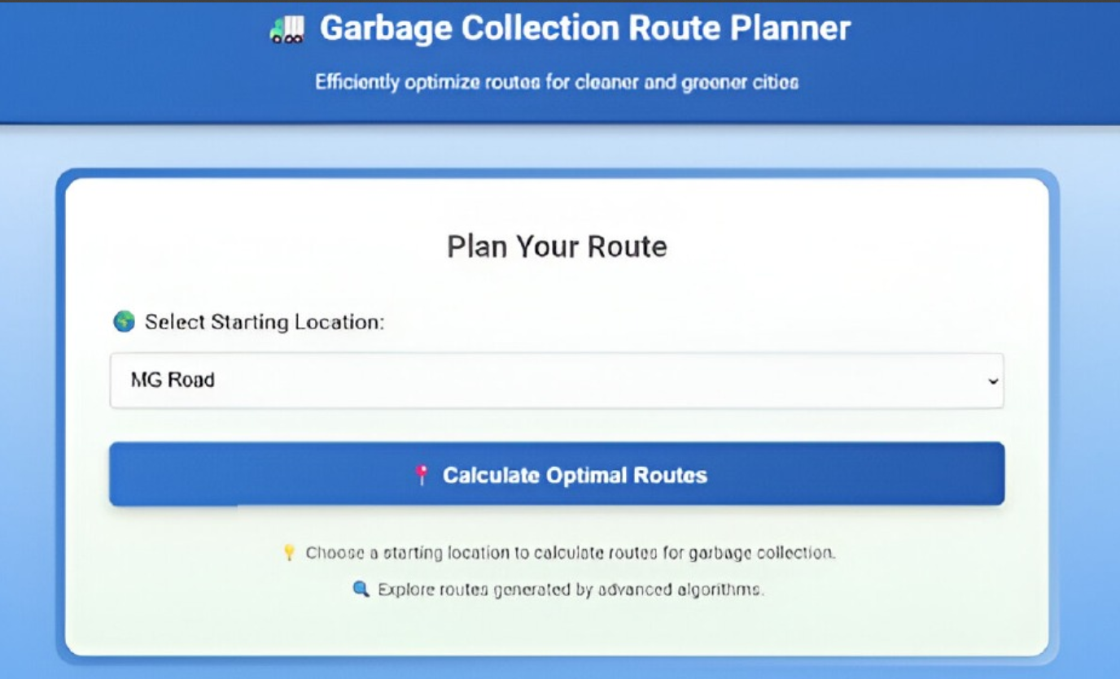
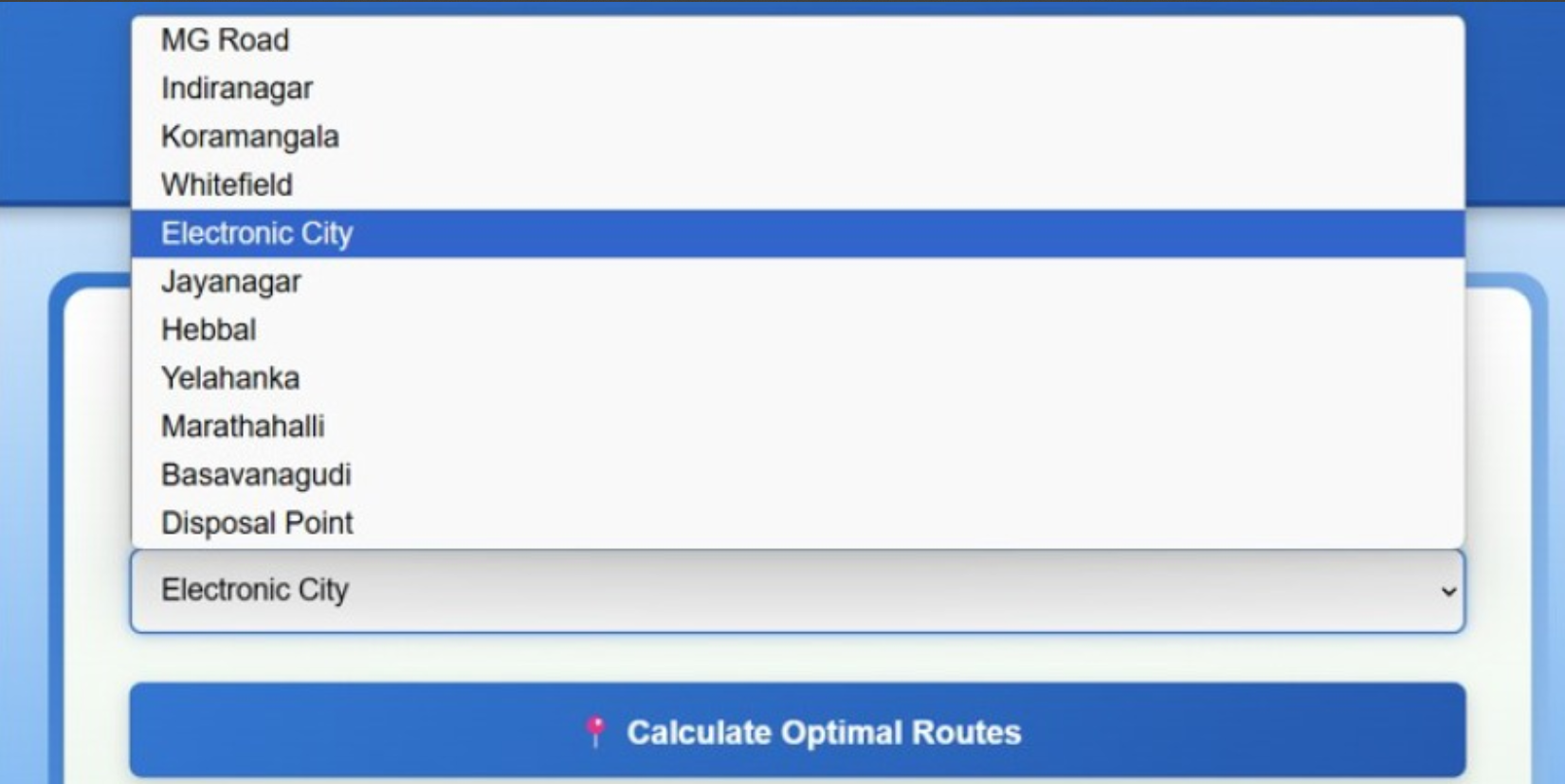
RESULTS
Fig 1: User interface showing the Garbage Collection Route Planner
Fig 2: Dropdown list of available starting locations for route calculation.

Slide 15
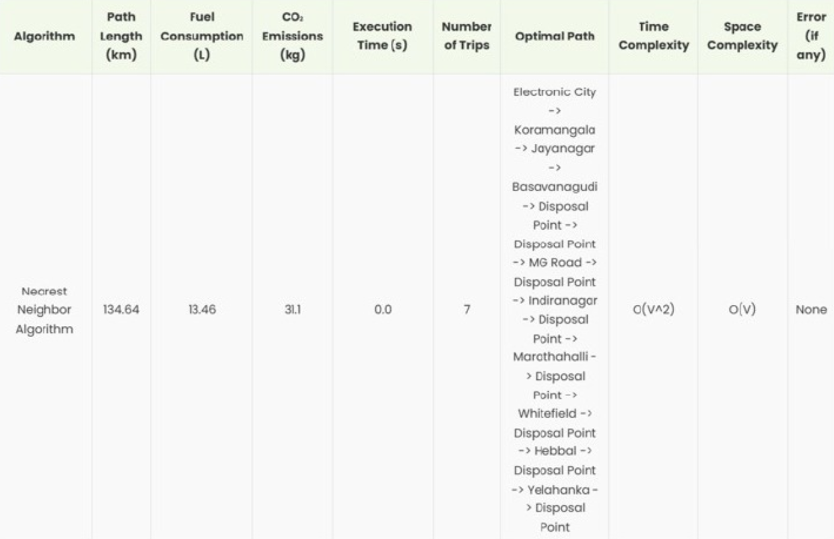
RESULTS
Fig 3: Tabular output of Nearest Neighbor Algorithm results including path, fuel, CO₂, and complexity.

Slide 16
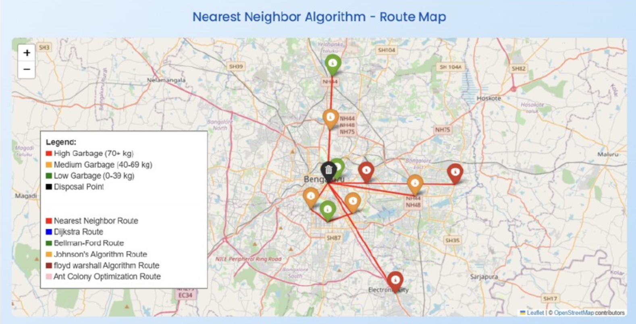
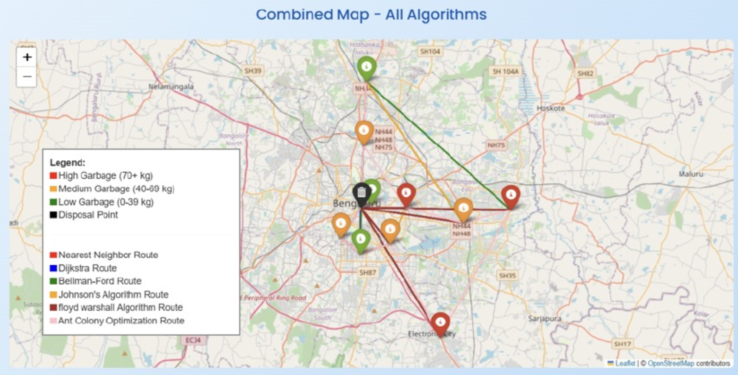
RESULTS
Fig 4: Route map showing Nearest Neighbor Algorithm's garbage collection route across Bengaluru.
Fig 5: Combined route map comparing all algorithms for garbage collection optimization.

Slide 17
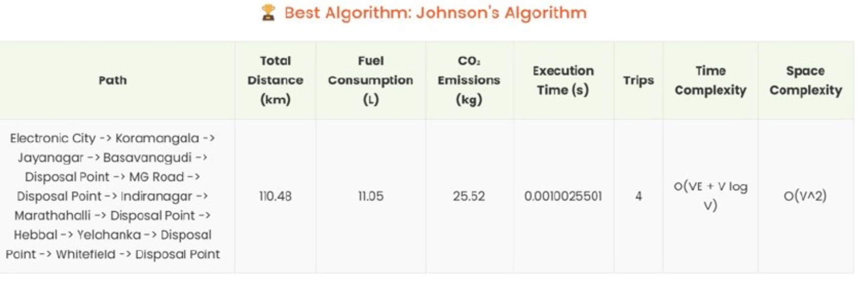
RESULTS
Fig 6: Best result summary from Johnson’s Algorithm highlighting performance and reduced metrics.

Slide 18
RESULTS
Sprint Planning:
Sprint 1: Location data collection using OpenStreetMap, Distance matrix calculation using Haversine formula, Garbage load simulation
Sprint 2: Priority classification, Implementation of routing algorithms (Dijkstra, Bellman-Ford, Floyd-Warshall, Johnson’s, Nearest Neighbor, ACO)
Sprint 3: Algorithm evaluation (distance, fuel, CO₂, execution time), Route visualization with color-coded priorities, Final result comparison
Definition of Done:
Location Data Extraction & Load Simulation
Garbage Priority Classification
Distance Matrix Generation
Route Optimization via Multiple Algorithms
Performance Evaluation (Distance, Fuel, Emission, Time)
Route Visualization & Final Comparative Analysis

Slide 19
CONCLUSION & FUTURE SCOPE
The project successfully demonstrates how intelligent routing algorithms can significantly improve the efficiency of urban waste collection. By integrating geospatial data, garbage priority levels, and vehicle constraints, the system generates optimized routes that reduce total distance traveled, fuel consumption, and CO₂ emissions. Comparative analysis across six algorithms provided insights into the trade-offs between performance and computation time, helping identify the most suitable method for real-world deployment.
Future Scope:
Integration of real-time IoT sensor data to monitor bin levels dynamically
Use of live traffic data to further enhance route optimization in congested zones
Incorporation of Machine Learning models to predict waste generation patterns
Deployment on a cloud-based platform for scalability and centralized access
Collaboration with municipal bodies for smart city implementation

Slide 20
THANK YOU

