Slide 1
HBITS Pricing Strategy
Briefing for IDIQ Pricing Quality Review
Briefing for State IDIQ Pricing Quality Review - NYS OGS Group 73012 / Award 23158 / Solicitation 23311
Bid opening 7/1/2026 - 5-year term + 2-year option - Confidential

Slide 2
Executive Summary
• Centralized, non-negotiated, FIXED bill-rate IT staffing contract (HBITS).
• NTE bill rates: 31 titles x 4 skills x 3 regions, firm for each placement's life.
• Version 1 (Baseline): internal cost/CPI estimate - lands in the expensive third.
• Version 1.1 (Rank Positioning): current formula - prices each role to rank #19 of 33 (mid-field).
• This deck is built to be challenged - see the Quality-Test Checklist.

Slide 3
Market at a Glance (2023-2025)
• 1,664 placements won across the market - worth $1.58B.
• 31 active competing vendors; average contract $948K.
• Market leader: Knowledge Builders (KBI) - 317 placements / $160.5M.
• Biggest buyer: Office of Information Technology Services (435 placements).
• Growing market: $514.6M (2023) to $813.9M (2025).

Slide 4
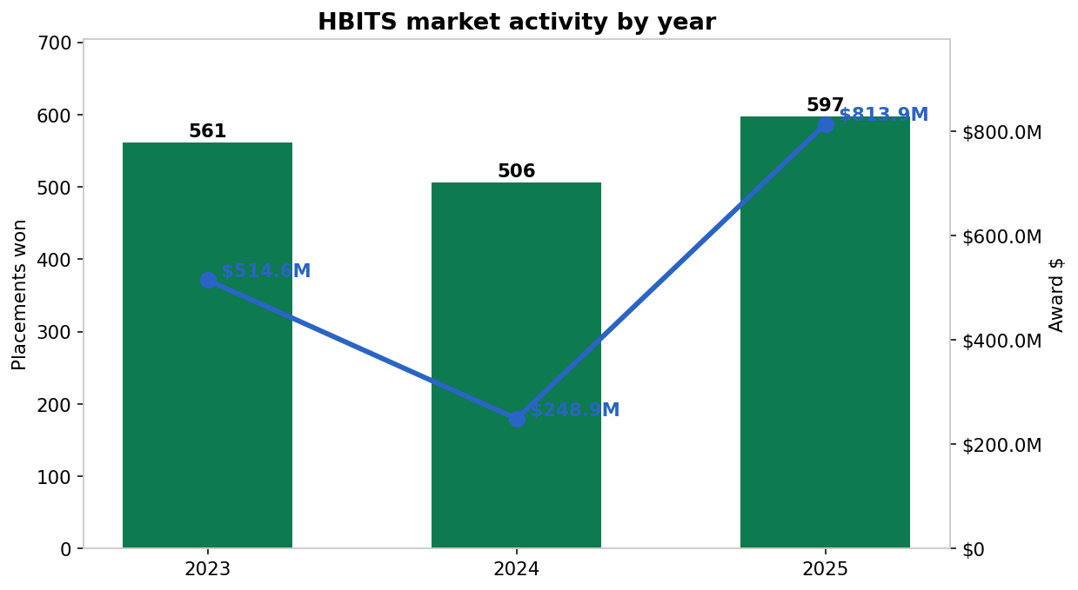
Market activity by year
Award dollars are rising - bigger, higher-value engagements each year.

Slide 5
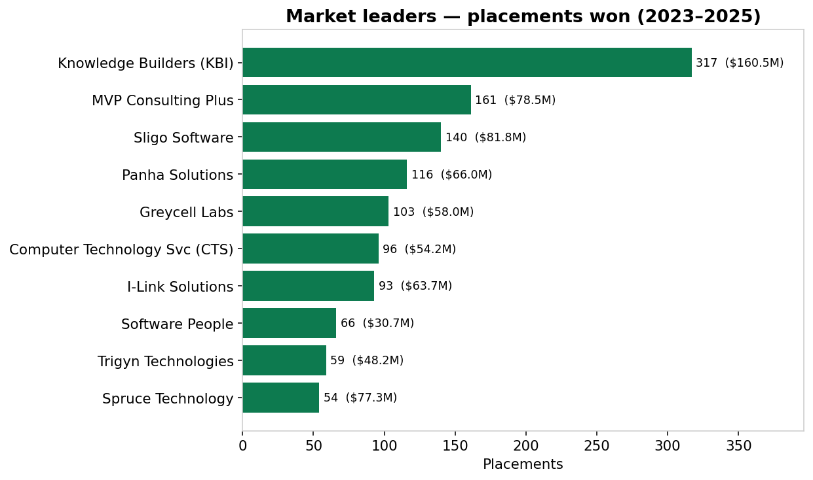
Market leaders - placements won
Knowledge Builders (KBI) dominates (~19% of all placements).

Slide 6
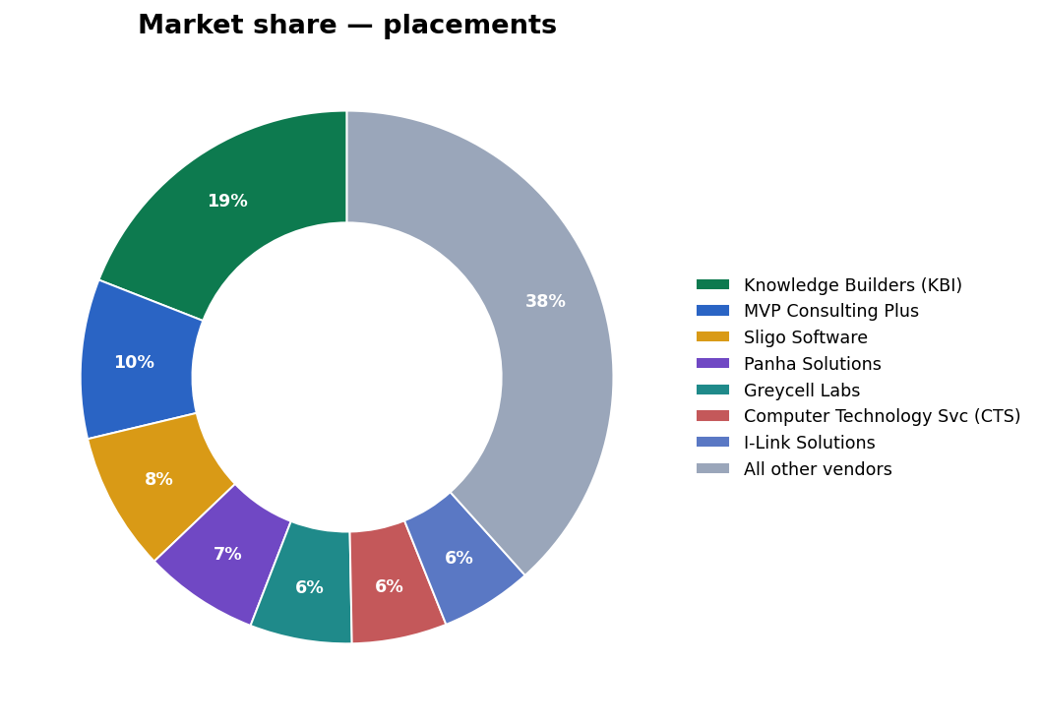
Market share
Just 7 vendors hold ~62% of placements - a concentrated field to break into.

Slide 7
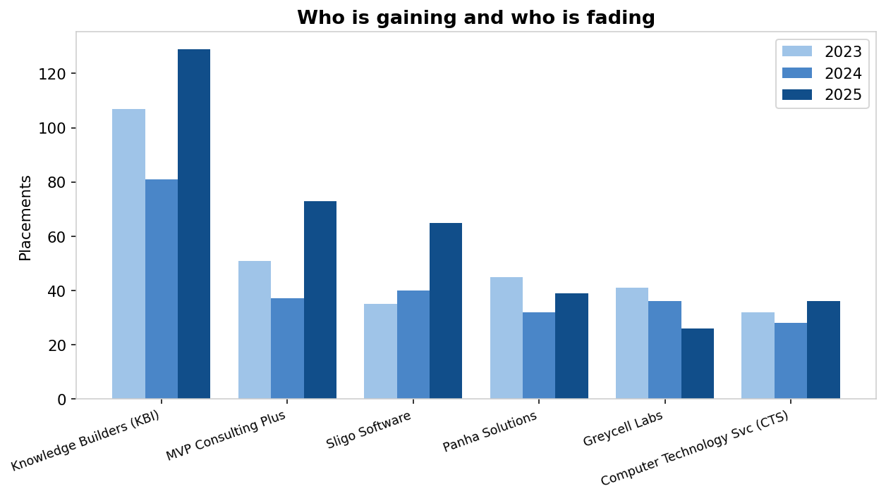
Who is gaining and who is fading
The leader is accelerating while some incumbents slide - that opens share for a sharp new bidder.

Slide 8
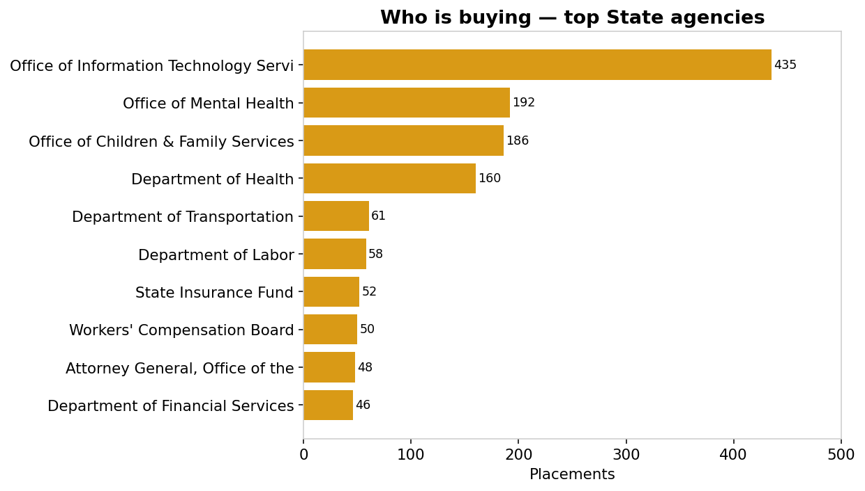
Who is buying
Office of Information Technology Services is by far the biggest buyer - focus capture efforts there first.

Slide 9
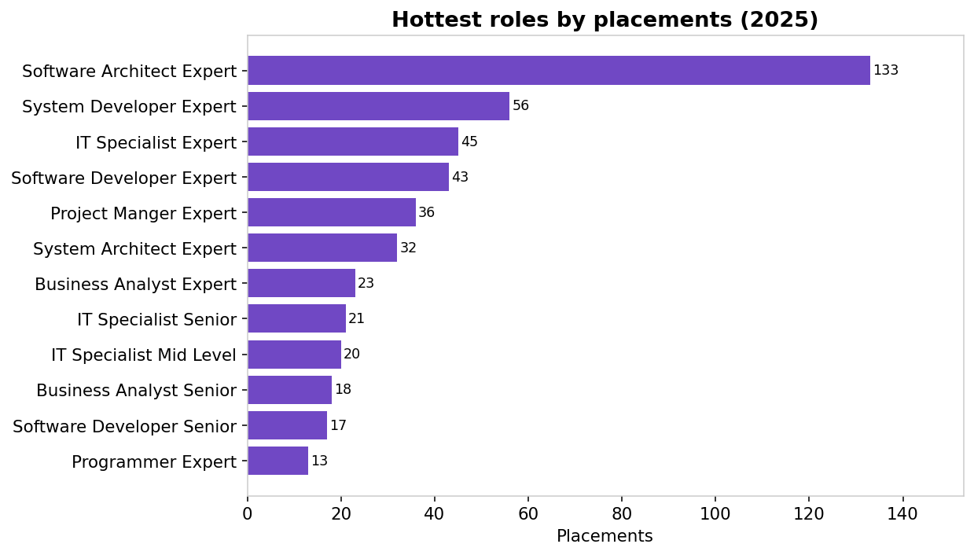
Hottest roles
Demand clusters in Expert and Senior roles - where the volume and the margin are.

Slide 10
Procurement Context - Three Regions
Region | Coverage | Character
R1 | NY counties outside R2/R3 (Albany) | Statewide baseline; most work
R2 | Dutchess, Orange, Putnam | Mid-Hudson, mid-market
R3 | NYC metro + 5 boroughs | Highest labor cost

Slide 11
The MSP Price Filter - the critical mechanic
• Applied BEFORE any technical evaluation, on price alone:
• 10-40 candidates: only the lowest 50% of bill rates forwarded (+1% buffer).
• 6-10 candidates: only the 5 lowest forwarded.
• 5 or fewer: filter bypassed - all forwarded.
• Implication: a rank #19 of 33 rate sits in the UPPER half - filtered out on high-volume roles.

Slide 12
The Strategic Story
• Bid too high (big markup): protect margin, but get filtered out of high-volume orders.
• Bid too low (small markup): pass the filter & win volume, but compress margin.
• Fixed bill rate => low-markup vendors can pay a HIGHER wage for the same bill rate.
– e.g. BA Junior bill $40.33: 11% markup pays ~$36.33 vs 47% markup pays ~$27.43.
• Better wages -> better talent -> higher agency satisfaction scores.

Slide 13
Core Formula & CPI Escalation
• HBR_NTE = HWR x (1 + Markup/100)
• Markup must cover payroll, insurance, overhead & G&A, OGS fee, and net profit.
• CPI escalation (Sec 6.5): Adj% = (CPI_t - CPI_t-12) / CPI_t-12 x 100
– Bid-year multiplier (Apr2026/Apr2025): 1.0381 (+3.81%).
– 2026->2029 projection: 1.0716 (+7.16%).
• NOT automatic - must be filed with BLS sheets in a 90-day window or forfeited.

Slide 14
Version 1 - Baseline
• Internal Bid Year 2026 estimate (labor benchmarks x CPI multipliers).
• Covers 30 of 31 titles (omits Business Analyst).
• Region 1 values applied across all regions.
• Position: expensive third (Programmer/R1/Senior = #26 of 33).
• Cost-up baseline ignores where competitors sit -> prices above the filter cutoff.

Slide 15
Version 1.1 - Rank Positioning (current)
• Market-relative: price each role to a target rank (default #19 of 33).
• Sort competitors asc; set B* between the 18th and 19th cheapest => 18 below, 14 above.
• 356/372 roles hit exactly #19; 16/372 fall to #18 due to competitor ties.
• Per-region; covers all 31 titles; reproducible from public data.
• Target rank is one tunable knob - re-rank live in the Bid Builder.

Slide 16
Data Foundation - Snapshot
Metric | Value
Competitors | 32
Bidders per role | 33
Role combinations | 372
Competitor markups | 11% - 110%
Roles at exactly #19 | 356
Roles at nearest (ties) | 16

Slide 17
Margin & Cost Build
• Net margin% = [(bill-wage) - wage x (payroll+ins+oh) - bill x OGSfee] / bill
• Defaults: payroll 13.5%, insurance 3.5%, overhead+G&A 10.5% (of wage); OGS fee 0.75%.
– 30% markup -> ~1-2% net margin.
– 45% markup -> ~11% net margin.
• Margin is driven by MARKUP, not the role. Rank-#19 needs ~40-45% markup for ~10% margin.

Slide 18
Competitive Landscape - Archetypes
Archetype | Markup | Examples
High-volume / low-margin | 11-33% | CTS, GCOM, Broad Crossing
Mid-market | 38-52% | Mindlance, Sligo, Experis
Aggregator / niche-high | 65-110% | Spruce, CMA/OST, KBI

Slide 19
Quality-Test Checklist - Critical & Material
• A. Does rank #19 survive the 50% MSP filter? (upper half = filtered)
• B. Are competitor benchmarks current, or stale/un-escalated pre-2025 rates?
• C. Flat rank vs tiered strategy by role scarcity?
• D. Margin vs recruiting trade-off (markup sets payable wage)?
• E. Replace assumed wage / cost loadings with audited rates?

Slide 20
Quality-Test Checklist - Verification
• F. Model 10-year profitability decay (CPI escalation trails IT wage inflation).
• G. 16/372 roles land at #18 (ties) - acceptable?
• H. Is the 32-vendor pool complete?
• I. Confirm regional competitor sets are distinct.
• J. Workflow to file CPI escalation within the window each anniversary.

Slide 21
Risks, Assumptions & Next Steps
• Assumes competitors re-bid near current rates; MSP mechanics unchanged.
• Wage/margin figures illustrative pending audited cost data.
• Recommended next steps:
– Decide target rank per role tier (commodity <=16 to pass the filter).
– Escalate stale competitor rates to 2026 before ranking.
– Plug in audited cost build; model multi-year margin.

