Slide 1
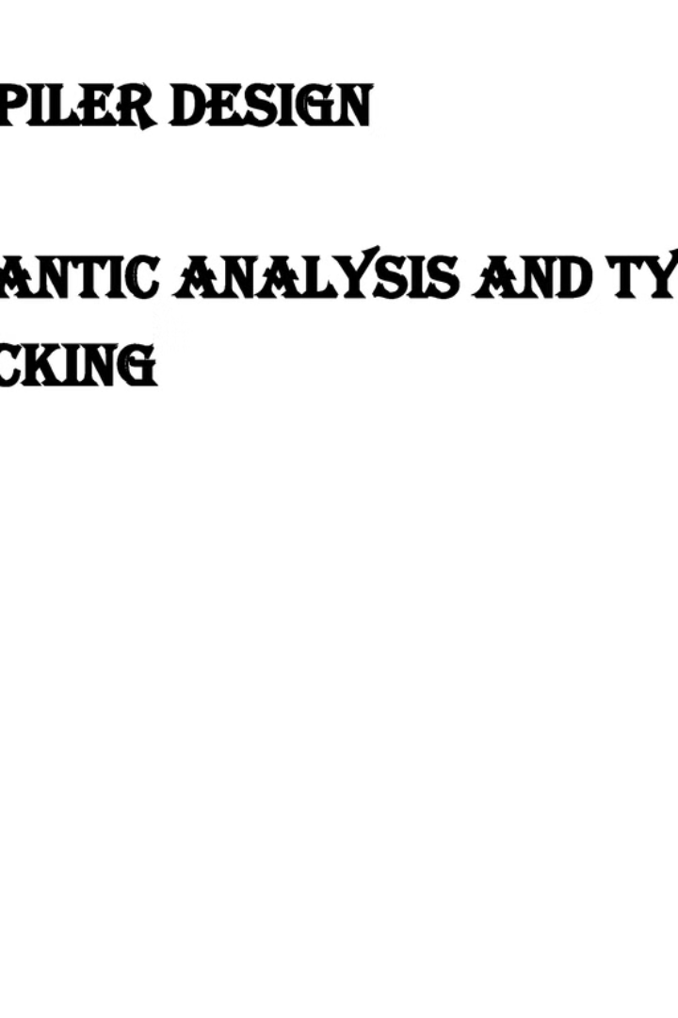


Introduction to Type Checking and Semantic Analysis
Type checking and semantic analysis are essential processes in compiler design, ensuring the validity and meaning of programming language constructs. Type checking verifies the types of expressions to prevent runtime errors, while semantic analysis focuses on interpreting the meaning of the code. These stages play a crucial role in ensuring program correctness and robustness.
by Mani Shankar. K

Slide 2
Purpose and Importance of Type Checking in Compiler Design
Type checking in compiler design is crucial for ensuring the reliability and correctness of programs. It helps to catch errors and inconsistencies in data types, leading to more robust and efficient code generation. Additionally, type checking facilitates better program optimization and enhances the overall security of software systems.

Slide 3
Static vs Dynamic Type Checking
Static Type Checking
Dynamic Type Checking
Performed at compile time
Performed at runtime
Detects type errors before the program runs
Requires type information at runtime
Requires explicit type declarations
Allows for more flexibility

Slide 4

Type Systems and Type Inference
Static Type Systems: Enforce type constraints at compile time.
Dynamic Type Inference: Automatically deduces types during runtime.
Type Safety: Ensures type correctness to prevent runtime errors.

Slide 5
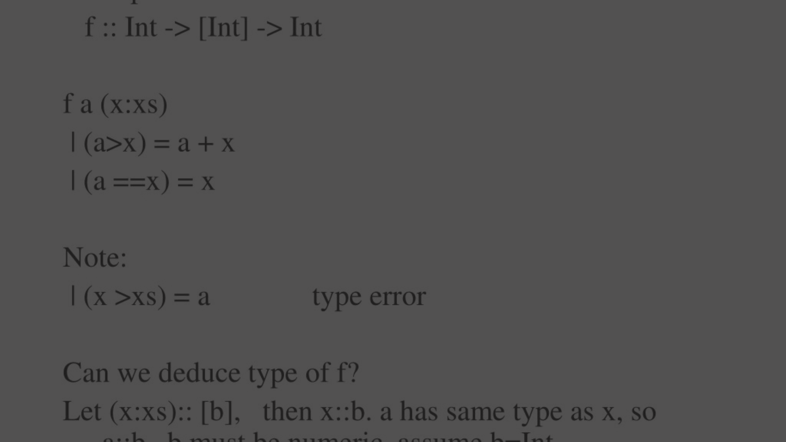
Type checking algorithms and techniques
1
Lexical Analysis
The first step involves tokenizing the input source code to identify the lexical units such as keywords, identifiers, and literals.
2
Syntax Analysis
This step verifies the syntax of the code based on the defined grammar rules and constructs a parse tree to represent the code structure.
3
Type Inference
This technique infers the data types of expressions and variables within the program, enabling static type checking during compilation.

Slide 6
Common Type Errors and How to Detect Them
Mismatched Types
Undefined Variables
Detect when one data type is used where another is expected. For example, using a string in an arithmetic operation.
Identify when a variable is used before it has been declared or initialized, leading to unexpected behavior.
Type Conversions
Null Pointer Dereferencing
Recognize issues caused when converting data from one type to another, such as loss of precision or unexpected behavior.
Identify instances where a null pointer is dereferenced, leading to runtime errors and program crashes.

Slide 7
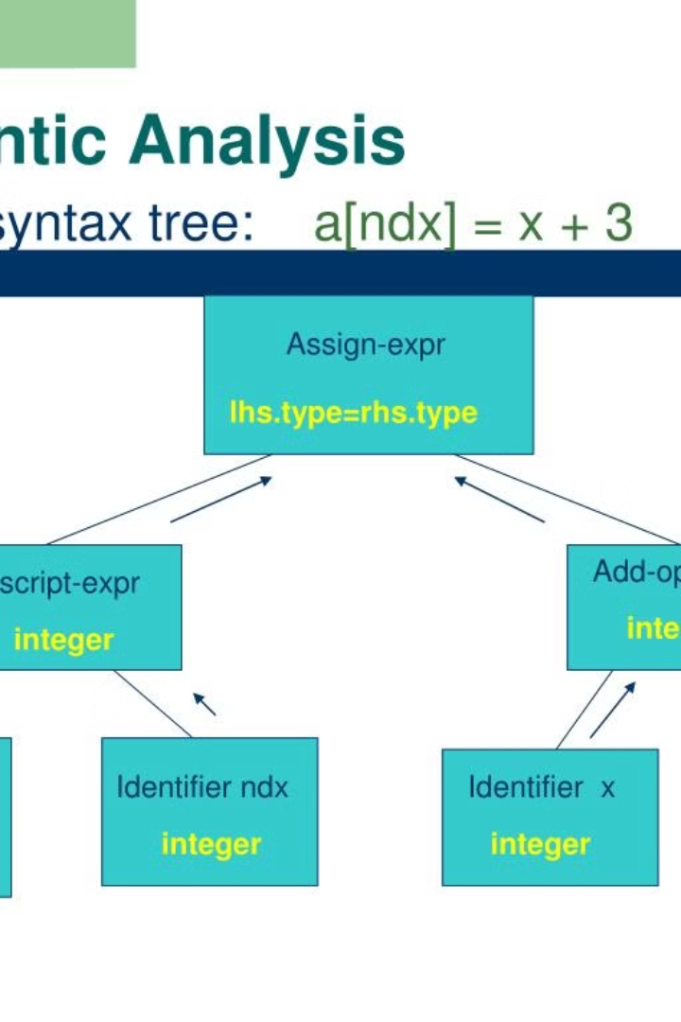
Semantic analysis and its role in compiler design
Semantic analysis is a crucial phase in compiler design, responsible for ensuring that the code has meaningful and logical meaning. It checks for semantic errors and enforces language-specific rules and constraints. Additionally, semantic analysis lays the foundation for generating optimized and efficient code.

Slide 8
Semantic Analysis Techniques and Algorithms
Lexical Analysis
Syntax Analysis
The first phase of semantic analysis that involves tokenization of the source code.
Also known as parsing, it checks the syntax of the code and builds the parse tree.
Semantic Parsing
Control Flow Analysis
Analyzes the meaning of the code, checking for logical and contextual errors.
Examines the flow of control within the program to identify unreachable code and loops.

Slide 9


Scope Management
Symbol Table
Handling scope is crucial for variable visibility and lifetime.
Symbol table stores identifiers and relevant information for access.

Slide 10
Integration of type checking and semantic analysis in the compiler workflow
1
Type Checking
Ensures data types are used appropriately
2
Semantic Analysis
Checks for meaning and context of the code
Error Detection
3
Identifying and reporting type and semantic errors
Integrating type checking and semantic analysis within the compiler workflow is crucial for ensuring the accuracy and reliability of the compiled code. By implementing these steps, the compiler can verify the correctness and coherence of the program, leading to more robust and efficient software development.

