Slide 1

Predicting Sepsis Using Correlation
Based Clustering of Patient Features
Mini project
The Machine Learning model will result in a simple clinical scale that can be used to predict Sepsis labels (1/0), 6 hours prior to actual Sepsis onset for each new patient per timestamp.
Submitted By:
Ajith K J
Pinaka Pani
Under the Guidance:
Prof. Sudarsan N S Acharya

Slide 2
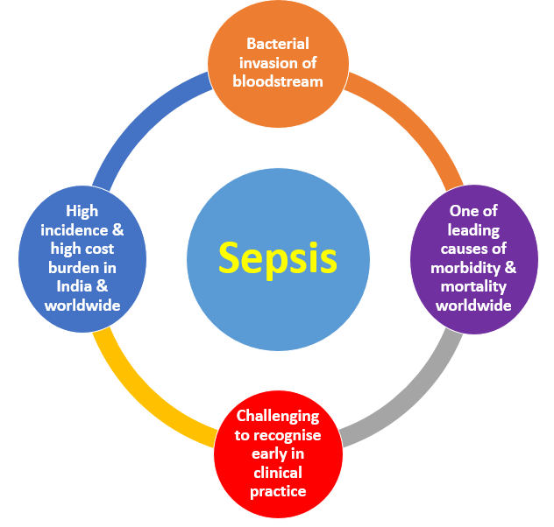
Sepsis?
Sepsis is a life-threatening condition that occurs when the body's response to infection causes tissue damage, organ failure, or death.

Slide 3
Data Sets
We are using physiological data which is hosted on PhysioNet Computing in Cardiology Challenge 2019.
Retrieving the dataset which is having pipe seperated features for respective timestamp.

Slide 4
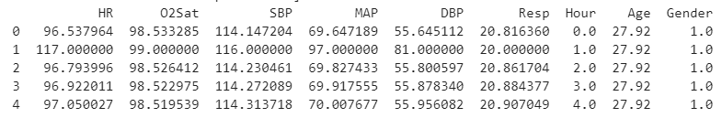
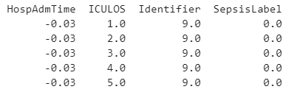
Example of one patient

Slide 5
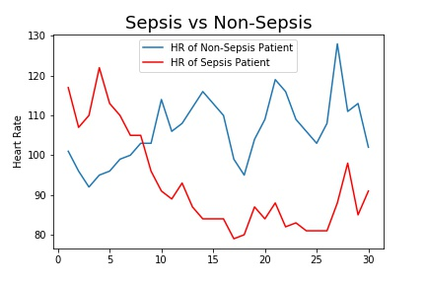
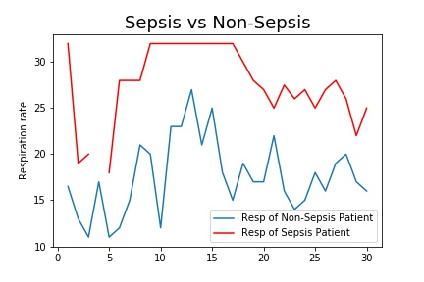
Analysis each features of sepsis and non-sepsis patient

Slide 6
Retaining the features
We retain features which are needed for finding correlation matrix.
Dividing the retained features into Continuous, Binary and Ordinal Features.

Slide 7
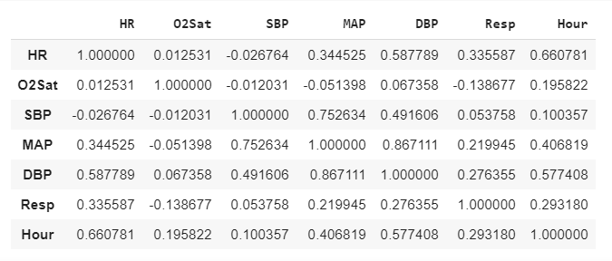
Pearson’s Rho
Pearson’s Rho method to find the correlation for Continuous vs Continuous

Slide 8
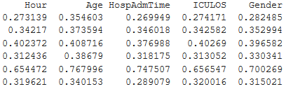

Correlation Ratio
Correlation ratio method to find the correlation for Continuous vs binary and Continuous vs ordinal features.

Slide 9

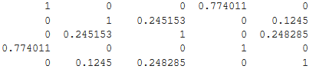
Cramer’s V
Cramer’s V method to find the correlation for ordinal vs ordinal , ordinal vs binary and binary vs binary .

Slide 10
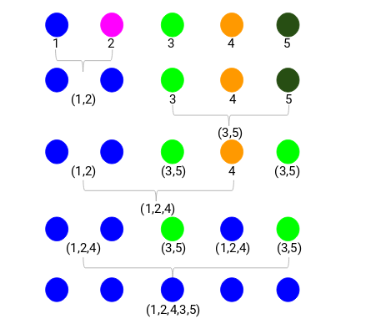
Hierarchical Clustering
Agglomerative Hierarchical Clustering
We use 'ward' as the method since it minimizes then variants of distances between the clusters.

Slide 11
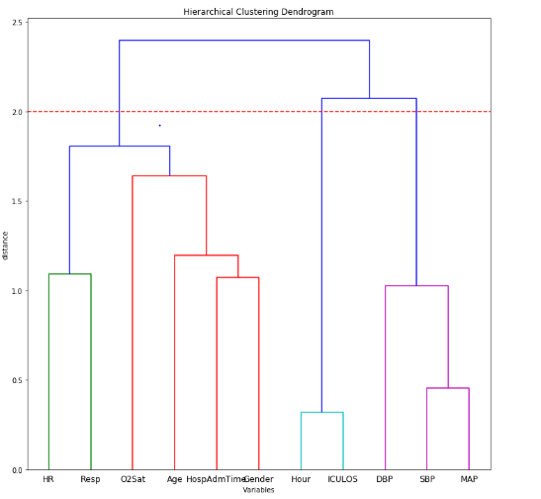

Slide 12
Principal Component Analysis
PCA is to reduce the dimensionality of a data set consisting of many variables correlated with each other, either heavily or lightly, while retaining the variation present in the dataset, up to the maximum extent.
We applied PCA for each Cluster

Slide 13
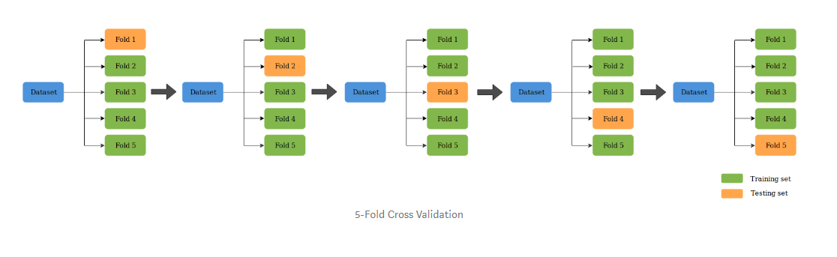
K-Fold Cross Validation
K-Fold CV is where a given data set is split into a K number of sections/folds where each fold is used as a testing set at some point

Slide 14
Result.
 | Precision | Recall | Accuracy
Train | 5.756% | 58.631% | 78.650%
Test | 5.588% | 56.720% | 78.647%

Slide 15
Thank You.

