Slide 1
Analyzing Maternal Mortality and Healthcare Disparities in the U.S.
BINF 5030 E00W: Visualization in Health Informatics
Ajith Kumar Kannan

Slide 2
Introduction
Maternal mortality is a critical public health issue that refers to the death of a woman during pregnancy or within 42 days of pregnancy termination, often due to complications related to pregnancy or childbirth.
The U.S. continues to have one of the highest maternal mortality rates among high-income countries, a concern that has only intensified with recent trends showing increasing rates and widening disparities across racial and socioeconomic lines.
This presentation will delve into key trends, disparities, and implications of this crisis.

Slide 3
Goal of the Project
To create a data-driven understanding of maternal mortality trends across the U.S. from 2018-2023.
To explore trends, identify key drivers, and uncover disparities in maternal mortality rates.
Analyze data at the state and demographic levels.
To offer insights that can guide public health strategies and close healthcare gaps.

Slide 4
Data Overview
Dataset 1: Kaiser Family Foundation (KFF) - Maternal Mortality Rates by State
Collected By: Kaiser Family Foundation (KFF).
Covers data from 2018 to 2022, providing an up-to-date overview of recent trends.
Includes data for all 50 states, focusing on variables such as Location (State), Maternal Mortality Rate, and Number of Maternal Deaths.
Dataset 2: Maternal Mortality Rate by State (2018-2021)
Collected By: worldpopulationreview.
Contains data for U.S. states, with variables including State, Maternal Mortality Rate, and Maternal Death Counts.
Dataset 3: Vital Statistics Rapid Release (VSRR)
Collected By: Centers for Disease Control and Prevention (CDC).
Contains provisional data from 2019 to 2023.
Covers variables like Year, Month, Age Range, Race, Maternal Deaths, and Live Births.

Slide 5
Data Visualizations
Line Chart
Stacked Bar Chart
Slope Chart
Highlight Table
Bar Chart
Dynamic Map

Slide 6
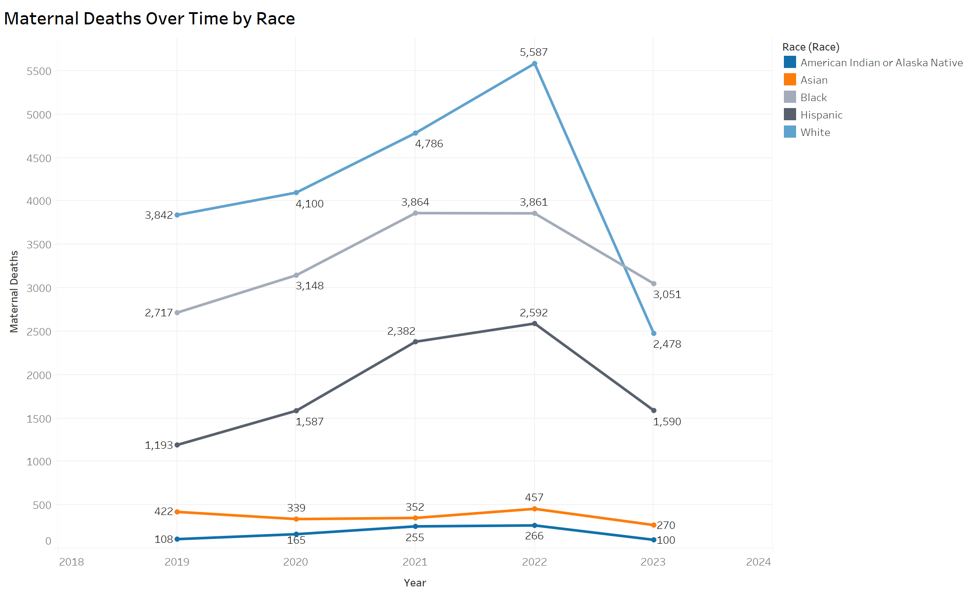
Line Chart
This line chart shows the maternal mortality rate over time from 2019 to 2023. We can see a concerning upward trend, particularly during the pandemic years, which impacted access to care."

Slide 7
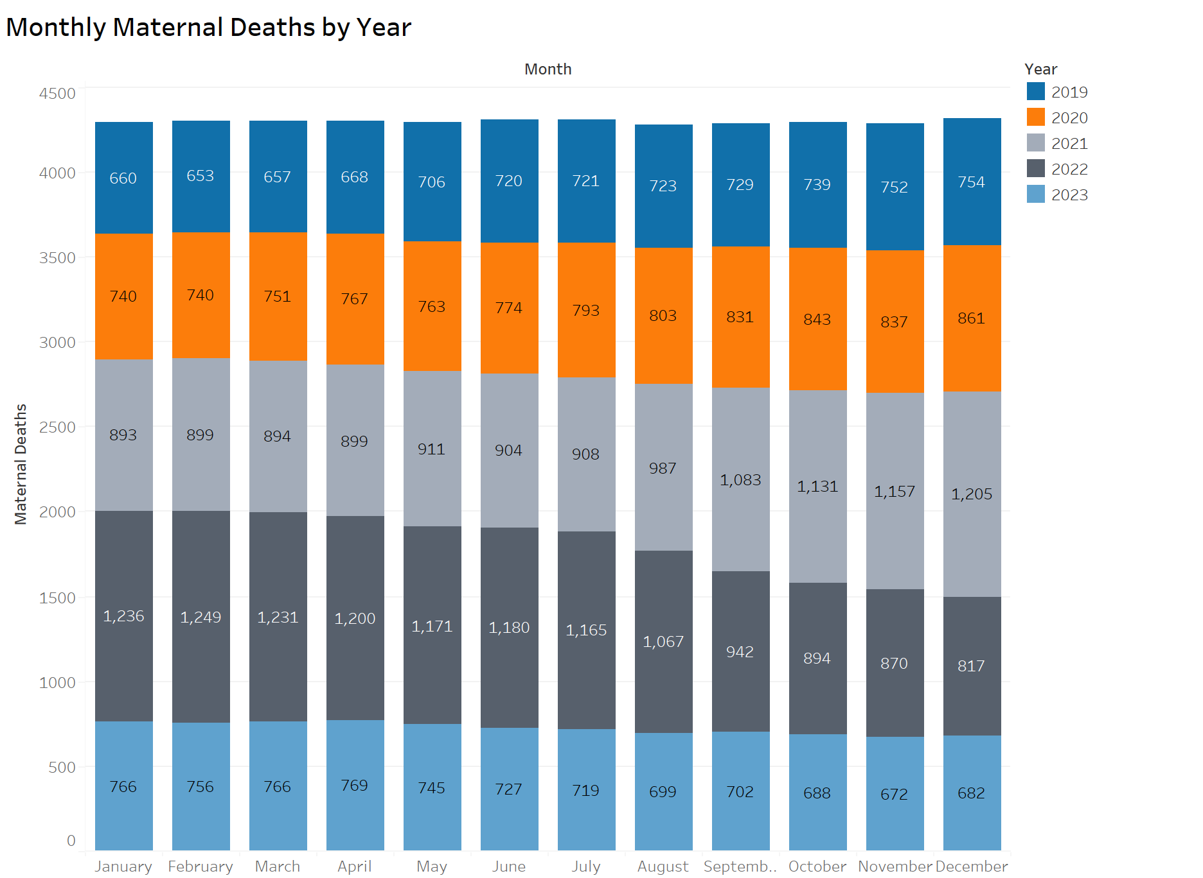
Stacked Bar Chart
Monthly maternal mortality trends by year (2019 – 2023)

Slide 8
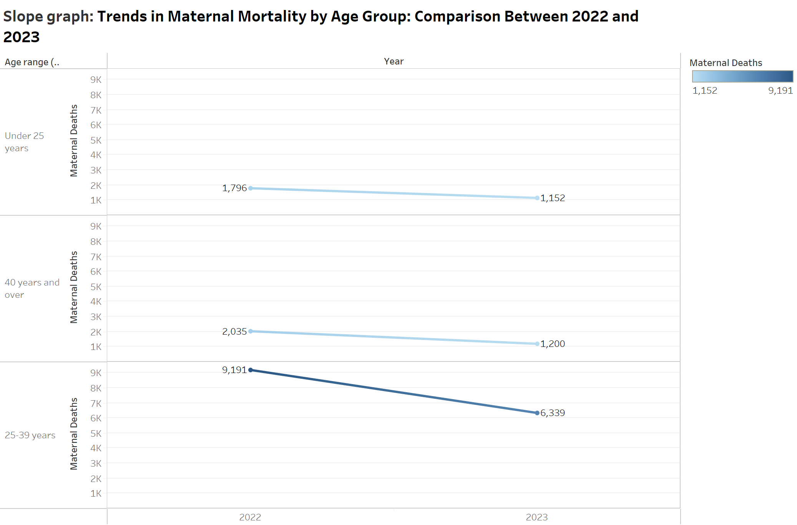
Slope Chart
Changes in maternal mortality by age group from 2022 to 2023.

Slide 9
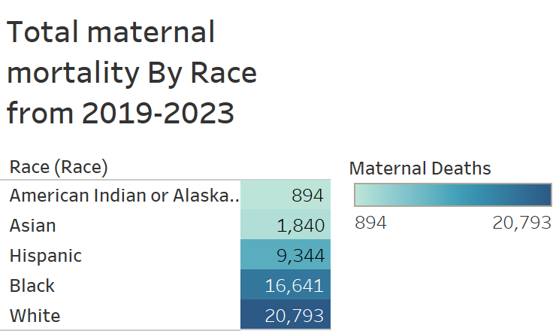
Highlight Table

Slide 10
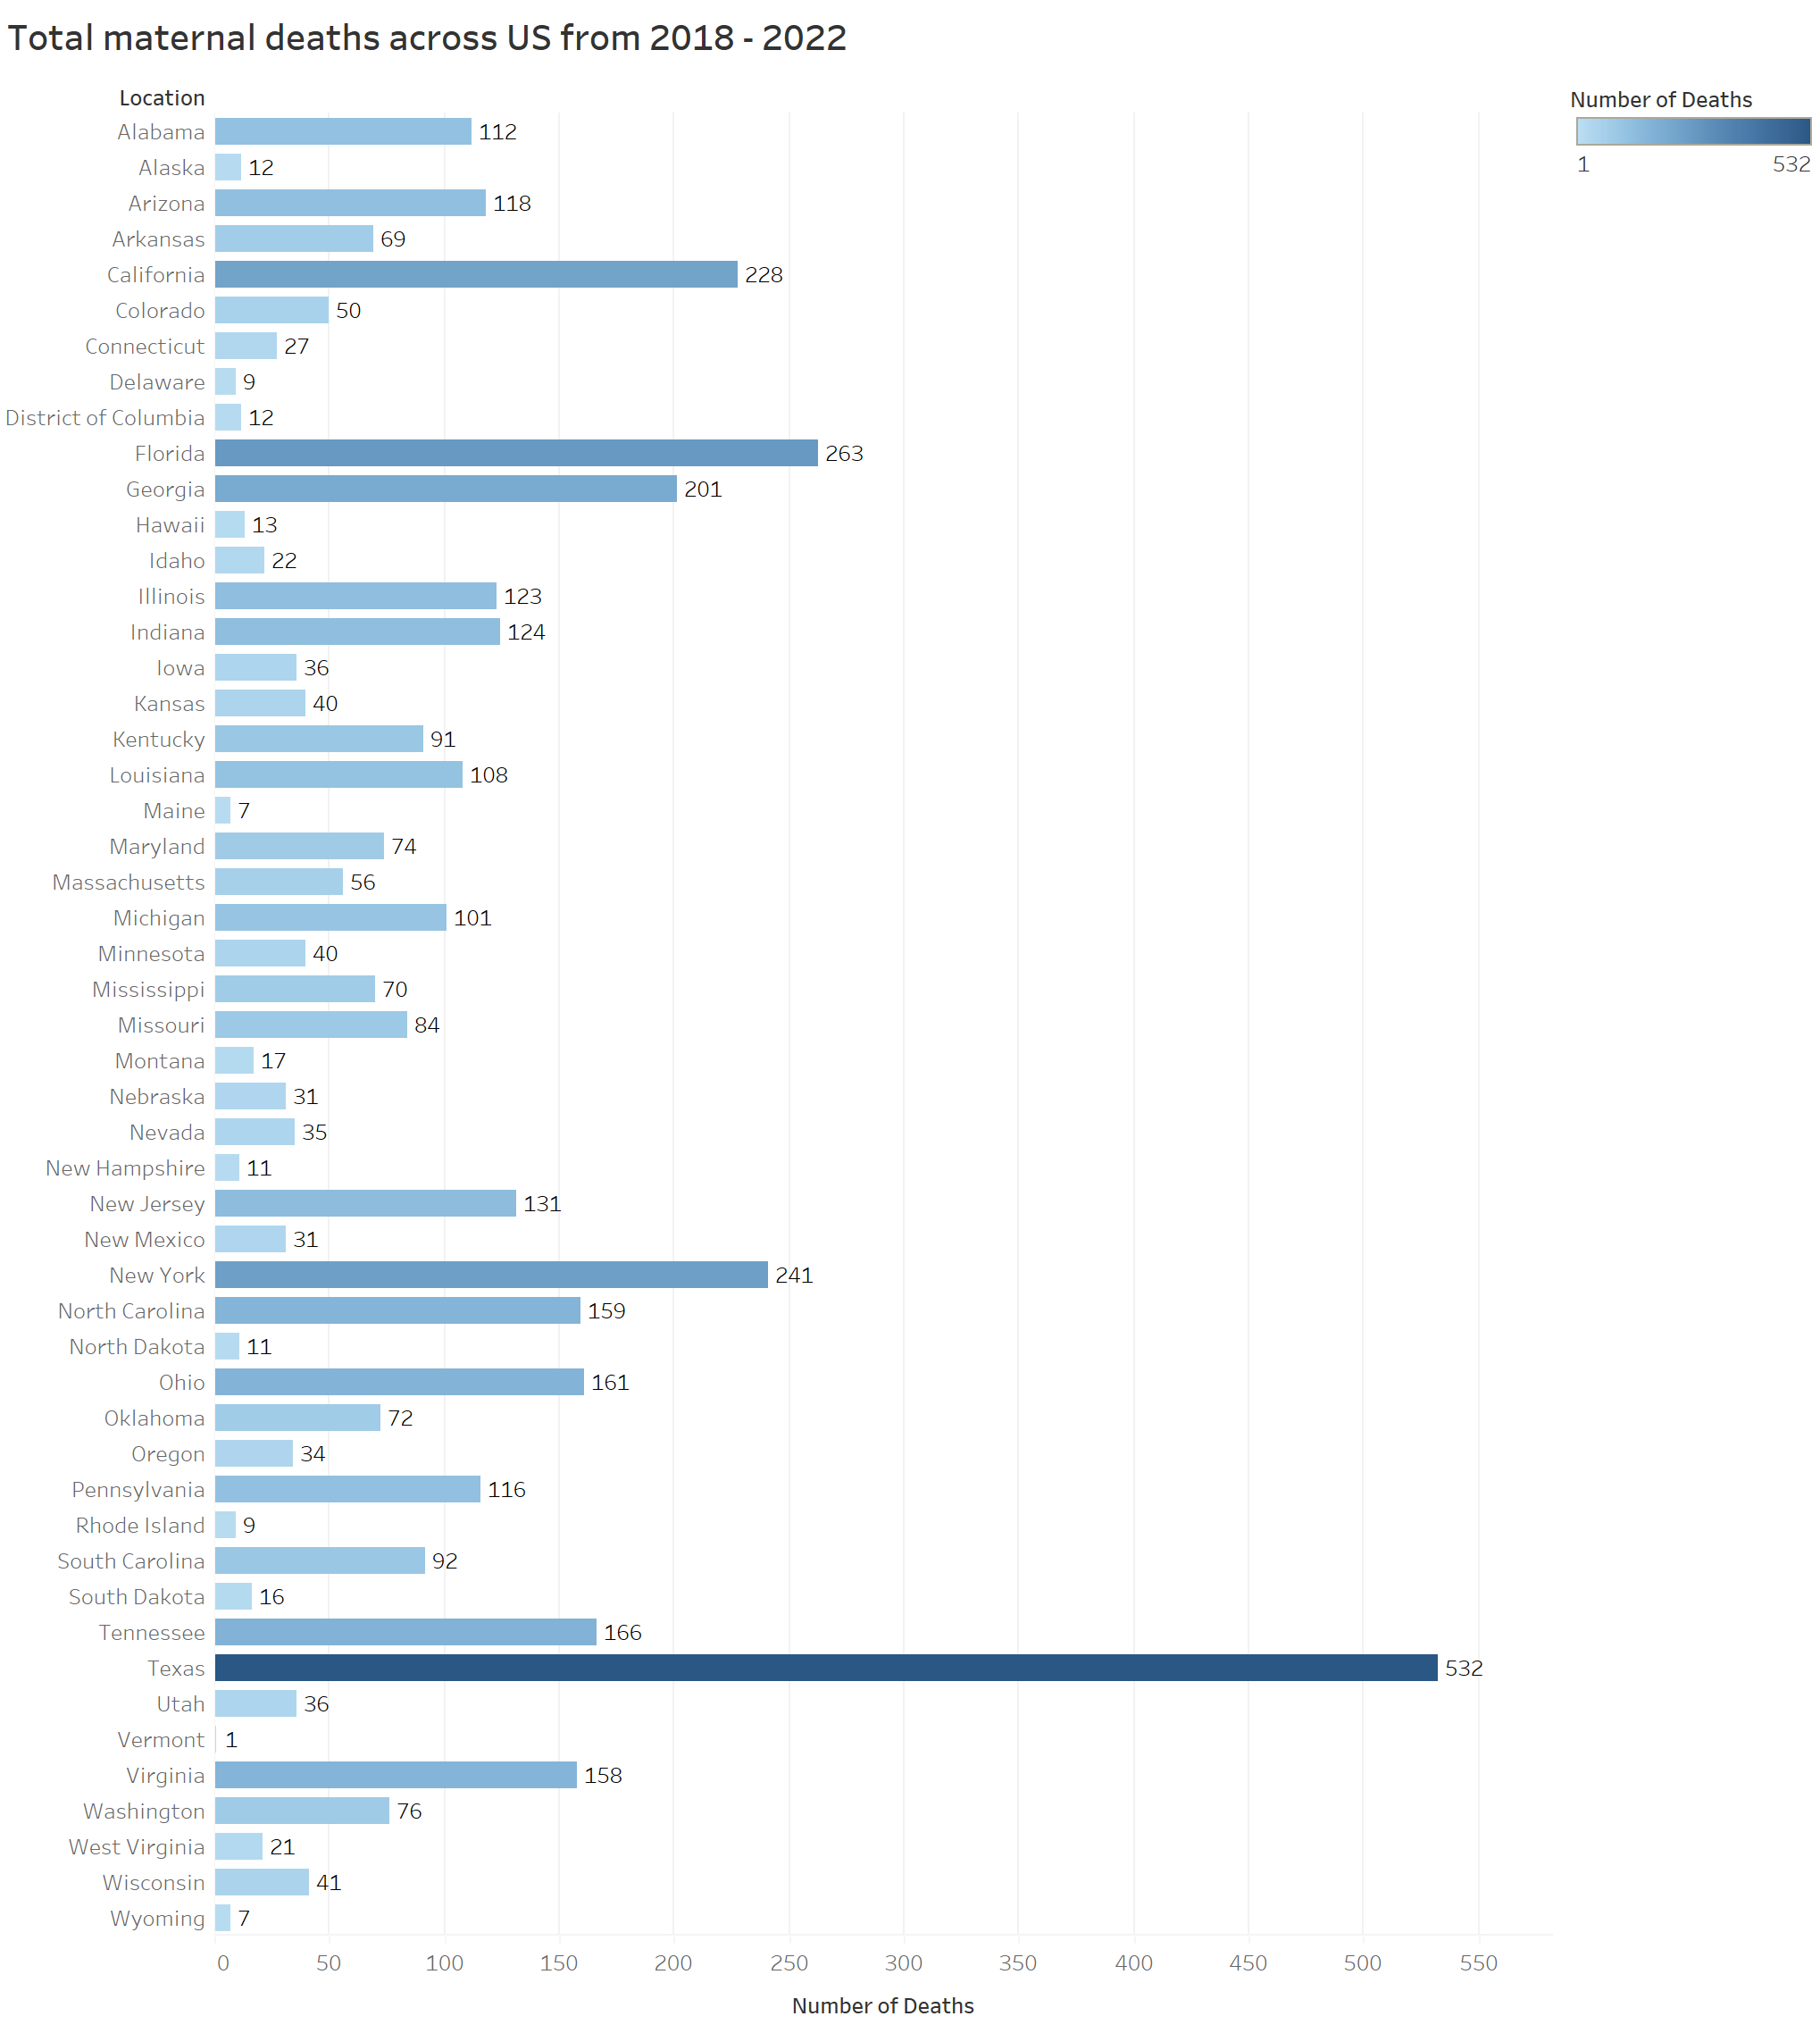
Bar Chart
State-wise maternal deaths (2018–2022).

Slide 11
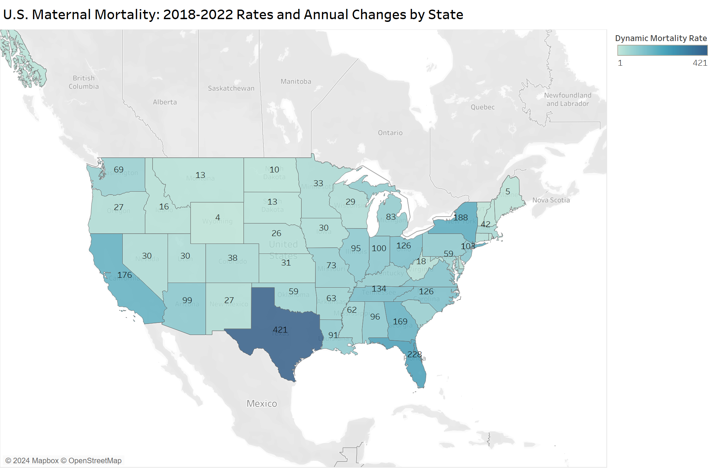
Dynamic Map
Geographic view of maternal mortality rates with dynamic filters (2018–2021, 2018–2022, Difference).

Slide 12
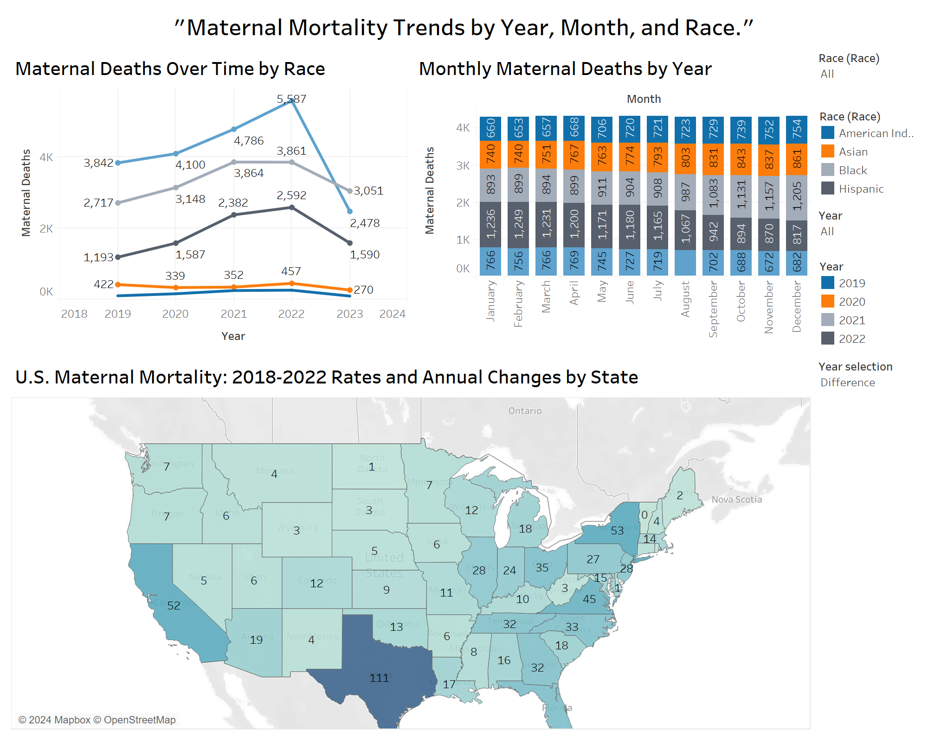
Dashboard
The dashboard integrates the line chart, stacked bar chart, and dynamic map. With interactive filters for race, year, and map type, users can explore trends dynamically, uncovering insights into temporal and geographic patterns.

Slide 13
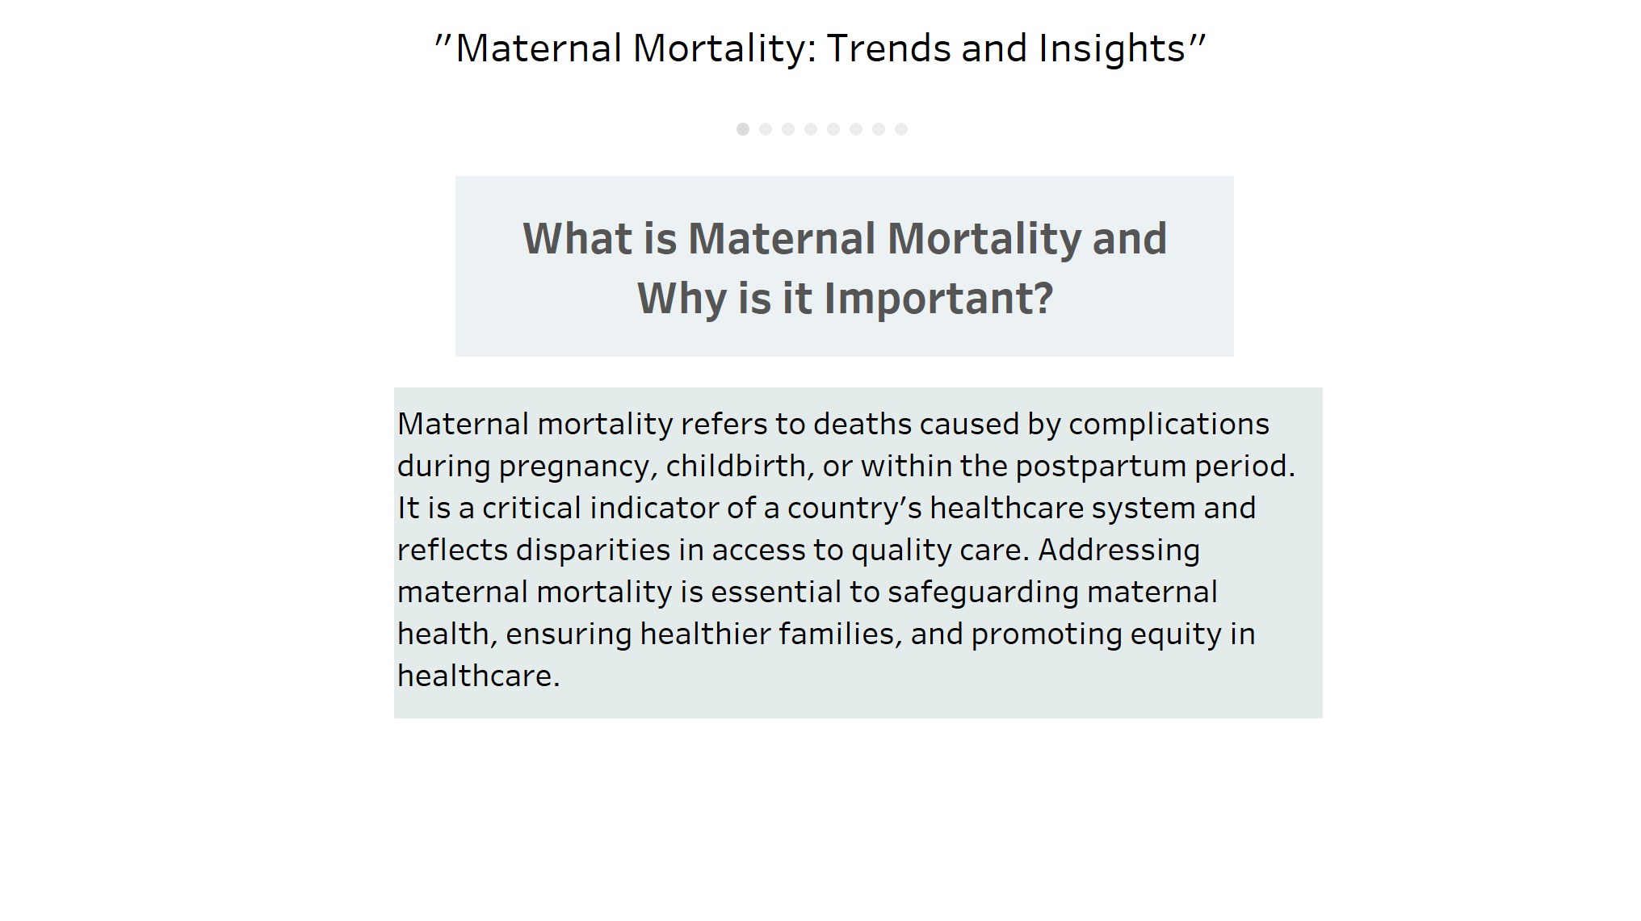
Tableau Story
The Tableau story begins with an introduction to maternal mortality, followed by visualizations that explore trends, disparities, and causes. Each story point builds on the previous one, creating a cohesive narrative.

Slide 14
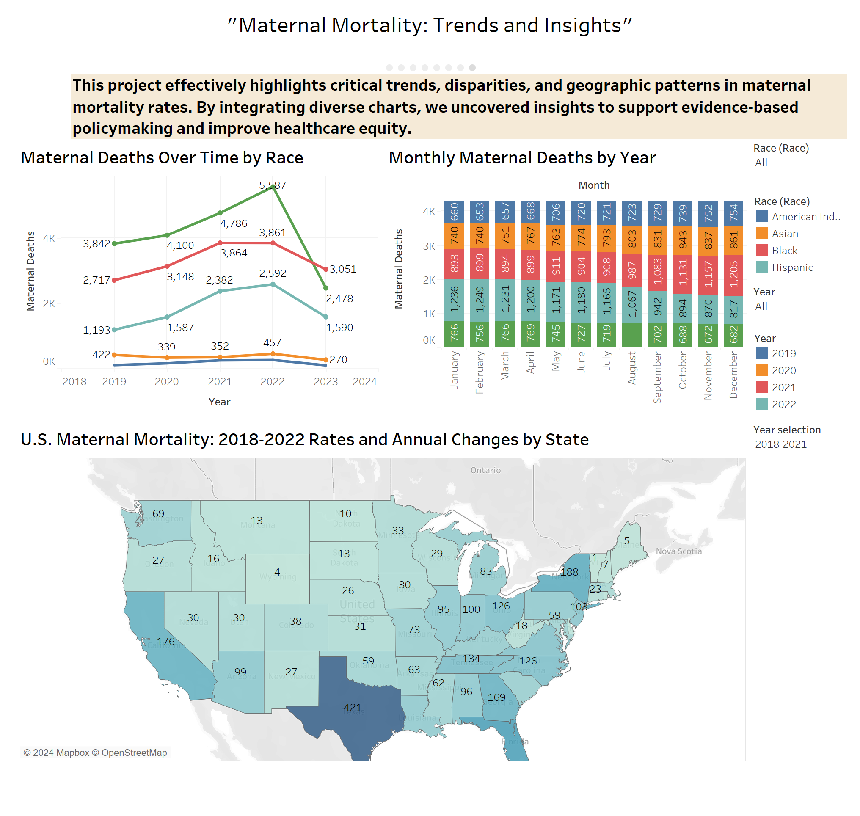
The story concludes with a summary that synthesizes the insights from all charts and highlights the need for targeted interventions.

Slide 15
Conclusion
Highlighted significant trends in maternal mortality rates, with rising numbers over time and stark disparities across racial and geographic lines.
Racial and state-level inequities demonstrate the urgent need for targeted interventions and resources.
Focus on equitable healthcare policies, expanded Medicaid coverage, and implicit bias training for healthcare providers.
Emphasize collaboration between policymakers, healthcare providers, and communities to ensure better maternal health outcomes.

Slide 16
References
(KFF), K. F. F. (2024). Maternal Deaths and Mortality Rates per 100,000 Live Births (Kaiser Family Foundation (KFF). https://www.kff.org/other/state-indicator/maternal-deaths-and-mortality-rates-per-100000-live-births/?currentTimeframe=0&sortModel=%7B%22colId%22:%22Location%22,%22sort%22:%22asc%22%7D#notes (Dataset)
Hill, L., Artiga, S., & Ranji, U. (2022). Racial disparities in maternal and infant health: Current status and efforts to address them. Kaiser Family Foundation, 1.
Hill, M., Tremont, J., McCraw, M., Spach, N., & Berry, A. (2021). Maternal mortality in the United States: a focus on health disparities.
Hoyert DL, U. S., Minino, AM. (2024). Provisional Maternal Mortality Rates 2019-2023 (Centers for Disease Control and Prevention (CDC). https://www.cdc.gov/nchs/nvss/vsrr/provisional-maternal-deaths-rates.htm (Dataset)
Petersen, E. E. (2019). Racial/ethnic disparities in pregnancy-related deaths—United States, 2007–2016. MMWR. Morbidity and mortality weekly report, 68.
Stoneburner, A., Lucas, R., Fontenot, J., & DeMaria, A. (2024). Nowhere to go: Maternal and infant health outcomes in maternity care deserts. APHA 2024 Annual Meeting and Expo,
WHO. (2004). ICD-10: International statistical classification of diseases and related health problems : tenth revision, 2nd ed. WHO. https://icd.who.int/browse10/Content/statichtml/ICD10Volume2_en_2010.pdf
WHO. (2024). Maternal Mortality. https://www.who.int/news-room/fact-sheets/detail/maternal-mortality
worldpopulationreview. (2022). Maternal Mortality Rate by State 2018-2021 (https://worldpopulationreview.com/state-rankings/maternal-mortality-rate-by-state (Dataset)

