Slide 1
Data Science Capstone project
<Ajith Kumar>
<xx.August.2021>

Slide 2

Outline
Executive Summary
Introduction
Methodology
Results
Conclusion
Appendix

Slide 3

Executive Summary
Analyzing data for SpaceX rocket launches to predict possible configurations that could lead to a successful recovery of Stage 1 of the rocket. This is made possible via data collection, data wrangling, data visualization and machine learning algorithms for prediction.
Factors that influence the successful recuperation of Stage 1 are, the Orbit where the payload is delivered to, Payload mass, possibly also the Launch site.
Major classification methods of machine learning are able to accurately predict successful recuperation.

Slide 4

Introduction
Space Exploration Technologies Corp. or SpaceX is an American aerospace manufacturer, space transportation services and communications company. We in this project focus on the space transportation side of it mainly the Falcon 9 rockets.
The goal of the project is to predict if Falcon 9 rocket’s first stage will land successfully, helping the company to keep the cost low by enabling re-use.
Github link: https://github.com/ajithkumars/dspython
All resources related to the project can be found in the link above

Slide 5

Methodology
Data is collected via API provided by SpaceX and from Wikipedia page for Falcon 9 launches.
We perform data wrangling by looking for patterns, simplifying and enriching the data
Further exploratory data analysis is performed using SQL.
Interactive analysis is done using Plotly Dash and Folium maps
Predictive analysis is performed using classification models

Slide 6
Methodology

Slide 7
Data collection
We primarily use publically available data from
url: https://api.spacexdata.com/v4/launches/past
Packages used: requests, pandas and numpy
We also use Wikipedia page link and web scrapping for alternatives for data and comparison
url: https://en.wikipedia.org/wiki/List_of_Falcon_9_and_Falcon_Heavy_launches
Packages used: requests, beautiful soup, pandas
Helper functions are used to extract exactly the data required

Slide 8
Data collection : SpaceX Api
We primarily use publicly available data from
url: https://api.spacexdata.com/v4/launches/past
Packages used: requests, pandas and numpy
Requests package is used to access the data via REST API (json format).
Pandas and numpy packages are used to clean and process the data
Numpy is used to fill up null values if any.
Pandas is for table like processing of data
Lastly processed data is saved as CSV file for further processing
Notebook link : https://github.com/ajithkumars/dspython/blob/main/Data-Collection.ipynb
Requests Package
URL
Pandas,
numpy
Package
Clean
Process data
Pandas
Package
CSV
RESTAPI CALL
Conversion
CSV File

Slide 9
Data collection : Webscraping
We also use Wikipedia page link and web scrapping for alternatives for data and comparison
url: https://en.wikipedia.org/wiki/List_of_Falcon_9_and_Falcon_Heavy_launches
Packages used: requests, beautiful soup, pandas
Requests package is used to access the data via REST API. (html format)
Beautiful soup package here is used to process html data
Pandas and numpy packages are used to clean and process the data ()
Notebook link : https://github.com/ajithkumars/dspython/blob/main/Webscraping.ipynb
Requests BeautifulSoup
URL
Pandas,
numpy
Clean
Process data
Pandas
CSV
RESTAPI CALL
Conversion
CSV File

Slide 10
Data Wrangling
Mainly, pandas and numpy packages/libraries are used.
We classify landing outcomes mainly as a new column (success : 1 and failure : 0)
We count different interesting columns to look for different patterns.
Including launch sites, orbit etc.
Launch outcomes, success rate for entire data set etc.
We identify different possible outcomes
Notebook link : https://github.com/ajithkumars/dspython/blob/main/Data-Wrangling.ipynb

Slide 11
EDA with data visualization
We use data visualizations to get insights to correlation/relationship between different features within the data set. We mainly plot scatter plots of:
Flight number vs payload mass (with landing outcome as hue)
Flight number vs Launch site (with landing outcome as hue)
Payload vs Launch site
Bar chart for Orbit type and their success rates.
Line plot for success over the years
Finally, OneHotEncoder is applied to features that we are interested in to create data set that Prediction can be applied on.
Notebook link : https://github.com/ajithkumars/dspython/blob/main/Exploratory-dataviz.ipynb

Slide 12
EDA with SQL
SQL is a powerful query language that has been extensively used in accessing data from database in numerous different ways.
We use the same for some quick summarization of spacex data.
Distinct launch sites
Summation of payload mass, average mass for given customer etc.
Success and failure rates for given booster version etc.
First successful landing on particular location (E.g. ground pad)
Nested queries with sub queries to get information like booster versions that have successful landing and has payload between 4000 and 6000 kg.
Boosters that carried maximum load.
Notebook link : Has been removed since it needs to link to IBM database which cannot be open.

Slide 13
Build an interactive map with Folium
We use interactive map from Folium and its packages to get some geographical insights related to rocket launches. These include answering questions like:
Where are launch sites located geographically (marked with markers)?
Can we mark success and failures on these?
Can we check and mark distance between railway, highway, sea and cities and launch sites to see if there is a pattern?
Notebook link : https://github.com/ajithkumars/dspython/blob/main/Folium-Demo.ipynb

Slide 14
Build a Dashboard with Plotly Dash
Plotly Dash allows users to create interactive dashboards where we can manipulate and interact with the data to get useful insights.
We create dashboard for success rate for different launch sites shown as a pie chart.
Which also includes a payload vs success scatter plot which has slider support to check different payloads a bit more closely
Notebook link for the code of the python application: Data should be obtained from the lab.
https://github.com/ajithkumars/dspython/blob/master/plotly/spacex_dash_app.py

Slide 15
Predictive analysis (Classification)
Using the previously processed dataset we perform some analysis to get the best machine learning algorithm to predict successful outcomes for Falcon 9. In the process we try algorithms like:
Logistic Regression
Support Vector Machine (SVM)
Decision Tree Classifier
K Nearest Neighbors
We perform a grid search across multiple configurations to obtain the best possible parameters for each of these algorithms to get the best possible model.
Notebook link: https://github.com/ajithkumars/dspython/blob/main/Machine-Learning.ipynb

Slide 16
Results
Exploratory data analysis results
Interactive analytics demo in screenshots
Predictive analysis results

Slide 17
EDA with Visualization
Exploratory Data Analysis with visualizations to back discussions

Slide 18
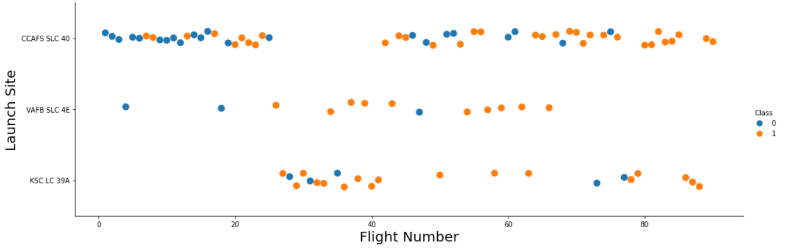
Flight Number vs. Launch Site
The latter flight numbers are increasingly successful.

Slide 19
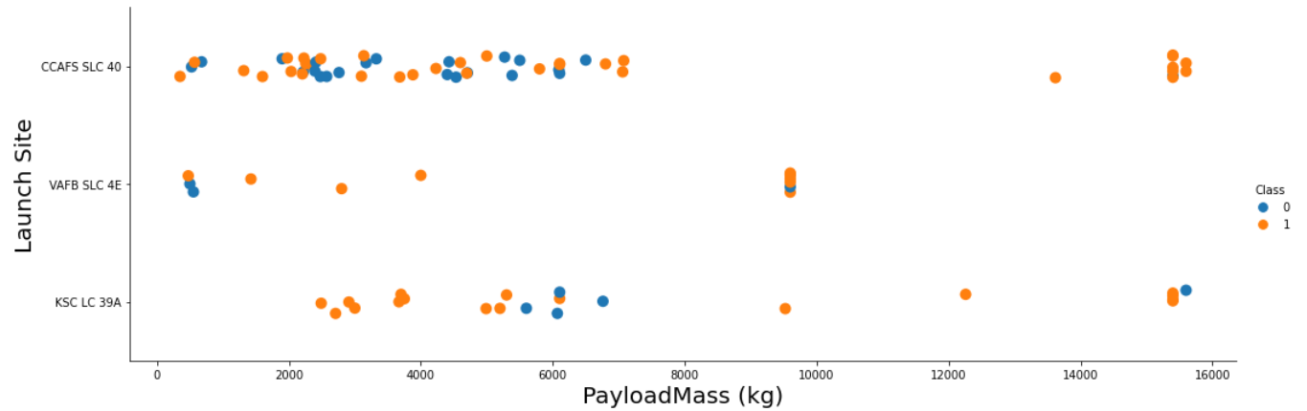
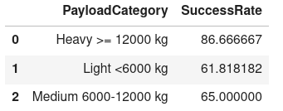
Payload vs. Launch Site
Heavyier payload are more likely to be successful

Slide 20
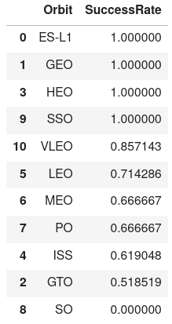
Success rate vs. Orbit type
Launches to orbits ES-L1, GEO, HEO and SSO are more likely to succeed than the others

Slide 21
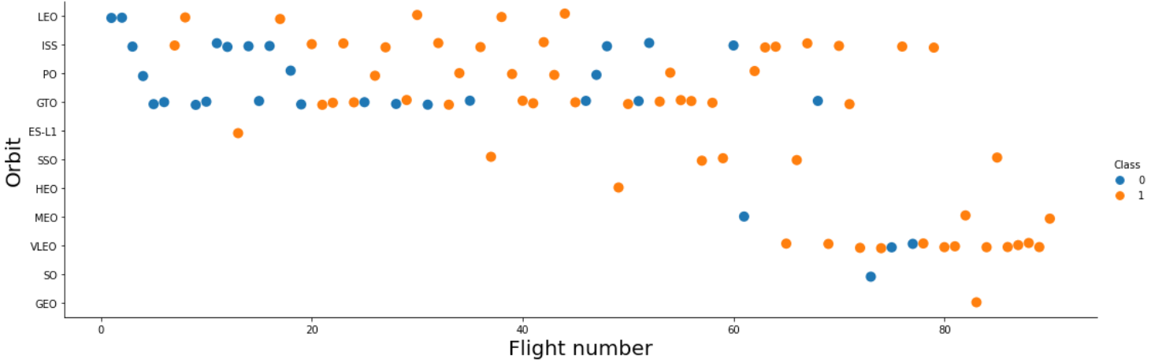
Flight Number vs. Orbit type
LEO has more success in latter flight numbers
Rest of them are rather arbitrary

Slide 22
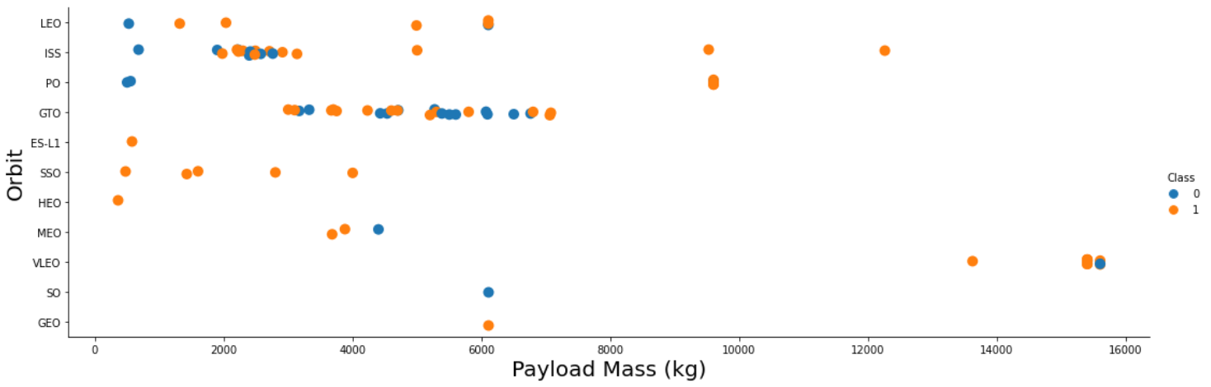
Payload vs. Orbit type
Heavy payloads have negative influence on GTO orbits and positive on LEO and ISS

Slide 23
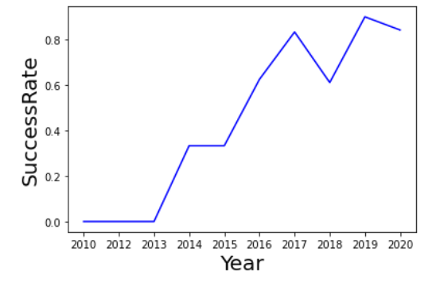
Launch success yearly trend
Over the year success rates have improved (with a small dip in 2018)

Slide 24
EDA with SQL

Slide 25
All launch site names
Query:
%sql select distinct(launch_site) from SPACEXDATASET;
Selects distinct values for launch_site column
Launch sites (listed) – CCAFS SLC-40 has been repeated here due to possible miss entry:
CCAFS LC-40
CCAFS SLC-40
CCAFSSLC-40
KSC LC-39A
VAFB SLC-4E

Slide 26
Launch site names begin with `CCA`
Query:
%sql select distinct(launch_site) from SPACEXDATASET where launch_site LIKE 'CCA%’;
Out of the selected distinct columns we match regular expression where launch_site name starts with CCA
Launch Sites: Same issue as last slide.
CCAFS LC-40
CCAFS SLC-40
CCAFSSLC-40

Slide 27
Total payload mass
Query:
%sql select sum(payload_mass__kg_) from SPACEXDATASET where customer like 'NASA (CRS)’;
Sums all the elements in column for payload mass where the rows are selected based on customer name
Total payload mass for all NASA (CRS) related launches : 45596 kg

Slide 28
Average payload mass by F9 v1.1
Query:
%sql select avg(payload_mass__kg_) from SPACEXDATASET where booster_version like 'F9 v1.1%’
Sums all the elements in column for payload mass and presents the average, with condition set for booster_version with regular expression matching for F9 v1.1 version.
Average payload was found to be 2534 (so low payload mass is carried by this booster version)

Slide 29
First successful ground landing date
Query:
%sql select min(DATE) from SPACEXDATASET where landing__outcome like 'Success (ground pad)’
Minimum date where the landing_outcome condition of success and on gournd pad is met.
First successful ground pad landing was achieved on 22nd December 2015.

Slide 30
Successful drone ship landing with payload between 4000 and 6000
Query:
%sql select distinct(booster_version) from SPACEXDATASET where landing__outcome like 'Success (drone ship)' AND payload_mass__kg_ BETWEEN 4000 AND 6000;
(distinct) Booster versions selected where two conditions based on landing outcome and payload mass are met.
Result:
booster_version
F9 FT B1021.2
F9 FT B1031.2
F9 FT B1022
F9 FT B1026

Slide 31
Total number of successful and failure mission outcomes
Query:
%sql select mission_outcome, count(*) from SPACEXDATASET GROUP BY mission_outcome
Count mission_outcome categories
Result: Almost all mission outcomes have been a success except 1.
Failure (in flight) | 1
Success | 99
Success (payload status unclear) | 1

Slide 32
Boosters carried maximum payload
Query:
%sql select distinct(booster_version) from SPACEXDATASET where payload_mass__kg_ in (select max(payload_mass__kg_) from SPACEXDATASET);
A nested query, with subquery that finds out the maximum payload mass and uses in the main query to get booster versions(distinct) that carried it.
Results: ➔
F9 B5 B1048.4
F9 B5 B1048.5
F9 B5 B1049.4
F9 B5 B1049.5
F9 B5 B1049.7
F9 B5 B1051.3
F9 B5 B1051.4
F9 B5 B1051.6
F9 B5 B1056.4
F9 B5 B1058.3
F9 B5 B1060.2
F9 B5 B1060.3

Slide 33
2015 launch records
Query:
%sql Select MONTHNAME(DATE) as month,booster_version,landing__outcome,launch_site from SPACEXDATASET where landing__outcome like 'Failure%' AND to_char(DATE,'yyyy')='2015’
Selects date which is presented by month name and other expected columns based on failed attempts in year 2015
Result: 2 failures noticed for the year of 2015 from the same launch site.
MONTH | booster_version | landing__outcome | launch_site
January | F9 v1.1 B1012 | Failure (drone ship) | CCAFS LC-40
April | F9 v1.1 B1015 | Failure (drone ship) | CCAFS LC-40

Slide 34
Rank success count between 2010-06-04 and 2017-03-20
Query:
%sql select landing__outcome,count(landing__outcome) as outcomes from SPACEXDATASET where DATE between '2010-06-04' AND '2017-03-20' AND landing__outcome like 'Success%' GROUP BY landing__outcome ORDER BY outcomes desc;
Rank landing outcomes between given dates, achieved by counting the outcomes and grouping and ordering them.
Result: drone ship outcomes have had more successful outcomes
landing__outcome | outcomes
Success (drone ship) | 5
Success (ground pad) | 3

Slide 35
Interactive map with Folium

Slide 36
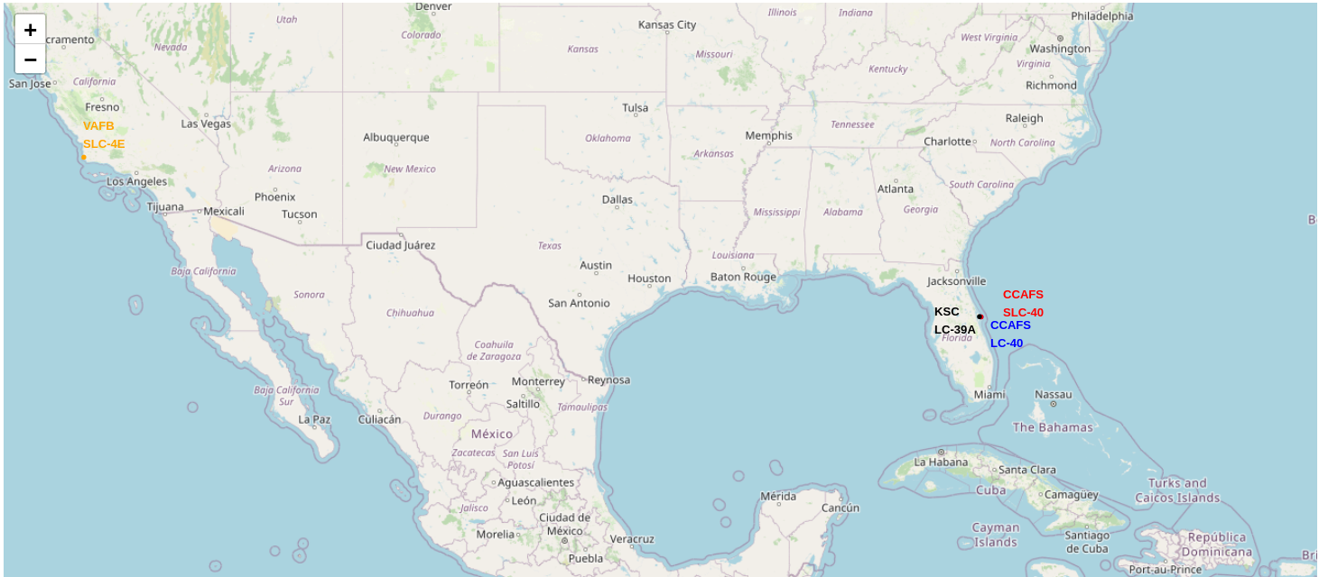
Launch sites
All launch sites as you see are close to the equator and to the coast.
Equator: Due to speed advantages.
Coast: Possibly due to safety in case of failures?

Slide 37
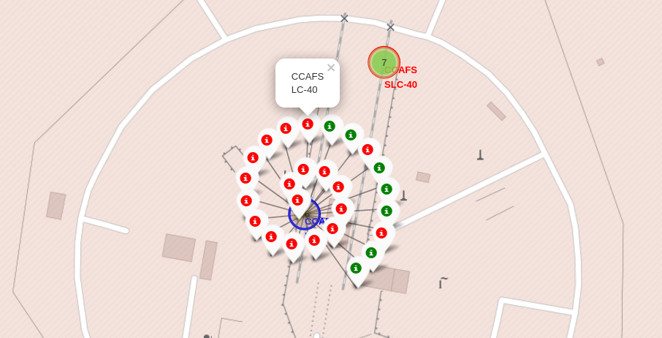
Launch records by Launch Site
Easily visible success rate of launches from the chosen site.

Slide 38
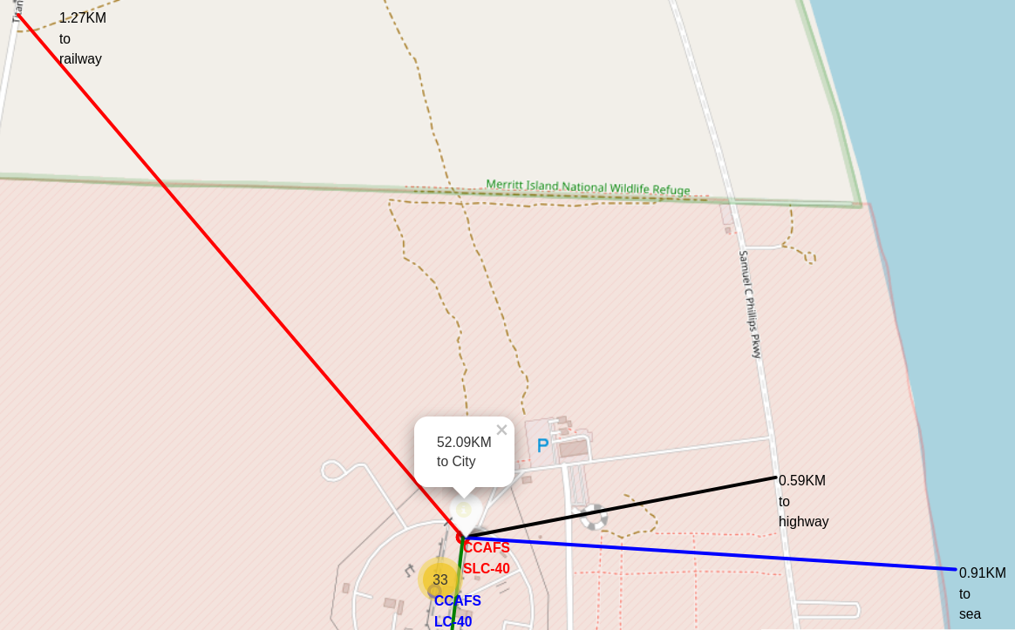
Launch site proximity
We considered one launch site CCAFS SLC-40 and its proximity to railway, sea, highway and city.
It does seem to have close proximity to sea, railway and highway and long distance to nearest city as listed in the popup (possibly due to safety reasons

Slide 39
Build a Dashboard with Plotly Dash

Slide 40
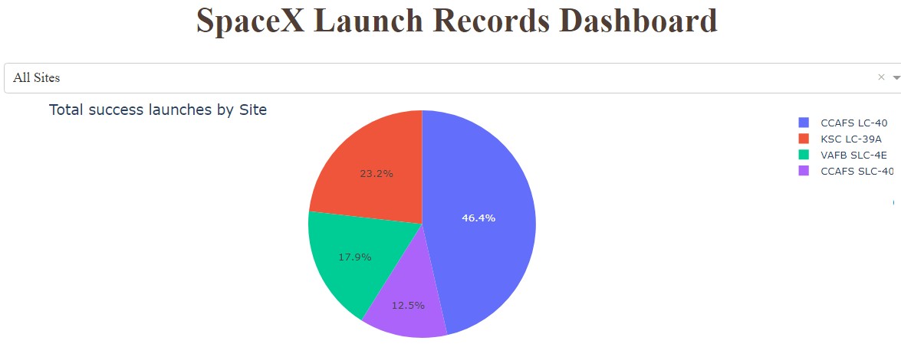
Successful launches
CCAFS LC-40 has the major portion of the pie with successful launches, has the most launches as well
CCAFS LC-40 -- 26 (Launches)
KSC LC-39A -- 13
VAFB SLC-4E -- 10
CCAFS SLC-40 -- 7

Slide 41
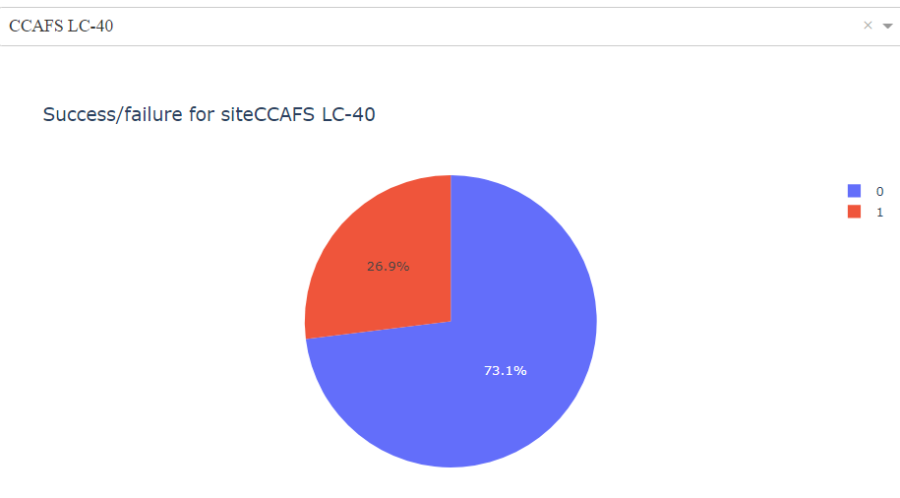
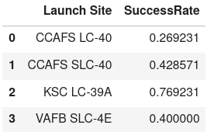
Launch outcomes for site CCAFS LC-40
CCAFS LC-40 has had a very low success rate (1) of 26,9% (unfortunate coloring)
0 represents the failed launches and 1 for successful launches

Slide 42
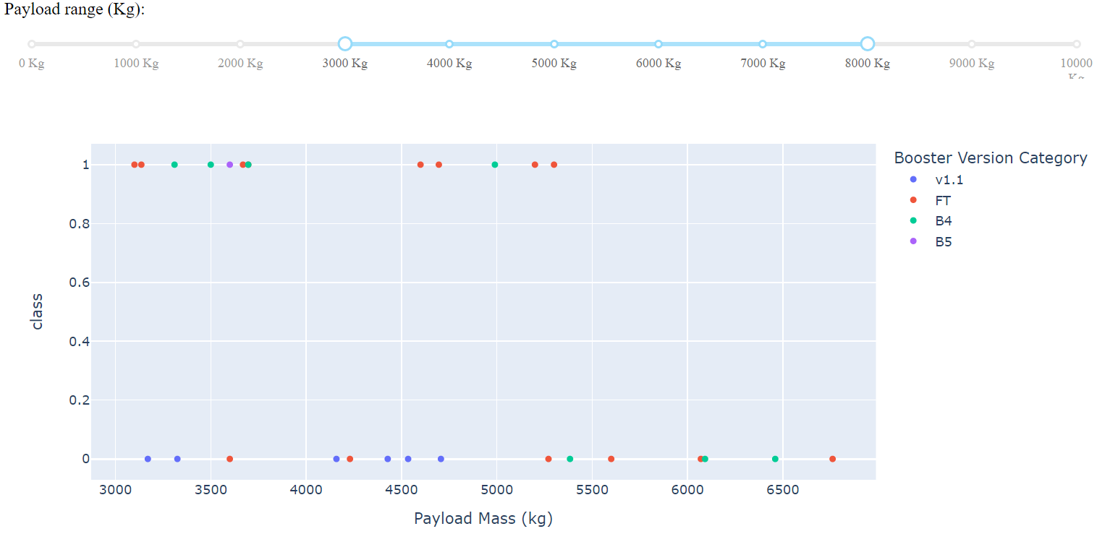
Payload vs Success
A chart along with slider is provided to provide an interactive experience to check different combinations, here we have a range of 3000 to 8000 kg.

Slide 43
Predictive analysis (Classification)

Slide 44
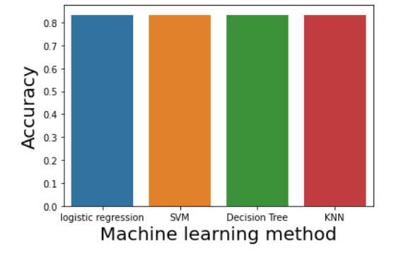
Classification Accuracy
All methods used seem to have the same accuracy

Slide 45
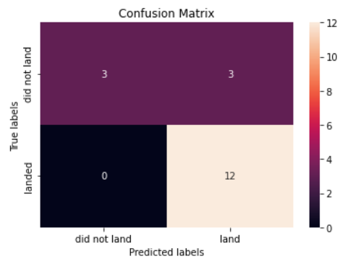
Confusion Matrix
All methods have the same confusion matrix.
There are three false positives as seen in the matrix (which can be an issue)

Slide 46

CONCLUSION
Higher payloads have higher success rate
Certain orbits have higher success rate
Launch sites should have close proximity to ocean and railways
It is possible to predict launch outcomes with fairly high accuracy (83%), thus based on machine learning it is possible to create a new company by testing what kind of features they should work to get high probability for successful outcome

Slide 47

APPENDIX
Include any relevant assets like Python code snippets, SQL queries, charts, Notebook outputs, or data sets that you may have created during this project

