Slide 2

Angular Universal
Server-Side Rendering in Angular App

Slide 3
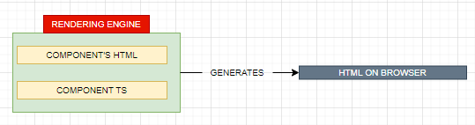
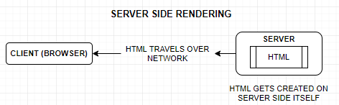
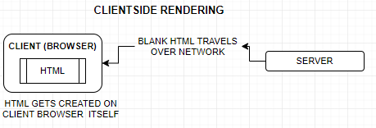
What is Angular Universal ?
Angular Universal is a Server-side Rendering Engine of Angular front-end Application
What is a Rendering Engine?
The job of rendering engines is to generate the HTML of the component by leveraging component’s template and data.
When the rendering engine work on Client’s browser we call it a Client-side Rendering and if the same happens to be Server Side it termed as Server-side rendering

Slide 4
Why Angular Universal ?
Performance Benefits
PROBLEMS WITH CSR !
In a common client-side rendered application – The HTML rendered to the client browser is an empty HTML .
HTML cannot be rendered until the client-side JavaScript kicks in.
WHAT WE GET IN SSR ?
Server rendering generates the full HTML for a page on the server in response to navigation.
This avoids additional round-trips for data fetching and templating on the client since it’s handled before the browser gets a response.

Slide 5
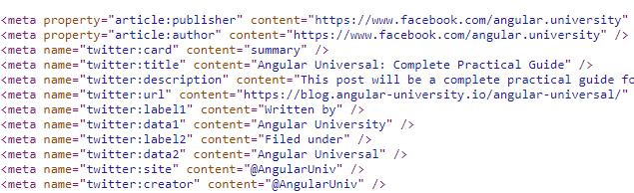
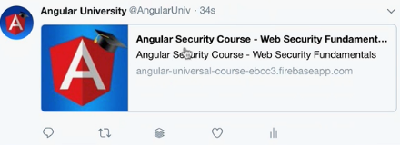
Why Angular Universal ?
Social Media Crawlers
For any integration with a Social Media Platform, the page need to have meta information in its HTML
When we want to share a post on Social Media like twitter and Facebook. The social media crawler reads the title , images and the above meta information to generate a post
For client side rendered page – What we get is a blank HTML over the wire .Hence the Social Media crawler will not be able to process the page and extract the meta information from as the HTML received from server is a blank page.
Note : The Social Media Crawler can only extract and process the information on HTML which are rendered from server side not the once generated dynamically on client side.

Slide 6
Why Angular Universal ?
Search Engine Optimization(SEO)
Indexation issue
Note – Google Search Engine and some other popular Search engine can be able to index the SPA application
Exception Search Engines : https://www.baidu.com/

Slide 7

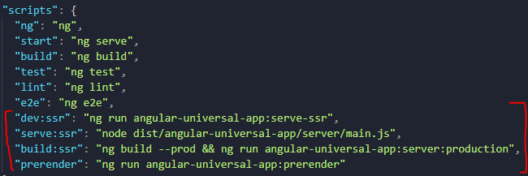
Setting up Angular Universal
ng add @nguniversal/express-engine
Package.json

Slide 8
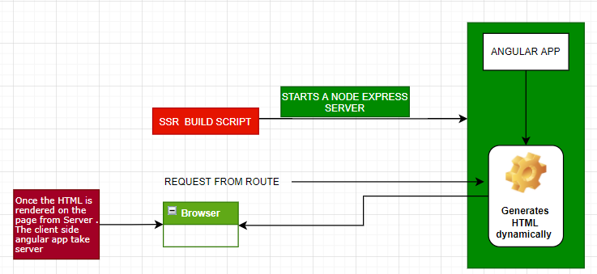
Angular Universal – Behind the Scene
On executing the script . It starts Node Express server
The express server takes the request and generates the HTML dynamically on server and send the processed HTML
Once the HTML is rendered on the browser . The Angular client-side application takes over and post that the application behaves like a SPA.

Slide 9
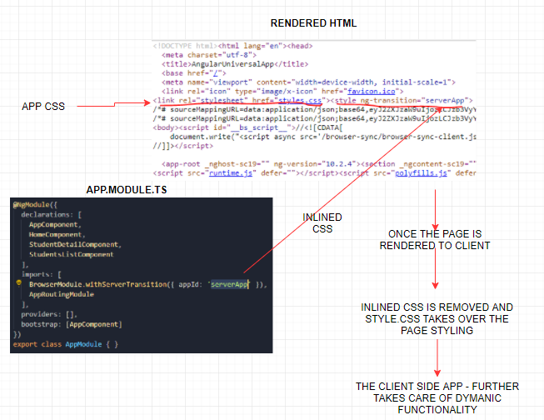
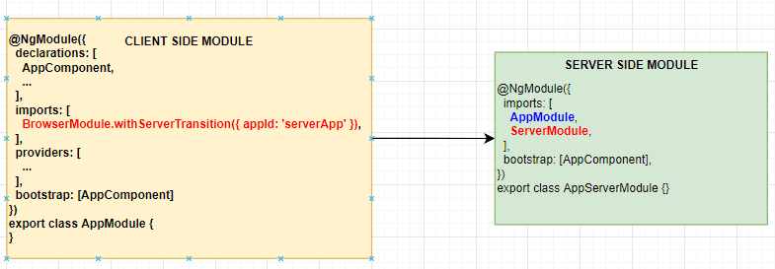
Angular Universal – Client and Server-Side Application Interact?
The server-side module imports all the App module components – so the server rendering engine knows what HTML it must generates.
Due to the in-lined CSS the end user never feels that the interface of app is broken.
The “appId” identifier helps angular to remove the in-lined style from finally rendered page.
BrowserModule.withServerTransition({ appId: 'serverApp' })

Slide 10
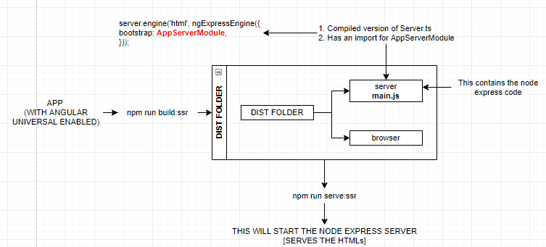
Angular Universal – Prod Build Steps

Slide 11
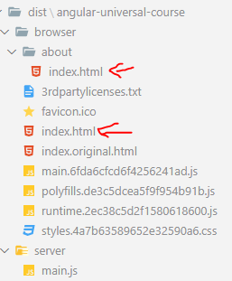
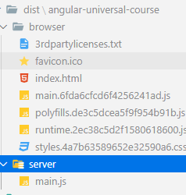
Prerendering in Angular Universal
NPM SCRIPT : npm run prerender
Pre-render Build
Server-side Build

Slide 12
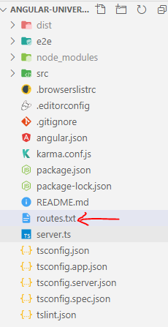
Prerendering Dynamic Routes
ng run angular-universal-course:prerender --routes-file routes.txt
/courses/01
/courses/02
routes.txt

Slide 13
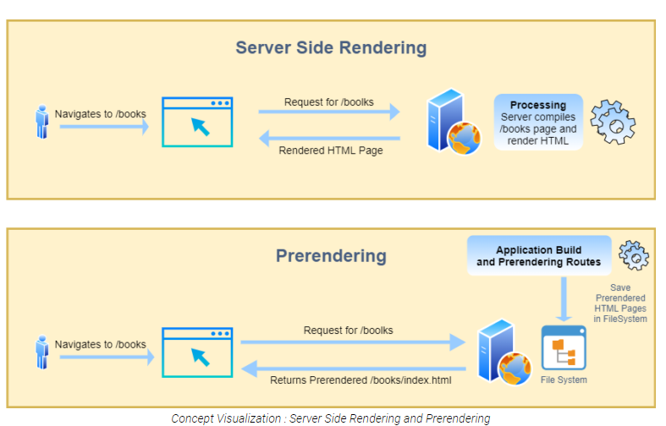
Prerendering in Angular Universal
HOW PRERENDERING IS DIFFERENT FROM SERVER-SIDE RENDERING ?
In both rendering techniques, we generate static HTML pages which can be easily crawled by crawlers.
Just the major difference is the location where HTML pages are generated. In Server-Side Rendering Technique when the user navigates to the URL => for example - /books route, the server compiles the application(render on a server) and sends the generated HTML page back to the client.
While In Prerendering Technique, All routes of the application are compiled at build time and saved as static HTML pages on file-system. These HTML pages can be served to the client using CDN. So, whenever the user navigates to any route, he/she will get prerendered HTML pages.

Slide 14

Next Session
Angular Universal Application Shell
Angular Universal State API

Slide 15
Thank you !

