Slide 2
Gradle
An Overview

Slide 3
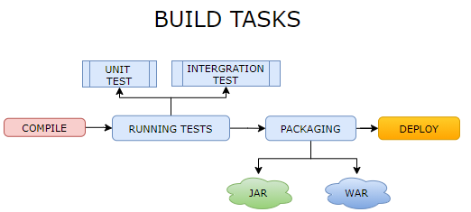
Gradle
Gradle is a build automation tool
The tasks like compiling, running the test cases, package the artifact as jar/war and deploying it to server or cloud environment can be automated by gradle.
Gradle needs JDK 1.8 or higher

Slide 4

Comparison with ANT and Maven
ANT | MAVEN | GRADLE
Ant uses build.xml where various build tasks can be created/ configured in an XML file. | Maven supports convention over configuration- means Maven will create a folder structure for us | Gradle takes best of both world
Flexibility of customization | Customization in Maven is difficult | Supports convention over configuration
Ant don’t have its own dependency management. It uses IVY for the same. | It has in-built dependency management – using xml pom.xml | Easy Customization
Due to customization – The ant based the project does not have fixed guideline for project structure. |  | Own Dependency Management

Slide 5
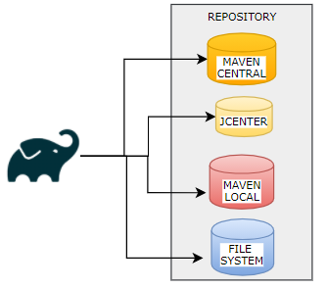
Why Gradle ?
LANGUAGE SUPPORT: Gradle is used by multiple projects like Java, C++, Groovy , Kotlin, Swift
DEPENDENCY MANANAGMENT
Gradle manages the dependencies from the repository we configure in build.gradle file
It supports multiple repositories like Maven Central Repo , Maven Local , JCenter even the file system.
SCOPE MANAGEMENT : Maven has limited scope of dependency management like test, compile and runtime. On the other hand, apart from these scopes gradle supports custom scopes as well.
4. DSL SUPPORT : Gradle uses programming languages like Groovy or Kotlin (known as DLS – Domain Specific Languages) in it configuration file (build.gradle)
5. PERFORMANCE
INCREMENTAL BUILD: Gradle support incremental build. For example - It only compiles the changed the files and used the compiled code of previous build.
PLUGIN SUPPORT: Gradle never have configuration specific to a particular project type. It uses the plugin which brings in specific features like compiling , executing and running the test case for a particular project type. Example jar, war, jacoco, bootRun

Slide 6
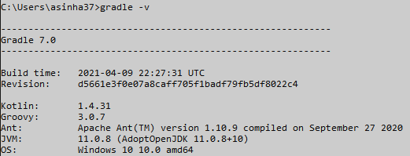
Gradle – Installation (Windows)
Need Java SDK 1.8 or higher.
Download the Zipped binary : https://gradle.org/releases/
Set the “bin” path in the Environment variables as System variables.
INSTALLATION STEPS : https://gradle.org/install/#manually
TO CHECK VERSION : gradle – v
Current Version is : Gradle 7.2

Slide 7
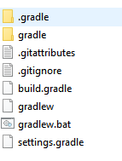
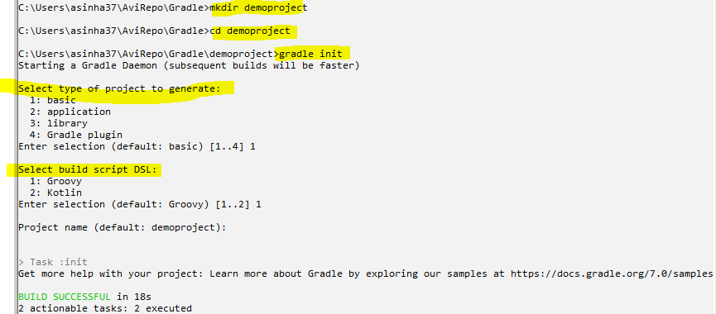
Creating Basic Gradle Project
Initializing the a gradle project – gradle init
GENERATED PROJECT STRUCTURE
INITIALIZATION
build.gradle : We write all the build task in this file. It is like build.xml in ANT or POM.xml in Maven
settings.gradle : It has meta information of the project
gradlew : Gradle Project can be built with its own gradle version. So, when the projects are deployed to any environment, Gradle wrapper downloads the exact version which the project is using – instead of using the version pre-installed gradle version.
Hence - jenkin pipeline uses gradlew instead of gradle command to run and build the gradle project.

Slide 8
Creating Gradle Tasks
We write all build task in build.gradle file
CREATING A TASK | task firstTask { println "hello world!" description "This is my first task" }
RUNNING THE TASK | gradle <taskName> e.g gradle firstTask USING ABBREVIATION : gradle fT
VIEW TASKS | gradle --all
RUNNING THE TASK USING WRAPPER | gradlew fT

Slide 9
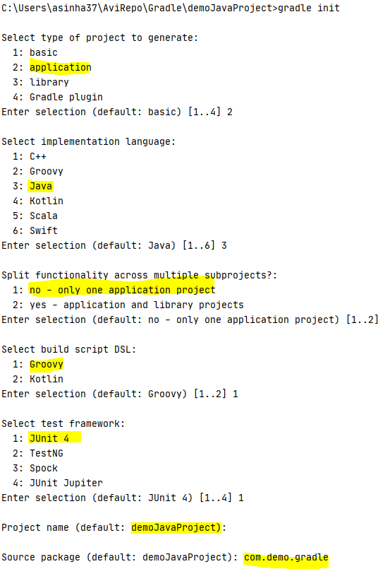
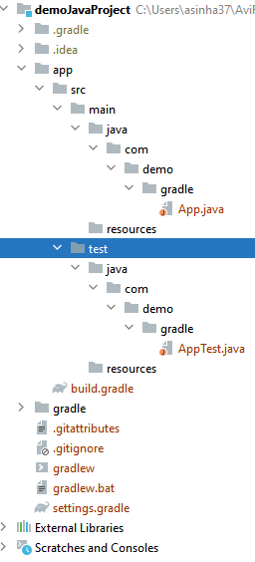
Creating Java Project
Java Project Structure – Similar to Maven Folder structure
RUNNING COMMON JAVA PROJECT TASKS
View all task – gradle --all
Running the project
Building the project
Build Jars for project
Cleaning the project
Creating Java Docs
Running unit and integration test

Slide 10
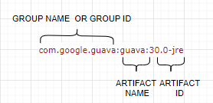
Understanding build.gradle
Repositories
All the dependencies are downloaded from a central repository. The repos can be Maven, Ivy or Jcenter . It can be a file repository (Folder in local machine).
In local machine Gradle stores/caches the dependency or transitive dependency jars in “.gradle/caches” folder in users directory.
We can add multiple repositories . They work as a fallback of each other. For ex.. if the dependency is not found in maven central - gradle will look for it in Jcenter .
plugins {
id 'application'
}
repositories {
mavenCentral()
jcenter()
mavenLocal()
}
dependencies {
testImplementation 'junit:junit:4.13.1'
implementation 'com.google.guava:guava:30.0-jre'
}
application {
mainClass = 'com.training.App'
}
Dependencies
DEPENDENCY TYPE | DESCRIPTION
implementation | Dependency needed for entire app
providedCompile | Dependency needed for compile time
testImplementation | Dependency needed for running Test

Slide 11
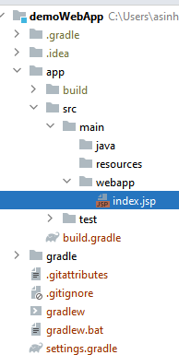
Creating Java Web Project
Create a webapp folder in below location
plugins { id 'war' id "org.gretty" version "3.0.6" } repositories { mavenCentral() } dependencies { compileOnly 'javax.servlet:javax.servlet-api:4.0.1' }

Slide 12
References
Gradle Docs : https://docs.gradle.org/
Gradle Plugin : https://plugins.gradle.org/

Slide 13
Thank you !

