Slide 1
CodeMaster
Learn Anytime Anywhere

Slide 2
codeMaster//
;
Learn Anytime Anywhere
TEAM MEMBERS
ADITYA RAJ - 2020179001
AISHWARYA R - 2020179002
AJITHKUMAR SHAH J K - 2020179003
ANAND S - 2020179005
ANITHA K - 2020179006
ARUNADEVI G - 2020179009
ANUGRAHA S - 2020179008

Slide 3
.
CodeMaster
MORE DETAILS
XML
HTML
CSS
We provide
All basics to advance
JS
Programming language.
PYTHON.
Munich, Germany

Slide 4
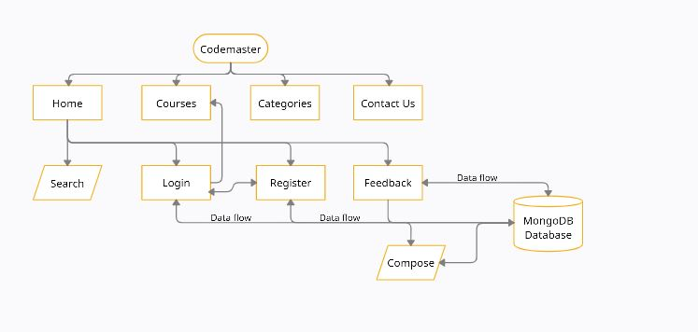
Architectural Diagram
MORE DETAILS

Slide 5
Modules
Home Module:
Get Access to courses on programming languages FREE !
Start Learning Now…
Courses Module:
All of the available programming courses on our
website are listed here.
Categories module:
Latest technologies or web development?
Choose your favourite category
Feedback module:
Users can share their suggestions and thoughts about the website
Search Module:
Look up for your favourite language in the search bar.
Login module: If you already have an account just use login module.
Register module: If you doesn’t have an account first register and then go to the login page
MORE DETAILS

Slide 6


Implementation:
LOGIN FORM: User name – Must be of string type and unique. Password – Must be of string datatype. REGISTER FORM: Name - Must be of string datatype. Mail Address – string type and should be of the format example@gmail.com. Contact Number – must contain maximum of 10 digits. Location – must be of string datatype. Password - Must be of string datatype. Confirm Password - Must be of string datatype. FEEDBACK FORM: Your Feedback User Comment
MORE DETAILS
MORE DETAILS
CodeMaster://
2019.All Rights Reserved

Slide 7
<7/>
codeMaster makes it easy and fun for you to code.
#include <stdio.h>
int main(void)
{
printf("hello, world\n");
}
Learn by
Doing://

Slide 8

Snap Shots: Homepage
Code to the web design
There's no one "best" programming language, and once you've learned one, it's fairly easy to pick up another, so don't get hung too up on choosing your first language.
MORE DETAILS
MORE DETAILS

Slide 9
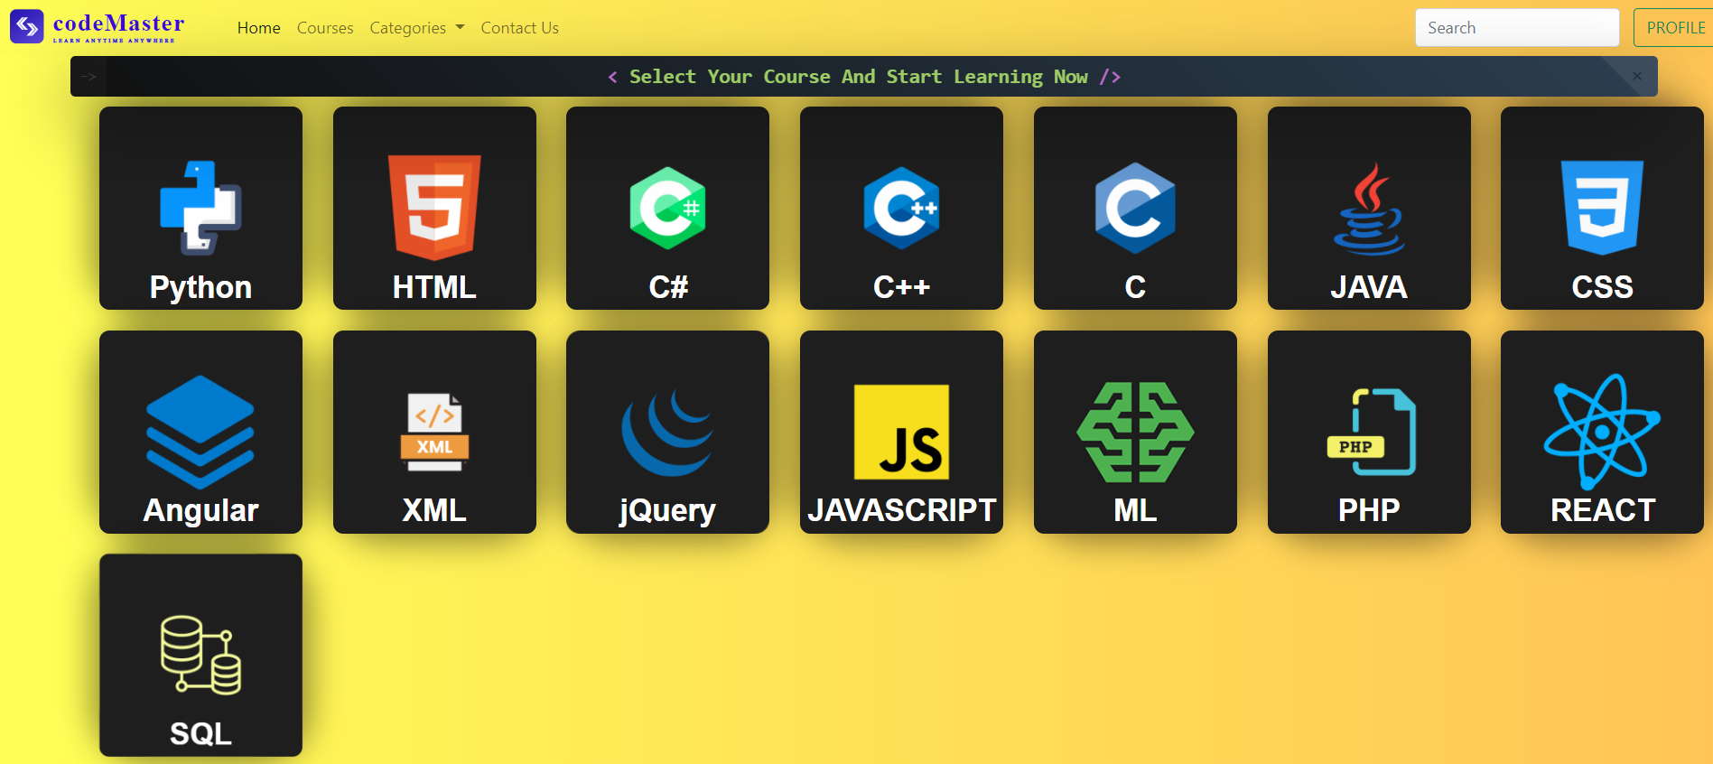
Snap Shots: Courses
Code to the web design
There's no one "best" programming language, and once you've learned one, it's fairly easy to pick up another, so don't get hung too up on choosing your first language.
MORE DETAILS
MORE DETAILS

Slide 10
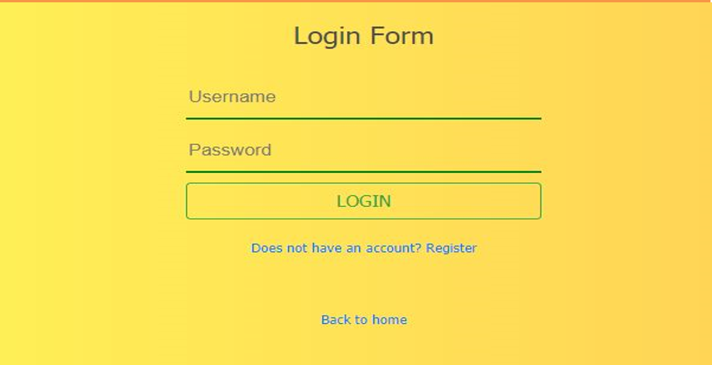
Snap Shots: Login Form
Code to the web design
There's no one "best" programming language, and once you've learned one, it's fairly easy to pick up another, so don't get hung too up on choosing your first language.
MORE DETAILS
MORE DETAILS

Slide 11






Slide 12
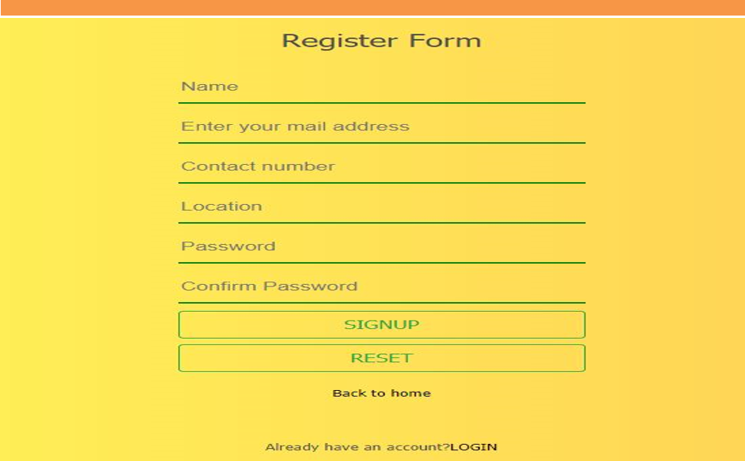
Snap Shots: Register Form
MORE DETAILS

Slide 13
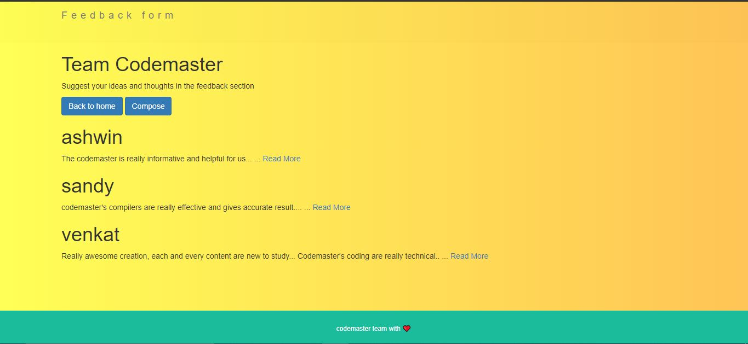
Snap Shots: Feedback
Code to the web design
There's no one "best" programming language, and once you've learned one, it's fairly easy to pick up another, so don't get hung too up on choosing your first language.
MORE DETAILS
MORE DETAILS

Slide 14
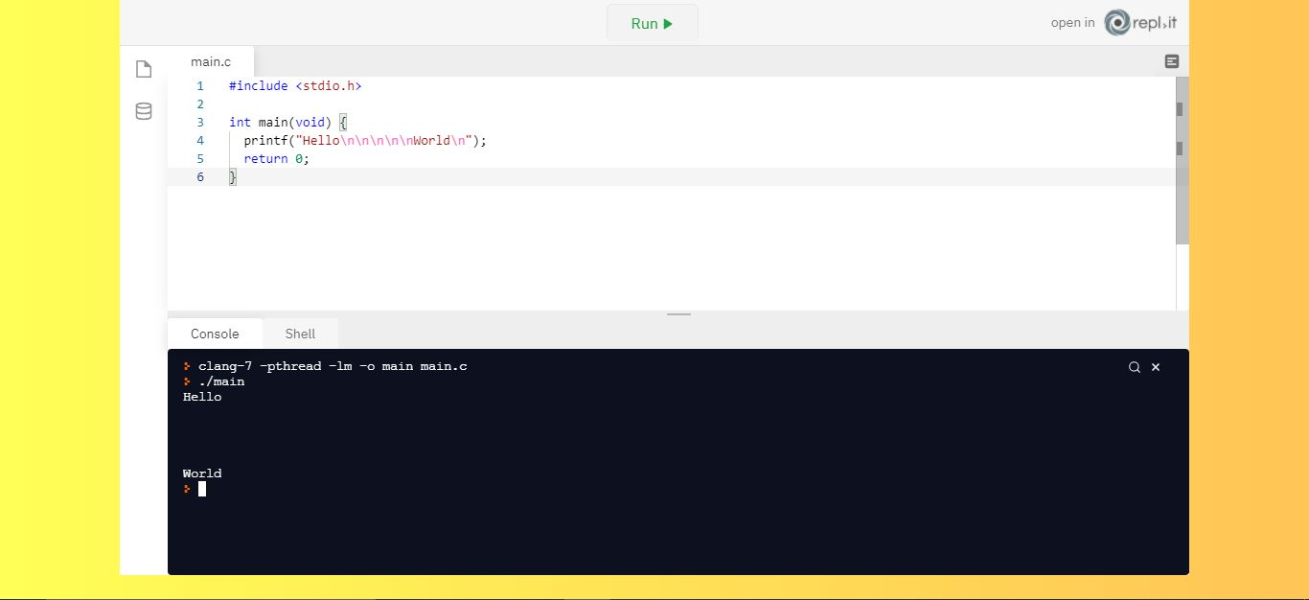
Snap Shots: online compiler
Code to the web design
There's no one "best" programming language, and once you've learned one, it's fairly easy to pick up another, so don't get hung too up on choosing your first language.
MORE DETAILS
MORE DETAILS

Slide 15
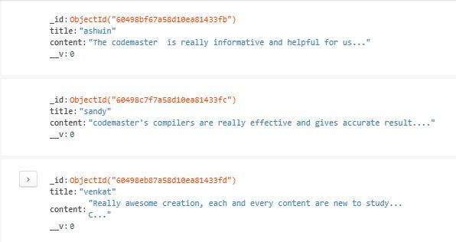
Snap Shots: mongodb feedback
Code to the web design
There's no one "best" programming language, and once you've learned one, it's fairly easy to pick up another, so don't get hung too up on choosing your first language.
MORE DETAILS
MORE DETAILS

Slide 16
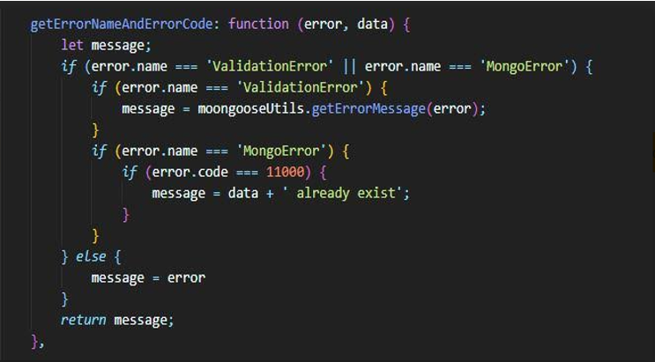
Code Snippets:
Do not allow user to create existing username
Do not allow user to create existing username
MORE DETAILS

Slide 17
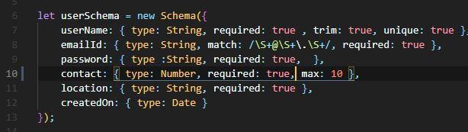
Code Snippets:
Do not allow user to create existing username
User
Schema
validation
MORE DETAILS

Slide 18
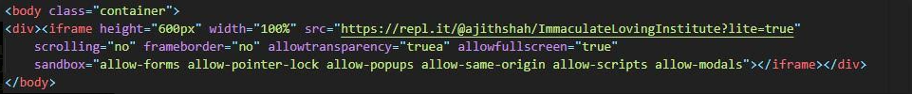
Code Snippets:
Do not allow user to create existing username
Online
API
For
compiler
MORE DETAILS

Slide 19
06
Programming
Language
05
We provide “Compiler" for all Programming language
There's no one "best" programming language, and once you've learned one, it's fairly easy to pick up another, so don't get hung too up on choosing your first language.

Slide 20
Compilers Are also available to execute the Code And test your code Online In our CodeMaster
Example
<table>
<tr>
<th>Company</th> <th>Contact</th> <th>Country</th>
</tr>
<tr>
<td>Alfreds Futterkiste</td> <td>Maria Anders</td><td>Germany</td>
</tr>
<tr>
<td>Centro Moctezuma</td> <td>Francisco Chang</td> <td>Mexico</td>
</tr>
<tr>
<td>Ernst Handel</td> <td>Roland Mendel</td> <td>Austria</td>
</tr>
</table>
HTML Table Example
Result
Company | Contact | Country
Alfreds Futterkiste | Maria Anders | Germany
Centro Moctezuma | Francisco Chang | Mexico
Ernst Handel | Roland Mendel | Austria
MORE DETAILS

Slide 21





Meet our team
FRONTEND
UI-DESIGNER & DEVELOPER
UI-DESIGNER & DEVELOPER
DEVELOPER
DEVELOPER
DEVELOPER
ADITYA RAJ
AJITHKUMAR SHAH J K
AISHWARYA R
ANUGRAHA S
ANITHA K
MORE DETAILS

Slide 22



Meet our team
BACKEND
DEVELOPER
DEVELOPER
DEVELOPER
ANAND S
ARUNADEVI G
AJITHKUMAR SHAH JK
MORE DETAILS
MORE DETAILS

Slide 23
Thank you
For your attention

