Slide 1
Census Data Standardization and Analysis Pipeline
From Cleaning to Visualization
Ajith Kumar S

Slide 2
Project Overview
Objective: Clean and standardize census data for analysis.
Technologies: Python, MySQL, MongoDB, Streamlit

Slide 3
Problem Statement
Task: Clean, process, and analyze census data from a given source.
Includes: Data renaming, missing data handling, state name standardization, data storage, database connection, and querying.
Goal: Ensure uniformity, accuracy, and accessibility of census data for further analysis and visualization.

Slide 4
Data Fetching & Cleaning
Fetch Data from GitHub Repository & load it to Pandas DataFrame.
Rename the state names as per current record.
Handling null values and filling missing values.
Packages : pandas , requests, docx

Slide 5
Loading Data to NOSQL Database
Load the standardized Data to Mongodb Database
Package : Pymongo

Slide 6
Load Data To RDBMS
Create Normalized Data Model
Create Tables in MySQL Database.
Insert the data to MySQL form Mongodb
Package : mysql-connector-python

Slide 7
Streamlit Application
Create Buttons to Trigger Each Stages.
Create Multiple Questionaries for Visualization
Visualize the cleaned data as a Dataframe as per the Questions selected.
Start The Application by : streamlit run census.py
Package : Streamlit

Slide 8
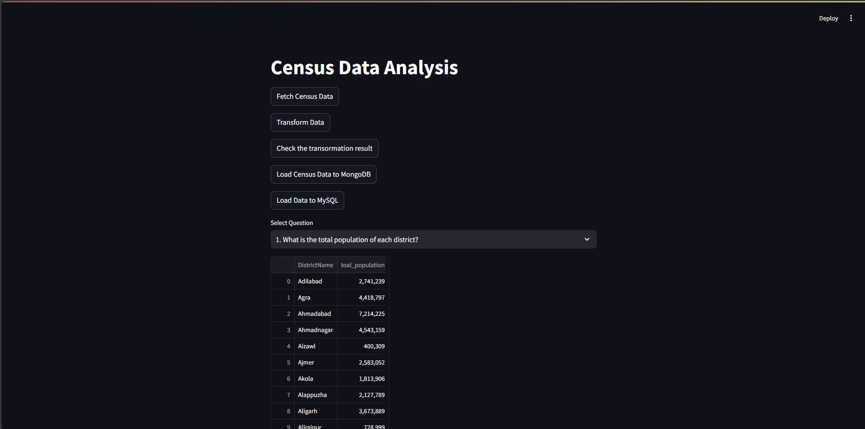
Streamlit UI Interface

Slide 9
Data Repository
Source Data Set
Data: https://github.com/ajithstarks/dataset/raw/main/census_2011.xlsx
Data: https://github.com/ajithstarks/dataset/raw/main/Telangana.docx
GITHUB Project Code Repository
GITHUB Link : https://github.com/ajithstarks/Census_Data_Standardization_and_Analysis_Pipeline.git

Slide 10
Conclusion
Summary: Achieved data standardization and visualization.
Future Work: Enhance data processing, incorporate additional datasets, and improve visualizations.

Slide 11
THANK YOU

