Slide 1
Social Media Hashtag Trend Analyzer
A Streamlit Application Integrated with AWS Lambda & DynamoDB
Ajith Kumar S

Slide 2
Problem Statement
Current Social Media Platforms: Users are often unaware of which topics or hashtags are trending across different platforms.Limited Insights: There is a need for a tool that provides real-time insights into popular topics and trends based on user posts.
Manual Tracking: Currently, users have to manually search for trending hashtags, which can be time-consuming and inefficient.
Challenge: A lack of streamlined platforms where users can compose posts, track hashtags, and instantly view real-time trends in a single, easy-to-use interface.

Slide 3
Project Overview
Project Objective
To develop a platform where users can compose and publish posts containing hashtags, similar to popular social media platforms.
Integrate with AWS Lambda to process posts and analyze trending hashtags using DynamoDB.
Technologies Used
Frontend: Streamlit (Python)
Backend: AWS Lambda, DynamoDB
Deployment: AWS Services

Slide 4
Architecture & Workflow
Overview:
Frontend: Streamlit for user interface.
Backend: AWS Lambda functions to process post data.
Data Storage: DynamoDB for storing posts and hashtags.
Workflow:
User submits a post via Streamlit → Lambda function processes post → Stores hashtags in DynamoDB → Trend analysis displayed in Streamlit UI.

Slide 5
AWS Lambda & DynamoDB Integration
Lambda Function
DynamoDB
Post Processing: AWS Lambda receives the post content from Streamlit, parses hashtags, and processes the post.
Data Storage: Lambda stores the parsed data (post text and hashtags) into DynamoDB for future analysis.
Stateless: Lambda is serverless and automatically scales to handle requests without requiring manual provisioning of servers.
NoSQL Database: DynamoDB is used to store and manage post data and hashtags efficiently.
Data Schema: The database stores posts with the associated hashtags in an easily retrievable format.
Trend Analysis: DynamoDB allows real-time querying and aggregation of data to identify trending hashtags based on post frequency.
Scalable: DynamoDB scales seamlessly with the increase in post volume, making it ideal for this real-time application.

Slide 6
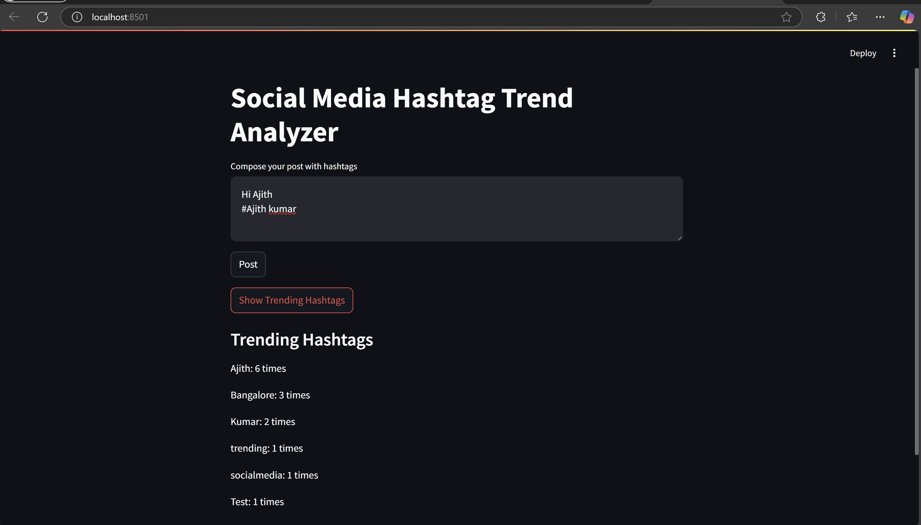
Streamlit Application

Slide 7
GitHub Code & Future Improvements
GitHub Link:
https://github.com/ajithstarks/Social_Media_Hashtag_Trend_Analyzer_Application.git
The complete project code is available here for reference and further enhancement.
Future Enhancements:
Real-Time Post Processing: Improve Lambda to handle larger volumes of data efficiently.
Advanced Hashtag Analytics: Add sentiment analysis to assess post engagement along with hashtag trends.
User Authentication: Implement user login for personalized hashtag insights.

Slide 8
THANK YOU

