Slide 1
Inter-state Traffic Volume Prediction
Revision Number: 1.0
Last date of Revision: 06/01/2024

Slide 2
Date Issued | Version | Description | Author
06/01/2024 | 1 | Initial DPR- V1.0 | Ajith Kumar V HariHara Sudan R

Slide 3
Objective:
The goal of this project is to build a prediction model using machine learning techniques and to use a template to document the end-to-end stages. We're trying to forecast the value of a continuous variable with the Metro Interstate Traffic Volume dataset, which is a regression issue and deploy in AWS
Benefits:
By predicting traffic volume, authorities can optimize traffic flow by implementing adaptive signal control systems
Efficient prediction allows for better allocation of resources, such as traffic personnel, emergency services, and infrastructure maintenance.
Predictive models contribute to accurate estimation of travel times for different routes
Traffic volume predictions aid in long-term infrastructure planning

Slide 4
Data Description:
Given is the variable name, variable type, the measurement unit and a brief description. The order of the listing corresponds to the order of numerals along the rows of the database.

Slide 5
Name | Data Type | Measurement
clouds_all | int | Percentage of cloud cover
day | int | dayof the data collected
holiday | int | US National holidays plus regional holiday
hour | int | Hour of the data collected in local CST time
month | int | Month of the particular data collected
rain_1h | float | Amount in mm of rain that occurred in the hour
snow_1h | float | Amount in mm of snow that occurred in the hour
temp | float | Average temp in kelvin
traffic_volume | int | Hourly I-94 ATR 301 reported westbound traffic volume
weather_description | int | Longer textual description of the current weather
weather_main | int | Short textual description of the current weather
year | int | Year of the particular data collected

Slide 6
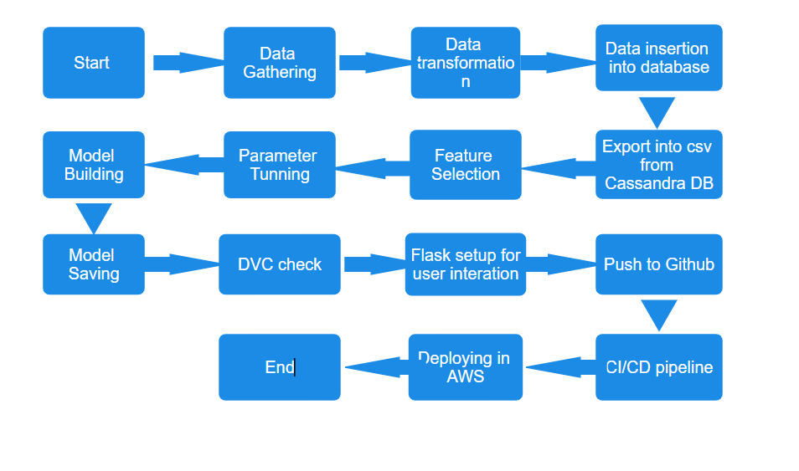
Architecture

Slide 7
Architecture Description
Data gathering
Data Source: https://archive.ics.uci.edu/dataset/492/metro+interstate+traffic+volume
Train and Test data are splitted in ratio of 80:20 using random seed during training and validating.
Data Transformation
Before sending data into database, data transformation is required so that data are converted into such form which can be easily interpreted by the model. Here, weather description, weather main were in textual form so they are modified into numeric form using one hot encoding and then datetime were in string format so they are splitted into year,month,date and hour so that it can be interpreted easily by the model.
Database insertion
Dataset is inserted into cloud database and here Cassandra DB is used which was specified as a requirement
Export as ‘CSV’ from database
From database we are making a CQL query using necessary drivers and tokens and the data is stored into CSV file. Now this CSV file is used for further processing.
5. Feature Selection
Necessary features like holiday data,time, rain fall amount, snow fall amount and other weather parameters are selected for processing. Inclusion of these key features aims to improve the accuracy and reliability of our predictive models ensuring a comprehensive consideration of factors influencing traffic volume.

Slide 8
Model Building
After doing all kinds of operations mentioned above our focus turns to the pivotal stage of model building.Following a thorough exploration and refinement of feature selection and parameter tuning we have opted for LSTM model. This choice is based on the fact that LSTM is good in time series prediction. The constructed model comprises of two layers of LSTM which can accept a feature of (11,1) and two dense layers enhancing models capacity for capturing relationships within the data.
Parameter Tuning
Parameters like learning rate and epoch are chosen so that the loss converges. This ensures that our predictive models achieve optimal performance striking a balance between computational efficiency and the precision required for accurate traffic volume predictions.
Model Training
In the process of training our chosen LSTM model, we discovered that running it for 200 cycles (epochs) with groups of 500 data points (batch size) resulted in the validation loss settling down. This means the model became good at making predictions, providing us with reliable forecasts for traffic volume.
Model Saving
Model is saved using .h5 format using tf library

Slide 9
10. Flask Setup for user interaction
Setting up Flask for user interaction involves a few steps. First, after saving the model, we initiate the process of building an API using Flask. This creates a web application. Now, whenever a user enters data, it gets checked to make sure it's valid, and then it's sent to the model for predicting traffic volume. This way, users can easily interact with and get predictions from the model through the web application.
11. DVC Check
To make sure we're not doing the same thing over and over, we've included a Data Version Check (DVC check). This helps us avoid unnecessary repetition of a specific stage in our process. If we've already done something once, the check ensures we don't do it again, saving time and resources
12. Github CI/CD
The whole project is pushed into github repository and CI/CD pipeline is being used with AWS as host
13. Deployment
We arranged things so our project could run on the internet using Amazon Web Services (AWS). Specifically, we used AWS ECR to store our software and AWS EC2 to run it. This setup allows our system to be accessible and functional in the cloud.

Slide 10
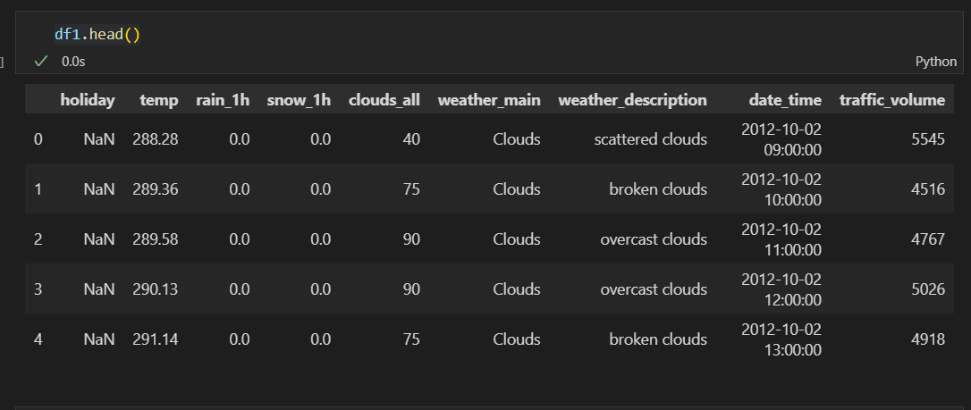
Dataset description
The dataset snapshot provides valuable insights into weather conditions and traffic volume at specific date and time points. Notably, the "holiday" column indicates the absence of holidays for the initial entries, suggesting routine, non-holiday periods. Weather details reveal a moderate temperature range in Kelvin, with recorded rainfall or snowfall during the observed hours. The "clouds_all" column suggests varying levels of cloud coverage. The "weather_main" consistently categorizes the weather as "Clouds," and the accompanying "weather_description" offers additional details such as "scattered clouds," "broken clouds,", "overcast clouds." etc The "date_time" column provides precise timestamps in the format "YYYY-MM-DD HH:MM:SS." Traffic volume, recorded in the "traffic_volume" column. This initial analysis sets the stage for further exploration, enabling a deeper understanding of patterns and correlations within the dataset.

Slide 11
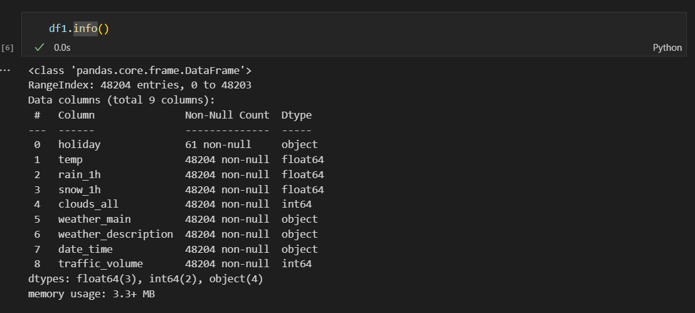
The dataset consists of various data types from integers to floating points and to object as shown in above Fig

Slide 12
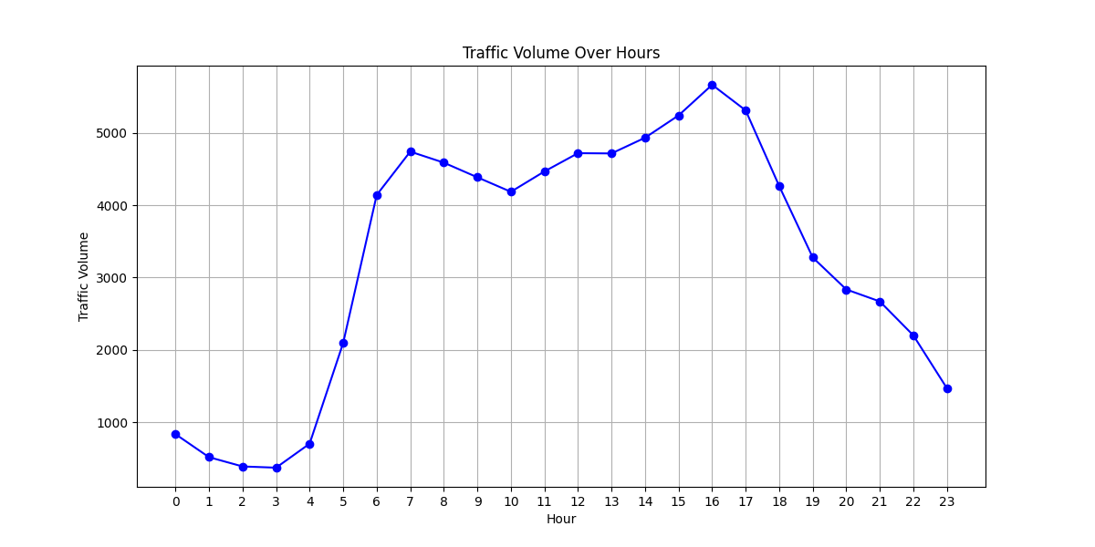
Observation It is evident that the peak times occur from 6 to 8 am in the morning and from 3 pm to 5 pm in the evening.

Slide 13
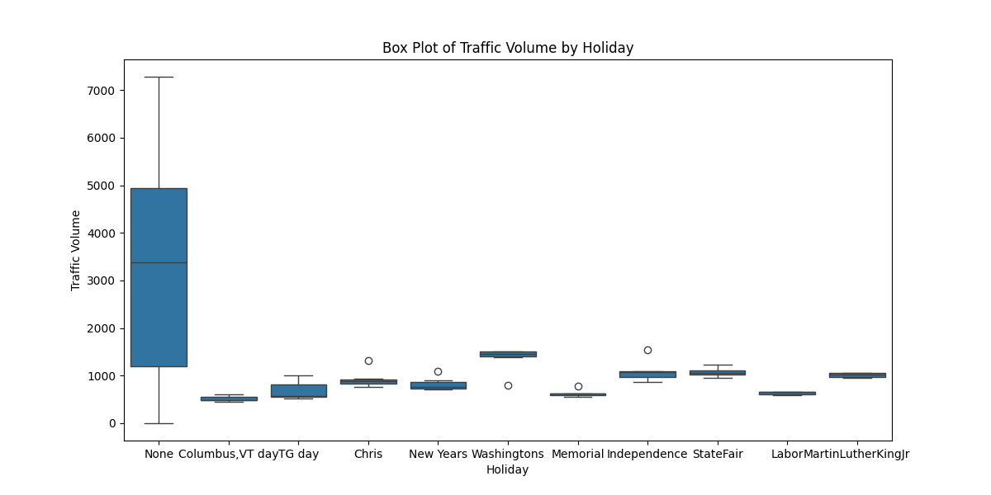
Observation It is evident that more traffic occurs during non holiday days and during holiday the traffic volume is low therefore this plays a important role in traffic volume estimation

Slide 14
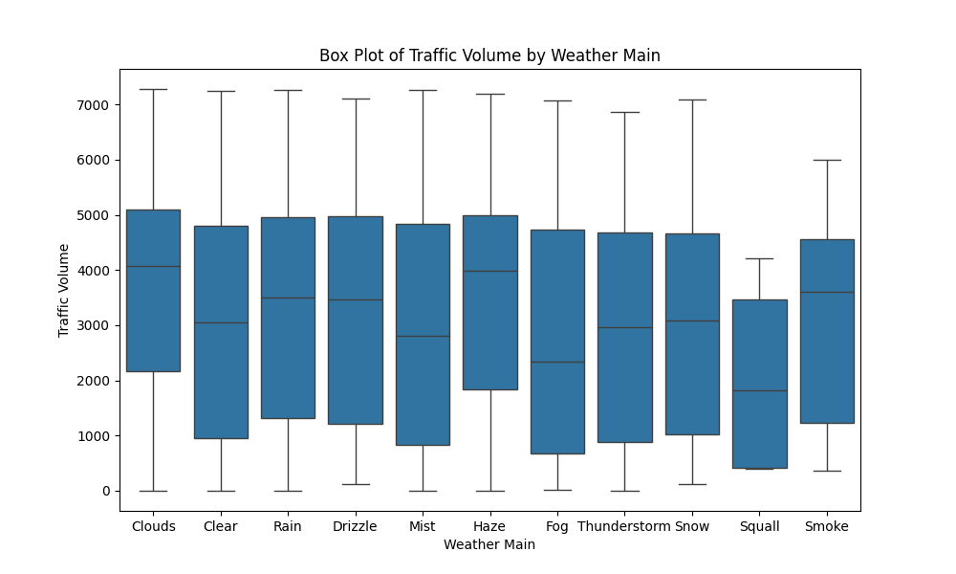
Observation It can be observed that during squall and smoke the traffic volume is low.

Slide 15
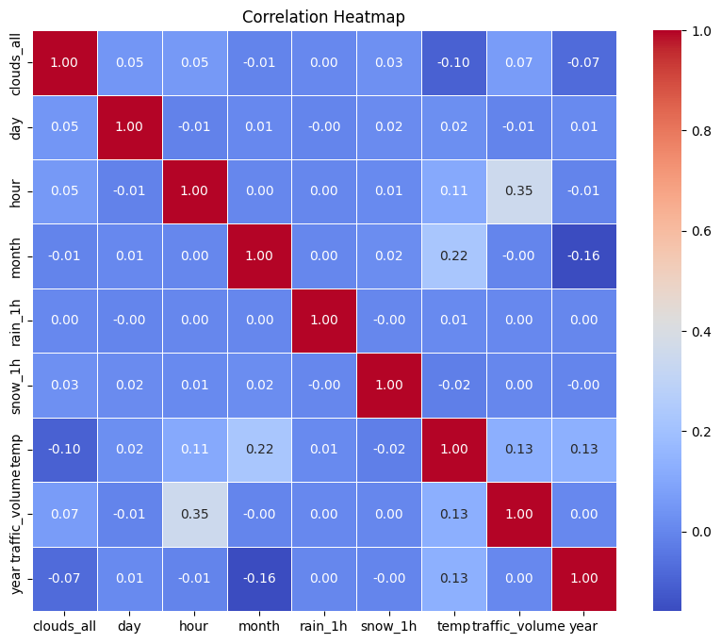
Observation From the heat map it can be seen that hour feature and temp plays a significant role in estimation of traffic volume.

Slide 16
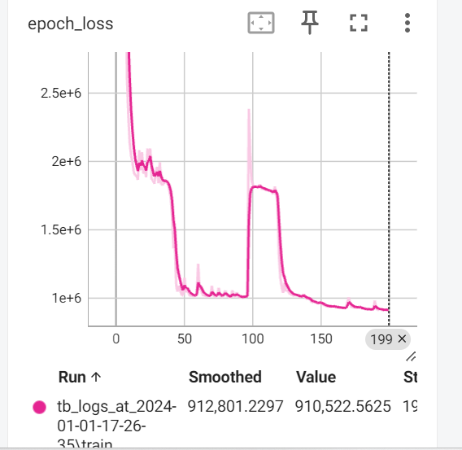
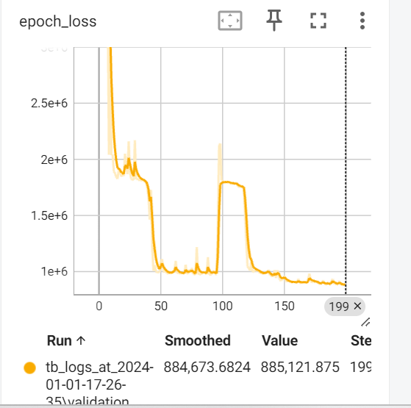
Train loss and Val loss graph

Slide 17
Conclusion
It can be concluded that during holiday there seems to be drop in traffic and user can travel more. Also when during normal days 10am the traffic seems to be low and at evening traffic seems to be low so one can prefer travelling at that time.

Slide 18
Q&A:
What’s the source of data?
The data for training is provided from here https://archive.ics.uci.edu/dataset/492/metro+interstate+traffic+volume
What was the type of data?
The data was a combination of numerical and categorical values
What’s the complete flow you followed in this project?
Refer the Architecture section for this
How logs are managed?
We have logged every even in all stages like data ingestion, model creation, model training, evaluation and deployment

Slide 19
5. What techniques were you using for data pre-processing?
Splitting Date time into column
Converting weather description and weather main to one hot encoding
Visualizing relation of independent variables with each other and output variables
6. How training was done or what models were used ?
LSTM model is being used as its good in these type of tasks
7. How Prediction was done?
User data is converted to necessary format and fed to the model which is in .h5 format and prediction is returned to the UI
8. Where the model was deployed?
After CI/CD pipeline is passed model is deployed in AWS EC2

