Slide 1


Consumer Goods
Ad - hoc Insights
Presented by Mr. Ajit Jadhav

Slide 2
Problem Statement
Provide Consumer Goods Ad Hoc Insights of “Atliq Technologies” via 10 requests.
Understanding The Data And Relationships
This file contains a detailed overview of the tables in the 'gdb041’ ( Atliq hardware database) database. It contains information for six major tables with around 1.5 M records.
Steps
Importing database and completing all requests
Connecting MYSQL and Power BI for visualisations
Created presentations using the above requests and visuals.
Gaining insights from each request.

Slide 3
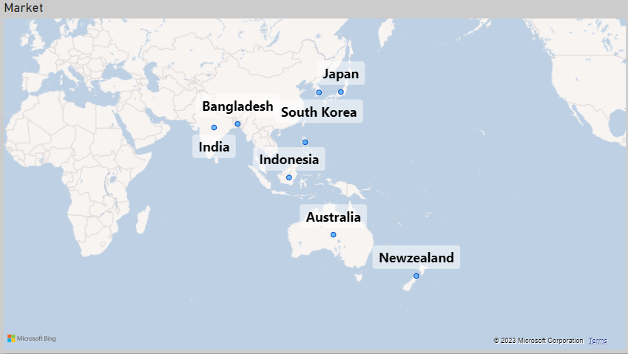
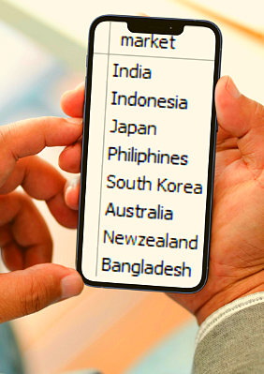
First request : Provide the list of markets in which customer
"Atliq Exclusive" operates its business in the APAC region.
Output & visual

Slide 4
Insights
There are a number of markets in the APAC region where customer "Atliq Exclusive" conducts business, including Bangladesh, India, Indonesia, Japan, the Philippines, South Korea, Australia, and New Zealand.

Slide 5

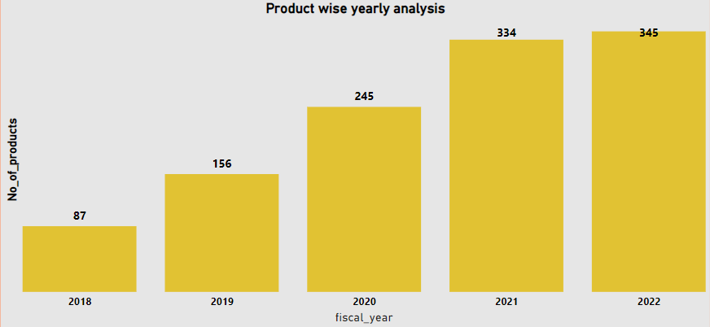
Request 2. What is the percentage of unique product increase in 2021 vs. 2020? The final output contains these fields,unique_products_2020 unique_products_2021 & percentage_chg .
Output & visual

Slide 6
Insights
In 2020, there will be a total of 245 unique products.
In 2021, the total number of unique products was 344.
This demonstrates that 99 new products were added to the inventory in 2021, with a 36.33% increase in unique products.

Slide 7
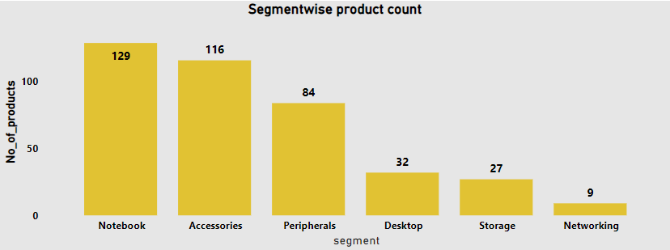
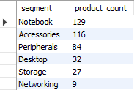
Request 3. Provide a report with all the unique product counts for each segment and sort them in descending order of product counts. The final output contains 2 fields, segment & product_count
Output & visual

Slide 8
Insights
The Notebook segment has the most unique products, with 129.
The Networking segment has the fewest unique products (9 products).
Both the Notebook and Accessories segments have over 100 unique products.

Slide 9
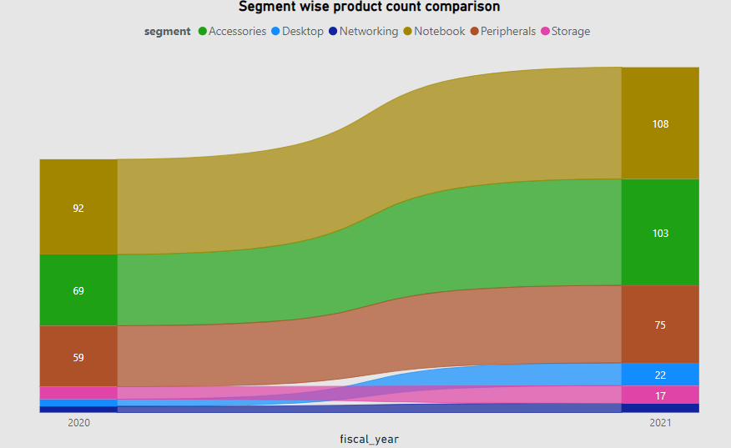
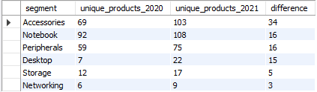
Request 4. Follow-up: Which segment had the most increase in unique products in 2021 vs 2020? The final output contains these fields segment,product_count_2020,product_count_2021 & difference
Output & visual

Slide 10
Insights
It is a good sign that there is an increase in product launches in every segment, as we can clearly see in the accessories segment, which has more unique products than the previous year, and the networking segment, which has fewer.

Slide 11
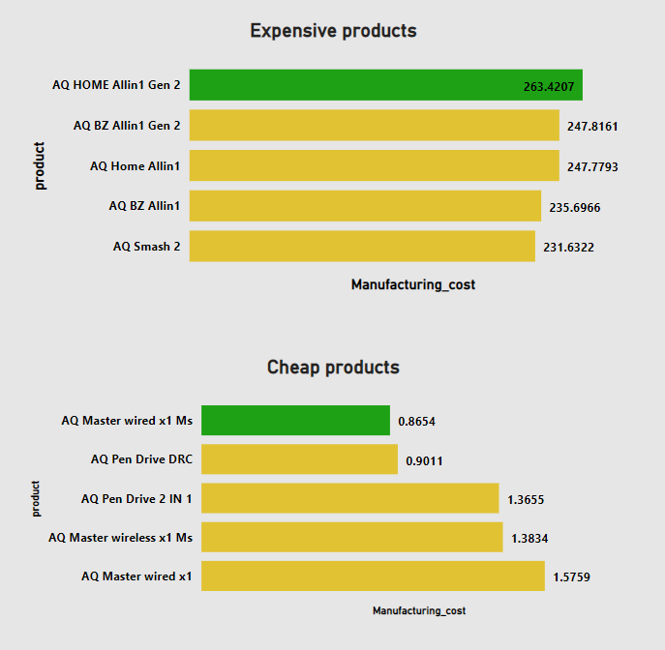


Request 5. Get the products that have the highest and lowest manufacturing costs. The final output should contain these fields, product_code ,product & manufacturing cost
Output & visual

Slide 12
Insights
We can conclude from the results that the desktop is the most expensive product, while accessories such as mice and pen drives are inexpensive.

Slide 13
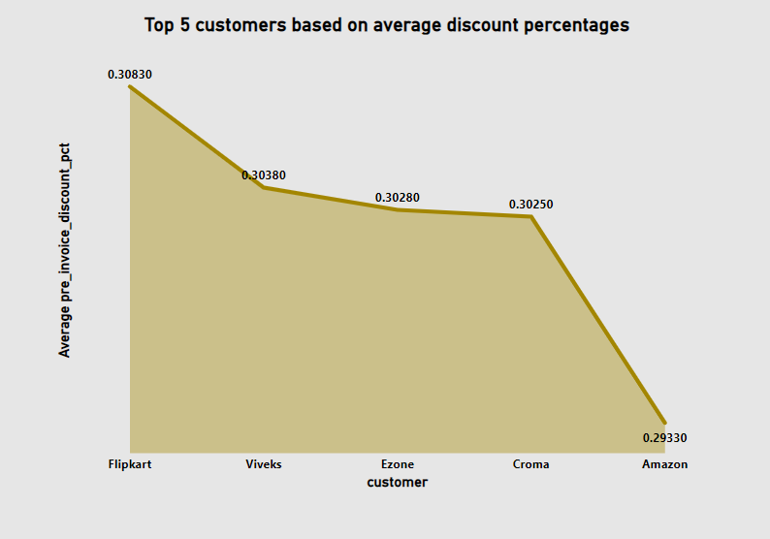
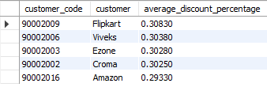
Request 6. Generate a report which contains the top 5 customers who received an average high pre_invoice_discount_pct for the fiscal year 2021 and in the Indian market. The final output contains these fields, customer_code, customer average_discount_percentage
Output & visual

Slide 14
Insights
We can conclude from the graph that Flipkart, Vivek's, Ezone, Croma, and Amazon have the highest average discount received having
30.83% ,30.38%,30.28%,30.25% & 29.33% resp.

Slide 15
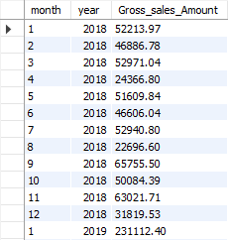
Request 7. Get the complete report of the Gross sales amount for the customer “Atliq Exclusive” for each month. This analysis helps to get an idea of low and high-performing months and take strategic decisions. The final report contains these columns: Month, Year and Gross sales Amount

Slide 16
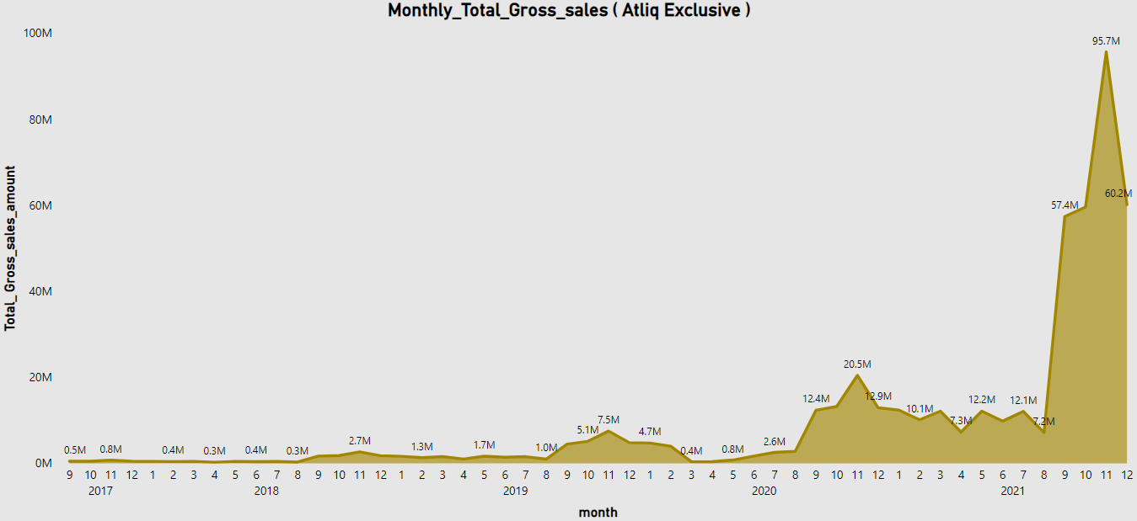
Visual

Slide 17
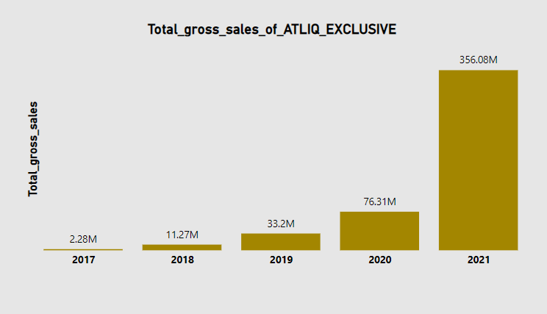
Insights
The highest sales of Atliq Exclusive are 97.7 M in NOV 2021 and the lowest sales are in APRIL 2018.
The good news is that total gross sales of Atliq Exclusive are increasing year by year due to innovating and launching new products, and sales are slightly declining in the beginning of 2019 and then increasing due to hype of online earning.

Slide 18
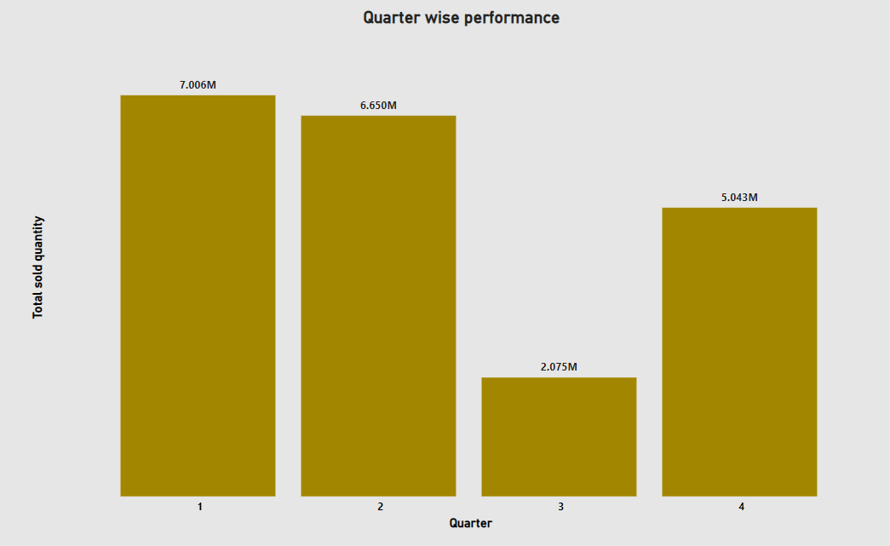

Request 8. In which quarter of 2020, got the maximum total_sold_quantity? The final output contains these fields sorted by the total_sold_quantity, Quarter & total_sold_quantity
Output & visual

Slide 19
Insights
As quarter - 1 has the highest sold quantity because there is no fear of covid - 19 lockdown and quarter - 3 has the lowest sold quantity because of lockdown and after that peoples were sitting idle and thinking of working from home and after that started increasing quantities in quarter - 4 because of same

Slide 20
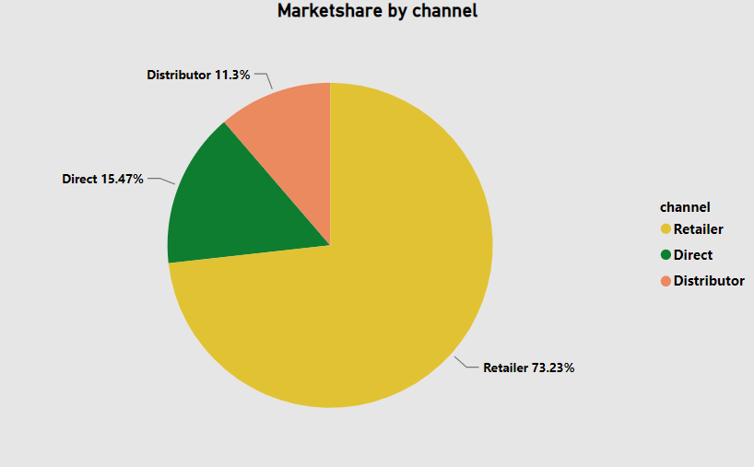

Request 9. Which channel helped to bring more gross sales in the fiscal year 2021 and the percentage of contribution? The final output contains these fields, channel, gross_sales_mln & percentage
Output & visual

Slide 21
Insights
Retailers have the highest percentage of sales (73.23%), but there is room for improvement in the Direct and Distributor channels.

Slide 22
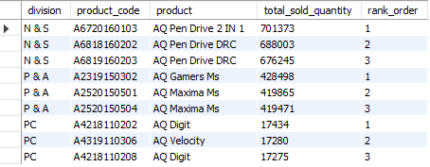
Request 10. Get the Top 3 products in each division that have a high total_sold_quantity in the fiscal_year 2021? The final output contains these fields, division ,product_code , product, total_sold_quantity & rank_order
Output

Slide 23
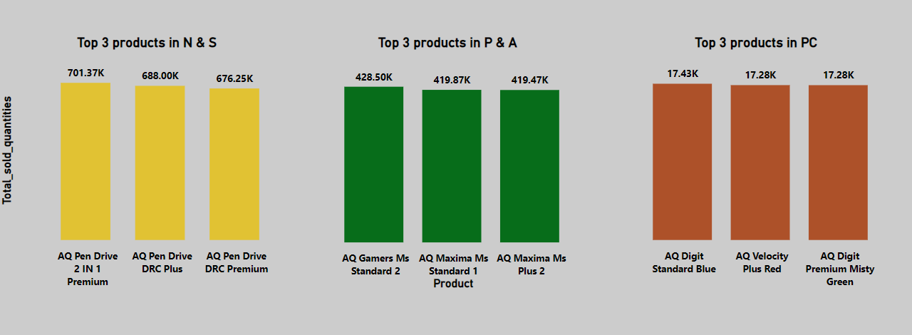
visual

Slide 24
Insights
As we can see, pen drives sold in greater quantities than mice and PCs, and the AQ pen drive 2 in 1 premium was the most popular product in N & S.

Slide 25
Thanks for watching…

