Slide 1
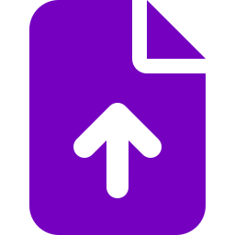






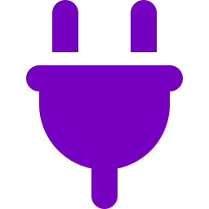
Digital Brain
ARCHITECTURE
KEY FEATURES
Organizations: portfolio → product → application, access per app
Connect
Graph management: source → graph → quality check → publish
pluggable
connectors
Upload & links
SharePoint
OneDrive
GitHub
Jira
ServiceNow
Add more
Code Factory: ticket → plan → approval → draft PR → Re-sync Knowledge
ServiceOps: incidents open with past fixes and recent changes
Ingest
Secure upload
Security scan
To Markdown
Knowledge
Guided onboarding: Onboarding checklist per application
safe &
traceable
held privately
unsafe files blocked
converted offline
version controlled
Usage tracking: AI cost per call, per application
FORMATS
PDF · Word · Excel · PowerPoint · Outlook · HTML · CSV · JSON · XML · Text
Connectors: Jira, ServiceNow and GitHub synced on a schedule
CODE FACTORY
USES
Project docs
Code
Bug
KEY DIFFERENTIATORS
knowledge graph
code graph
from ticket
Answers that prove themselves
Know &
Act
Every answer is traceable to a verified source.
RUNS
Pre-checks
Analysis
Approve gaps
Agents
Pull request
Tests
Re-sync
One brain for build and run
Every resolved incident strengthens the next response.
sealed per
application
SERVICEOPS
Knowledge released like software
USES
Knowledge
History
Changes
Incident
All knowledge is reviewed and approved before use.
app graph
past incidents
same CI
new ticket
Always up to date
Sources and knowledge refresh after major changes, like a bug fix.
RUNS
Evidence
Redact
Hypotheses
Verify & score
Responder decides
Requirements and code in one graph
Every change is linked to its requirement and code.
results update the knowledge
Bring your own model
OpenAI or Claude
Access
Chat · REST API · MCP
for people and any AI tool
Trusted knowledge is accessible from any AI tool.
TECH STACK
CORE
Python · Django · PostgreSQL
AI & GRAPH
OpenAI Agents SDK · Claude Agent SDK · Graphify
SUPPORTING
MarkItDown · MCP · Docker

