Slide 1
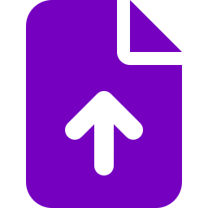


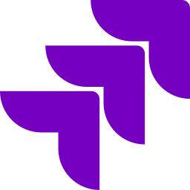

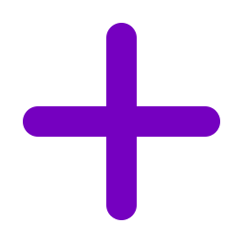

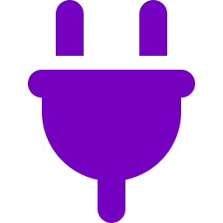
Digital Brain
ARCHITECTURE
KEY FEATURES
Organizations: portfolio → product → application, access per app
Connect
Upload & links
SharePoint
OneDrive
GitHub
Jira
ServiceNow
Add more
Graph management: source → graph → quality check → publish
pluggable
connectors
Code Factory: ticket → plan → approval → draft PR → Re-sync Knowledge
ServiceOps: incidents open with past fixes and recent changes
Ingest
Secure upload
Security scan
To Markdown
Knowledge
Guided onboarding: Onboarding checklist per application
safe &
traceable
held privately
unsafe files blocked
converted offline
version controlled
Usage tracking: AI cost per call, per application
FORMATS
PDF · Word · Excel · PowerPoint · Outlook · HTML · CSV · JSON · XML · Text
Connectors: Jira, ServiceNow and GitHub synced on a schedule
CODE FACTORY
KEY DIFFERENTIATORS
USES
Project docs
Code
Bug
Answers that prove themselves
knowledge graph
code graph
from ticket
Every answer is traceable to a verified source.
One brain for build and run
Know &
Act
RUNS
Pre-checks
Analysis
Approve gaps
Agents
Pull request
Tests
Re-sync
Every resolved incident strengthens the next response.
Knowledge released like software
All knowledge is reviewed and approved before use.
sealed per
application
SERVICEOPS
Always up to date
Sources and knowledge refresh after major changes, like a bug fix.
USES
Knowledge
History
Changes
Incident
Requirements and code in one graph
app graph
past incidents
same CI
new ticket
Every change is linked to its requirement and code.
Bring your own model
Evidence
Redact
Hypotheses
Verify & score
Responder decides
Trusted knowledge is accessible from any AI tool.
RUNS
Graph-based efficiency
results update the knowledge
Graph-based RAG reuses connected knowledge for more efficient retrieval and better-supported answers, with potential reductions in token use and response time.
OpenAI or Claude
Access
Chat · REST API · MCP
for people and any AI tool
TECH STACK
CORE
Python · Django · PostgreSQL
AI & GRAPH
OpenAI Agents SDK · Claude Agent SDK · Graphify
SUPPORTING
MarkItDown · MCP · Docker
Notes:
Graph-based retrieval: https://www.microsoft.com/en-us/research/project/graphrag/
Token use and latency improvements depend on the implementation and workload; no measured savings are claimed. Cost reference: https://techcommunity.microsoft.com/blog/azure-ai-foundry-blog/graphrag-costs-explained-what-you-need-to-know/4207978

