Slide 1
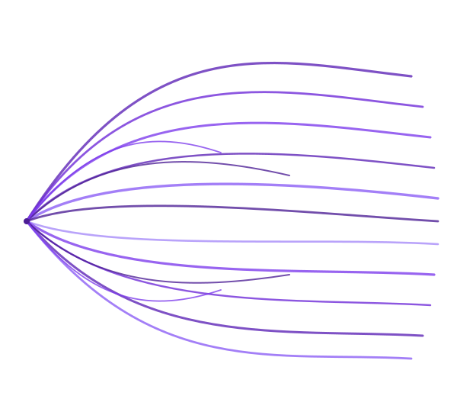
From Console Chaos
to Conversational
Intelligence
An MQ/ACE Platform Maturity Story
PRESENTED BY
Ajit K.
MQ/ACE Platform Support
Notes:
Set the room. Over the next few minutes I'll walk you through the platform we run, the daily reality of running it, what we've already done about that, and where we're taking it next — with agentic AI.

Slide 2















MQ & ACE PLATFORM STORY
IBM MQ guarantees the message, while IBM ACE transforms it
1. Channel
150+
60
200
2. Gateway
Queue Managers
ACE Integration Nodes
Integration Servers
3. Orchestration
4. Integration (ACE)
600
5,000+
8,000+
5. Messaging (MQ)
Deployed Applications
Active Queues
Message Flows
6. Systems of Record
7. Data
Claims
Eligibility
Enrollment
Portals
Provider Data
Pharmacy
Correspondence
Reinsurance
2 / 7
Notes:
MQ owns the transport guarantee; ACE owns the translation. The carrier can swap a portal, upgrade a claims engine, or onboard a new partner without touching the rest — because everything meets in the middle on a queue or a flow. That's the architecture on paper. The next slide is what running it actually looks like, day to day.

Slide 3

MQ & ACE PLATFORM STORY
Every routine diagnostic requires a detective trail across disconnected tools
Console A
Monitor B
No single pane of glass.
Dozens of consoles per question.
Log C
Config D
Audit F
Events E
Platform admin
20–45 min
16×5
2–3
Months
To trace a stuck message or answer a routine query
Our coverage vs a 24×7 platform requirement
Subject Matter Experts holding deep tribal knowledge
Time required to onboard a new platform admin
3 / 7
Notes:
Every pain on this slide has the same root cause: the diagnostic experience is manual, fragmented, and expert-gated. It's not a staffing problem — adding people doesn't fix it, because the tooling forces the same workflow on every person. We haven't sat still: over the last two years the team has built thirteen in-house automations that take the most painful, repetitive work off our plate — the next slide walks through that journey, and the five tracks they now cover.

Slide 4
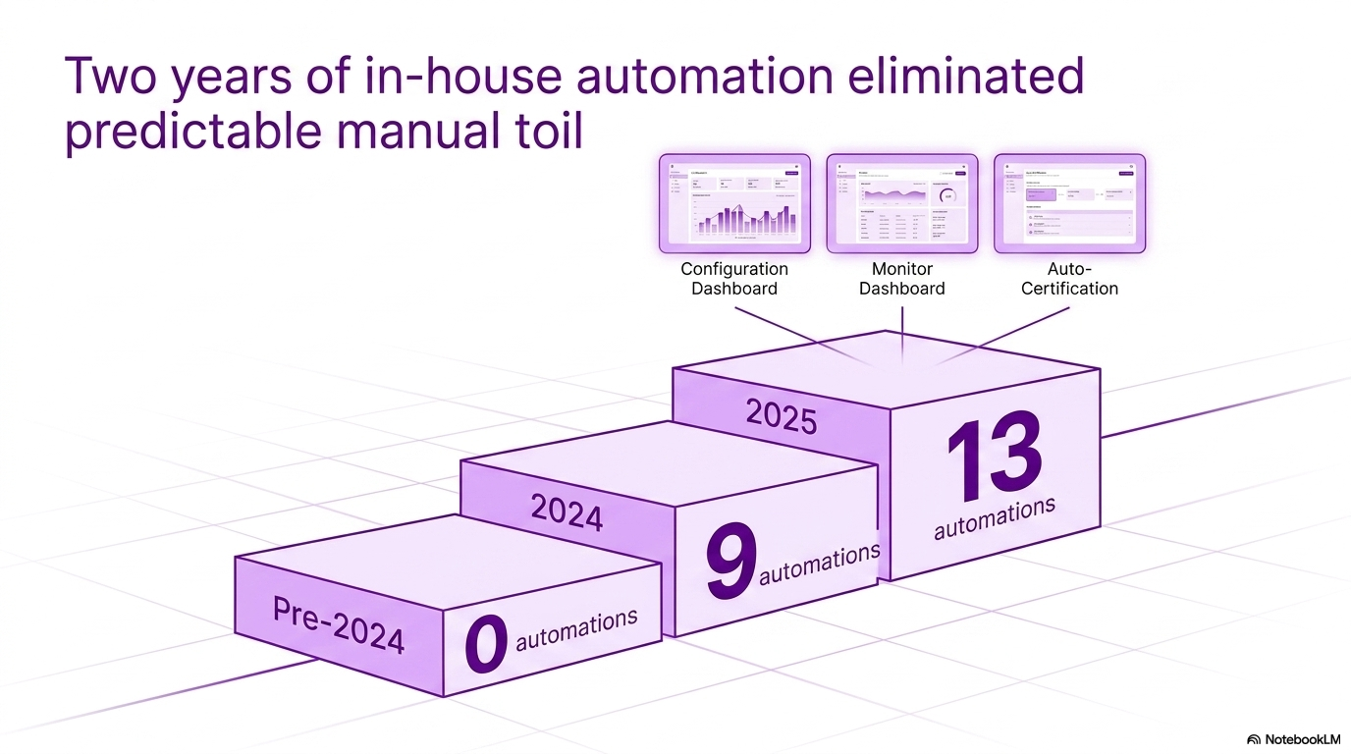



MQ & ACE PLATFORM STORY
4 / 7
Notes:
Thirteen automations is real progress — but it isn't the finish line. Each automation still answers a predefined question; anything outside the script still escalates to a human. The next step is closing that gap.

Slide 5






MQ & ACE PLATFORM STORY
Observability answers what we scripted, but Agentic AI answers what we didn't
4. Agentic AI Self-Service
3. Self-Healing
Scripted Automation
Answers predefined questions.
Runs on schedules or thresholds.
2. Observability
1. The Estate
Agentic AI
Picks the right tool dynamically.
Reasons across the estate.
Plain English in, structured answer out.
5 / 7
Notes:
Slide 3 was about taking known toil off the team's plate. Slide 4 is about taking the rest off — the free-form, unpredictable, "I just need to know X" questions that no script can anticipate. This isn't a chatbot bolted onto a dashboard; it's an autonomous reasoner that decides which diagnostics to run, in what order, and how to present the answer — within guardrails we set. The foundation we built in 2024-25 is exactly what makes this safe and credible to roll out.

Slide 6






MQ & ACE PLATFORM STORY
Autonomous reasoning streams through an open protocol and strict safety layers
Web Chat UI
Agentic Backend
MCP Server
Safety
Layer
Target Systems
(Streamlit)
(FastAPI / LangGraph /
GPT-4o)
(FastMCP)
Live
IBM MQ, IBM ACE,
Offline Inventory CSVs
Audit Log
(JSONL · Power BI)
6 / 7
Notes:
This is not a chatbot with an API stitched to the back. It is an autonomous reasoning agent with a bounded, audited surface area — every layer was chosen so the security, observability, and read-only guarantees are properties of the architecture itself, not policies that have to be re-enforced by every developer. The next slide opens the hood further — the engineering controls, coding standards, security shield, and governance that make this safe to roll out against production diagnostics.

Slide 7



MQ & ACE PLATFORM STORY
Production-ready AI demands capabilities you can trust and controls you can prove
Capabilities
Controls
Craft
Autonomous reasoning · 13 read-only tools · open MCP protocol
Read-only by construction · 6-layer defence-in-depth
Single-route enforcement · per-call audit · ContextVars
Defense-
in-Depth
GET-ONLY · NO MODIFY VERBS · HOSTNAME ALLOW-LIST · 10/12 AGENTIC COMPONENTS
7 IBM MQ Tools
6 IBM ACE Tools
find_mq_object · dspmq · dspmqver · runmqsc · run_mqsc_for_object · get_queue_depth · get_channel_status
list_ace_nodes · get_ace_node_status · list_ace_servers · list_ace_applications · list_ace_message_flows · search_ace_local_dump
7 / 7
Notes:
The agentic AI is not a demo glued to our platform — it's a governed system whose security, observability, and read-only guarantees are architectural properties, not policies that have to be re-enforced by every developer who touches the codebase. That distinction is what makes it credible to run against production diagnostics, and what lets us onboard new tools (or new domains entirely) without lowering the bar.

