Slide 1
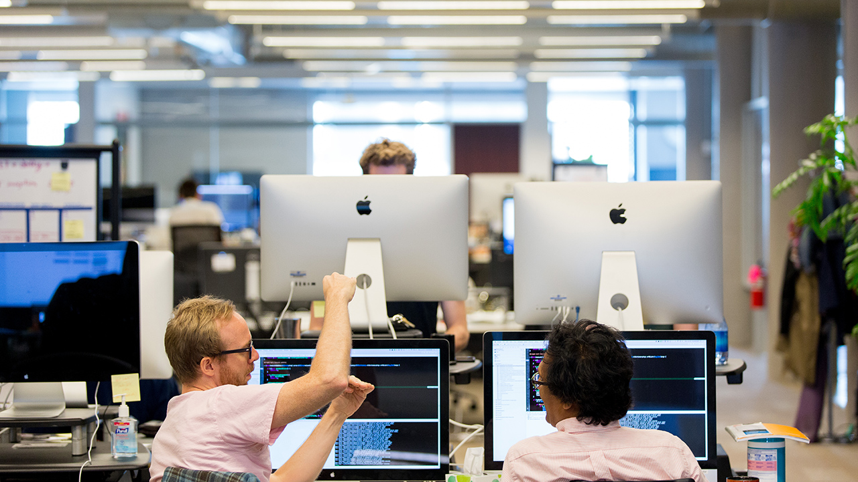

Cloud Native Workshop
Steve Womack, Dan Kennedy

Slide 2

What inhibits your ability to deliver software today?

Slide 3
What do you need to get your application to the Cloud?
Your App
A Cloud

