Slide 1
Retail Inventory Management System
Full-stack platform with stateless JWT security and multi-warehouse inventory
Java 17 · Spring Boot
Angular 22
JWT · RBAC
MySQL 8
Tailwind CSS v4
DEVELOPER
Ajit Kumar Saini | 2400320100114
B.Tech CSE, 3rd Year · ABES Engineering College, Ghaziabad
MENTOR
Ms. Sakshi Mohinia
Faculty Guide

Slide 2
01 | MOTIVATION
Problem Statement & Objectives
Replacing error-prone manual records with one integrated inventory system
THE PROBLEM
OBJECTIVES
Fragmented records: Spreadsheets and paper cause duplication and discrepancies.
1
Centralized inventory
Catalog, warehouses and stock in one relational store.
Stockouts & holding costs: No low-stock warnings leads to shortages or overstock.
2
Dual order pipelines
Sales orders (6 stages) and purchase orders (5 stages).
Warehouse blindspots: No consolidated on-hand vs reserved view per hub.
3
Stateless RBAC
Spring Security with JWT; ADMIN and USER roles.
Unregulated access: No role boundary between operators and administrators.
4
Modern web interface
Angular 22 SPA with REST APIs and Tailwind UI.

Slide 3
02 | TECHNICAL FOUNDATION
Technology Stack
Decoupled three-tier architecture built on industry-standard frameworks
PRESENTATION
APPLICATION
PERSISTENCE & TOOLS
Angular 22 & Tailwind v4
Spring Boot & Security
MySQL 8 & Tooling
Standalone components, Router
TypeScript with Signals
Route guards for protected pages
HttpClient with JWT interceptor
Tailwind CSS v4 dual theme
Java 17 LTS
Spring Data JPA / Hibernate
Spring Security + JWT filter
Bean Validation (@NotNull, @Min)
Maven build
10 normalized tables (3NF)
Foreign keys, unique SKU
Postman / Thunder Client
Git / GitHub
Node.js / npm

Slide 4
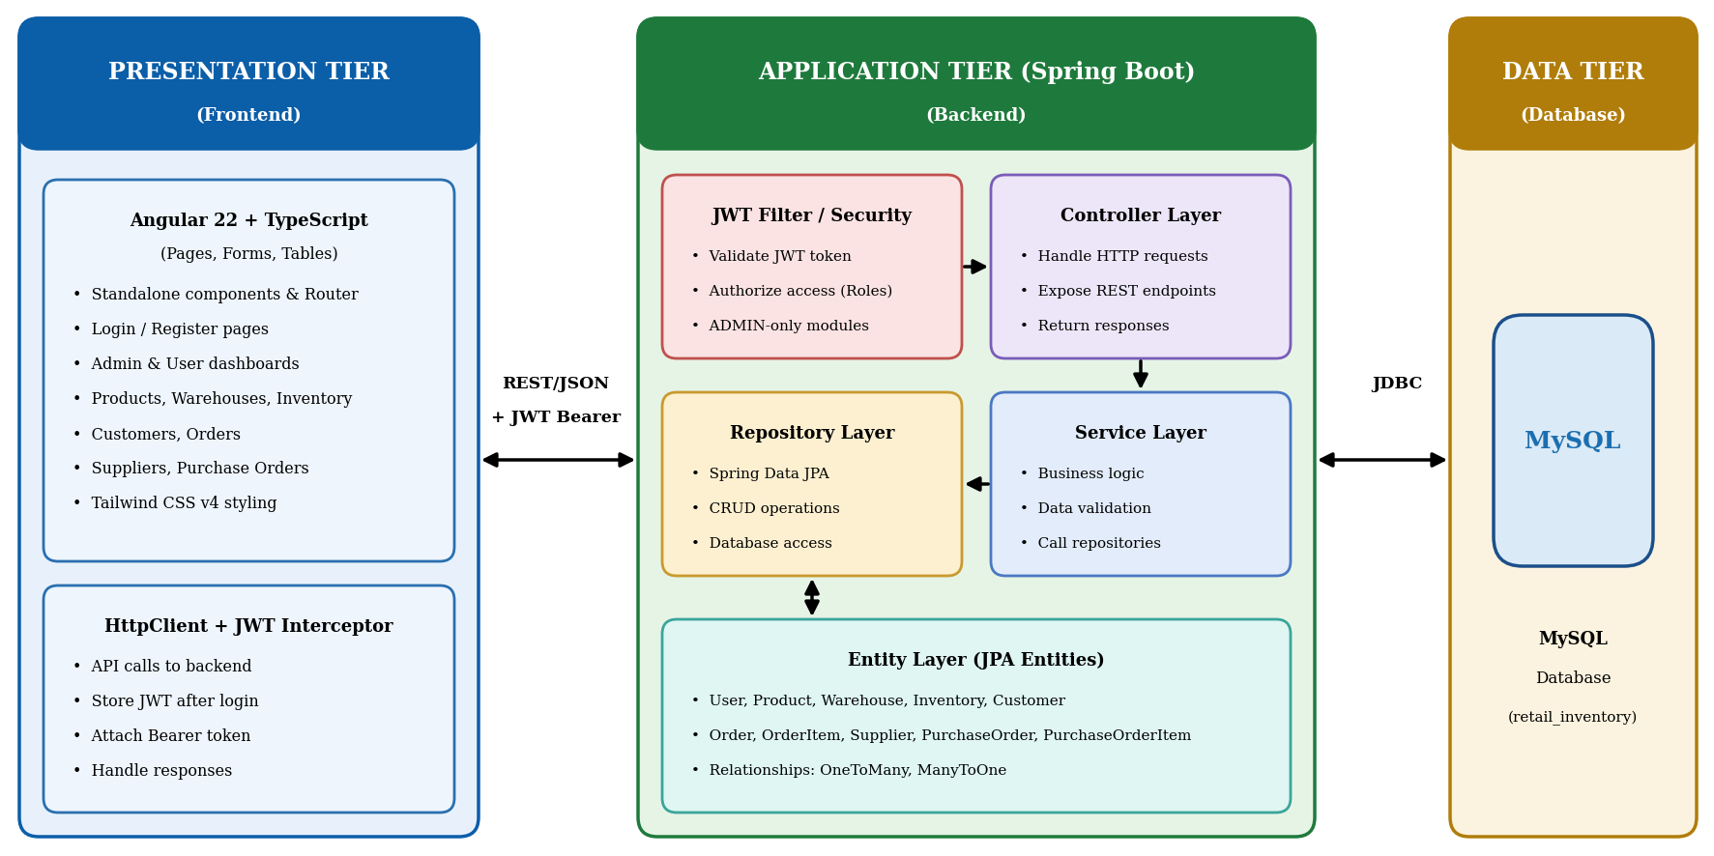
03 | ARCHITECTURE
3-Tier Architecture & Request Flow
Stateless REST communication with JWT filter gatekeeping
1
Presentation
Angular sends JSON requests with an Authorization: Bearer header.
2
Security
JWT filter validates the token and extracts the role.
3
Business logic
Services check stock and manage order lifecycles.
4
Persistence
Spring Data JPA over JDBC to MySQL.

Slide 5
04 | MODULES & RBAC
Core Business Modules & Access Control
Eight modules; Supplier, Purchase Order and User APIs are ADMIN-only
Products
SKU, brand, category, price
Warehouses
Capacity, contact, status
Inventory
On-hand, reserved, reorder level
Customers
Accounts and contact details
Sales Orders
Multi-item orders, 6 stages
Suppliers
Vendor profiles · ADMIN
Purchase Orders
Approve, receive stock · ADMIN
Users
Accounts and roles · ADMIN
ADMIN
Full access to all modules
Approves purchase orders; receiving stock raises inventory
Manages suppliers, users and roles
USER
Sales order entry and customer lookup
View products and stock availability
First registered account becomes ADMIN

Slide 6
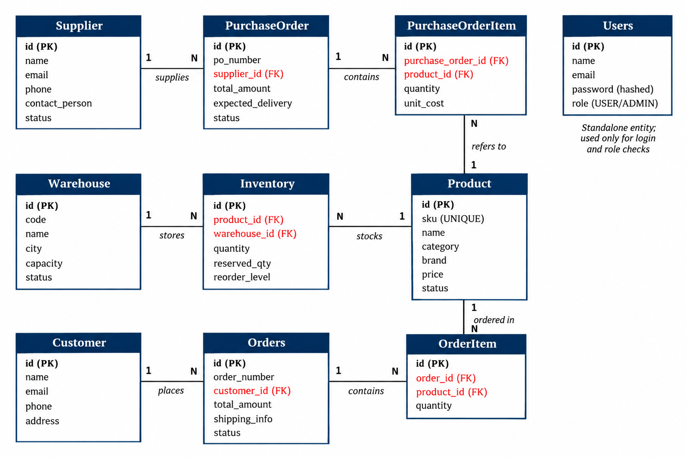
05 | DATA ARCHITECTURE
Database Schema & ER Model
10 normalized tables enforcing referential integrity and status pipelines
Integrity rules
Unique SKU per product, unique user email
Inventory unique per product + warehouse
Order items bound to parent order
Passwords stored hashed
Sales order
PENDING → CONFIRMED → PROCESSING → SHIPPED → DELIVERED (or CANCELLED)
Purchase order
PENDING → APPROVED → ORDERED → RECEIVED (or CANCELLED)

Slide 7
06 | EVALUATION & ROADMAP
Verification, Limits & Future Roadmap
Verified
Current limits
Future roadmap
13 acceptance test cases
Login, CRUD, duplicate SKU rejected
Validation errors on bad input
USER blocked from ADMIN-only APIs
No barcode / QR scanning
No payment gateway
No shipment tracking
No email / SMS notifications
Low-stock alerts
Inventory analytics, demand prediction
Mobile companion app
Cloud deployment
CONCLUSION
RIMS is a secure, modular inventory and procurement platform that replaces manual spreadsheet records with one role-controlled web application.

