Slide 1

Smart Lead Scoring Engine
Submitted by: Ajitesh Kumar

Slide 2
Problem Statement
A D2C startup develops products using cutting edge technologies like Web 3.0. Over the past few months, the company has started multiple marketing campaigns offline and digital both. As a result, the users have started showing interest in the product on the website. These users with intent to buy product(s) are generally known as leads (Potential Customers).
Leads are captured in 2 ways - Directly and Indirectly.
Direct leads are captured via forms embedded in the website while indirect leads are captured based on certain activity of a user on the platform such as time spent on the website, number of user sessions, etc.
Now, the marketing & sales team wants to identify the leads who are more likely to buy the product so that the sales team can manage their bandwidth efficiently by targeting these potential leads and increase the sales in a shorter span of time.
Our task at hand is to predict the propensity to buy a product based on the user's past activities and user level information.

Slide 3
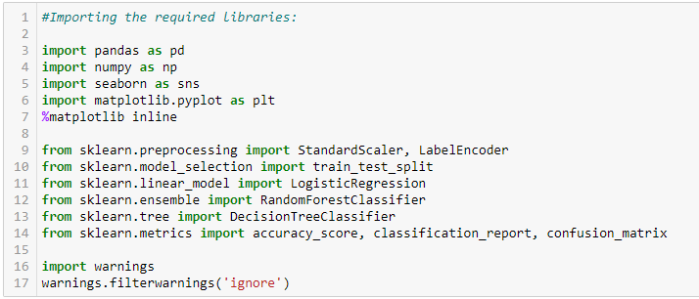
Approch
First of all we’ll import the required libraries which we’ll be required to complete this project.

Slide 4
After importing the libraries. we’ll load the train and test dataset.
We’ll look at the dataset and figure out the missing values.
We’ll handle the missing values as per the requirements.
As in the provided dataset there were missing values which we replaced using the most occuring values (mode).
After doing the data preproceesing and data cleaning part, we move to the model building part.
Used 3 types of machine learning algorithms to predict the required results.
Logistic Regression
RandomForestClassifier
DecisionTreeClassifier
We compared the accuracy score which we obtained from the above 3 algorithms with the cross validation score.

Slide 6
After comparing the values with the cross validation score we came to know that RandomForestClassifier was performing best among all other.
So, we picked RandomForestClassifier as our final model and stared to perform the Hyper parameter score to enchance our accuracy score.
Finally, we were able to obtained a accuracy score of 91% and saved the final model.
Worked on the test dataset and predicted the values using our final model.

