Slide 1
INFOSYS
Multi-Cloud FinOps on Google Cloud
AWS, Azure, GCP and OCI spend in one FOCUS warehouse, with an agentic control plane
Prepared for Con Edison
— Three clouds normalised to the FinOps Foundation's FOCUS 1.2 specification, in BigQuery
— One credential per payer — not one per account — with no static keys stored anywhere
— 59 optimization levers detected from the bill; $5.52M identified on a representative estate
— A Google ADK agent team on Gemini that can only quote numbers it measured
— Serverless on Cloud Run: scales to zero, ~$240/month plus model usage
Infosys · Con Edison · GCP Platform Overview
Infosys

Slide 2
THE PROBLEM
Three clouds, three schemas, no single truth
Multi-cloud FinOps is a data problem before it is a savings problem
Three billing schemas
AWS, Azure, GCP and OCI each bill in their own shape. Reconciling them by hand is a monthly project, not a dashboard.
Credential sprawl
Teams assume one credential per account. It is one per payer — and the difference is dozens of keys nobody rotates.
Tool lock-in
Pick a FinOps platform and every dashboard, KPI and script is written against that vendor's field names.
Unallocated spend
Untagged resources land in a bucket nobody owns, so chargeback is disputed and showback is ignored.
Blind forecasting
A trend line walks straight through a commitment expiry. The rate snaps back to on-demand and the variance lands unannounced.
Scale
A utility estate is millions of billing line-items a month. A single-process dashboard cannot hold it.
Infosys

Slide 3
THE APPROACH
One idea: normalise everything to FOCUS 1.2
The FinOps Foundation's Open Cost and Usage Specification is the contract
AWS
Azure
Google Cloud
OCI
Data Exports — FOCUS_1_2_AWS
GA 19 Nov 2025 (1.0 GA Nov 2024)
Cost Management exports
dataset type FocusCost
gcp_billing_export_focus_*
native, inside BigQuery already
FOCUS Reports in the Oracle-owned
'bling' bucket, gzipped CSV
All four providers emit FOCUS natively today. So do CloudZero and Vantage; Cloudability, CloudHealth and Flexera ingest it. That is why this platform is vendor-neutral by construction rather than by adapter: no dashboard, KPI formula, optimization detector or agent tool has ever seen a vendor-specific field.
CONNECTORS
ADOPTING A NEW TOOL
DOWNSTREAM CHANGES
18
1 subclass
None
3 native + 12 procured tools + any FOCUS file
plus one line in the registry
every dashboard and agent keeps working
Infosys

Slide 4
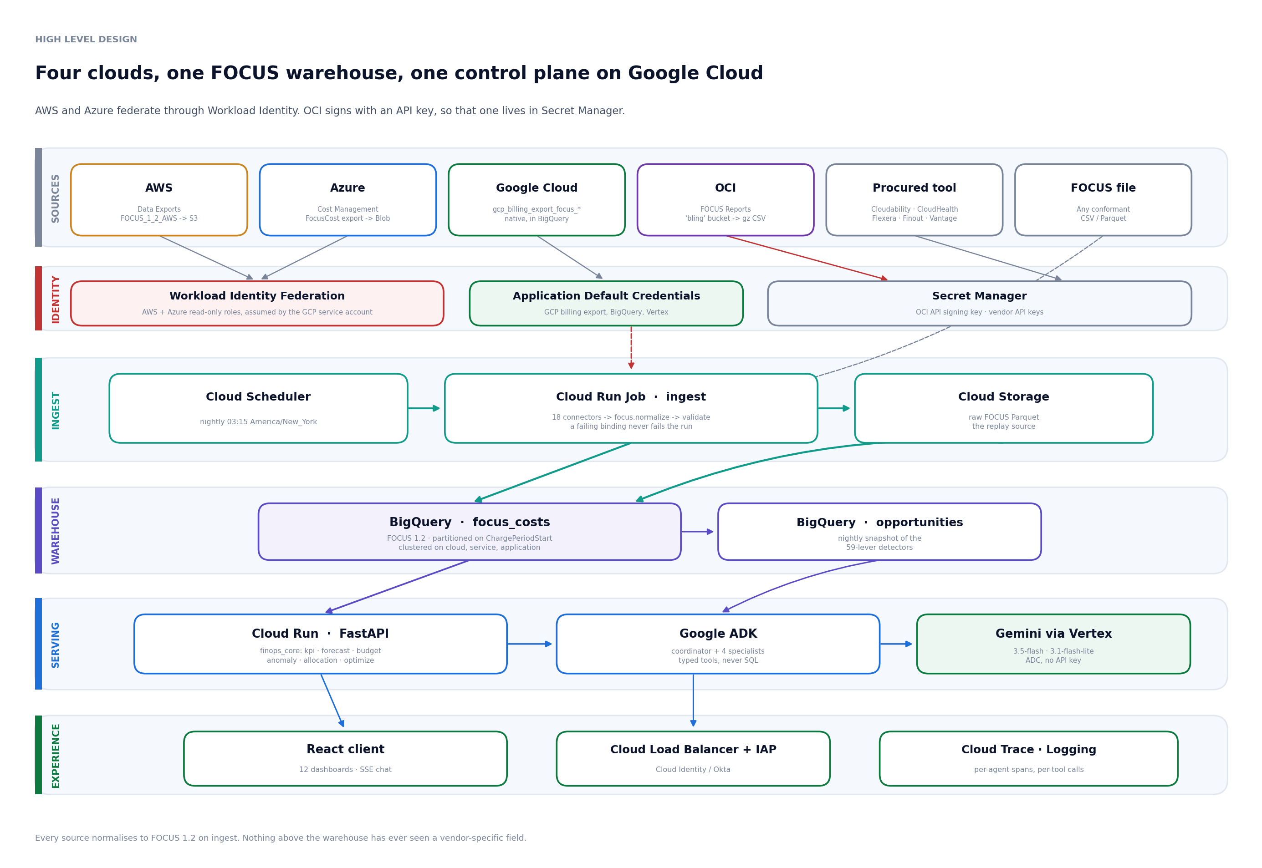
HIGH LEVEL DESIGN
Four clouds, one FOCUS warehouse, one control plane
Sources · Identity · Ingest · Warehouse · Serving · Experience
Vector source: docs/diagrams/hld.svg
docs/diagrams/hld.svg
Infosys

Slide 5
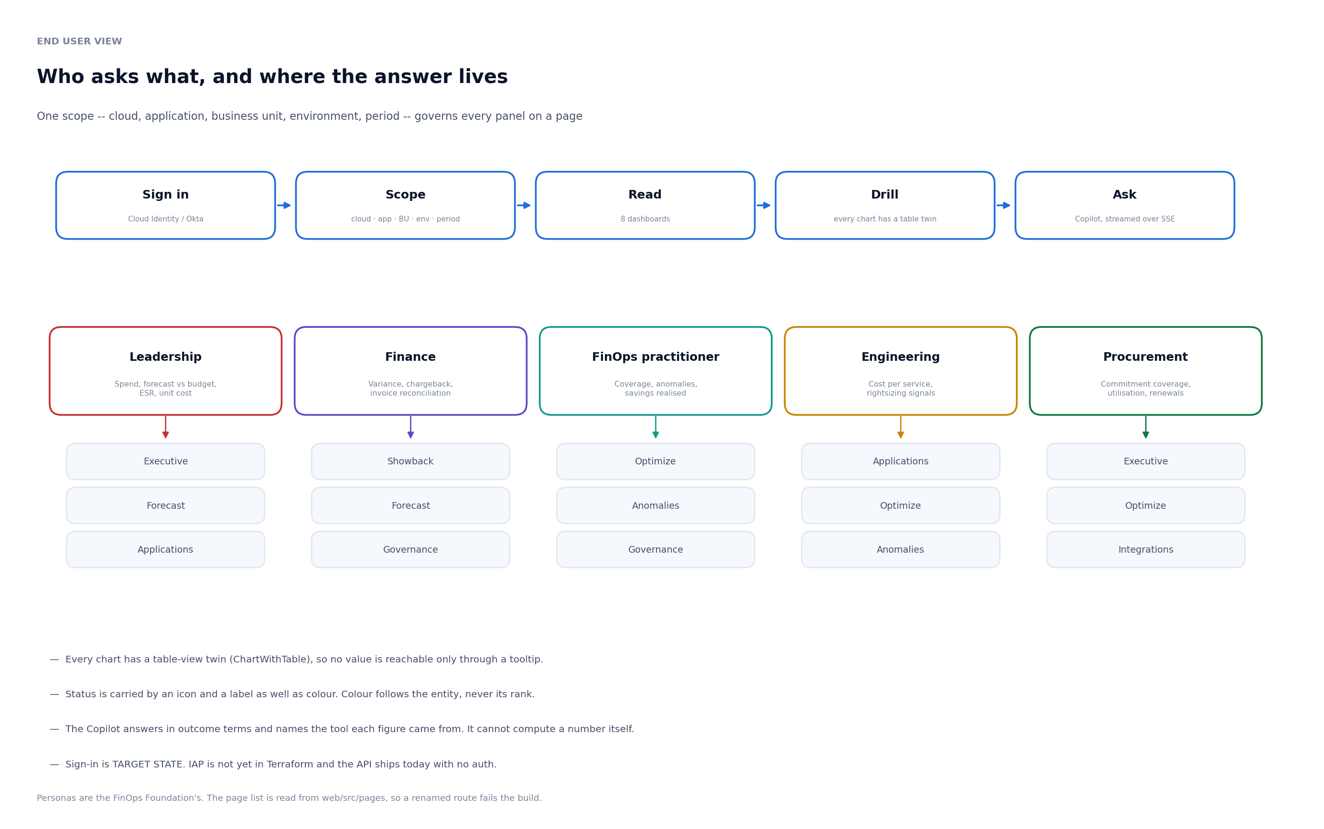
END USER VIEW
Who asks what, and where the answer lives
Five personas, nine pages, one scope that governs every panel
Vector source: docs/diagrams/end_user_view.svg
docs/diagrams/end_user_view.svg
Infosys

Slide 6
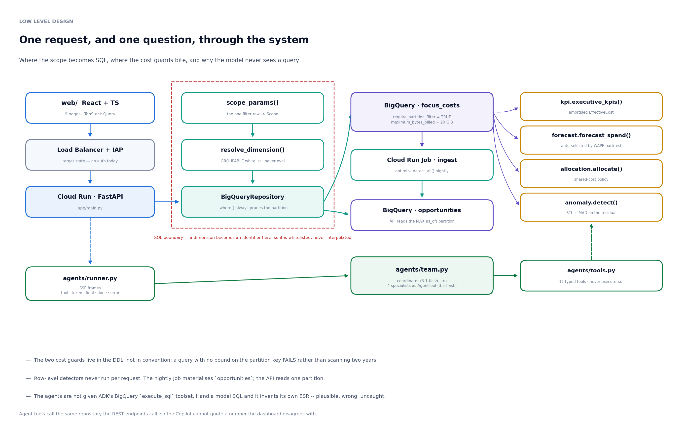
LOW LEVEL DESIGN
One request, and one question, through the system
Where the scope becomes SQL, where the cost guards bite, and why the model never sees a query
Vector source: docs/diagrams/lld.svg
docs/diagrams/lld.svg
Infosys

Slide 7
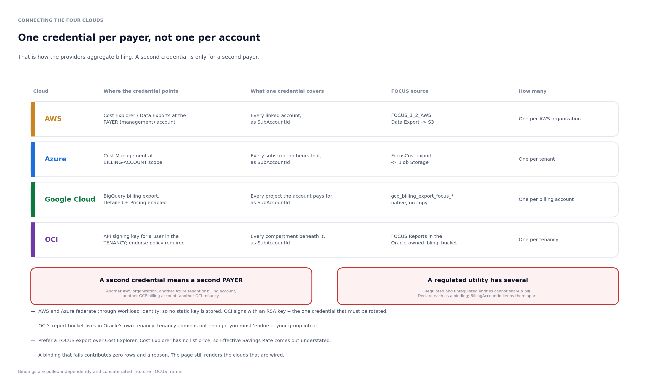
CONNECTING THE CLOUDS
One credential per payer, not one per account
How AWS, Azure, Google Cloud and OCI each aggregate billing
Vector source: docs/diagrams/cloud_onboarding.svg
docs/diagrams/cloud_onboarding.svg
Infosys

Slide 8
STREAMLIT VS GOOGLE CLOUD
What actually changes, and what does not
The engines are identical. The warehouse, the runtime, the model and the front end are not.
Streamlit (reference)
Google Cloud (target)
Where it runs
Streamlit Community Cloud, one process
Cloud Run, scales to zero, one service per concern
Data
Whole FOCUS frame in pandas memory
BigQuery, partitioned and clustered; aggregates pushed to SQL
Scale ceiling
~63k rows demo; ~8 GB at 500k line-items/month
Billions of rows; queries prune to a slice
Cost control
None needed
Partition filter required, bytes-billed capped, detectors run nightly
Agents
LangGraph supervisor on gpt-5
Google ADK coordinator on Gemini, via Vertex
Model credentials
OPENAI_API_KEY in a secret
ADC on the service account — no model API key exists
Front end
Streamlit, server-rendered
React + TypeScript, Plotly figure JSON from the same chart code
Auth
Shared password
Cloud Identity / Okta behind IAP, per-persona RBAC
Ingest
On demand, in the request
Nightly Cloud Run Job, idempotent, GCS as replay source
Shared code
9,100 lines
The same 9,100 lines, as an installable package
The Streamlit app is not thrown away. It stays as the reference implementation and the demo surface — and a bug fixed there is re-extracted into the package, so one copy of the FinOps definitions exists.
Infosys

Slide 9
WHY REBUILD
It was never the user interface. It was pandas.
The single number that forced the architecture
DEMO ESTATE
CON EDISON SCALE
LARGE ENTERPRISE
63,358 rows
~8 GB
~31 GB
36 MB — about 654 bytes per row
500k line-items/month over two years
2M line-items/month over two years
The Streamlit design loads the entire FOCUS frame into one process. It demonstrates beautifully and it will not survive a utility. BigQuery is not an upgrade; it is the only option that works at Con Edison's scale.
Three cost guards, because BigQuery will happily bill you
Partition filter required
A query with no bound on the charge period is rejected, not answered. Writing this guard immediately caught a query of ours that had no WHERE clause at all.
Bytes billed capped
Every job carries a ceiling (20 GiB ≈ 12¢). BigQuery fails the job rather than billing past it.
Detectors run nightly
The row-level scans never run per request. Their answer changes once a day at most.
Infosys

Slide 10
AGENTIC AI
A coordinator and four specialists, on Google ADK
Every figure quoted comes from a tool call against the FOCUS frame
Coordinator
Analyst
Understand Usage and Cost
spend, allocation, anomalies, coverage
gemini-3.1-flash-lite
Forecaster
Quantify Business Value
forecast, budget variance, commitment cliffs
Optimizer
Optimize Usage and Cost
levers, opportunities, ESR uplift
Governor
Manage the FinOps Practice
tagging, chargeback readiness, policy
Two decisions worth defending in review
— Specialists are held as tools, not sub-agents. Handing over control lets the last specialist to run write the answer in its own register; a FinOps question spans domains and the answer must be one voice speaking to one persona.
— The model is never given SQL. Hand it a SQL prompt and it invents its own Effective Savings Rate — dropping the on-demand-equivalent denominator, or counting Purchase rows. Plausible, wrong, uncaught. It gets typed tools that call the same engines the API calls.
Infosys

Slide 11
AGENTIC AI
What the agents actually cost
Token footprint measured against the running system, not estimated
Per question
Input tokens
Output tokens
PER QUESTION
PER MONTH
Coordinator (routing)
3,600
90
$0.026
$116
Specialists (reasoning)
12,000
820
coordinator + specialists
4,400 questions
Total
15,600
910
Model choice — and a naming trap
— Reasoning: gemini-3.5-flash at $1.50 in / $9.00 out per 1M tokens. Routing: gemini-3.1-flash-lite at $0.25 / $1.50.
— Google's flagship is 3.5-flash despite the .5, while Pro and Lite are 3.1. There is no bare gemini-3-flash or gemini-3-pro — those identifiers return 404. A test pins the model ids, because a typo surfaces only when a user asks a question in production.
— gemini-2.0-flash was retired on 1 June 2026 and the whole gemini-2.5-* family shuts down on 16 October 2026.
— Context caching gives 90% off repeated input; batch gives 50% off but is useless here, because the Copilot is interactive.
For scale: the model bill is roughly 0.0085% of the $32.65M of cloud spend under management. The Copilot is not where a FinOps programme's money goes.
Gemini list prices, July 2026. Token counts measured against the running agent team.
Infosys

Slide 12
WHAT IT TELLS YOU
The executive view
Amortised spend across AWS, Azure, GCP and OCI · 24 months of history
TOTAL AMORTISED SPEND
EFFECTIVE SAVINGS RATE
COMMITMENT COVERAGE
$32.65M
21.6%
42.0%
FOCUS EffectiveCost
vs on-demand equivalent
of eligible spend
COMMITMENT UTILISATION
COST OF WASTE
ALLOCATION COVERAGE
95.6%
$2.52M
82.6%
$346K unused
7.7% of spend
Hybrid: chargeback tagged, showback remainder
Effective Savings Rate is the outcome metric, not coverage. 100% coverage at 60% utilisation is still a bad deal, and only ESR shows that. Foundation benchmarks: median ~0%, 75th percentile ~23%, 98th ~46%. This estate sits at 21.6%, with $346K of commitment already burned unused.
Figures computed from a synthetic 24-month utility estate shipped with the platform. No customer data.
Infosys

Slide 13
FORECAST
Two years ahead, and the cliff a trend line cannot see
Method chosen by rolling-origin backtest: Linear · WAPE 4.74% (Best-in-class)
24-MONTH FORECAST
$48.85M
point estimate, cumulative
WITH COMMITMENT CLIFFS
$53.79M
expiry in Jul 2026
When an RI, Savings Plan or CUD term ends, the rate snaps back to on-demand. The overlay adds $4.94M that the trend line never sees. This is the single most important thing naive cloud forecasting misses.
Foundation forecast-variance maturity bands: Crawl <20%, Walk <15%, Run <12%, best-in-class <5%. WAPE is dollar-weighted, so a small service rounding to zero cannot dominate the score as it does under MAPE.
Figures computed from a synthetic 24-month utility estate shipped with the platform. No customer data.
Infosys

Slide 14
OPTIMIZATION
$5.52M identified, across 36 opportunities
Detected from the FOCUS frame by rule, not read from a vendor's recommendation API
Largest opportunities
Lever
Name
Cloud
Annual
Effort/Risk
R1
AWS Compute Savings Plan
AWS
$1.19M
Low/Low
U10
Schedule / park non-prod
AWS, Azure, GC
$787K
Low/Low
R5
Azure Reservations
Azure
$745K
Low/Medium
R7
GCP Flexible (spend-based) CUD
GCP
$462K
Low/Low
R17
OCI Annual Universal Credits
OCI
$340K
Low/Low
U17
Previous-generation instance fam
AWS, Azure, GC
$179K
Low/Low
R9
Spot / Preemptible / Azure Spot
AWS
$152K
Medium/High
R12
BYOL / licence mobility
AWS
$151K
Medium/Medium
Executing the rate levers alone would move Effective Savings Rate from 21.6% to 40.2% (+18.6 points). Savings percentages in the catalog are vendor 'up-to' figures — ceilings, not guarantees. Where a detector cannot see what it needs (access patterns, CPU utilisation) it lowers its confidence and says so.
Figures computed from a synthetic 24-month utility estate shipped with the platform. No customer data.
Infosys

Slide 15
ANOMALY DETECTION
Catching the runaway workload, not the weekend
STL decomposition, then a median-absolute-deviation test on the residual
Date
Service category
Actual
Expected
Deviation
Severity
20 May 2026
Analytics
$27K
$5K
+489%
Critical
13 Jun 2026
Networking
$10K
$2K
+388%
Critical
01 Nov 2025
AI and Machine Learning
$257
$158
+63%
Serious
ANOMALIES FLAGGED
Before the materiality rule this detector flagged 347 points and simultaneously graded 318 of them 'good' — the statistical test and the severity grade were computed from different quantities and contradicted each other. An alert nobody can act on teaches people to ignore the channel.
23
over 24 months, across 8 service categories
— A point is an anomaly only if it is BOTH statistically odd (|modified z| > 3.5) AND financially material (≥25% deviation)
— The test runs on the STL residual, so weekday, weekend and monthly cycles do not trip alerts
— Mirrors AWS Cost Anomaly Detection semantics: ≥10-day warm-up, dynamic thresholds rather than a static dollar line
Figures computed from a synthetic 24-month utility estate shipped with the platform. No customer data.
Infosys

Slide 16
SECURITY
Read-only, keyless, and cost-bounded
What a regulated utility's security review will ask about
No static cloud keys
AWS and Azure are reached through Workload Identity Federation — nothing to rotate there. OCI is the exception: its SDK signs with an RSA key, so that one key lives in Secret Manager and does need rotation.
No model API key
Gemini is reached through Vertex, authenticated by Application Default Credentials on the Cloud Run service account. There is no key to store.
Least privilege
The API service account holds bigquery.dataViewer, bigquery.jobUser and aiplatform.user. Ingest adds dataEditor and a bucket-scoped objectAdmin. Nothing can change a cloud resource.
The agent cannot write SQL
It calls typed tools with a whitelisted column set. No eval, no string interpolation into a query, and no path from a prompt to the warehouse.
Cost is bounded, not monitored
Every query caps bytes billed and must filter the partition. BigQuery fails the job rather than presenting an invoice.
Human access
Cloud Identity or Okta behind Identity-Aware Proxy, with the FinOps personas mapped to groups.
Infosys

Slide 17
RUN COST
What the platform costs to operate
Serverless: it scales to zero between the nightly job and the working day
Cloud Run — API
~$60
min 1 instance, 2 vCPU / 4 GiB
TOTAL
~$316 / month
Cloud Run — React client
~$10
or Firebase Hosting
before Cloud SQL high availability
Cloud SQL (Postgres)
~$50
policies and scenarios; no HA
Memorystore Redis
~$35
aggregate cache
AS A SHARE OF THE ESTATE
0.279%
BigQuery
~$5
storage + partitioned queries
of $32.65M under management
Load Balancer + IAP
~$20
Artifact Registry, Secret Manager, logging
~$20
BigQuery is negligible only because the table is partitioned and clustered. An unpartitioned full scan on every dashboard load is how a $5 line becomes a $500 one — which is why the partition filter is enforced by the schema, not by convention.
Gemini
~$116
4,400 questions/month
Cost estimates for a single environment. Gemini at list price, July 2026.
Infosys

Slide 18
DELIVERY
A phased rollout, value in the first wave
Sequenced by risk, not by dollar size
Phase 1 · Weeks 1–3
Phase 2 · Weeks 4–10
Phase 3 · Quarter 2+
Land it
Make it useful
Operate it
— GCP project, Workload Identity Federation to AWS and Azure, an API signing key for OCI
— BigQuery warehouse, first ingest of one payer per cloud
— Cloud Run API + executive dashboard, behind IAP
— Validate FOCUS conformance against real exports
— All payers; tagging remediation to cross the chargeback line
— Nightly optimization snapshot; quick wins first
— Forecast vs budget in the monthly finance cycle
— The remaining dashboards; Gemini Copilot enabled
— Chargeback with the agreed shared-cost policy
— Unit economics per customer, per kWh, per meter read
— Anomaly alerting into ServiceNow
— FinOps for AI: GPU and token spend under the same lens
Phase 1 is deliberately all low-effort, low-risk work. The programme should pay for itself before it asks for trust.
Infosys

Slide 19
ASSUMPTIONS AND LIMITS
What this does not claim
Stated up front, because a FinOps tool that overstates is worse than none
— Every figure in this deck comes from a synthetic 24-month utility estate. The dollars are invented; the mechanics are not.
— No live GCP deployment has been performed. The service, the warehouse DDL and the agent team are tested end to end against the demo estate with no cloud project and no model key.
— AWS Cost Explorer does not expose list price. On that ingest path ListCost is set equal to BilledCost, so Effective Savings Rate is understated. Use a FOCUS Data Export.
— Business drivers — customers served, kWh delivered, meter reads — cannot be read from a cloud bill by definition. Unit economics needs a feed from a system of record.
— Savings percentages in the lever catalog are vendor 'up-to' figures. Treat them as ceilings.
— Storage-tiering and rightsizing detectors infer from billing data alone. Where a detector cannot see access patterns or CPU utilisation, it lowers its confidence and says what telemetry would confirm it.
— Cost estimates assume a single environment and list pricing. They exclude any Google committed-use discount you already hold.
Infosys

Slide 20
NEXT STEPS
What we would need to go live
A GCP project
Plus a billing account, a VPC, and Owner long enough to land the Terraform.
An identity provider
Cloud Identity, Okta or Entra, behind Identity-Aware Proxy. This replaces the demo password.
One read-only credential per payer
Not per account. AWS and Azure via Workload Identity Federation; GCP needs only the billing export enabled; OCI needs one API key plus an 'endorse' policy into Oracle's report tenancy.
A FOCUS export, ideally
AWS Data Exports (FOCUS 1.2) and Azure FocusCost give a true list price, so Effective Savings Rate is correct rather than understated.
Your tagging standard
So the canonical keys map to Con Edison's own: application, business unit, cost centre, environment, owner, project.
A business driver feed
Customers served, kWh delivered, work orders closed. This is what turns a cloud bill into a unit cost a VP can defend.
An allocation policy decision
Even split, proportional, or a fixed percentage for the shared platform pool. An accounting choice, not a technical one.
Infosys · Con Edison
Infosys

