Slide 1
INFOSYS
Multi-Cloud FinOps Command Center
A single plane of control for AWS, Azure, GCP and OCI spend
Prepared for Con Edison
— VP and Director visibility by application, business unit and environment
— Showback and chargeback with a defensible shared-cost split
— A 24-month forecast against budget that sees the commitment cliff
— 59 FinOps optimization levers, detected from the bill itself
— Vendor-neutral: 18 connectors, one FOCUS schema underneath
Infosys · Con Edison · FinOps Solution Overview
Infosys

Slide 2
THE PROBLEM
Four clouds, four answers, no single truth
Why multi-cloud FinOps is hard before it is expensive
Fragmented data
Each provider bills in its own schema. Reconciling AWS, Azure, GCP and OCI by hand is a monthly project, not a dashboard.
Tool lock-in
Pick a FinOps platform and every dashboard, KPI and script is written against that vendor's field names. Switching means rebuilding.
Unallocated spend
Untagged resources land in a bucket nobody owns, so chargeback is disputed and showback is ignored.
Blind forecasting
A trend line walks straight through a commitment expiry. The rate snaps back to on-demand and the variance lands unannounced.
Waste is invisible
Unused commitment and idle resources do not announce themselves; they arrive as a slightly larger invoice.
Infosys

Slide 3
THE APPROACH
One idea: normalise everything to FOCUS
The FinOps Foundation's Open Cost and Usage Specification is the contract
Executive KPIs
AWS Data Exports
Forecast & budget
Azure Cost Management
FOCUS 1.2
Connector
Showback / chargeback
GCP Billing Export
one frame
Optimization levers
OCI FOCUS Reports
Anomalies
AI agent team
Any procured FinOps tool
No dashboard, KPI formula, optimization detector or agent tool has ever seen a vendor-specific field. Adopting a new FinOps platform is one Connector subclass; dropping one is deleting it. That is the whole architectural bet — and it is the same bet the FinOps Foundation made with FOCUS.
Any FOCUS CSV / Parquet
Infosys

Slide 4
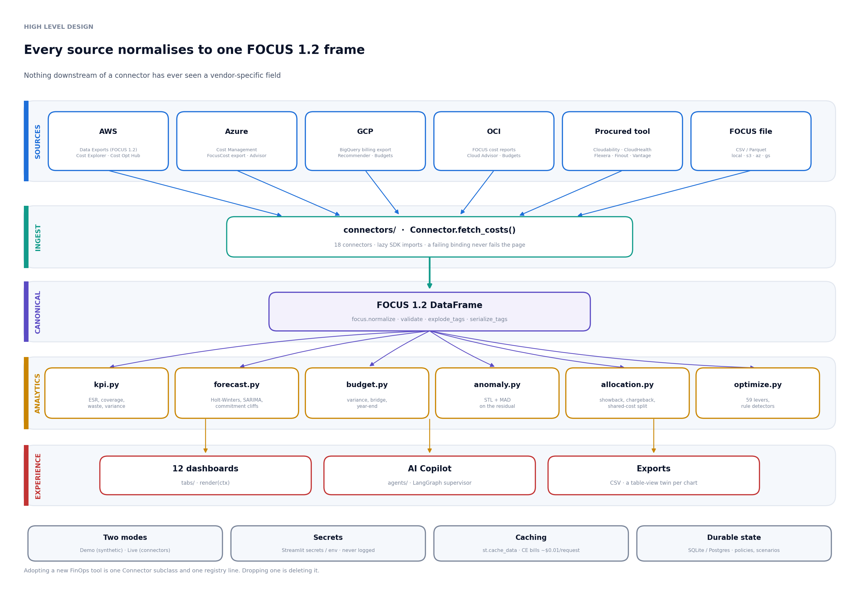
HIGH LEVEL DESIGN
Every source normalises to one FOCUS 1.2 frame
Sources · Ingest · Canonical · Analytics · Experience
Vector source: docs/diagrams/hld.svg
docs/diagrams/hld.svg
Infosys

Slide 5
ARCHITECTURE
Two modes, one code path
Nothing below the loader knows which mode is active
Demo Mode
Live Mode
— Deterministic synthetic estate, generated in-process
— 24 months, 3 clouds, 11 applications
— 63,358 FOCUS charge rows
— No credentials, no network calls, no cloud spend
— Used for evaluation, training and demos
— Real billing data through configured connectors
— Native AWS / Azure / GCP / OCI, or a procured tool
— Multiple payers, tenants and billing accounts
— A half-wired estate still renders the wired parts
— Cached: Cost Explorer bills ~$0.01 per request
Demo Mode is not a mock. It uses the same Connector interface and produces a frame that passes FOCUS validation, containing real commitment waste, untagged spend, idle resources, a migration step-change and two injected anomalies.
Infosys

Slide 6
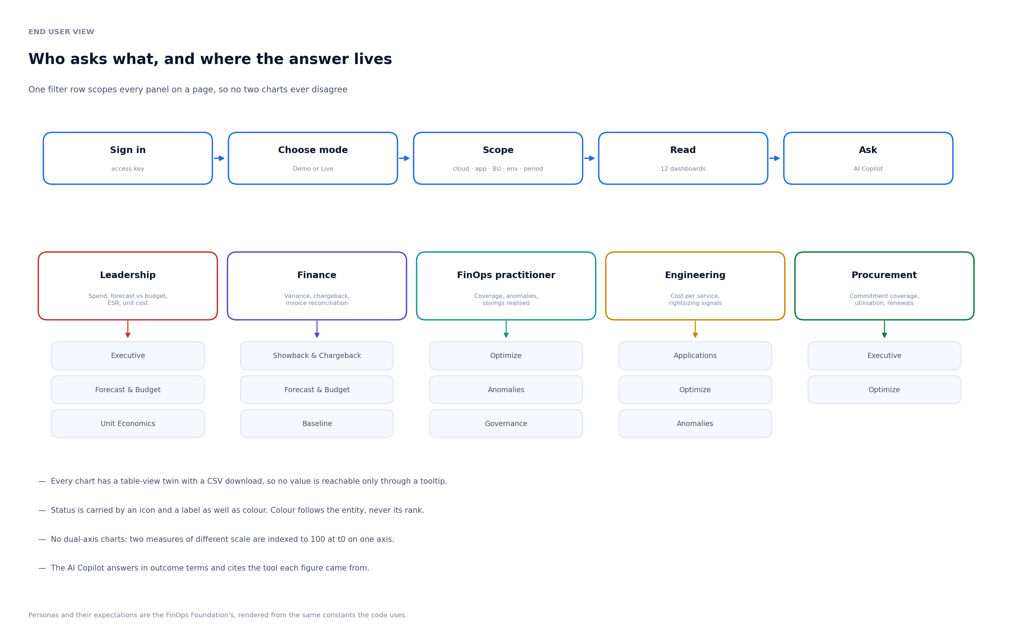
END USER VIEW
Who asks what, and where the answer lives
The journey, the six FinOps personas, and the dashboards each one lands on
Vector source: docs/diagrams/end_user_view.svg
docs/diagrams/end_user_view.svg
Infosys

Slide 7
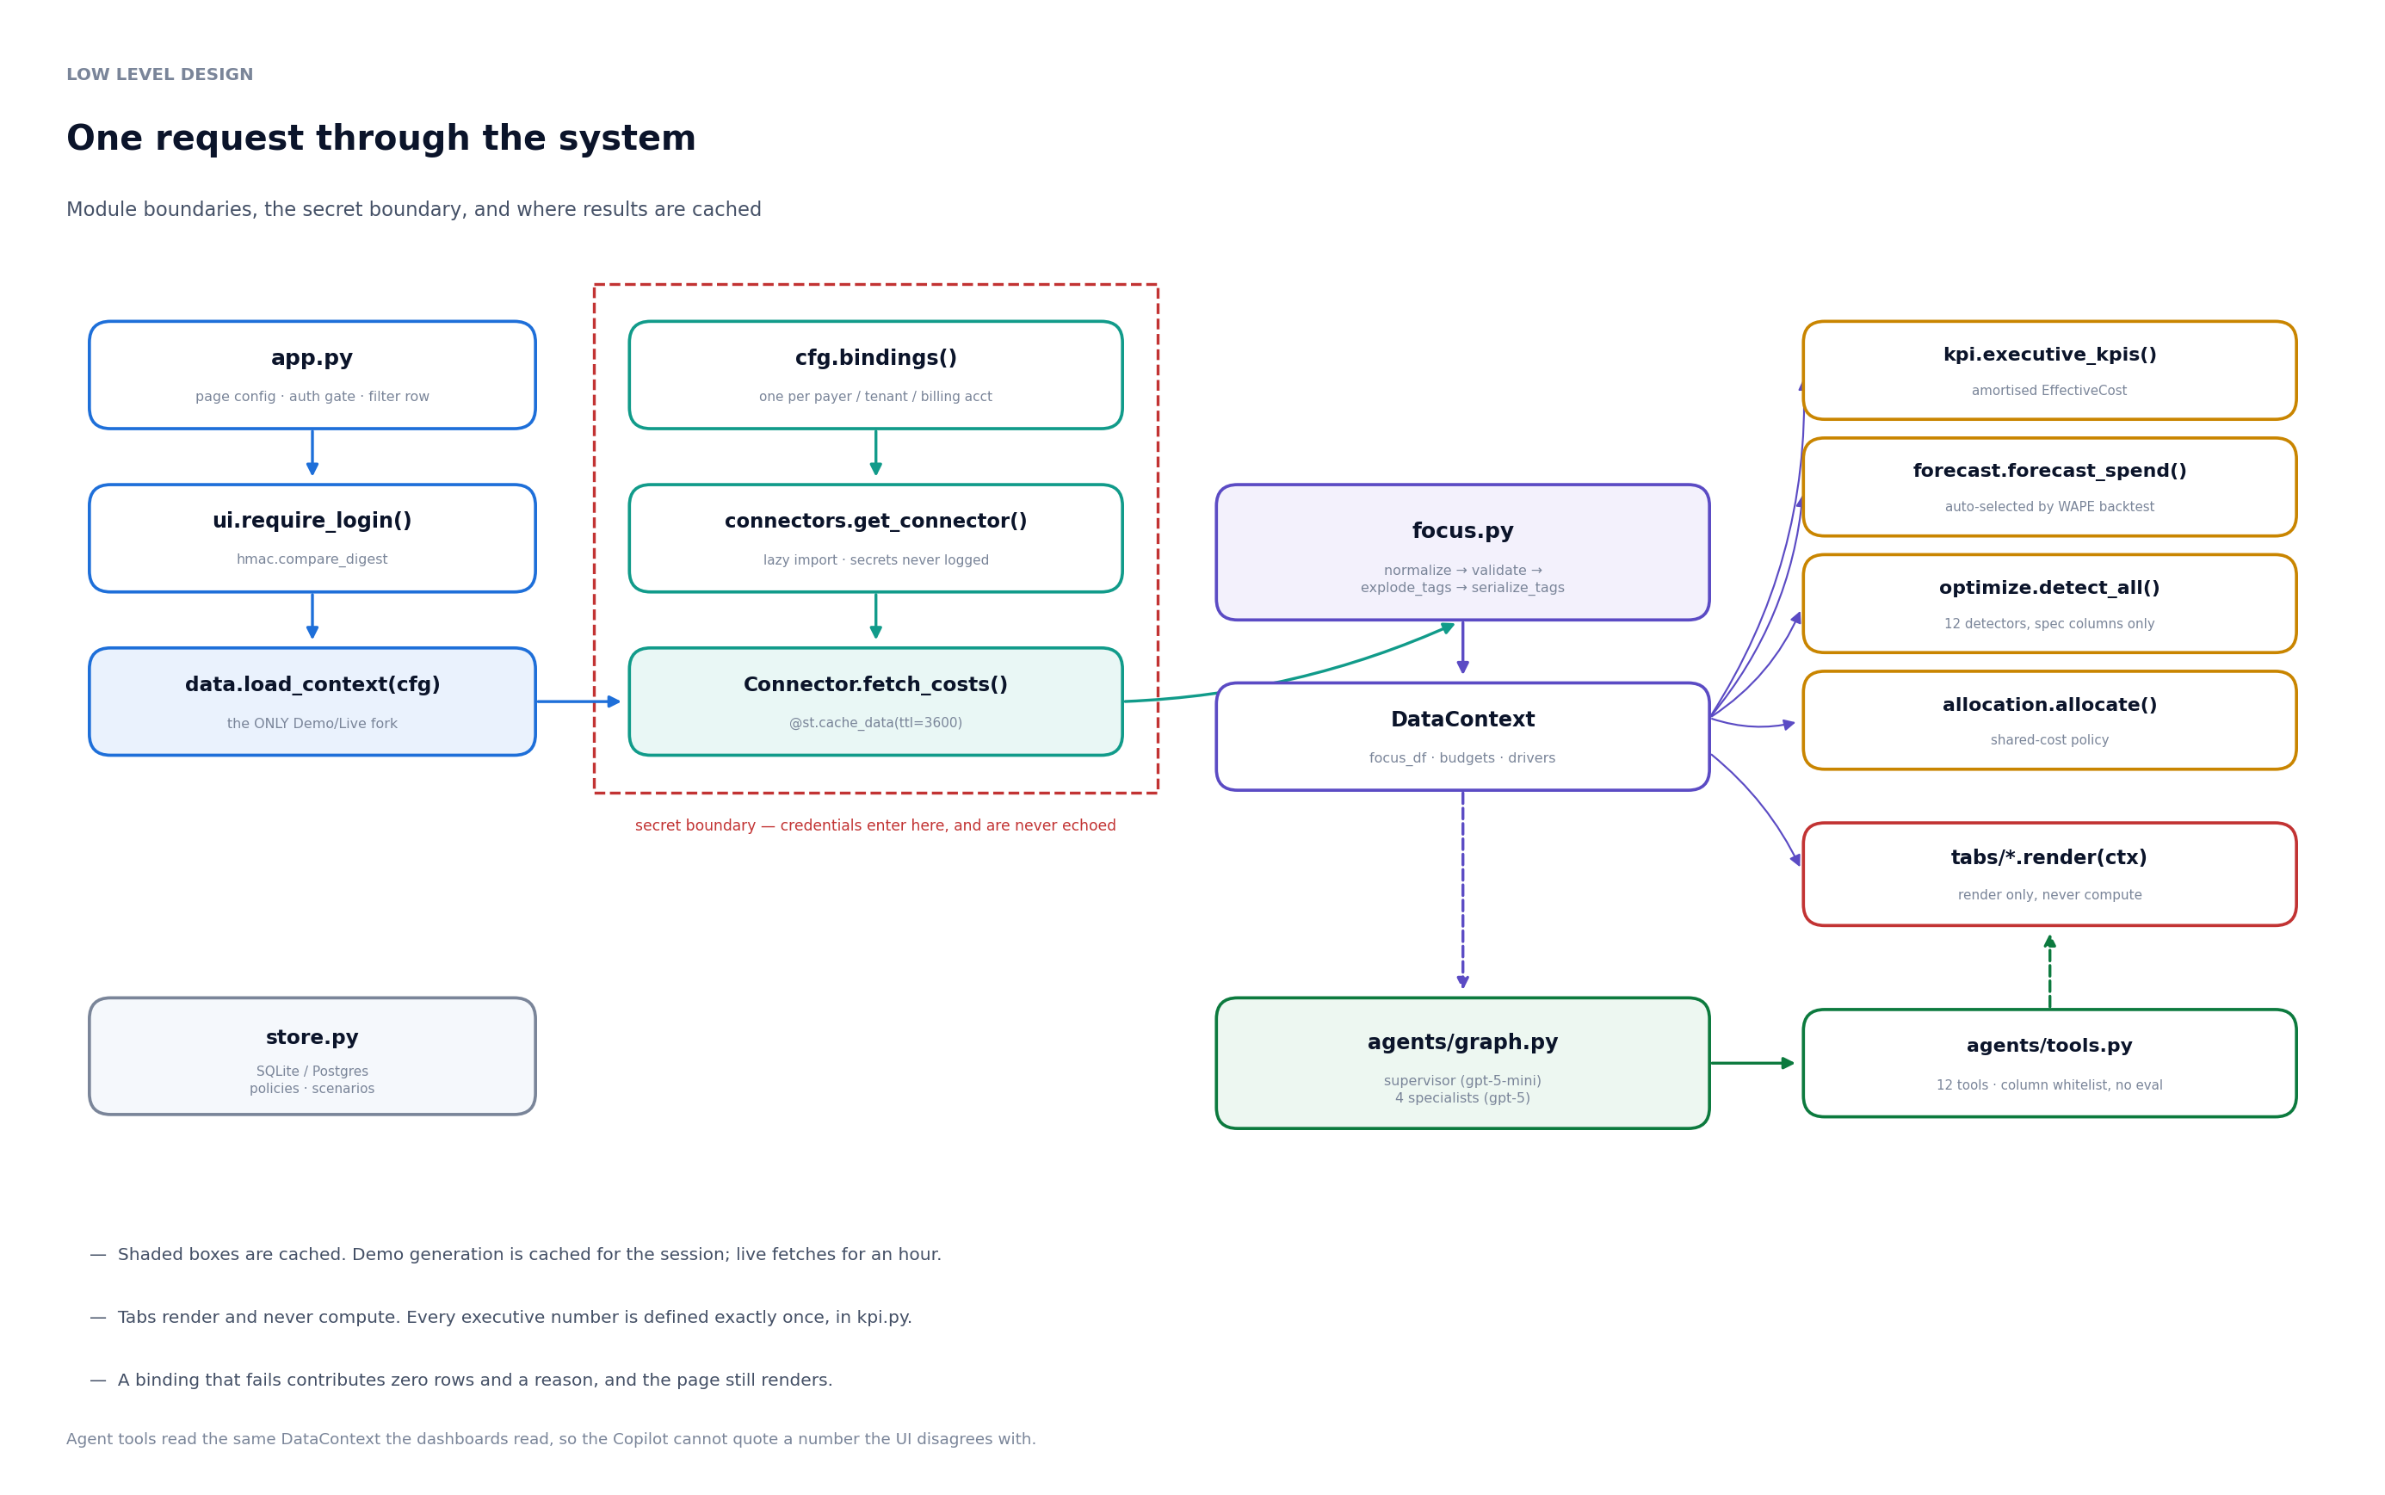
LOW LEVEL DESIGN
One request through the system
Module boundaries, the secret boundary, and where results are cached
Vector source: docs/diagrams/lld.svg
docs/diagrams/lld.svg
Infosys

Slide 8
EXECUTIVE VIEW
What a VP sees first
Amortised spend across AWS, Azure, GCP and OCI · 24 months of history
TOTAL AMORTISED SPEND
EFFECTIVE SAVINGS RATE
COMMITMENT COVERAGE
$32.65M
21.6%
42.0%
Run-rate $16.32M/yr
vs on-demand equivalent
of eligible spend
COMMITMENT UTILISATION
COST OF WASTE
ALLOCATION COVERAGE
95.6%
$2.52M
82.6%
$346K unused
7.7% of spend
Hybrid: chargeback tagged, showback remainder
Effective Savings Rate is the outcome metric, not coverage. 100% coverage at 60% utilisation is still a bad deal, and only ESR shows that. FinOps Foundation benchmarks: median ~0%, 75th percentile ~23%, 98th percentile ~46%. This estate sits at 21.6% — above median, with $346K of commitment already burned unused.
Figures computed from a synthetic 24-month utility estate shipped with the platform. No customer data.
Infosys

Slide 9
WHERE THE MONEY IS
Spend by cloud and by month
Amortised EffectiveCost — never blended or unblended on a leadership view
Month on month -1.1%. Year on year +34.4% — the step change is a data-centre exit wave, which is precisely the shape a naive trend model extrapolates straight through.
Figures computed from a synthetic 24-month utility estate shipped with the platform. No customer data.
Infosys

Slide 10
SHOWBACK & CHARGEBACK
A defensible split, including the shared-cost pool
Direct costs, plus each unit's share of the platform they all consume
Five allocation methods
— Direct — the resource carries its own owner tag
— Even split — pool ÷ N consumers
— Proportional to direct spend — the fair tax
— Fixed percentage — a negotiated share
— Usage driver — a metered proxy
Allocation coverage is 82.6%. Practitioner consensus puts the chargeback-readiness line near 90%, so this estate is: hybrid: chargeback tagged, showback remainder. Showback moves information; chargeback moves money. Neither is 'more mature' — it is an accounting-policy choice.
Figures computed from a synthetic 24-month utility estate shipped with the platform. No customer data.
Infosys

Slide 11
FORECAST & BUDGET
Two years ahead, and the cliff a trend line cannot see
Method chosen by rolling-origin backtest: Linear · WAPE 4.74% (Best-in-class)
24-MONTH FORECAST
$48.85M
point estimate, cumulative
WITH COMMITMENT CLIFFS
$53.79M
expiry in Jul 2026
When an RI, Savings Plan or CUD term ends, the rate snaps back to on-demand. The overlay adds $4.94M the trend line never sees. This is the single most important thing naive cloud forecasting misses.
Foundation forecast-variance maturity bands: Crawl <20%, Walk <15%, Run <12%, best-in-class <5%. WAPE is dollar-weighted, so a small service rounding to zero cannot dominate the score the way it does under MAPE.
Figures computed from a synthetic 24-month utility estate shipped with the platform. No customer data.
Infosys

Slide 12
OPTIMIZATION
$5.52M identified, across 36 opportunities
Detected from the FOCUS frame by rule, not read from a vendor's recommendation API
Largest opportunities
Lever
Name
Cloud
Annual
Effort/Risk
R1
AWS Compute Savings Plan
AWS
$1.19M
Low/Low
U10
Schedule / park non-prod
AWS, Azure, GC
$787K
Low/Low
R5
Azure Reservations
Azure
$745K
Low/Medium
R7
GCP Flexible (spend-based) CUD
GCP
$462K
Low/Low
R17
OCI Annual Universal Credits
OCI
$340K
Low/Low
U17
Previous-generation instance fam
AWS, Azure, GC
$179K
Low/Low
R9
Spot / Preemptible / Azure Spot
AWS
$152K
Medium/High
R12
BYOL / licence mobility
AWS
$151K
Medium/Medium
Executing the rate levers alone would move Effective Savings Rate from 21.6% to 40.2% (+18.6 points). Savings percentages in the catalog are vendor 'up-to' figures — ceilings, not guarantees. Where a detector cannot see what it needs (access patterns, CPU utilisation) it lowers its confidence and says so.
Figures computed from a synthetic 24-month utility estate shipped with the platform. No customer data.
Infosys

Slide 13
ANOMALY DETECTION
Catching the runaway workload, not the weekend
STL decomposition, then a median-absolute-deviation test on the residual
Date
Service category
Actual
Expected
Deviation
Severity
20 May 2026
Analytics
$27K
$5K
+489%
Critical
13 Jun 2026
Networking
$10K
$2K
+388%
Critical
01 Nov 2025
AI and Machine Learning
$257
$158
+63%
Serious
— Modified z-score = 0.6745 × (x − median) / MAD, threshold ≈ 3.5 — robust to the very outliers it is hunting
— The test runs on the STL residual, so weekday, weekend and monthly cycles do not trip alerts
— A point must be BOTH statistically odd AND financially material (≥25% deviation). The statistical test alone flags a 5% wobble in a low-variance series, and an alert nobody can act on teaches people to ignore the channel
— Mirrors AWS Cost Anomaly Detection semantics: ≥10-day warm-up, dynamic thresholds rather than a static dollar line
— Severity is carried by an icon and a label as well as colour — never by colour alone
Figures computed from a synthetic 24-month utility estate shipped with the platform. No customer data.
Infosys

Slide 14
CONNECTING YOUR ESTATE
How many credentials do you actually need?
Far fewer than you think — one credential already spans many accounts
AWS
Cost Explorer / Data Exports at the payer (management) account return every linked account. They arrive in FOCUS as SubAccountId.
One credential per payer
Azure
Billing-account scope covers every subscription beneath it. Subscription scope covers exactly one — prefer the billing account.
One credential per tenant
GCP
A billing account's BigQuery export carries every project it pays for, again as SubAccountId.
One credential per billing account
A second credential is needed only for a second PAYER — another AWS organization, another Azure tenant, another OCI tenancy or billing account, another GCP billing account. A regulated utility usually has several, because regulated and unregulated entities cannot share a bill. Declare each as an [[accounts]] entry; they are pulled independently and concatenated into one FOCUS frame, where BillingAccountId keeps them apart. A failing binding never takes the page down.
Infosys

Slide 15
AGENTIC AI
A supervisor and four specialists, grounded in your data
Google ADK on Gemini — every figure quoted comes from a tool call against the FOCUS frame
Supervisor
Analyst
Understand Usage & Cost
spend, allocation, anomalies, coverage
routes on gemini-3.1-flash-lite
Forecaster
Quantify Business Value
forecast, budget variance, year-end
Optimizer
Optimize Usage & Cost
levers, opportunities, ESR uplift
Governor
Manage the FinOps Practice
tagging, chargeback readiness, policy
— Typed tools query the loaded FOCUS frame directly — the model never recites a number from memory, and it cannot write SQL
— The coordinator routes on the cheap model and specialists reason on the strong one: the small-model-first lever, applied to ourselves
— Specialists are held as tools, not sub-agents, so one voice writes the final answer for one persona
— A column whitelist guards every query. No eval, ever. Loop-guarded, and it degrades to an explanation when the model is unreachable
Infosys

Slide 16
AGENTIC AI
What actually happens when you ask a question
Worked example: "Why did spend rise last month, and what should we do?"
1
Route
The coordinator reads the question and the asking persona, and calls the specialists it needs. Cheap model, one call.
2
Call tools
The Analyst calls get_spend_summary and get_anomalies against the real frame. It receives numbers, not prose.
3
Hand back
The specialist returns to the supervisor with its finding recorded in shared state. The supervisor decides whether another domain is needed.
4
Escalate
Spend rose and an anomaly is implicated, so the supervisor routes to the Optimizer, which calls find_optimization_opportunities and explain_lever.
5
Answer
The coordinator writes one answer, streamed token by token, citing the figure and the tool it came from, in outcome terms for a VP.
Guard rails: a bounded agent loop, a session keyed by a stable id so the conversation survives a page reload, and a tool layer that returns a status rather than raising -- a tool that throws kills the agent.
Infosys

Slide 17
TARGET ARCHITECTURE
Running this on Google Cloud
The engines are unchanged. What changes is the warehouse, the runtime and the model.
Cloud Run
Why pandas forced the rebuild
FastAPI service, scales to zero. React client behind a load balancer and IAP.
A utility estate at ~500k billing line-items a month is roughly 8 GB of memory over two years; a large enterprise at 2M/month is ~31 GB. The demo loads the whole frame into one process. It demonstrates well and it will not survive Con Edison. BigQuery is not optional.
BigQuery
The FOCUS 1.2 warehouse. Partitioned on ChargePeriodStart, clustered on cloud, service category and application.
Three cost guards
Cloud Run Job
— A query with no period filter is rejected, not answered
— Every job caps bytes billed — BigQuery fails rather than bills
— Row-level detectors run nightly, never per request
Nightly ingest through the same connectors, plus a materialised optimization snapshot.
Gemini via Vertex
Agents authenticate with the service account. No API key exists anywhere.
PLATFORM RUN COST
GEMINI
SHARE OF ESTATE
~$240 / month
~$117 / month
0.0005%
Cost estimates. Gemini priced at gemini-3.5-flash / gemini-3.1-flash-lite list rates, July 2026.
Cloud Run, BigQuery, Cloud SQL, LB
4,400 questions; ~$0.027 each
of the $30.28M under management
Infosys

Slide 18
VENDOR NEUTRALITY
18 connectors, one schema
Whatever Con Edison procures, the dashboards do not change
Native cloud
· AWS — Data Exports (FOCUS 1.2), Cost Explorer, Cost Optimization Hub
· Azure — Cost Management, FocusCost exports, Advisor
· GCP — BigQuery billing export, Recommender, Budgets
· OCI — FOCUS cost reports, Cloud Advisor, Budgets
Procured platforms
· Apptio Cloudability · Tanzu CloudHealth · Flexera One
· Finout · Vantage · CloudZero · Harness CCM · nOps
· Kubecost · OpenCost · IBM Turbonomic · ServiceNow
Zero-code path
· Any FOCUS CSV or Parquet — local, S3, Azure Blob or GCS
· CloudZero and Vantage emit FOCUS natively
· Cloudability, CloudHealth and Flexera ingest it
Adopting a new tool is one Connector subclass and one registry line. Nothing downstream changes.
Infosys

Slide 19
DELIVERY
A phased rollout, value in the first wave
Sequenced by effort and risk, not by dollar size
Wave 1 · Weeks 1–4
Wave 2 · Weeks 5–12
Wave 3 · Quarter 2+
FinOps phase: Inform
FinOps phase: Optimize
FinOps phase: Operate
— Connect payers; validate FOCUS conformance
— Stand up the executive view and showback
— Baseline the estate; publish allocation coverage
— Quick wins: idle resources, gp2→gp3, orphaned snapshots
— Tagging remediation to cross the chargeback line
— Commitment strategy: coverage to the sustained floor
— Non-prod scheduling; previous-generation migration
— Forecast vs budget in the monthly finance cycle
— Chargeback with the agreed shared-cost policy
— Unit economics per customer, per kWh, per meter read
— Anomaly alerting into ServiceNow
— AI Copilot for self-service, FinOps for AI/GPU spend
Wave 1 is deliberately all low-effort, low-risk levers — the programme should pay for itself before it asks for trust.
Infosys

Slide 20
ASSUMPTIONS & LIMITS
What this does not claim
Stated up front, because a FinOps tool that overstates is worse than none
— Every figure in this deck comes from a synthetic 24-month utility estate. The dollars are invented; the mechanics are not.
— AWS Cost Explorer does not expose list price. On that path ListCost is set equal to BilledCost, so Effective Savings Rate is understated. Use the FOCUS Data Export for the true number.
— Business drivers — customers served, kWh delivered, meter reads — cannot be read from a cloud bill by definition. Unit economics needs a feed from a system of record.
— Savings percentages in the lever catalog are vendor 'up-to' figures. Treat them as ceilings.
— Storage-tiering and rightsizing detectors infer from billing data alone. Where a detector cannot see access patterns or CPU utilisation, it lowers its confidence and says what telemetry would confirm it.
— Several vendor endpoints are marked UNVERIFIED in code where public documentation was thin — notably ServiceNow's Cloud Cost Management table names, which must be enumerated in Con Edison's own instance.
— The ~90% allocation-coverage chargeback threshold is practitioner consensus, not a published FinOps Foundation number.
Infosys

Slide 21
NEXT STEPS
What we would need to go live
Read-only credentials
One per payer / tenant / billing account. Cost Explorer, Cost Management and BigQuery billing export access — nothing that can change a resource.
A FOCUS export, ideally
AWS Data Exports (FOCUS 1.2) and Azure FocusCost give a true list price, so Effective Savings Rate is correct rather than understated.
Your tagging standard
So the canonical keys map to Con Edison's own — application, business unit, cost centre, environment, owner, project.
A business driver feed
Customers served, kWh delivered, work orders closed. This is what turns a cloud bill into a unit cost a VP can defend.
An allocation policy decision
Even split, proportional, or a fixed percentage for the shared platform pool. This is an accounting choice, not a technical one.
A GCP project
Plus a billing account and an identity provider for IAP. Vertex authenticates the agents through the service account, so no model API key is ever created.
Infosys · Con Edison
Infosys

